Slide 1


The Power of Entrepreneurship
Chapter 1

Slide 2
DEFINITION OF
ENTREPRENEURSHIP
Schumpeter
An entrepreneur is the person who destroys the existing economic order by introducing new products and services, by introducing new methods of production, by creating new forms of organization, or by exploiting new raw materials.
Simpler
An entrepreneur is the person who perceives an opportunity and creates an organization to pursue it.

Slide 3
BUSINESS IN THE U.S.
99.9% are small
businesses
(with 500 or fewer
employees)
Full-time
businesses
(14 million)
33% are incorporated
28 million
businesses
Part-time
businesses
(14 million)

Slide 4
10-YEAR SURVIVAL RATES
81% survive
65% survive
40% survive
25% survive
1 YEAR
2 YEARS
5 YEARS
10 YEARS

Slide 5
DJIA COMPANIES
1896 | 1928 | 2012
American Cotton Oil | Allied Can | 3M
American Sugar | Allied Chemical | Alcoa
American Tobacco | American Smelting & Refining | American Express
Chicago Gas | American Sugar | AT&T
Distilling & Cattle Feeding | American Tobacco | Bank of America
General Electric | Atlantic Refining | Boeing
Laclede Gas Light | Bethlehem Steel | Caterpillar
National Lead | Chrysler | Chevron Corporation
North American | General Electric | Cisco Systems
Tennessee Coal, Iron & Railroad | General Motors | Coca-Cola
U.S. Leather | General Railway | DuPont
U.S. Rubber | Goodrich | ExxonMobil
 | International Harvester | General Electric
 | International Nickel | Hewlett-Packard
 | Mack Trucks | The Home Depot
 | Nash Motors | Intel
 | North American | IBM
 | Paramount Publix | Johnson & Johnson
 | Postum | JPMorgan Chase
 | Radio Corporation | UnitedHealth Group
 | Sears, Roebuck | McDonald's
 | Standard Oil (NJ) | Merck
 | Texas Corporation | Microsoft
 | Texas Gulf Sulphur | Pfizer
 | Union Carbide | Procter & Gamble
 | U.S. Steel | Travelers
 | Victor Talking Machines | United Technologies Corporation
 | Westinghouse | Verizon
 | Woolworth | Walmart
 | Wright | Walt Disney

Slide 6
NEW TECHOLOGY ADOPTION
TIME FOR NEW TECHNOLOGIES TO
PENETRATE 25% OF U.S. POPULATION
Household electricity (1873) | 46 years
Telephone (1875) | 35 years
Automobile (1885) | 55 years
Airplane travel (1903) | 54 years
Radio (1906) | 22 years
Television (1925) | 26 years
VCR (1952) | 34 years
PC (1975) | 15 years
Mobile Phone (1983) | 13 years
World Wide Web (1992) | 5 years
Source: The Wall Street Journal, June 1997;
http://en.wikipedia.org/wiki/Advanced_Mobile_Phone_Service;
www.netbanker.com/2000/04/internet_usage_web_users_world.html

Slide 7
INTERNET PENETRATION
AROUND THE WORLD

Slide 8
ENTREPRENEURSHIP
STRIKES GOLD
Netscape Communications
$6 million of own money + $6 million of VC money = $2.2 billion of market capitalization on the first day of IPO
eBay
Benchmark Capital’s investment of $5 million in eBay multiplied 1500-fold in just two years – the all-time record for Silicon Valley

Slide 9
VC FAST FACTS
$500 billion of venture capital has backed 32,000 U.S. companies since the early 1970s
Venture-backed companies employed more than 12 million people in 2010
Venture-backed companies generated revenues of $3.1 trillion, or 21% of the U.S. GDP, in 2010

Slide 10
SHIFTING INFLUENCES ON ENTREPRENEURSHIP
Entrepreneurial Framework
Cultural norms
Education & training
R&D transfer
Commercial & legal
Internal market openness
Financial
People resources
Physical resources
Government

Slide 11
TOTAL ENTREPRENEURIAL ACTIVITY BY COUNTRY
Country | Nascent Entrepreneurship Rate | New business ownership rate | Early-stage (TEA) rate | Established business ownership rate | Discontinua-tion of businesses rate | Necessity-driven (% of TEA) | Improvement-driven opportunity (% of TEA)
LATIN AMERICA & CARRIBEAN
Argentina | 12 | 7 | 19 | 10 | 5 | 35 | 47
Brazil | 4 | 11 | 15 | 15 | 5 | 30 | 59
Chile | 15 | 8 | 23 | 8 | 5 | 17 | 69
Colombia | 14 | 7 | 20 | 7 | 7 | 12 | 48
Mexico | 8 | 4 | 12 | 5 | 4 | 13 | 52
Peru | 15 | 6 | 20 | 5 | 7 | 23 | 53
Average | 11 | 7 | 18 | 8 | 6 | 22 | 55
MIDDLE EAST & NORTH AFRICA
Egypt | 3 | 5 | 8 | 4 | 5 | 34 | 23
Iran | 4 | 6 | 11 | 10 | 5 | 42 | 36
Israel | 3 | 3 | 7 | 4 | 4 | 19 | 46
Average | 3 | 5 | 9 | 6 | 5 | 32 | 35
SUB-SAHARAN AFRICA
Ghana | 15 | 23 | 37 | 38 | 16 | 28 | 51
South Africa | 4 | 3 | 7 | 2 | 5 | 32 | 40
Average | 10 | 13 | 22 | 20 | 11 | 30 | 48
ASIA PACIFIC & SOUTH ASIA
China | 5 | 7 | 13 | 12 | 4 | 37 | 39
Japan | 2 | 2 | 4 | 6 | 1 | 21 | 66
Thailand | 9 | 11 | 19 | 30 | 3 | 17 | 67
Average | 5 | 7 | 12 | 16 | 3 | 25 | 57
EUROPEAN UNION
France | 4 | 2 | 5 | 3 | 2 | 18 | 59
Germany | 4 | 2 | 5 | 5 | 2 | 22 | 51
Greece | 4 | 3 | 7 | 12 | 4 | 30 | 32
Italy | 2 | 2 | 4 | 3 | 2 | 16 | 22
Netherlands | 4 | 6 | 10 | 9 | 2 | 8 | 66
Spain | 3 | 2 | 6 | 9 | 2 | 26 | 33
UK | 5 | 4 | 9 | 6 | 2 | 18 | 43
Average (unweighted) | 4 | 3 | 7 | 7 | 2 | 20 | 44
NON-EUROPEAN UNION
Russia | 3 | 2 | 4 | 2 | 1 | 36 | 31
Switzerland | 3 | 3 | 6 | 8 | 2 | 18 | 57
Average (unweighted) | 3 | 3 | 5 | 5 | 2 | 27 | 44
UNITED STATES
USA | 9 | 4 | 13 | 9 | 4 | 21 | 59

Slide 12
TEA BY AGE FOR GEOGRAPHIC REGIONS
40
35
18-24 years
25-34 years
35-44 years
45-54 years
55-64 years
30
25
20
15
10
5
0
Latin America
& Caribbean
Middle East
& North Africa
Sub-Saharan
Africa
Asia Pacific
& South Asia
European
Union
Non-European
Union
United States
Source: GEM 2012 Global Report. http://www.gemconsortium.org/docs/download/2645

Slide 13
TEA BY GENDER FOR GEOGRAPHIC REGIONS
35
30
25
20
15
10
Male (%TEA)
Female (%TEA)
5
0
Latin America
& Caribbean
Middle East
& North Africa
Sub-Saharan
Africa
Asia Pacific
& South Asia
European
Union
Non-European
Union
United States
Source: GEM 2012 Global Report. http://www.gemconsortium.org/docs/download/2645

Slide 14
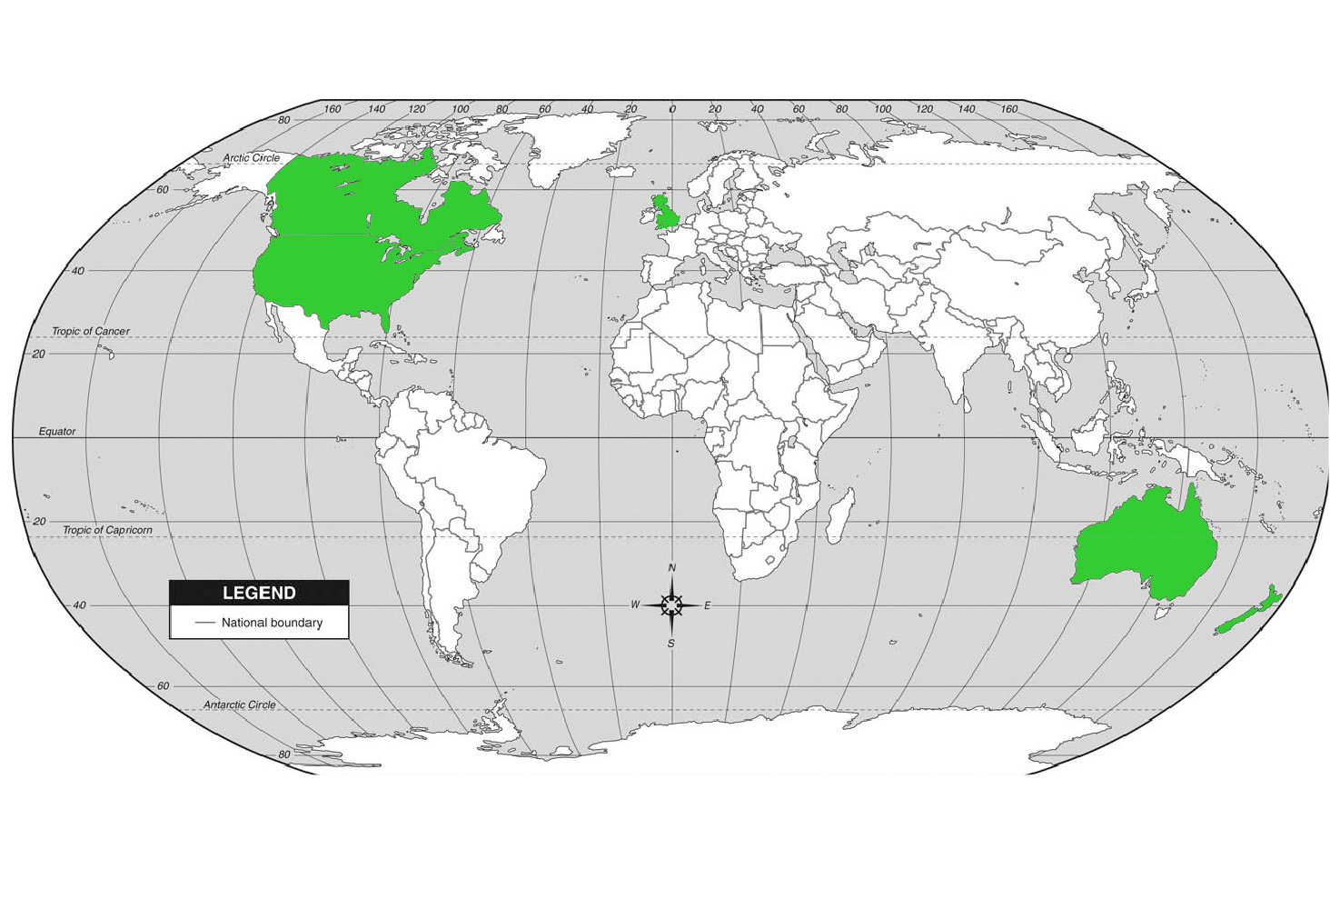
21st CENTURY ECONOMIES
ANGLO-SAXON OR SOCIAL MODELS?
Anglo-
Saxon
Economic
Systems
Anglo-Saxon economic systems have a high prevalence rate of high-expectation entrepreneurial activity

