Slide 1

UNDERSTANDING YOUR BUSINESS MODEL & DEVELOPING STRATEGY
Chapter 4

Slide 2
Your first steps are to…
Select a business model
Determine a basic strategy category
Differentiation
Low cost
Niche

Slide 3
Create your business model
Business Model
Cost Model
Cost of Goods Sold
Operating Expenses
Revenue Model
Sources of Revenue

Slide 4
Amazon’s revenue & cost model requires high volume
Revenues just exceed costs
48.1
14.8
(14.2)
(18.3)
(23.0)
2007 2008 2009 2010 2011

Slide 5
To succeed as a successful first mover you must…
Be first (or very early) into the market
Capture a large percentage of the market quickly
Create switching costs so customers stick with you
First movers rarely win and its an expensive strategy to take

Slide 6
First mover’s are often surpassed
Industry | First Mover | Current Leader
Social Networking | Friendster | Facebook
Video Games | Atari | Nintendo
Web Browser | Mosaic | Google
Internet Search Engine | Excite | Google
Word Processing Software | WordStar | Microsoft Word
Personal Computer | Altair | Dell
Email | Juno | Yahoo Mail
Diet Soda | No-Cal | Diet Coke
Presentation Software | Harvard Graphics | Microsoft PowerPoint
Online Bookseller | Book Stacks Unlimited | Amazon
ATM Machines | Docutel | Diebold

Slide 7
To win, your strategy must be to be one, or more, of these…
Faster
Better
Cheaper

Slide 8
Your People are your Advantage
Values
Structure
Selection
Founders need to create a culture and align the employees they select with the values and structure of the company

Slide 9
Develop your Entry Strategy
Benchmark
Devise Initial Market Test
Create a Platform

Slide 10
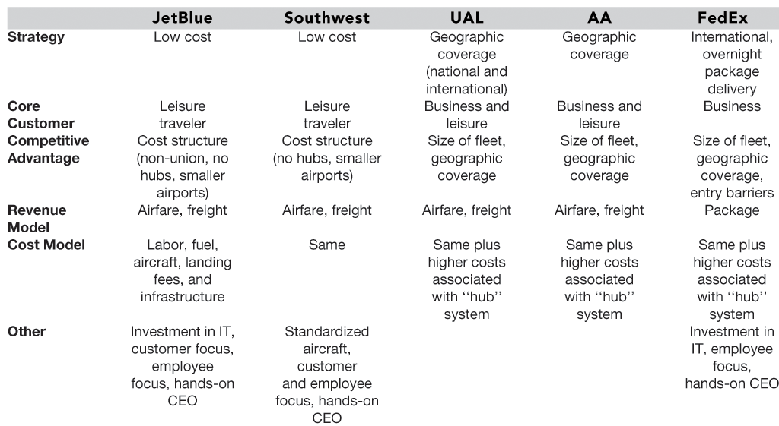
Benchmark your Competition: The JetBlue Example

Slide 11
You can drive growth 3 ways
Franchising
Product mix expansion
Geographic expansion
Growth

Slide 12
Franchising has 3 main benefits
Replicability
Established and proven methods
New sources of revenue
Royalties and fees from franchisees
New capital funds growth
Franchising works best with service businesses that are easy to replicate. Be sure to monitor franchisees to maintain brand purity

Slide 13
Top 10 US franchisors do well
# | Chain | US Total Franchise Sales ($) | US Franchise Units | Sales per store ($ rounded)
1 | McDonald’s | 24 billion | 11,833 | 2 million
2 | Subway | 8.2 billion | 21,195 | 387,000
3 | Burger King | 7.6 billion | 6,280 | 1.2 million
4 | Wendy’s | 5.8 billion | 4,662 | 1.3 million
5 | Dunkin’ Donuts | 5 billion | 5,451 | 913,000
6 | Taco Bell | 4.2 billion | 4,322 | 983,000
7 | KFC | 4 billion | 4,302 | 925,000
8 | Pizza Hut | 3.9 billion | 6,196 | 629,000
9 | Applebee’s | 3.3 billion | 1,343 | 2.5 million
10 | SONIC Drive-Ins | 3 billion | 2,706 | 1.1 million
Source: Technomic/Restaurant Finance, compiled by Blue MauMau 2007

Slide 14
Drive growth with product mix
Tangents and adjacencies
What makes sense with current offerings?
Spread current costs
New products ⬆ revenues more than costs
Maintain same distribution channels
Build on the base that was already created from existing products. Share resources, relationships and channels with current lines?

Slide 15
Consider these 3 topics before expanding geographically
Customers
Go where they are
Mimic proven success strategies
Vendors
Can you use the same vendors?
Any new costs? Leverage volume for better pricing
Distribution
Same channels?
Leverage volume

Slide 16
There are 8 basic ways to expanded internationally

Slide 17
International expansion has risks
Means | Pros | Cons
Technology Transfer | - Reduces entry costs | - Risk of losing the technology
Technology Licensing | - Creates revenue, conserves resources | - Doesn’t extend the brand
Outsourcing | - Cost-saving | - Managing partners
Exporting | Cheap and easy | Extra sales and transport costs Moral hazard
Foreign Direct Investment | - Physical presence - Control of assets | - Expensive
Franchising | - Licenses an operational system | - Risk of damaging the brand name
Venture financing | - Enabling and enacting mechanism | - Can lead to mergers and acquisitions with foreign companies
Mergers and acquisitions | - Established infrastructure - Company can grow quickly | - Very expensive

Slide 18
Recap
Determine revenue and cost structure
Choose a strategy
Create a culture
Seek and select people who fit culture and goals
Plan entry approach, including benchmarks
Plan growth drivers

