Slide 1

ENTREPRENEURIAL MARKETING
Chapter 5

Slide 2
Marketing defined…
An organizational function and a set of processes for creating, communicating, and delivering value to customers and for managing customer relationships in ways that benefit the organization and its stake holders.
- American Marketing Association
Marketing practices vary depending on the type of company and the products and services it sells.

Slide 3
Marketing is Critical
Establishes a customer market
Differentiates product or service to customers
Gains customer acceptance, trust and loyalty
Incites trial and usage
Companies must be able to switch marketing gears quickly to attract new customer segments

Slide 4
Entrepreneurs face unique marketing challenges
Limited by:
Financial and managerial resources
Time
Market information
Muddling decision-making with personal biases and beliefs
Establishes poor relations with multiple audiences

Slide 5
Entrepreneurs must acquire market data & information
Four main categories:
Product attributes important to customers
Customer behavior indicating a willingness to pay
Trends
Customer preference locations
Two main types:
Secondary – economical, already published
Primary – collected directly for specific purposes
Groups, survey’s, & experiments

Slide 6
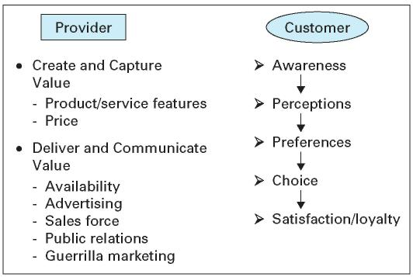
Understand the customer choice process
Notes:
***new slide

Slide 7
Marketing strategy means aligning ends, ways, & means
MEANS
ENDS
Strategic Variables
Marketing Strategy Gap or Risk
WAYS
An entrepreneurs’ resources & capabilities (means), and objectives (ends) differ from those of established companies, therefore they must employ different strategies (ways)

Slide 8
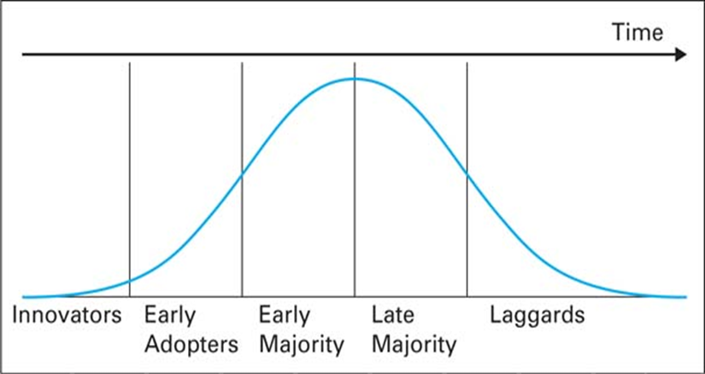
Be attentive to consumer adoption behavior
Product Diffusion Curve
Particularly applies to innovative products
Adoption rate can vary (i.e. slower for complex products)
Notes:
***new slide

Slide 9
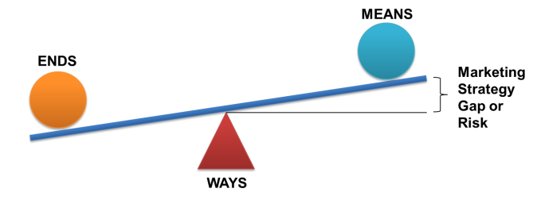
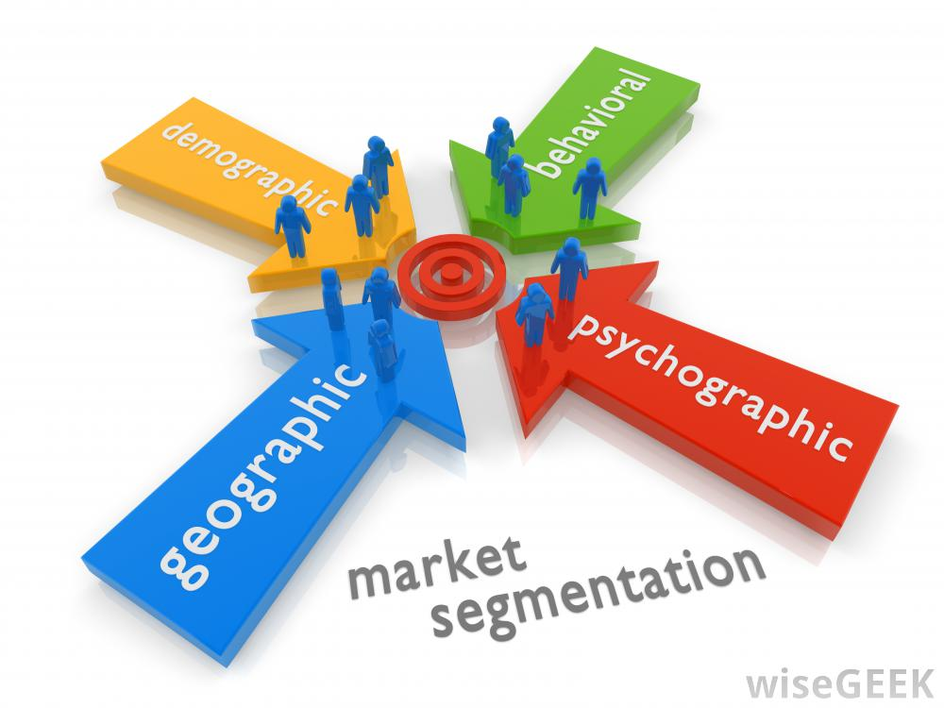
Segmentation, Targeting, and Positioning frame strategic ‘ends’
Detect customer segments in your market
Decide which profitable segments to target
Position your offering in the minds of your target segments

Slide 10
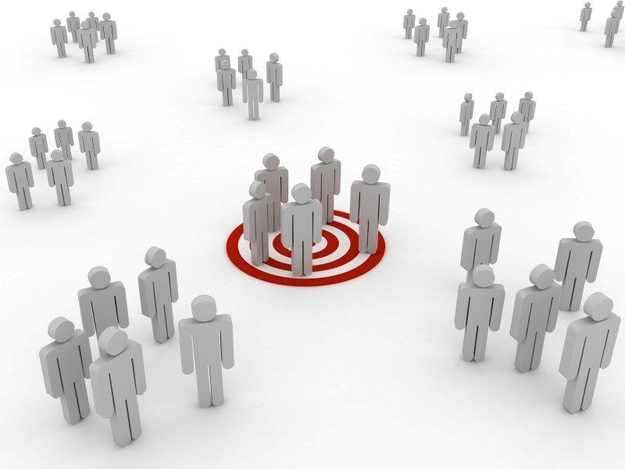
Segmentation, Targeting, and Positioning frame strategic ‘ends’
Detect customer segments in your market
Decide which profitable segments to target
Position your offering in the minds of your target segments

Slide 11
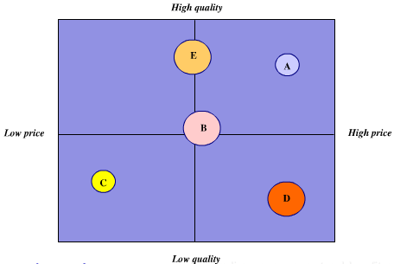
Segmentation, Targeting, and Positioning frame strategic ‘ends’
Detect customer segments in your market
Decide which profitable segments to target
Position your offering in the minds of your target segments

Slide 12
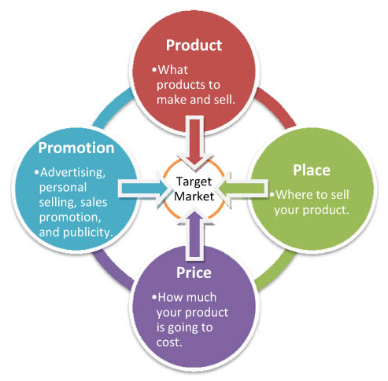
Marketing mix = Ways you employ Means to achieve Ends
The 4-P’s are derived from your choice of target segment & positioning
All 4 variables are interdependent…a change to one, may require a change to the others.

Slide 13
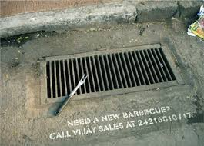
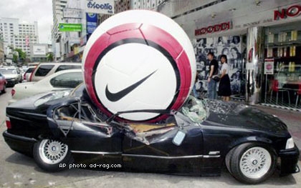
Guerilla marketing is often used by entrepreneurs
It is non-traditional, grassroots, captivating, & viral
It creates word-of mouth & buzz
Why? - Fewer resources require each effort to yield out-sized impact.
Think this got anyone’s attention?

Slide 14
Skills for Managing Growth
Understanding and listening to the customer
Obtain information to understand customer behavior and expectations related to the 4P’s
Building the brand
Awareness – ability to recall brand upon cue
Equity – effect of brand awareness on customer

Slide 15
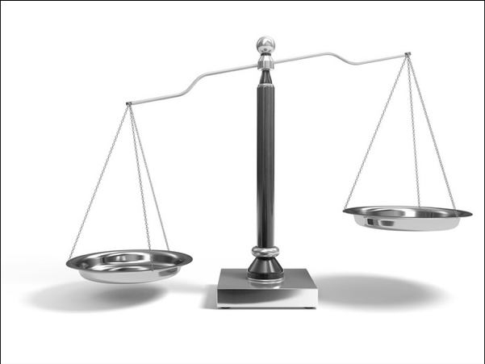
Recap: Marketing is a delicate balance of art and science.
Have a solid, consistent strategy
Adapt your tactics as conditions change (scale)
Focus on the fundamentals
SCIENCE
ART

