Slide 1


BUILDING YOUR
PRO-FORMA FINANCIAL STATEMENTS
Chapter 8

Slide 2
COMMON ENTREPRENEURIAL
MISTAKES
Not understanding the revenue drivers
Underestimating costs
Underestimating time to generate revenues
Lack of comparables
Top-down versus bottom-up forecasting
Underestimating time to secure financing
Reduced survival chance

Slide 3
BUILDING PROCESS
Build-up method
Comparable method
Integrated financial statements
Final Steps

Slide 4
FINANCIAL CONSTRUCTION
CHECKLIST
Build-Up Method
1. Identify all your sources of revenues
2. Determine your revenues for a “typical day”
3. Understand your revenue drivers
a. How many customers you will serve
b. How much product they will buy
c. How much they will pay for each product
d. How often they will buy
4. Validate driver assumptions
a. Primary research (talk to customers, attend trade shows, etc.)
b. Secondary research (industry reports, company reports, etc.)
5. Recombine. Multiply the typical day by the number of days in a year
6. Determine Cost of Goods Sold (COGS) for a typical day
7. Recombine. Multiply COGS by number of days in a year
8. Determine operating expenses by most appropriate time frame
9. Refine operating costs
10. Create preliminary income statement
Comparable Method
11. Compare revenue projections to industry metrics
12. Run scenario analysis
13. Compare common-sized cost percentages to industry averages
Building Integrated Financial Statements
14. Derive monthly income statements for first two years, yearly statements for year 3–5
15. Create balance sheet (yearly for year 1–5)
16. Create cash-flow statement (monthly for years 1 and 2, yearly for years 3–5)
Final Steps
17. Write a two- to three-page description of financial statements

Slide 5
UNDERSTANDING YOUR
REVENUE DRIVERS
Revenue drivers
Customer visits
Advertising
Store location
Up-selling
Sales associates

Slide 6
BUILD-UP METHOD
Revenue
Projections
Revenue Worksheet
COGS
COGS Worksheet
Operating
Expenses
Operating Expense Worksheet
Preliminary
Income Statement

Slide 7
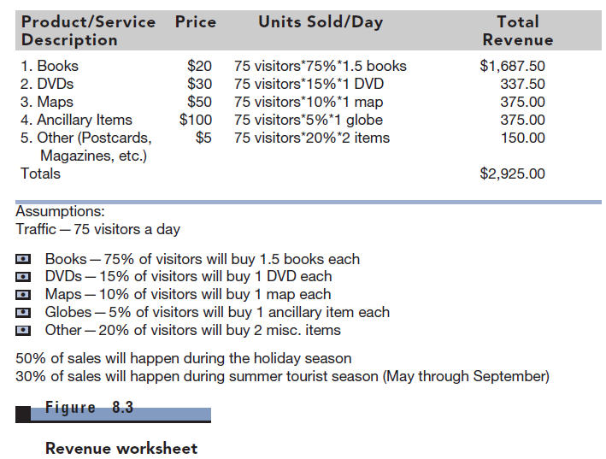
REVENUE WORKSHEET

Slide 8
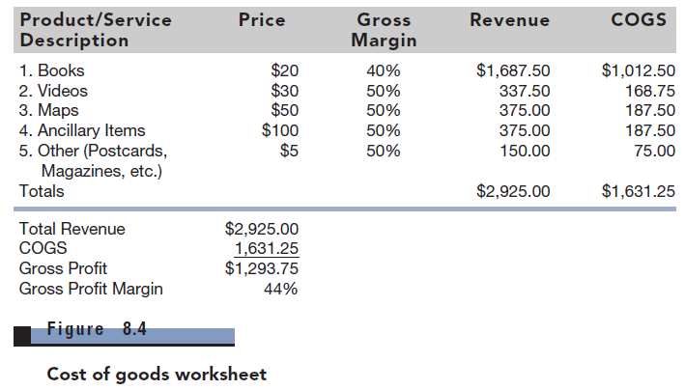
COST OF GOODS WORKSHEET

Slide 9
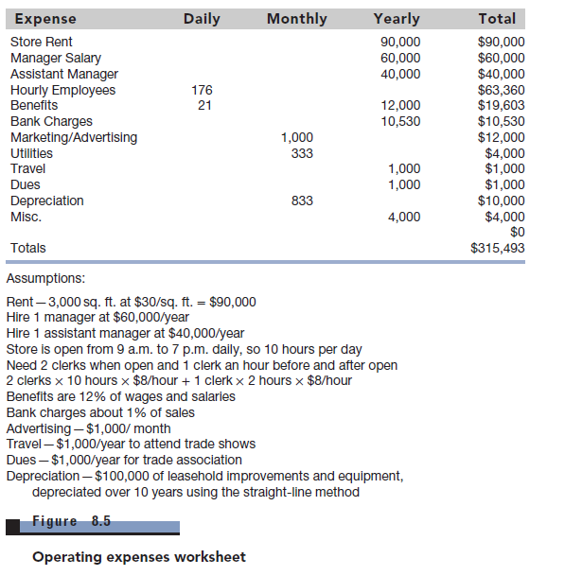
OPERATING EXPENSES WORKSHEET

Slide 10
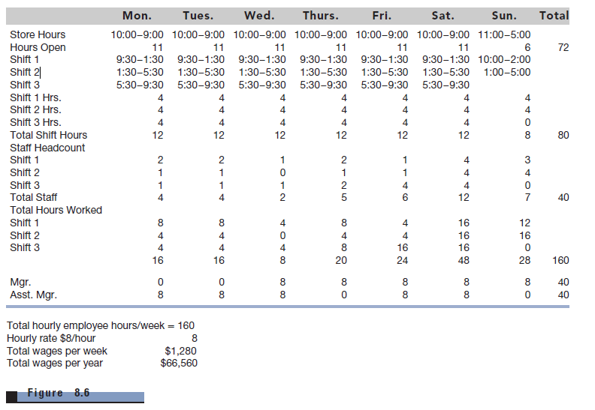
HEADCOUNT TABLE

Slide 11
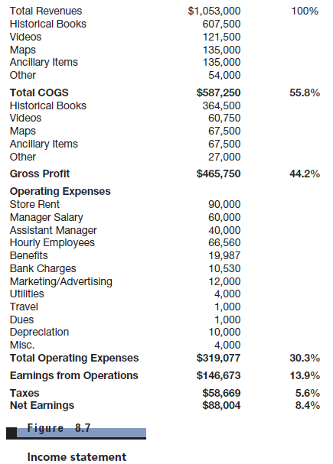
INCOME STATEMENT

Slide 12
COMPARABLE METHOD
Choose industry metrics
Benchmark similar companies in industry
Compare your company to industry average and other companies

Slide 13
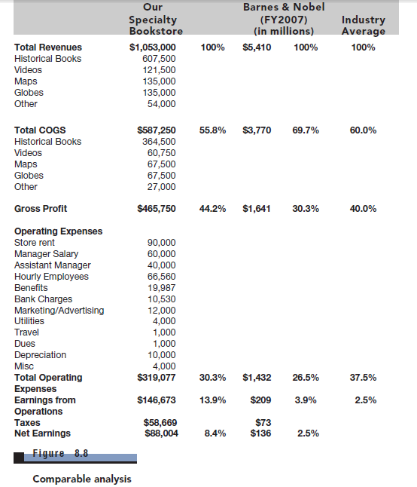
COMPARABLE ANALYSIS

Slide 14
INTEGRATED FINANCIAL
STATEMENTS
INTEGRATED FINANCIAL STATEMENTS
Income Statement
Balance Sheet
Statement of
Cash Flows
Monthly forecasts
for years 1 and 2
Consider
Accounts Receivable
Adjust monthly forecasts
according to seasonality
Show outflow and
depreciate PP&E
Annual forecasts
for years 3-5
Consider
Accounts Payable

Slide 15
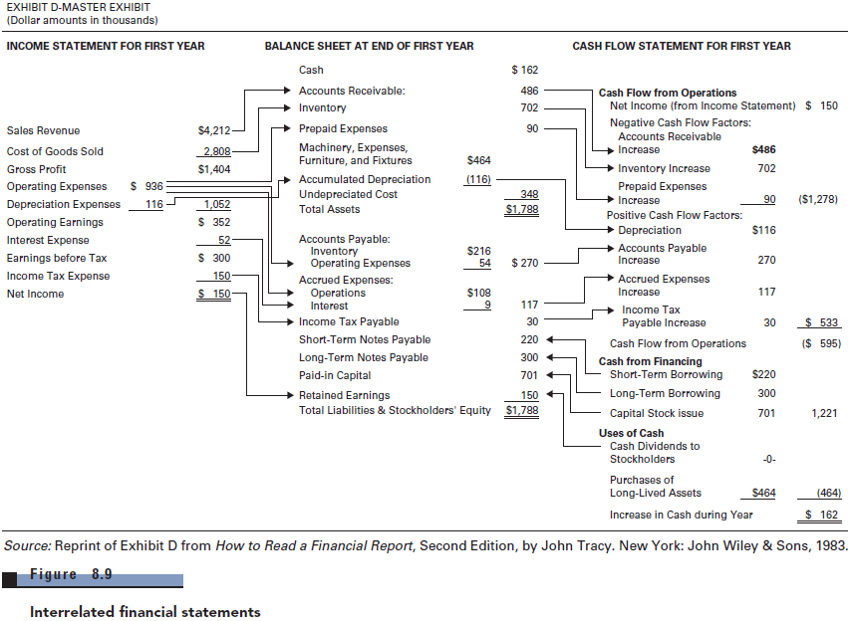
INTEGRATED FINANCIAL STATEMENTS

Slide 16
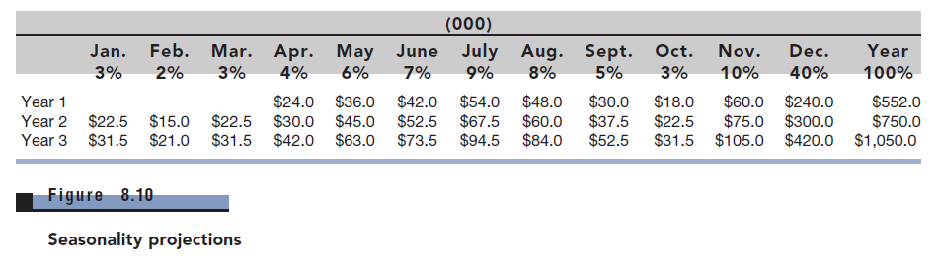
SEASONALITY PROJECTIONS

Slide 17
PUTTING IT ALL TOGETHER
Explanation of spreadsheets (2-3 pages)
Details of income statement
Revenue drivers and seasonality
Details of cash flows
Major cash infusions, A/R, PP&E, A/P
Details of balance sheet
Major assets and liabilities

Slide 18
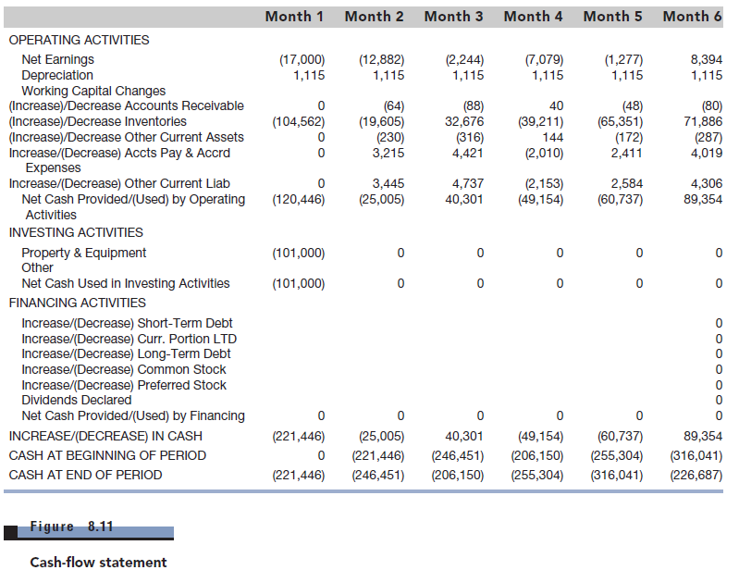
CASH-FLOW STATEMENT

Slide 19
RECAP
Execute each step in order to build realistic pro formas
Know your numbers cold
Further refine numbers as you launch the business
Financials help you gauge actual performance

