Slide 1


FINANCING ENTREPRENEURIAL VENTURES WORLDWIDE
Chapter 9

Slide 2
MICROFINANCING & MICROCREDIT
 | Growth in the implementation of microcredit, 1997-2010
Year | Number of Institutions Reporting | Total Number of Clients Reached | Number of 'poorest' clients reported
12/31/97 | 618 | 13,478,797 | 7,600,000
12/31/98 | 925 | 20,938,899 | 12,221,918
12/31/99 | 1,065 | 23,555,689 | 13,779,872
12/31/00 | 1,567 | 30,681,107 | 19,327,451
12/31/01 | 2,186 | 54,932,235 | 26,878,332
12/31/02 | 2,572 | 67,606,080 | 41,594,778
12/31/03 | 2,931 | 80,868,343 | 54,785,433
12/31/04 | 3,164 | 92,270,289 | 66,614,871
12/31/05 | 3,133 | 113,261,390 | 81,949,036
12/31/06 | 3,316 | 133,030,913 | 92,922,574
12/31/07 | 3,552 | 154,825,825 | 106,584,679
12/31/09 | 3,589 | 190,135,080 | 126,220,051
12/31/10 | 3,652 | 205,314,502 | 137,547,441
Source: Maes, J.P. and Reed, L.R. State of the Microcredit Summit Campaign Report 2012. Microcredit Summit Campaign. 2013. p.35.
Microfinancing by region, 2010 (in millions)
 | Asia | Africa/ Middle East | Latin America/ Caribbean |  | Eastern Europe & Central Asia
Number of Poorest Families | 182.4 | 79.8 | 9 |  | 3.4
Number Reached by Microfinance | 125.5 | 8.9 | 2.9 |  | 0.13
Percent Coverage | 69% | 11% | 32% |  | 4%
Source: Maes, J.P. and Reed, L.R.. State of the Microcredit Summit Campaign Report 2012. Microcredit Summit Campaign, 2012. Page 39.

Slide 3
INFORMAL INVESTORS
Brazil
Morocco
Yemen
Uinted Kingdom
Russia
Romania
Venezuela
Germany
West Bank & Gaza Strip
Bosnia and Herzegovina
South Africa
Japan
Italy
Netherlands
Lebanon
Malaysia
Jordan
Denmark
Finland
Belgium
Greece
Panama
Hong Kong
Uruguay
Slovenia
Ecuador
Tonga
Croatia
Spain
Argentina
Korea
Israel
Shenzhen
Iran
Saudi Arabia
Colombia
United States
France
Serbia
Switzerland
Hungary
Syria
Dominican Republic
Tunisia
China
Norway
Iceland
Algeria
Latvia
Peru
Jamaica
United Arab Emirates
Chile
Guatemala
Uganda

Slide 4
INFORMAL INVESTMENT
Annual informal investment as a percentage of GDP, 2009
10.33%
11.29%
7.00
6.00
5.00
4.00
3.00
2.00
1.00
0.00
Amount of Informal Capital, % GDP
Russia
Brazil
Morocco
Jamaica
Finland
United Kingdom
Ecuador
Venezuela
Malaysia
Panama
Norway
Hungary
Guatemala
Japan
Spain
Korea
Tonga
Germany
Argentina
Saudi Arabia
France
Lebanon
Colombia
Netherlands
Dominican Republic
Denmark
South Africa
Uganda
Switzerland
Romania
Peru
Italy
Belgium
Greece
Slovenia
Tunisia
Chile
United States
Israel
Jordan
Serbia
Uruguay
United Arab Emirates
West Bank & Gaza Strip
Hong Kong
Croatia
Iceland
Iran
Latvia
Algeria
Syria
Shenzhen
Bosnia and Herzegovina
China

Slide 5
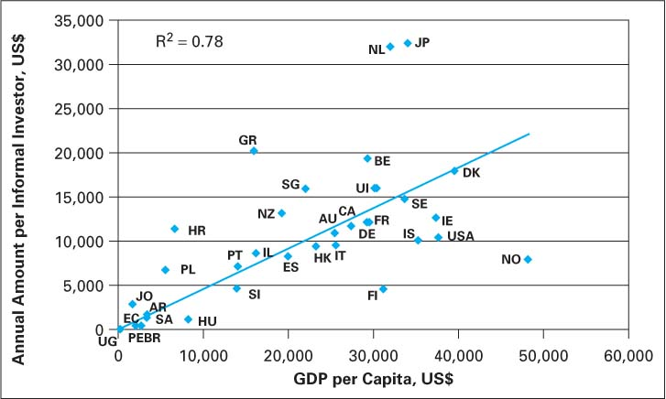
ANNUAL AMOUNT PER
INFORMAL INVESTOR
Annual amount per informal investor vs. GDP per capita (US$)

Slide 6
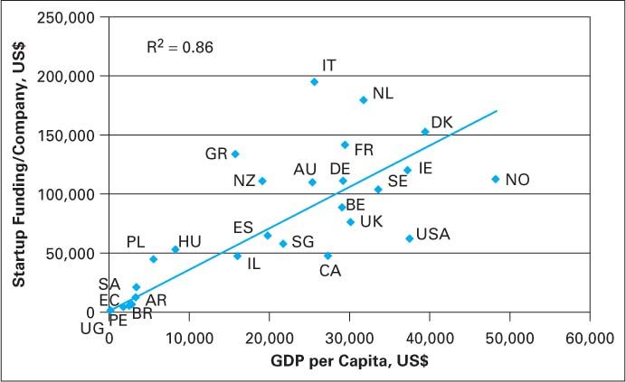
SEED FUNDING PER COMPANY
Startup funding per company vs. GDP per capita (US$)

Slide 7
RELATIONSHIP OF INFORMAL
INVESTOR TO INVESTEE
Relationship: Investor-Investee | Percent Total | Mean Amount Invested US$ | Median Payback Time | Median X Return
Close family | 49.4% | 23,190 | 2 years | 1 x
Other relative | 9.4% | 12,345 | 2 years | 1 x
Work colleague | 7.9% | 39,032 | 2 years | 1 x
Friend, neighbor | 26.4% | 15,548 | 2 years | 1 x
Stranger | 6.9% | 67,672 | 2-5 years | 1.5 x
 | 100.0% | 24,202 | 2 years | 1 x

Slide 8
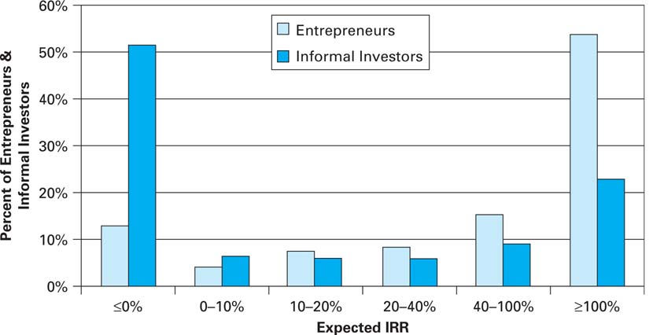
FINANCIAL RETURNS ON
INFORMAL INVESTMENT
Expected IRR for entrepreneurs and informal investors

Slide 9
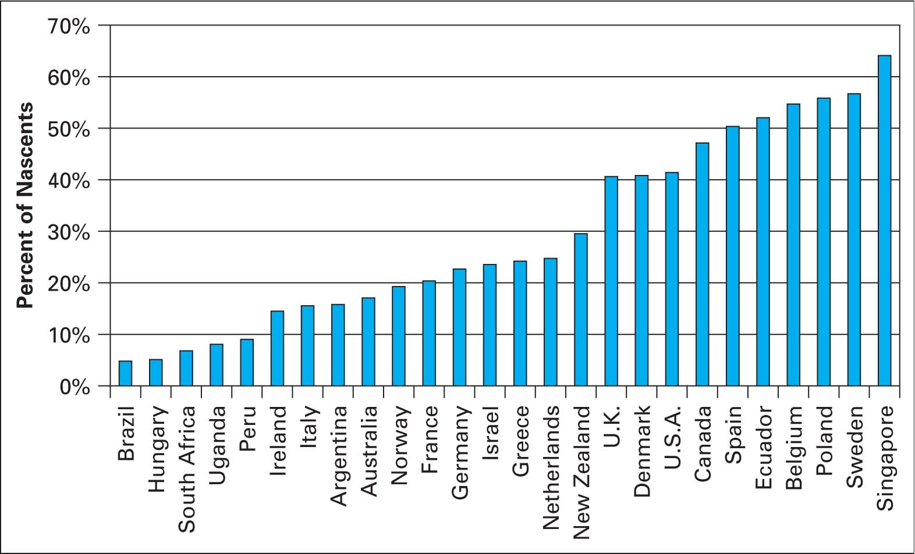
SUPPLY AND DEMAND FOR
STARTUP FINANCING
Percentage of nascent businesses that could be funded by available informal investment

Slide 10
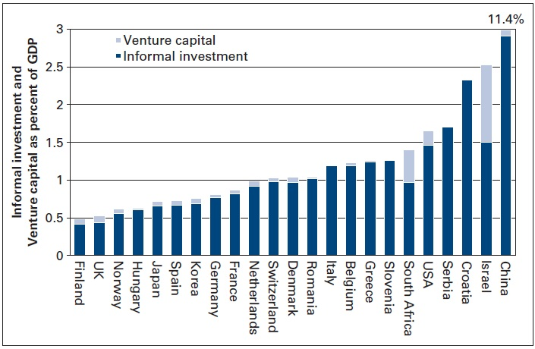
INFORMAL INVESTMENT VS. VENTURE CAPITAL

Slide 11
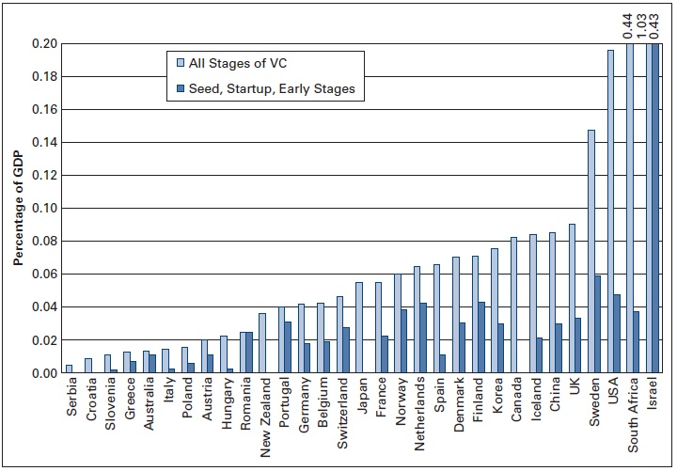
CLASSIC VENTURE CAPITAL
INVESTMENT

Slide 12
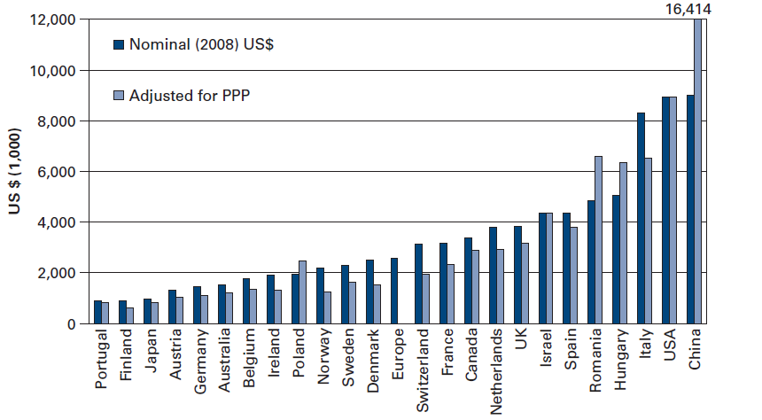
CLASSIC VENTURE CAPITAL INVESTMENT
Classic venture capital investment per company, 2008

Slide 13
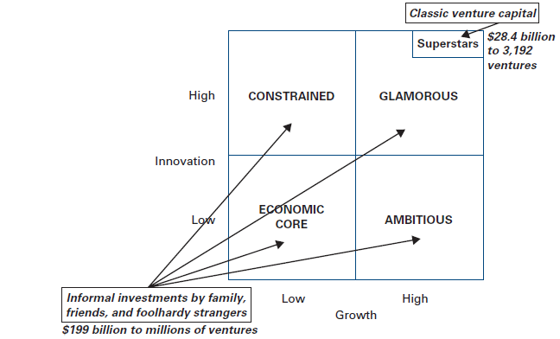
FINANCING ENTREPRENEURIAL VENTURES
Financing entrepreneurial ventures in the United States, 2008

Slide 14
ECONOMIC BENEFITS OF
VENTURE CAPITAL-BACKED COMPANIES
 | 2000 | 2010 | 2000-2010 Annual Growth
Jobs | 8.7 Million | 11.9 Million | 2.9%
Sales | $1.5 Trillion | $3.08 Trillion | 6.8%
Top 5 States by Employment at
Venture-Capital-Backed Companies
Headquartered in the State in 2010
California 2,887,063
Texas 1,129,551
Pennsylvania 783,527
Washington 778,579
Massachusetts 775,151

Slide 15
FLOW OF VENTURE CAPITAL
INVESTORS
VENTURE CAPITAL
FIRMS
PORTFOLIO COMPANIES
Money
TAKEDOWN
Money
Gatekeepers 1% Annual Fee
2-3% Annual Fee
Limited Partners
Pension Funds
Insurance Companies
Corporations
Foreign Endowments
Individuals
Funds of Funds
General Partners
Entrepreneurs
20% of
Capital Gains
DISTRIBUTION
IPOs/Mergers/Acquisitions
Return of Principal & 80% of Capital Gains
Unrealized
RESIDUAL
Equity

Slide 16
FINANCIAL RETURNS ON VENTURE CAPITAL
Venture capital IRRs and NASDAQ and S&P 500 Returns
Fund Type | 1 Year | 3 Years | 5 Years | 10 Years | 20 Years
Seed/Early Stage | 8.4 | 12.9 | 4.5 | 4.9 | 39.7
Later/Expansion Stage | 5.4 | 17.1 | 8.1 | 10.3 | 12.5
Multi Stage | 7.5 | 9.4 | 3.0 | 6.8 | 13.9
All Venture Funds | 7.7 | 12.2 | 4.5 | 6.1 | 28.8
NASDAQ | 29.0 | 13.7 | 2.9 | 10.3 | 8.7
S&P 500 | 30.2 | 13.2 | 1.1 | 8.0 | 8.5
Source: Cambridge Associates LLC. U.S. Venture Capital Index® and Selected Benchmark Statistics

Slide 17
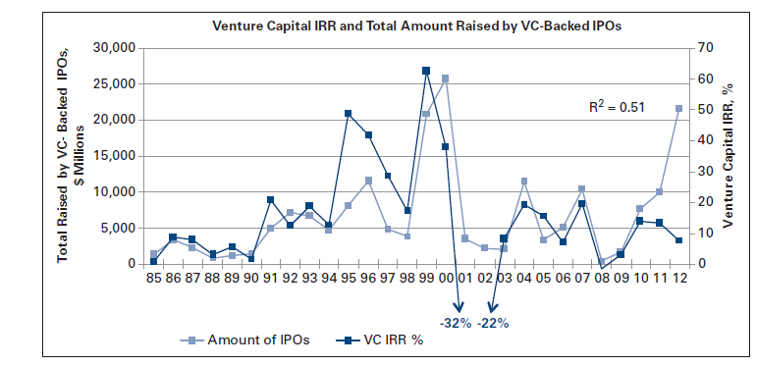
FINANCIAL RETURNS ON VENTURE CAPITAL

