Slide 1

DEBT AND OTHER FORMS OF FINANCING
Chapter 11

Slide 2
Financing is a continuing activity
Factors within, and outside of, your control impact your cash needs & can change suddenly
Cash needs must be frequently forecasted with a margin of error
Plan for the most likely case
Be prepared for the worst case (maintain access to a reserve)
Remember the 3 “Rules of Cash”
More cash is better than less cash
Cash now is better than cash later
Never run out of cash (#1 killer of new ventures!)

Slide 3

Align your sources & uses of funds
Uses of funds
Start-up costs
Working capital
Growth
Sources of funds (cash flow)
External
Require external analysts or investors to independently appraise the worthiness of capital investments before releasing funds
Internal
Funds you control directly & absolutely
Forecast uses of funds further out than the time required to secure sources of funds

Slide 4
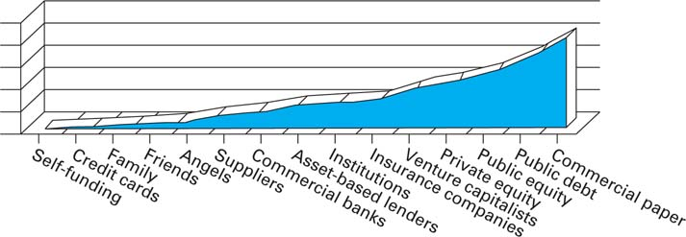
Mature firms enjoy greater access to funds
FIRM MATURITY
INTERNAL SOURCES OF FUNDS
EXTERNAL SOURCES OF FUNDS

Slide 5
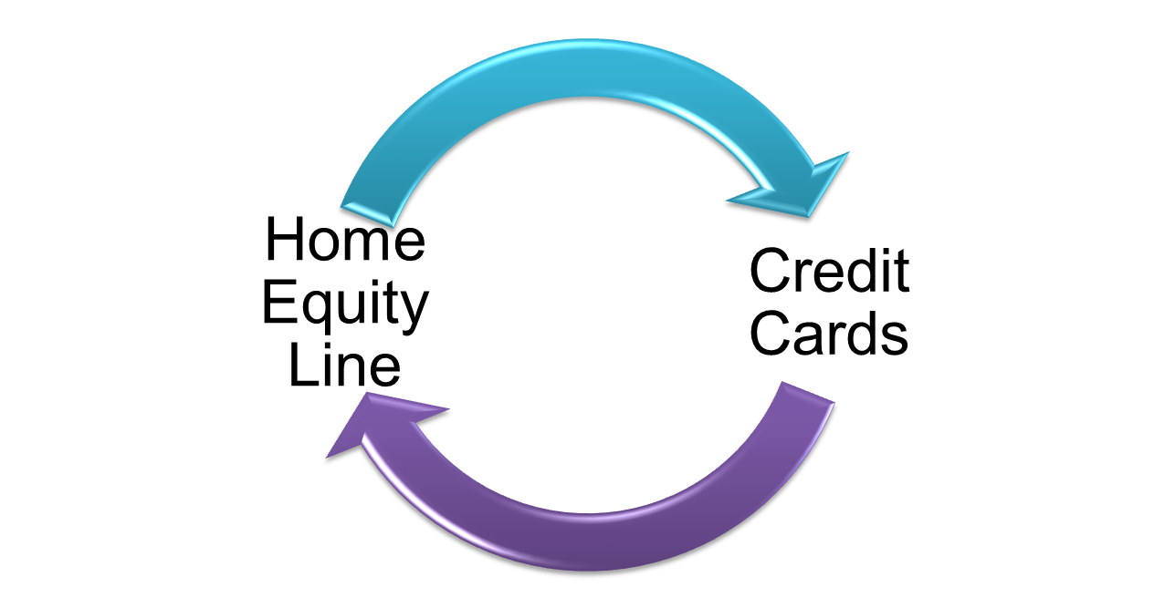
Start with internal funds sources
Home equity lines of credit
Interest rates are comparatively low
Better for mid to longer term debt
Credit cards
Higher interest rates
Miles/points may be available
Better for short term debt to minimize cost of capital
Use personal funds to “de-risk” your venture
Confirm/deny market demand
Confirm/deny your value proposition
Create conditions needed to access other fund types

Slide 6
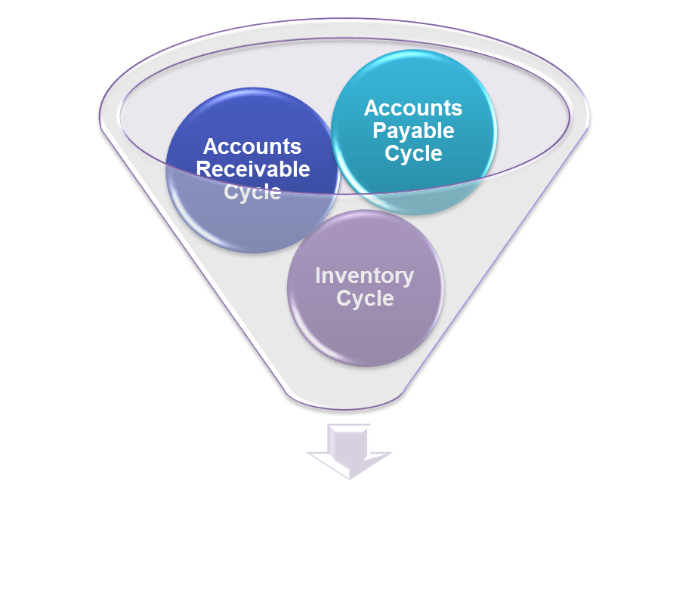
Optimize your cash collection cycle (CCC)
Ideal - a negative cycle
Customer pays you before you pay suppliers
Highest liquidity
Next best – Customers pay cash, you pay credit
Influenced by industry norms
Optimize your CCC
Extend payables
Shorten receivables
Minimize inventory costs

Slide 7
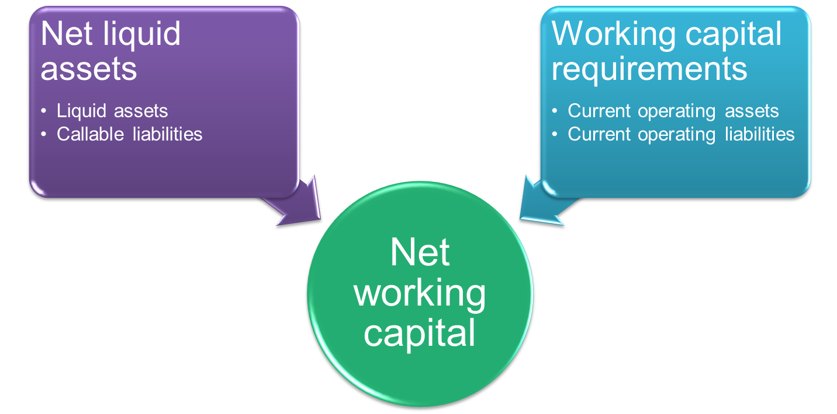
Obtain working capital from receivables and inventories
New working capital doesn’t equal liquidity
Some working capital is tied up in operating assets
Operating assets can be liquidated prematurely at a cost, if no other sources of funds exist.

Slide 8

Obtain working capital from receivables by adjusting…
the pattern of your sales
Forecast sales to plan working capital
the ratio of cash vs. credit
Credit vs. credit cards vs. cash
your terms for credit sales
A competitive factor within industries
Consider demand elasticity
Length of payment & discounts
your way of enforcing your credit terms
Cutting off vs. cash-only vs. collection agencies vs. legal recourse

Slide 9
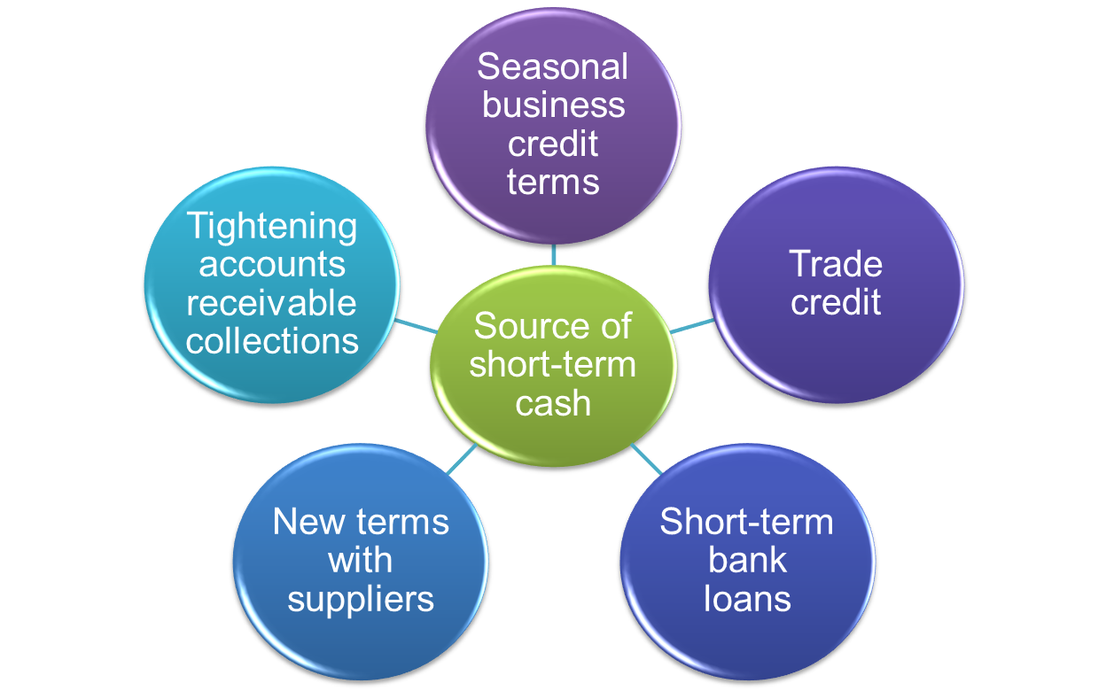
Increase payables & decrease receivables for short term cash
Receivables secure a bank loan
Maximize existing trade credits
Negotiate extended trade credits
Use seasonal trade credits
Emphasize cash sales
Accept credit cards

Slide 10
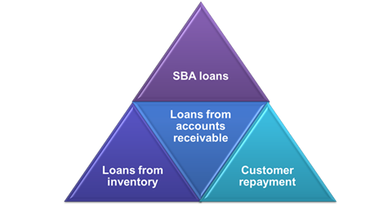

Get short term cash from banks by financing receivables
Pledging
Receivable become collateral
Loan is given for a percentage of collateral full value
Pledging with notification
Customer instructed to pay the lender directly
Factoring
Sell receivables at a discount to a “factor”
Factor collects receivable payments
Recourse
Means the factor can still get receivables payments from your customers don’t pay.
Re-course & non-recourse exists.

Slide 11
Obtain working capital with bank loans against inventory
Chattel Mortgage
Secured by property assets (i.e. “Widget #2873B4”)
Floating Lien
Secured by blanket assets (i.e. entire inventory)
Field Warehousing
Lender secures your inventory on your premises
Public Warehousing
Your pledged inventory goes to another warehouse
NOTE: You retain inventory access

Slide 12

“Finance” working capital through customer prepayments
Goes back to the ideal negative cycle...not easy
Common in large, complex, long-term projects
Customers pay ahead in installments to fund phases of work until completion

Slide 13

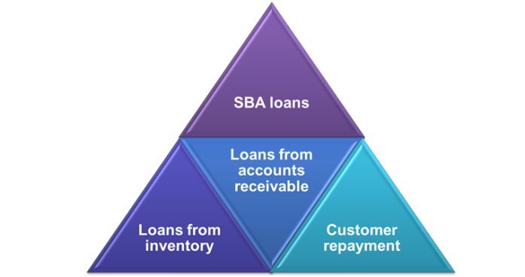
Obtain Small Business Administration (SBA) loans
For those unable to get conventional bank loans
Government backs loans
90% under $155,000
Up to 85%, between $155,000 and $750,000 (max.)
Must be for-profit
Used for working capital, CAPEX, & line of credit
3:1 Debt-to-equity ratio required
After loan is made
Use banks that process SBA loan routinely

Slide 14


Many factors to consider in acquiring short term bank loans
Maturity of loans
Interest rates
Collateral
Loan applications
Restrictive covenants
General provisions
Routine provisions
Specific provisions

Slide 15

Finance equipment needs
Non-bank companies charge interest higher than banks
Collateral (i.e. the equipment) must exceed loan balance
Loan repayment schedule stays ahead of depreciation schedule
Conditional sales contracts extend purchase over 2-5 years

Slide 16

When selecting the right short-term financing mix, consider…
your needs
Current
Future
cost of alternatives
Current
Future

Slide 17
Plan cash flows & profits
Profitability vs. Solvency
An unprofitable venture can recover…measure of health
An Insolvent venture ceases to exist because it cannot pay its’ suppliers (insufficient working capital)…vital sign
Profits doesn’t equal cash flow
Some cash transactions do not impact profits
Non-cash transaction do not impact cash flow
Free cash flow (FCF); matters to bank loan officers
= Cash from operations (CFO) – capital expenditures (CAPEX)
Pretax undedicated cash flow; matter to acquirers
= FCF + TAX + INTEREST

Slide 18
Recap
Working capital doesn’t equal liquidity
Most of working capital is tied up in operations
Cash flow forecasts help to determine financing needs
Manage customer and supplier payments
Debt options when actual cash doesn’t meet needs: banks, private placement, leases, suppliers, government agencies, customers

