Slide 1

ENTREPRENEURIAL GROWTH
Chapter 13

Slide 2
You’ll have multiple post-startup options
Stay With Company
Start Another Venture
Sell
Seek Other Employment
Become a Manager
Startup
Maintain
Exit Day-to-Day Management
Become an Entrepreneurial Leader
Grow
Take Alternate Position in the Firm
Exit Day-to-Day Management
Options for Venture
Options for Founder

Slide 3
Execution becomes core driving force
Opportunity
Domain
Organizational Resources and Capabilities
Stakeholders
Execution
Environmental Conditions
Uncertainty
Leadership

Slide 4
Control System Components
A/R and collections policies
Inventory management
A/P policy
Assessment of performance and expenditures
Metrics to track trends

Slide 5
Tracking performance to support decision-making
DP
The Entrepreneurs Critical Information Needs???
SUPPORTS
TIMELY
DECISIONS
EXTERNAL
EXTERNAL
INTERNAL
What the Entrepreneur needs to know about the customer/market?
What the Entrepreneur needs to know about the competition/industry
What the Entrepreneur needs to know about his/her own company
CRITICAL FACTS & ASSUMPTIONS ABOUT PERFORMANCE MUST BE TRACKED TO CONFIRM/DENY THEM IN TIME

Slide 6
Know the difference between performance & effectiveness
Measure of Performance:
Are we doing things right?
Measure of Effectiveness:
Are we doing the right things?
Focus on tracking effectiveness
If effectiveness is lacking, check performance
If performance is lacking, you’re having trouble executing
If performance is fine, you’re strategy needs improvement

Slide 7
The faster you convert cash, the less you’ll need
 | Average Inventory Collection Period +
Cash Conversion Cycle = | Average Receivables Processing Period –
 | Average Payables Period
Payment Received
from Customers
Inventory Received
Sale
98 Days
53 Days
Days in Inventory
Days Sales Outstanding
53 Days
98 Days
Days in Payables
Cash Conversion Period
Payment made to Suppliers

Slide 8
Consider outsourcing non-core activities
Activities that don’t underpin your competitive advantage might be done better and/or for less by others.
Focus on your critical competencies.
Balance your need for control with your ability to control.

Slide 9
Implement controls and remain entrepreneurial
Minimize controls to those needed to align and coordinate your venture
Within those controls, give employees wide latitude to achieve objectives
Underwrite mistakes of employees who take rational risks
When large enough, organize to simultaneously:
Execute the present (tactical)
Refine near-future plans (operational)
Innovate new ways to realize your vision in the future (strategic)

Slide 10
Expand from your competitive advantage
YANKEE CANDLES’ OPPORTUNITY DOMAIN
Geographic Expansion
Regional
National
International
New Products
New Candles
Home Fragrance
Gifts
Distribution
To Gift Shops
Direct through retail, online, catalogs
Wholesale
Candles
Acquisition
Gifts for fundraising market

Slide 11
Obtain & program resources to develop critical capabilities
During growth, you’ll focus on funding
Capable and well run ventures get higher quality funding
Use of funds must support developing your organizations’ intangible capabilities (i.e., your team)
Forecast to align capabilities with market needs and your strategy
Balance between developing capabilities for your customers & finding more customers for your capabilities
Similar to cash conversion; the capability development cycle can take time…plan ahead.

Slide 12
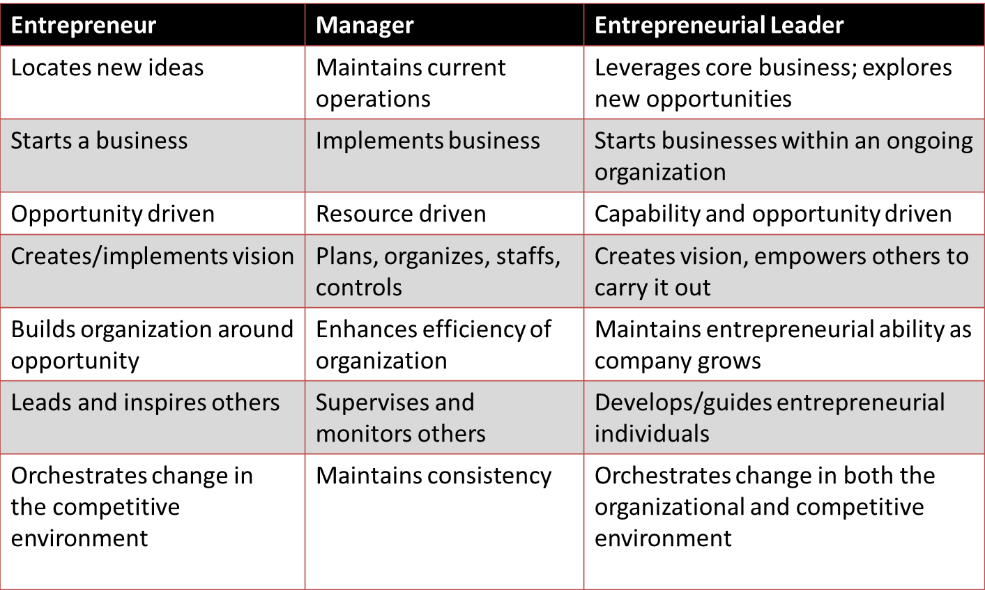
Understand what type of leader your team needs you to be

Slide 13
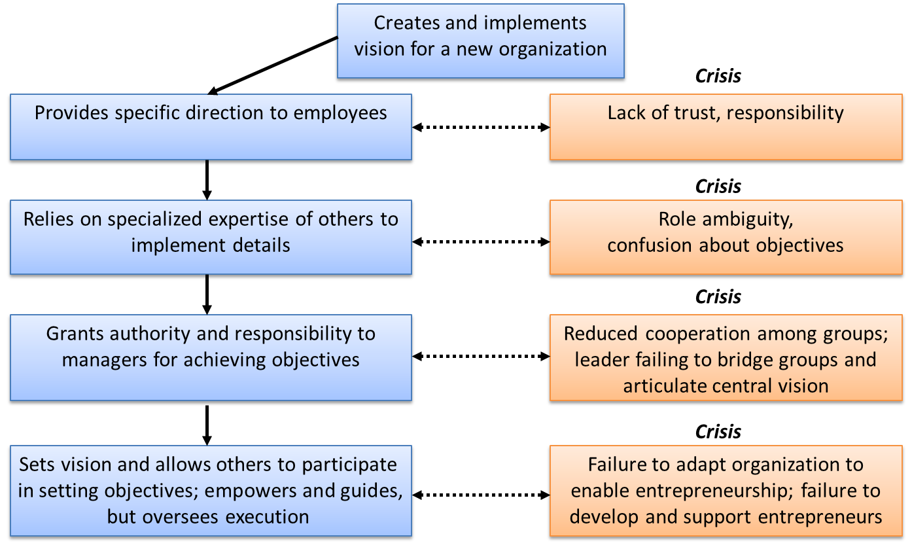
Become an entrepreneurial leader

Slide 14
Growth requires more managers
Promote current employees
May not be the most competent for the position
Hire outside management
Current employees may not accept newcomers

