Slide 1

Chapter 5
Systems Analysis

Slide 2
Objectives
Define systems analysis and relate it to the scope definition, problem analysis, requirements analysis, logical design, and decision analysis phases.
Describe a number of systems analysis approaches for solving business system problems.
Describe scope definition, problem analysis, requirements analysis, logical design, and decision analysis phases in terms of information system building blocks.
Describe scope definition, problem analysis, requirements analysis, logical design, and decision analysis phases in terms of purpose, participants, inputs, outputs, techniques, and steps.
Identify those chapters in this textbook that can help you learn specific systems analysis tools and techniques.

Slide 3
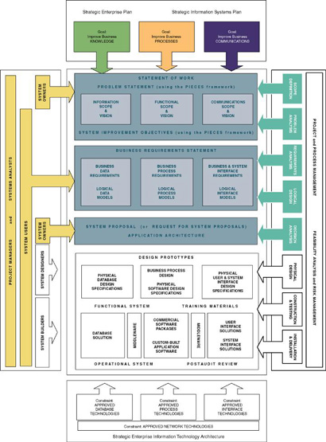

Slide 4
What is Systems Analysis ?
  Systems analysis – a problem-solving technique that decomposes a system into its component pieces for the purpose of studying how well those component parts work and interact to accomplish their purpose.
  Systems design – a complementary problem-solving technique (to systems analysis) that reassembles a system’s component pieces back into a complete system—hopefully, an improved system. This may involves adding, deleting, and changing pieces relative to the original system.
  Information systems analysis – those development phases in an information systems development project the primarily focus on the business problem and requirements, independent of any technology that can or will be used to implement a solution to that problem.

Slide 5
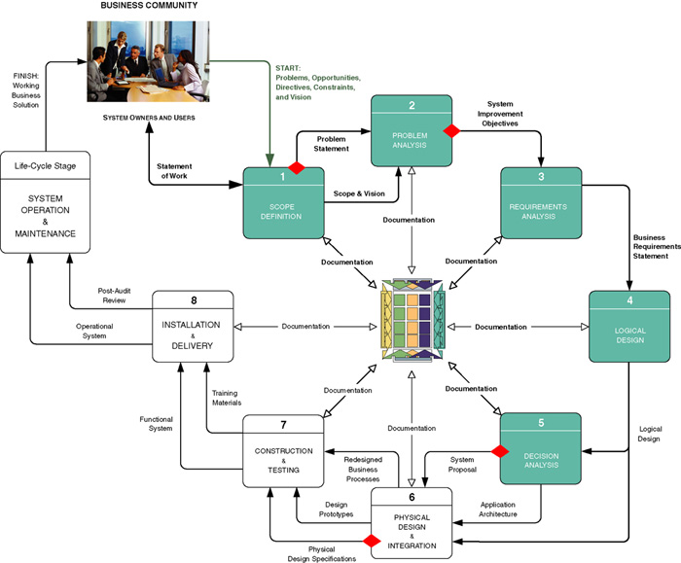
Context of Systems Analysis

Slide 6
Repository
Repository – a location (or set of locations) where systems analysts, systems designers, and system builders keep all of the documentation associated with one or more systems or projects.
  Network directory of computer-generated files that contain project correspondence, reports, and data
  CASE tool dictionary or encyclopedia (Chapter 3)
  Printed documentation (binders and system libraries)
  Intranet website interface to the above components

Slide 7
Model-Driven Analysis Methods
  Model-driven analysis – a problem-solving approach that emphasizes the drawing of pictorial system models to document and validate both existing and/or proposed systems. Ultimately, the system model becomes the blueprint for designing and constructing an improved system.
  Model – a representation of either reality or vision. Since “a picture is worth a thousand words,” most models use pictures to represent the reality or vision.

Slide 8
Model-Driven Approaches
Traditional Approaches
  Structured Analysis
    Focuses on the flow of data through processes
    Key model: data flow diagram
  Information Engineering
    Focuses on structure of stored data
    Key model: entity relationship diagram
Object-Oriented Approach
  integrates data and process concerns into objects
    Object – the encapsulation of the data (called properties) that describes a discrete person, object, place, event, or thing, with all the processes (called methods) that are allowed to use or update the data and properties. The only way to access or update the object’s data is to use the object’s predefined processes.
  Unified Modeling Language (UML)

Slide 9
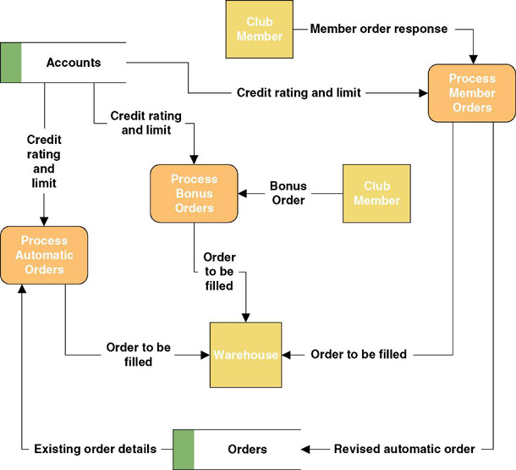
A Simple Process Model

Slide 10
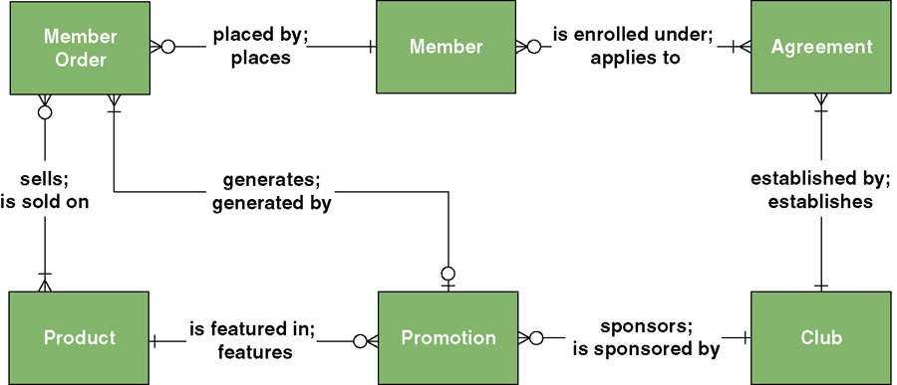
A Simple Data Model

Slide 11
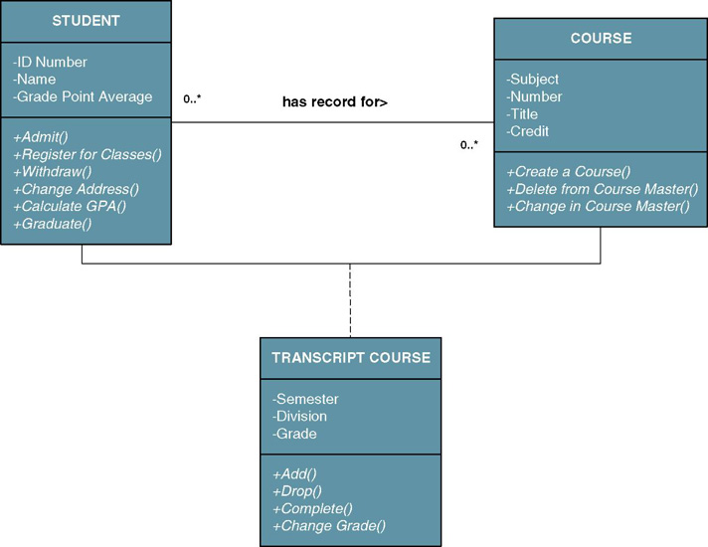
A Simple Object Model

Slide 12
Accelerated Systems Analysis
Accelerated systems analysis approaches emphasize the construction of prototypes to more rapidly identify business and user requirements for a new system.
prototype – a small-scale, incomplete, but working sample of a desired system.
  Accelerated systems analysis approaches
    Discovery Prototyping
    Rapid Architected Analysis

Slide 13
Discovery Prototyping
Discovery prototyping – a technique used to identify the users’ business requirements by having them react to a quick-and-dirty implementation of those requirements.
  Advantages
    Prototypes cater to the “I’ll know what I want when I see it” way of thinking that is characteristic of many users and managers.
  Disadvantages
    Can become preoccupied with final “look and feel” prematurely
    Can encourage a premature focus on, and commitment to, design
    Users can be misled to believe that the completed system can be built rapidly using prototyping tools

Slide 14
Rapid Architected Analysis
  Rapid architected analysis – an approach that attempts to derive system models (as described earlier in this section) from existing systems or discovery prototypes.
    Reverse engineering – the use of technology that reads the program code for an existing database, application program, and/or user interface and automatically generates the equivalent system model.

Slide 15
Requirements Discovery
Requirements discovery – the process, used by systems analysts of identifying or extracting system problems and solution requirements from the user community.

Slide 16
Requirements Discovery Methods
Fact-finding – the process of collecting information about system problems, opportunities, solution requirements, and priorities.
  Sampling existing documentation, reports, forms, databases, etc
  Research of relevant literature
  Observation of the current system
  Questionnaires and surveys
  Interviews
Joint requirements planning (JRP) –use of facilitated workshops to bring together all of the system owners, users, and analysts, and some systems designer and builders to jointly perform systems analysis.
  Considered a part of a larger method called joint application development (JAD), a more comprehensive application of the JRP techniques to the entire systems development process.

Slide 17
Business Process Redesign
  Business process redesign (BPR) – the application of systems analysis methods to the goal of dramatically changing and improving the fundamental business processes of an organization, independent of information technology.

Slide 18
Agile Methods
Agile method – integration of various approaches of systems analysis and design for applications as deemed appropriate to problem being solved and the system being developed.
  Most commercial methodologies do not impose a single approach (structured analysis, IE, OOA) on systems analysts.
  Instead, they integrate all popular approaches into a collection of agile methods.
  System developers are given the flexibility to select from a variety of tools and techniques to best accomplish the tasks at hand,
  Hypothetical FAST methodology operates this way.

Slide 19
FAST Systems Analysis Phases
Scope Definition Phase
  Is the project worth looking at?
Problem Analysis Phase
  Is a new system worth building?
Requirements Analysis Phase
  What do the users need and want from the new system?
Logical Design Phase
  What must the new system do?
Decision Analysis Phase
  What is the best solution?

Slide 20
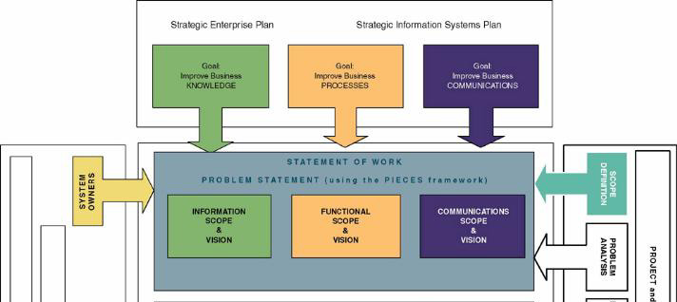
Context of Scope Definition Phase

Slide 21
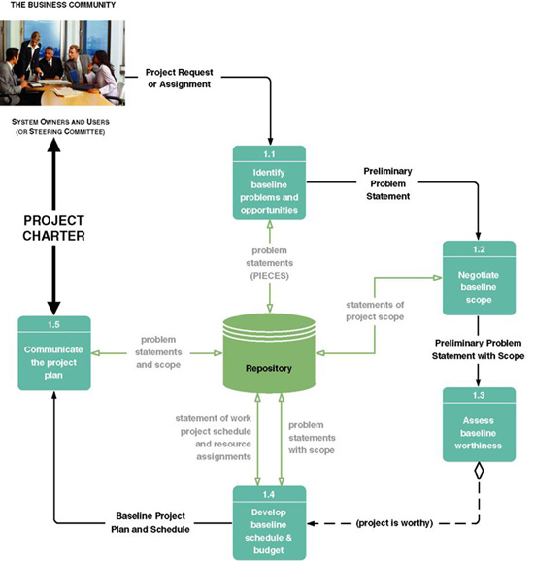
Tasks for the Scope Definition Phase

Slide 22
Key Terms for Scope Definition Phase
Steering body – a committee of executive business and system managers that studies and prioritizes competing project proposals to determine which projects will return the most value to the organization and thus should be approved for continues systems development.
  Also called a steering committee.
Project charter – the final deliverable for the preliminary investigation phase. A project charter defines the project scope, plan, methodology, standards, and so on.
  Preliminary master plan includes preliminary schedule and resource assignments (also called a baseline plan).
  Detailed plan and schedule for completing the next phase of the project.

Slide 23
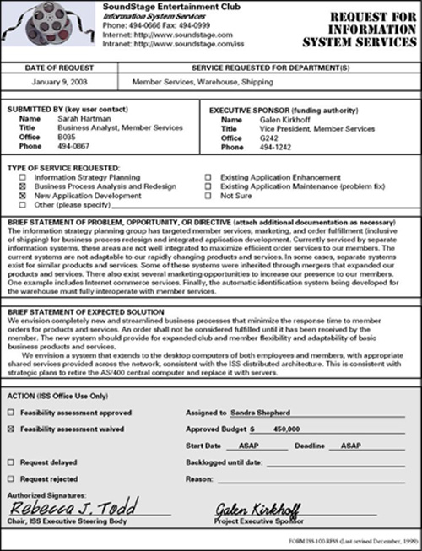
Sample Request for System Services

Slide 24
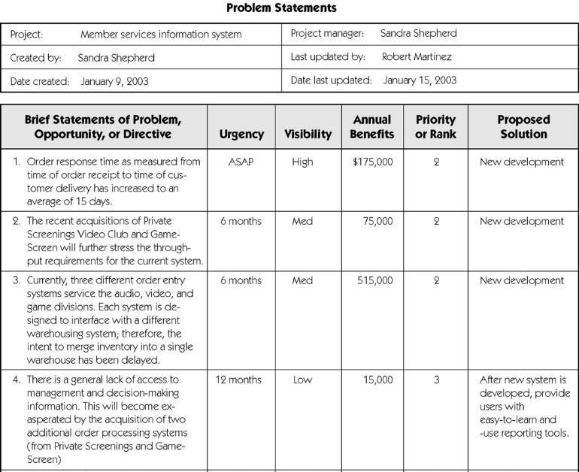
Sample Problem Statements

Slide 25
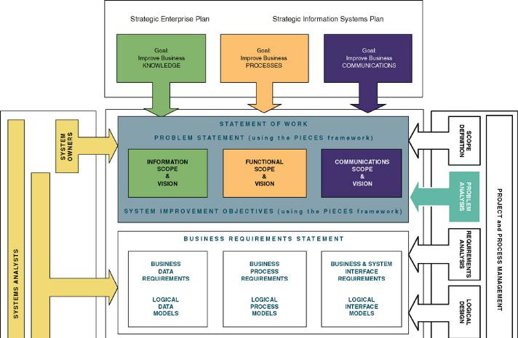
Context of Problem Analysis Phase

Slide 26
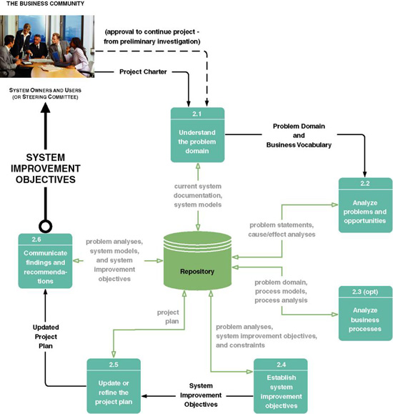
Tasks of the Problem Analysis Phase

Slide 27
Key Terms of the
Problem Analysis Phase
  Cause-and-effect analysis – a technique in which problems are studied to determine their causes and effects.
    In practice, effects can be symptomatic of more deeply rooted problems which, in turn, must be analyzed for causes and effects until the causes and effects do not yield symptoms of other problems.
  Context Diagram – a pictorial model that shows how the system interacts with the world around it and specifies in general terms the system inputs and outputs.

Slide 28
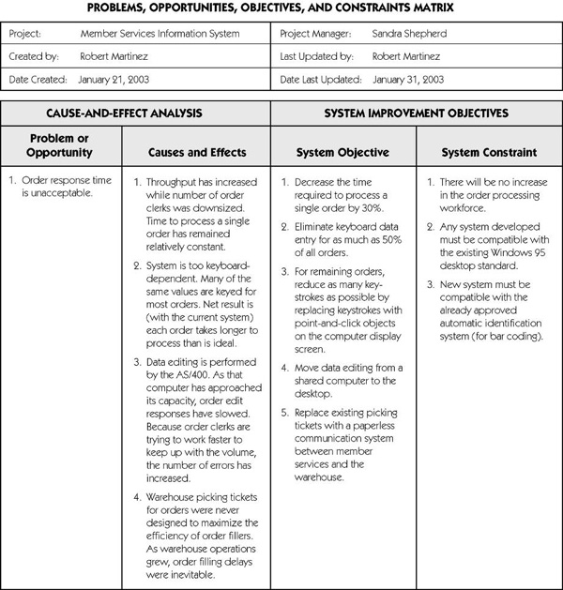
Sample Cause-and-Effect Analysis

Slide 29
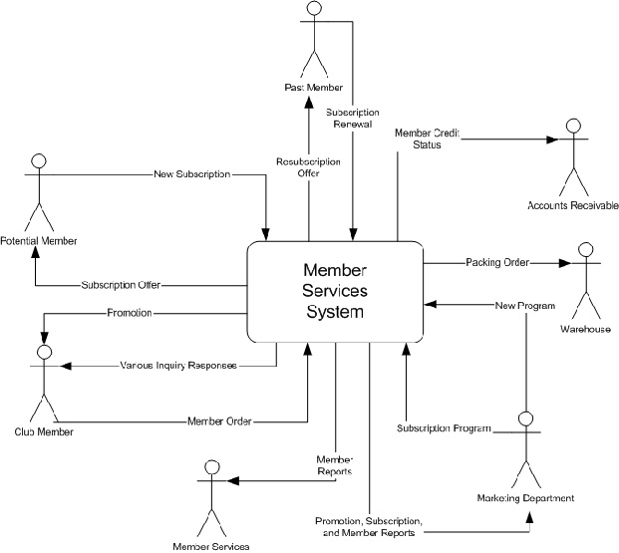
Sample Context Diagram

Slide 30
Key Terms of the
Problem Analysis Phase (cont.)
Objective – a measure of success. It is something that you expect to achieve, if given sufficient resources.
  Reduce the number of uncollectible customer accounts by 50 percent within the next year.
  Increase by 25 percent the number of loan applications that can be processed during an eight-hour shift.
  Decrease by 50 percent the time required to reschedule a production lot when a workstation malfunctions.
Constraint – something that will limit your flexibility in defining a solution to your objectives. Essentially, constraints cannot be changed.
  The new system must be operational by April 15.
  The new system cannot cost more than $350,000.
  The new system must be web-enabled.
  The new system must bill customers every 15 days.

Slide 31
System Improvement Report Outline
Executive summary (approximately 2 pages)
  Summary of recommendation
  Summary of problems, opportunities, and directives
  Brief statement of system improvement objectives
  Brief explanation of report contents
Background information (approximately 2 pages)
  List of interviews and facilitated group meetings conducted
  List of other sources of information that were exploited
  Description of analytical techniques used
Overview of current system (approximately 5 pages)
  Strategic implications (if project is part of or impacts existing IS strategic plan)
  Models of the current system
    Interface model (showing project scope)
    Data model (showing project scope)
    Geographical models (showing project scope)
    Process model (showing functional decomposition only)

Slide 32
System Improvement Report Outline (cont.)
Analysis of the current system (approx. 5-10 pages)
  Performance problems, opportunities, cause-effect analysis
  Information problems, opportunities, cause-effect analysis
  Economic problems, opportunities, cause-effect analysis
  Control problems, opportunities, cause-effect analysis
  Efficiency problems, opportunities, cause-effect analysis
  Service problems, opportunities, and cause-effect analysis
Detailed recommendations (approx. 5-10 pages)
  System improvement objectives and priorities
  Constraints
  Project Plan
    Scope reassessment and refinement
    Revised master plan
    Detailed plan for the definition phase
Appendixes
  Any detailed system models
  Other documents as appropriate

Slide 33
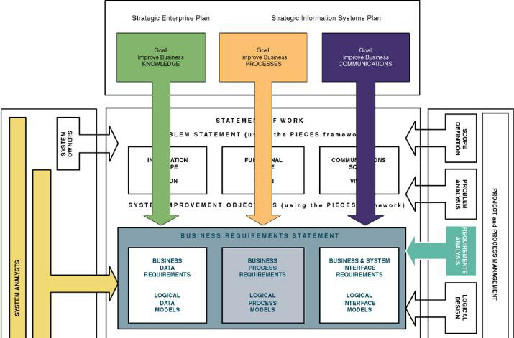
Context of Requirements
Analysis Phase

Slide 34
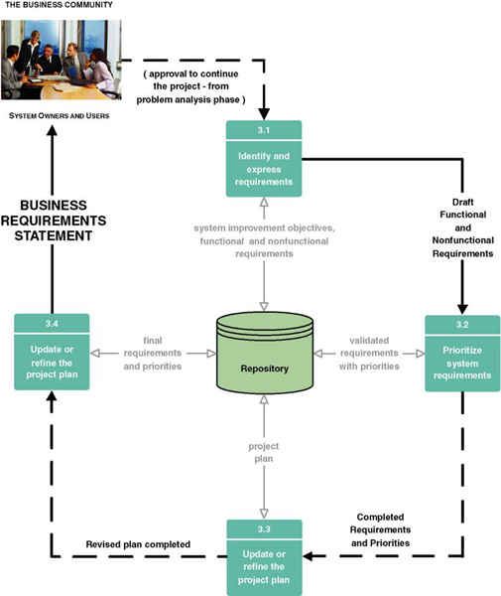
Requirements Analysis Phase Tasks

Slide 35
Key Terms of
Requirements Analysis Phase
  Functional requirement – a description of activities and services a system must provide.
    inputs, outputs, processes, stored data
  Nonfunctional requirement – a description of other features, characteristics, and constraints that define a satisfactory system.
    Performance, ease of learning and use, budgets, deadlines, documentation, security, internal auditing controls

Slide 36
Key Terms of Requirements Analysis Phase (cont.)
  Use case – a business scenario or event for which the system must provide a defined response. Use cases evolved out of object-oriented analysis; however, their use has become common in many other methodologies for systems analysis and design.

Slide 37
Key Terms of Requirements Analysis Phase (cont.)
Timeboxing – a technique that delivers information systems functionality and requirements through versioning.
  The development team selects the smallest subset of the system that, if fully implemented, will return immediate value to the systems owners and users.
  That subset is developed, ideally with a time frame of six to nine months or less.
  Subsequently, value-added versions of the system are developed in similar time frames.
  A mandatory requirement is one that must be fulfilled by the minimal system, version 1.0
  A desirable requirement is one that is not absolutely essential to version 1.0. It may be essential to the vision of a future version.

Slide 38
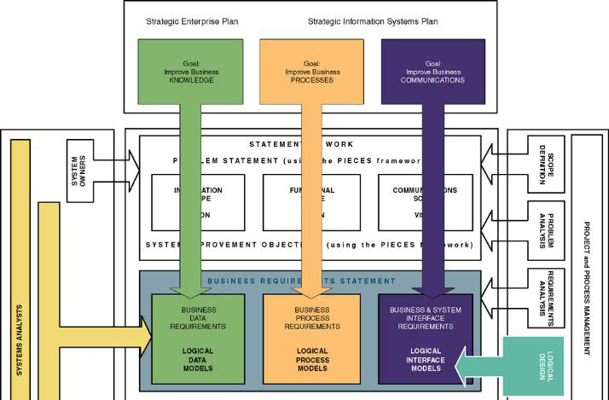
Context of Logical Design Phase of Systems Analysis

Slide 39
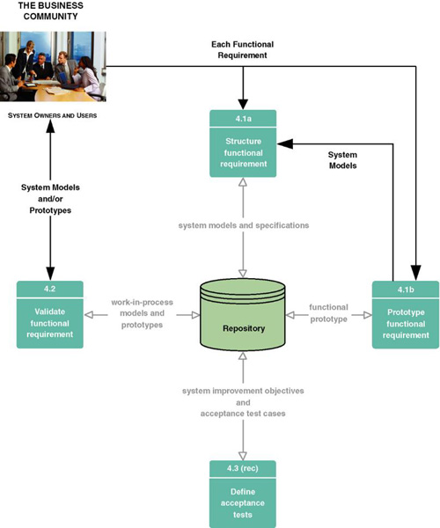
Tasks for Logical Design Phase

Slide 40
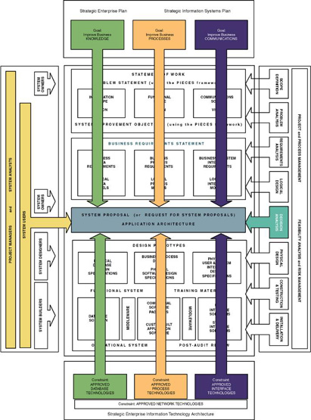
Context of Decision Analysis Phase

Slide 41
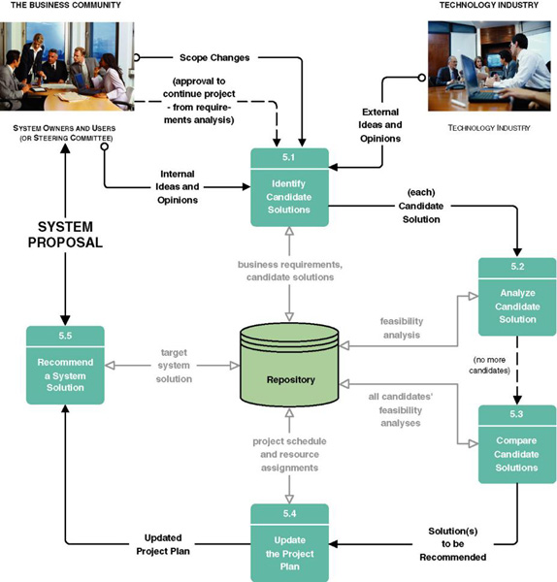
Tasks for Decision Analysis Phase

Slide 42
Key Terms of Decision Analysis Phase
Technical feasibility – Is the solution technically practical? Does our staff have the technical expertise to design and build this solution?
Operational feasibility – Will the solution fulfill the users’ requirements? To what degree? How will the solution change the users’ work environment? How do users feel about such a solution?
Economic feasibility – Is the solution cost-effective?
Schedule feasibility – Can the solution be designed and implemented within an acceptable time period?

Slide 43
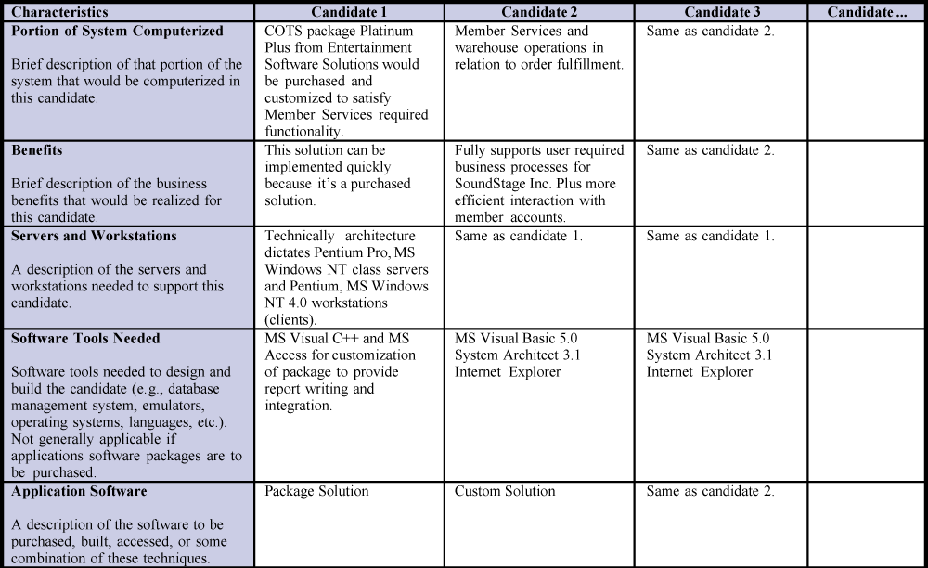
Candidate Systems Matrix

Slide 44
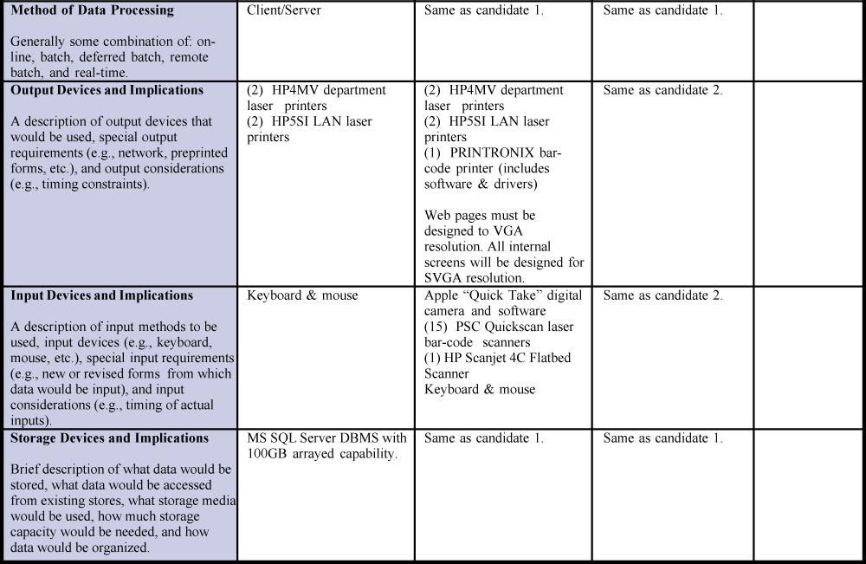
Candidate Systems Matrix (cont.)

Slide 45
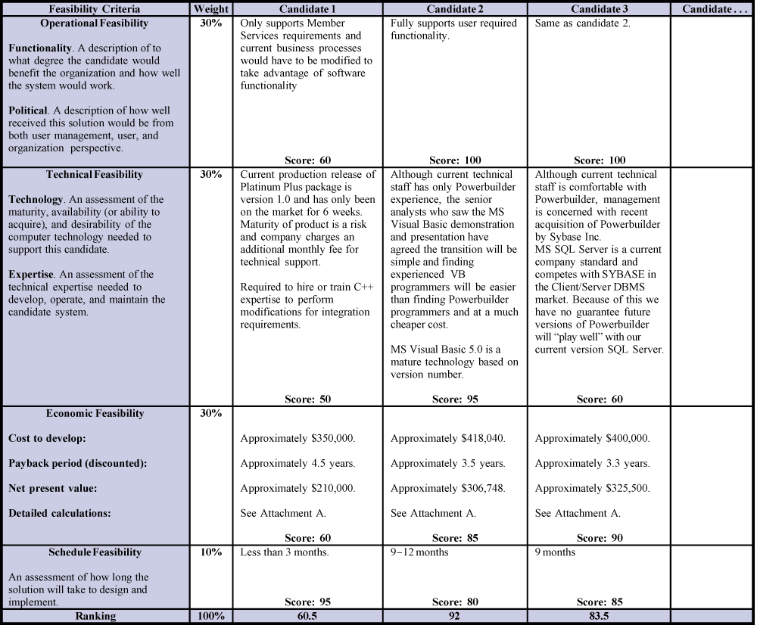
Feasibility Matrix

Slide 46
Typical System Proposal Outline
Introduction
  Purpose of the report
  Background of the project leading to this report
  Scope of the report
  Structure of the report
Tools and techniques used
  Solution generated
  Feasibility analysis (cost-benefit)
Information systems requirements
Alternative solutions and feasibility analysis
Recommendations
Appendices

