Slide 1
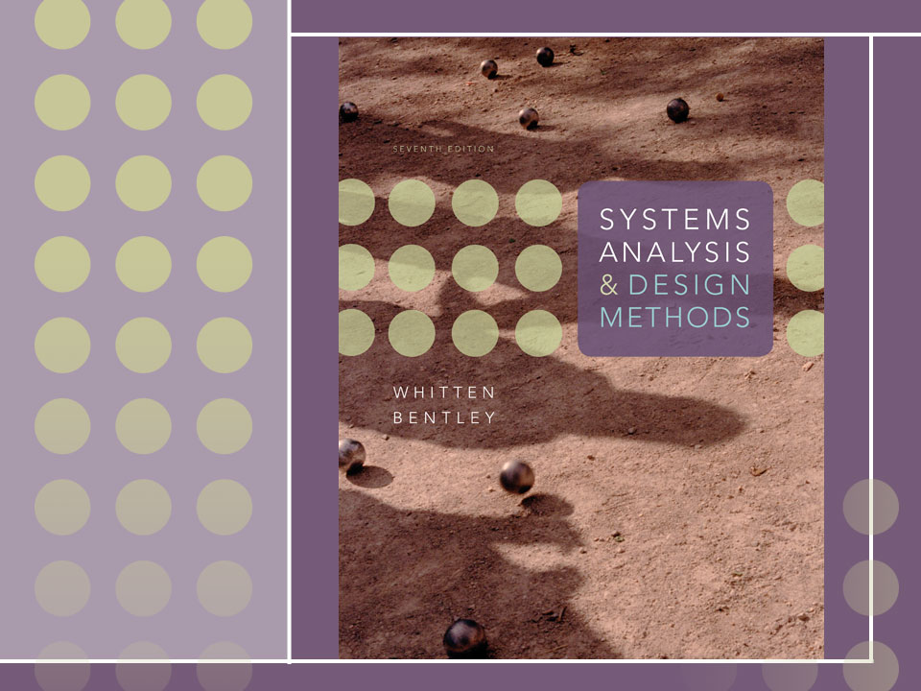
Chapter 13
Application Architecture and Modeling

Slide 2
Objectives
Define an information system’s architecture in terms of the KNOWLEDGE, PROCESSES, and COMMUNICATION building blocks.
Differentiate between logical and physical data flow diagrams, and explain how physical data flow diagrams are used to model an information system’s architecture.
Describe centralized and distributed computing alternatives, including client/server and Internet-based computing options.
Describe database and data distribution alternatives for system design.
Describe user and system interface alternatives for system design.
Describe various software development environments for information system design.
Describe strategies for developing or determining architecture of an information system.
Draw physical data flow diagrams for an information system’s architecture and processes.

Slide 3
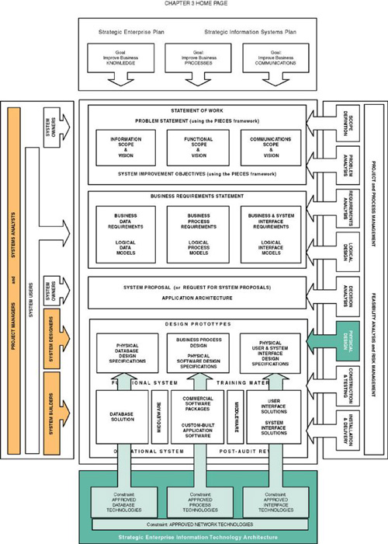

Slide 4
Application Architecture
Application architecture – a specification of the technologies to be used to implement information systems. The blueprint to communicate the following design decisions:
  The degree to which the information system will be centralized or distributed.
  The distribution of stored data.
  The implementation technology for software developed in-house.
  The integration of commercial off-the-shelf software.
  The technology to be used to implement the user interface.
  The technology to be used to interface with other systems

Slide 5
Physical Data Flow Diagram (DFD)
Physical data flow diagram (DFDs) – a process model used to communicate the technical implementation characteristics of an information system.
  Communicate technical choices and other design decisions to those who will actually construct and implement the system.
  Recall from Chapter 9 that DFDs are a type of process model.

Slide 6
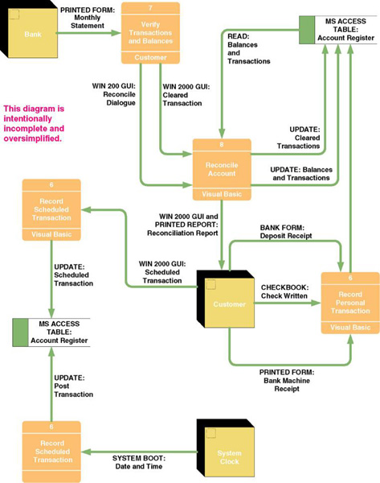
Sample Physical
Data Flow Diagram

Slide 7
Physical Processes
Physical process – either a processor, such as a computer or person, or a technical implementation of specific work to be performed, such as a computer program or manual process.
  Logical processes may be assigned to physical processors such as PCs, servers, people, or devices in a network. A physical DFD would model that network structure.
  Each logical process requires an implementation as one or more physical processes.
  A logical process may be split into multiple physical processes:
    To define aspects performed by people or computers.
    To define aspects implemented by different technologies.
    To show multiple implementations of the same process.
    To add processes for exceptions and security.

Slide 8
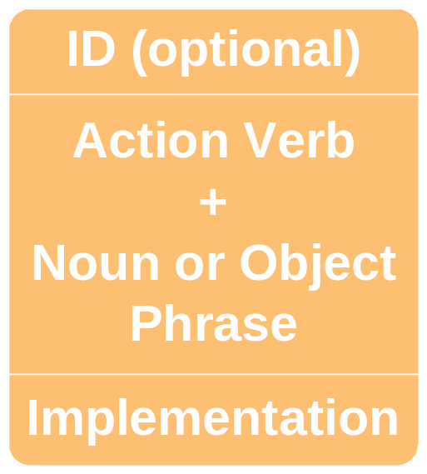
Physical Process Notation

Slide 9
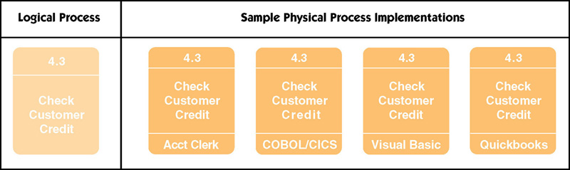
Samples of Physical Processes

Slide 10
Possible Computer Process Implementations
A purchased application software package
  Also called commercial off-the-shelf (COTS) software
A system or utility program
  Such as an e-mail/message server or third-party framework
An existing application program from a program library
  May require modification
A program to be written

Slide 11
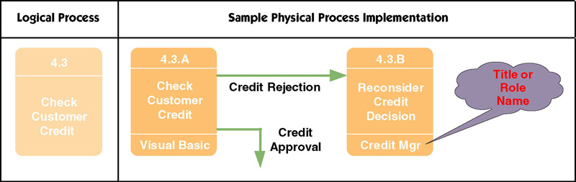
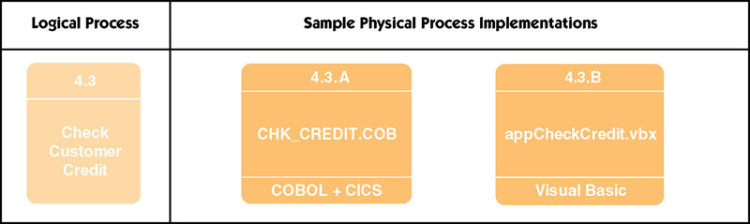
Sample Physical Process Implementations

Slide 12
Physical Data Flows
A physical data flow represents:
  Planned implementation of an input to, or output from a physical process.
  Database command or action such as create, read, update, or delete.
  Import of data from, or
  export of data to another
  information system.
  Flow of data between
  two modules or
  subroutines (represented
  as physical processes).
Implementation method:
Data flow name
OR
Data flow name
(Implementation method)

Slide 13
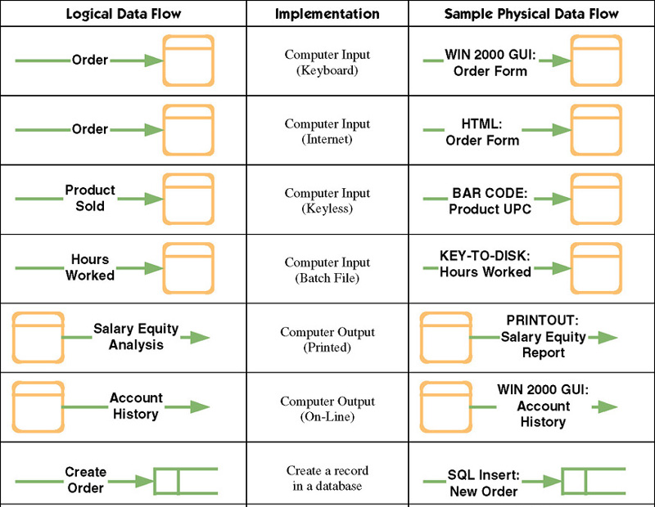
Sample Physical Data Flows

Slide 14
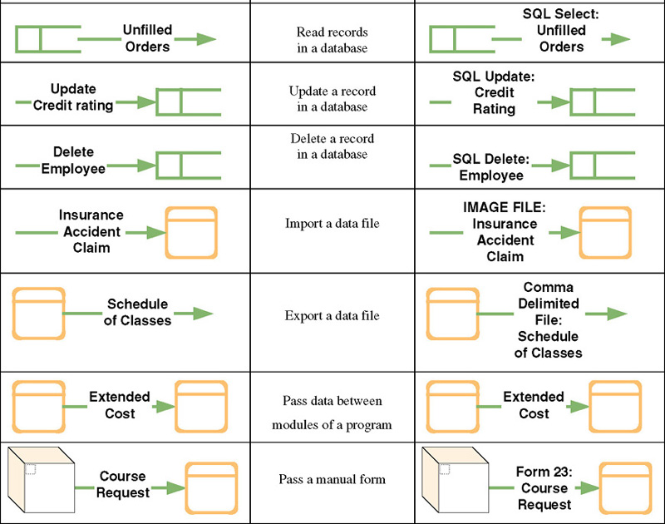
Sample Physical Data Flows (continued)

Slide 15
Physical External Agents
Physical external agents are carried over from the logical DFD models.
  If scope changes, the logical models should be changed before the physical models are drawn.

Slide 16
Physical Data Stores
A physical data store represents the planned implementation of one of:
  A database
  A table in a database
  A computer file
  A tape or media backup of anything important
  A temporary file or batch
  Any type of noncomputerized file

Slide 17
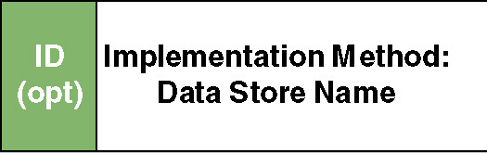
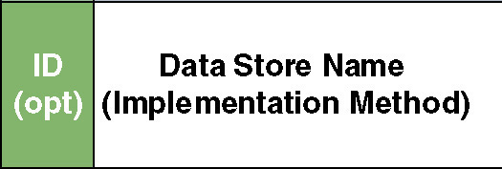
Physical Data Store Notation

Slide 18
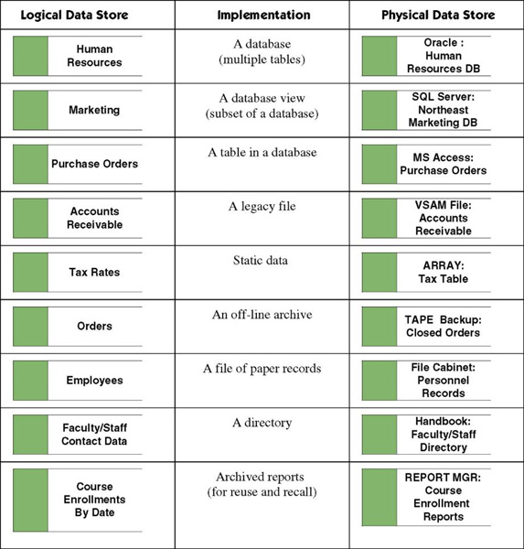
Physical Data Store Implementations

Slide 19
Distributed versus Centralized Systems
Distributed system – a system in which components are distributed across multiple locations and computer networks.
  Accordingly, the processing workload is distributed across multiple computers on the network.
Centralized systems – a system in which all components are hosted by a central, multi-user computer.
  Users interact with the system via terminals (or a PC emulating a terminal).
  Virtually all the actual processing and work is done on the host computer.

Slide 20
Why the Trend Toward Distributed Systems?
Modern businesses are already decentralized (distributed).
Distributed computing moves information and services closer to the customers and users who need them.
Distributed computing consolidates the power of personal computers across the enterprise.
Distributed computing solutions are in general more user-friendly because they use the PC as the user interface processor.
Personal computers and network servers are less expensive than mainframe computers
  Though total cost of ownership is at least as expensive

Slide 21
Computing Layers
Presentation layer—the user interface
Presentation logic layer—processing that must be done to generate the presentation, such as editing input data or formatting output data.
Application logic layer—the logic and processing to support business rules, policies, and procedures
Data manipulation layer—to store and retrieve data to and from the database
Data layer—the actual business data

Slide 22
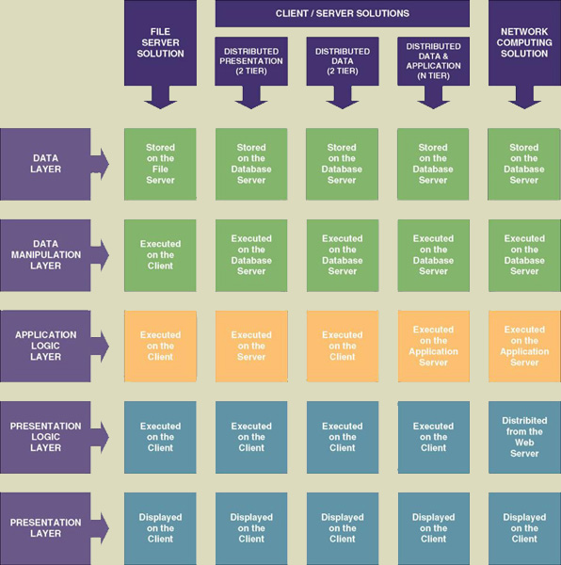
Types of Distributed Computing

Slide 23
File Server Architecture
Local area network (LAN) – a set of client computers (PCs) connected over a relatively short distance to one or more servers.
File server system – a LAN in which a server hosts the data of an information system.
  All other layers are implemented on the client computers.
  Frequently excessive network traffic to transport data between servers and clients.
  Client must be fairly robust (“fat”) because it does most of the work.
  Database integrity can be compromised.

Slide 24
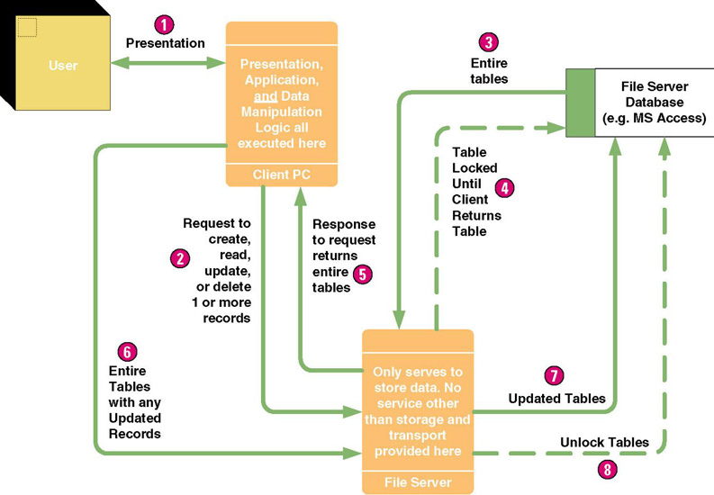
File Server Architecture

Slide 25
Client/Server Architecture — Clients
Client/server system – a distributed computing solution in which the presentation, presentation logic, application logic, data manipulation, and data layers are distributed between client PCs and one or more servers.
Thin client – a personal computer that does not have to be very powerful because it only presents the user interface to the user.
Fat client – a personal computer, notebook computer, or workstation that is typically powerful.

Slide 26
Client/Server Architecture — Servers
Database server – a server that hosts one or more databases and executes all data manipulation commands at the server.
Transaction server – a server that hosts services which ensure that all database updates for a transaction succeed or fail as a whole.
Application server – a server that hosts application logic and services for an information system.
Messaging or groupware server – a server that hosts services for e-mail, calendaring, and other work group functionality.
Web server – a server that hosts Internet or intranet websites.

Slide 27
Client/Server—Distributed Presentation
Distributed presentation – a client/server system in which the presentation and presentation logic layers are shifted from the server to reside on the client.
  The application logic, data manipulation, and data layers remain on the server (frequently a mainframe).
  Character user interface (CUI)
  Graphical user interface (GUI)

Slide 28
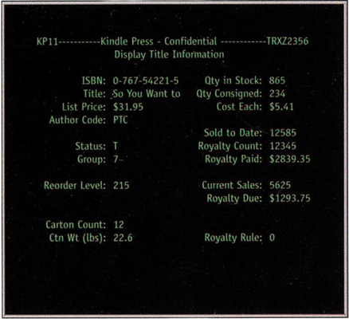
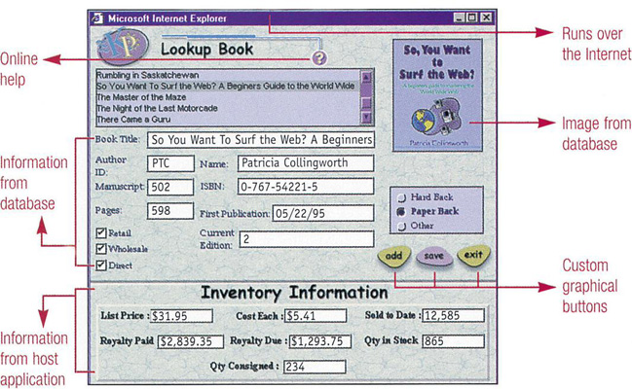
Building a GUI From a CUI – Screen Scrapers

Slide 29
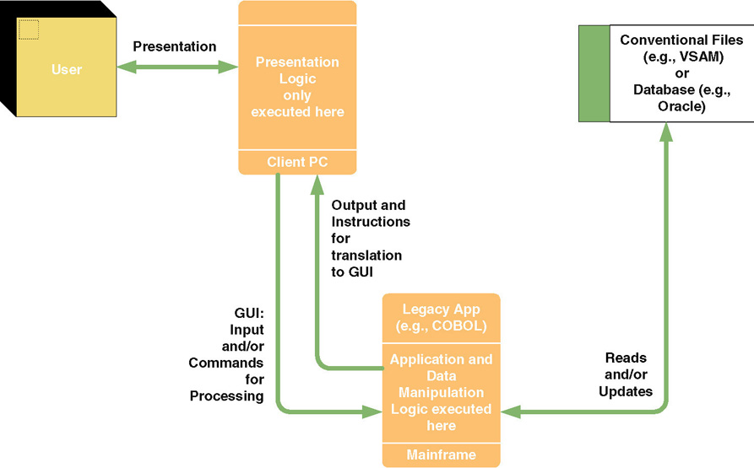
Client/Server—Distributed Presentation

Slide 30
Client/Server—Distributed Data
Distributed data – a client/server system in which the data and data manipulation layers are placed on the server(s), and other layers are placed on the clients.
  Sometimes called two-tiered client/server computing.
  Difference to file server systems is where the data manipulation commands are executed.
  Much less network traffic than file server systems because only the database requests and the results of those requests are transported across the network.
  Database integrity is easier to maintain.

Slide 31
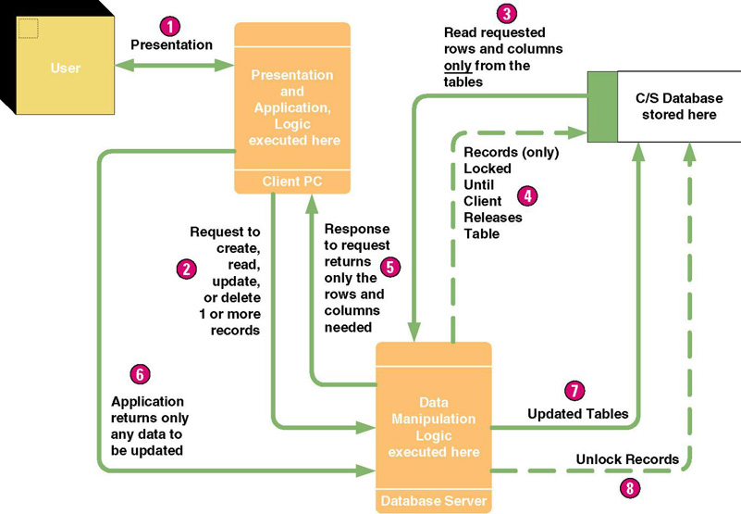
Client/Server—Distributed Data

Slide 32
Client/Server—Distributed Data and Application
Distributed data and application – client/server system:
  The data and data manipulation layers are placed on their own server(s),
  The application logic is placed on its own server,
  The presentation logic and presentation layers are placed on the clients.
  Also called three-tiered or n-tiered client/server computing.
  Requires design partitioning.
Partitioning – the art of determining how to best distribute (duplicate) application components across the network.

Slide 33
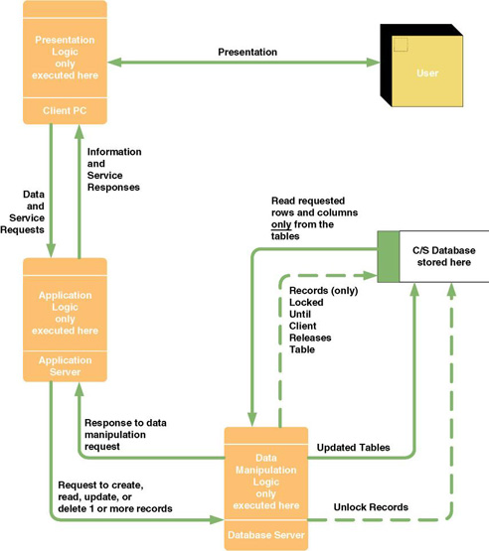
Client/Server — Distributed Data and Application

Slide 34
Internet- and Intranet-based Architectures
Network computing system – presentation and presentation logic layers implemented in client-side Web browsers using content downloaded from a Web server.
  Presentation logic layer connects to application logic layer running on application server, which connects to database servers on the backside of the system.
  The greatest potential of this approach is its applicability to redesign of traditional information systems to run on an intranet.
Intranet – a secure network that uses Internet technology to integrate desktop, work group, and enterprise computing into a cohesive framework.

Slide 35
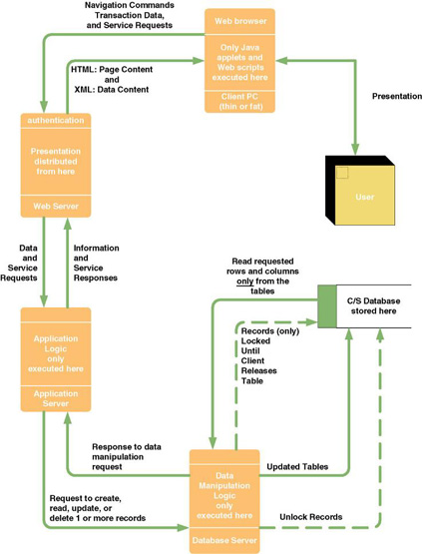
Network Computing System: Internet/Intranet

Slide 36
Internet and Intranet Technologies
Java
  Mostly for programming server-side application logic called “servlets”
  Occasionally for programming client-side application logic called “applets”
HTML (HyperText Markup Language)
  Mostly for programming the presentation layer
XML (Extensible Markup Language)
  Mostly for programming data content to be transported across the web
SQL (Structured Query Language)
  Universal standard language for database manipulation
Web Browsers

Slide 37
Data Architectures
Relational database stores data in tabular form. Each file is implemented as a table. Each field is a column in the table. Related records between two tables are implemented by intentionally duplicated columns in the two tables.
Distributed relational database – A database system that duplicates tables to multiple database servers located in geographically important locations.
Distributed relational database management system – a software program that controls access to and maintenance of stored data in the relational format.

Slide 38
Types of Data(base) Distribution
Data partitioning truly distributes rows and columns of tables to specific database servers with little or no duplication between servers.
  Vertical partitioning assigns different columns to different servers.
  Horizontal partitioning assigns different rows to different servers.
Data replication duplicates some or all tables on more than one database server.
  Propagates updates on one database server to any other database server where the data is duplicated.

Slide 39
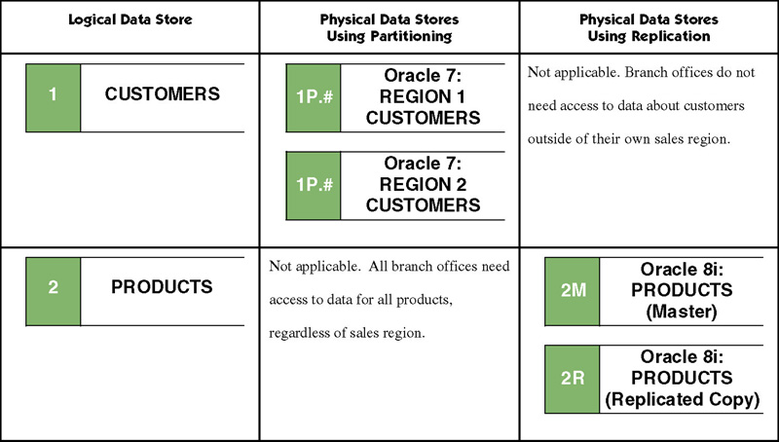
Data Partitioning versus
Data Replication

Slide 40
Interface Architectures – Inputs, Outputs, & Middleware
Batch inputs and outputs
Online inputs and outputs
Remote batch
Keyless data entry (and automatic identification)
Pen input
Electronic messaging and work group technology
Electronic Data Interchange (EDI)
Imaging and document interchange
Middleware

Slide 41
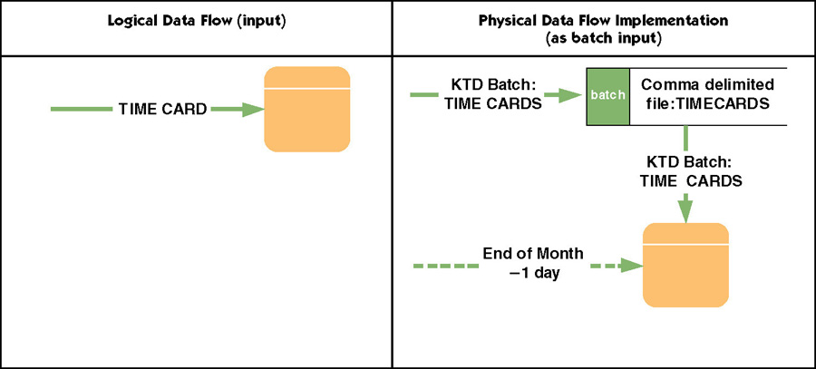
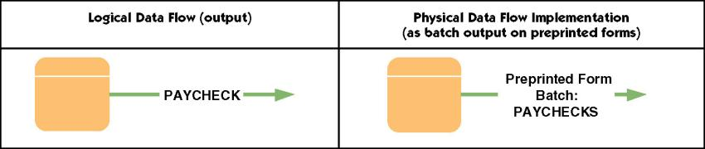
Batch Inputs and Outputs

Slide 42
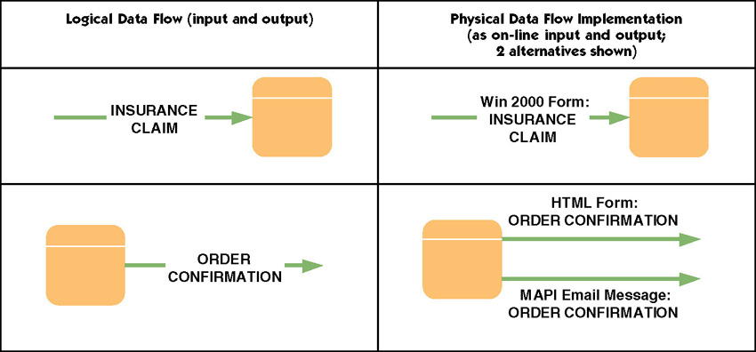
On-Line Inputs and Outputs

Slide 43
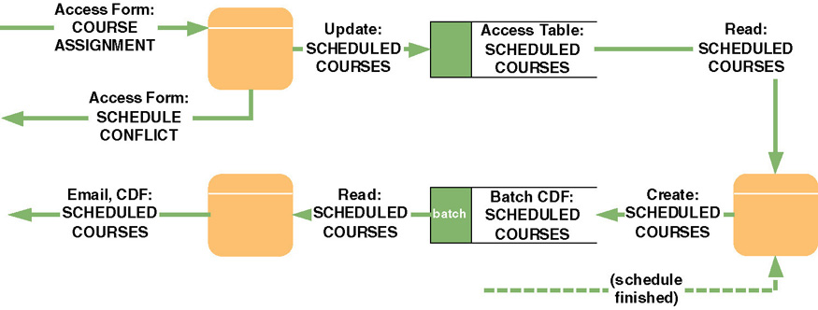
Remote Batch

Slide 44
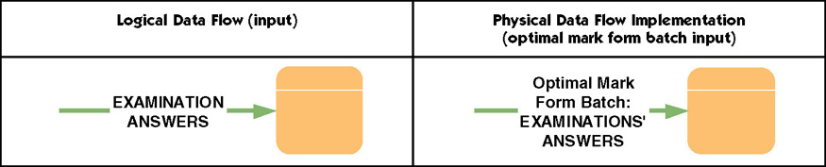
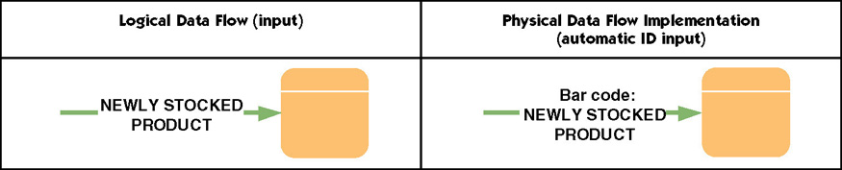
Keyless Data Entry (and Automatic Identification)

Slide 45
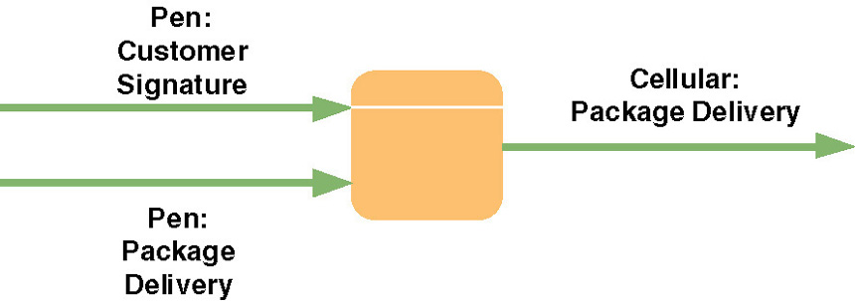
Pen Input

Slide 46
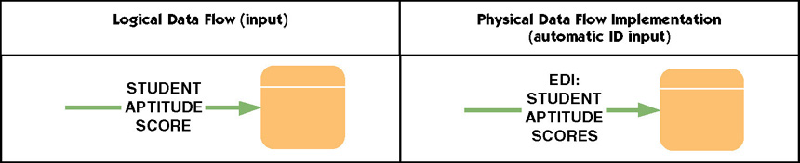
Electronic Data Interchange (EDI)
Electronic Data Interchange (EDI) – the standardized electronic flow of business transactions or data between businesses.
  Typically, many businesses must agree to a common data format to make EDI feasible.

Slide 47
Middleware
Middleware – utility software that enables communication between different processors in a system.
  It may be built into the respective operating systems or added through purchased middleware products.
  Presentation middleware
  Application middleware
  Database middleware

Slide 48
Process Architectures
Software development environment (SDE) – a language and tool kit for developing applications.
  SDEs exist for centralized computing
  SDEs exist for distributed presentation
  SDEs exist for two-tiered client/server
  SDEs exist for multi-tiered client/server
  SDEs exist for Internet and intranet client/server
Clean layering – a design strategy that requires that presentation, application, and data layers of an application be physically separated.
  Allows components of each layer to be revised or enhanced without affecting the other layers.

Slide 49
Application Architecture Strategies for System Design
The Enterprise Application Architecture Strategy
  Enterprise-wide information technology architecture to be followed in all development projects.
    Approved network, data, interface, and processing technologies and development tools.
    Strategy for integrating legacy systems and technologies.
    On-going process for continuously reviewing application architecture.
    On-going process for researching emerging technologies
    Process for analyzing requests for variances from the above.
The Tactical Application Architecture Strategy
  Defines architecture for each new system on an application-by-application basis as needed.
  Requires feasibility analysis for each application.

Slide 50
Drawing Physical DFDs for Network Architecture
Develop a physical data flow diagram (DFD) for the network architecture.
  Each process symbol represents a server or class of clients.
For each processor, develop a physical DFD to show the event processes (from Chapter 9) that are assigned to that processor.
All but simple processes should be factored into design units and modeled as a more detailed physical DFDs.

Slide 51
Design Units
Design unit – a self-contained collection of processes, data stores, and data flows that share similar design characteristics.
  A design unit serves as a subset of the total system whose inputs, outputs, files and databases, and programs can be designed, constructed, and tested as a self-contained unit.
  Ultimately, design units must be integrated into a whole system.

Slide 52
The Network Architecture DFD
Network architecture – a physical DFD that allocates processors (clients and servers) and devices (machines and robots) to a network and establishes:
  the connectivity between clients and servers
  where users will interface with the processors

Slide 53
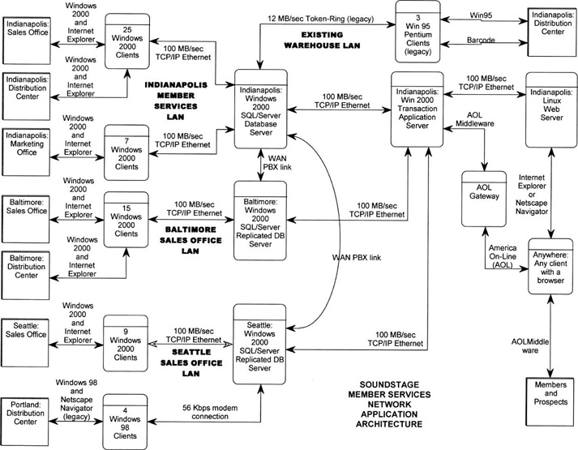
Network Architecture DFD

Slide 54
Data Distribution Options
Store all data on a single server.
Store specific tables on different servers.
Store subsets of specific tables on different servers.
Replicate (duplicate) specific tables or subsets on different servers.

Slide 55
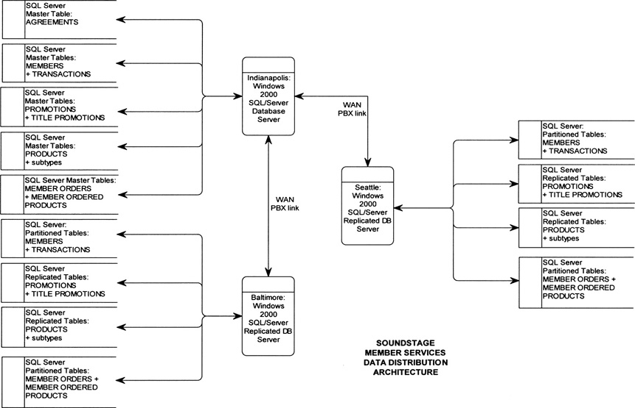
Data Distribution and Technology Assignments DFD

Slide 56
Process Distribution and Technology Assignments
For two-tiered client/server systems, all logical even diagrams are assigned to the client.
For three-tiered client/server and network computing systems, must closely examine each event’s primitive (detailed) DFD.
  Determine which primitive processes should be assigned to the client and which should be assigned to an application server.
  Generally data capture and editing are assigned to servers
  If different aspects of a single DFD are partitioned to different clients and servers, draw separate physical DFD for each.

Slide 57
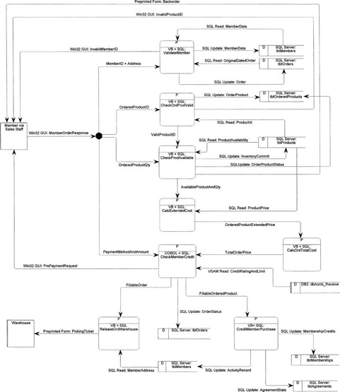
Physical DFD for an Event
See Figure 13-13 in text for a more readable version

Slide 58
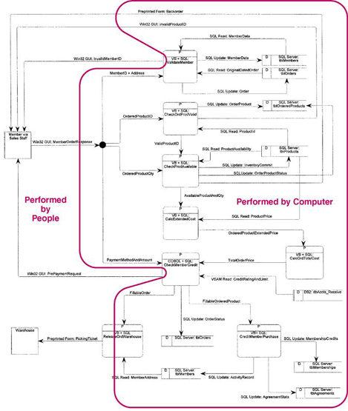
The Person/Machine Boundary
See Figure 13-14 in text for a more readable version

Slide 59
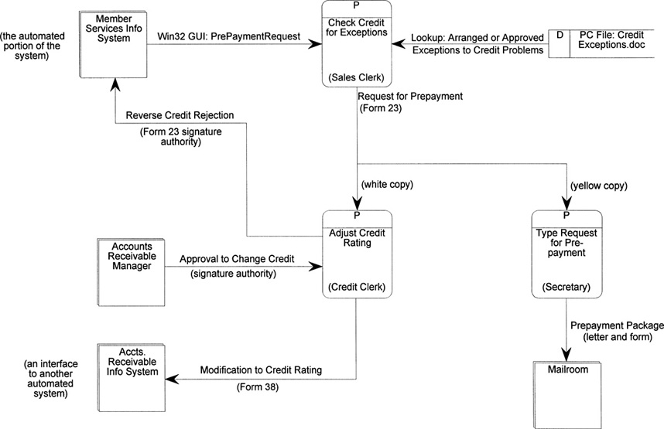
A Manual Design Unit

