Slide 1
1
Introduction to Information Systems

Slide 2
[ LEARNING OBJECTIVES]
Identify the reasons why being an informed user of information systems is important in today’s world.
Describe the various types of computer-based information systems in an organization.
Discuss ways in which information technology can affect managers and nonmanagerial workers.
Identify positive and negative societal effects of the increased use of information technology.

Slide 3
[ CHAPTER OUTLINE ]
Why Should I Study Information Systems?
Overview of Computer-Based Information Systems
How Does IT Impact Organizations?
Importance of Information Systems to Society

Slide 4
[ WEB RESOURCES]
Student PowerPoints for note taking
WileyPLUS Learning Space
E-Book
Author video lecture for each chapter section
Practice quizzes
Flash Cards for vocabulary review
Additional “What’s in IT for Me?” cases
Video interviews with managers
Lab Manuals - Microsoft Office 2010 & 2013

Slide 5
[ Opening Case AngelList Helps Entrepreneurs Build Companies]
What are the advantages that AngelList offers to entrepreneurs?
What are potential disadvantages that entrepreneurs might encounter by using AngelList? (Hint: What if you listed your company profi le on AngelList and no investor provided funding?)

Slide 6
1.1
Why Should I Study Information Systems
The Informed User—You!
IT Offers Career Opportunities
Managing Information Resources
Notes:
Information Technology (IT): any computer-based tool that people use to work with information and to support the information and information-processing needs of an organization.
Information System (IS): collects, processes, stores, analyzes, and disseminates information for a specific purpose.
Informed User: A person knowledgeable about information systems and information technology

Slide 7
The Informed User – You!
You benefit more when you understand what is “behind” IT applications
You can provide valuable input
You can recommend and help select IT Applications
You will be aware of new technology
You understand how IT improves performance
Understanding IT is very beneficial to entrepreneurs.

Slide 8
IT Offers Career Opportunities
IT is vital to modern business providing many lucrative career opportunities
Programmers, business analysts, systems analysts, and designers
Chief Information Officer (CIO) – executive in charge of the IS function
Career opportunities will remain strong in the future
Notes:
CIO: The executive who is in charge of the IS function

Slide 9
Top Job Rankings: Forbes (out of 12)
#1 Software Developer
#6 Web Developer
#8 Database Administrators
#12 Information Security Analysts

Slide 10
Top Job Rankings: U.S. News & World Report (out of 100)
#3 Software Developer
#7 Computer Systems Analyst
#8 Information Security Analysts
#11 Web Developer
#21 IT Manager

Slide 11
Top Job Rankings: Money
#1 Software Architect
#8 Database Administrator
#11 Clinical Applications Specialist (IT in Healthcare)
#14 User Experience Designer
#17 IT Program Manager

Slide 12
Managing Information Resources
Managing Information Resources is difficult and complex because:
IS has an enormous strategic value to organizations
IS’s are very expensive to acquire, operate, and maintain
Evolution of the MIS function within the organization

Slide 13
Managing Information Resources
MIS personnel vs. end users
Changing Role of the IS Department
Traditional Function of the MIS Department
New (Consultative) Functions of the MIS Department
Notes:
Evolution of the IS Function….
Traditional Functions of the MIS Department:
• Managing systems development and systems project management
• Managing computer operations, including the computer center
• Staffing, training, and developing IS skills
• Providing technical services
• Infrastructure planning, development, and control
New (Consultative) Functions of the MIS Department
• Initiating and designing specific strategic information systems
• Incorporating the Internet and electronic commerce into the business
• Managing system integration including the Internet, intranets, and extranets
• Educating the non-MIS managers about IT
• Educating the MIS staff about the business
• Partnering with business-unit executives
• Managing outsourcing
• Proactively using business and technical knowledge to seed innovative ideas about IT
• Creating business alliances with business partners

Slide 14
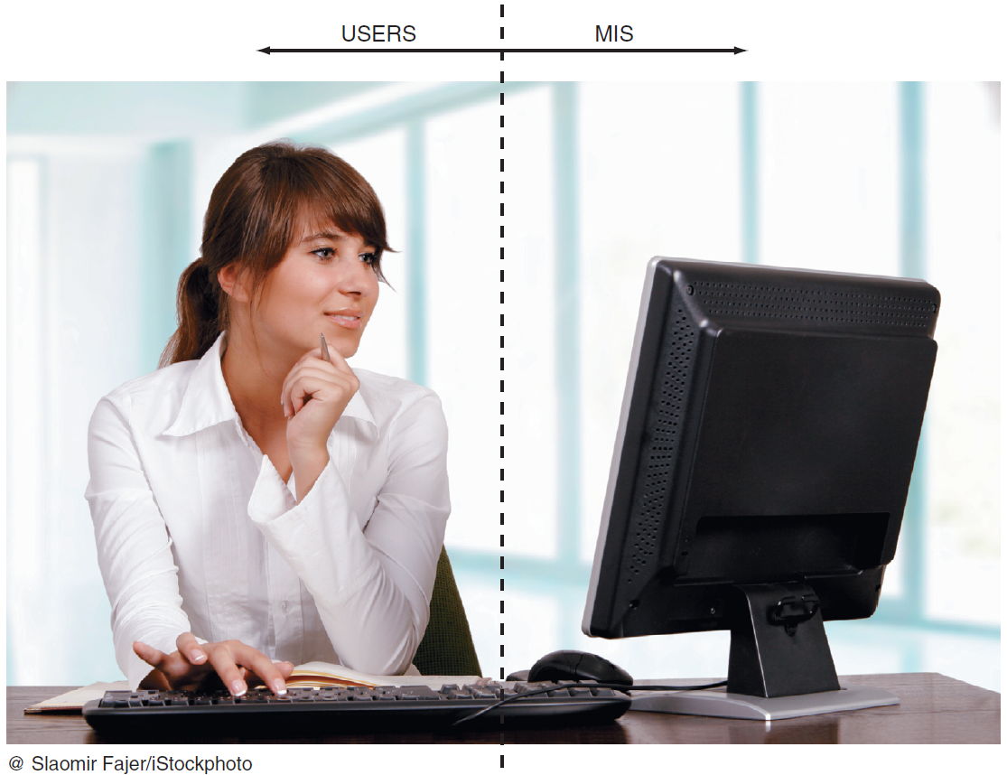
FIGURE 1.1 MIS provides what users see on their computer screens.
Notes:
FIGURE 1.1
MIS provides what users see on their computer screens.

Slide 15
Traditional Function of the MIS Department
Managing systems development and systems project management
Managing computer operations
Staffing, training, and developing IS skills
Providing technical services
Infrastructure planning, development, and control

Slide 16
New (Consultative) Functions of the MIS Department
Initiating and designing specific strategic IS
Incorporating the Internet and e-commerce into the business
Managing system integration including Internet, Intranets, and Extranets
Educating the non-MIS staff about IT
Educating the MIS staff about the business
Notes:
Initiating and designing specific strategic information systems
As an end user, your information needs will often mandate the development of new strategic information systems.
You will decide which strategic systems you need (because you know your business needs better than the MIS department does), and you will provide input into developing these systems.
Incorporating the Internet and electronic commerce into the business
As an end user, you will be primarily responsible for effectively using the Internet and electronic commerce in your business. You will work with the MIS department to accomplish this task.
Managing system integration, including the Internet, intranets, and extranets
As an end user, your business needs will determine how you want to use the Internet, your corporate intranets, and extranets to accomplish your goals. You will be primarily responsible for advising the MIS department on the most effective use of the Internet, your corporate intranets, and extranets.
Educating the non-MIS managers about IT
Your department will be primarily responsible for advising the MIS department on how best to educate and train your employees about IT.
Educating the MIS staff about the business
Communication between the MIS department and the business units is a two-way street. You will be responsible for educating the MIS staff on your business, its needs, and its goals.

Slide 17
New (Consultative) Functions of the MIS Department
Partnering with business-unit executives
Managing outsourcing
Proactively using business and technical knowledge to seed innovative IT ideas
Creating business alliances with business partners
Notes:
Partnering with business unit executives
Essentially, you will be in a partnership with the MIS department. You will be responsible for seeing that this partnership is one “between equals” and ensuring its success.
Managing outsourcing
Outsourcing is driven by business needs. Therefore, the outsourcing decision resides largely with the business units (i.e., with you). The MIS department, working closely with you, will advise you on technical issues such as communications bandwidth and security.
Proactively using business and technical knowledge to seed innovative ideas about IT
Your business needs will often drive innovative ideas about how to effectively use information systems to accomplish your goals. The best way to bring these innovative uses of IS to life is to partner closely with your MIS department. Such close partnerships have amazing synergies!
Creating business alliances with business partners
The needs of your business unit will drive these alliances, typically along your supply chain. Again, your MIS department will act as your advisor on various issues, including hardware and software compatibility, implementing extranets, communications, and security.

Slide 18
1.1
Information Technology Supports Students in Georgia
Notes:
Describe how the University System of Georgia manages its information resources vis-à-vis the individual universities in the system.
What are the advantages of central management of information systems in the University System of Georgia?
What are the disadvantages of central management of information systems in the University System of Georgia?

Slide 19
1.2
Overview of Computer-Based Information Systems
Types of Computer-Based Information Systems
Data, Information, Knowledge
IT Infrastructure
IT Components
IT Personnel
IT Services
Notes:
Computer-Based Information Systems (CBIS): an information system that uses computer technology to perform some or all of the its intended tasks.

Slide 20



FIGURE 1.2 Data, Information, and Knowledge.
Data
Information
Knowledge
Notes:
FIGURE 1.2 Data, information, and knowledge.
Data Items: an elementary description of things, events, activities, and transactions that are recorded, classified, and stored but are not organized to convey any specific meaning.
Information: refers to data that have been organized so that they have meaning and value to the recipient.
Knowledge: consists of data and/or information that have been organized and processed to convey understanding, experience, accumulated learning, and expertise as they apply to a current business problem.

Slide 21
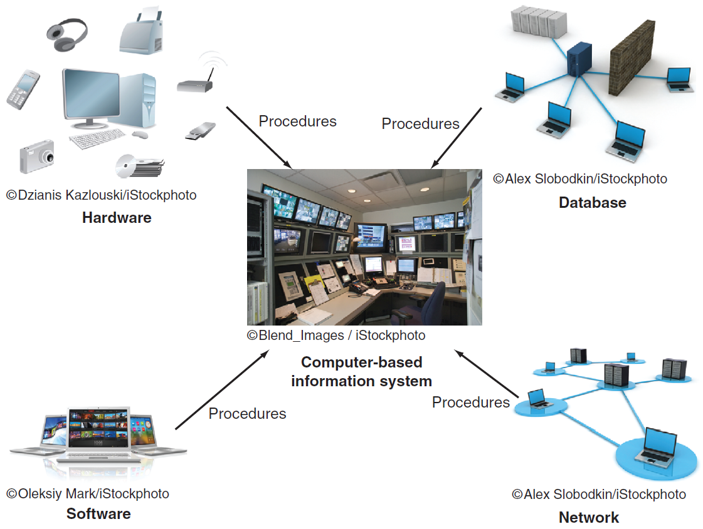
FIGURE 1.3 Computer-based information systems
Notes:
Computer-Based Information Systems (CBIS): an information system that uses computer technology to perform some or all of the its intended tasks.
FIGURE 1.3 Computer-based information systems consist of:
Hardware: consists of devices such as the processor, monitor, keyboard, and printer.
Software: a program or collection of programs that enable the hardware to process data.
Database: a collection of related fi les or tables containing data.
Network: a connecting system (wireline or wireless) that permits different computers to share resources.
Procedures: are the instructions for combining the above components to process information and generate the desired output.
People: individuals who use the hardware and software, interface with it, or utilize its output.

Slide 22
IT Components
Hardware
Software
Database
Network
Procedures
People
Notes:
Hardware: consists of devices such as the processor, monitor, keyboard, and printer.
Software: a program or collection of programs that enable the hardware to process data.
Database: a collection of related fi les or tables containing data.
Network: a connecting system (wireline or wireless) that permits different computers to share resources.
Procedures: are the instructions for combining the above components to process information and generate the desired output.
People: individuals who use the hardware and software, interface with it, or utilize its output.

Slide 23
Types of Computer-Based Information Systems
Major Capabilities of Information Systems
Breadth of Support of IS’s
Support for Organizational Employees

Slide 24
Major Capabilities of Information Systems
Perform high-speed, high-volume numerical computations.
Provide fast, accurate communication and collaboration within and among organizations.
Store huge amounts of information in an easy-to-access, yet small space.
Allow quick and inexpensive access to vast amounts of information, worldwide.
Interpret vast amounts of data quickly and effi ciently.
Automate both semiautomatic business processes and manual tasks.

Slide 25
Breadth of Support of Information Systems
Functional Area Information Systems (FAIS)
Accounting
Finance
Production & Operations Management
Marketing
HR
Notes:
Functional Area Information Systems (FAIS) : a collection of application programs in a single department or functional area.

Slide 26
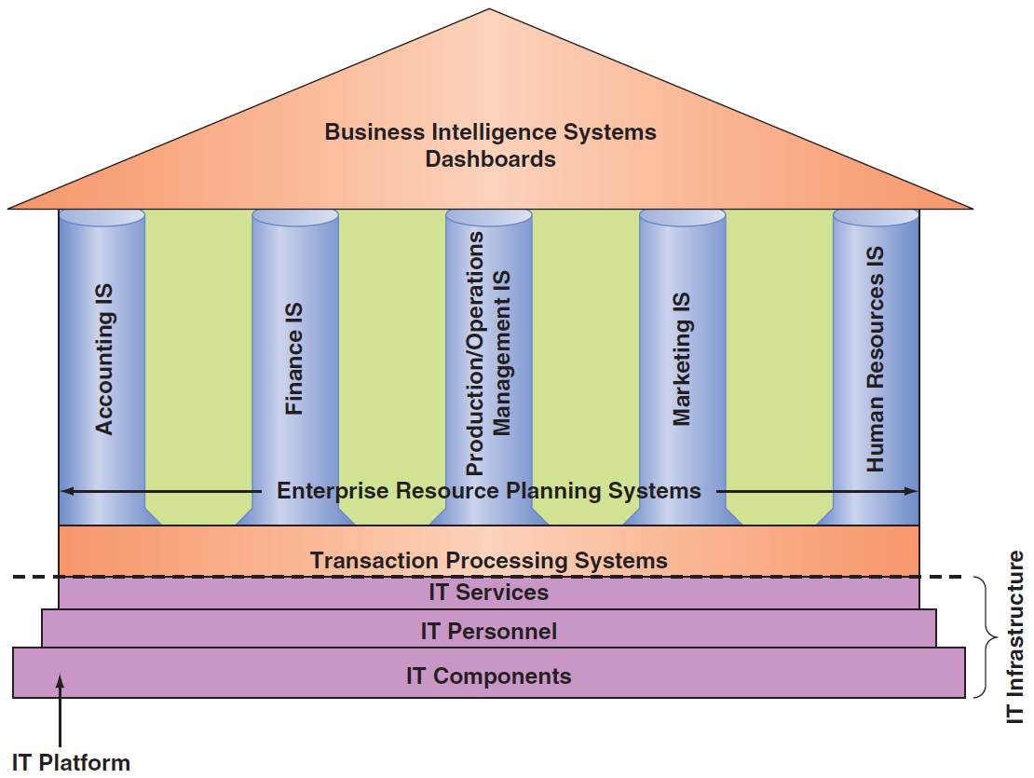
FIGURE 1.4 IT inside your organization
Notes:
FIGURE 1.4 Information technology inside your organization.
IT Components: Hardware, Software, a database, a network, procedures, and people.
IT Services: IT Personnel use IT Components to develop IS’s, oversee security & risk, and manage data.
IT Infrastructure: The IT components and IT services.
Application: A program designed to support a specific task or business process.
Functional Area Information Systems (FAIS) : a collection of application programs in a single department or functional area.

Slide 27
Breadth of Support of Information Systems
Two Information Systems support the entire organization:
Enterprise Resource Planning (ERP) Systems
Provide communication among functional area ISs
Transaction Processing Systems (TPS)
Support the “real time” monitoring, collection, storage, and processing of data from the organization’s day to day operations
Notes:
Enterprise Resource Planning (ERP): systems are designed to correct a lack of communication among the functional area IS.
Transaction Processing System (TPS): systems that support the monitoring, collection, storage, and processing of data from the organization’s basic business transactions, each of which generates data.

Slide 28
Breadth of Support of Information Systems
Interorganizational Information Systems (IOS)
Supports many Interorganizational operations
Examples of IOS:
Supply Chain Management (SCM)
Electronic commerce (e-commerce) systems
Notes:
Interorganizational Information systems (IOSs): Information systems that connect two or more organizations.
Electronic Commerce (e-commerce) Systems: an interorganizational information system that enable organizations to conduct transactions, called business-to-business (B2B) electronic commerce, and customers to conduct transactions with businesses, called business-to-consumer (B2C) electronic commerce.

Slide 29
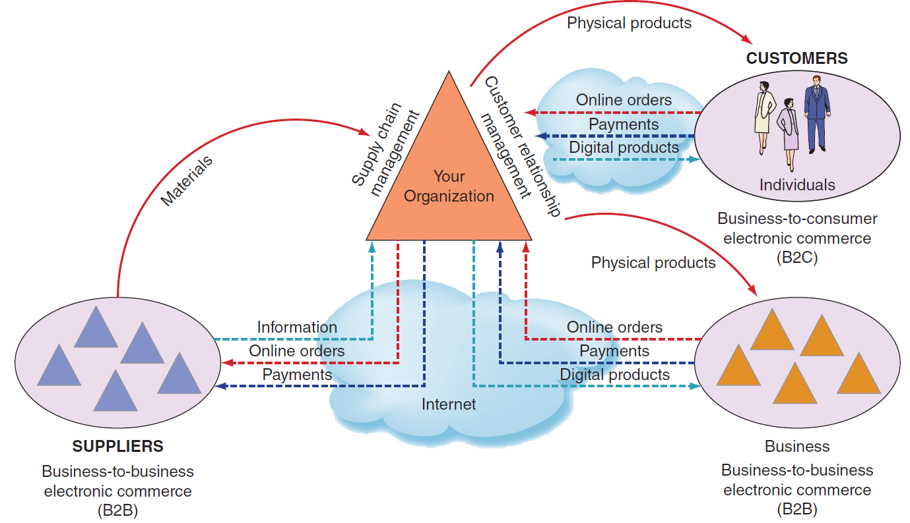
FIGURE 1.5 IS that function among multiple orgs
Notes:
FIGURE 1.5
Information systems that function among multiple organizations.

Slide 30
1.2
Warby Parker
Notes:
Provide two examples of how Warby Parker uses information technology to support its business model.
How might Warby Parker further use information technology to counter major competitors who want to emulate Warby’s business model? Support your answer.

Slide 31
Support for Organizational Employees
Clerical Workers
Knowledge Workers
Office Automation Systems (OAS)
Business Intelligence (BI)
Expert Systems (ES)
Dashboards (aka Digital Dashboards)
Notes:
Knowledge Workers: professional employees that are experts in a particular subject area (e.g., financial and marketing analysts, engineers, lawyers, and accountants.).
Office Automation Systems (OASs): typically support the clerical staff, lower and middle managers, and knowledge workers (e.g., word processing and desktop publishing software).
Business Intelligence (BI) Systems: systems that provide computer-based support for complex, nonroutine decisions, primarily for middle managers and knowledge workers.
Expert Systems (ES): systems that attempt to duplicate the work of human experts by applying reasoning capabilities, knowledge, and expertise within a specific domain.
Dashboards: a special form of IS that support all managers of the organization by providing rapid access to timely information and direct access to structured information in the form of reports.

Slide 32
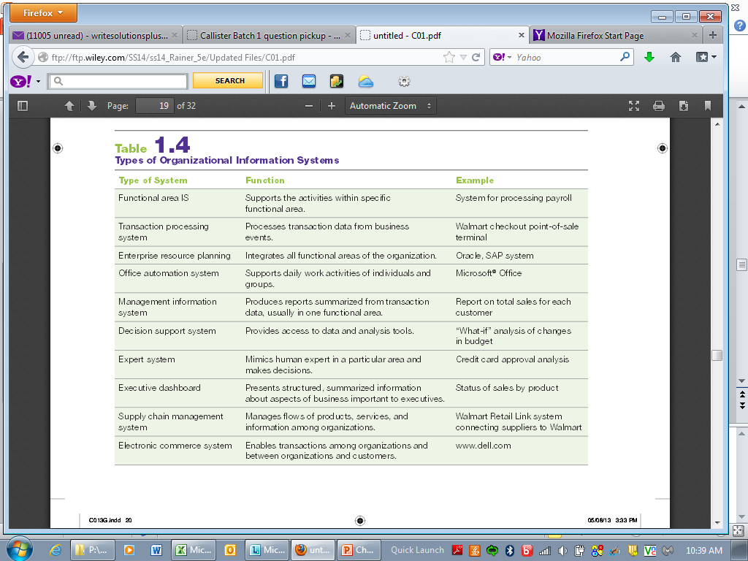
Table 1.4 Types of Organizational Information Systems

Slide 33
1.3
How Does IT Impact Organizations?
IT Impacts Entire Industries
IT Reduces the Number of Middle Managers
IT Changes the Manager’s Job
Will IT Eliminate Jobs?
IT Impacts Employees at Work

Slide 34
How Does IT Impact Organizations? Examples
Book Industry
Music Industry
Video Industry
Software Industry
Videogame Industry
Photography Industry

Slide 35
How Does IT Impact Organizations? Examples
Marketing Industry
Recruiting Industry
Financial Services Industry
Motion Picture Industry
DreamWorks Animation
Automobile Industry
Agriculture Industry

Slide 36
How Does IT Impact Organizations? Examples
National Defense Industry
Fashion Industry
Education
Legal Profession

Slide 37
IT Reduces the Number of Middle Managers
IT makes middle managers more productive
Consequently, IT reduces the number of middle managers required

Slide 38
IT Changes the Manager’s Job
Decision making is the most important managerial task
IT changes the way managers make decisions
IT provides near-real-time information
Managers have less time to make decisions
IT provides tools for analysis to assist in decision making

Slide 39
Will IT Eliminate Jobs?
The competitive advantage of replacing people with IT & machines is increasing rapidly
Increasing the use of IT in business also:
Creates new job categories
Requires more employees with IT knowledge and skills

Slide 40
IT Impacts Employees at Work
IT Impacts Employees’ Health & Safety
Job Stress
Long-term use of the keyboard & mouse
IT Provides Opportunities for People with Disabilities
Speech-recognition for employees unable to type due to physical impairment
Audible screen tips for employees who are visually impaired

Slide 41
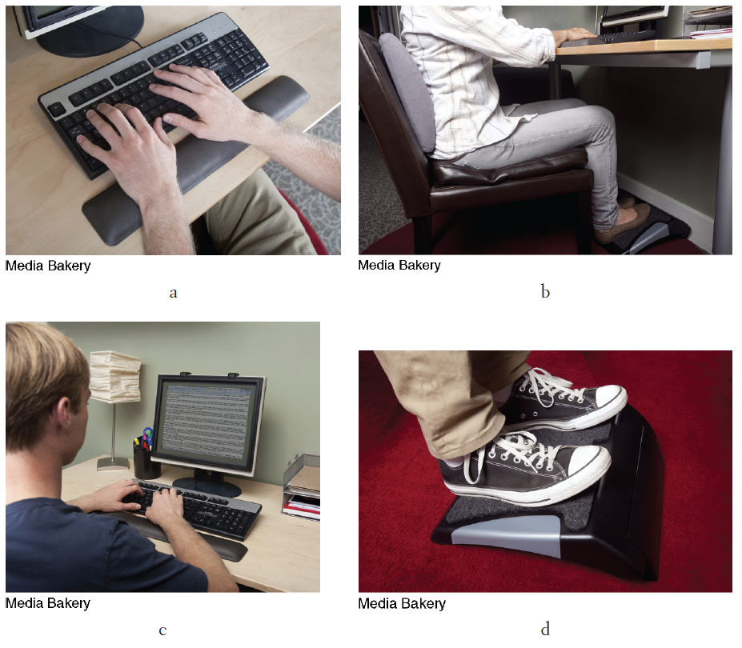
FIGURE 1.6 Ergonomic products protect computer users.
Notes:
FIGURE 1.6
Ergonomic products protect computer users.
Wrist support.
Back support.
Eye protection filter (optically coated glass).
Adjustable foot rest.

Slide 42
1.4
Importance of Information Systems to Society
IT Affects Our Quality of Life
The Robot Revolution Is Here Now
Improvements in Healthcare

Slide 43
IT Affects Our Quality of Life
IT has changed the way we work
Smartphones provide constant access to text, email, and voice communications
The lines between time at work and leisure time at home have become blurred
Surveys indicate employees take laptops and smartphones on vacation

Slide 44
The Robot Revolution is Here Now
Robotics used in Industry:
Manufacturing
Hospitals
Farming operations

Slide 45
The Robot Revolution is Here Now
Robotics used in the Home:
Roomba to vacuum our floors
Scooba to wash our floors
Verro to clean our pools
Looj to clean our gutters

Slide 46
1.3
Social, Collaborative Robots
Notes:
Rethink Robotics claims that Baxter will not necessarily replace workers, rather it will enable workers to transition into higher paying jobs (e.g., programming Baxter robots and supervising Baxter robots). Will Baxter replace workers in small manufacturing companies? Why or why not? Support your answer.
Discuss the possible reactions of labor unions to Baxter.
Identify and discuss additional potential applications for Baxter.

Slide 47
Improvements in Healthcare
IT used in Healthcare to:
Make better/faster diagnoses
Monitor critically ill patients more accurately
Streamline the process of researching & developing new drugs
To enhance the work of radiologists
Allow surgeons to use virtual reality to plan complex surgeries & use robots to remotely perform surgery

Slide 48
1.4
Apricot Forest Helps China’s Physicians
Notes:
Explain how Apricot Forest’s apps will help improve the relationship between physicians and patients in China.
Explain how Apricot Forest’s apps will help improve overall healthcare in China.
Discuss potential disadvantages of Apricot Forest’s apps to patients.
Discuss potential disadvantages of Apricot Forest’s apps to physicians.

Slide 49
[ Closing Case What to Do About Commercial Drones]
The Business Problem
An Interim Solution
The Next Step in the Solution
The Very Early Results
Notes:
Questions
1. Why do you think the FAA took six years to issue regulations on the commercial use of drones? Support your answer.
2. What are the advantages of commercial drones (in general)?
3. What are the disadvantages of commercial drones (in general)?
4. Do you think the advantages outweigh the disadvantages, or vice versa? Support your answer.

