Slide 1
2
Organizational Strategy, Competitive Advantage, and Information Systems

Slide 2
[ LEARNING OBJECTIVES]
Discuss ways in which information systems enable cross-functional business processes and business processes for a single functional area.
Differentiate between business process reengineering, business process improvement, and business process management.
Identify effective IT responses to different kinds of business pressures.
Describe the strategies that organizations typically adopt to counter Porter’s five competitive forces.

Slide 3
[ CHAPTER OUTLINE ]
Business Processes
Business Process Reengineering, Business Process Improvement, and Business Process Management
Business Pressures, Organizational Responses, and Information Technology Support
Competitive Advantage and Strategic Information Systems

Slide 4
[ WEB RESOURCES]
Student PowerPoints for note taking
WileyPLUS Learning Space
E-Book
Author video lecture for each chapter section
Practice quizzes
Flash Cards for vocabulary review
Additional “What’s in IT for Me?” cases
Video interviews with managers
Lab Manuals - Microsoft Office 2010 & 2013

Slide 5
[ Opening Case Grub Hub]
Questions
Look ahead in this chapter. Which one of Porter’s strategies for competitive advantage is GrubHub pursuing? Explain your answer.
Propose additional applications that GrubHub could develop to gain a competitive advantage in the marketplace.

Slide 6
2.1
Business Processes
Cross-Functional Processes
Information Systems and Business Processes

Slide 7
Business Processes
A business process is:
an ongoing collection of related activities that create a product or service of value to the organization, its business partners, and/or its customers.
Comprised of three elements:
Inputs
Resources
Outputs
Efficiency vs. Effectiveness
Notes:
Efficiency focuses on doing things well in the process; for example, progressing from one process activity to another without delay or without wasting money or resources.
Effectiveness focuses on doing the things that matter; that is, creating outputs of value to the process customer—for example, high-quality products.

Slide 8
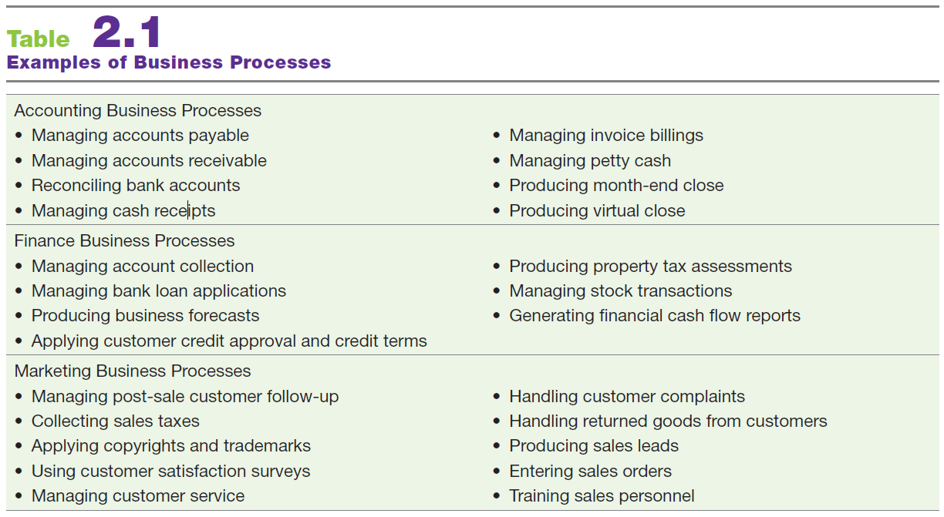
Examples of Business Processes

Slide 9
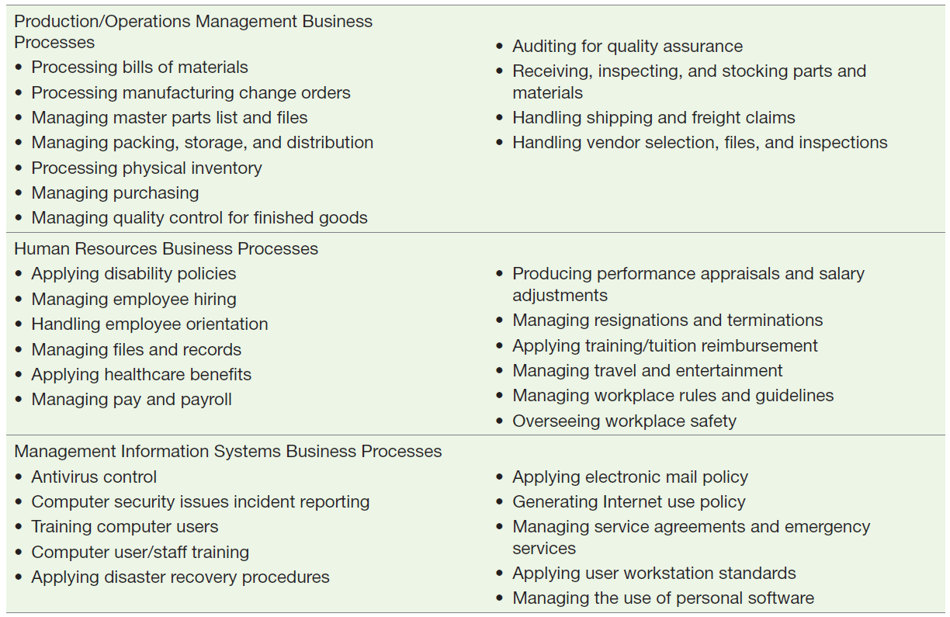
Examples of Business Processes (Continued)

Slide 10
Cross-Functional Processes
No single functional area is responsible
steps executed in a coordinated, collaborative way
Procurement & Fulfillment Cross-functional processes

Slide 11
Receive Ticket Order
Traveler
Airline Web Site
Seats Available
NO
Notify Traveler
Plan Trip
YES
Check Flights
Reserve Seats
NO
Frequent Flyer Mileage Sufficient?
Use Credit Card?
NO
Seats Available?
NO
YES
Charge Credit Card
YES
YES
Subtract Mileage
Submit Ticket Order
Charge OK?
NO
Notify Traveler
Receive e-Ticket
YES
Confirm Flight(s)
Issue e-Ticket

Slide 12
Information Systems & Business Processes
IS’s vital role in three areas of business processes
Executing the process
Capturing and storing process data
Monitoring process performance

Slide 13
2.1
NASCAR Uses IT in Its Pre-Race Inspection
Notes:
Describe why pre-race inspection is a business process for NASCAR.
Describe the various benefi ts that the app provides NASCAR.
Look ahead to Section 2.4. Is the app a strategic information system (SIS) for NASCAR? Why or why not? Support your answer.

Slide 14
Executing the Process
IS’s help Execute the Process by:
Informing employees when it is time to complete a task
Providing required data
Providing a means to complete the task

Slide 15
Capturing & Storing Process Data
Processes generate data
Dates, times, product numbers, quantities, prices, addresses, names, employee actions
IS’s capture & store process data (aka, transaction data)
Capturing & storing data provides immediate, ‘real time’ feedback

Slide 16
Monitoring Process Performance
IS evaluates information to determine how well a process is being executed
Evaluations occur at two levels
Process level
Instance level
Monitoring identifies problems for process improvement

Slide 17
2.2
Business Process Reengineering, Business Process Improvement, and Business Process Management
Reengineering
Improvement
Management

Slide 18
Measures of Excellence in Executing Business Processes
Customer Satisfaction
Cost Reduction
Cycle and fulfillment time reduction
Quality
Differentiation
Productivity

Slide 19
Business Process Reengineering (BPR)
Michael Hammer & James Champy, 1993, Reengineering the Corporation
BPR
A radical redesign of an organization’s business processes to increase productivity and profitability
Examines business processes with a “clean slate” approach

Slide 20
Business Process Improvement (BPI)
BPI
An incremental approach to move an organization toward business process centered operations
Focuses on reducing variation in process outputs by identifying the underlying cause of the variation
Six Sigma is a popular methodology for BPI

Slide 21
Business Process Improvement (BPI)
Five basic phases of successful BPI
Define
Measure
Analyze
Improve
Control
Notes:
BPI project generally follows five basic phases: Define, Measure, Analyze, Improve, and Control (DMAIC).
Define Phase: documents the existing “as is” process activities, process resources, and process inputs and outputs, usually as a graphical process map or diagram; AND, documents the customer and the customer’s requirements and a description of the problem.
Measure Phase: relevant process metrics, such as time and cost to generate one output (product or service) are identified, and data is collected to understand how the
metrics evolve over time. (data sources, such as customer and employee observations, interviews, and surveys)
Analysis Phase: the BPI team examines the “as is” process map and the collected data to identify problems with the process (e.g., decreasing efficiency or effectiveness) and
their root causes. If possible, the team should also benchmark the process by comparing its performance with that of similar processes in other companies, or other areas of the organization.
Improve Phase: the BPI team identifies possible solutions for addressing the root causes, maps the resulting “to be” process alternatives, and selects and implements the most appropriate solution.
Control Phase: the team establishes process metrics and monitors the improved process after the solution has been implemented to ensure the process performance remains stable. An IS system can be very useful for this purpose.

Slide 22
2.2
BPR, BPI, and BPM at Chevron
Notes:
Describe the main advantages of BPR at Chevron.
Why did Chevron adopt BPI?
How does Chevron apply BPM in its operations today?

Slide 23
BPR versus BPI
BPI
BPR
Low risk / low cost
Incremental change
Bottom-up approach
Takes less time
Quantifiable results
All employees trained in BPI
High risk / high cost
Radical redesign
Top-down approach
Time consuming
Impacts can be overwhelming
High failure rate

Slide 24
Business Process Management (BPM)
A management system used to support continuous BPI initiatives for core business processes over time
Important components of BPM:
Process modeling
Web-enabled technologies
Business Activity Monitoring (BAM)

Slide 25
Business Process Management (BPM)
Business Process Management Suite (BPMS)
An integrated set of applications used for BPM
Emerging Trend of Social BPM
Technologies enabling employees to collaborate across functions internally and externally using social media tools

Slide 26
2.3
Business Pressures, Organizational Responses, and Information Technology Support
Business Pressures
Organizational Responses

Slide 27
Business Pressures
Market Pressures
Technology Pressures
Societal/Political/Legal Pressures
Notes:
Market Pressures: business pressures generated by the global economy, intense competition, the changing nature of the workforce, and powerful customers.
Technology Pressures: business pressures caused by technological innovation and information overload.
Societal/Political/Legal Pressures: business pressures related to social responsibility, government regulation/deregulation, spending for social programs, spending to protect against terrorism, and ethics.

Slide 28
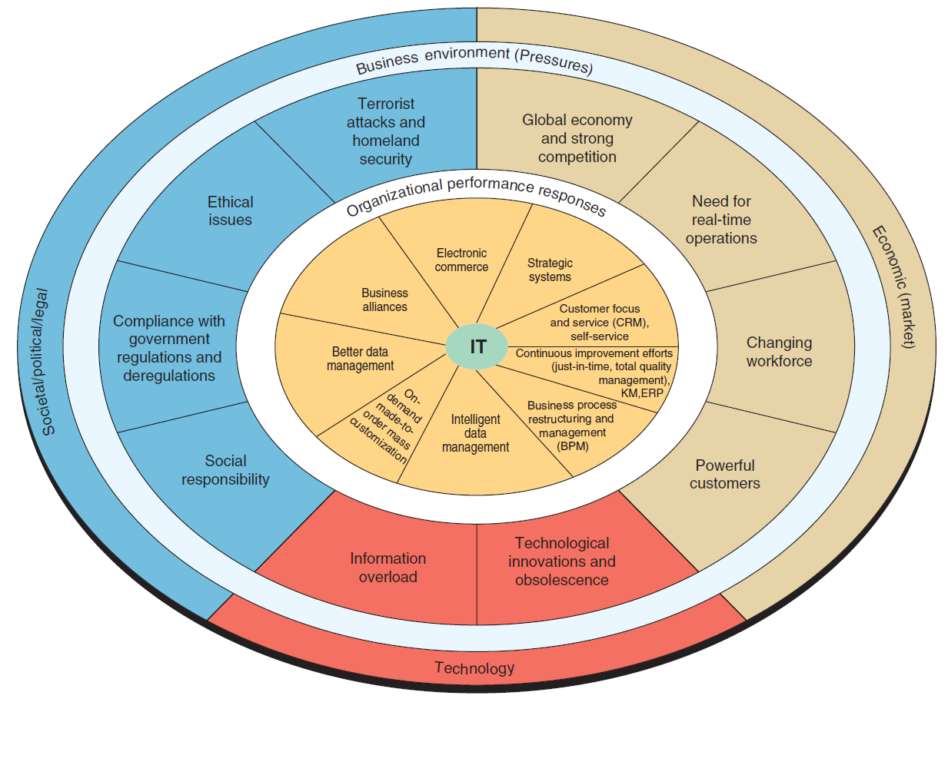
Notes:
FIGURE 2.2 Business pressures, organizational performance and responses, and IT support.

Slide 29
Market Pressures
Globalization
Changing Nature of the Workforce
Powerful Customers
Notes:
Globalization: the integration and interdependence of economic, social, cultural, and ecological facets of life, made possible by rapid advances in information technology.
Changing Nature of the Workforce: The workforce, particularly in developed countries, is becoming more diversified. Increasing numbers of women, single parents, minorities, and persons with disabilities are now employed in all types of positions.
Powerful Customers: consumer sophistication and expectations increase as customers become more knowledgeable about the products and services they acquire. Customers can use the Internet to find detailed information about products and services, to compare prices, and to purchase items at electronic auctions.

Slide 30
Globalization
The integration and interdependence of economic, social, cultural, and ecological facets of life, made possible by rapid advances in IT.

Slide 31
Globalization
The World is Flat, by Thomas Friedman
Technology is leveling global competition making the world “Flat”
Friedman’s Three Eras of Globalization
Globalization 1.0
Globalization 2.0
Globalization 3.0
Notes:
Thomas Friedman --> Three eras of globalization:
Globalization 1.0:
Timeframe: 1492 to 1800
Distinct Focus: Countries
Driver: Brute Force, Braun
Globalization 2.0:
Timeframe: 1800 to 2000
Distinct Focus: International Companies
Driver:
-- first half of this period --> Falling Transportation Costs (Steam Engine/Railroads)
-- second half of this period --> Falling Telecommunication Costs (Telegraph, Telephone, Computer, Satellite, Fiber Optics, Internet)
Globalization 3.0:
Timeframe: 2000 to Present
Distinct Focus: Groups and Individuals
Driver: Convergence of 10 forces (or Flatteners)

Slide 32
Globalization 1.0 (1st Era)
1492 - 1800
Focus:
Countries
Drivers:
Muscle
Horse power
Wind power
Steam power
Notes:
Thomas Friedman --> Three eras of globalization:
Globalization 1.0:
Timeframe: 1492 to 1800
Distinct Focus: Countries
Driver: Brute Force, Braun

Slide 33
Globalization 2.0 (2nd Era) 1800 - 2000
Focus:
Companies
Main Driver:
Multinational Companies
First Half of 2.0
Driver: Falling transport costs
Second Half of 2.0
Driver: Falling telecom costs
Notes:
Thomas Friedman --> Three eras of globalization:
Globalization 2.0:
Timeframe: 1800 to 2000
Distinct Focus: International Companies
Driver:
-- first half of this period --> Falling Transportation Costs (Steam Engine/Railroads)
-- second half of this period --> Falling Telecommunication Costs (Telegraph, Telephone, Computer, Satellite, Fiber Optics, Internet)

Slide 34
Globalization 3.0 (3rd Era)
2000 - Present
Focus:
Groups & Individuals
Drivers:
Convergence of 10 forces or “Flatteners”
Notes:
Thomas Friedman --> Three eras of globalization:
Globalization 3.0:
Timeframe: 2000 to Present
Distinct Focus: Groups and Individuals
Driver: Convergence of 10 forces (or Flatteners)

Slide 35
The Ten “Flatteners”
11/9/1989: Berlin Wall Falls
8/9/1995: Netscape Goes Public
Development of Workflow Software
Uploading
Outsourcing
Offshoring
Supply Chaining
Insourcing
Informing
The Steriods
Notes:
Fall of the Berlin Wall on November 9, 1989:
Shifted the world toward free-market economies and away from centrally planned economies.
Led to the emergence of the European Union and early thinking about the world as a single, global market.
Netscape goes public on August 9, 1995:
Popularized the Internet and the World Wide Web.
Development of workflow software:
Enabled computer applications to work with one another without human intervention.
Enabled faster, closer collaboration and coordination among employees, regardless of their location.
Uploading:
Empowered all Internet users to create content and put it on the Web.
Led the transition from a passive approach to content to an active, participatory, collaborative approach.
Outsourcing:
Contracting with an outside company to perform a specifi c function that your company was doing itself and then integrating their work back into your operation; for example, moving customer call centers to India.
Offshoring:
Relocating an entire operation, or certain tasks, to another country; for example, moving an entire manufacturing operation to China.
Supply chaining:
Technological revolution led to the creation of networks composed of companies, their suppliers, and their customers, all of which could collaborate and share information for increased efficiency.
Insourcing:
Delegating operations or jobs within a business to another company that specializes in those operations; for example, Dell hires FedEx to “take over” Dell’s logistics process.
Informing:
The ability to search for information, best illustrated by search engines.
The Steroids (computing, instant messaging and fi le sharing, wireless technologies, Voice over Internet Protocol, videoconferencing, and computer graphics):
Technologies that amplify the other flatteners.
Enable all forms of computing and collaboration to be digital, mobile, and personal.

Slide 36
Changing Nature of the Workforce
Workforce is Becoming More Diversified
Women
Single Parents
Minorities
Persons with Disabilities
IT is Enabling Telecommuting Employees

Slide 37
Powerful Customers
Increasing consumer sophistication & expectations
Consumer more knowledgeable about
Products and services
Price comparisons
Electronic auctions
Customer Relationship Management

Slide 38
Technology Pressures
Technological Innovation & Obsolescence
Rapid development of both New and Substitute Products & Services
Information Overload
Vast stores of data, information, & knowledge
Difficulties in managing data for decision making
Notes:
Technological Innovation and Obsolescence: Few and improved technologies rapidly create or support substitutes for products, alternative service options, and superb quality. As a result, today’s state-of-the-art products may be obsolete tomorrow.
Information Overload: Internet and other telecommunications networks are bringing a flood of information to managers. To make decisions effectively and efficiently, managers must be able to access, navigate, and utilize these vast stores of data, information, and knowledge.

Slide 39
Societal / Political / Legal Pressures
Social Responsibility
Compliance with Government Regulations
Protection against Terrorist Attacks
Ethical Issues
Notes:
Social Responsibility: Social issues that affect businesses and individuals range from the state of the physical environment, to company and individual philanthropy, to education. Some corporations and individuals are willing to spend time and/or money to address various social problems. These efforts are known as organizational social responsibility or individual social responsibility.
Compliance with Government Regulations: government regulations regarding health, safety, environmental protection, and equal opportunity. Businesses tend to view government regulations as expensive constraints on their activities. In general, government deregulation intensifies competition. In the wake of 9/11 and numerous corporate scandals, the U.S. government passed many new laws, including the Sarbanes–Oxley Act, the USA PATRIOT Act, the Gramm–Leach–Bliley Act, and the Health Insurance Portability and Accountability Act (HIPAA).
Protection Against Terrorist Attacks: Since September 11, 2001, organizations have been under increased pressure to protect themselves against terrorist attacks. In addition, employees who are in the military reserves have been called up for active duty, creating personnel problems. Information technology can help protect businesses by providing security systems and possibly identifying patterns of behavior associated with terrorist activities, including cyberattacks.
Ethical Issues: Ethics relates to general standards of right and wrong. Information ethics relates specifically to standards of right and wrong in information processing practices. Ethical issues are very important because, if handled poorly, they can damage an organization’s image and destroy its employees’ morale.

Slide 40
Social Responsibility
Green IT
Facilities design and management
Carbon management
International and U.S. state environmental laws
Energy management
Digital Divide
One Laptop per Child (OLPC) http://one.laptop.org
Notes:
IT is instrumental in organizational efforts to “go green” in three areas:
Facilities design and management
Carbon management
International and U.S. environmental laws
Digital Divide: refers to the wide gap between those individuals who have access to information and communications technology and those who do not.

Slide 41
2.3
Solar-Powered Tablets in Ethiopia
Notes:
What advantages could result from increasing the literacy of 100 million children around the world? Be specific.
In this experiment, the tablets were not connected to the Internet. Discuss the advantages and disadvantages to the children if the tablets were connected.

Slide 42
Social Responsibility & Philanthropy in Business
www.patientslikeme.com
www.giftflow.org
www.ourgoods.org
www.sparked.com
www.thredup.com
www.collaborativeconsumption.com
www.kiva.org
www.donorschooce.org

Slide 43
Compliance with Government Regulations
Sarbanes-Oxley Act
USA PATRIOT act
Gramm-Leach-Bliley Act
Health Insurance Portability & Accountability Act (HIPAA)

Slide 44
Protection against Terrorist Attacks
Employees in military reserves called to active duty
Information Technology used to identify and protect against terrorists and cyberattacks
Department of Homeland Security’s (DHS) US-VISIT program
Network of biometric-screening systems

Slide 45
Ethical Issues
General standards of right and wrong
Information-processing activities
Monitoring employee email
Monitoring employee Internet activity at work
Privacy of customer data

Slide 46
Organizational Responses
Strategic Systems
Customer Focus
Make-to-Order and Mass Customization
Bodymetrics (www.bodymetrics.com)
E-Business & E-Commerce
Notes:
Strategic Systems: provide organizations with advantages that enable them to increase their market share and/or profits, to better negotiate with suppliers, and to prevent competitors from entering their markets.
Customer Focus: Organizational attempts to provide superb customer service can make the difference between attracting and retaining customers versus losing them to competitors. Numerous IT tools and business processes have been designed to keep customers happy.
Make-to-Order: a strategy of producing customized (made to individual specifications) products and services.
Mass Customization: a company produces a large quantity of items, but it customizes them to match the needs and preferences of individual customers. Mass customization is essentially an attempt to perform make-to-order on a large scale (Example: Bodymetrics <www.bodymetrics.com>).
E-Business and E-Commerce: Conducting business electronically is an essential strategy for companies that are competing in today’s business environment.
Electronic commerce (EC or e-commerce): describes the process of buying, selling, transferring, or exchanging products, services, or information via computer networks, including the Internet.
E-business: a somewhat broader concept than EC that includes servicing customers, collaborating with business partners, and performing electronic transactions within an organization.

Slide 47
2.4
The Weather Channel
Notes:
Identify several reasons (not discussed in the case) why accurate weather predictions are so important. Can an accurate weather prediction be considered a competitive advantage for an organization that receives this information? Why or why not? Support your answer with specific examples.
Will Dark Sky, Sky Motion, and WeatherSphere enjoy a lasting competitive advantage over The Weather Channel? Why or why not? Support your answer.

Slide 48
2.4
Competitive Advantage and Strategic Information Systems
Porter’s Competitive Forces Model
Porter’s Value Chain Model
Strategies for Competitive Advantage
Notes:
Competitive Advantage: any assets that provide an organization with an edge against its competitors in some measure such as cost, quality, or speed. It also helps an organization to control a market and to accrue larger-than-average profits.
Business Environment: the combination of social, legal, economic, physical, and political factors in which businesses conduct their operations. Significant changes in any of these factors are likely to create Business Pressures on organizations.
Organizations Responses: Organizations respond to the various pressures by implementing Information Technology (IT) such as strategic systems, customer focus, make-to-order and mass customization, and e-business.

Slide 49
2.4
Competitive Advantage and Strategic Information Systems
Competitive Strategy
A statement identifying a business’s approach to compete, it’s goals, and the plans and policies required to attain those goals.

Slide 50
2.4
Competitive Advantage and Strategic Information Systems
Strategic Information Systems (SIS)
An information system that helps an organization achieve and maintain a competitive advantages

Slide 51
Porter’s Competitive Forces Model
Threat of Entry of New Competitors
Bargaining Power of Suppliers
Bargaining Power of Customers/Buyers
Threat of Substitute Products or Services
Rivalry Among Existing Firms within the Industry
Notes:
Threat of Entry of New Competitors: The threat that new competitors will enter your market is high when entry is easy and low when there are significant barriers to entry.
Bargaining Power of Suppliers: Supplier power is high when buyers have few choices from whom to buy and low when buyers have many choices.
Bargaining Power of Customers (Buyers): Buyer power is high when buyers have many choices from whom to buy and low when buyers have few choices.
Threat of Substitute Products or Services: If there are many alternatives to an organization’s products or services, then the threat of substitutes is high. If there are few alternatives, then the threat is low.
Rivalry Among Existing Firms: The threat from rivalry is high when there is intense competition among many firms in an industry. The threat is low when the competition is among fewer firms and is not as intense.
---------------------
Barrier to Entry: a product or service feature that customers have learned to expect from organizations in a certain industry. A competing organization must offer this feature in order to survive in the marketplace (e.g., legal requirements such as admission to the bar to practice law).
Switching Costs: the costs, in money and time, imposed by a decision to buy elsewhere (e.g., contracts with smartphone providers).

Slide 52
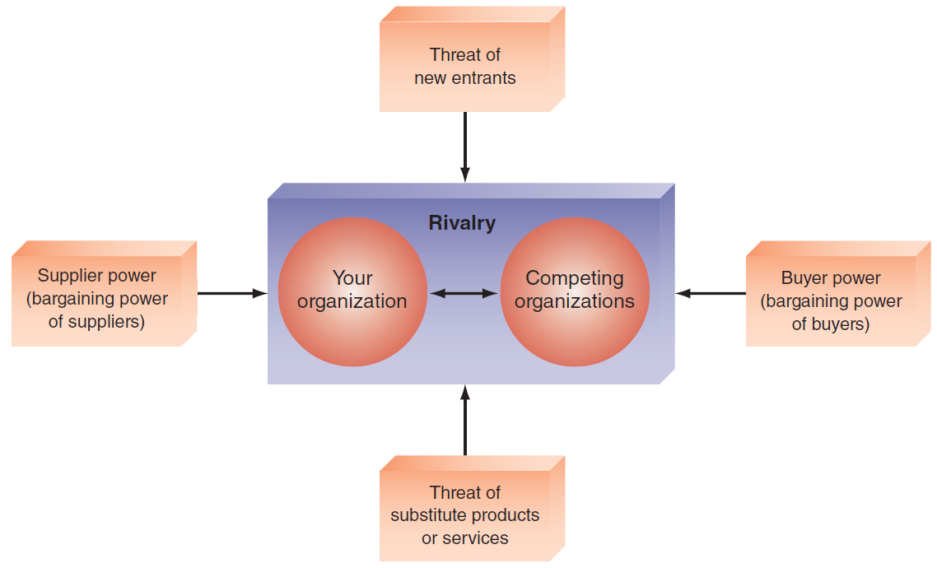
Porter’s Competitive Forces Model
Notes:
Threat of Entry of New Competitors: The threat that new competitors will enter your market is high when entry is easy and low when there are significant barriers to entry.
Bargaining Power of Suppliers: Supplier power is high when buyers have few choices from whom to buy and low when buyers have many choices.
Bargaining Power of Customers (Buyers): Buyer power is high when buyers have many choices from whom to buy and low when buyers have few choices.
Threat of Substitute Products or Services: If there are many alternatives to an organization’s products or services, then the threat of substitutes is high. If there are few alternatives, then the threat is low.
Rivalry Among Existing Firms: The threat from rivalry is high when there is intense competition among many firms in an industry. The threat is low when the competition is among fewer firms and is not as intense.
---------------------
Barrier to Entry: a product or service feature that customers have learned to expect from organizations in a certain industry. A competing organization must offer this feature in order to survive in the marketplace (e.g., legal requirements such as admission to the bar to practice law).
Switching Costs: the costs, in money and time, imposed by a decision to buy elsewhere (e.g., contracts with smartphone providers).

Slide 53
Porter’s Value Chain Model
Value Chain
A sequence of activities through which the organization’s inputs are transformed into valuable outputs.
Primary Activities
Relate to Production & Distribution of Products & Services
Support Activities
Support Primary Activities Contributing to Competitive Advantage
Notes:
Value Chain: a sequence of activities through which the organization’s inputs, whatever they are, are transformed into more valuable outputs, whatever they are.
Value System: includes the suppliers that provide the inputs necessary to the firm along with their value chains. After the firm creates products, these products pass through the value chains of distributors (which also have their own value chains), all the way to the customers. All parts of these chains are included in the value system.
-------------------
Two Categories of Organization Activities in the Value Chain:
Primary Activities: relate to the production and distribution of the firm’s products and services. These activities create value for which customers are willing to pay.
Support activities: contribute to the firm’s competitive advantage by supporting the primary activities, but do not add value directly to the firm’s products or services.

Slide 54
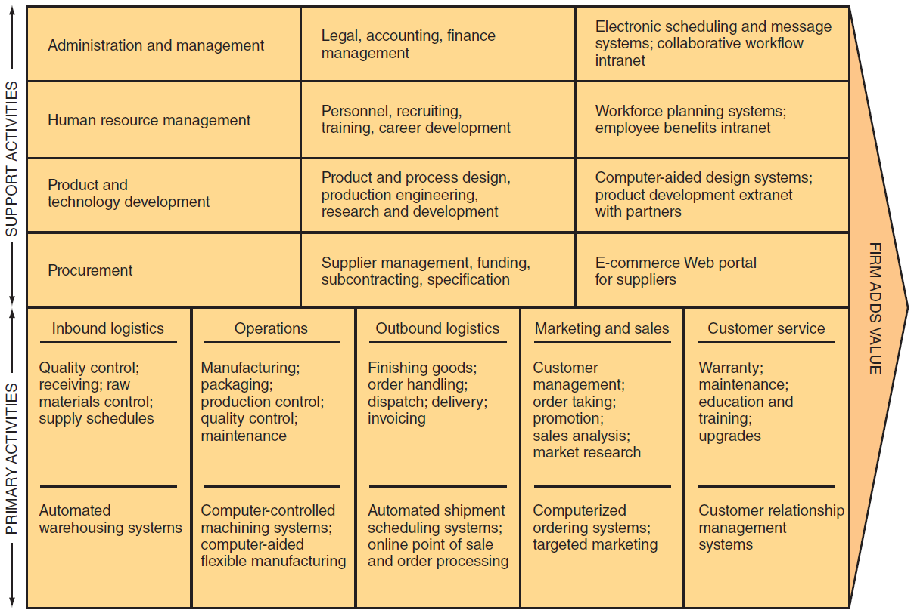
Notes:
FIGURE 2.4 Porter’s value chain model.
Value Chain: a sequence of activities through which the organization’s inputs, whatever they are, are transformed into more valuable outputs, whatever they are.
Value System: includes the suppliers that provide the inputs necessary to the firm along with their value chains. After the firm creates products, these products pass through the value chains of distributors (which also have their own value chains), all the way to the customers. All parts of these chains are included in the value system.
-------------------
Two Categories of Organization Activities in the Value Chain:
Primary Activities: relate to the production and distribution of the firm’s products and services. These activities create value for which customers are willing to pay.
Support activities: contribute to the firm’s competitive advantage by supporting the primary activities, but do not add value directly to the firm’s products or services.

Slide 55
Primary Activities
Five Primary Activities for Manufacturing
Inbound Logistics (inputs)
Operations (manufacturing & testing)
Outbound Logistics (storage & distribution)
Marketing & Sales
After Sales Services
Notes:
Primary Activities: relate to the production and distribution of the firm’s products and services. These activities create value for which customers are willing to pay.

Slide 56
Support Activities
Four Support Activities
Firm’s Infrastructure (accounting, finance, management)
Human Resources Management
Product & Technology Development (R&D)
Procurement
Notes:
Support activities: contribute to the firm’s competitive advantage by supporting the primary activities, but do not add value directly to the firm’s products or services.

Slide 57
Strategies for Competitive Advantage
Cost Leadership
Differentiation
Innovation
Operational Effectiveness
Customer-Orientation
Notes:
Competitive Advantage Strategies:
Cost leadership strategy: Produce products and/or services at the lowest cost in the industry (e.g., Walmart’s automatic inventory replenishment system).
Differentiation Strategy: Offering different products, services, or product features than your competitors (e.g., Southwest Airlines has differentiated itself as a low-cost, short-haul, express airline).
Innovation Strategy: Introduce new products and services, add new features to existing products and services, or develop new ways to produce them (Classic Example: the first introduction of automated teller machines (ATMs) by Citibank).
Operational Effectiveness Strategy: Improve the manner in which a firm executes its internal business processes so that it performs these activities more effectively than its rivals. Such improvements increase quality, productivity, and employee and customer satisfaction while decreasing time to market.
Customer Orientation Strategy: Concentrate on making customers happy. Web-based systems are particularly effective in this area because they can create a personalized, one-to-one relationship with each customer.

Slide 58
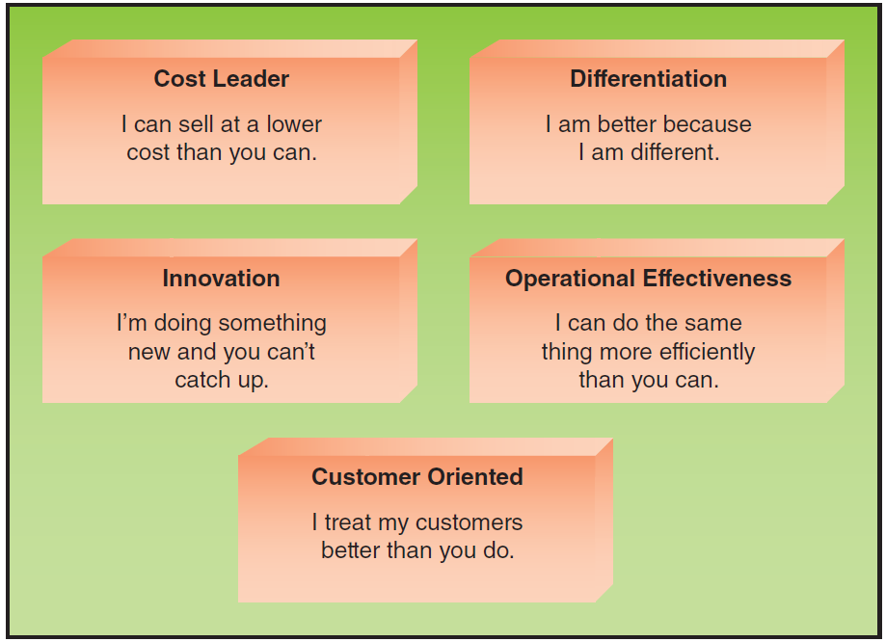
FIGURE 2.5 Strategies for competitive advantage.
Notes:
FIGURE 2.5 Strategies for competitive advantage.

Slide 59
2.5
The University of Pittsburgh Medical Center Makes Effective Use of IT
Notes:
Describe the strategic advantages that IT provides to UPMC.
Which of Porter’s competitive strategies is UPMC employing? Support your answer.
Describe how UPMC illustrates effective business–IT alignment.

Slide 60
[ Closing Case IBM’s Watson]
The Business Problem
An Interesting IT Solution
The Results
Notes:
Questions
1. What applications can you think of for Watson in a university setting?
2. What are potential disadvantages of using Watson in healthcare settings?
3. Would you consider being diagnosed only by Watson? Why or why not?
4. Would you consider being diagnosed by your personal physician, if he or she consulted Watson? Why or why not?

