Slide 1
5
Data and Knowledge Management

Slide 2
[ LEARNING OBJECTIVES]
Discuss ways that common challenges in managing data can be addressed using data governance.
Discuss the advantages and disadvantages of relational databases.
Define Big Data, and discuss its basic characteristics.
Explain the elements necessary to successfully implement and maintain data warehouses.
Describe the benefits and challenges of implementing knowledge management systems in organizations.
Understand the processes of querying a relational database, entity-relationship modeling, and normalization and joins.

Slide 3
[ CHAPTER OUTLINE ]
Managing Data
The Database Approach
Big Data
Data Warehouses and Data Marts
Knowledge Management
Appendix: Fundamentals of Relational Database Operations

Slide 4
[ WEB RESOURCES]
Student PowerPoints for note taking
WileyPLUS Learning Space
E-Book
Author video lecture for each chapter section
Practice quizzes
Flash Cards for vocabulary review
Additional “What’s in IT for Me?” cases
Video interviews with managers
Lab Manuals - Microsoft Office 2010 & 2013

Slide 5
[ Opening Case Database Save the State of Washington Medicaid Dollars]
The Problem
The Results
What We Learned From This Case
Notes:
Questions
Describe additional benefits (beyond those discussed in the case) of the State of Washington’s EDIE database.
Describe potential disadvantages of the State of Washington’s EDIE database.

Slide 6
5.1
Managing Data
The Difficulties of Managing Data
Data Governance

Slide 7
Difficulties in Managing Data
Data increases exponentially with time
Multiple sources of data
Data rot, or data degradation
Data security, quality, and integrity
Government Regulation
Notes:
The amount of data increases exponentially over time
Multiple Sources of Data:
Data are scattered throughout organizations
Data are generated from multiple sources (internal, personal, external)
New sources of data (e.g., blogs, podcasts, videocasts, and RFID tags and other wireless sensors)
Data Degradation (e.g., customers move to new addresses, change their names, etc.)
Data Rot: refers primarily to problems with the media on which the data are stored. Over time, temperature, humidity, and exposure to light can cause physical problems with storage media and thus make it difficult to access the data.
Data security, quality, and integrity are critical
Government Regulation:
Legal requirements change frequently and differ among countries and industries
Federal regulations:
-- Sarbanes–Oxley Act of 2002 requires that:
(1) public companies evaluate and disclose the effectiveness of their internal financial controls
(2) independent auditors for these companies agree to this disclosure.

Slide 8
Multiple Sources of Data
Internal Sources
Corporate databases, company documents
Personal Sources
Personal thoughts, opinions, experiences
External Sources
Commercial databases, government reports, and corporate Web sites.
Notes:
Multiple Sources of Data:
Internal Data Sources (e.g., corporate databases and company documents)
Personal Data Sources (e.g., personal thoughts, opinions, and experiences)
External Data Sources (e.g., commercial databases, government reports, and corporate Web sites).

Slide 9
Data Governance
An approach to managing information across an entire organization.
Master Data
Master Data Management
Notes:
Data Governance: is an approach to managing information across an entire organization involving a formal set of unambiguous rules for creating, collecting, handling, and protecting its information.
Master Data Management: a strategy for data governance involving a process that spans all organizational business processes and applications providing companies with the ability to store, maintain, exchange, and synchronize a consistent, accurate, and timely for the company’s master data.
Master Data: a set of core data (e.g., customer, product, employee, vendor, geographic location, etc.) that span the enterprise information systems.

Slide 10
5.2
The Database Approach
The Data Hierarchy
The Relational Database Model

Slide 11
Database Management Systems Minimize Three Main Problems
Data Redundancy
Data Isolation
Data Inconsistency
Notes:
Database Management System (DBMS): a set of programs that provide users with tools to create and manage a database.
Data redundancy: The same data are stored in multiple locations.
Data isolation: Applications cannot access data associated with other applications.
Data inconsistency: Various copies of the data do not agree.

Slide 12
Database Management Systems Maximize Three Things
Data Security
Data Integrity
Data Independence
Notes:
Database Management System (DBMS): a set of programs that provide users with tools to create and manage a database.
Data security: Because data are “put in one place” in databases, there is a risk of losing a lot of data at one time. Therefore, databases must have extremely high security measures in place to minimize mistakes and deter attacks.
Data integrity: Data meet certain constraints; for example, there are no alphabetic characters in a Social Security number field.
Data independence: Applications and data are independent of one another; that is, applications and data are not linked to each other, so all applications are able to access the same data.

Slide 13
5.1
Google’s Knowledge Graph
Notes:
Refer to the definition of a relational database. In what way can the Knowledge Graph be considered a database? Provide specific examples to support your answer.
Refer to the definition of an expert system in Technology Guide 4. Could the Knowledge Graph be considered an expert system? If so, provide a specific example to support your answer.
What are the advantages of the Knowledge Graph over traditional Google searches?

Slide 14
Data Hierarchy
Bit
Byte
Field
Data File or Table
Database
Notes:
Bit (binary digit): represents the smallest unit of data a computer can process and it consists only of a 0 or a 1.
Byte: A group of eight bits represents a single character (letter, number, or symbol).
Field: A column of data containing a logical grouping of characters into a word, a small group of words (e.g., last name, social security number, etc.).
Record: A logical grouping of related fields in a row (e.g., student’s name, the courses taken, the date, and the grade).
Data File: logical grouping of related records is called a data file or a table similar in appearance to a speadsheet in Excel consisting of multiple columns and multiple rows.
Database: logical grouping of related data files (aka database tables).

Slide 15
The Relational Database Model
Key Terms
Database Management System
Relational Database Model
Entity
Instance
Attribute
Primary Key
Foreign or Secondary Keys
Notes:
Relational Database Model: is based on the concept of two-dimensional tables and is usually designed with a number of related tables with each of these tables contains records (listed in rows) and attributes (listed in columns).
Data Model: a diagram that represents entities in the database and their relationships.
Entity: a person, place, thing, or event (e.g., customer, an employee, or a product).
Instance of an entity: refers to each row (or record) in a relational table, which is a specific, unique representation of the entity.
Attribute: each characteristic or quality of a particular entity.
Primary Key: a field in a database that uniquely identify each record so that it can be retrieved, updated, and sorted.
Secondary Key: a field that has some identifying information, but typically does not identify the record with complete accuracy and therefore cannot serve at the Primary Key.
Foreign Key: a field (or group of fields) in one table that uniquely identifies a row of another table. It is used to establish and enforce a link between two tables.

Slide 16
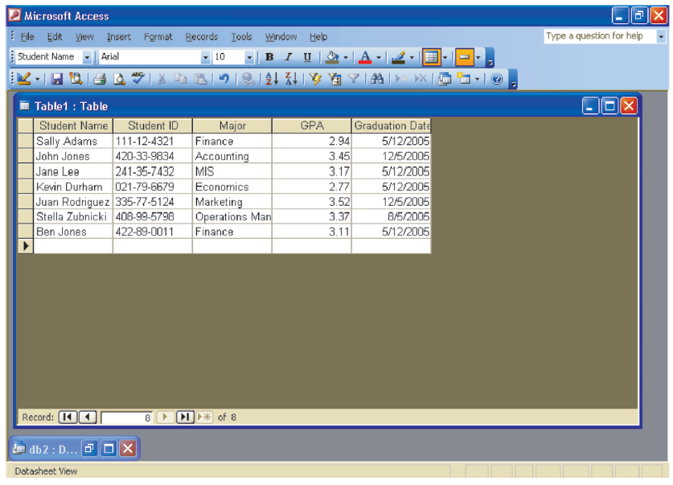
FIGURE 5.3 Student database example.
Notes:
FIGURE 5.3 Student database example.

Slide 17
5.3
Big Data
Defining Big Data
Characteristics of Big Data
Managing Big Data
Leveraging Big Data

Slide 18
Defining Big Data
Big data is difficult to define
Two Descriptions of Big Data

Slide 19
From Gartner Research (Big Data Description 1 of 2)
Diverse, high-volume, high-velocity information assets that require new forms of processing to enable enhanced decision making, insight discovery, and process optimization. (www.gartner.com)

Slide 20
From the Big Data Institute (Big Data Description 2 of 2)
Exhibit variety
Includes structured, unstructured, and semi-structured data
Are generated at high velocity with an uncertain pattern
Do not fit neatly into traditional, structured, relational databases
Can be captured, processed, transformed, and analyzed in a reasonable amount of time only by sophisticated information systems.
(www.the-bigdatainstitute.com)

Slide 21
Defining Big Data
Big Data Generally Consist of:
Traditional enterprise data
Machine-generated/sensor data
Social Data
Images captured by billions of devices located around the world
Digital cameras, camera phones, medical scanners, and security cameras

Slide 22
Characteristics of Big Data
Volume
Velocity
Variety
Notes:
Volume: incredible volume of data.
Velocity: The rate at which data flow into an organization is rapidly increasing and it is critical because it increases the speed of the feedback loop between a company and its customers.
Variety: Big Data formats change rapidly and can include include satellite imagery, broadcast audio streams, digital music files, Web page content.

Slide 23
Issues with Big Data
Untrusted data sources
Big Data is dirty
Big Data changes, especially in data streams
Notes:
Big Data can come from untrusted sources.
Big Data is dirty: Dirty data refers to inaccurate, incomplete, incorrect, duplicate, or erroneous data.
Big Data changes, especially in data streams: Organizations must be aware that data quality in an analysis can change, or the data itself can change, because the conditions under which the data are captured can change.

Slide 24
Managing Big Data
When properly analyzed big data can reveal valuable patterns and information.
Database environment
Traditional relational databases versus NoSQL databases
Open source solutions

Slide 25
5.2
The MetLife Wall
Notes:
Describe the problems that MetLife was experiencing with customer data before it implemented the MetLife Wall.
Describe how these problems originated.

Slide 26
Putting Big Data to Use
Making Big Data Available
Enabling Organizations to Conduct Experiments
Microsegmentation of Customers
Creating New Business Models
Organizations Can Analyze Far More Data
Notes:
Making Big Data Available: Making Big Data available for relevant stakeholders can help organizations gain value.
Enabling Organizations to Conduct Experiments: Big Data allows organizations to improve performance by conducting controlled experiments. For example, Amazon (and many other companies such as Google and LinkedIn) constantly experiments by offering slight different “looks” on its Web site.
Micro-Segmentation of Customers: Segmentation of a company’s customers means dividing them up into groups that share one or more characteristics.
Creating New Business Models: Companies are able to use Big Data to create new business models. For example, a commercial transportation company operated a large fleet of large, long-haul trucks. Th e company recently placed sensors on all its trucks. These sensors wirelessly communicate large amounts of information to the company, a process called telematics. Th e sensors collect data on vehicle usage (including acceleration, braking, cornering, etc.), driver performance, and vehicle maintenance. By analyzing this Big Data, the transportation company was able to improve the condition of its trucks through near-real-time analysis that proactively suggested preventive maintenance.
Organizations Can Analyze Far More Data: In some cases, organizations can even process all the data in a population relating to a particular phenomenon, meaning that they do not have to rely as much on sampling.

Slide 27
Big Data Used in the Functional Areas of the Organization
Human Resources
Product Development
Operations
Marketing
Government Operations

Slide 28
5.4
Data Warehouses and Data Marts
Describing Data Warehouses and Data Marts
A Generic Data Warehouse Environment

Slide 29
Describing Data Warehouses & Data Marts
Data Warehouse
A repository of historical data that are organized by subject to support decision makers in the organization
Data Mart
A low-cost, scaled-down version of a data warehouse designed for end-user needs in a strategic business unit (SBU) or individual department.
Notes:
Data Warehouse: a repository of historical data that are organized by subject to support decision makers in the organization.
Data Mart: a low-cost, scaled-down version of a data warehouse that is designed for the end-user needs in a strategic business unit (SBU) or an individual department.

Slide 30
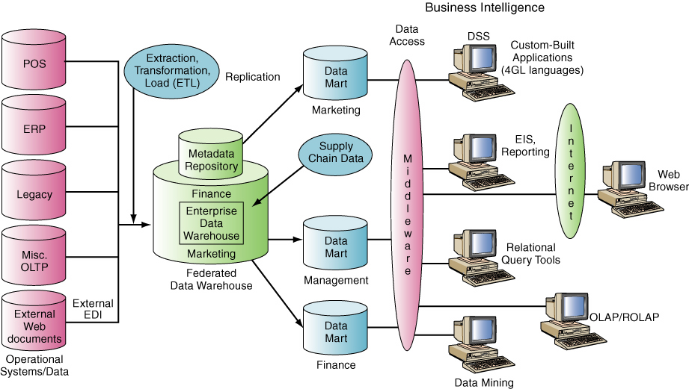
FIGURE 5.4 Data warehouse framework.
Notes:
FIGURE 5.4 Data warehouse framework.

Slide 31
Describing Data Warehouses & Data Marts
Basic characteristics of data warehouses and data marts
Organized by business dimension or subject
Use online analytical processing (OLAP)
Integrated
Time variant
Nonvolatile
Multidimensional
Notes:
Data Warehouse: a repository of historical data that are organized by subject to support decision makers in the organization.
Data Mart: a low-cost, scaled-down version of a data warehouse that is designed for the end-user needs in a strategic business unit (SBU) or an individual department.
Basic Characteristics of Data Warehouses and Data Marts:
Organized by business dimension or subject - Data are organized by subject. For example, by customer, vendor, product, price level, and region. This arrangement differs from transactional systems, where data are organized by business process, such as order entry, inventory control, and accounts receivable.
Use online analytical processing (OLAP)
Integrated - Data are collected from multiple systems and then integrated around subjects.
Time variant - Data warehouses and data marts maintain historical data (i.e., data that include time as a variable).
Nonvolatile - Data warehouses and data marts are nonvolatile—that is, users cannot change or update the data.
Multidimensional - Typically the data warehouse or mart uses a multidimensional data structure. Recall that relational databases store data in two-dimensional tables.

Slide 32
A Generic Data Warehouse Environment
Source Systems
Data Integration
Storing the Data
Metadata
Data Quality
Data Governance
Users
Notes:
Source Systems: Systems that provide a source of organizational data.
Data Integration: reflects the growing number of ways that source system data can be handled. Typically organizations need to Extract, Transform, and Load (ETL) data from source system into a data warehouse or data mart.
Storing the Data: A variety of architectures can be used to store decision-support data and the most common architecture is one central enterprise data warehouse, without data marts.
Metadata: data maintained about the data within the data warehouse. (e.g., database, table, and column names; refresh schedules; and data-usage measures.
Data Quality: quality of the data in the warehouse must meet users’ needs. If it does not, users will not trust the data and ultimately will not use it. Some of the data can be improved with data-cleansing soft ware, but the better, long-term solution is to improve the quality at the source system level.
Governance: To ensure that BI is meeting their needs, organizations must implement governance to plan and control their BI activities. Governance requires that people, committees, and processes be in place.
Users: There are many potential BI users, including IT developers; frontline workers; analysts; information workers; managers and executives; and suppliers, customers, and regulators.
----------------
Common Examples of Source Systems Include:
operational/transactional systems
enterprise resource planning (ERP) systems
Web site data
third-party data (e.g., customer demographic data)
operational databases

Slide 33
5.3
Data Warehouse Gives Nordea Bank a Single Version of the Truth
Notes:
What are other advantages (not mentioned in the case) that Nordea Bank might realize from its data warehouse?
What recommendations would you give to Nordea Bank about incorporating Big Data into its data management? Provide specific examples of what types of Big Data you think Nordea should consider.

Slide 34
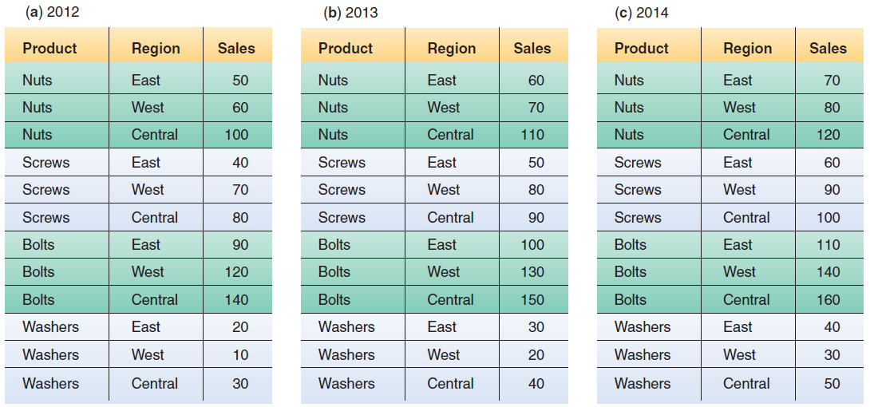
FIGURE 5.5 Relational databases.
Notes:
FIGURE 5.5 Relational databases.

Slide 35
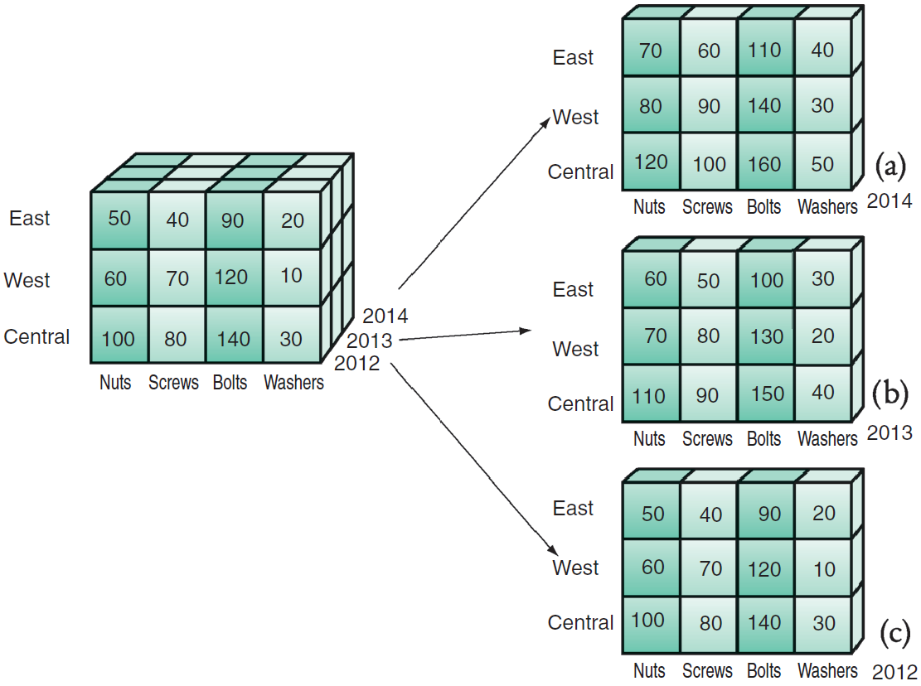
FIGURE 5.6 Data cube.
Notes:
FIGURE 5.6 Data cube.

Slide 36
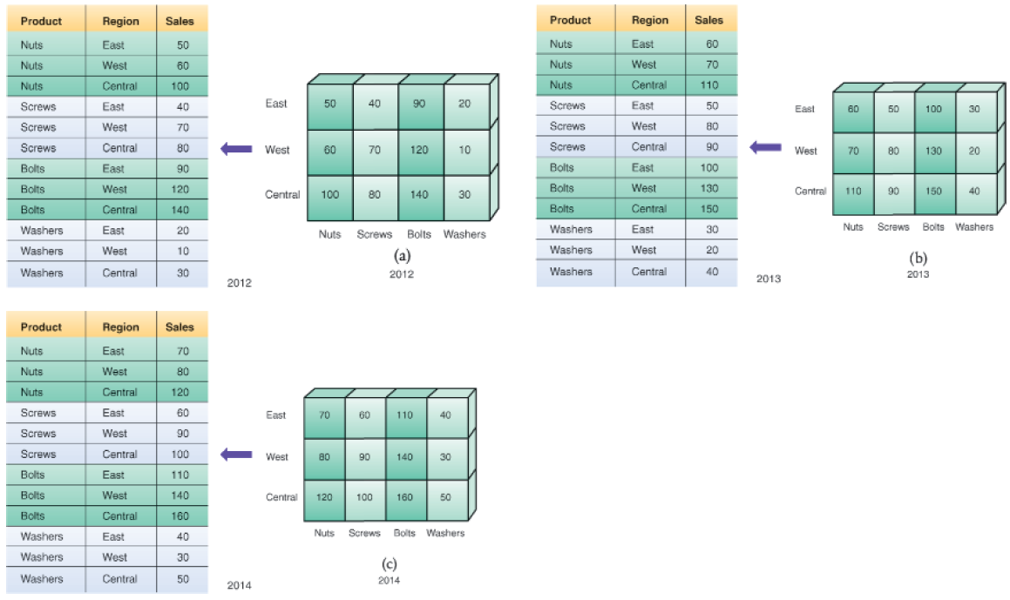
FIGURE 5.7 Equivalence between relational and multidimensional databases.
Notes:
FIGURE 5.7 Equivalence between relational and multidimensional databases.

Slide 37
5.5
Knowledge Management
Concepts and Definitions
Knowledge Management Systems
The KMS Cycle
Notes:
Knowledge management (KM): a process that helps organizations manipulate important knowledge that comprises part of the organization’s Knowledge: information that is contextual, relevant, and useful. It is information in action. Intellectual capital (or intellectual assets) is another term for knowledge.
Explicit Knowledge: more objective, rational, and technical knowledge. In an organization, explicit knowledge consists of the policies, procedural guides, reports, products, strategies, goals, core competencies, and IT infrastructure of the enterprise.
Tacit Knowledge: the cumulative store of subjective or experiential learning. In an organization, tacit knowledge consists of an organization’s experiences, insights, expertise, know-how, trade secrets, skill sets, understanding, and learning. It is generally imprecise and costly to transfer.
Knowledge management systems (KMSs): refer to the use of modern information technologies—the Internet, intranets, extranets, databases—to systematize, enhance, and expedite intra-firm and inter-firm knowledge management. KMSs are intended to help an organization cope with turnover, rapid change, and downsizing by making the expertise of the organization’s human capital widely accessible.
------------------------------
The KMS Cycle Consists of Six Steps:
Create knowledge: Knowledge is created as people determine new ways of doing things or develop know-how. Sometimes external knowledge is brought in.
Capture knowledge: New knowledge must be identified as valuable and be represented in a reasonable way.
Refine knowledge: New knowledge must be placed in context so that it is actionable. This is where tacit qualities (human insights) must be captured along with explicit facts.
Store knowledge: Useful knowledge must then be stored in a reasonable format in a knowledge repository so that other people in the organization can access it.
Manage knowledge: Like a library, the knowledge must be kept current. It must be reviewed regularly to verify that it is relevant and accurate.
Disseminate knowledge: Knowledge must be made available in a useful format to anyone in the organization who needs it, anywhere and anytime.

Slide 38
Concepts & Definitions
Knowledge Management (KM)
A process that helps manipulate important knowledge that comprises part of the organization’s memory, usually in an unstructured format.
Knowledge
Explicit & Tacit Knowledge
Notes:
Knowledge management (KM): a process that helps organizations manipulate important knowledge that comprises part of the organization’s Knowledge: information that is contextual, relevant, and useful. It is information in action. Intellectual capital (or intellectual assets) is another term for knowledge.
Explicit Knowledge: more objective, rational, and technical knowledge. In an organization, explicit knowledge consists of the policies, procedural guides, reports, products, strategies, goals, core competencies, and IT infrastructure of the enterprise.
Tacit Knowledge: the cumulative store of subjective or experiential learning. In an organization, tacit knowledge consists of an organization’s experiences, insights, expertise, know-how, trade secrets, skill sets, understanding, and learning. It is generally imprecise and costly to transfer.
Knowledge management systems (KMSs): refer to the use of modern information technologies—the Internet, intranets, extranets, databases—to systematize, enhance, and expedite intra-firm and inter-firm knowledge management. KMSs are intended to help an organization cope with turnover, rapid change, and downsizing by making the expertise of the organization’s human capital widely accessible.
------------------------------
The KMS Cycle Consists of Six Steps:
Create knowledge: Knowledge is created as people determine new ways of doing things or develop know-how. Sometimes external knowledge is brought in.
Capture knowledge: New knowledge must be identified as valuable and be represented in a reasonable way.
Refine knowledge: New knowledge must be placed in context so that it is actionable. This is where tacit qualities (human insights) must be captured along with explicit facts.
Store knowledge: Useful knowledge must then be stored in a reasonable format in a knowledge repository so that other people in the organization can access it.
Manage knowledge: Like a library, the knowledge must be kept current. It must be reviewed regularly to verify that it is relevant and accurate.
Disseminate knowledge: Knowledge must be made available in a useful format to anyone in the organization who needs it, anywhere and anytime.

Slide 39
Knowledge Management Systems (KMS)
Refer to the use of modern information technologies – the Internet, intranet, extranets, databases – to systematize, enhance, and expedite intrafirm and interfirm knowledge management.
Best practices

Slide 40
The KMS Cycle
Create Knowledge
Capture Knowledge
Refine Knowledge
Store Knowledge
Manage Knowledge
Disseminate Knowledge
Notes:
The KMS Cycle Consists of Six Steps:
Create knowledge: Knowledge is created as people determine new ways of doing things or develop know-how. Sometimes external knowledge is brought in.
Capture knowledge: New knowledge must be identified as valuable and be represented in a reasonable way.
Refine knowledge: New knowledge must be placed in context so that it is actionable. This is where tacit qualities (human insights) must be captured along with explicit facts.
Store knowledge: Useful knowledge must then be stored in a reasonable format in a knowledge repository so that other people in the organization can access it.
Manage knowledge: Like a library, the knowledge must be kept current. It must be reviewed regularly to verify that it is relevant and accurate.
Disseminate knowledge: Knowledge must be made available in a useful format to anyone in the organization who needs it, anywhere and anytime.

Slide 41
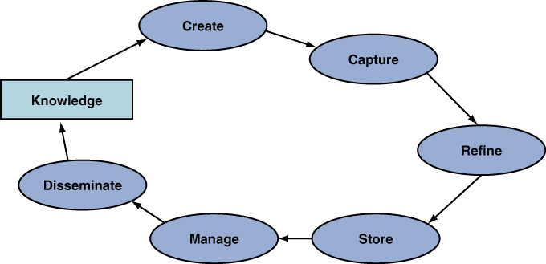
FIGURE 5.8 The knowledge management system cycle.
Notes:
FIGURE 5.8 The knowledge management system cycle.

Slide 42
5.6
Appendix: Fundamentals of Relational Database Operations
Query Languages
Entity Relationship Modeling
Normalization and Joins
Notes:
Relational Database: a collection of interrelated two-dimensional tables, consisting of rows and columns.
Record: Each row in a database table or file.
Field: Each column in a database table or file which represents an attribute (or characteristic) of that record.
Primary Key: at least one field that uniquely identifies each record so that it can be retrieved, updated, and sorted.
Secondary Key: is another field that has some identifying information, but typically does not uniquely identify the record.
Foreign key: is a field (or group of fields) in one table that matches the primary key value in a another table. A foreign key is used to establish and enforce a link between two tables.

Slide 43
Query Languages
Structured Query Language (SQL)
Query By Example (QBE)
Notes:
Structured Query Language (SQL): the most popular query language used for interacting with a database. SQL allows people to perform complicated searches by using relatively simple statements or key words.
Query By Example (QBE): the user fills out a grid or template—also known as a form—to construct a sample or a description of the data desired.

Slide 44
Entity Relationship Modeling
Entity Relationship Diagram (ERD)
Business Rules
Data Dictionary
Relationships
Unary, Binary, Ternary
Cardinality
Connectivity
Notes:
Entity–Relationship (ER) Modeling: A process by which designers plan and create databases using an entity–relationship diagram.
ER Diagrams: consist of entities, attributes, and relationships. To properly identify entities, attributes, and relationships, database designers first identify the business rules for the particular data model.
Business Rules: precise descriptions of policies, procedures, or principles in any organization that stores and uses data to generate information. Business rules are derived from a description of an organization’s operations, and help create and enforce business processes in that organization.
Data Dictionary: provides information on each attribute, such as its name, if it is a key, part of a key, or a non-key attribute, the type of data expected (alphanumeric, numeric, dates, etc.), and valid values. Data dictionaries can also provide information on why the attribute is needed in the database; which business functions, applications, forms, and reports use the attribute; and how often the attribute should be updated.
Relationships: illustrate an association between entities.
Degree of a Relationship: indicates the number of entities associated with a relationship.
Unary Relationship: exists when an association is maintained within a single entity.
Binary Relationship: exists when two entities are associated.
Ternary Relationship: exists when three entities are associated.
Cardinality: refers to the maximum number of times an instance of one entity can be associated with an instance in the related entity. Cardinality can be mandatory single, optional single, mandatory many, or optional many.

Slide 45
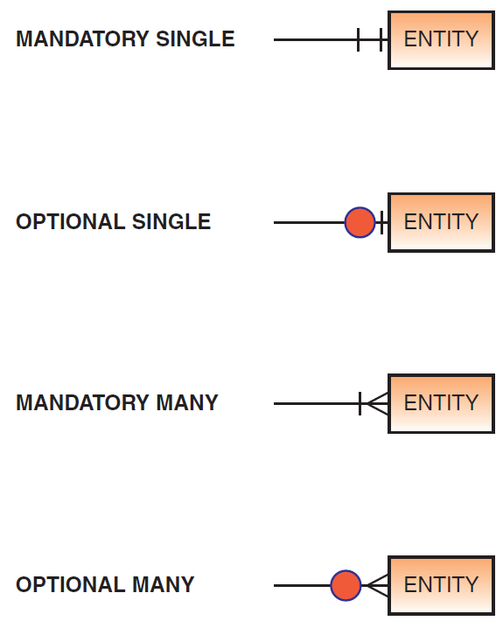
Figure 5A.1 Cardinality Symbols

Slide 46
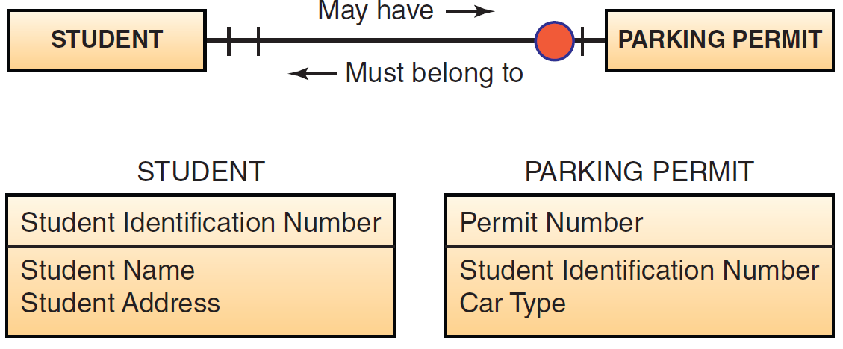
Figure 5A.2 One-to-one Relationship

Slide 47
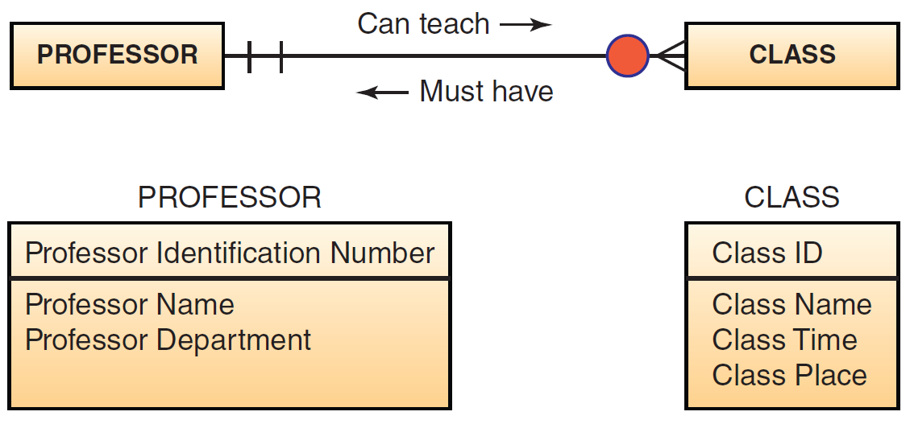
Figure 5A.3 One-to-Many Relationship

Slide 48
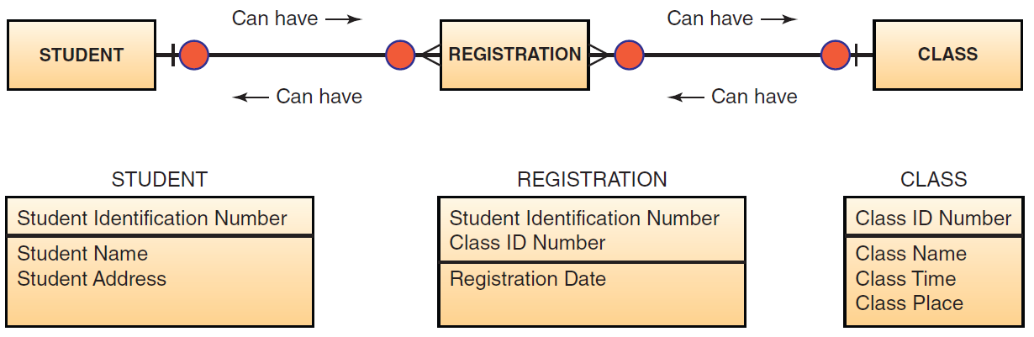
Figure 5A.4 Many-to-Many Relationship

Slide 49
Normalization and Joins
Normalization
Functional Dependencies
First Normal Form
Second Normal Form
Third Normal Form
Notes:
Normalization: is a method for analyzing and reducing a relational database to its most streamlined form to ensure minimum redundancy, maximum data integrity, and optimal processing performance.
Functional Dependencies: a means of expressing that the value of one particular attribute is associated with a specific single value of another attribute. For example, for a Student Number 05345 at a university, there is exactly one Student Name, John C. Jones, associated with it. That is, Student Number is referred to as the determinant because its value determines the value of the other attribute. We can also say that Student Name is functionally dependent on Student Number.

Slide 50
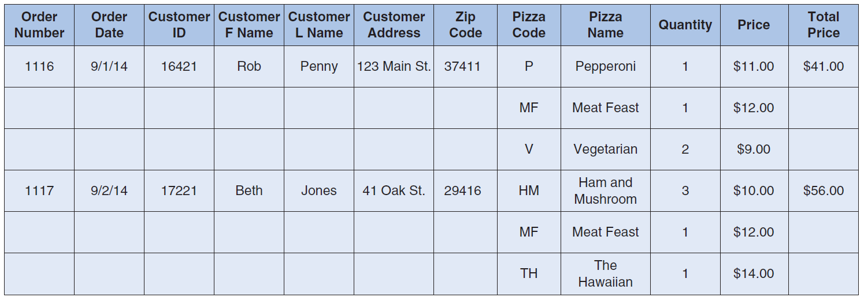
Figure 5A.5 Raw Data Gathered from Orders at the Pizza Shop
Notes:
Functional Dependencies: a means of expressing that the value of one particular attribute is associated with a specific single value of another attribute. For example, for a Student Number 05345 at a university, there is exactly one Student Name, John C. Jones, associated with it. That is, Student Number is referred to as the determinant because its value determines the value of the other attribute. We can also say that Student Name is functionally dependent on Student Number.

Slide 51
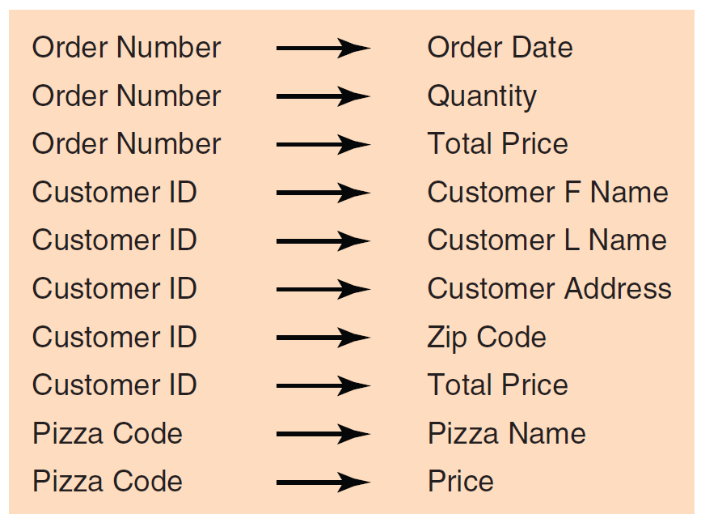
Figure 5A.6 Functional Dependencies in Pizza Shop Example
Notes:
Functional Dependencies: a means of expressing that the value of one particular attribute is associated with a specific single value of another attribute. For example, for a Student Number 05345 at a university, there is exactly one Student Name, John C. Jones, associated with it. That is, Student Number is referred to as the determinant because its value determines the value of the other attribute. We can also say that Student Name is functionally dependent on Student Number.

Slide 52
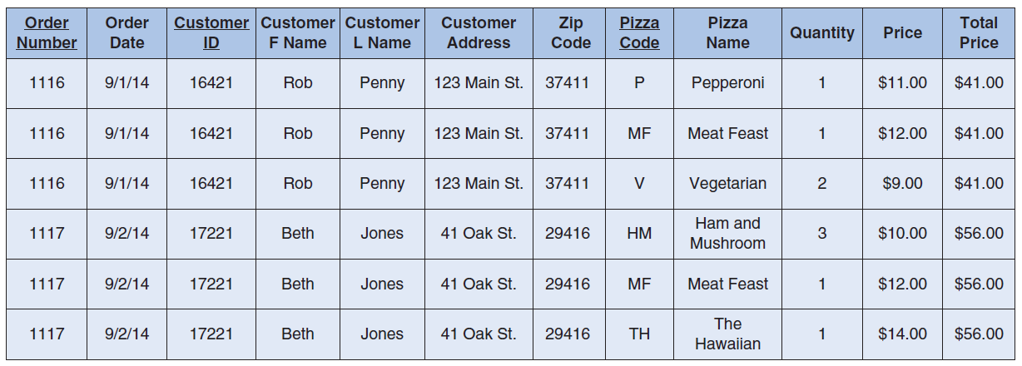
Figure 5A.7 First Normal Form for Data from Pizza Shop
Notes:
Figure 5A.7 demonstrates the data in first normal form. The attributes under consideration are listed in one table and primary keys have been established. Our primary keys are Order Number, Customer ID, and Pizza Code. In first normal form, each ORDER has to repeat the order number, order date, customer first name, customer last name, customer address, and customer zip code. This data file contains repeating groups and describes multiple entities. That is, this relation has data redundancy, a lack of data integrity, and the flat file would be difficult to use in various applications that the pizza shop might need.

Slide 53
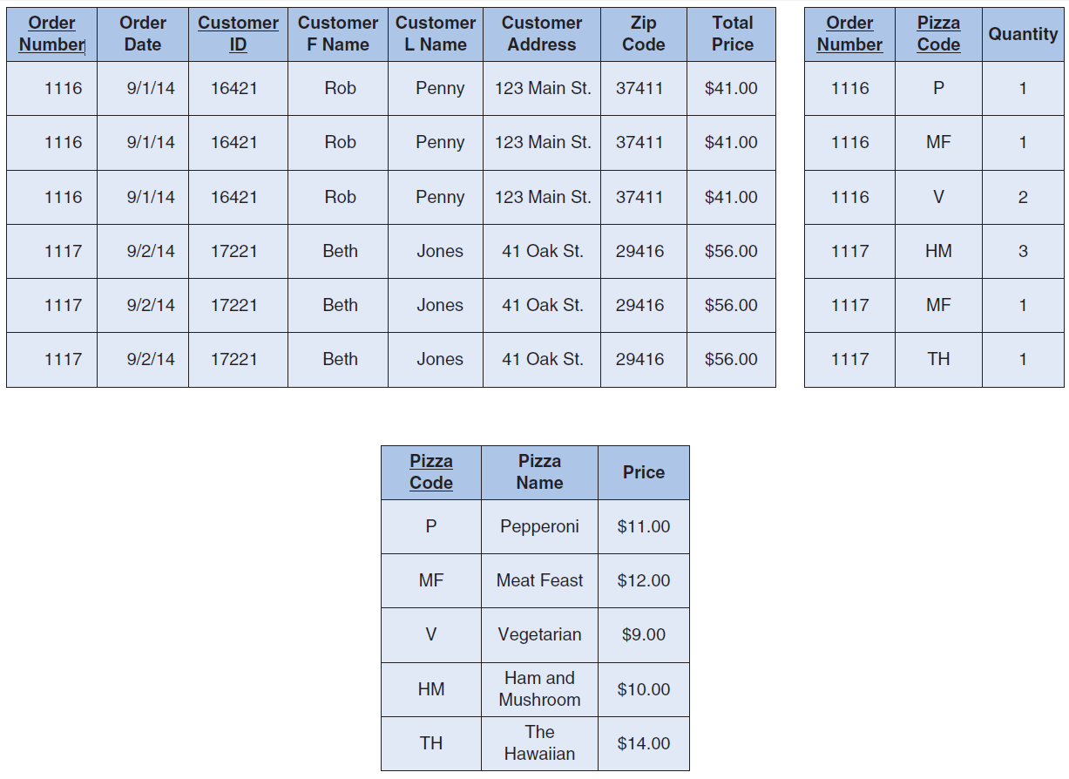
Figure 5A.8 Second Normal Form for Data from Pizza Shop
Notes:
To produce second normal form, we break Figure 5A.5 into smaller tables to eliminate some of its data redundancy. Second normal form does not allow partial functional dependencies. That is, in a table in second normal form, every non-key attribute must be functionally dependent on the entire primary key of that table. Figure 5A.8 shows the data from the pizza shop in second normal form.

Slide 54
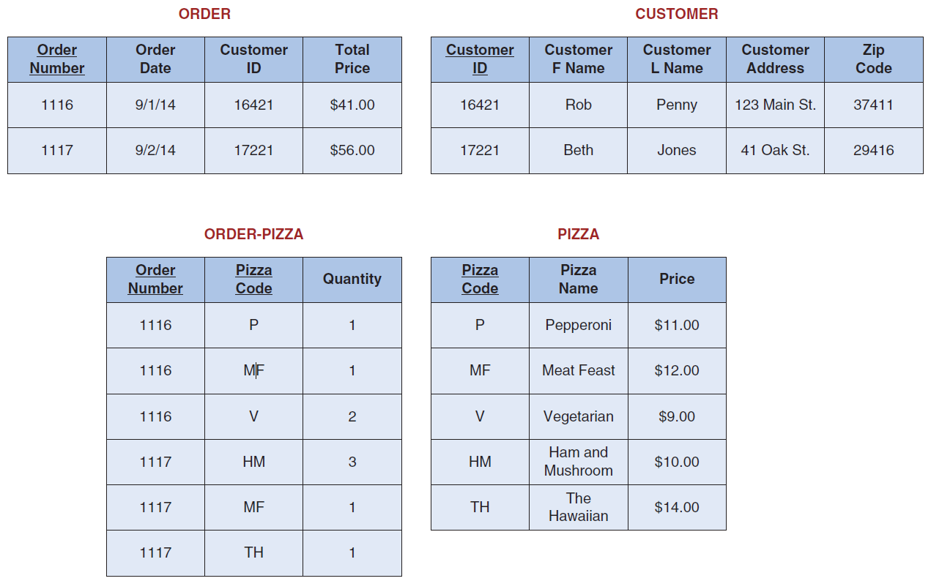
Figure 5A.9 Third Normal Form for Data from Pizza Shop
Notes:
In third normal form, non-key attributes are not allowed to define other non-key attributes. That is, third normal form does not allow transitive dependencies in which one non-key attribute is functionally dependent on another. In our example, customer information depends both on Customer ID and Order Number. Figure 5A.9 shows the data from the pizza shop in third normal form. Third normal form structure has these important points:
It is completely free of data redundancy.
All foreign keys appear where needed to link related tables.

Slide 55
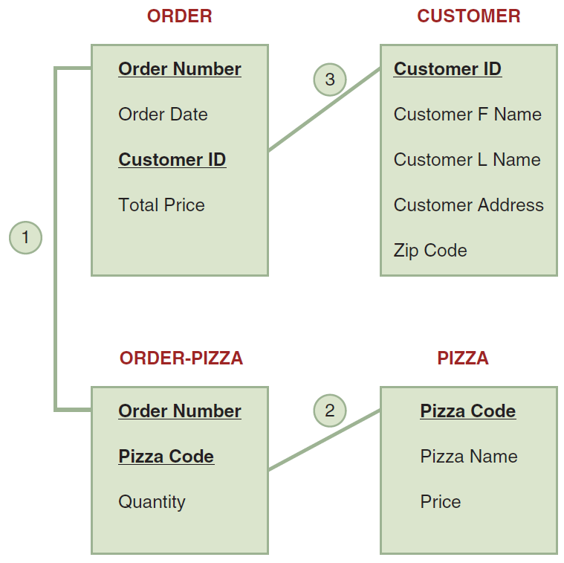
Figure 5A.10 The Join Process with the tables of third normal form to produce an order
Notes:
The join operation combines records from two or more tables in a database to obtain information that is located in different tables. In our example, the join operation combines records from the four normalized tables to produce an ORDER. Here is how the join operation works:
The ORDER relation provides the Order Number (the primary key), Order Date, and Total Price.
The primary key of the ORDER relation (Order Number) provides a link to the ORDER– PIZZA relation (the link numbered 1 in Figure 5A.5).
The ORDER–PIZZA relation supplies the Quantity to ORDER.
The primary key of the ORDER–PIZZA relation is a composite key that consists of Order Number and Pizza Code. Therefore, the Pizza Code component of the primary key provides a link to the PIZZA relation (the link numbered 2 in Figure 5A.10).
The PIZZA relation supplies the Pizza Name and Price to ORDER.
The Customer ID in ORDER (a foreign key) provides a link to the CUSTOMER relation (the link numbered 3 in Figure 5A.10).
The CUSTOMER relation supplies the Customer FName, Customer LName, Customer Address, and Zip Code to ORDER.

Slide 56
[ Closing Case Flurry Gathers Data from Smartphone Users]
The Business Problem
The Solution
The Results
Notes:
Questions
Do you feel that Flurry should be installed on your smartphone by various app makers without your consent? Why or why not? Support your answer.
What problems would Flurry encounter if someone other than the smartphone’s owner uses the device? (Hint: Note how Flurry gathers data.)
Can Flurry survive the privacy concerns that are being raised about its business model?

