Slide 1
6
Telecommunications and Networking

Slide 2
[ LEARNING OBJECTIVES]
Compare and contrast the major types of networks.
Describe the wireline communications media and transmission technologies.
Describe the most common methods for accessing the Internet.
Explain the impact that discovery network applications have had on business and everyday life.
Explain the impact that communication network applications have had on business and everyday life.
Explain the impact that collaboration network applications have had on business and everyday life.
Explain the impact that educational network applications have had on business and everyday life.

Slide 3
[ CHAPTER OUTLINE ]
What Is a Computer Network?
Network Fundamentals
The Internet and the World Wide Web
Network Applications: Discovery
Network Applications: Communication
Network Applications: Collaboration
Network Applications: Educational

Slide 4
[ WEB RESOURCES]
Student PowerPoints for note taking
WileyPLUS Learning Space
E-Book
Author video lecture for each chapter section
Practice quizzes
Flash Cards for vocabulary review
Additional “What’s in IT for Me?” cases
Video interviews with managers
Lab Manuals - Microsoft Office 2010 & 2013

Slide 5
[ Opening Case What to Do About Landline Telephones]
The Problem
Proposed Solutions
The Results
What We Learned from This Case
Notes:
Questions
Should the large carriers be able to eliminate their POTS networks?
Debate this argument from the viewpoint of the large telecommunications carriers.
Debate this argument from the viewpoint of rural customers.
Why are wireless networks not able to take over all of the functions of POTS networks at this time (early 2015)?

Slide 6
6.1
What Is a Computer Network?
Bandwidth
Broadband
Local Area Networks (LAN)
Wide Area Networks (WAN)
Router
Enterprise Networks
Corporate Backbone Networks
Software Defined Networks
Notes:
Computer Network: a system that connects computers and other devices (e.g., printers) via communications media so that data and information can be transmitted among them.
Bandwidth: refers to the transmission capacity of a network; it is stated in bits per second.
Broadband: based on the Federal Communications Commission (FCC) 2010 definition, broadband is the transmission capacity of a communications medium (discussed late
Local Area Network (LAN): connects two or more devices in a limited geographical region, usually within the same building, so that every device on the network can communicate with every other device.
Wide Area Network (WAN): a network that covers a large geographical area. WANs typically connect multiple LANs. They are generally provided by common carriers such as telephone companies and the international networks of global communications services providers. WANs have large capacity, and they typically combine multiple channels (e.g., fiber-optic cables, microwave, and satellite). The Internet is an example of a WAN.
Router: a communications processor that routes messages from a LAN to the Internet, across several connected LANs, or across a wide area network such as the Internet.
Enterprise Network: organizational interconnected networks consisting of multiple LANs and may also include multiple WAN's.
Corporate backbone networks: high-speed central networks to which multiple smaller networks (such as LANs and smaller WANs) connect.
Software-Defined Networks (SDN): an emerging technology that is becoming increasingly important to help organizations manage their data flows across their enterprise networks. With SDN, decisions controlling how network traffic flows across network devices are managed centrally by software. The software dynamically adjusts data flows to meet business and application needs.

Slide 7
6.2
Network Fundamentals
Basic Concepts
Communications Media and Channels
Network Protocols
Types of Network Processing
Notes:
Bits
Dial-up Modem
Cable Modem
DSL Modem

Slide 8
Basic Concepts
Digital Signals
Modem or Modulator-demodulator
Dial-up modem
Cable modems
DSL
Notes:
Digital Signals: discrete pulses that are either on or off, representing a series of bits (0s and 1s). Th is quality allows digital signals to convey information in a binary form that can be interpreted by computers.
Modem (modulator-demodulator): converts digital signals to analog signals—a process called modulation—and analog signals to digital signals—a process called demodulation. (The name modem is a contraction of modulator–demodulator.)

Slide 9
Communications Media and Channels
Twisted-pair Wire
Coaxial Cable
Fiber Optics
Notes:
Communications Channel: a pathway or medium communicating data from one location to another.
Communications Media: is the physical media used to send data (e.g., twisted-pair wire, coaxial cable, fiber optic cable, satellite, etc.).
Twisted-Pair Wire: the most prevalent form of communications wiring used for almost all business telephone wiring and As the name suggests, it consists of strands of copper wire twisted in pairs. It is relatively inexpensive to purchase, widely available, and easy to work with.
Coaxial Cable: a single strand of insulated copper wire. It is much less susceptible to electrical interference, and it can carry much more data than twisted-pair. It is commonly used to carry high-speed data traffic as well as television signals.
Fiber-Optic Cable: consists of thousands of very thin filaments of glass fibers that transmit information via light pulses generated by lasers. The fiber-optic cable is surrounded by cladding, a coating that prevents the light from leaking out of the fiber.

Slide 10
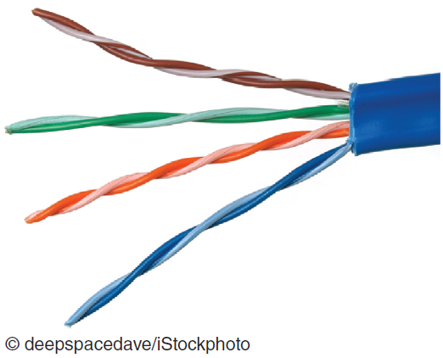
Figure 6.3 Twisted-Pair Wire
Notes:
Twisted-Pair Wire: the most prevalent form of communications wiring used for almost all business telephone wiring and As the name suggests, it consists of strands of copper wire twisted in pairs. It is relatively inexpensive to purchase, widely available, and easy to work with.

Slide 11
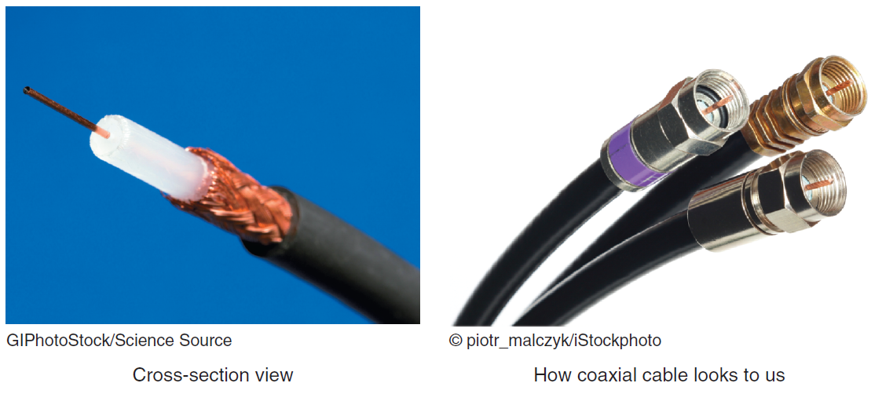
Figure 6.4 Two views of coaxial cable.
Notes:
Coaxial Cable: a single strand of insulated copper wire. It is much less susceptible to electrical interference, and it can carry much more data than twisted-pair. It is commonly used to carry high-speed data traffic as well as television signals.

Slide 12
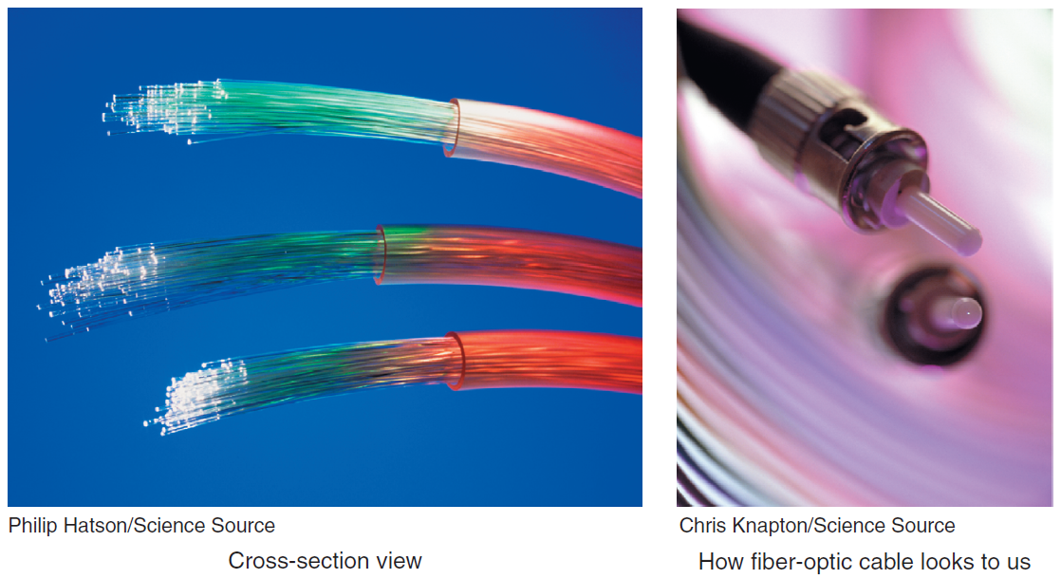
Figure 6.5 Two views of fiber optic cable.
Notes:
Fiber-Optic Cable: consists of thousands of very thin filaments of glass fibers that transmit information via light pulses generated by lasers. The fiber-optic cable is surrounded by cladding, a coating that prevents the light from leaking out of the fiber.

Slide 13
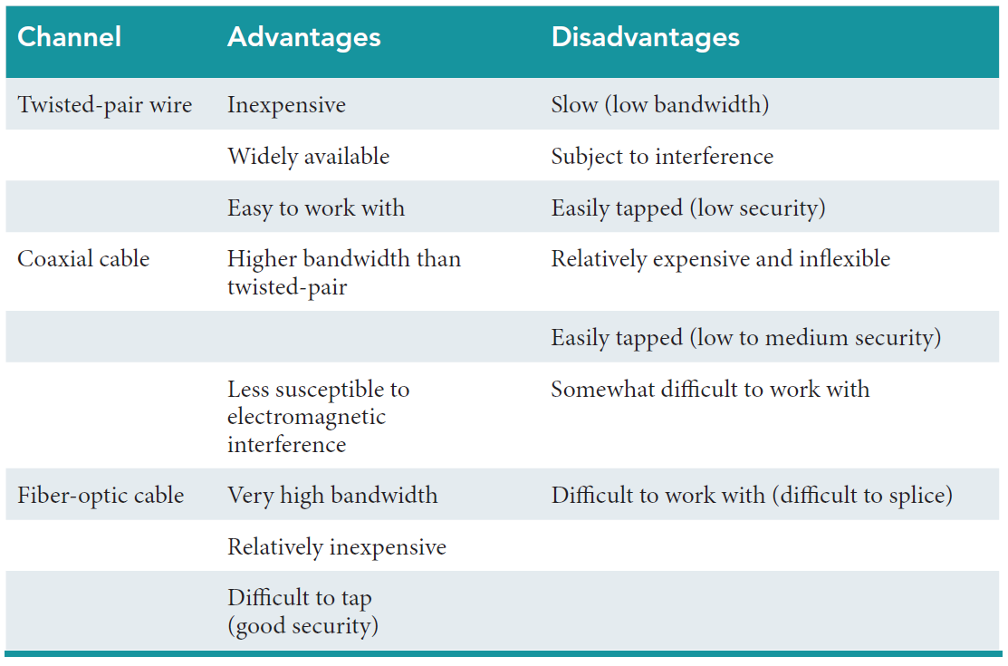
Table 6.1 Advantages and Disadvantages of Wireline Communications Channels

Slide 14
Network Protocols
Ethernet
Transmission Control Protocol/Internet Protocol (TCP/IP)
Four Layers
Packet Switching
Notes:
Ethernet: A common LAN protocol. Many organizations use 100-gigabit Ethernet, where the network provides data transmission speeds of 100 gigabits (100 billion bits) per second.
Transmission Control Protocol/Internet Protocol (TCP/IP): the protocol of the Internet. TCP/IP uses a suite of protocols, the main ones being the Transmission Control Protocol (TCP) and the Internet Protocol (IP).
--------------------
TCP performs three basic functions:
It manages the movement of data packets between computers by establishing a connection between the computers
it sequences the transfer of packets
it acknowledges the packets that have been transmitted
--------------------
Internet Protocol (IP): is responsible for disassembling, delivering, and reassembling the data during transmission.
Packets: Before data are transmitted over the Internet, they are divided into small, fixed bundles called packets.
Packet Switching: the transmission technology that breaks up blocks of data into packets is called packet switching. Each packet carries the information that will help it reach its destination—the sender’s IP address, the intended receiver’s IP address, the number of packets in the message, and the number of the particular packet within the message. Each packet travels independently across the network and can be routed through different paths in the network. When the packets reach their destination, they are reassembled into the original message.

Slide 15
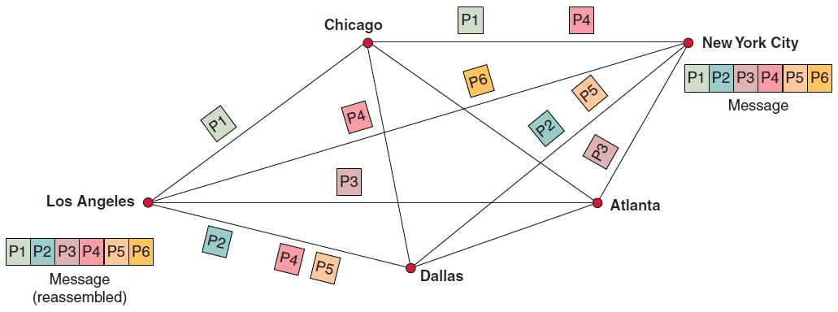
Figure 6.7 Packet Switching
Notes:
Packets: Before data are transmitted over the Internet, they are divided into small, fixed bundles called packets.
Packet Switching: the transmission technology that breaks up blocks of data into packets is called packet switching. Each packet carries the information that will help it reach its destination—the sender’s IP address, the intended receiver’s IP address, the number of packets in the message, and the number of the particular packet within the message. Each packet travels independently across the network and can be routed through different paths in the network. When the packets reach their destination, they are reassembled into the original message.

Slide 16
Three Basic Functions of the TCP
Manages the movement of data packets between computers by establishing a connection between the computers
Sequences the transfer of packets
Acknowledges the packets that have been transmitted

Slide 17
Four Layers of the TCP/IP Reference Model
Application Layer
Transport Layer
Internet Layer
Network Interface Layer
Notes:
TCP/IP functions in four layers:
Application Layer: enables client application programs to access the other layers, and it defines the protocols that applications use to exchange data.
Transport Layer: provides the application layer with communication and packet services.
Internet Layer: responsible for addressing, routing, and packaging data packets.
Network Interface Layer: places packets on, and receives them from, the network medium, which can be any networking technology.

Slide 18
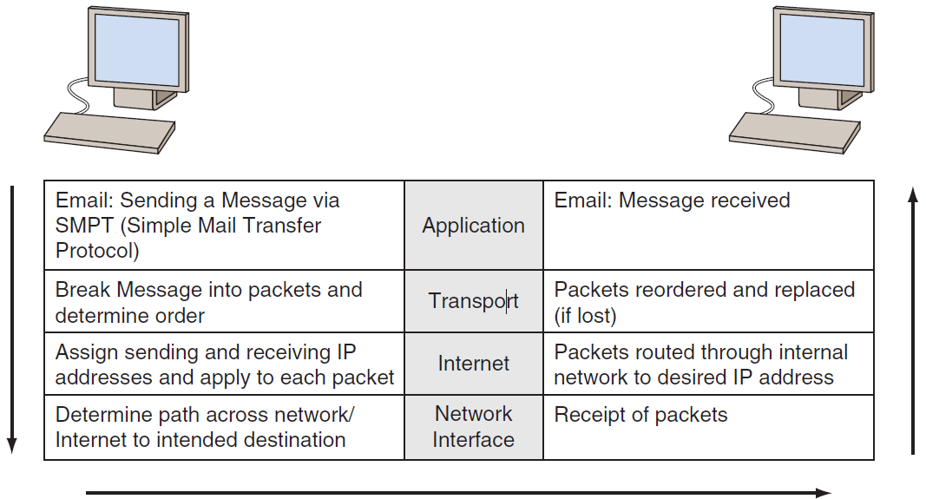
Figure 6.6 The four layers of the TCP/IP reference model.
Notes:
TCP/IP functions in four layers:
Application Layer: enables client application programs to access the other layers, and it defines the protocols that applications use to exchange data.
Transport Layer: provides the application layer with communication and packet services.
Internet Layer: responsible for addressing, routing, and packaging data packets.
Network Interface Layer: places packets on, and receives them from, the network medium, which can be any networking technology.

Slide 19
Types of Network Processing
Client/server computing
Peer-to-peer Processing (P2P)
Notes:
Distributed Processing: divides processing work among two or more computers which enables computers in different locations to communicate with one another via telecommunications.
Client/Server Computing: Client/server computing links two or more computers in an arrangement in which some machines, called servers, provide computing services for user PCs, called clients.
Peer-to-Peer (P2P) Processing: a type of client/server distributed processing where each computer acts as both a client and a server. Each computer can access (as assigned for security or integrity purposes) all files on all other computers.

Slide 20
6.3
The Internet and the World Wide Web
Accessing the Internet
The Future of the Internet
The World Wide Web
Notes:
World Wide Web: a system of universally accepted standards for storing, retrieving, formatting, and displaying information via a client/server architecture.
Internet (“the Net”): a global WAN that connects approximately 1 million organizational computer networks in more than 200 countries on all continents, including Antarctica. It has become so widespread that it features in the daily routine of some 3 billion people.
Internet Backbone: The primary network connections and telecommunications lines that link the nodes made up of a fiber-optic network that is operated primarily by large telecommunications companies.
Intranet: a network that uses Internet protocols so that users can take advantage of familiar applications and work habits. Intranets support discovery (easy and inexpensive browsing and search), communication, and collaboration inside an organization.
Extranet: connects parts of the intranets of different organizations.

Slide 21
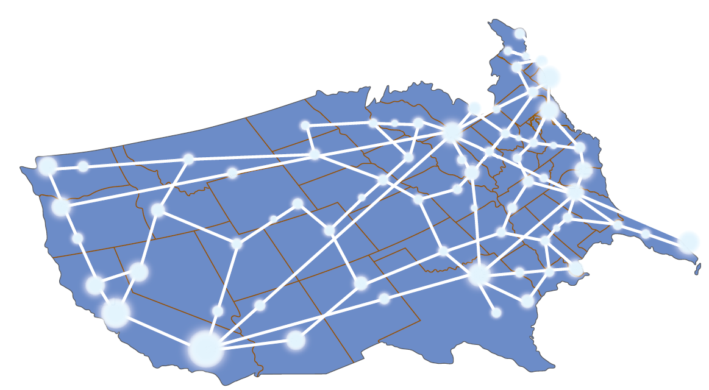
Figure 6.8 Internet (backbone in white).

Slide 22
Accessing the Internet
Connecting via an Online Service
Connecting via Other Means
Addresses on the Internet
Notes:
Connecting Via an Online Service:
Internet Service Provider: is a company that provides Internet connections for a fee. Large ISPs include Comcast (www.comcast.com), AT&T (www.att.com), Time Warner Cable (www.timewarnercable.com), and Verizon (www.verizon.com).
Network Access Point: often used by ISPs to connect one another, NAPs are exchange points for Internet traffic. They determine how traffic is routed. NAPs are key components of the Internet backbone. Figure 6.8 displays a schematic of the Internet.
Connecting Via Other Means:
Internet Kiosks in public places such as libraries and airports.
Fiber to the Home (FTTH)
Smart Phones
Tablets
Internet Via Satellite
Internet Via High Altitude Balloons (Google Project Loon).

Slide 23
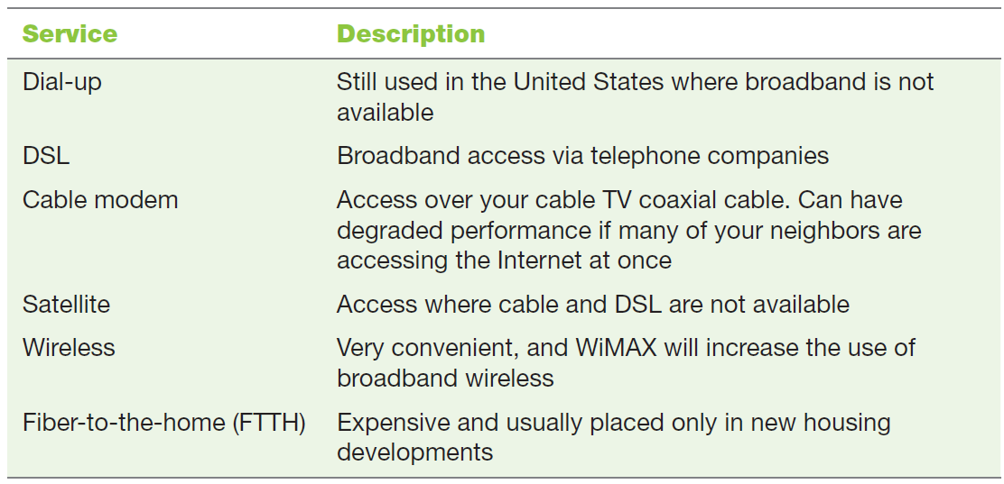
Table 6.2 Internet Connection Methods

Slide 24
6.1
Google Fiber
Notes:
Why would a “search company” such as Google decided to enter the fi ber services business? Describe the benefi ts that Google expects to obtain from this venture.
Describe the various outcomes that might occur in an area that receives ultrafast fi ber, regardless of the provider.

Slide 25
6.2
Internet Access in Cuba
Notes:
Describe the advantages and disadvantages of the global Internet to Cuban citizens.
Describe the advantages and disadvantages of the global Internet to the Cuban government.

Slide 26
Addresses on the Internet
Internet Protocal (IP) Address
Internet Corporation for Assigned Names (ICANN)
Top Level Domain (TLD)
.com, .edu, .mil, .gov, .org
Notes:
Internet Corporation for Assigned Names (ICANN) (www.icann.org): coordinates these unique addresses throughout the world. Without that coordination, we would not have one global Internet.
Top-Level Domain (TLD): the domain at the highest level in the hierarchical Domain Name System of the Internet. The top-level domain names are located in the root zone (rightmost zone) of the name. Management of most TLDs is delegated to responsible organizations by ICANN.
Internet Assigned Numbers Authority (IANA): which is in charge of maintaining the DNS root zone. Today, IANA distinguishes the following groups of
TLDs:
Country-code top-level domains (ccTLD): Two letter domains established for countries or territories. For example, de stands for Germany, it for Italy, and ru for Russia.
Internationalized country code top-level domains (IDN ccTLD): These are ccTLDs in non-Latin character sets (e.g., Arabic or Chinese).
Generic top-level domains (gTLD): Top-level domains with three or more characters. gTLDs initially consisted of .gov, .edu, .com, .mil, .org, and .net. In late 2000, ICANN introduced .aero, .biz, .coop, .info, .museum, .name, and .pro. In June 2012, ICANN revealed nearly 2,000 applications for new top-level domains.

Slide 27
The Future of the Internet
Three Factors Could Cause Internet Brownout
Increasing number of people who work online
Soaring popularity of Web sites such as YouTube requiring large amounts of bandwidth
Tremendous demand for high-definition television delivered over the Internet
Internet2
Notes:
Internet2: develops and deploys advanced network applications such as remote medical diagnosis, digital libraries, distance education, online simulation, and virtual laboratories. It is designed to be fast, always on, everywhere, natural, intelligent, easy, and trusted. Note that Internet2 is not a separate physical network from the Internet.

Slide 28
World Wide Web (WWW)
A system of universally accepted standards for storing, retrieving, formatting, and displaying information via a client/server architecture
Web site
Webmaster
Uniform Resource Locator (URL)
Browsers
Notes:
Hypertext is the underlying concept defining the structure of the World Wide Web. Hypertext is the text displayed on a computer display or other electronic device with references, called hyperlinks, to other text that the reader can immediately access, or where text can be revealed progressively at additional levels of details.

Slide 29
6.4
Network Applications
Discovery
Communication
Collaboration
E-Learning and Distance Learning
Virtual Universities
Telecommuting

Slide 30
6.4
Network Applications: Discovery
Search Engines and Metasearch Engines
Publication of Material in Foreign Languages
Portals
Notes:
Users can apply the Internet’s discovery capability to areas ranging from education to government services to entertainment to commerce.
Search Engine: a computer program that searches for specific information by keywords and then reports the results.
Metasearch Engines: search several engines at once and then integrate the findings to answer users’ queries.
Publication of Material in Foreign Languages: information on the Internet is written in many different languages, and automatic translation of Web pages is essential.
Portals: a Web-based, personalized gateway to information and knowledge that provides relevant information from different IT systems and the Internet using advanced search and indexing techniques.

Slide 31
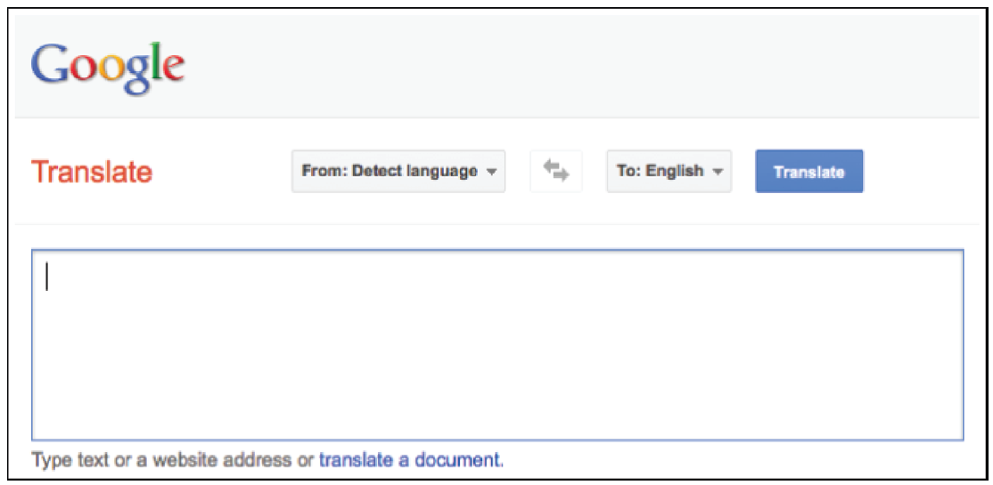
Figure 6.9 Google Translate
Notes:
FIGURE 6.9 Google Translate. (Google and the Google logo are registered trademarks of Google Inc., used with permission).

Slide 32
Portals
Commercial Portal
Affinity Portal
Corporate Portal
Industrywide Portal
Notes:
Portals: a Web-based, personalized gateway to information and knowledge that provides relevant information from different IT systems and the Internet using advanced search and indexing techniques.
Commercial (public) Portal: the most popular type of portal on the Internet and is intended for broad and diverse audiences (e.g., a stock ticker).
Affinity Portal: offers a single point of entry to an entire community of affiliated interests, such as a hobby group or a political party.
Corporate Portal: offers a personalized, single point of access through a Web browser to critical business information located inside and outside an organization. These portals are also known as enterprise portals, information portals, and enterprise information portals.
Industrywide Portal: a portal that serves an entire industry (e.g., TruckNet <www.truck.net>).
Unified Communications: simplifies and integrates all forms of communications (voice, voice mail, fax, chat, e-mail, instant messaging, short message service, presence (location) services, and videoconferencing) on a common hardware and soft ware platform.

Slide 33
6.5
Network Applications: Communication
Electronic Mail (E-mail)
Web-Based Call Centers
Electronic Chat Rooms
Voice Communication
Internet Telephony (VoIP)
Unified Communications (UC)
Telecommuting
Notes:
Communication: a major category of network applications related to communication technologies delivered online (e.g., including e-mail, call centers, chat rooms, and voice).
Unified Communications: simplifies and integrates all forms of communications (voice, voice mail, fax, chat, e-mail, instant messaging, short message service, presence (location) services, and videoconferencing) on a common hardware and soft ware platform.
Electronic Teleconferencing: the use of electronic communication technology that enables two or more people at different locations to hold a conference.
Telecommuting: A process in which knowledge workers are being called the distributed workforce, or “digital nomads.” This group of highly prized workers is now able to work anywhere and anytime.

Slide 34
6.3
Get Rid of E-Mail? Seriously?
Notes:
Is it feasible for your university to eliminate e-mail? Why or why not? Would you support such a policy at your school? Why or why not?
Describe the advantages and disadvantages of eliminating e-mail from an organization. Provide specific examples to support your answers.

Slide 35
Telecommuting
A process in which highly prized workers are able to work anywhere anytime.
Knowledge workers
Advantages versus disadvantages
Notes:
Telecommuting: the process in which highly prized “knowledge” workers are now able to work anywhere and anytime.
Knowledge workers are being called the distributed workforce, or “digital nomads.”

Slide 36
6.6
Network Applications: Collaboration
Microsoft SharePoint
Google Docs
IBM Lotus Quickr
Jive
Electronic Teleconferencing

Slide 37
Collaboration
Work group
Workflow
Virtual Team
Virtual Collaboration
Crowdsourcing
Electronic Teleconferencing and Video Conferencing
Notes:
Workgroup: two or more individuals who act together to perform some task.
Workflow: the movement of information as it progresses through the sequence of steps that make up an organization’s work procedures. Workflow management makes it possible to pass documents, information, and tasks from one participant to another in a way that is governed by the organization’s rules or procedures.
Virtual Group (Team): Virtual groups conduct virtual meetings—that is, they “meet” electronically.
Virtual collaboration (or e-collaboration): the use of digital technologies that enable organizations or individuals who are geographically dispersed to collaboratively plan, design, develop, manage, and research products, services, and innovative applications.
Crowdsourcing: a process in which an organization outsources a task to an undefined, generally large group of people in the form of an open call.
Synchronous Collaboration: all team members meet at the same time.
Teleconferencing: the use of electronic communication technology that enables two or more people at different locations to hold a conference.
Videoconference: participants in one location can view participants, documents, and presentations at other locations.
Telepresence: The latest form of videoconferencing which enables participants to seamlessly share data, voice, pictures, graphics, and animation by electronic means.
Asynchronous Collaboration: occurs when team members cannot meet at the same time.

Slide 38
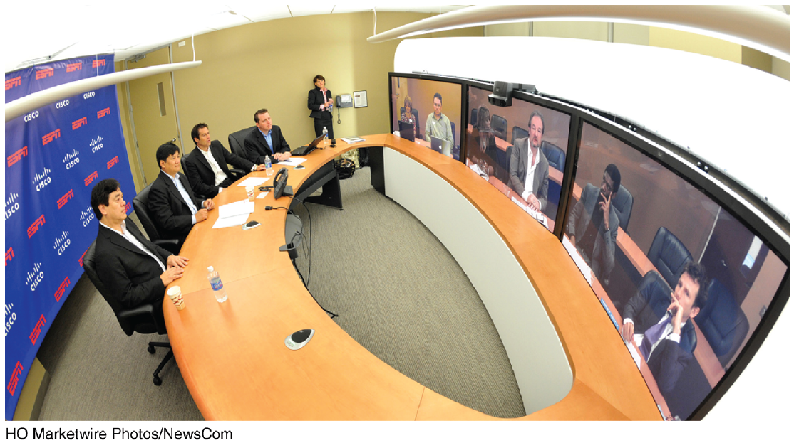
Figure 6.11 Telepresence System

Slide 39
6.7
Network Applications:
Educational
E-Learning
Learning supported by the Web
Distance Learning
Any learning situation in which teachers and students do not meet face-to-face.
Notes:
E-learning: learning supported by the Web. It can take place inside classrooms as a support to conventional teaching, such as when students work on the Web during class. It also can take place in virtual classrooms, in which all coursework is completed.
Distance Learning (DL): refers to any learning situation in which teachers and students do not meet face-to-face.

Slide 40
6.4
Massive Open Online Courses
Notes:
Discuss possible quality control issues with MOOCs. For each issue that you list, describe how you would solve the problem.
What are some specifi c examples of the impact that MOOCs could have on traditional higher education? Explain your answer.
Would you be willing to enroll in a MOOC as a full-time student at your university? Why or why not?
Would you be willing to enroll in a MOOC after you graduate? Why or why not?

Slide 41
Virtual Universities
Online universities in which students take classes via the Internet at home or an off-site location.

Slide 42
[ Closing Case Network Neutrality Wars]
The Problem
A Possible Solution
The Results
Notes:
Questions
Are the ISPs correct in claiming that network neutrality will limit their development of new technologies? Support your answer.
Are the content providers (e.g., Netflix) correct in claiming that eliminating network neutrality will encourage censorship by the ISPs? Support your answer.
Are the content providers correct in claiming that eliminating network neutrality will result in consumers paying higher prices for the content they watch over the Internet? Support your answer.
Why is the debate over network neutrality so important to you? Support your answer.

