Slide 1
8
Wireless, Mobile Computing, and Mobile Commerce

Slide 2
[ LEARNING OBJECTIVES]
Identify advantages and disadvantages of each of the four main types of wireless transmission media.
Explain how businesses can use short-range, medium-range, and long-range networks.
Provide a specific example of how each of the five major m-commerce applications can benefit a business.
Describe the Internet of Things, and provide examples of how organizations can utilize the Internet of Things.
Explain how the four major threats to wireless networks can damage a business.

Slide 3
[ CHAPTER OUTLINE ]
Wireless Technologies
Wireless Computer Networks and Internet Access
Mobile Computing and Mobile Commerce
The Internet of Things
Wireless Security

Slide 4
[ WEB RESOURCES]
Student PowerPoints for note taking
WileyPLUS Learning Space
E-Book
Author video lecture for each chapter section
Practice quizzes
Flash Cards for vocabulary review
Additional “What’s in IT for Me?” cases
Video interviews with managers
Lab Manuals - Microsoft Office 2010 & 2013

Slide 5
[ Opening Case Republic Wireless and Freedom-Pop Could Disrupt…]
The Business Problem
Two Disruptive Solutions
The Results
Notes:
Questions
Describe how Republic Wireless and FreedomPop can be disruptive to the major U.S. cellular service providers.
What actions should the major cellular service providers take to combat Republic and FreedomPop’s business models?

Slide 6
8.1
Wireless Technologies
Wireless Devices
Smartphones
Wireless Transmission Media
Microwave
Satellite
Radio
Notes:
Wireless: without wires.
Mobile: something that changes its location over time.
Mobile Computing: a real-time, wireless connection between a mobile device and other computing environments, such as the Internet or an intranet.
Mobile Commerce (or M-Commerce): e-commerce (EC) transactions conducted with a mobile device.
Pervasive Computing (or Ubiquitous Computing): virtually every object has processing power with either wireless or wired connections to a global network.
Dematerialization: a phenomenon that occurs when the functions of many physical devices are included in one other physical device. Consider that your smartphone includes the functions of digital cameras for images and video, radios, televisions, Internet access via Web browsers, recording studios, editing suites, movie theaters, GPS navigators, word processors, spreadsheets, stereos, flashlights, board games, card games, video games, an entire range of medical devices, maps, atlases, encyclopedias, dictionaries, translators, textbooks, watches, alarm clocks, books, calculators, address books, credit card swipers, magnifying glasses, money and credit cards, car keys, hotel keys, cellular telephony, Wi-Fi, e-mail access, text messaging, a full QWERTY keyboard, and many, many others.

Slide 7
Wireless Devices
Three Major Advantages for Users
Small enough to easily carry or wear.
Sufficient computing power to perform productive tasks.
Communicate wirelessly with the Internet & other devices.
One Major Disadvantage for Business
Workers can capture and transmit sensitive proprietary information
Notes:
Wireless Devices Provide Three Major Advantages:
1. Small enough to easily carry or wear
2. Sufficient computing power to perform productive tasks.
3. Can communicate wirelessly with the Internet and other devices.
Wireless: without wires.
Mobile: something that changes its location over time.
Mobile Computing: a real-time, wireless connection between a mobile device and other computing environments, such as the Internet or an intranet.
Mobile Commerce (or M-Commerce): e-commerce (EC) transactions conducted with a mobile device.
Pervasive Computing (or Ubiquitous Computing): virtually every object has processing power with either wireless or wired connections to a global network.
Dematerialization: a phenomenon that occurs when the functions of many physical devices are included in one other physical device. Consider that your smartphone includes the functions of digital cameras for images and video, radios, televisions, Internet access via Web browsers, recording studios, editing suites, movie theaters, GPS navigators, word processors, spreadsheets, stereos, flashlights, board games, card games, video games, an entire range of medical devices, maps, atlases, encyclopedias, dictionaries, translators, textbooks, watches, alarm clocks, books, calculators, address books, credit card swipers, magnifying glasses, money and credit cards, car keys, hotel keys, cellular telephony, Wi-Fi, e-mail access, text messaging, a full QWERTY keyboard, and many, many others.

Slide 8
Modern Smartphone Capabilities
Cellular telephony
Bluetooth
Wi-Fi
Digital camera for images & video
Global Positioning System (GPS)
Organizer
Scheduler
Address book
Calculator
E-mail
Short Message Service (SMS, sending and receiving short text messages up to 160 characters in length)
Instant Messaging
Text messaging
MP3 music player
Video player
Internet access with full-function browser
QWERTY keyboard

Slide 9
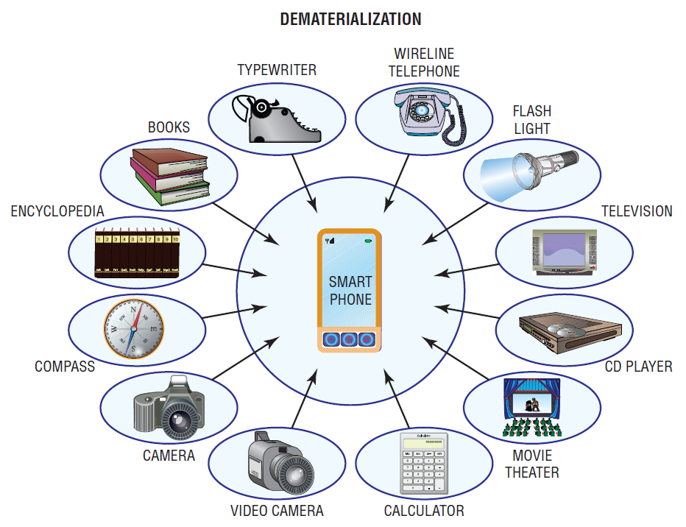
FIGURE 8.1 Dematerialization with smartphones.
Notes:
FIGURE 8.1 Dematerialization with smartphones.

Slide 10
Wireless Transmission Media (WTM)
Wireless Media (aka, broadcast media)
transmit signals without wires
Major Types of Wireless Media Channels:
Microwave
Satellite
Radio
Infrared

Slide 11
WTM: Microwave
Disadvantages
Advantages
High bandwidth
Relatively Inexpensive
Requires an unobstructed line of sight
Susceptible to environmental interference

Slide 12
WTM: Satellite
Disadvantages
Advantages
High bandwidth
Large coverage area
Expensive
Requires unobstructed line of sight
Signals experience propagation delay
Requires the use of encryption for security

Slide 13
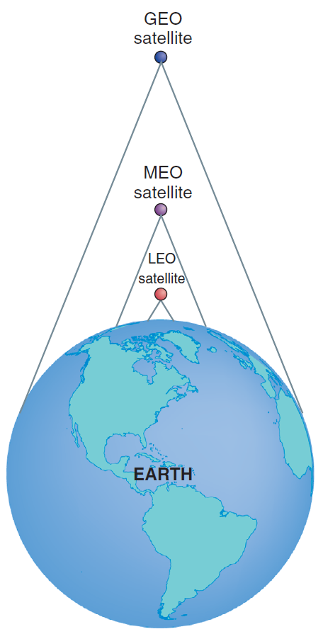
FIGURE 8.2 Comparison of satellite footprints.

Slide 14
8.1
Skybox Imaging Provides Commercial Images from Earth’s Orbit
Notes:
Describe other possible applications of Skybox Imaging (not mentioned in the case).
Why might the U.S. government object to Skybox Imaging’s business? Provide specifi c examples in your answer.
Might other nations object to Skybox Imaging’s business? If so, which ones, and why?
Describe other applications for Urthecast satellites.

Slide 15
Three Basic Types of Telecommunications Satellites
Geostationary Earth Orbit (GEO)
Middle Earth Orbit (MEO)
Low Earth Orbit (LEO)

Slide 16
Geostationary Earth Orbit (GEO)
Orbit:
Number of Satellites:
Use:
Characteristics:
A
A
A
A
A
A
a
22,300 miles
8
TV Signal
Satellites stationary relative to point on Earth
Few satellites needed for global coverage
Transmission delay (approximately .25 second)
Most expensive to build and launch
Longest orbital life (many years)

Slide 17
Internet over Satellite (IoS)
Disadvantages
Advantages
Provides Internet services to remote areas of Earth
Propagation delay
Disrupted by environmental conditions

Slide 18
Middle Earth Orbit (MEO)
Orbit:
Number of Satellites:
Use:
Characteristics:
A
A
A
A
A
A
a
6,434 miles
10 - 12
Global Positioning Systems (GPS)
Satellites move relative to point on Earth
Moderate number needed for global coverage
Requires medium-powered transmitters
Negligible transmission delay
Less expensive to build and launch
Moderate orbital life (6–12 years)

Slide 19
Global Positioning Systems (GPS)
A wireless system that utilizes satellites to enable users to determine their position anywhere on Earth.
Supported by 24 MEO Satellites
Uses of GPS
Navigating, Mapping, Surveying, 911 location
Three additional GPS Systems
GLONASS, Russia 2005
Galileo, European Union 2015
Beidou, China 2020

Slide 20
Low Earth Orbit (LEO)
Orbit:
Number of Satellites:
Use:
Characteristics:
A
A
A
A
A
A
a
400 - 700 miles
Many
Telephone, Internet
Satellites move rapidly relative to point on Earth
Large number needed for global coverage
Requires only low-power transmitters
Negligible transmission delay
Least expensive to build and launch
Shortest orbital life (as low as 5 years)

Slide 21
WTM: Radio
Advantages
Disadvantages
High bandwidth
Signals pass through walls
Inexpensive and easy to install
Creates electrical interference problems
Susceptible to ‘snooping’ unless encrypted
Notes:
Radio: uses radio-wave frequencies to send data directly between transmitters and receivers.

Slide 22
WTM: Infrared
Advantages
Disadvantages
Low to medium bandwidth
Used only for short distances
Requires an unobstructed line of sight
Notes:
Infrared: is red light that is not commonly visible to human eyes and common applications of infrared light are found in remote control units for televisions and DVD and CD players.

Slide 23
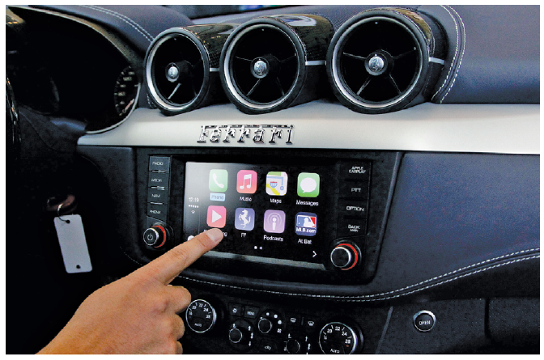
FIGURE 8.3 Obtaining GPS information in an automobile.

Slide 24
8.2
Wireless Computer Networks & Internet Access
Short-Range Wireless Networks
Medium-Range Wireless Networks
Wide-Area Wireless Networks
Notes:
Wireless Devices Provide Three Major Advantages:
1. Small enough to easily carry or wear
2. Sufficient computing power to perform productive tasks.
3. Can communicate wirelessly with the Internet and other devices.
Wireless: without wires.
Mobile: something that changes its location over time.
Mobile Computing: a real-time, wireless connection between a mobile device and other computing environments, such as the Internet or an intranet.
Mobile Commerce (or M-Commerce): e-commerce (EC) transactions conducted with a mobile device.
Pervasive Computing (or Ubiquitous Computing): virtually every object has processing power with either wireless or wired connections to a global network.
Dematerialization: a phenomenon that occurs when the functions of many physical devices are included in one other physical device. Consider that your smartphone includes the functions of digital cameras for images and video, radios, televisions, Internet access via Web browsers, recording studios, editing suites, movie theaters, GPS navigators, word processors, spreadsheets, stereos, flashlights, board games, card games, video games, an entire range of medical devices, maps, atlases, encyclopedias, dictionaries, translators, textbooks, watches, alarm clocks, books, calculators, address books, credit card swipers, magnifying glasses, money and credit cards, car keys, hotel keys, cellular telephony, Wi-Fi, e-mail access, text messaging, a full QWERTY keyboard, and many, many others.

Slide 25
Short-Range Wireless Networks
Bluetooth
Ultra-Wideband
Near-Field Communications
Notes:
Short-Range Wireless Networks: have a range of 100 feet or less (e.g., Bluetooth, ultra-wideband (UWB), and near-field communications (NFC)).
Bluetooth: an industry specification used to create small personal area networks.
Bluetooth 1.0: can link up to eight devices within a 10-meter area (about 30 feet) with a bandwidth of 700 kilobits per second (Kbps) using low-power, radio-based communication.
Bluetooth 4.0: can transmit up to approximately 25 megabits per second (Mbps) up to 100 meters (roughly 300 feet).
Personal Area Network: a computer network used for communication among computer devices (e.g., telephones, personal digital assistants, and smartphones) located close to one person.
Ultra-Wideband: a high-bandwidth wireless technology with transmission speeds in excess of 100 Mbps which makes UWB a good choice for applications such as streaming multimedia from a personal computer to a television.
Near-Field Communications: has the smallest range of any short-range wireless networks, and is designed to be embedded in mobile devices such as cell phones and credit cards.

Slide 26
Medium-Range Wireless Networks
Wireless Fidelity (Wi-Fi)
Wireless Local Area Networks (WLAN)
Wi-Fi Direct
MiFi
Super Wi-Fi
Wireless Mesh Networks
Notes:
Medium-Range Wireless Networks: the familiar wireless local area networks (WLANs) and the most common type of Medium-Range network is wireless fidelity (Wi-Fi).
Wireless Fidelity (Wi-Fi): a medium-range WLAN.
Wireless Mesh Networks: networks using multiple Wi-Fi access points to create a wide area network that can be quite large and are essentially a series of interconnected local area networks.

Slide 27
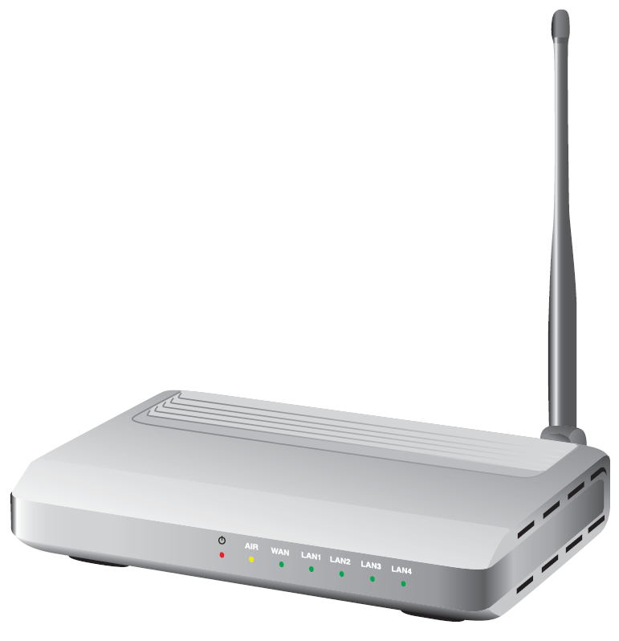
FIGURE 8.4 Wireless access point.
Notes:
FIGURE 8.4 Wireless access point.

Slide 28
8.2
A Wi-Fi Network Provides Communications at the 2014 Winter Olympic Games
Notes:
Describe why wireless communications were critical to the success of the 2014 Winter Olympic Games. Provide specific examples to support your answer.
What other potential problems did Avaya have to consider that were not mentioned in this case? Provide specific examples to support your answer.

Slide 29
Wide-Area Wireless Networks
Cellular Radio (Cellular telephones)
1G
2G
3G
CDMA
EV-DO
GSM
4G
Wireless Broadband (or WiMax)
Notes:
Generations of Cellular Technology Evolution:
First generation (1G): cellular networks used analog signals and had low bandwidth (capacity).
Second generation (2G): uses digital signals primarily for voice communication; it provides data communication up to 10 Kbps.
2.5G: uses digital signals and provides voice and data communication up to 144 Kbps.
Third generation (3G): uses digital signals and can transmit voice and data up to 384 Kbps when the device is moving at a walking pace, 128 Kbps when it is moving in a car, and up to 2 Mbps when it is in a fixed location. It supports video, Web browsing, and instant messaging.
Fourth generation (4G): is not one defined technology or standard. The International Telecommunications Union (ITU) has specified speed requirements for 4G: 100 Mbps (million bits per second) for high-mobility communications such as cars and trains, and 1 Gbps (billion bits per second) for low-mobility communications such as pedestrians. A 4G system is expected to provide a secure all-IP-based mobile broadband system to all types of mobile devices.
Fifth Generation (5G): expected to be deployed by 2020, 5G networks are predicted to be faster and more intelligent than previous generations of cellular networks. With 5G, wearable computers (e.g., Fitbit), smartphones, tablets, and other devices with sensors that are location- and context-aware will work together with apps and services that you use.
Wireless Broadband or WiMAX: Worldwide Interoperability for Microwave Access (WiMAX) is the name for IEEE Standard 802.16 which has a wireless access range of up to 31 miles and a data transfer rate of up to 75 Mbps. It is a secure system, and it offers features such as voice and video.

Slide 30
8.3
Mobile Computing and Mobile Commerce
Mobile Computing
Refers to a real-time connection between a mobile device and other computing environments, such as the Internet or an Intranet.
Mobile Commerce
Electronic commerce (EC) transactions conducted in a wireless environment, especially via the Internet.
Notes:
Mobile Computing: a real-time connection between a mobile device and other computing environments, such as the Internet or an intranet.
Mobility: means that users carry a device with them and can initiate a real-time contact with other systems from wherever they happen to be.

Slide 31
Mobile Computing
Two Major Characteristics
Mobility
Broad Reach
Mobility & Broad Reach Create 5 value-added attributes
Ubiquity
Convenience
Instant connectivity
Personalization
Localization of Products and Services

Slide 32
Mobile Commerce
Also known as “M-commerce”
Drivers of M-commerce
Widespread availability of mobile devices
Declining prices
Bandwidth improvement
Notes:
Mobile Computing: a real-time connection between a mobile device and other computing environments, such as the Internet or an intranet.
Mobility: means that users carry a device with them and can initiate a real-time contact with other systems from wherever they happen to be.
Broad Reach: when users carry an open mobile device, they can be reached instantly, even across great distances.
Mobility and Broad Reach Create Five Value-added Attributes that Break the Barriers of Geography and Time:
Ubiquity
Convenience
Instant connectivity
Personalization
Localization of products and services
Mobile Commerce: electronic commerce (EC) transactions that are conducted in a wireless environment, especially via the Internet.
Development of M-Commerce is Driven by:
Widespread availability of mobile devices: By mid-2014, some 6 billion cell phones were in use throughout the world. Cell phones are spreading more quickly in the developing world than the developed world. Experts estimate that within a few years about 70 percent of cell phones in developed countries will have Internet access. Mobile Internet access in developing countries will increase rapidly as well.
Declining prices: The price of wireless devices is declining and will continue to decline.
Bandwidth improvement: To properly conduct m-commerce, you need sufficient bandwidth for transmitting text, voice, video, and multimedia. Wi-Fi, 4G cellular technology, and WiMAX all provide the necessary bandwidth.

Slide 33
Mobile Commerce (continued)
Mobile Commerce Applications Include:
Location-Based Applications and Services
Financial Services
Intrabusiness Applications
Accessing Information
Telemetry Applications
Notes:
Location-Based Applications and Services: M-commerce B2C applications include location-based services and location-based applications.
Location-Based Commerce (L-Commerce): Location-based mobile commerce.

Slide 34
Generations of Cellular Technology Evolution
(1G) First generation
(2G) Second generation
2.5G
(3G) Third generation
(4G) Fourth generation
(5G) Fifth generation
Notes:
Generations of Cellular Technology Evolution:
First generation (1G): cellular networks used analog signals and had low bandwidth (capacity).
Second generation (2G): uses digital signals primarily for voice communication; it provides data communication up to 10 Kbps.
2.5G: uses digital signals and provides voice and data communication up to 144 Kbps.
Third generation (3G): uses digital signals and can transmit voice and data up to 384 Kbps when the device is moving at a walking pace, 128 Kbps when it is moving in a car, and up to 2 Mbps when it is in a fixed location. It supports video, Web browsing, and instant messaging.
Fourth generation (4G): is not one defined technology or standard. The International Telecommunications Union (ITU) has specified speed requirements for 4G: 100 Mbps (million bits per second) for high-mobility communications such as cars and trains, and 1 Gbps (billion bits per second) for low-mobility communications such as pedestrians. A 4G system is expected to provide a secure all-IP-based mobile broadband system to all types of mobile devices.
Fifth Generation (5G): expected to be deployed by 2020, 5G networks are predicted to be faster and more intelligent than previous generations of cellular networks. With 5G, wearable computers (e.g., Fitbit), smartphones, tablets, and other devices with sensors that are location- and context-aware will work together with apps and services that you use.

Slide 35
Wireless Broadband or WiMAX
Worldwide Interoperability for Microwave Access (WiMAX)
WiMAX = IEEE Standard 802.16
Wireless access range of up to 31 miles
Data transfer rate of up to 75 Mbps
A secure system offering voice and video
Notes:
Wireless Broadband or WiMAX: Worldwide Interoperability for Microwave Access (WiMAX) is the name for IEEE Standard 802.16 which has a wireless access range of up to 31 miles and a data transfer rate of up to 75 Mbps. It is a secure system, and it offers features such as voice and video.

Slide 36
10.5
Wireless Security
Four Major Threats to Wireless Networks
Rogue Access Point (Evil Twin)
War Driving
Eavesdropping
Radio Frequency Jamming
Notes:
Four Major Threats to Wireless Networks:
Rogue Access Point: an unauthorized access point connected to a wireless network.
Evil Twin Attack: the attacker is in the vicinity with a Wi-Fi-enabled computer and a separate connection to the Internet. Using a hotspotter—a device that detects wireless networks and provides information on them the attacker simulates a wireless access point with the same wireless network name, or SSID, as the one that authorized users expect. If the signal is strong enough, users will connect to the attacker’s system instead of the real access point.
War Driving: the act of locating WLANs while driving (or walking) around a city or elsewhere.
Eavesdropping: efforts by unauthorized users to access data that are traveling over wireless networks.
Radio-Frequency (RF) Jamming: a person or a device intentionally or unintentionally interferes with your wireless network transmissions.

Slide 37
8.3
Apple’s iBeacon
Notes:
What other uses for iBeacon can you think of?
Other than privacy concerns, what are other possible disadvantages of the iBeacon app? Provide specific examples to support your answer.

Slide 38
8.4
Telemedicine at the Miami Children’s Hospital
Notes:
Describe the advantages and the disadvantages of the iPad mobile app for patients. Do the same for medical carts and medical kiosks.
Describe the advantages and the disadvantages of the iPad mobile app for Miami Children’s Hospital. Do the same for medical carts and medical kiosks.

Slide 39
8.4
The Internet of Things (IoT)
Internet of Everything
Internet of Anything
Machine-to-Machine (M2M) Communication
Radio-Frequency Identification (RFID)
Versus bar codes
Versus QR codes
Wireless Sensor Networks
Notes:
Wireless Sensor Networks (WSNs): networks of interconnected, battery powered, wireless sensors called motes that are placed into the physical environment.
Internet of Things (IoT): a scenario in which objects, animals, and people are provided with unique identifiers and the ability to automatically transfer data over a network without requiring human-to-human or human-to-computer interaction.
Radio-Frequency Identification (RFID): technology that allows manufacturers to attach tags with antennas and computer chips on goods and then track their movement through radio signals. RFID was developed to replace bar codes.
Universal Product Code (UPC): A typical bar code made up of 12 digits that are batched in various groups. The first digit identifies the item type, the next five digits identify the manufacturer, and the next five identify the product. The last digit is a check digit for error detection.
RFID Systems: tags have embedded microchips, which contain data, and antennas to transmit radio signals over a short distance to RFID readers including information that uniquely identifies an item (location and when it was made).
QR code: a two-dimensional code, readable by dedicated QR readers and camera phones
Limitations of Bar codes:
Require a line of sight to the scanning device
Pose substantial problems in a manufacturing plant, warehouse or shipping/receiving dock
can be ripped, soiled, or lost
identifies the manufacturer and product but not the actual item
Two Basic Types of RFID Tags:
Active RFID: tags that use internal batteries for power, and they broadcast radio waves to a reader.
Passive RFID: tags rely entirely on readers for their power, less expensive than active tags, and can be read only up to 20 feet.

Slide 40
Examples of the Internet of Things in USe
The Smart Home
Healthcare
Automotive
Supply Chain Management
Environmental Monitoring
Notes:
Internet of Things (IoT): a scenario in which objects, animals, and people are provided with unique identifiers and the ability to automatically transfer data over a network without requiring human-to-human or human-to-computer interaction.
Examples of IoT Use:
Coke machines
A heart monitor implant
A farm animal with a biochip transmitter
An automobile tire pressure
Capabilities of IoT:
Reducing waste, loss, and cost
Identifying the need for repair, replacement, or recall
Tracking expiration data on perishable items

Slide 41
Examples of the Internet of Things in Use (Continued)
Infrastructure Management
Energy Management
Agriculture
Transportation
Notes:
Internet of Things (IoT): a scenario in which objects, animals, and people are provided with unique identifiers and the ability to automatically transfer data over a network without requiring human-to-human or human-to-computer interaction.
Examples of IoT Use:
Coke machines
A heart monitor implant
A farm animal with a biochip transmitter
An automobile tire pressure
Capabilities of IoT:
Reducing waste, loss, and cost
Identifying the need for repair, replacement, or recall
Tracking expiration data on perishable items

Slide 42
8.5
Marks & Spencer Embraces RFID
Notes:
Describe how RFID technology can generate increased customer satisfaction.
What are potential disadvantages to implementing RFID technology in a retailer such as Marks & Spencer?
Why did Marks & Spencer initially deploy RFID technology on a limited basis? In your opinion, was this the correct strategy? Why or why not? Be specific.

Slide 43
8.5
Wireless Security
Four Major Threats
Rogue access points
War driving
Eavesdropping
Radio-frequency jamming
Notes:
Four Major Threats to Wireless Networks:
Rogue Access Point: an unauthorized access point connected to a wireless network.
Evil Twin Attack: the attacker is in the vicinity with a Wi-Fi-enabled computer and a separate connection to the Internet. Using a hotspotter—a device that detects wireless networks and provides information on them the attacker simulates a wireless access point with the same wireless network name, or SSID, as the one that authorized users expect. If the signal is strong enough, users will connect to the attacker’s system instead of the real access point.
War Driving: the act of locating WLANs while driving (or walking) around a city or elsewhere.
Eavesdropping: efforts by unauthorized users to access data that are traveling over wireless networks.
Radio-Frequency (RF) Jamming: a person or a device intentionally or unintentionally interferes with your wireless network transmissions.

Slide 44
[ Closing Case Has Facebook Solved the Mobile Ad Problem?]
The Business Problem
The IT Solution
The Results
Notes:
Questions
Explain why mobile ads are so effective on Facebook. Provide specific examples to support your answer.
You are accessing Facebook on your smartphone or tablet. Would ads placed directly into your news feed bother you? Why or why not?
You are accessing Facebook from your desktop computer. Would ads placed directly into your news feed bother you? Why or why not?
If there is a difference between your answers to questions 2 and 3 above, explain why.

