Slide 1
10
Information Systems within the Organization

Slide 2
[ LEARNING OBJECTIVES]
Explain the purpose of transaction processing systems.
Explain the types of support information systems can provide for each functional area of the organization.
Identify advantages and drawbacks to businesses implementing an enterprise resource planning system.
Describe the three main business processes supported by ERP systems.

Slide 3
[ CHAPTER OUTLINE ]
Transaction Processing Systems
Functional Area Information Systems
Enterprise Resource Planning (ERP) Systems
ERP Support for Business Processes

Slide 4
[ WEB RESOURCES]
Student PowerPoints for note taking
WileyPLUS Learning Space
E-Book
Author video lecture for each chapter section
Practice quizzes
Flash Cards for vocabulary review
Additional “What’s in IT for Me?” cases
Video interviews with managers
Lab Manuals - Microsoft Office 2010 & 2013

Slide 5
[ Opening Case General Motors Transforms Its IT Strategy]
The Business Problem
The IT Solution
The Results
Notes:
Questions
Take the “pros” side, and discuss GM’s insourcing strategy.
Take the “cons” side, and discuss GM’s insourcing strategy.
Discuss the ways in which information technology can help GM prevent safety problems such as the 2014 recall.
Explain how GM’s insourcing strategy relates to the topic of this chapter.

Slide 6
10.1
Transaction Processing Systems (TPS)
Transaction
Transaction Processing System (TPS)
Online Transaction Processing (OLTP)
Notes:
Transaction: any business event that generates data worthy of being captured and stored in a database (e.g., product manufactured, a service sold, a person hired, and a payroll check generated)
Transaction Processing System (TPS): supports the monitoring, collection, storage, and processing of data from the organization’s basic business transactions, each of which generates and collects data continuously, in real time.
Source Data Automation: a process in which organizations try to automate the TPS data entry as much as possible because of the large volume involved.
Batch Processing: the firm collects data from transactions as they occur, placing them in groups or batches then prepares and processes the batches periodically.
Online Transaction Processing (OLTP): business transactions are processed online as soon as they occur and system performs these tasks in real time by means of online technologies.

Slide 7
Transaction Processing Systems (TPS)
Transaction Processing System (TPS)
Continuous ‘real-time’ data collection
Efficiently handle high volumes of data and large variations in those volumes
Avoid errors and downtime
Record results accurately and securely
Maintain privacy and security
Source data automation
Batch processing

Slide 8
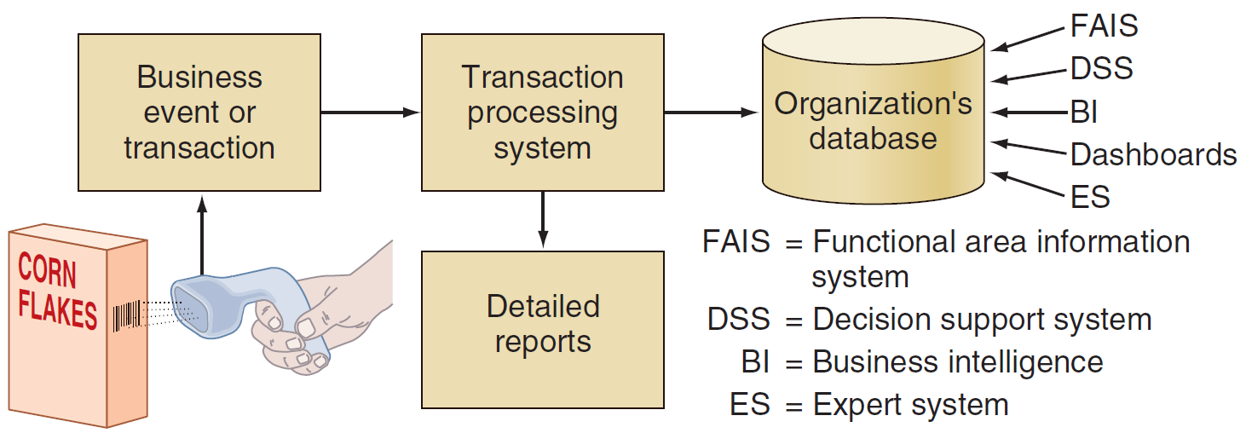
FIGURE 10.1 How transaction processing systems manage data.
Notes:
FIGURE 10.1 How transaction processing systems manage data.

Slide 9
10.2
Functional Area Information Systems
Information Systems for Accounting and Finance
Information Systems for Marketing
Information Systems for Production/Operations Management
Information Systems for Human Resource Management

Slide 10
Information Systems for Accounting and Finance
Financial Planning and Budgeting
Managing Financial Transactions
Investment Management
Control and Auditing
Notes:
Financial Planning and Budgeting: Appropriate management of financial assets and is an important part of managerial planning for both acquiring and utilizing resources.
Managing Financial Transactions: accounting/finance software packages that are integrated with other functional areas (e.g., Peachtree offers a sales ledger, a purchase ledger, a cash book, sales order processing, invoicing, stock control, a fixed assets register, etc.). Organizations, business processes, and business activities operate with, and manage, financial transactions.
Investment Management: Systems for managing organization investments in in stocks, bonds, real estate, and other assets that are subject to complex regulations and tax laws, which vary from one location to another.
Control and Auditing: effectively control their finances and financial statements. Let us examine some of the most common forms of financial control.

Slide 11
Financial Planning and Budgeting
Financial Planning and Budgeting
Financial and economic forecasting
Budgeting
Notes:
Financial Planning and Budgeting: Appropriate management of financial assets and is an important part of managerial planning for both acquiring and utilizing resources.
Financial and Economic Forecasting: Knowledge about the availability and cost of money a key ingredient for successful financial planning including flow projections which inform organizations what funds they need, when they need them, and how they will acquire them.
Budgeting: allocates the organization’s financial resources among participants and activities allowing management to distribute resources in the way that best supports the organization’s mission and goals.

Slide 12
Managing Financial Transactions
Managing Financial Transactions
Global stock exchanges
Managing multiple currencies
Virtual close
Expense management automation (EMA)
Notes:
Managing Financial Transactions: accounting/finance software packages that are integrated with other functional areas (e.g., Peachtree offers a sales ledger, a purchase ledger, a cash book, sales order processing, invoicing, stock control, a fixed assets register, etc.). Organizations, business processes, and business activities operate with, and manage, financial transactions.
Global stock exchanges: Financial markets operate in global, 24/7/365, distributed electronic stock exchanges that use the Internet both to buy and sell stocks and to broadcast real-time stock prices
Managing multiple currencies: Financial and accounting systems utilize financial data from different countries to convert currencies (with conversion ratios that constantly flux) in seconds.
Virtual close: the ability the books quickly at any time, on very short notice (rather than quarterly) which provides almost real-time information on the organization’s financial health.
Expense management automation (EMA): systems that automate the data entry and processing of travel and entertainment expenses through Web-based applications that enable companies to quickly and consistently collect expense information, enforce company policies and contracts, and reduce unplanned purchases as well as airline and hotel expenses.

Slide 13
Control and Auditing
Control and Auditing
Budgetary control
Auditing
Two basic purposes of Audits
Monitor how the organization’s monies are being spent
Access the organization’s financial health
Financial ratio analysis
Notes:
Control and Auditing: effectively control their finances and financial statements. Let us examine some of the most common forms of financial control.
Budgetary control: managers at various levels monitor departmental expenditures and compare them against the budget and the operational progress of corporate plans.
Auditing: monitoring how the organization’s monies are being spent and assessing the organization’s financial health.
Financial ratio analysis: monitoring the company’s financial health by assessing a set of fi nancial ratios including liquidity ratios (the availability of cash to pay debt), activity ratios (how quickly a firm converts noncash assets to cash assets), debt ratios (measure thefi rm’s ability to repay long-term debt), and profitability ratios (measure the fi rm’s use of its assets and control of its expenses to generate an acceptable rate of return).

Slide 14

Information Systems for Production/ Operations Management
In-House Logistics and Materials Management
Inventory Management
Quality Control
Planning Production and Operations
Computer-Integrated Manufacturing
Product Life Cycle Management

Slide 15
10.1
The Lion King Roars Back
Notes:
Why are yield management systems so important to the producers of Broadway shows? Hint: What is the value of an unsold seat once the curtain goes up?
Describe potential disadvantages of Disney’s yield management system.

Slide 16
Information Systems for Human Resource Management
Recruitment
Human Resources Development
Human Resources Planning and Management
Payroll and employees’ records
Benefits administration
Employee relationship management
Notes:
Recruitment: systems that assist human resource personnel in finding potential employees, evaluating them, and deciding which ones to hire.
Human Resources Development: IS that assist human resource personnel in helping new hires become part of the corporate human resources pool through evaluation and development.
Human Resources Planning and Management: Managing human resources in large organizations requires extensive planning and detailed strategy.

Slide 17
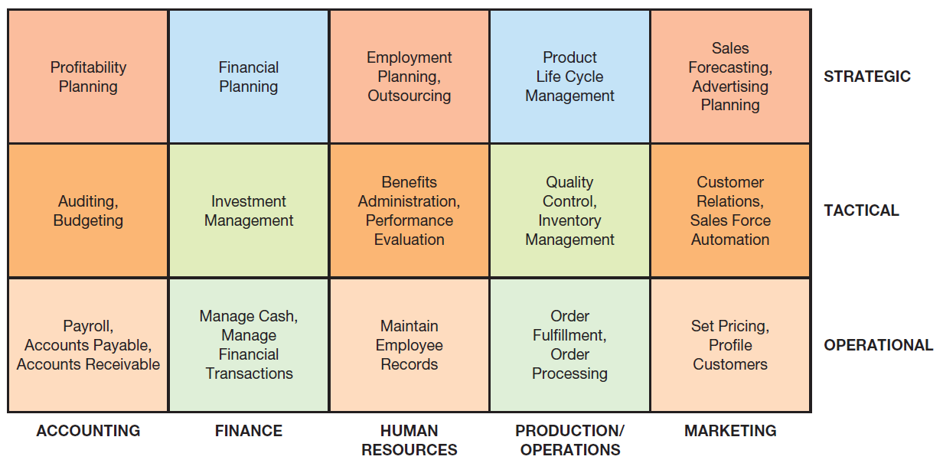
FIGURE 10.2 Examples of information systems supporting the functional areas.
Notes:
FIGURE 10.2 Examples of information systems supporting the functional areas.

Slide 18
10.3
Enterprise Resource Planning (ERP) Systems
ERP II Systems
Benefits and Limitation of ERP Systems
Implementing ERP Systems
Software-as-a-Service ERP Implementation
Enterprise Application Integration
Enterprise Application Integration (EAI)
Notes:
Enterprise Resource Planning (ERP) Systems: systems designed to correct a lack of communication among the functional area IS and they adopt a business process view of the overall organization to integrate the planning, management, and use of all of an organization’s resources, employing a common software platform and database.
ERP II Systems: interorganizational ERP systems that provide Web-enabled links among a company’s key business systems—such as inventory and production—and its customers, suppliers, distributors, and other relevant parties.
Enterprise Application Integration (EAI) System: integrates existing systems by providing software, called middleware, that connects multiple applications allowing existing applications to communicate and share data.

Slide 19
10.2
GEA Group Uses SAP for Financial Reporting
Notes:
Discuss the reasons why financial reports must be timely.
Explain how the SAP solution enabled the GEA Group to produce their financial reports in an efficient, timely manner.
What are the advantages of the SAP solution to the GEA Group?

Slide 20
Core ERP Modules
Financial Management
Operations Management
Human Resource Management
Notes:
FIGURE 10.3 ERP II system.
Core ERP Modules
Financial Management: These modules support accounting, financial reporting, performance management, and corporate governance. They manage accounting data and financial processes such as general ledger, accounts payable, accounts receivable, fixed assets, cash management and forecasting, product-cost accounting, cost-center accounting, asset accounting, tax accounting, credit management, budgeting, and asset management.
Operations Management: These modules manage the various aspects of production planning and execution such as demand forecasting, procurement, inventory management, materials purchasing, shipping, production planning, production scheduling, materials requirements planning, quality control, distribution, transportation, and plant and equipment maintenance.
Human Resource Management: These modules support personnel administration (including workforce planning, employee recruitment, assignment tracking, personnel planning and development, and performance management and reviews), time accounting, payroll, compensation, benefits accounting, and regulatory requirements.
Extended ERP Modules
Customer Relationship Management: (Discussed in detail in Chapter 11.) These modules support all aspects of a customer’s relationship with the organization. They help the organization to increase customer loyalty and retention, and thus improve its profitability. They also provide an integrated view of customer data and interactions, helping organizations to be more responsive to customer needs.
Supply Chain Management: (Discussed in detail in Chapter 11.) These modules manage the information fl ows between and among stages in a supply chain to maximize supply chain efficiency and effectiveness. They help organizations plan, schedule, control, and optimize the supply chain from the acquisition of raw materials to the receipt of finished goods by customers.
Business Intelligence: (Discussed in detail in Chapter 12.) These modules collect information used throughout the organization, organize it, and apply analytical tools to assist managers with decision making.
E-Business: (Discussed in detail in Chapter 7.) Customers and suppliers demand access to ERP information including order status, inventory levels, and invoice reconciliation. Furthermore, they want this information in a simplified format that can be accessed via the Web. As a result, these modules provide two channels of access into ERP system information—one channel for customers (B2C) and one for suppliers and partners (B2B).

Slide 21
Extended ERP Modules
Customer Relationship Management (CRM)
Supply Chain Management (SCM)
Business Intelligence (BI)
E-Business
Notes:
Extended ERP Modules
Customer Relationship Management: (Discussed in detail in Chapter 11.) These modules support all aspects of a customer’s relationship with the organization. They help the organization to increase customer loyalty and retention, and thus improve its profitability. They also provide an integrated view of customer data and interactions, helping organizations to be more responsive to customer needs.
Supply Chain Management: (Discussed in detail in Chapter 11.) These modules manage the information fl ows between and among stages in a supply chain to maximize supply chain efficiency and effectiveness. They help organizations plan, schedule, control, and optimize the supply chain from the acquisition of raw materials to the receipt of finished goods by customers.
Business Intelligence: (Discussed in detail in Chapter 12.) These modules collect information used throughout the organization, organize it, and apply analytical tools to assist managers with decision making.
E-Business: (Discussed in detail in Chapter 7.) Customers and suppliers demand access to ERP information including order status, inventory levels, and invoice reconciliation. Furthermore, they want this information in a simplified format that can be accessed via the Web. As a result, these modules provide two channels of access into ERP system information—one channel for customers (B2C) and one for suppliers and partners (B2B).

Slide 22
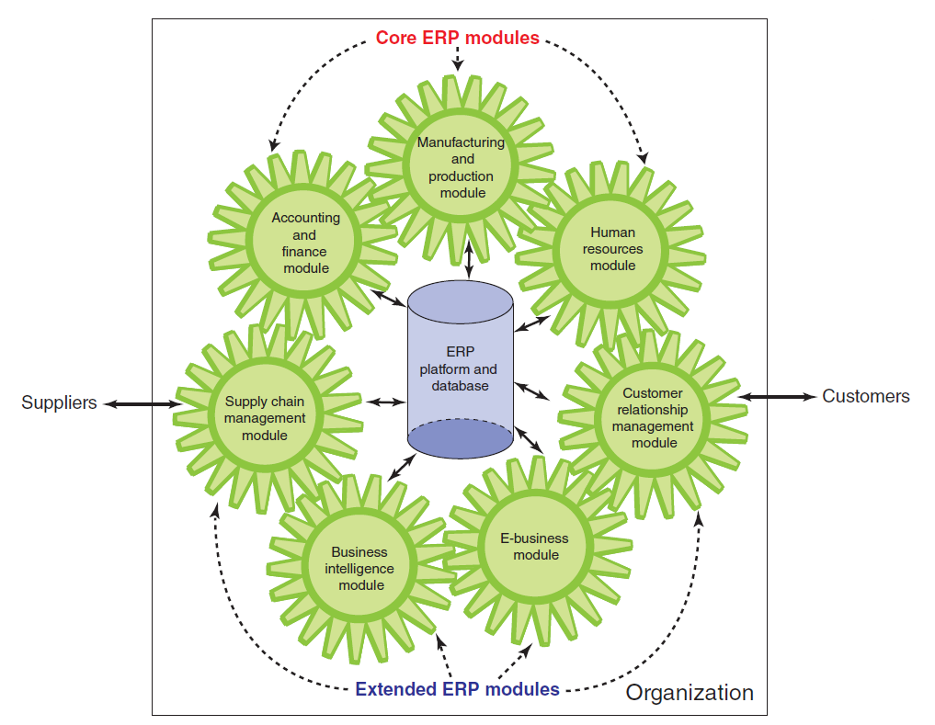
FIGURE 10.3 ERP II system.
Notes:
FIGURE 10.3 ERP II system.
Core ERP Modules
Financial Management: These modules support accounting, financial reporting, performance management, and corporate governance. They manage accounting data and financial processes such as general ledger, accounts payable, accounts receivable, fixed assets, cash management and forecasting, product-cost accounting, cost-center accounting, asset accounting, tax accounting, credit management, budgeting, and asset management.
Operations Management: These modules manage the various aspects of production planning and execution such as demand forecasting, procurement, inventory management, materials purchasing, shipping, production planning, production scheduling, materials requirements planning, quality control, distribution, transportation, and plant and equipment maintenance.
Human Resource Management: These modules support personnel administration (including workforce planning, employee recruitment, assignment tracking, personnel planning and development, and performance management and reviews), time accounting, payroll, compensation, benefits accounting, and regulatory requirements.
Extended ERP Modules
Customer Relationship Management: (Discussed in detail in Chapter 11.) These modules support all aspects of a customer’s relationship with the organization. They help the organization to increase customer loyalty and retention, and thus improve its profitability. They also provide an integrated view of customer data and interactions, helping organizations to be more responsive to customer needs.
Supply Chain Management: (Discussed in detail in Chapter 11.) These modules manage the information fl ows between and among stages in a supply chain to maximize supply chain efficiency and effectiveness. They help organizations plan, schedule, control, and optimize the supply chain from the acquisition of raw materials to the receipt of finished goods by customers.
Business Intelligence: (Discussed in detail in Chapter 12.) These modules collect information used throughout the organization, organize it, and apply analytical tools to assist managers with decision making.
E-Business: (Discussed in detail in Chapter 7.) Customers and suppliers demand access to ERP information including order status, inventory levels, and invoice reconciliation. Furthermore, they want this information in a simplified format that can be accessed via the Web. As a result, these modules provide two channels of access into ERP system information—one channel for customers (B2C) and one for suppliers and partners (B2B).

Slide 23
Benefits and Limitations of ERP Systems
Major Benefits of ERP Systems
Major limitations of ERP implementations
Major causes of ERP implementation failure

Slide 24
Major Benefits of ERP Systems
Organizational flexibility and agility
Decision support
Quality and efficiency
Notes:
Organizational Flexibility and Agility: ERP systems break down many former departmental and functional silos of business processes, information systems, and information resources making organizations more flexible, agile, and adaptive.
Decision Support: provide essential information on business performance across functional areas which significantly improves managers’ ability to make better, more timely decisions.
Quality and Efficiency: ERP systems integrate and improve an organization’s business processes, generating signifi cant improvements in the quality of production, distribution, and customer service.

Slide 25
Major Limitations of ERP Implementations
Since ERP’s are based on best practices companies may need to change their methods of achieving business objectives
ERP systems can be complex, expensive, and time-consuming to implement.
Notes:
Business Processes Predefined by Best Practices: may require companies need to change their existing business processes to fit the predefined business processes incorporated into the ERP software.
Difficult to Implement: ERP systems can be extremely complex, expensive, and time consuming to implement.
Potential for Failure

Slide 26
Major Causes of ERP Implementation Failure
Failure to involve affected employees in the planning and development phases and in change management processes
Trying to do too much too fast in the conversion process
Insufficient training in the new work tasks required by the ERP system
The failure to perform proper data conversion and testing for the new system

Slide 27
Implementing ERP Systems
On-Premise ERP Implementation
Vanilla approach
Custom approach
Best of breed approach
Notes:
Vanilla Approach: a company implements a standard ERP package, using the package’s built-in configuration options.
Custom Approach: a company implements a more customized ERP system by developing new ERP functions designed specifically for that firm.
Best of Breed Approach: combines the benefits of the vanilla and customized systems while avoiding the extensive costs and risks associated with complete customization.

Slide 28
Software-as-a-Service ERP Implementation
Three major advantages of using a cloud-based ERP system are:
Three major disadvantages of using cloud-based ERP systems

Slide 29
Three major advantages of using a cloud-based ERP system are:
The system can be used from any location that provides Internet access
Companies using cloud-based ERP avoid the initial hardware and software expenses that are typical of on-premise implementations
Cloud-based ERP solutions are scalable, meaning it is possible to extend ERP support to new business processes and new business partners (e.g., suppliers) by purchasing new ERP modules.

Slide 30
Three major disadvantages of using cloud-based ERP systems are:
It is not clear whether cloud-based ERP systems are more secure than on-premise systems
Companies that adopt cloud-based ERP systems sacrifice their control over a strategic IT resource
Lack of control over IT resources when the ERP system experiences problems

Slide 31
10.4
ERP Support for Business Processes
The Procurement, Fulfillment, and Production Processes
The Procurement Process
The Fulfillment Process
The Production Process
Interorganizational Processes: ERP with SCM and CRM
SCM and CRM
ERP SCM
ERP CRM
Notes:
Procurement Process: originates when a company needs to acquire goods or services from external sources, and it concludes when the company receives and pays for them.
Order Fulfillment Process: (order-to-cash process) process in which the company sells goods to a customer originating when the company receives a customer order, and concluding when the company receives a payment from the customer.
Production Process: occurring only in companies that produce physical goods, this process follows one of two strategies: make-to-stock and make-to-order.

Slide 32
ERP Support for Business Processes
The Procurement, Fulfillment, and Production Processes
Interorganizational Processes: ERP with SCM and CRM
Notes:
Procurement Process: originates when a company needs to acquire goods or services from external sources, and it concludes when the company receives and pays for them.
Order Fulfillment Process: (order-to-cash process) process in which the company sells goods to a customer originating when the company receives a customer order, and concluding when the company receives a payment from the customer.
Production Process: occurring only in companies that produce physical goods, this process follows one of two strategies: make-to-stock and make-to-order.

Slide 33
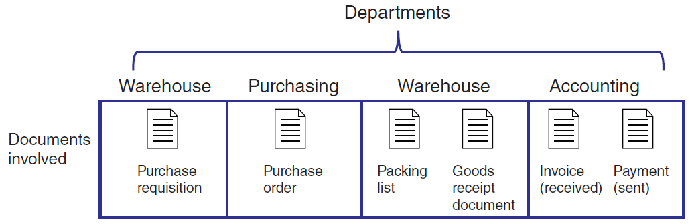
FIGURE 10.4 Departments and documents flow in the procurement process.
Notes:
FIGURE 10.4 Departments and documents flow in the procurement process.

Slide 34
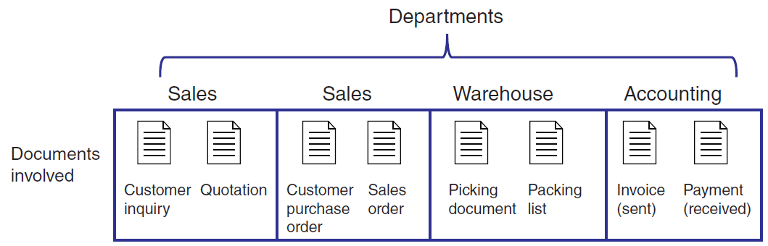
FIGURE 10.5 Departments and documents flow in the fulfillment process.
Notes:
FIGURE 10.5 Departments and documents flow in the fulfillment process.

Slide 35
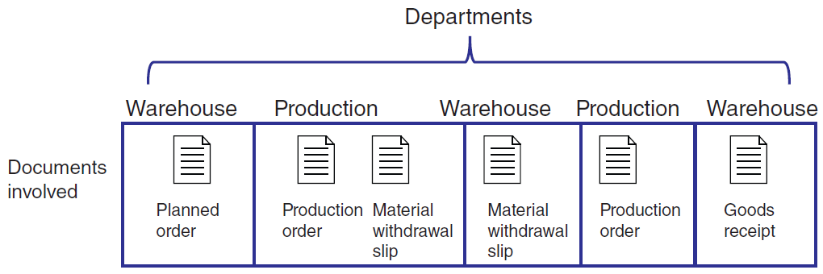
FIGURE 10.6 Departments and documents flow in the production process.
Notes:
FIGURE 10.6 Departments and documents flow in the production process.

Slide 36
Interorganizational Processes: ERP with SCM and CRM
SCM and CRM
ERP SCM
ERP CRM

Slide 37
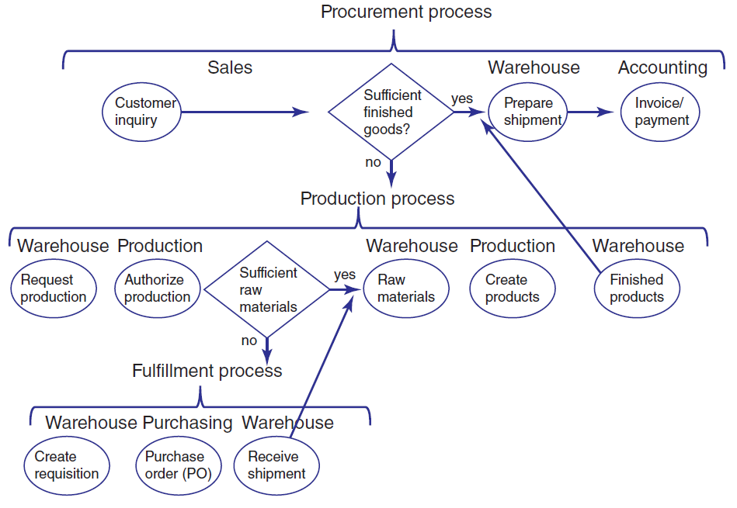
FIGURE 10.7 Integrated processes with ERP systems.
Notes:
FIGURE 10.7 Integrated processes with ERP systems.

Slide 38
10.5
Reports
Routine Reports
Ad-hoc (on-demand) Reports
Drill-down reports
Key-indicator reports
Comparative reports
Exception Reports

Slide 39
[ Closing Case Airlines Use IT to Combat Flight Cancelations]
The Business Problem
The IT Solution
The Results
Notes:
Questions
Describe why many passengers still experience long delays when the weather disrupts fl ight operations.
Refer to Chapter 2. Do you consider the airlines’ automated booking software to be a strategic information system? Why or why not?

