Slide 1
11
Customer Relationship Management and Supply Chain Management

Slide 2
[ LEARNING OBJECTIVES]
Identify the primary functions of both customer relationship management (CRM) and collaborative CRM strategies.
Describe how businesses might utilize applications of each of the two major components of operational CRM systems.
Discuss the benefits of analytical CRM systems to businesses.
Explain the advantages and disadvantages of mobile CRM systems, on-demand CRM systems, and open-source CRM systems.
Describe the three components and the three flows of a supply chain.
Identify popular strategies to solving different challenges of supply chains.
Explain the utility of each of the three major technologies that supports supply chain management.

Slide 3
[ CHAPTER OUTLINE ]
Defining Customer Relationship Management
Operational Customer Relationship Management Systems
Analytical Customer Relationship Management Systems
Other Types of Customer Relationship Management Systems
Supply Chains
Supply Chain Management
Information Technology Support for Supply Chain Management

Slide 4
[ WEB RESOURCES]
Student PowerPoints for note taking
WileyPLUS Learning Space
E-Book
Author video lecture for each chapter section
Practice quizzes
Flash Cards for vocabulary review
Additional “What’s in IT for Me?” cases
Video interviews with managers
Lab Manuals - Microsoft Office 2010 & 2013

Slide 5
[ Opening Case Organic and Beyond Corporation Manages Its New B2C…]
What We Learned from This Case
Notes:
Questions
Why is B2C electronic commerce so important in China?
Why is customer relationship management so important to B2C electronic commerce?

Slide 6
11.1
Defining Customer Relationship Management
Customer Relationship Management (CRM)
Customer Touch Points
Data Consolidation
Notes:
Customer Touch Points: the numerous and diverse interactions organizations have with their customers including traditional customer touch points such as telephone contact, direct mailings, and actual physical interactions with customers during their visits to a store and the additional touch points that occur through organizational CRM systems such as e-mail, Web sites, and communications via smartphones.
Data Consolidation: the organization’s CRM systems must manage customer data effectively with modern interconnected systems built around a data warehouse to make all customer-related data available to every unit of the business.
360° Data View Customer: complete data set on each customer that allows a company can enhance its relationship with its customers and ultimately make more productive and profitable decisions.
-----------------
Data consolidation and the 360° view of the customer enable the organization’s functional areas to readily share information about customers which leads to collaborative CRM.
Collaborative CRM Systems: provide effective and efficient interactive communication in all aspects of marketing, sales, and customer support with the customer throughout the entire organization.

Slide 7
11.1
Amazon: Truly Superb Customer Service
Notes:
Describe the advantages that Amazon has over bricks-andmortar retailers.
Describe the many facets of Amazon’s relentless focus on customer relationship management.

Slide 8
Customer Relationship Management (CRM)
Customer Relationship Management (CRM)
Lifetime value
Customer churn
CRM Strategy versus CRM Systems
Low-end CRM Systems versus High-end CRM Systems

Slide 9
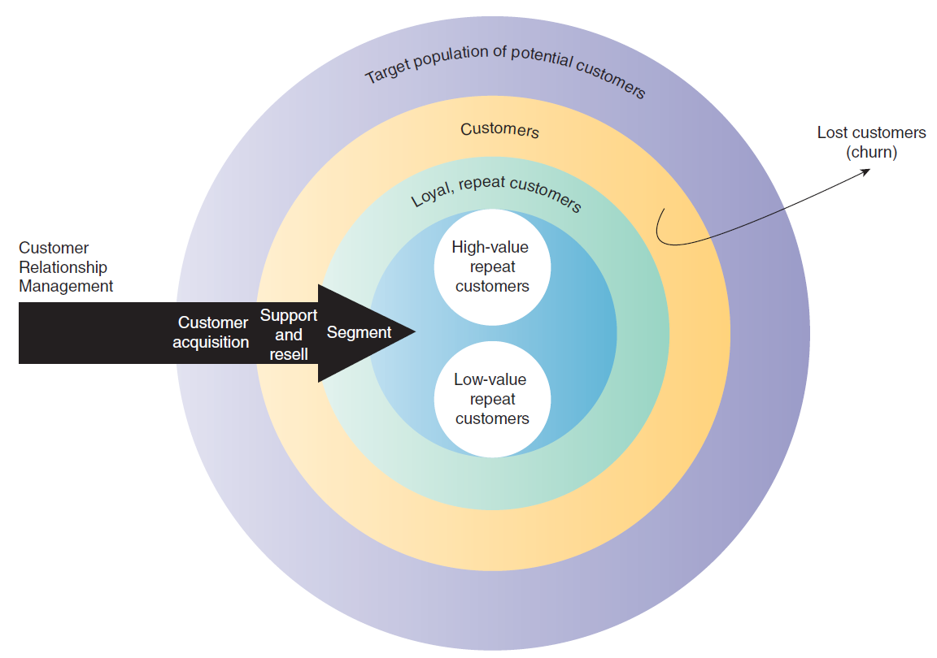
FIGURE 11.1 The customer relationship management process
Notes:
FIGURE 11.1 The customer relationship management process

Slide 10
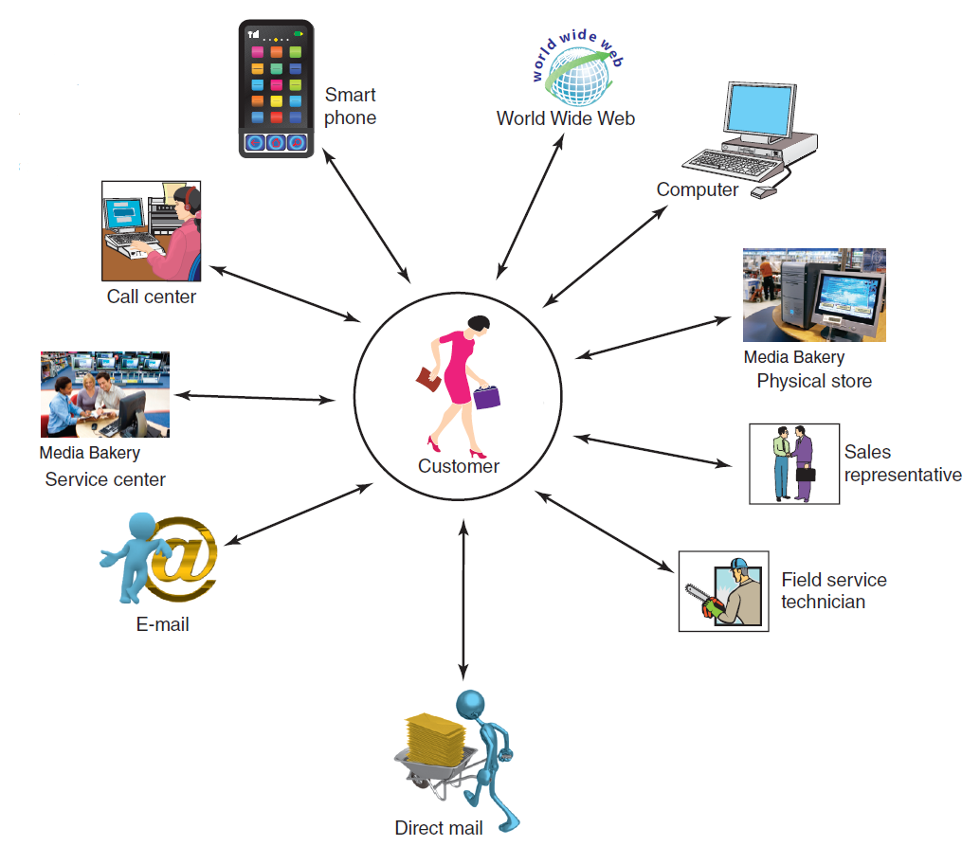
FIGURE 11.2 Customer touch points.
Notes:
FIGURE 11.2 Customer touch points. (“Oleksiy Mark/Shutterstock” for the smartphone and “Media Bakery” for the service center and “Media Bakery” for the physical store.)

Slide 11
11.2
Rating Online Customer Service
Notes:
Why is it so valuable for an online retailer to be able to post StellaService’s seal of approval on its Web site and advertising materials?
Why doesn’t StellaService provide the same service for bricksand-mortar retailers?

Slide 12
Data Consolidation
360-degree view
Collaborative CRM
Notes:
Data Consolidation: the organization’s CRM systems must manage customer data effectively with modern interconnected systems built around a data warehouse to make all customer-related data available to every unit of the business.
360° Data View Customer: complete data set on each customer that allows a company can enhance its relationship with its customers and ultimately make more productive and profitable decisions.

Slide 13
11.2
Operational Customer Relationship Management Systems
Operational CRM Systems
Customer-Facing Applications
Customer-Touching Applications
Notes:
Operational CRM: systems that support front-office business processes.
Front-Office Processes: those processes that directly interact with customers (i.e., sales, marketing, and service).
Customer-Facing Applications: allow an organization’s sales, field service, and customer interaction center representatives interact directly with customers through customer service and support, sales force automation, marketing, and campaign management.
Customer-Touching Applications: (or electronic CRM e-CRM) customer self-help applications/technologies.
-----------------
Two Major Components of Operational CRM:
Customer-Facing Applications
Customer-Touching Applications
-------------------

Slide 14
Operational CRM Systems
Two Major Components
Customer-facing applications
Customer touching applications
Operational CRM Systems provide the following benefits:
Efficient, personalized marketing, sales, and service
A 360-degree view of each customer
The ability of sales and service employees to access a complete history of customer interaction with the organization, regardless of the touch point.

Slide 15
Customer-Facing Applications
Customer Service and Support
Sales Force Automation (SFA)
Marketing
Campaign Management
Notes:
Customer-Facing Applications: allow an organization’s sales, field service, and customer interaction center representatives interact directly with customers through customer service and support, sales force automation, marketing, and campaign management.
Sales Force Automation (SFA): the component of an operational CRM system that automatically records all of the components in a sales transaction process.
Marketing: CRM Marketing applications use data mining to sift through volumes of customer data
Campaign Management: applications that help organizations plan campaigns that send the right messages to the right people through the right channels (e.g., avoid targeting people who have opted out of receiving marketing communications).

Slide 16
Customer Service and Support
Customer Interaction Centers (CIC)
Call center
Outbound telesales
Inbound teleservice
Notes:
Customer-Facing Applications: allow an organization’s sales, field service, and customer interaction center representatives interact directly with customers through customer service and support, sales force automation, marketing, and campaign management.
--------------
Customer Service and Support: systems that automate service requests, complaints, product returns, and requests for information.
Customer Interaction Centers (CIC): where organizational representatives use multiple channels such as the Web, telephone, fax, and face-to-face interactions to communicate with customers.
Call Center: a centralized office set up to receive and transmit a large volume of requests by telephone.
Oubound Telesales: the CIC generates a call list for the sales team, whose members contact sales prospects.
Inbound Teleservice: customers communicate directly with the CIC to initiate a sales order, inquire about products and services before placing an order, and obtain information about a transaction they have already made.
Information Help Desk: assists customers with their questions concerning products or services, and it also processes customer complaints.
Live Chat: allows customers to connect to a company representative and conduct an instant messaging session enabling the participants to share documents and photos.

Slide 17
Sales Force Automation
Contact management system
Sales lead tracking system
Sales forecasting system
Product knowledge system
Configurators
Notes:
Customer-Facing Applications: allow an organization’s sales, field service, and customer interaction center representatives interact directly with customers through customer service and support, sales force automation, marketing, and campaign management.
--------------
Sales Force Automation (SFA): the component of an operational CRM system that automatically records all of the components in a sales transaction process.
Contact Management System: tracks all communications between the company and the customer, the purpose of each communication, and any necessary follow-up which eliminates duplicated contacts and redundancy, which in turn reduces the risk of irritating customers.
Sales Lead Tracking System: lists potential customers or customers who have purchased related products; that is, products similar to those that the salesperson is trying to sell to the customer.
Sales Forecasting System: a mathematical technique for estimating future sales.
Product Knowledge System: a comprehensive source of information regarding products and services.
Configurator: an online product-building feature that enables customers to model the product to meet their specific needs.

Slide 18
Marketing
Cross selling
Up selling
Bundling
Notes:
Customer-Facing Applications: allow an organization’s sales, field service, and customer interaction center representatives interact directly with customers through customer service and support, sales force automation, marketing, and campaign management.
--------------
Marketing: CRM Marketing applications use data mining to sift through volumes of customer data
Data Mining: develops a purchasing profile or snapshot of a consumer’s buying habits that may lead to additional sales through cross-selling, upselling, and bundling.
Cross-Selling: the marketing of additional related products to customers based on a previous purchase.
Upselling: a strategy in which the salesperson provides customers with the opportunity to purchase related products or services of greater value in place of, or along with, the consumer’s initial product or service selection.
Bundling: is a form of cross-selling in which a business sells a group of products or services together at a lower price than their combined individual prices.

Slide 19
Customer-Touching Applications
Search and Comparison Capabilities
Technical and Other Information and Services
Customized Products and Services
Personalized web pages
FAQs
E-mail and Automated Response
Loyalty Programs
Notes:
Customer-Touching Applications: (or electronic CRM e-CRM) customer self-help applications/technologies.
-----------------
Search and Comparison Capabilities: search and comparison capabilities offered to customers by online stores, online malls, and independent comparison Web sites.
Technical and Other Information and Services: personalized experiences offered by organizations to induce customers to make purchases or to remain loyal (e.g., allowing customers to download product manuals; providing detailed technical information, maintenance information, and replacement parts to customers).
Customized Products and Services: offering customers the ability to custimize products, view account balances, check shipping status of an order, etc.
Mass Customization: a process in which customers can configure their own products (e.g., customized computer systems from Dell).
Personalized Web Pages: organizations permit their customers to create personalized Web pages used to record purchases and preferences, as well as problems and requests.
Frequently Asked Questions (FAQs): a simple tool for answering repetitive customer queries and when customers find the information they need by using FAQs the need to communicate with an actual person is eliminated.
E-mail and Automated Response: the most popular tool for customer service, inexpensive, fast, and companies use e-mail not only to answer customer inquiries but also to disseminate information, send alerts and product information, and conduct correspondence on any topic.
Loyalty Programs: programs that recognize customers who repeatedly use a vendor’s
products or services.

Slide 20
11.3
Analytical Customer Relationship Management Systems
Analytical CRM systems analyze customer data for a variety of purposes
Notes:
Analytical CRM: provide business intelligence by analyzing customer behavior and perceptions providing information concerning customer requests and transactions, as well as customer responses to the organization’s marketing, sales, and service initiatives. These systems also create statistical models of customer behavior and the value of customer relationships over time, as well as forecasts about acquiring, retaining, and losing customers.
Analytical CRM Systems Analyze Customer Data for:
Designing and executing targeted marketing campaigns
Increasing customer acquisition, cross-selling, and upselling
Providing input into decisions relating to products and services (e.g., pricing and product development)
Providing financial forecasting and customer profitability analysis

Slide 21
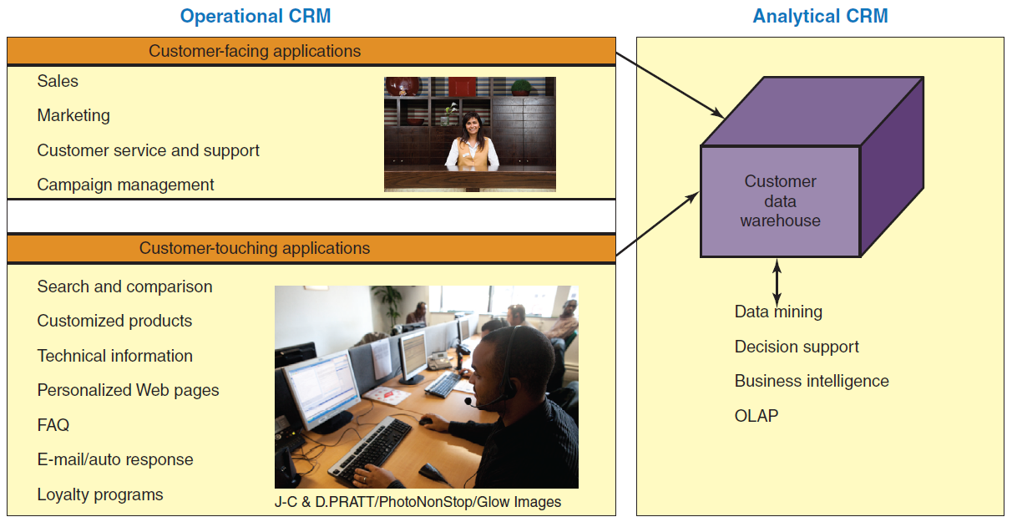
FIGURE 11.3 The relationship between operational CRM and analytical CRM.
Notes:
FIGURE 11.3 The relationship between operational CRM and analytical CRM.

Slide 22
Analytical CRM systems analyze customer data for a variety of purposes, including:
Designing and executing targeted marketing campaigns
Increasing customer acquisition, cross selling, and up selling
Providing input into decisions relating to products and services (e.g., pricing and product development)
Providing financial forecasting and customer profitability analysis
Notes:
Analytical CRM: provide business intelligence by analyzing customer behavior and perceptions providing information concerning customer requests and transactions, as well as customer responses to the organization’s marketing, sales, and service initiatives. These systems also create statistical models of customer behavior and the value of customer relationships over time, as well as forecasts about acquiring, retaining, and losing customers.
Analytical CRM Systems Analyze Customer Data for:
Designing and executing targeted marketing campaigns
Increasing customer acquisition, cross-selling, and upselling
Providing input into decisions relating to products and services (e.g., pricing and product development)
Providing financial forecasting and customer profitability analysis

Slide 23
11.4
Other Types of Customer Relationship Management Systems
On-demand CRM systems
Mobile CRM Systems
Open-Source CRM Systems
Social CRM Systems
Notes:
On-Demand CRM Systems: systems hosted by an external vendor in the vendor’s data center which spares the organization the costs associated with purchasing the system, maintenance, and employees need to know only how to access and utilize it. Also known as utility computing or soft ware-as-a-service (SaaS).
Mobile CRM Systems: an interactive system that enables an organization to conduct communications related to sales, marketing, and customer service activities through a mobile medium for the purpose of building and maintaining relationships with its customers.
Open-Source CRM Systems: the source code for open-source software is available at no cost.
Social CRM: the use of social media technology and services to enable organizations to engage their customers in a collaborative conversation in order to provide mutually beneficial value in a trusted and transparent manner.

Slide 24
11.3
Mobile CRM at Disney World
Notes:
How do MyMagic+ and MagicBands contribute positively to the customer experience at Disney parks? Provide specific examples to support your answer.
Other than privacy, what are other disadvantages of MyMagic+ and MagicBands to guests? To Disney? To Disney employees? Provide specific examples to support your answer.

Slide 25
Other Types of Customer Relationship Management Systems
On-demand CRM systems
Utility computing
Software-as-a-service
Mobile CRM Systems
Open-Source CRM Systems
SugarCRM
Social CRM Systems
Notes:
On-Demand CRM Systems: systems hosted by an external vendor in the vendor’s data center which spares the organization the costs associated with purchasing the system, maintenance, and employees need to know only how to access and utilize it. Also known as utility computing or soft ware-as-a-service (SaaS).
Potential Problems with On-Demand CRM:
Unreliable vendors
Hosted software difficult to modify
Upgrades only available through the vendor
Difficult to integrate with organization’s existing software
Information security and privacy risks
------------------
Open-Source CRM Systems: the source code for open-source software is available at no cost.
Benefits of Open-Source CRM:
source code is available to developers and users
Provide the same features or functions as other CRM
Implemented either on-premise or on-demand
Favorable pricing
Wide variety of applications
Easy to customize
Updates and bug (software error) fixes rapidly distributed
Extensive support information available for free
Open-Source CRM Disadvantages:
Risk related to quality control
Company IT platform must match development platform of open-source CRM system
Examples:
SugarCRM (www.sugarcrm.com)
Concursive (www.concursive.com)
Vtiger (www.vtiger.com)

Slide 26
11.4
uShip Benefits from SugarCRM
Notes:
Describe the advantages provided to uShip by the SugarCRM system.
Describe the business needs of uShip that led to the company’s decision to implement a CRM system.

Slide 27
11.5
Morton’s Steakhouse Surprises a Customer
Notes:
Explain how Morton’s monitoring of social media illustrates how CRM is reviving personal marketing.
Do you see any disadvantages in such close monitoring of social media? Provide specifi c examples to support your answer.

Slide 28
11.5
Supply Chains
Supply Chain
Supply Chain Visibility
The Structure and Components of Supply Chains

Slide 29
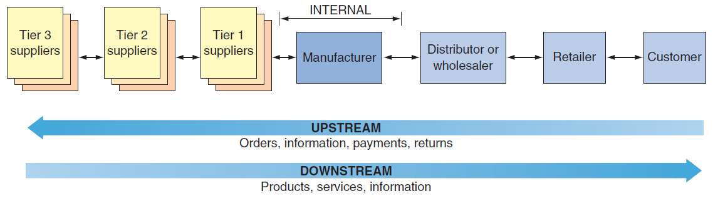
FIGURE 11.4 Generic supply chain.
Notes:
FIGURE 11.4 Generic supply chain.

Slide 30
The Structure and Components of Supply Chains
The Structure of Supply Chains
The Components of Supply Chains
Notes:
Supply Chain: the flow of materials, information, money, and services from raw material suppliers, through factories and warehouses, to the end customers.
Supply Chain Visibility: the ability of all organizations within a supply chain to access or view relevant data on purchased materials as these materials move through their suppliers’ production processes and transportation networks to their receiving docks.
Inventory Velocity: the speed at which a company can deliver products and services after receiving the materials required to make them.

Slide 31
The Structure of Supply Chains
Upstream
Internal
Downstream
Notes:
The Supply Chain Involves Three Segments:
Upstream: where sourcing or procurement from external suppliers occurs.
Internal: where packaging, assembly, or manufacturing takes place.
Downstream: where distribution takes place, frequently by external distributors.
-------------------
Tiers of Suppliers: a supplier may have one or more subsuppliers, a subsupplier may have its own subsupplier(s), and so on. For an automobile manufacturer, for example, Tier 3 suppliers produce basic products such as glass, plastic, and rubber; Tier 2 suppliers use these inputs to make windshields, tires, and plastic moldings; and Tier 1 suppliers produce integrated components such as dashboards and seat assemblies.
-------------------
Material Flows: the physical products, raw materials, supplies, and so forth that flow along the chain. Material flows also include the reverse flows.
Reverse Flows (or reverse logistics): returned products that are damaged, unwanted, or in need of recycling.
Information Flows: data related to demand, shipments, orders, returns, and schedules, as well as changes in any of these data.
Financial Flows: involve money transfers, payments, credit card information and authorization, payment schedules, e-payments, and credit-related data.
-------------------

Slide 32
The Components of Supply Chains
Tiers of Suppliers
The Flows in the Supply Chain
Materials Flows
Information Flows
Financial Flows
Notes:
Tiers of Suppliers: a supplier may have one or more subsuppliers, a subsupplier may have its own subsupplier(s), and so on. For an automobile manufacturer, for example, Tier 3 suppliers produce basic products such as glass, plastic, and rubber; Tier 2 suppliers use these inputs to make windshields, tires, and plastic moldings; and Tier 1 suppliers produce integrated components such as dashboards and seat assemblies.
-------------------
Material Flows: the physical products, raw materials, supplies, and so forth that flow along the chain. Material flows also include the reverse flows.
Reverse Flows (or reverse logistics): returned products that are damaged, unwanted, or in need of recycling.
Information Flows: data related to demand, shipments, orders, returns, and schedules, as well as changes in any of these data.
Financial Flows: involve money transfers, payments, credit card information and authorization, payment schedules, e-payments, and credit-related data.
-------------------

Slide 33
11.6
Supply Chain Management
Five Basic Components of SCM
Interorganizational Information Systems (IOS)
The Push Model versus the Pull Model
Problems along the Supply Chain
Solutions to Supply Chain Problems
Notes:
Five Basic Components of SCM: Plan, Source, Make, Deliver, Return
Supply Chain Management Systems: a type of interorganizational information system (IOS) in which information flows among two or more organizations.
Push Model: In this model, also known as make-to-stock, the production process begins with a forecast, which is simply an educated guess as to customer demand.
Pull Model: In this model, also known as make-to-stock, the production process begins with a forecast, which is simply an educated guess as to customer demand.

Slide 34
11.6
Crate & Barrel Improves Its Supply Chain Visibility
Notes:
Discuss the advantages of supply chain visibility for any organization.
Explain how an increase in shipping costs can actually generate higher revenues for Crate & Barrel.

Slide 35
Five Basic Components of Supply Chain Management
Plan
Source
Make
Deliver
Return
Notes:
Five Basic Components of SCM:
Plan: Planning is the strategic component of SCM that involves developing a set of metrics (measurable deliverables) to monitor the organization’s supply chain to ensure that it is efficient and it delivers high quality and value to customers for the lowest cost.
Source: organizations choose suppliers to deliver the goods and services they need to create their product or service.
Make: the manufacturing component in which managers schedule the activities necessary for production, testing, packaging, and preparation for delivery. This is the most metric-intensive part of the supply chain, where organizations measure quality levels, production output, and worker productivity.
Deliver: (or logistics) is where organizations coordinate the receipt of customer orders, develop a network of warehouses, select carriers to transport their products to their customers, and create an invoicing system to receive payments.
Return: a responsive and flexible network for receiving defective, returned, or excess products back from their customers, as well as for supporting customers who have problems with delivered products.

Slide 36
Interorganizational Information Systems (IOS)
Enable the partners to perform the following:
Reduce the costs of routine business transactions
Improve the quality of the information flow by reducing or eliminating errors
Compress the cycle time involved in fulfilling business transactions
Eliminate paper processing and its associated inefficiencies and costs
Make the transfer and processing of information easier for users

Slide 37
The Push Model versus the Pull Model
Push Model
make-to-stock
Pull Model
make-to-order
Notes:
Push Model: In this model, also known as make-to-stock, the production process begins with a forecast, which is simply an educated guess as to customer demand.
Pull Model: In this model, also known as make-to-stock, the production process begins with a forecast, which is simply an educated guess as to customer demand.

Slide 38
Problems along the Supply Chain
Two main sources of problems
Uncertainties
The need to coordinate multiple activities, internal units, and business partners.
Demand forecast
Bullwhip effect
Notes:
Two Primary Sources of Problems Along the Supply Chain:
Uncertainties
The need to coordinate multiple activities, internal units, and business partners.
Demand Forecast: Demand for a product can be influenced by numerous factors such as competition, price, weather conditions, technological developments, overall economic conditions, and customers’ general confidence.
Bullwhip Effect: erratic shifts in orders up and down the supply chain.

Slide 39

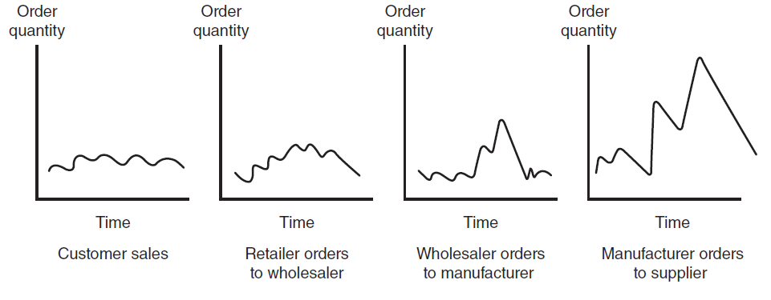
FIGURE 11.5 The bullwhip effect.
Notes:
FIGURE 11.5 The bull
Bullwhip Effect: erratic shifts in orders up and down the supply chain.
whip effect.

Slide 40
Solutions to Supply Chain Problems
Using Inventories to Solve Supply Chain Problems
Just-in-time (JIT) inventory system
Information Sharing
Vendor-managed inventory (VMI)
Notes:
Vertical Integration: a business strategy in which a company purchases its upstream suppliers to ensure that its essential supplies are available as soon as the company needs them.
Just-In-Time (JIT) Inventory: a strategy to minimize inventories deliver the precise number of parts, called work-in-process inventory, to be assembled into a finished product at precisely the right time.
Information Sharing: facilitated by electronic data interchange and extranets, it helps to improve demand forecasts.
Vendor-Managed Inventory (VMI): occurs when the supplier, rather than the retailer, manages the entire inventory process for a particular product or group of products.

Slide 41
11.7
Information Technology Support for Supply Chain Management
Electronic Data Interchange (EDI)
Extranets
Portals and Exchanges
Notes:
Electronic Data Interchange (EDI): a communication standard that enables business partners to exchange routine documents, such as purchasing orders, electronically. EDI formats these documents according to agreed-upon standards (e.g., data formats). It then transmits messages over the Internet using a converter, called translator.
Extranets: link business partners over the Internet by providing them access to certain areas of each other’s corporate intranets
Industry Extranet: a network used for mission-critical business transactions by leading international organizations in aerospace, automotive, chemical, electronics, financial services, healthcare, logistics, manufacturing, transportation, and related industries.
EDI Benefits:
Minimizes data entry errors
Length of the message can be shorter
Messages are secured
Reduces cycle time
Increases productivity
Enhances customer service
Minimizes paper usage and storage
EDI Disadvantages:
Business processes sometimes must be restructured to fit EDI requirements
Many EDI standards in use today

Slide 42
Extranets
Virtual Private Network (VPN)
A Company and Its Dealers, Customers, or Suppliers
An Industry’s Extranet
Joint Ventures and Other Business Partnerships
Notes:
Extranets: link business partners over the Internet by providing them access to certain areas of each other’s corporate intranets
A Company and Its Dealers, Customers, or Suppliers: This type of extranet centers on a single company.
Industry Extranet: a network used for mission-critical business transactions by leading international organizations in aerospace, automotive, chemical, electronics, financial services, healthcare, logistics, manufacturing, transportation, and related industries.
Joint Ventures and Other Business Partnerships: In this type of extranet, business partners use the extranet as a vehicle for communication and collaboration.

Slide 43
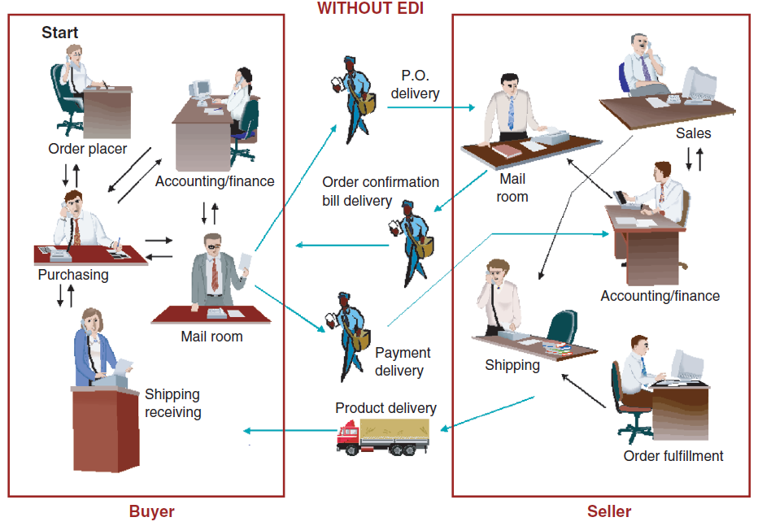
FIGURE 11.6 Comparing purchase order (PO) fulfillment without EDI.
Notes:
FIGURE 11.6 Comparing purchase order (PO) fulfillment with and without EDI. (Drawn by E. Turban.)

Slide 44
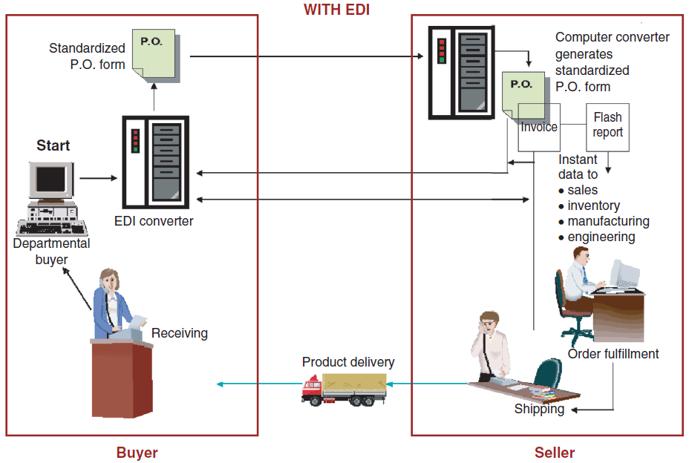
FIGURE 11.6 Comparing purchase order (PO) fulfillment with EDI.
Notes:
FIGURE 11.6 Comparing purchase order (PO) fulfillment with and without EDI. (Drawn by E. Turban.)

Slide 45
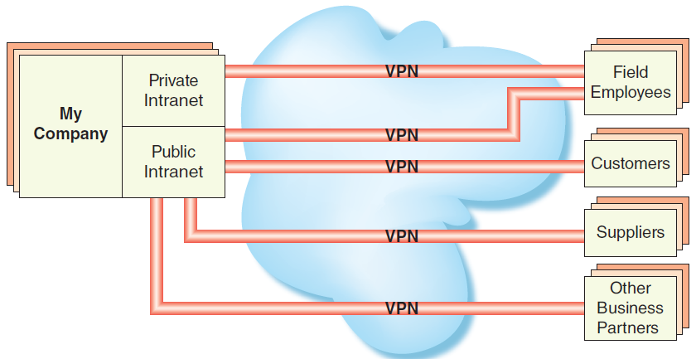
FIGURE 11.7 The structure of an extranet.
Notes:
FIGURE 11.7 The structure of an extranet.

Slide 46
11.7
India’s New Automotive Supply Chain Extranet
Notes:
Discuss the diffi culties involved in implementing Auto DX.
Describe the advantages of Auto DX to the Indian automotive supply chain.

Slide 47
Portal and Exchanges
Two basic types of corporate portals
Procurement portals
Distribution portals
Notes:
Procurement Portal: for a company’s suppliers (upstream in the supply chain) this type of portal automates the business processes involved in purchasing or procuring products between a single buyer and multiple suppliers.
Distribution Portal: for a company’s customers (downstream in the supply chain) automate the business processes involved in selling or distributing products from a single supplier to multiple buyers.

Slide 48
[ Closing Case Super Retail Group Consolidates Demand Forecasting…]
The Business Problem
An IT Solution
The Results
Notes:
Questions
Explain why Super Retail Group decided to use JDA software along its supply chain.
Why did Super Retail Group pilot test in its Leisure Retailing division?
Why did Super Retail Group implement a cloud-based solution? Do you believe this was the correct decision? Why or why not?

