Slide 1
12
Business Intelligence

Slide 2
[ LEARNING OBJECTIVES]
Identify the phases in the decision-making process, and use a decision support framework to demonstrate how technology supports managerial decision making.
Describe and provide examples of different ways that organizations use business intelligence (BI).
Specify the BI application available to users for data analysis, and provide examples of how each application can be used to solve a business problem at your university.
Describe three BI applications that present the results of data analyses to users, and offer examples of how businesses and government agencies can use each of these applications.

Slide 3
[ CHAPTER OUTLINE ]
Managers and Decision Making
What Is Business Intelligence?
Business Intelligence Applications for Data Analysis
Business Intelligence Applications for Presenting Results

Slide 4
[ WEB RESOURCES]
Student PowerPoints for note taking
WileyPLUS Learning Space
E-Book
Author video lecture for each chapter section
Practice quizzes
Flash Cards for vocabulary review
Additional “What’s in IT for Me?” cases
Video interviews with managers
Lab Manuals - Microsoft Office 2010 & 2013

Slide 5
[ Opening Case ConocoPhillips Uses BI to Produce More Oit & Gas]
The Business Problem
An IT Solution
The Results
Notes:
Questions
Describe the impact of the PLOT system on the quantity and quality of the data collected from ConocoPhillips’s wells. Now, describe the impact of these data on the quality of the analyses from the PLOT system. What relationship you can infer between the quality and quantity of data and the quality of the analysis performed on that data?
If plunger lift technology had been in place for 50 years, why is ConocoPhillips just now developing its PLOT system?
Speculate how well operators will react to PLOT. Positively or negatively? Support your answer.

Slide 6
12.1
How Much Rent Can You Charge
Notes:
What additional sources of data could RentRange collect to enhance its predictive accuracy? Provide examples to support your answer.
What other companies or institutions could utilize RentRange’s predictions?

Slide 7
12.1
Managers and Decision Makers
The Manager’s Job and Decision Making
Why Managers Need IT Support
What Information Technologies Are Available to Support Managers?
A Framework for Computerized Decision Analysis

Slide 8
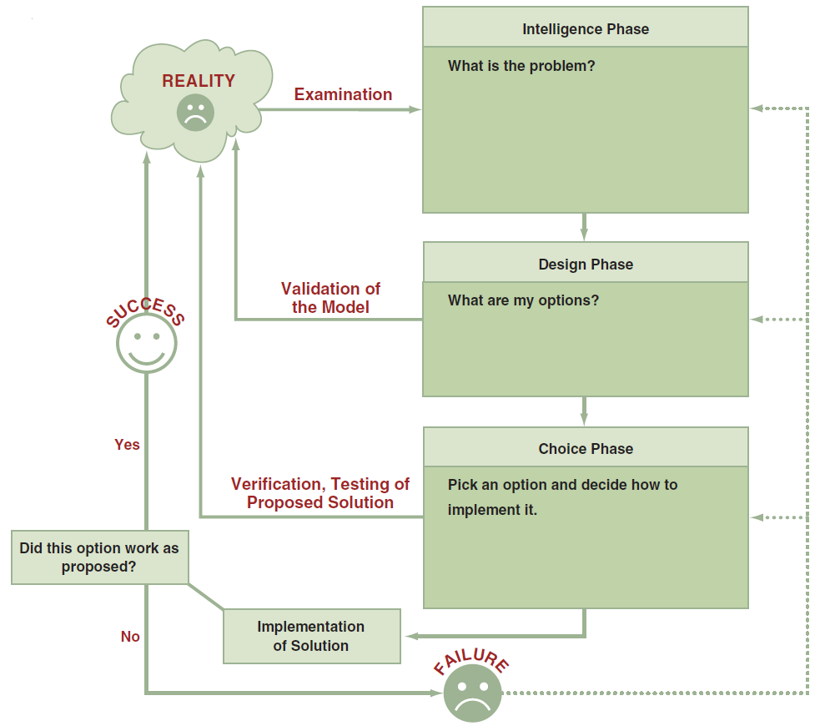
FIGURE 12.1 The process and phases in decision making.
Notes:
FIGURE 12.1 The process and phases in decision making.
Decision: a choice among two or more alternatives that individuals and groups make. Decisions are diverse and are made continuously.
Phases of the Decision Making Process:
Intelligence Phase: managers examine a situation and then identify and defi ne the problem or opportunity.
Design Phase: decision makers construct a model for addressing the situation. They perform this task by making assumptions that simplify reality and by expressing the relationships among all of the relevant variables. Managers then validate the model by using test data. Finally, decision makers set criteria for evaluating all of the potential solutions that are proposed.
Choice Phase: involves selecting a solution or course of action that seems best suited to resolve the problem. Th is solution (the decision) is then implemented.
Implementation Phase: is successful if the proposed solution solves the problem or seizes the opportunity. If the solution fails, then the process returns to the previous phases. Computer-based decision support assists managers in the decision-making process.

Slide 9
The Manager’s Job and Decision Making
Three basic roles of a manager
Interpersonal
Informational
Decisional
Notes:
Management: a process by which an organization achieves its goals through the use of resources (people, money, materials, and information).
Three Basic Roles of Managers (Mintzberg, 1973):
1. Interpersonal roles: fi gurehead, leader, liaison
2. Informational roles: monitor, disseminator, spokesperson, analyzer
3. Decisional roles: entrepreneur, disturbance handler, resource allocator, negotiator

Slide 10
Why Managers Need IT Support
Decision making is difficult due to the following trends:
Number of alternatives is constantly increasing
Most decisions must be made under time pressure
Increased uncertainty in the decision environment
Often necessary to rapidly access remote information, consult with experts, or conduct a group decision-making session

Slide 11
What Information Technologies are Available to Support Managers?
Business Intelligence (BI)
Notes:
Business Intelligence (BI): is a broad category of applications, technologies, and processes for gathering, storing, accessing, and analyzing data to help business users make better decisions. BI applications enable decision makers to quickly ascertain the status of a business enterprise by examining key information.

Slide 12
A Framework for Computerized Decision Analysis
Problem Structure
Structured
Semi-structure
Unstructured Decisions
Nature of Decisions
Three broad categories of managerial decisions
Operational control
Management control
Strategic planning
The Decision Matrix
Computer Support for Structured Decisions
Notes:
Problem Structure: where decision-making processes fall along a continuum ranging from highly structured to highly unstructured.
Nature of Decisions:
All managerial decisions fall into one of three broad categories:
Operational Control: executing specific tasks efficiently and effectively.
Management Control: acquiring and using resources efficiently in accomplishing organizational goals.
Strategic Planning: the long-range goals and policies for growth and resource allocation.

Slide 13
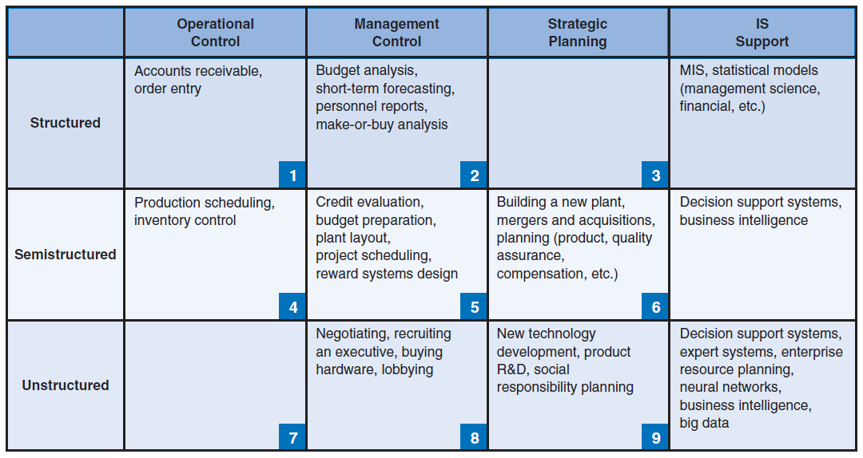
FIGURE 12.2 Decision support framework.
Notes:
FIGURE 12.2 Decision support framework. Technology is used to support the decisions shown in the column at the far right and in the bottom row.

Slide 14
Problem Structure
Structured
Semi-structure
Unstructured Decisions
Notes:
Problem Structure: where decision-making processes fall along a continuum ranging from highly structured to highly unstructured.
Nature of Decisions:
All managerial decisions fall into one of three broad categories:
Operational Control: executing specific tasks efficiently and effectively.
Management Control: acquiring and using resources efficiently in accomplishing organizational goals.
Strategic Planning: the long-range goals and policies for growth and resource allocation.

Slide 15
Nature of Decision
Three broad categories of managerial control in decision making
Operational control
Management control
Strategic planning

Slide 16
12.2
What is Business Intelligence?
The Scope of Business Intelligence
The Development of One or a Few Related BI Applications
The Development of Infrastructure to Support Enterprise-wide BI
Support for Organizational Transformation

Slide 17
12.2
Predicting Airplane Arrivals More Accurately
Notes:
Do you think that satellite-based navigation will meet resistance among air traffi c controllers? Why or why not?
Do you think that pilots will object to having “smart assistants” help them make decisions? Why or why not?
Do you think the overall response of the airlines to satellitebased navigation and smart assistants for pilots will be positive or negative? Support your answer.
What is the relationship between analytics and smart assistants for pilots?

Slide 18
12.3
Cardlytics Analyzes Customer Buying Behaviors
Notes:
Questions
Discuss the advantages and disadvantages of Cardlytics’s data analyses for the customer. Use specific examples in your answers.
Discuss the advantages and disadvantages of Cardlytics’s data analyses for the merchants. Use specific examples in your answers.

Slide 19
12.3
Business Intelligence Applications for Data Analysis
Multidimensional Analysis or Online Analytical Processing (OLAP) (aka, multidimensional analysis)
Data Mining
Decision Support Systems (DSS)
Notes:
Online Analytical Processing (OLAP - also referred to as multidimensional analysis) capabilities. OLAP involves “slicing and dicing” data stored in a dimensional format, drilling down in the data to greater detail, and aggregating the data.
Data Mining: the process of searching for valuable business information in a large database, data warehouse, or data mart.
Data Mining Can Perform Two Basic Operations:
(1) predicting trends and behaviors
(2) identifying previously unknown patterns.

Slide 20
Data Mining is Used in:
Retailing and sales
Banking
Manufacturing and production
Insurance
Police work
Healthcare
Marketing

Slide 21
Decision Support Systems (DSS)
Sensitivity Analysis
What-if Analysis
Goal-Seeking Analysis
Notes:
Decision support systems (DSSs): combine models and data to analyze semistructured problems and some unstructured problems that involve extensive user involvement. Models are simplified representations, or abstractions, of reality.
Sensitivity Analysis: Sensitivity analysis is the study of the impact that changes in one or more parts of a decision-making model have on other parts.
What–If Analysis: A model builder must make predictions and assumptions regarding the input data, many of which are based on the assessment of uncertain futures. The results depend on the accuracy of these assumptions, which can be highly subjective.
Goal-Seeking Analysis: represents a “backward” solution approach. It attempts to calculate the value of the inputs necessary to achieve a desired level of output.

Slide 22
12.4
Business Intelligence Applications for Presenting Results
Dashboards
Data Visualization Technologies
Real-Time BI
Notes:
Dashboard: provides easy access to timely information and direct access to management reports. They evolved from executive information systems, which were information systems designed specifically for the information needs of top executives
Data Visualization: data presented to users in visual formats such as text, graphics, and tables following data processing. Data Visualization makes IT applications more attractive and understandable to users.
Real-Time Business Intelligence: includes the use of real time data for analysis as it is created rather than using historical data for analysis.

Slide 23
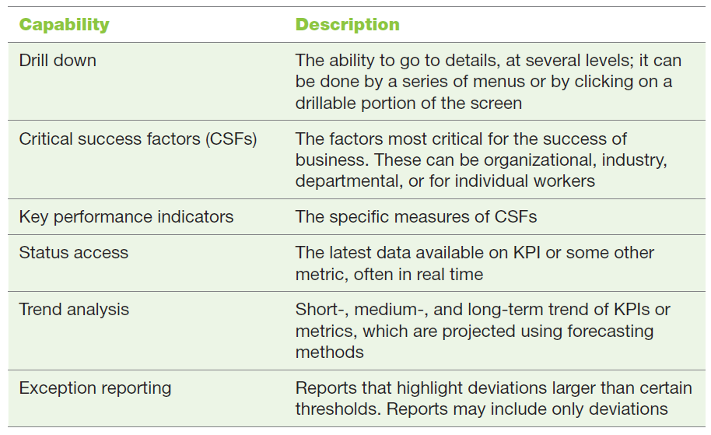
Table 12.1 The Capabilities of Dashboards
Notes:
Table 12.1 The Capabilities of Dashboards

Slide 24
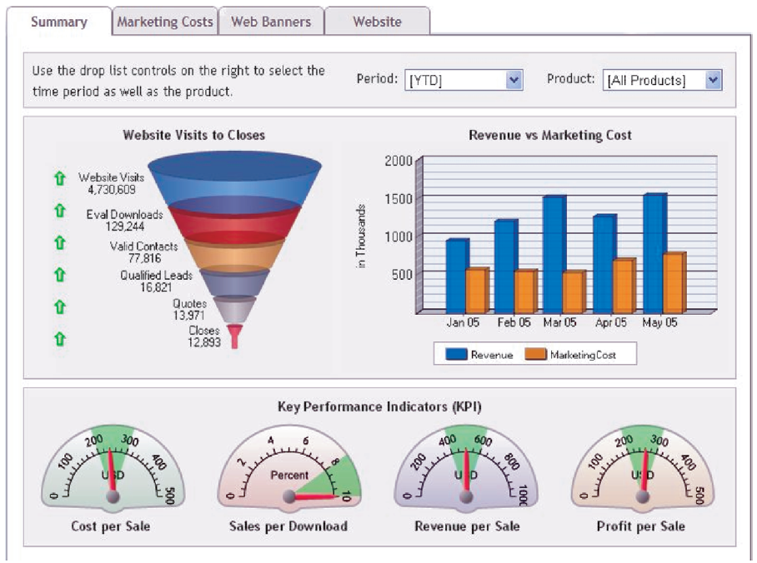
FIGURE 12.3 Sample performance dashboard.
Notes:
FIGURE 12.3 Sample performance dashboard. (Image courtesy of Dundas Data Visualization, Inc., 2014 (www.dundas.com).)

Slide 25
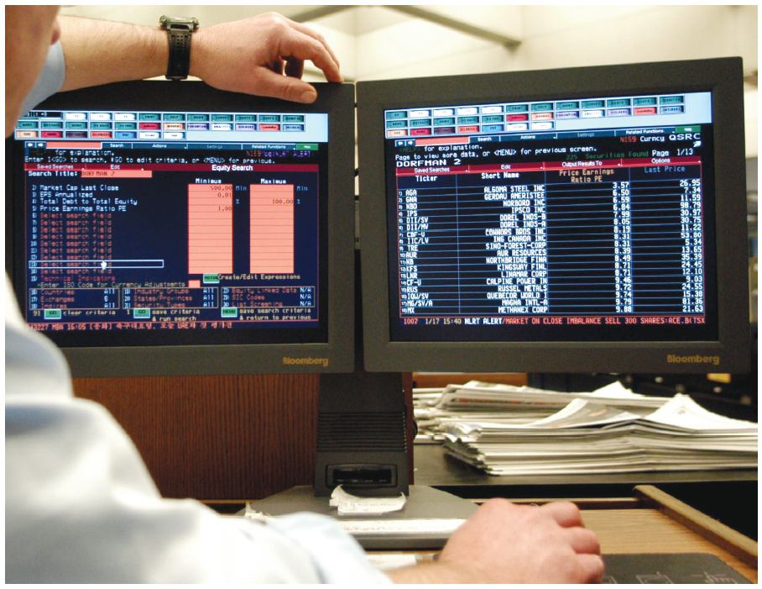
FIGURE 12.4 A Bloomberg terminal.
Notes:
FIGURE 12.4 A Bloomberg terminal. (Carlos Osario/Zuma Press.)

Slide 26
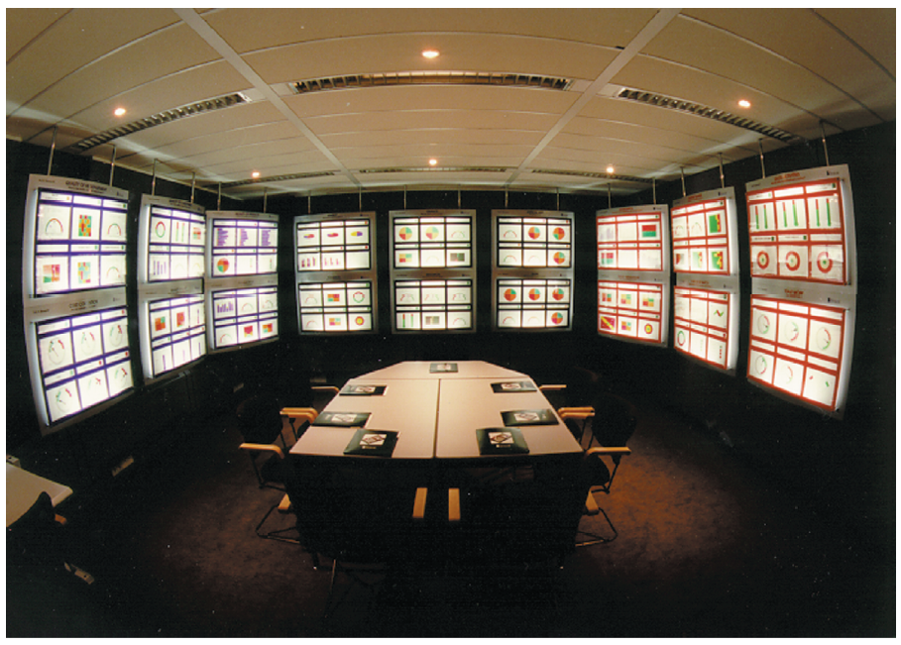
FIGURE 12.5 Management Cockpit.
Notes:
FIGURE 12.5 Management Cockpit. (The Management Cockpit is a registered trademark of SAP, created by Professor Patrick M. Georges.)

Slide 27
Dashboards
Capabilities of Dashboards
Drill-down
Critical Success Factors (CSF)
Key Performance Indicators (KPI)
Status Access
Trend Analysis
Exception Reporting

Slide 28
Data Visualization Technologies
Geographical Information Systems
Geocoding
Reality Mining
Example
New York City
Singapore
Other Major Cities
Notes:
Geographic Information System (GIS): a computer-based system for capturing, integrating, manipulating, and displaying data using digitized maps. Its most distinguishing characteristic is that every record or digital object has an identified geographical location.
Reality Mining: Graphical Information Systems (GIS) and Geographic Positioning Systems (GPS) together to produce an interesting new type of technology which allows analysts to extract information from the usage patterns of mobile phones and other wireless devices.

Slide 29
12.4
Geographic Information Systems Have Many Uses
Notes:
Describe how your university might use GIS. Provide specific examples in your answer.
What are potential disadvantages of GIS? Provide specific examples in your answer.

Slide 30
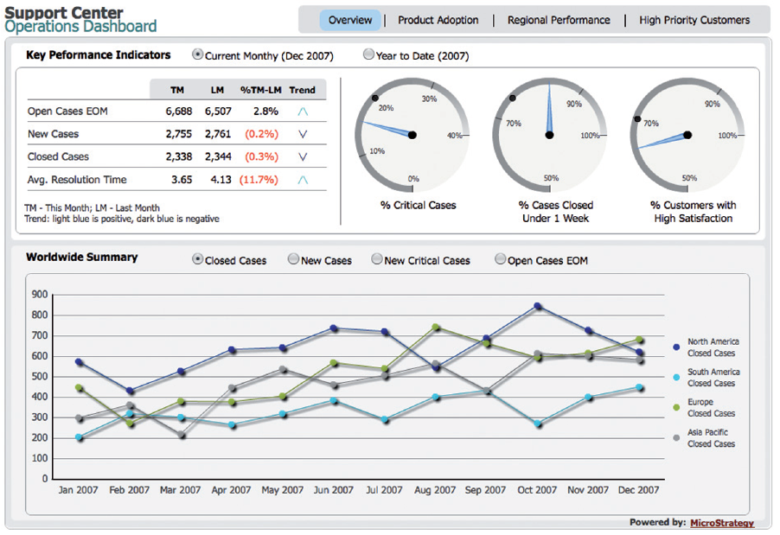
FIGURE 12.6 Support Center Operations Dashboard.
Notes:
FIGURE 12.6 Support Center Operations Dashboard.

Slide 31
[ Closing Case Social Sentiment Analysis]
The Business Problem
The IT Solution
The Results
Notes:
Questions
Describe areas in which social sentiment analysis would be beneficial for your university. Provide specific examples to support your answer.
Describe potential disadvantages that organizations might experience when using social sentiment analysis.
What impacts could social sentiment analysis have on television reality shows? Provide specific examples in your answer.

