Slide 1
13
Acquiring Information Systems and Applications

Slide 2
[ LEARNING OBJECTIVES]
Discuss the different cost/benefit analyses that companies must take into account when formulating an IT strategic plan.
Discuss the four business decisions that companies must make when they acquire new applications.
Enumerate the primary tasks and the importance of each of the six processes involved in the systems development life cycle.
Describe alternative development methods and the tools that augment development methods.

Slide 3
[ CHAPTER OUTLINE ]
Planning for and Justifying IT Applications
Strategies for Acquiring IT Applications
The Traditional Systems Development Life Cycle
Alternative Methods and Tools for Systems Development

Slide 4
[ WEB RESOURCES]
Student PowerPoints for note taking
WileyPLUS Learning Space
E-Book
Author video lecture for each chapter section
Practice quizzes
Flash Cards for vocabulary review
Additional “What’s in IT for Me?” cases
Video interviews with managers
Lab Manuals - Microsoft Office 2010 & 2013

Slide 5
[ Opening Case A Poor Start for Healthcare.gov]
The Business Problem
The Solution
The Results
Notes:
Questions
Were the problems with the Healthcare.gov Web site the result of management, technology, or both? Provide specific examples to support your answer.
What lessons can you draw from Healthcare.gov about successfully implementing very large information systems projects?

Slide 6
13.1
Planning for and Justifying IT Applications
IT Planning
Evaluating and Justifying IT Investment: Benefits, Costs, and Issues

Slide 7
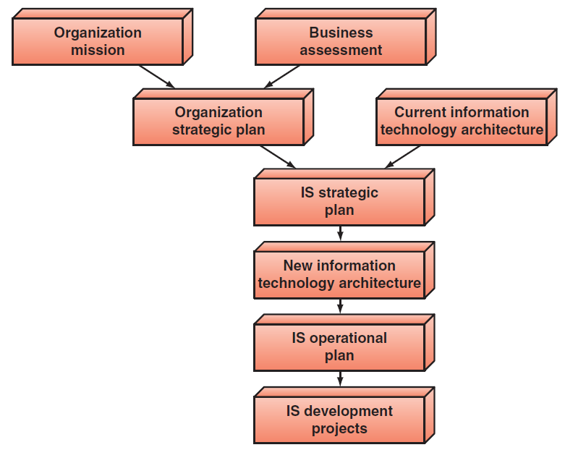
FIGURE 13.1 The information systems planning process.
Notes:
FIGURE 13.1 The information systems planning process.

Slide 8
IT Planning
Organizational Strategic Plan
IT Architecture
IT Strategic Plan
Notes:
Organization Strategic Plan: identifies the firm’s overall mission, the goals that follow from that mission, and the broad steps required to reach these goals.
IT Strategic Plan: a set of long-range goals that describe the IT infrastructure and identify the major IT initiatives needed to achieve the organization’s goals.
IT Steering Committee: comprised of a group of managers and staff who represent the various organizational units, is created to establish IT priorities and to ensure that the MIS function is meeting the organization’s needs.
IS Operational Plan: consists of a clear set of projects that the IS department and the functional area managers will execute in support of the IT strategic plan.

Slide 9
IT Strategic Plan
Must meet three main objectives
IT Steering Committee
Typical IS Operational Plan Contains the Following Elements:
Notes:
IT Strategic Plan: a set of long-range goals that describe the IT infrastructure and identify the major IT initiatives needed to achieve the organization’s goals.
Three Objectives of an IT Strategic Plan:
Must be aligned with the organization’s strategic plan. Alignment is critical because the organization’s information systems must support the organization’s strategies.
Provide for an IT architecture that seamlessly networks users, applications, and databases.
Efficiently allocate IS development resources among competing projects so that the projects can be completed on time and within budget and still have the required functionality.

Slide 10
Three Main Objectives of IT Strategic Plan
It must be aligned with the organization’s strategic plan
It must provide for an IT architecture that seamlessly networks users, applications, and databases
It must efficiently allocate IS development resources among competing projects so the projects can be completed on time an within budget and still have the required functionality

Slide 11
A Typical IS Operational Plan Includes:
Mission Statement
IS environment
Objectives of the IS Function
Constraints of the IS Function
The application portfolio
Resource allocation and project management

Slide 12
Evaluating and Justifying IT Investment: Benefits, Costs, and Issues
Assessing the Costs
Assessing the Benefits
Conducting the Cost-Benefit Analysis
Notes:
Assessing the Costs: Calculating the dollar value of IT investments is not as simple as it may seem. One of the major challenges --> allocating fixed costs among different IT projects.
Fixed Costs: are those costs that remain the same regardless of any change in the company’s activity level (e.g., costs associated with infrastructure ,IT services, and IT management.
-----------------
Assessing the Benefits: benefits may be more difficult to quantify, especially because many of them are intangible.
-----------------

Slide 13
Four Common Approaches to Cost-Benefit Analysis
Analysts use the net present value (NPV)
Return on Investment (ROI)
Breakeven analysis
Business case approach
Notes:
Four Common Approaches for Cost-Benefit Analysis:
Net Present Value: Analysts use the net present value (NPV) method to convert future values of benefits to their present-value equivalent by “discounting” them at the organization’s cost of funds. Th ey can then compare the present value of the future benefi ts with the cost required to achieve those benefits to determine whether the benefits exceed the costs.
Return on Investment (ROI): measures management’s effectiveness in generating profits with its available assets. ROI is calculated by dividing the net income generated by a project by the average assets invested in the project. ROI is a percentage, and the higher the percentage return, the better.
Breakeven Analysis: determines the point at which the cumulative dollar value of the benefits from a project equals the investment made in the project.
Business Case Approach: system developers write a business case to justify funding one or more specific applications or projects. IS professionals will be a major source of input when business cases are developed because these cases describe what you do, how you do it, and how a new system could better support you.

Slide 14
13.2
Strategies for Acquiring IT Applications
Fundamental Decisions in Acquiring IT Applications
Purchase a Prewritten Application
Customize a Prewritten Application
Lease the Application
Application Service Providers and Software-as-a-Service Vendors
Notes:
Purchase a Prewritten Application: Many commercial soft ware packages contain the standard features required by IT applications. Therefore, purchasing an existing package can be a cost-effective and time-saving strategy compared with custom-developing the application in-house.
Customize a Prewritten Application: Customizing existing software is an especially attractive option if the software vendor allows the company to modify the application to meet its needs. However, this option may not be attractive in cases where customization is the only method of providing the necessary flexibility to address the company’s needs. It also is not the best strategy when the software is either very expensive or likely to become obsolete in a short time.
Lease the Application: Compared with the buy option and the option to develop applications in-house, the lease option can save a company both time and money. Leased packages (like purchased packages) may not exactly fit the company’s application requirements. Leasing can be especially attractive to small and medium-sized enterprises (SMEs) that cannot aff ord major investments in IT software.
Application Service Provider (ASP): an agent or a vendor who assembles the software needed by enterprises and then packages it with services such as development, operations, and maintenance. The customer then accesses these applications via the Internet.
Software-as-a-Service (SaaS): a method of delivering software in which a vendor hosts the applications and provides them as a service to customers over a network, typically the Internet. Customers do not own the software; rather, they pay for using it. SaaS eliminates the need for customers to install and run the application on their own computers. Therefore, SaaS customers save the expense (money, time, IT staff) of buying, operating, and maintaining the software.

Slide 15
13.2
Strategies for Acquiring IT Applications (Continued)
Use Open-Source Software
Outsourcing
Continuous Development
Employ Custom Development
Notes:
Use Open-Source Software: Organizations obtain a license to implement an open-source soft ware product and either use it as is, customize it, or develop applications with it.
Outsourcing: Acquiring IT applications from outside contractors or external organizations is called outsourcing.
Employ Custom Development: Another option is to custom-build an application. Companies can either perform this operation in-house or outsource the process.

Slide 16
13.1
LinkedIn’s Fast Development Process Helps Save the Company
Notes:
Describe how freezing new feature development on its Web site “saved” LinkedIn.
Describe how rapid application development is enabling LinkedIn to add its next feature, mining users’ economic and job data.

Slide 17
13.2
Build Your Apps Yourself
Notes:
What are the advantages of learning to code so that you can build your own mobile apps? Provide specific examples to support your answer.
What are the disadvantages of learning to code so that you can build your own mobile apps? Provide specific examples to support your answer.

Slide 18
Fundamental Decisions in Acquiring IT Applications
How much computer code does the company want to write?
How will the company pay for the application?
Where will the application run?
Where will the application originate?
Notes:
Fundamental Decisions in IT Application Acquistion:
How much computer code does the company want to write? A company can choose to use a totally prewritten application (write no computer code), to customize a prewritten application (write some computer code), or to custom-write an entire application (write all new computer code).
How will the company pay for the application? Once the company has decided how much computer code to write, it must decide how to pay for it. With prewritten applications or customized prewritten applications, companies can buy them or lease them. With totally custom applications, companies use internal funding.
Where will the application run? The next decision is whether to run the application on the company’s platform or on someone else’s platform. In other words, the company can employ either a soft ware-as-a-service vendor or an application service provider.
Where will the application originate? Prewritten applications can be open-source software or they can come from a vendor. Th e company may choose to customize prewritten open-source applications or prewritten proprietary applications from vendors.

Slide 19
Application Service Providers and Software-as-a-Service
Application service provider (ASP)
Software-as-a-service (SaaS)

Slide 20
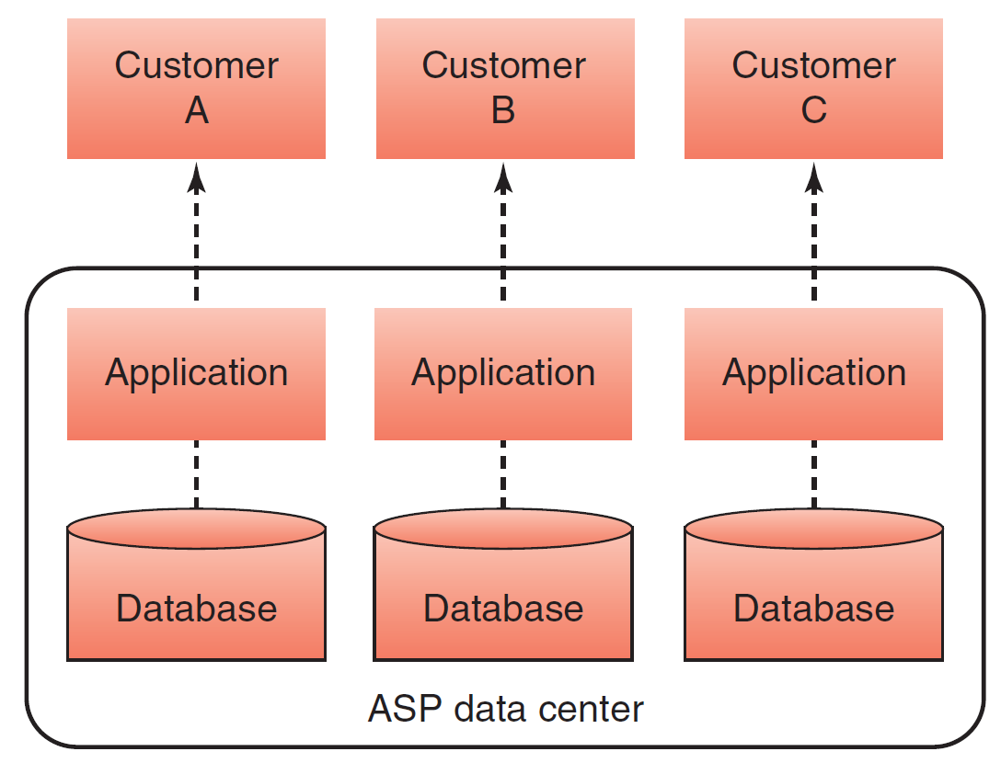
FIGURE 13.2 Operation of an application service provider.
Notes:
FIGURE 13.2 Operation of an application service provider.

Slide 21
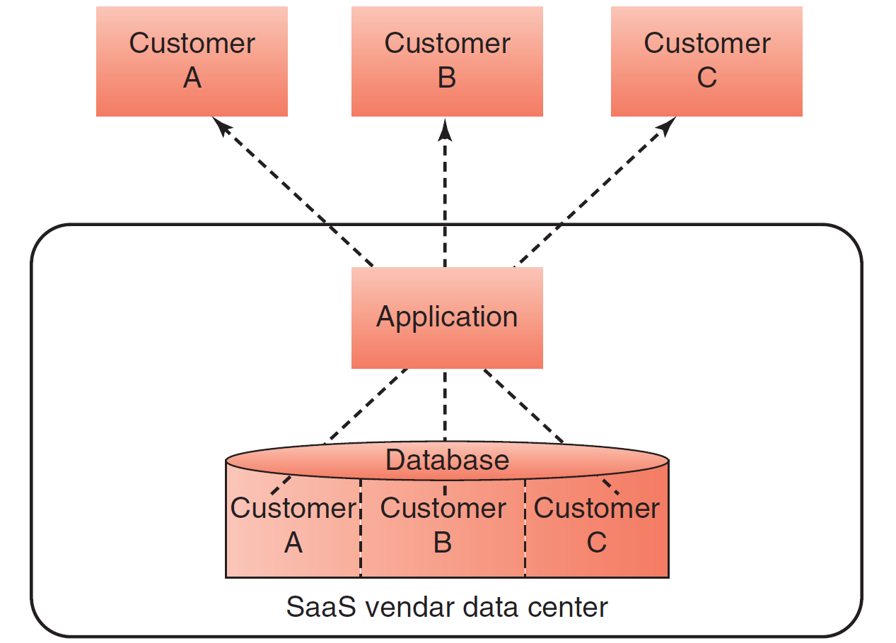
FIGURE 13.3 Operation of a software-as-a-service vendor.
Notes:
FIGURE 13.3 Operation of a software-as-a-service vendor.

Slide 22
13.3
The Traditional Systems Development Life Cycle
Systems Development Life Cycle (SDLC)
Systems Investigation
Systems Analysis
Systems Design
Programming and Testing
Implementation
Operation and Maintenance
Notes:
Systems Development Life Cycle (SDLC): the traditional systems development method that organizations use for large-scale IT projects. The SDLC is a structured framework that consists of sequential processes by which information systems are developed.
Systems Analysts: IS professionals who specialize in analyzing and designing information systems.
Programmers: IS professionals who either modify existing computer programs or write new programs to satisfy user requirements.
Technical Specialists: experts on a certain type of technology, such as databases or telecommunications.
Systems Stakeholders: include everyone who is affected by changes in a company’s information systems—for example, users and managers. All stakeholders are typically involved in systems development at various times and in varying degrees.

Slide 23
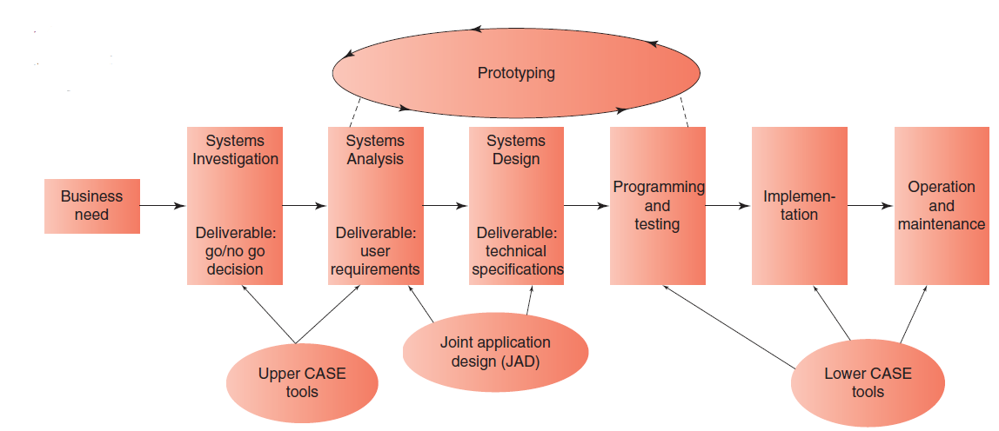
FIGURE 13.4 A six-stage systems development life cycle with supporting tools.
Notes:
FIGURE 13.4 A six-stage systems development life cycle with supporting tools.

Slide 24
The Traditional Systems Development Life Cycle (SDLC)
Six sequential processes of SDLC
Systems investigation
Systems analysis
Systems design
Programming and testing
Implementation
Operation and maintenance

Slide 25
The Traditional Systems Development Life Cycle (SDLC) (Con’t)
Systems analysts
Programmers
Technical Specialists
Stakeholders

Slide 26
SDLC: Systems Investigation
Three Basic Solutions
Feasibility study
Technical feasibility
Economic feasibility
Behavioral feasibility
Go/No Go Decision
Notes:
Systems Investigation: The initial stage in a traditional SDLC is systems investigation, and the primary task in the systems investigation stage is the feasibility study.
Organizations have three basic solutions to any business problem relating to an information system:
(1) do nothing and continue to use the existing system unchanged
(2) modify or enhance the existing system
(3) develop a new system.
Feasibility Study: analyzes which of three basic solutions best fits the particular business problem. It also provides a rough assessment of the project’s technical, economic, and behavioral feasibility, as explained below.
Technical Feasibility: determines whether the company can develop and/or acquire the hardware, soft ware, and communications components needed to solve the business problem. Technical feasibility also determines whether the organization can use its existing technology to achieve the project’s performance objectives.
Economic Feasibility: determines whether the project is an acceptable financial risk and, if so, whether the organization has the necessary time and money to successfully complete the project.
Behavioral Feasibility: addresses the human issues of the systems development project.
Outcome of the Feasibility Study is a “go/no-go” decision

Slide 27
SDLC: Systems Analysis
The process whereby systems analysts examine the business problem that the organization plans to solve with an IS.
Deliverable:
A set of system requirements (or User Requirements)
Notes:
Systems analysis: the process whereby systems analysts examine the business problem that the organization plans to solve with an information system. Systems analysis deliverable is a set of system requirements.
User Requirements: identifying business requirements the system must satisfy which is provided by users. This is often the most difficult task in systems analysis.

Slide 28
SDLC: Systems Design
Describes how the system will resolve the business problem.
Deliverable:
a set of technical system specifications.
Scope Creep
Notes:
Systems Design: describes how the system will resolve the business problem.
Deliverable: a set of technical system specifications.
Technical Specifications include following:
• System outputs, inputs, and user interfaces
• Hardware, soft ware, databases, telecommunications, personnel, and procedures
• A blueprint of how these components are integrated
Scope Creep: Adding functions after the project has been initiated causes the time frame and expenses associated with the project expand beyond the agreed-upon limits.

Slide 29
SDLC: Programming and Testing
Programming
Testing
Notes:
Programming: involves translating the design specifications into computer code.
Testing: the process that assesses whether the computer code will produce the expected and desired results.

Slide 30
SDLC: Implementation
Implementation
Major Conversion Strategies
Direct conversion
Pilot conversion
Phased conversion
Parallel conversion
Notes:
Implementation (or deployment): the process of converting from an old computer system to a new one.
Three Major Conversion Strategies:
Direct Conversion: the old system is cut off , and the new system is turned on at a certain point in time. This type of conversion is the least expensive and the most risky.
Pilot Conversion: introduces the new system in one part of the organization, such as in one plant or one functional area. The new system runs for a period of time and is then assessed. If the assessment confirms that the system is working properly, then the system is implemented in other parts of the organization.
Phased Conversion: introduces components of the new system, such as individual modules, in stages. Each module is assessed. If it works properly, then other modules are introduced, until the entire new system is operational.
---------------------
Parallel Conversion: old and new systems operate simultaneously for a time, but this strategy is seldom used today.

Slide 31
SDLC: Operations & Maintenance
Systems Require Several Types of Maintenance:
Debugging
Updating
Adding
Notes:
Operation and Maintenance: once a new system’s operations are stabilized, the company performs audits to assess the system’s capabilities and to determine if it is being utilized correctly.
Systems Require Several Types of Maintenance:
Debugging: (the system) a process that continues throughout the life of the system.
Updating: (the system) to accommodate changes in business conditions (e.g., adjusting to new governmental regulations).
Adding: new functions added to the existing system without disturbing its operation

Slide 32
13.3
Avon Writes Off $125 Million on Failed Software Implementation
Notes:
Is the Avon failure the fault of Avon? SAP? IBM? All three? Explain your answer.
Recall the discussion of strategic information systems in Chapter 2. Is Avon’s new system a strategic information system? Why or why not? Explain your answer.

Slide 33
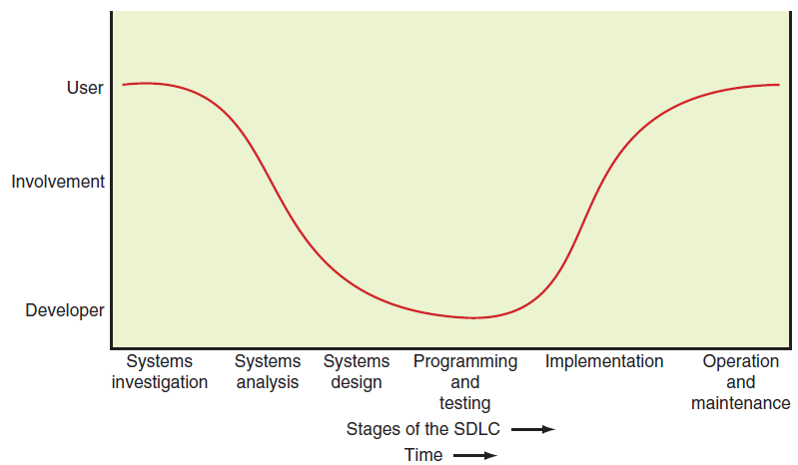
FIGURE 13.5 Comparison of user and developer involvement over the SDLC.
Notes:
FIGURE 13.5 Comparison of user and developer involvement over the SDLC.

Slide 34
13.4
Alternative Methods and Tools for Systems Development
Joint Application Design (JAD)
Rapid Application Development (RAD)
Agile Development
End-User Development
Tools for Systems Development
Notes:
Joint Application Design (JAD): a group-based tool for collecting user requirements and creating system designs. It is most often used within the systems analysis and systems design stages of the SDLC. JAD involves a group meeting attended by the analysts and all of the users that can be conducted either in person or via the computer. During this meeting, all users jointly define and agree on the systems requirements.
Rapid Application Development (RAD): a systems development method that can combine JAD, prototyping, and integrated computer-assisted software engineering (ICASE) tools to rapidly produce a high-quality system. In the first RAD stage, developers use JAD sessions to collect system requirements. This strategy ensures that users are intensively involved early on. The development process in RAD is iterative.
Agile Development: a software development methodology that delivers functionality in rapid iterations, which are usually measured in weeks. To be successful, this methodology requires frequent communication, development, testing, and delivery.
End-User Development: an approach in which the organization’s end users develop their own applications with little or no formal assistance from the IT department.

Slide 35
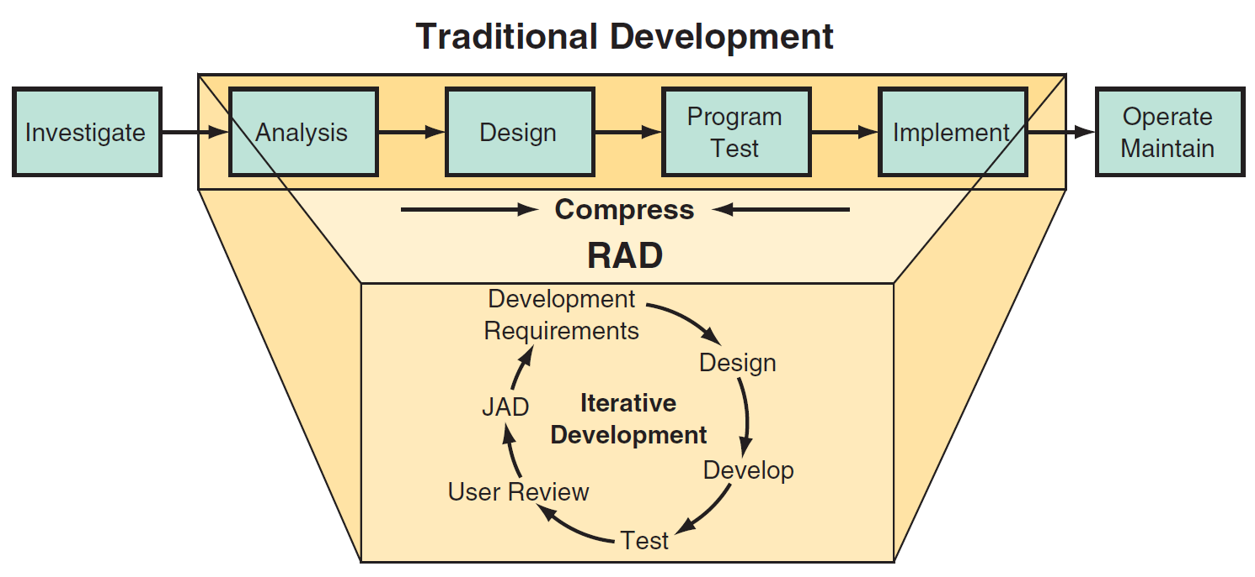
FIGURE 13.6 A rapid prototyping development process versus SDLC.
Notes:
FIGURE 13.6 A rapid prototyping development process versus SDLC. datawarehousetraining.com/Methodologies/rapid application-development.)

Slide 36
Tools for Systems Development
Prototyping
Integrated Computer-Assisted Software Engineering Tools (CASE)
Component-Based Development
Object-Oriented Development
Notes:
Prototyping: a development approach that defines an initial list of user requirements, builds a model of the system, and then refines the system in several iterations based on users’ feedback. Developers quickly develop a smaller version of the system.
Integrated Computer-Assisted Software Engineering Tools (CASE): a group of tools that automate many of the tasks in the SDLC.
Upper Case Tools: used to automate the early stages of the SDLC (systems investigation, analysis, and design).
Lower Case Tools: used to automate later stages in the SDLC (programming, testing, operation, and maintenance).
Integrated CASE (ICASE) Tools: provide links between upper CASE and lower CASE tools.
Component-Based Development: uses standard components to build applications. Components are reusable applications that generally have one specific function, such as a shopping cart, user authentication, or a catalog.
Object-Oriented Development: based on a different view of computer systems than the perception that characterizes traditional development approaches. An object-oriented (OO) system begins not with the task to be performed, but with the aspects of the real world that must be modeled to perform that task.

Slide 37
[ Closing Case The Federal Aviation Administration’s Next Generation…]
The Original Problem
The Intended Solution
The Results So Far (Early 2015)
Notes:
Questions
Describe the many problems that have caused problems with implementing NextGen.
In Technology Guide 1, you learned that hardware capabilities double roughly every 18 months (Moore’s law). What impact will increases in hardware processing power, with accompanying decreases in size, have on the Next-Gen system? Support your answer.
Recall the discussion of cloud computing in Technology Guide 3. What impact might a cloud computing solution have on the future of the NextGen system? Support your answer.

