Slide 1
1
Hardware

Slide 2
[ LEARNING OBJECTIVES]
Identify the major hardware components of a computer system.
Discuss strategic issues that link hardware design to business strategy.
Describe the various types of computers.
Differentiate the various types of input and output technologies and their uses.
Describe the design and functioning of the central processing unit.
Describe the main types of primary and secondary storage.

Slide 3
[ CHAPTER OUTLINE ]
Introduction
Strategic Hardware Issues
Types of Computers
Input and Output Technologies
The Central Processing Unit

Slide 4
[ WEB RESOURCES]
Student PowerPoints for note taking
WileyPLUS Learning Space
E-Book
Author video lecture for each chapter section
Practice quizzes
Flash Cards for vocabulary review
Additional “What’s in IT for Me?” cases
Video interviews with managers
Lab Manuals - Microsoft Office 2010 & 2013

Slide 5
TG 1.1
Introduction
Hardware Consists of the Following:
Central Processing Unit
Primary Storage
Secondary Storage
Input Technologies
Output Technologies
Communication Technologies
Notes:
Hardware: the physical equipment used for the input, processing, output, and storage activities of a computer system. Decisions about hardware focus on three interrelated factors: appropriateness for the task, speed, and cost.
Central Processing Unit (CPU): Manipulates the data and controls the tasks performed by the other components.
Primary Storage: Temporarily stores data and program instructions during processing.
Secondary Storage: Stores data and programs for future use.
Input Technologies: Accept data and instructions and convert them to a form that the computer can understand.
Output Technologies: Present data and information in a form people can understand.
Communication Technologies: Provide for the flow of data from external computer networks (e.g., the Internet and intranets) to the CPU, and from the CPU to computer networks.

Slide 6
TG 1.2
Strategic Hardware Issues
Successful hardware exploitation comes from addressing:
Rapid price reductions and performance advancements in Hardware
Need for new hardware infrastructures
How to manage new work styles enabled by mobile devices?
How to handle the employee bring-your-own-device (BYOD) phenomenon.

Slide 7
TG 1.3
Types of Computers
Servers
Supercomputers
Mainframe computers
Clients
Microcomputers (desktop PCs)
Laptops
Tablets
Wearable Clients (e.g., Apple Watch)
Notes:
Supercomputers: the fastest computers available at any given time. Due to the high cost they are generally used by large organizations to execute computationally demanding tasks involving very large datasets (military, scientific research, national weather service, etc.).
Mainframe Computers: computers at the high end of the performance and reliability scales. Today’s mainframes perform at teraflop (trillions of floating point operations per second) speeds and can handle millions of transactions per day.
Midrange Computers: (or minicomputers) are larger midrange computers that are relatively small, inexpensive, and compact computers that perform the same functions as mainframe computers, but to a more limited extent.
Servers
Microcomputers: also known as personal computers (or PCs) are the smallest and least expensive category of general-purpose computers.
Clients
Desktop PC: the familiar microcomputer system that has become a standard tool for business and the home. A desktop generally includes a central processing unit—which you will learn about later—and a separate but connected monitor and keyboard.
Thin-client systems: are desktop computer systems that do not offer the full functionality of a PC. Compared to PCs, or fat clients, thin clients are less complex, particularly because they do not have locally installed software. When thin clients need to run an application, they access it from a server over a network instead of from a local disk drive.
Laptop and Notebook Computers: small, easily transportable, lightweight microcomputers that fit comfortably into a briefcase.
Netbooks: a very small, lightweight, low-cost, energy-efficient, portable computer. Netbooks are generally optimized for Internet-based services such as Web browsing and e-mail.
Tablet Computers: a complete computer contained entirely in a flat touchscreen that users operate via a stylus, digital pen, or fingertip instead of a keyboard or mouse.
Wearable Computers: miniature computers that people wear under, with, or on top of their clothing.

Slide 8
Microcomputers
Desktop PC’s
Thin-Client / Fat Client Systems
Laptop and Notebook Computers
Netbooks
Tablet Computers

Slide 9
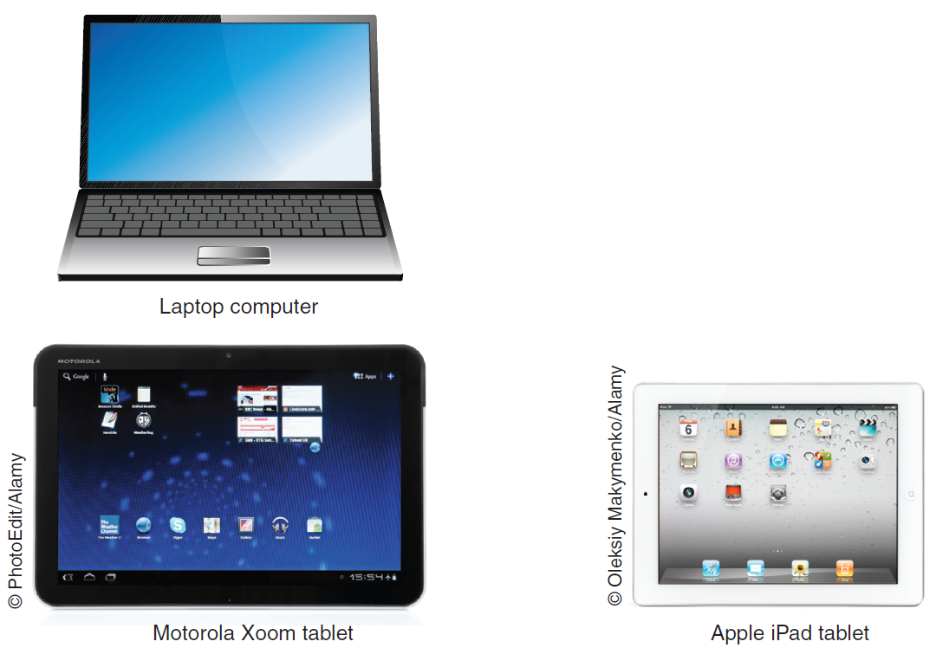
FIGURE TG 1.1 Laptop, notebook, and tablet computers.
Notes:
FIGURE TG 1.1 Laptop, notebook, and tablet computers.

Slide 10
It’s Personal: Purchasing a Computer
Major Considerations for Purchasing a Personal Computer
What do you plan to do with your computer?
Where do you plan to use your computer?
How long do you need service from this computer?

Slide 11
TG 1.4
Input and Output Technologies
Multimedia Technology
Input Devices
Output Devices

Slide 12
Input Devices
Human Data-Entry Devices
Gesture-Based Input
Source-Data Automation Input Devices

Slide 13
Input Devices – Human Data-Entry Devices
Keyboards
Mouse
Optical Mouse
Trackball
Pointing Stick
Touchpad
Graphics Tablet

Slide 14
Input Devices – Human Data-Entry Devices
Joystick
Touch Screen
Stylus
Digital Pen
Web Camera (Webcam)
Voice-Recognition

Slide 15
Input Devices – Gesture-Based Input
Gesture Recognition
Wii
Microsoft Kinect
Leap Motion Controller

Slide 16
Input Devices – Source Data Automation Devices
Automatic Teller Machine (ATM)
Magnetic Strip Reader
Point-of-sale Terminals
Barcode Scanners
Optical Mark Reader

Slide 17
Input Devices – Source Data Automation Devices
Magnetic Ink Character Reader
Optical Character Recognition
Sensors
Cameras
Radio Frequency Identification (RFID)

Slide 18
Output Devices
Monitors
Printers
Voice Output

Slide 19
Output Devices - Monitors
Monitors
Cathode Ray Tubes (CRT)
Liquid Crystal Displays (LCD)
Flexible Displays
Organic Light-Emitting Diodes (OLED)
Retinal Scanning Displays
Heads-up displays

Slide 20
Output Devices - Printers
Printers
Laser
Inkjet
Thermal
Plotters

Slide 21
Output Devices – Voice Output
Voice Output
Electronic Book Reader
Pocket Projector

Slide 22
TG 1.5
The Central Processing Unit (CPU)
Microprocessor
Control Unit
Arithmetic-Logic Unit (ALU)
How the CPU Works
Advances in Microprocessor Design
Computer Memory
PC Components/Cost Compared

Slide 23
How the CPU Works
Inputs come into the CPU from random access memory (RAM)
Data and instructions travel in the chip via electrical pathways called buses.
The Control Unit directs the flow of data and instructions within the chip
Notes:
Central Processing Unit: performs the actual computation or “number crunching” inside any computer. It is a microprocessor (e.g., Intel’s Core i3, i5, and i7 chips with more to come) made up of millions of microscopic transistors embedded in a circuit on a silicon wafer or chip.
-----------------------
How the CPU Works:
-- Inputs from software consisting of data and brief instructions about what to do with the data come into the CPU from random access memory (RAM).
-- Inputs are stored in registers until they are sent to the next step in the processing.
-- The Control Unit directs the flow of data and instructions within the chip.
-- The Arithmetic Processing Unit (ALU) receives the data and instructions from the registers and makes the desired computation.
-- The data in their original form and the instructions are sent to storage registers and then are sent back to a storage place outside the chip, such as the computer’s hard drive. Meanwhile, the transformed data go to another register and then on to other parts of the computer (e.g., to the monitor for display or to storage).
-----------------------
Moore’s Law:
In 1965, Gordon Moore, a cofounder of Intel Corporation, predicted that microprocessor complexity would double approximately every 18 months. The advances predicted from Moore’s law arise mainly from the following changes:
• Producing increasingly miniaturized transistors.
• Placing multiple processors on a single chip. Chips with more than one processor are called multicore chips.
• Intel’s three-dimensional (3D) chips require less power than Intel’s current chips while improving performance.

Slide 24
How the CPU Works (Con’t)
The ALU receives the data and instructions from the registers and makes the desired computation
The data in their original for an the instructions are sent to storage registers and then are sent back to a storage place outside the chip.

Slide 25
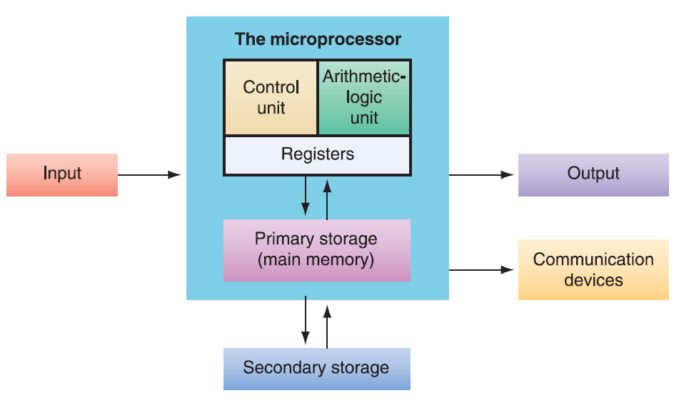
FIGURE TG 1.2 Parts of a microprocessor.
Notes:
FIGURE TG 1.2 Parts of a microprocessor.

Slide 26
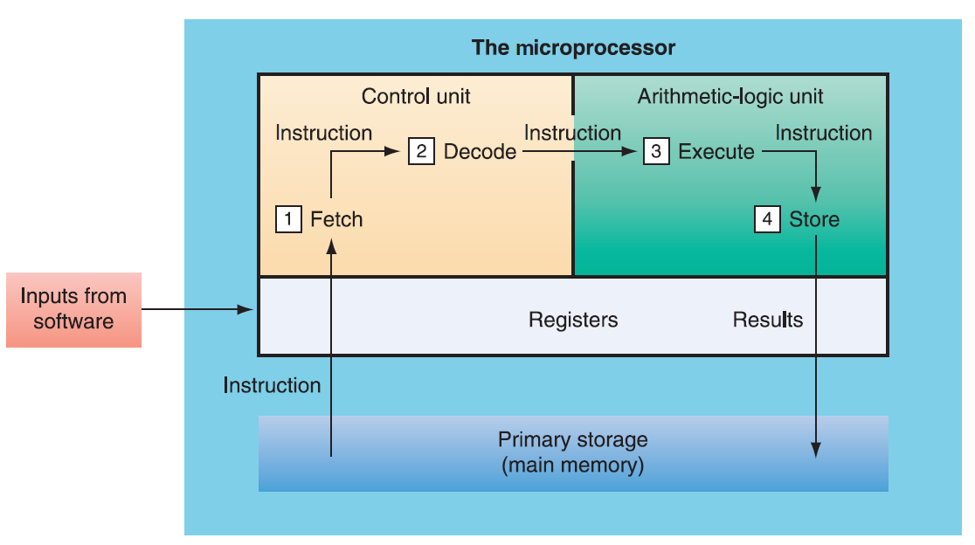
FIGURE TG 1.3 How the CPU works.
Notes:
FIGURE TG 1.3 How the CPU works.

Slide 27
Advances in Microprocessor Design
Moore’s Law
Producing increasingly miniaturized transistors
Placing multiple processors on one chip
April 2012, Intel launched next generation chips using a three-dimensional (3D) design

Slide 28
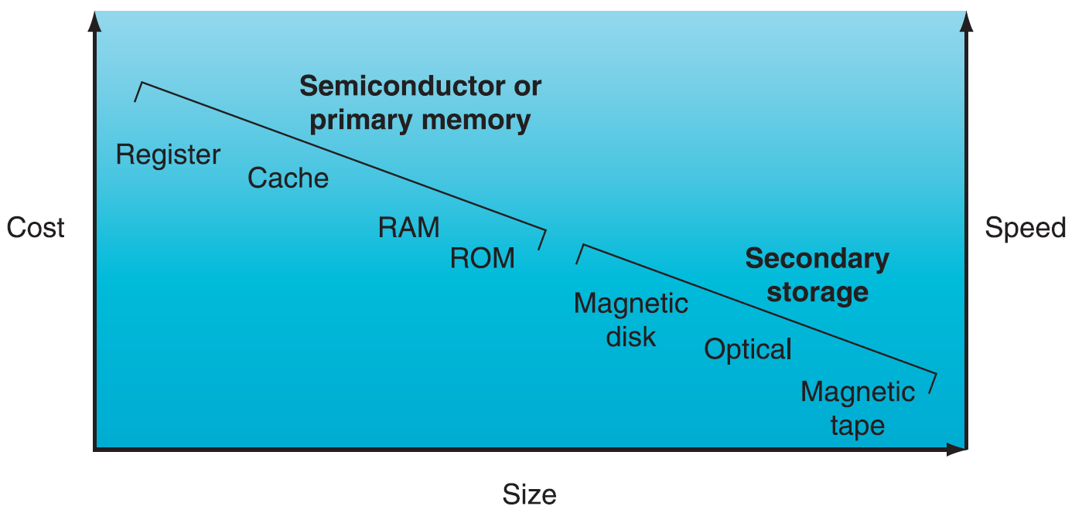
FIGURE TG 1.4 Primary memory compared with secondary storage.
Notes:
FIGURE TG 1.4 Primary memory compared with secondary storage.

Slide 29
Computer Memory
Memory Capacity
Primary Storage
Secondary Storage
Notes:
------------------------------
Memory Capacity
Hierarchy of terms used to describe computer memory capacity:
Bit: A binary unit. A "1" or "0".
Byte: a serious of eight bits representing an alphanumeric character.
Kilobyte: a kilobyte (KB) is approximately 1,000 bytes (1,024 bytes).
Megabyte: a megabyte (MB) is approximately 1 million bytes.
Gigabyte: a gigabyte (GB) is approximately 1 billion bytes.
Terabyte: A terabyte is approximately 1 trillion bytes.
Petabyte: A petabyte is approximately 1,000 terabytes.
Exabyte: An exabyte is approximately 1,000 petabytes.
Zettabyte: A zettabyte is approximately 1,000 exabytes.
------------------------------
Primary Storage (Main Memory): Primary storage takes place in chips mounted on the computer’s main circuit board, called the motherboard. These chips are located as close as physically possible to the CPU chip.
Primary storage stores three types of information for very brief periods of time:
data to be processed by the CPU
instructions for the CPU as to how to process the data
operating system programs that manage various aspects of the computer’s operation
Four main types of primary storage:
Registers: part of the CPU. They have the least capacity, storing extremely limited amounts of instructions and data only immediately before and aft er processing.
Cache memory: is a type of high-speed memory that enables the computer to temporarily store blocks of data that are used more often and that a processor can access more rapidly than main memory (RAM). Cache memory is physically located closer to the CPU than RAM.
Random Access Memory (RAM): is the part of primary storage that holds a software program and small amounts of data for processing.
Read-Only Memory (ROM): is the place—actually, a type of chip—where certain critical instructions are safeguarded. ROM is nonvolatile, so it retains these instructions when the power to the computer is turned off.
------------------------------
Secondary Storage: Stores very large amounts of data for extended periods.
Secondary Storage Characteristics:
It is nonvolatile.
It takes more time to retrieve data from it than from RAM.
It is cheaper than primary storage
It can utilize a variety of media
Types of Secondary Storage:
Magnetic Tape: is kept on a large open reel or in a smaller cartridge or cassette. It is the cheapest storage medium, and it can handle enormous amounts of data. It is also the slowest method for retrieving data because all the data are placed on the tape sequentially.
Solid-State Drives (SSDs): are data storage devices that serve the same purpose as a hard drive and store data in memory chips. Whereas hard drives have moving parts, SSDs do not.
Optical Disks: can store a great deal of information, both on a routine basis and when combined into storage systems. Types of optical disks include compact disk (CD) read-only memory, digital video disk (DVD)(17GB), and dual-layer Blu-ray disks (50 GB).
Flash Memory Devices (or memory cards): nonvolatile electronic storage devices that contain no moving parts and use 30 times less battery power than hard drives. Flash devices are also smaller and more durable than hard drives. One popular flash memory device is the thumb drive (also called memory stick, jump drive, or flash drive).
------------------------------

Slide 30
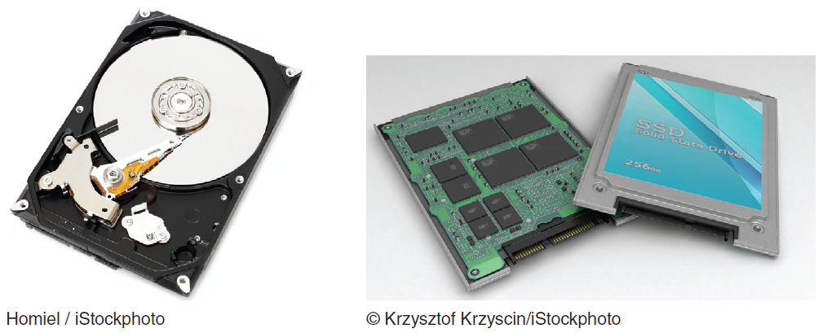
FIGURE TG 1.5 Traditional hard drives are less expensive, but solid-state drives are faster and are more reliable.

Slide 31
Computer Memory – Memory Capacity Hierarchy
Bit
Byte
Kilobyte
Megabyte
Gigabyte
Notes:
------------------------------
Memory Capacity
Hierarchy of terms used to describe computer memory capacity:
Bit: A binary unit. A "1" or "0".
Byte: a serious of eight bits representing an alphanumeric character.
Kilobyte: a kilobyte (KB) is approximately 1,000 bytes (1,024 bytes).
Megabyte: a megabyte (MB) is approximately 1 million bytes.
Gigabyte: a gigabyte (GB) is approximately 1 billion bytes.
Terabyte: A terabyte is approximately 1 trillion bytes.
Petabyte: A petabyte is approximately 1,000 terabytes.
Exabyte: An exabyte is approximately 1,000 petabytes.
Zettabyte: A zettabyte is approximately 1,000 exabytes.

Slide 32
Computer Memory – Memory Capacity Hierarchy
Terabyte
Petabyte
Exabyte
Zettabyte
Notes:
------------------------------
Memory Capacity
Hierarchy of terms used to describe computer memory capacity:
Bit: A binary unit. A "1" or "0".
Byte: a serious of eight bits representing an alphanumeric character.
Kilobyte: a kilobyte (KB) is approximately 1,000 bytes (1,024 bytes).
Megabyte: a megabyte (MB) is approximately 1 million bytes.
Gigabyte: a gigabyte (GB) is approximately 1 billion bytes.
Terabyte: A terabyte is approximately 1 trillion bytes.
Petabyte: A petabyte is approximately 1,000 terabytes.
Exabyte: An exabyte is approximately 1,000 petabytes.
Zettabyte: A zettabyte is approximately 1,000 exabytes.

Slide 33
Computer Memory – Primary Storage
Primary Memory (aka Main Memory)
Four Main Types of Primary Storage
Register Memory
Cache Memory
Random Access Memory (RAM)
Read-Only Memory (ROM)
Notes:
------------------------------
Primary Storage (Main Memory): Primary storage takes place in chips mounted on the computer’s main circuit board, called the motherboard. These chips are located as close as physically possible to the CPU chip.
Primary storage stores three types of information for very brief periods of time:
data to be processed by the CPU
instructions for the CPU as to how to process the data
operating system programs that manage various aspects of the computer’s operation
Four main types of primary storage:
Registers: part of the CPU. They have the least capacity, storing extremely limited amounts of instructions and data only immediately before and aft er processing.
Cache memory: is a type of high-speed memory that enables the computer to temporarily store blocks of data that are used more often and that a processor can access more rapidly than main memory (RAM). Cache memory is physically located closer to the CPU than RAM.
Random Access Memory (RAM): is the part of primary storage that holds a software program and small amounts of data for processing.
Read-Only Memory (ROM): is the place—actually, a type of chip—where certain critical instructions are safeguarded. ROM is nonvolatile, so it retains these instructions when the power to the computer is turned off.
------------------------------

Slide 34
Computer Memory – Secondary Storage
Magnetic Tape
Magnetic Discs
Solid State Drives (SSD)
Optical Storage Devices
Flash Memory
Notes:
Types of Secondary Storage:
Magnetic Tape: is kept on a large open reel or in a smaller cartridge or cassette. It is the cheapest storage medium, and it can handle enormous amounts of data. It is also the slowest method for retrieving data because all the data are placed on the tape sequentially.
Solid-State Drives (SSDs): are data storage devices that serve the same purpose as a hard drive and store data in memory chips. Whereas hard drives have moving parts, SSDs do not.
Optical Disks: can store a great deal of information, both on a routine basis and when combined into storage systems. Types of optical disks include compact disk (CD) read-only memory, digital video disk (DVD)(17GB), and dual-layer Blu-ray disks (50 GB).
Flash Memory Devices (or memory cards): nonvolatile electronic storage devices that contain no moving parts and use 30 times less battery power than hard drives. Flash devices are also smaller and more durable than hard drives. One popular flash memory device is the thumb drive (also called memory stick, jump drive, or flash drive).
------------------------------

