Slide 1
2
Software

Slide 2
[ LEARNING OBJECTIVES]
Discuss the major software issues that confront modern organizations.
Analyze the advantages and disadvantages of open-source software.
Differentiate between the two major types of software.
Describe the general functions of the operating system.
Identify the major types of application software.

Slide 3
[ CHAPTER OUTLINE ]
Introduction to Software
Software Issues
Systems Software
Application Software
Notes:
Software: computer programs or the instructions given to hardware.

Slide 4
[ WEB RESOURCES]
Student PowerPoints for note taking
WileyPLUS Learning Space
E-Book
Author video lecture for each chapter section
Practice quizzes
Flash Cards for vocabulary review
Additional “What’s in IT for Me?” cases
Video interviews with managers
Lab Manuals - Microsoft Office 2010 & 2013

Slide 5
TG 2.1
Introduction to Software
Software
Computer Programs
Programming
Documentation
Systems Software
Application Software
Notes:
Software: computer programs or the instructions given to hardware.
Programming: The process of writing or coding programs.
Programmers: individuals who program.
Systems Software: is a set of instructions that serves primarily as an intermediary between computer hardware and application programs.
Application Software: is a set of computer instructions that provides more specific functionality to a user.

Slide 6
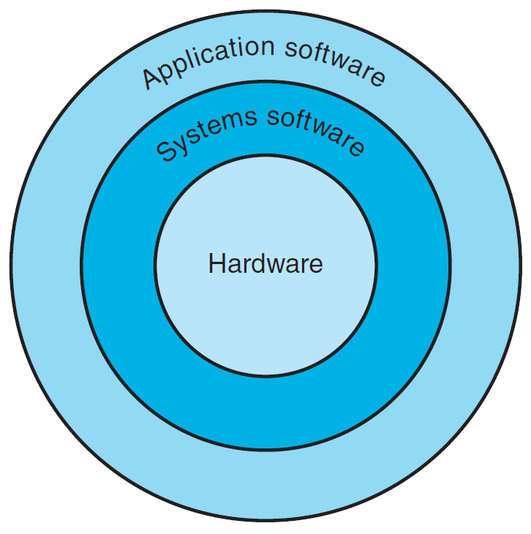
FIGURE TG 2.1 Systems software serves as an intermediary between hardware and functional applications.
Notes:
FIGURE TG 2.1 Systems software serves as an intermediary between hardware and functional applications.

Slide 7
TG 2.2
Software Issues
Software Defects
Software Licensing
Open Systems
Open-Source Software
Notes:
Software Defects: All too often, computer program code is inefficient, poorly designed, and riddled with errors. The Software Engineering Institute (SEI) at Carnegie Mellon University in Pittsburgh defines good software as usable, reliable, defect free, cost effective, and maintainable.
Software Licensing: Many people routinely copy proprietary soft ware. However, making copies without the manufacturer’s explicit permission—a practice known as piracy—is illegal.
Open Systems: a concept referring to a group of computing products that work together. In an open system, the same operating system with compatible soft ware is installed on all computers that interact within an organization.
Proprietary Software: is purchased soft ware that has restrictions on its use, copying, and modification. The company that develops proprietary software keeps the source code private.
Open-Source Software: the source code for open-source software is available at no cost to both developers and users, and is distributed with license terms that ensure that its source code will always be available.

Slide 8
TG 2.3
Systems Software
Operating System
Graphical User Interface (GUI)
Social Interface
Notes:
Systems Software: programs contained in systems software control and support the computer system and its information-processing activities.
Operating System (OS): the “director” of your computer system’s operations. It supervises the overall operation of the computer by monitoring the computer’s status, scheduling operations, and managing input and output processes. It also provides an interface between the user and the hardware.
Graphical User Interface (GUI): allows users to directly control the hardware by manipulating visible objects (such as icons) and actions that replace complex commands.
Social Interface: guides the user through computer applications by using cartoon-like characters, graphics, animation, and voice commands.
Motion Control Gaming Consoles: another type of human-computer interface (Example: the Xbox 360 Kinect, the PS3 PlayStation Move, and the Nintendo Wii).

Slide 9
TG 2.5
Application Software
Application
Package or Software Suite
Personal Application Software
Speech-Recognition Software
Voice-Recognition Software
Discreet versus Continuous Speech
Notes:
Application Software: consists of instructions that direct a computer system to perform specific information-processing activities and also to provide functionality for users.
Personal Application Software: general-purpose, off -the-shelf application programs designed to help individual users increase their productivity.
Examples of Personal Application Software:
Spreadsheets
Word processing
Desktop publishing
Data management
Presentation
Graphics
Personal information management
Personal finance
Web authoring
Communications

Slide 10
Personal Application Software
Spreadsheets
Word Processing
Desktop Publishing
Data Management
Presentation

Slide 11
Personal Application Software (Continued)
Graphics
Personal Information Management
Personal Finance
Web Authoring
Communications

