Slide 1

Chapter 3
Information Systems Development

Slide 2
Objectives
Describe the motivation for a system development process in terms of the Capability Maturity Model (CMM) for quality management.
Differentiate between the system life cycle and a system development methodology.
Describe 10 basic principles of system development.
Define problems, opportunities, and directives—the triggers for systems development projects.
Describe the PIECES framework for categorizing problems, opportunities, and directives.
Describe the essential phases of system development. For each phase, describe its purpose, inputs, and outputs.
Describe cross life cycle activities that overlap multiple system development phases.
Describe typical alternative “routes” through the basic phases of system development. Describe how routes may be combined or customized for different projects.
Describe various automated tools for system development.

Slide 3
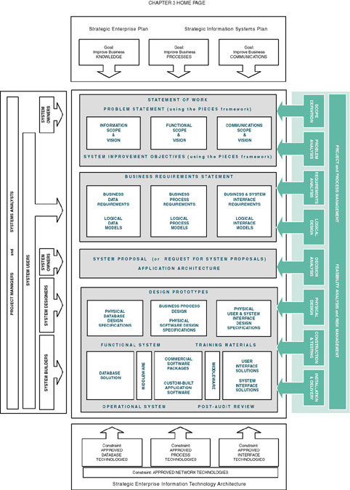

Slide 4
Process of System Development
System development process – a set of activities, methods, best practices, deliverables, and automated tools that stakeholders (Chapter 1) use to develop and continuously improve information systems and software (Chapters 1 and 2).
  Many variations
  Using a consistent process for system development:
    Create efficiencies that allow management to shift resources between projects
    Produces consistent documentation that reduces lifetime costs to maintain the systems
    Promotes quality

Slide 5
CMM Process Management Model
Capability Maturity Model (CMM) – a standardized framework for assessing the maturity level of an organization’s information system development and management processes and products. It consists of five levels of maturity:
  Level 1—Initial: System development projects follow no prescribed process.
  Level 2—Repeatable: Project management processes and practices established to track project costs, schedules, and functionality.
  Level 3—Defined: Standard system development process (methodology) is purchased or developed. All projects use a version of this process.
  Level 4—Managed: Measurable goals for quality and productivity are established.
  Level 5—Optimizing: The standardized system development process is continuously monitored and improved based on measures and data analysis established in Level 4.

Slide 6
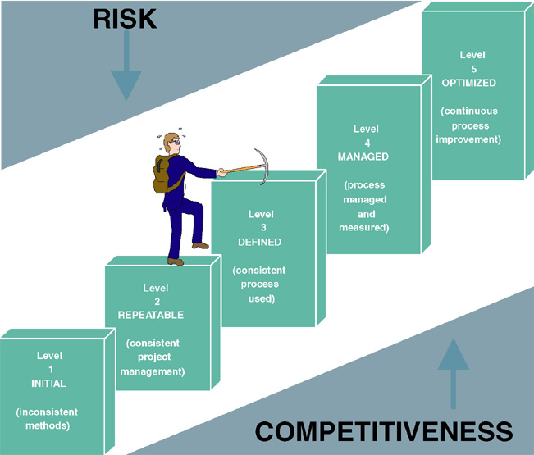
Capability Maturity Model (CMM)

Slide 7
Impact of System Development “Process” on Quality
CMM Project Statistics for a Project Resulting in 200,000 Lines of Code
Organization’s CMM Level | Project Duration (months) | Project Person-Months | Number of Defects Shipped | Median Cost ($ millions) | Lowest Cost ($ millions) | Highest Cost ($ millions)
1 | 30 | 600 | 61 | 5.5 | 1.8 | 100+
2 | 18.5 | 143 | 12 | 1.3 | .96 | 1.7
3 | 15 | 80 | 7 | .728 | .518 | .933

Slide 8
Life Cycle versus Methodology
System life cycle – the factoring of the lifetime of an information system into two stages, (1) systems development and (2) systems operation and maintenance.
System development methodology – a formalized approach to the systems development process; a standardized development process that defines (as in CMM Level 3) a set of activities, methods, best practices, deliverables, and automated tools that system developers and project managers are to use to develop and continuously improve information systems and software.

Slide 9
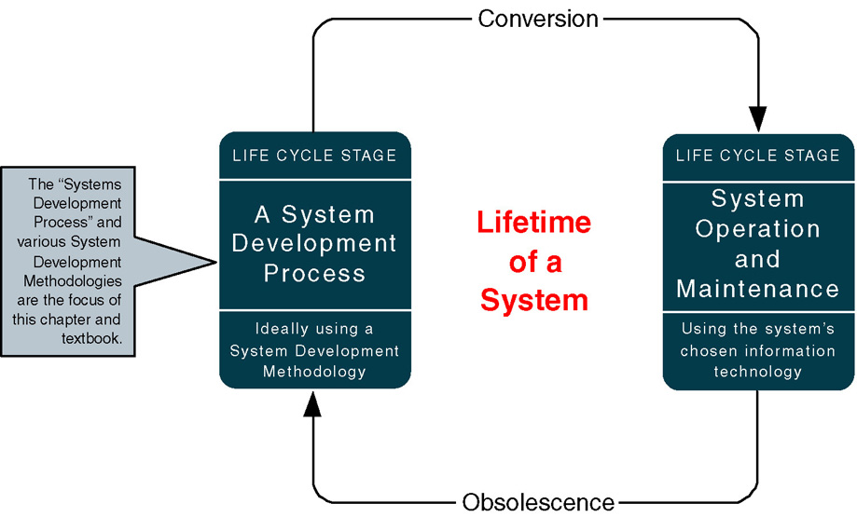
A System Life Cycle

Slide 10
Representative System Development Methodologies
Architected Rapid Application Development (Architected RAD)
Dynamic Systems Development Methodology (DSDM)
Joint Application Development (JAD)
Information Engineering (IE)
Rapid Application Development (RAD)
Rational Unified Process (RUP)
Structured Analysis and Design
eXtreme Programming (XP)

Slide 11
Principles of System Development
Get the system users involved.
Use a problem-solving approach.
Establish phases and activities.
Document through development.
Establish standards.
Manage the process and projects
Justify systems as capital investments.
Don’t be afraid to cancel or revise scope.
Divide and conquer.
Design systems for growth and change.

Slide 12
Use a Problem-Solving Approach
Classical Problem-solving approach
  Study and understand the problem, its context, and its impact.
  Define the requirements that must be meet by any solution.
  Identify candidate solutions that fulfill the requirements, and select the “best” solution.
  Design and/or implement the chosen solution.
  Observe and evaluate the solution’s impact, and refine the solution accordingly.

Slide 13
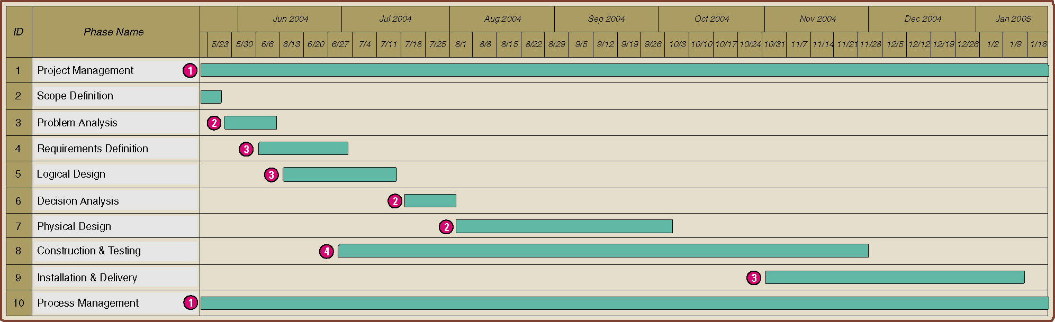
Establish Phases and Activities
Overlap of System Development Phases

Slide 14
Manage the Process and Projects
Process management – an ongoing activity that documents, manages, oversees the use of, and improves an organization’s chosen methodology (the “process”) for system development. Process management is concerned with phases, activities, deliverables, and quality standards should be consistently applied to all projects.
Project management is the process of scoping, planning, staffing, organizing, directing, and controlling a project to develop an information system at a minimum cost, within a specified time frame, and with acceptable quality.

Slide 15
Justify Information Systems as Capital Investments
Cost-effectiveness – The result obtained by striking a balance between the lifetime costs of developing, maintaining, and operating an information system and the benefits derived from that system. Cost-effectiveness is measured by a cost-benefit analysis.
Strategic information systems plan – a formal strategic plan (3-5 years) for building and improving an information technology infrastructure and the information system applications that use that infrastructure.
Strategic enterprise plan – a formal strategic plan (3-5 years) for an entire business that defines its mission, vision, goals, strategies, benchmarks, and measures of progress and achievement. Usually, the strategic enterprise plan is complemented by strategic business unit plans that define how each business unit will contribute to the enterprise plan. The information systems plan is one of those unit-level plans.

Slide 16
Don’t Be Afraid to Cancel or Revise Scope
Creeping commitment – a strategy in which feasibility and risks are continuously reevaluated throughout a project. Project budgets and deadlines are adjusted accordingly.
Risk management – the process of identifying, evaluating, and controlling what might go wrong in a project before it becomes a threat to the successful completion of the project or implementation of the information system. Risk management is drive by risk analysis or assessment.

Slide 17
Where Do Systems Development Projects Come From?
Problem – an undesirable situation that prevents the organization from fully achieving its purpose, goals, and/or objectives.
Opportunity – a chance to improve the organization even in the absence of an identified problem.
Directive - a new requirement that is imposed by management, government, or some external influence.

Slide 18
Where Do Systems Development Projects Come From?
Planned Projects
  An information systems strategy plan has examined the business as a whole to identify those system development projects that will return the greatest strategic (long-term) value to the business
  A business process redesign has thoroughly analyzed a series of business processes to eliminate redundancy and bureaucracy and to improve efficiency and value added. Not it is time to redesign the supporting information system for those redesigned business processes.

Slide 19
Where Do Systems Development Projects Come From?
Unplanned projects
  Triggered by a specific problem, opportunity, or directive that occurs in the course of doing business.
  Steering committee – an administrative body of system owners and information technology executives that prioritizes and approves candidate system development projects.
  Backlog – a repository of project proposals that cannot be funded or staffed because they are a lower priority than those that have been approved for system development.

Slide 20
The PIECES Problem-Solving Framework
P the need to improve performance
I the need to improve information (and data)
E the need to improve economics, control costs, or increase profits
C the need to improve control or security
E the need to improve efficiency of people and processes
S the need to improve service to customers, suppliers, partners, employees, etc.

Slide 21
Project Phases
FAST - (Framework for the Application of Systems Thinking ) a hypothetical methodology used throughout this book to demonstrate a representative systems development process.
Each methodology will use different project phases.
FAST Phases | Classic Phases (from Chapter 1)
 | Project Initiation | System Analysis | System Design | System Implementation
Scope Definition | X
Problem Analysis | X | X
Requirements Analysis |  | X
Logical Design |  | X
Decision Analysis | (a system analysis transition phase)
Physical Design and Integration |  |  | X
Construction and Testing |  |  | X | X
Installation and Delivery |  |  |  | X

Slide 22
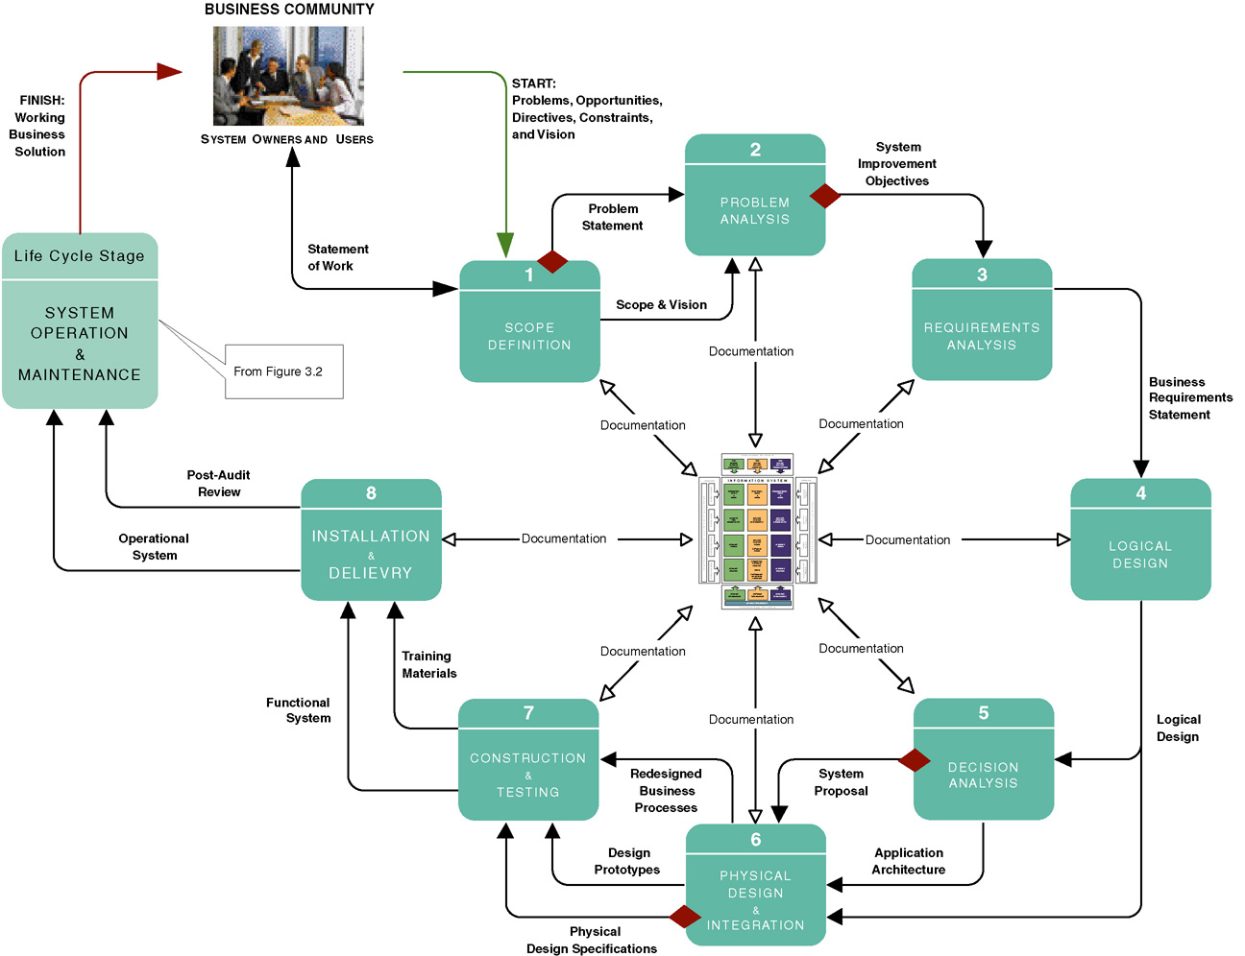
FAST Project Phases

Slide 23
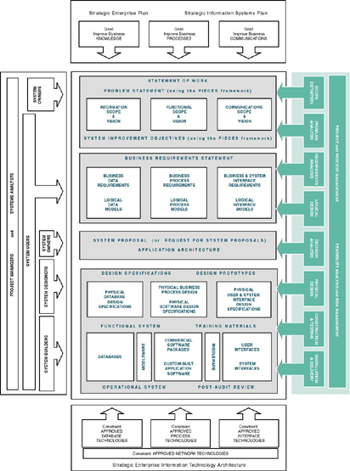
Building Blocks View of
System Development

Slide 24
Scope Definition Phase
Problem statement – a statement and categorization of problems, opportunities, and directives; may also include constraints and an initial vision for the solution. Synonyms include preliminary study and feasibility assessment.
Constraint – any factor, limitation, or restraint that may limit a solution or the problem-solving process.
Scope creep – a common phenomenon wherein the requirements and expectations of a project increase, often without regard to the impact on budget and schedule.
Statement of work – a contract with management and the user community to develop or enhance an information system; defines vision, scope, constraints, high-level user requirements, schedule, and budget. Synonyms include project charter, project plan, and service-level agreement.

Slide 25
Requirements Analysis Phase
What capabilities should the new system provide for its users?
What data must be captured and stored?
What performance level is expected?
What are the priorities of the various requirements?

Slide 26
Logical Design Phase
Logical design – the translation of business user requirements into a system model that depicts only the business requirements and not any possible technical design or implementation of those requirements. Common synonyms include conceptual design and essential design.
System model – a picture of a system that represents reality or a desired reality. System models facilitate improved communication between system users, system analysts, system designers, and system builders.
Analysis paralysis – a satirical term coined to describe a common project condition in which excessive system modeling dramatically slows progress toward implementation of the intended system solution.

Slide 27
Decision Analysis Phase
Candidate solutions evaluated in terms of:
  Technical feasibility – Is the solution technically practical? Does our staff have the technical expertise to design and build this solution?
  Operational feasibility – Will the solution fulfill the users’ requirements? To what degree? How will the solution change the users’ work environment? How do users feel about such a solution?
  Economic feasibility – Is the solution cost-effective?
  Schedule feasibility – Can the solution be designed and implemented within an acceptable time?
  Risk feasibility – What is the probability of a successful implementation using the technology and approach?

Slide 28
Physical Design & Integration Phase
Physical design – the translation of business user requirements into a system model that depicts a technical implementation of the users’ business requirements. Common synonyms include technical design or implementation model.
Two extreme philosophies of physical design
Design by specification – physical system models and detailed specification are produced as a series of written (or computer-generated) blueprints for construction.
Design by prototyping – Incomplete but functioning applications or subsystems (called prototypes) are constructed and refined based on feedback from users and other designers.

Slide 29
Construction and Testing Phase
Construct and test system components
  Software
    Purchased
    Custom-built
  Databases
  User and System Interfaces
  Hardware
  Networks

Slide 30
Installation and Delivery Phase
Deliver the system into operation (production)
Deliver User training
Deliver completed documentation
Convert existing data

Slide 31
System Operation & Maintenance
System support – the ongoing technical support for users of a system, as well as the maintenance required to deal with any errors, omissions, or new requirements that may arise.

Slide 32
Cross Life-Cycle Activities
Cross life-cycle activity – activities that overlap multiple phases
  Fact-finding - formal process of using research, interviews, meetings, questionnaires, sampling, and other techniques to collect information about system problems, requirements,and preferences.
  Documentation and presentation
    Documentation – recording facts and specifications for a systems for current and future reference.
    Presentation – communicating findings, recommendations, and documentation for review by interested users and mangers.
    Repository – database and/or file directory where system developers store all documentation, knowledge, and artifacts for information systems or project(s).
  Feasibility analysis
  Process and project management

Slide 33
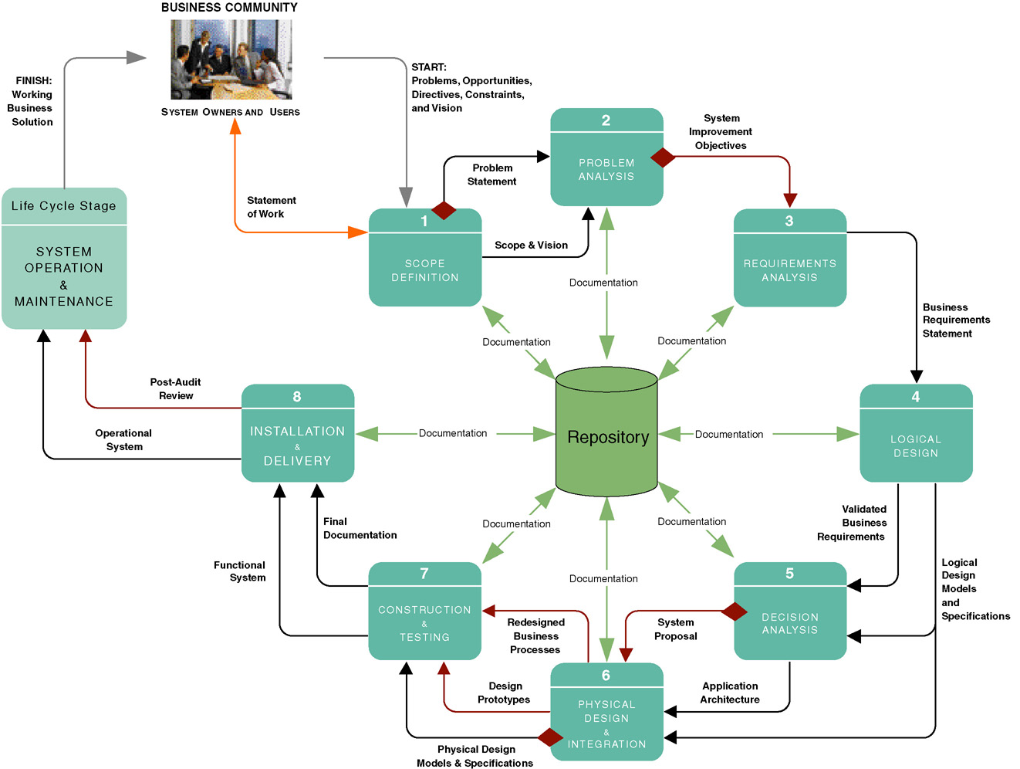
System Development Documentation, Repository, and Presentations

Slide 34
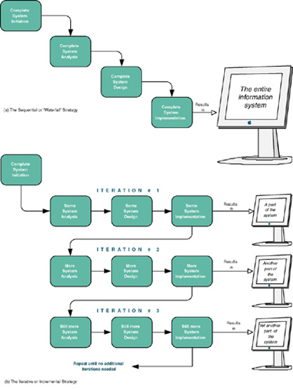
Sequential versus Iterative Development
Waterfall development approach an approach to systems analysis and design that completes each phase one after another and only once .
Iterative development approach an approach to systems analysis and design that completes the entire information system in successive iterations. Each iterations does some analysis, some design, and some construction. Synonyms include incremental and spiral.

Slide 35
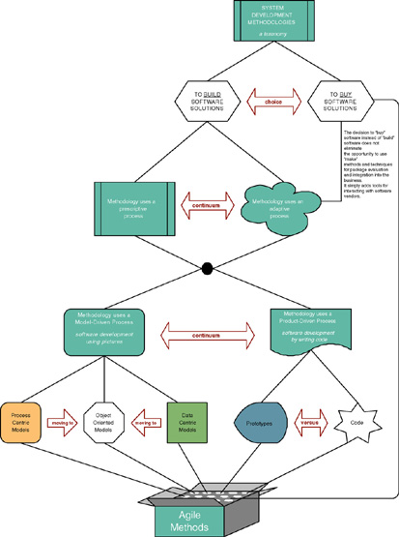
A Taxonomy for System Development Methodologies & Strategies

Slide 36
Model-Driven Development Strategy
Model-driven development – a system development strategy that emphasizes the drawing of system models to help visualize and analyze problems, define business requirements, and design information systems.
  Process modeling – a process-centered technique popularized by the structured analysis and design methodology that used models of business process requirements to derive effective software designs for a system.
  Data modeling – a data-centered technique used to model business data requirements and design database systems that fulfill those requirements.
  Object modeling – a technique that attempts to merge the data and process concerns into singular constructs called objects. Object models are diagrams that document a system in terms of its objects and their interactions.

Slide 37
Logical vs. Physical Models
Logical model - a pictorial representation that depicts what a system is or does.
Physical model - a technical pictorial representation that depicts what a system is or does and how the system is implemented.

Slide 38
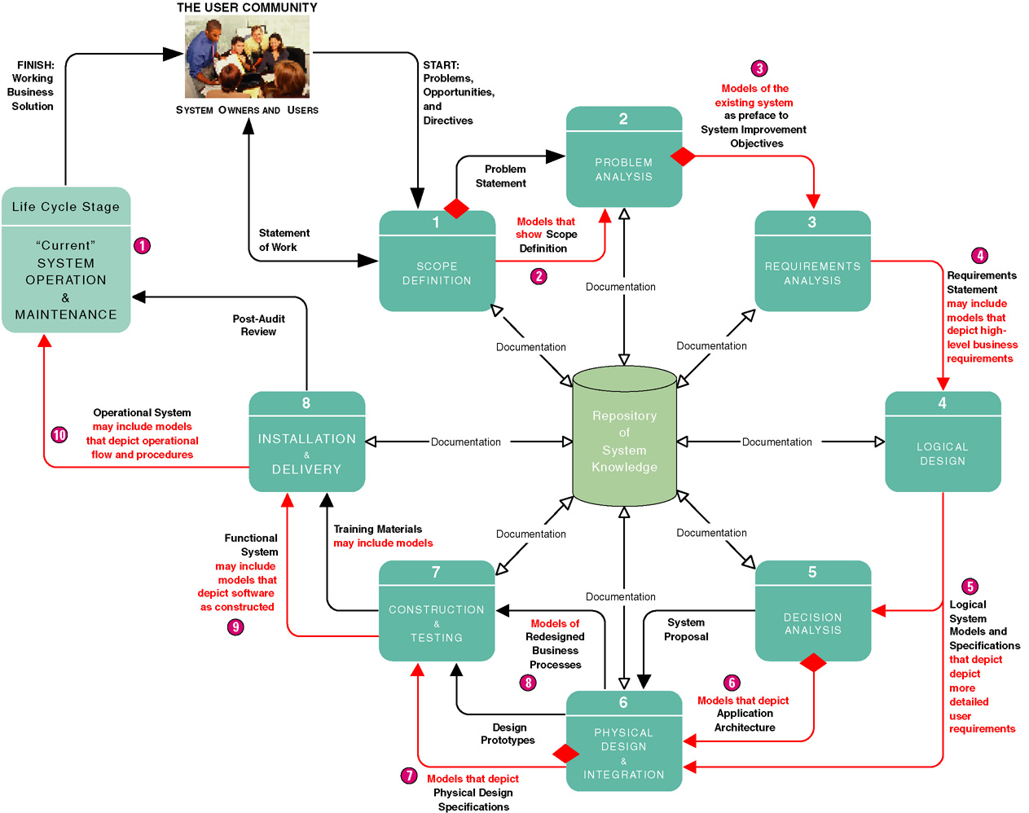
Model-Driven Development Strategy

Slide 39
Model-Driven Development Strategy
Advantages
Disadvantages
Requirements often more thorough
Easier to analyze alternatives
Design specifications often more stable and flexible
Systems can be constructed more correctly the first time
Time consuming
Models only as good as users' understanding of requirements
Reduces users' role because pictures are not software
Can be Inflexible

Slide 40
Rapid Application Development Strategy
Rapid application development (RAD) – a system development strategy that emphasizes speed of development through extensive user involvement in the rapid, iterative, and incremental construction of series of functioning prototypes of a system that eventually evolves into the final system.
  Prototype – a small-scale, representative, or working model of the users’ requirements or a proposed design for an information system.
  Time box – the imposition of a non-extendable period of time, usually 60-90 days, by which the first (or next) version of a system must be delivered into operation.

Slide 41
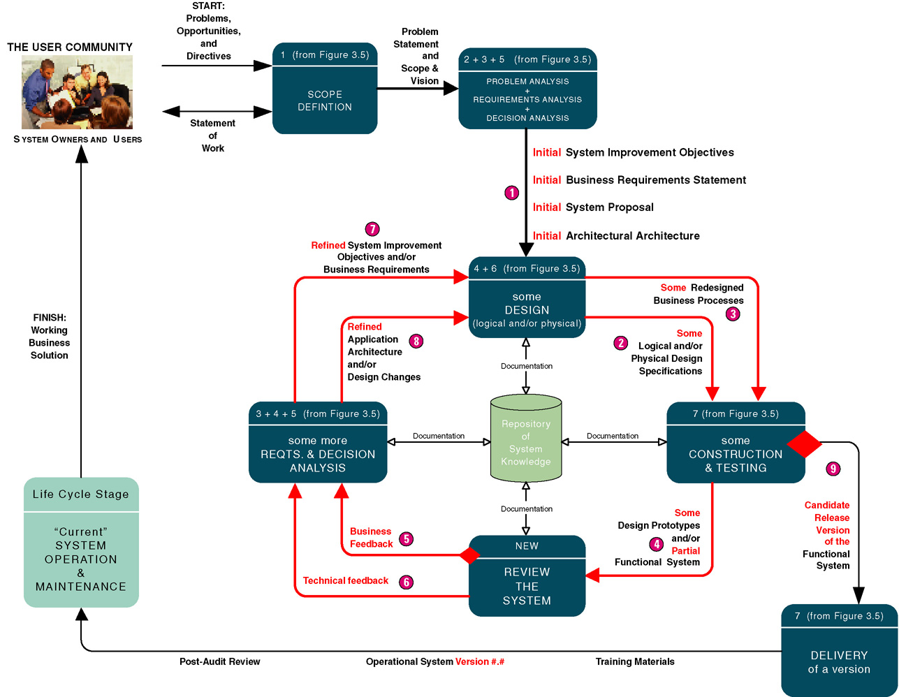
Rapid Application Development Strategy

Slide 42
Rapid Application Development Strategy
Advantages
Disadvantages
User requirements often uncertain or imprecise
Encourages active user and management participation
Projects get higher visibility and support
Stakeholders see working solutions more rapidly
Errors detected earlier
Testing and training are natural by-products
More natural process because change is expected
May encourage "code, implement, repair" mentality
Can solve wrong problem since problem analysis is abbreviated
May discourage analysts from considering alternatives
Stakeholders reluctant to throw away prototype
Emphasis on speed can adversely impact quality

Slide 43
Commercial Application Package Implementation Strategy
Commercial application package – software application that can be purchased and customized to meet business requirements of a large number of organizations or specific industry. A synonym is commercial off-the-shelf (COTS) system.
  Request for proposal (RFP) – formal document that communicates business, technical, and support requirements for application software package to vendors that may wish to compete for the sale of application package and services.
  Request for quotation (RFQ) – formal document that communicates business, technical, and support requirements for an application software package to a single vendor that has been determined as being able to supply that application package and services.
  Gap analysis – comparison of business and technical requirements for a commercial application package against capabilities and features of a specific commercial application package to define requirements that cannot be met.

Slide 44
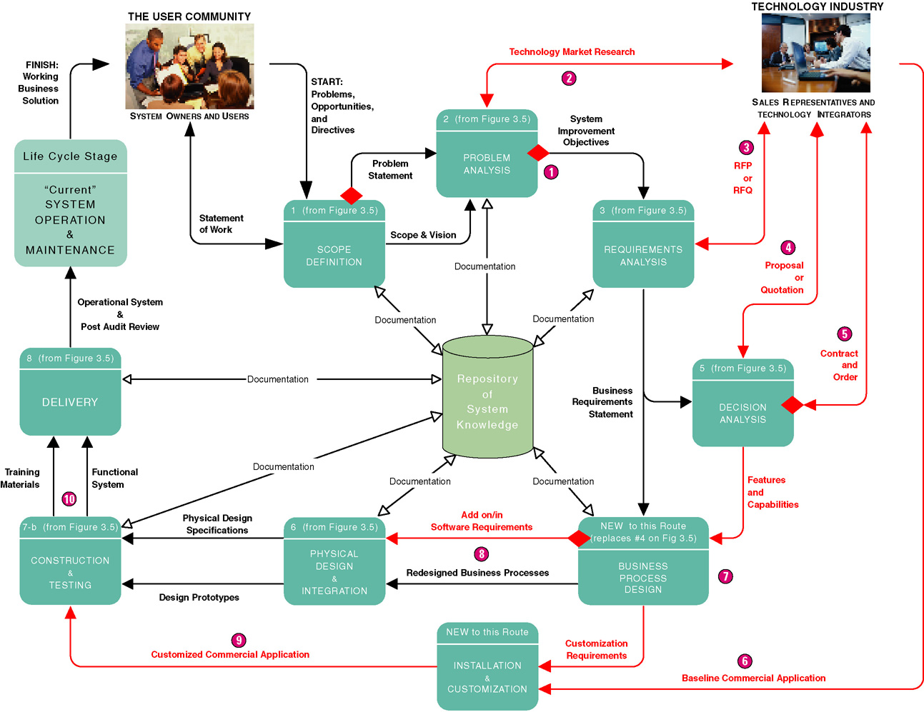
Commercial Application Package Implementation Strategy

Slide 45
Commercial Application Package Implementation Strategy
Advantages
Disadvantages
Systems usually implemented more quickly
Avoids staffing required to develop in-house solutions
Generally less expensive
Vendor assumes responsibility for improvements and corrections
Many business functions more similar than dissimilar for all businesses in a given industry
Dependent on long-term viability of vendor
Rarely reflects ideal solution
Often resistance to changes business processes to adapt to software

Slide 46
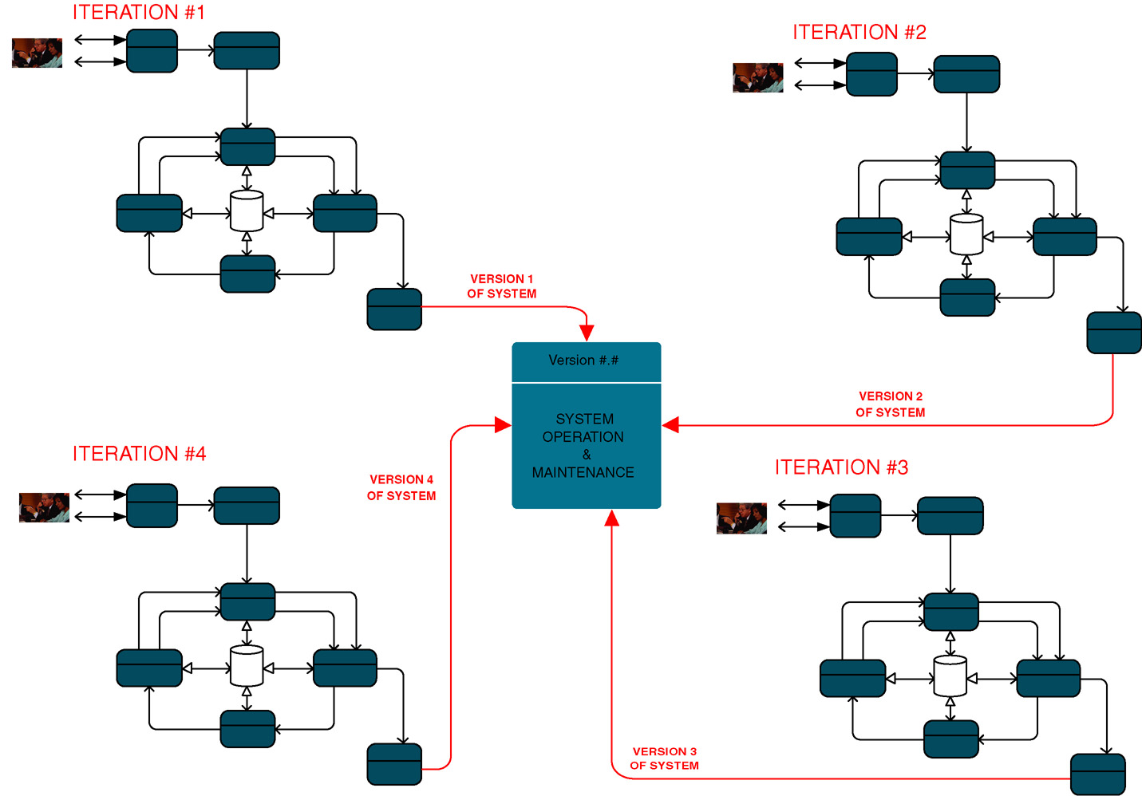
Hybrid Strategies

Slide 47
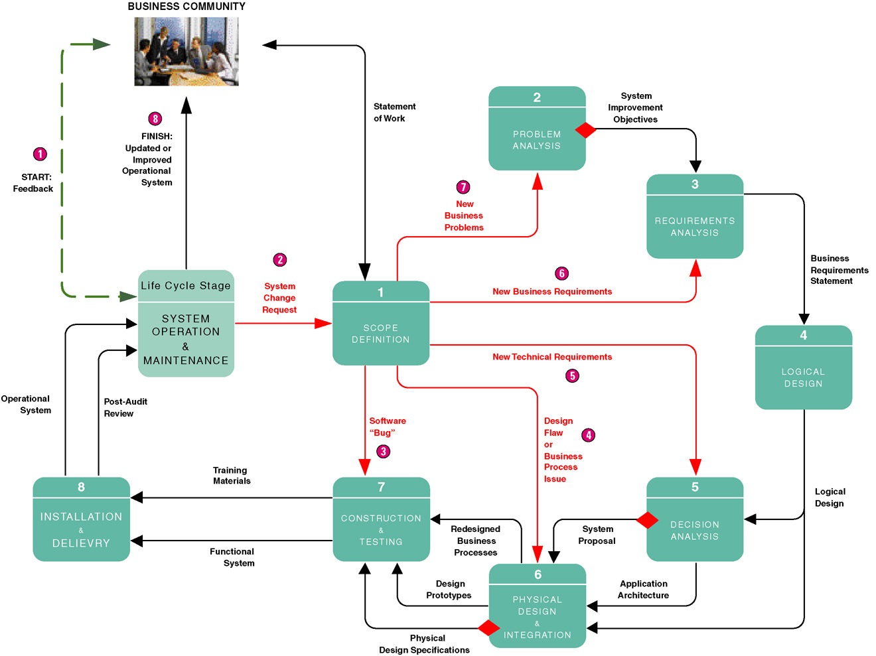
A System Maintenance Perspective

Slide 48
Automated Tools and Technology
Computer-aided systems engineering (CASE)
Application development environments (ADEs)
Process and project managers

Slide 49
Computer-Assisted Software Engineering (CASE)
Computer-aided systems engineering (CASE) –automated software tools that support the drawing and analysis of system models and associated specifications. Some CASE tools also provide prototyping and code generation capabilities.
  CASE repository – system developers’ database where developers can store system models, detailed descriptions and specifications, and other products of system development. Synonyms: dictionary and encyclopedia.
  Forward engineering – CASE tool capability that can generate initial software or database code directly from system.
  Reverse engineering – CASE tool capability that can generate initial system models from software or database code.

Slide 50
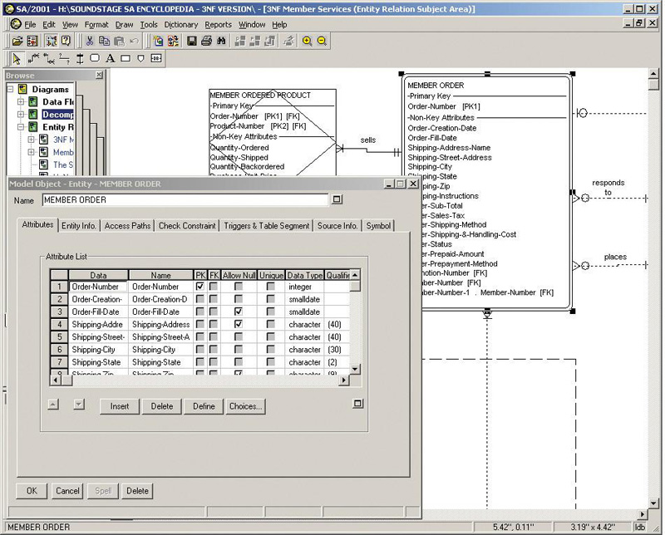
Using a CASE Tool for System Development

Slide 51
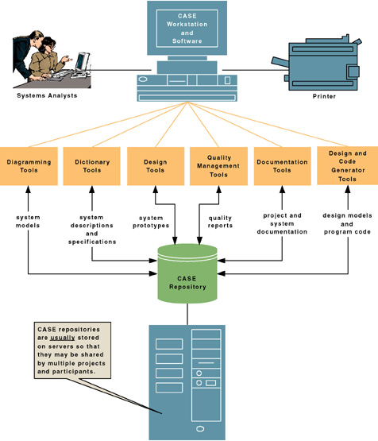
CASE Tool Architecture

Slide 52
Application Development Environments
Application development environments (ADEs) – an integrated software development tool that provides all the facilities necessary to develop new application software with maximum speed and quality. A common synonym is integrated development environment (IDE)
  ADE facilities may include:
    Programming languages or interpreters
    Interface construction tools
    Middleware
    Testing tools
    Version control tools
    Help authoring tools
    Repository links

Slide 53
Process and Project Managers
Process manager application – an automated tool that helps document and manage a methodology and routes, its deliverables, and quality management standards. An emerging synonym is methodware.
Project manager application – an automated tool to help plan system development activities (preferably using the approved methodology), estimate and assign resources (including people and costs), schedule activities and resources, monitor progress against schedule and budget, control and modify schedule and resources, and report project progress.

