Slide 1

Chapter 4
Project Management

Slide 2
Objectives
Define the terms project and project management, and differentiate between project and process management.
Describe causes of failed information systems and technology projects.
Describe basic competencies required of project managers.
Describe basic functions of project management.
Differentiate between PERT and Gantt as project management tools.
Describe role of project management software.
Describe eight activities in project management.
Define joint project planning and its role in project management.
Define scope and a write a statement of work to document scope.
Use a work breakdown structure to decompose a project into tasks.
Estimate tasks’ durations and specify intertask dependencies.
Assign resources and produce a project schedule with a Gantt chart.
Assign people to tasks and direct the team effort.
Use critical path analysis to adjust schedule and resource allocations in response to schedule and budget deviations.
Manage user expectations of a project and adjust project scope.

Slide 3
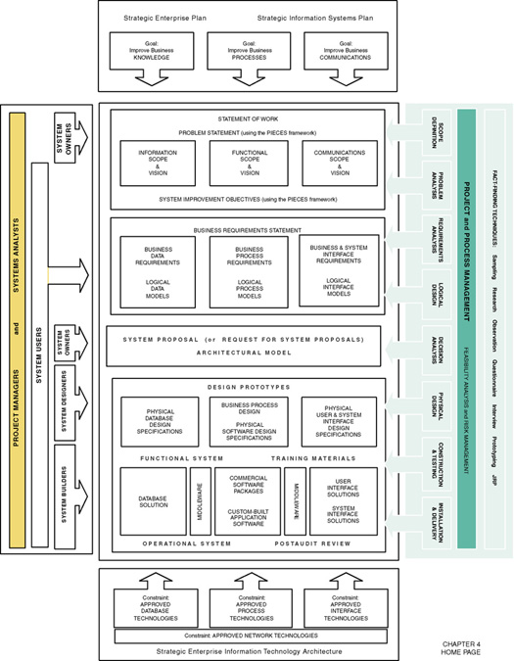

Slide 4
Projects and Project Managers
Project – a [temporary] sequence of unique, complex, and connected activities having one goal or purpose and that must be completed by specific time, within budget, and according to specification.
Project manager - the person responsible for supervising a systems project from initiation to conclusion

Slide 5
Project Management and Process Management
Project management – the process of scoping, planning, staffing, organizing, directing, and controlling the development of an acceptable system at a minimum cost within a specified time frame.
Process management – the activity of documenting, managing, and continually improving the process of systems development.

Slide 6
Measures of Project Success
  The resulting information system is acceptable to the customer.
  The system was delivered “on time.”
  The system was delivered “within budget.”
  The system development process had a minimal impact on ongoing business operations.

Slide 7
Causes of Project Failure
Failure to establish upper-management commitment to the project
Lack of organization’s commitment to the methodology
Taking shortcuts through or around the methodology
Poor expectations management
  Feature creep– uncontrolled addition of technical features to a system.
  Scope creep – unexpected and gradual growth of requirements during an information systems project.

Slide 8
Causes of Project Failure (cont.)
Premature commitment to a fixed budget and schedule
Poor estimating techniques
Overoptimism
The mythical man-month (Brooks, 1975)
Inadequate people management skills
Failure to adapt to business change
Insufficient resources
Failure to “manage to the plan”

Slide 9
Project Manager Competencies
Business awareness
Business partner orientation
Commitment to quality
Initiative
Information gathering
Analytical thinking
Conceptual thinking
Interpersonal awareness
Organizational awareness
Anticipation of impact
Resourceful use of influence
Motivating others
Communication skills
Developing others
Monitoring and controlling
Self-confidence
Stress management
Concern for credibility
Flexibility
(Adapted from Wysocki, Beck, and Crane, Effective Project Management: How to Plan, Manage, and Deliver Projects on Time and within Budget.)

Slide 10
Project Management Functions
Scoping – setting the boundaries of the project
Planning – identifying the tasks required to complete the project
Estimating – identifying the resources required to complete the project
Scheduling – developing the plan to complete the project
Organizing – making sure members understand their roles and responsibilities
Directing – coordinating the project
Controlling – monitoring progress
Closing – assessing success and failure

Slide 11
Project Management Tools
& Techniques
PERT chart – a graphical network model used to depict the interdependencies between a project’s tasks.
Gantt chart – a bar chart used to depict project tasks against a calendar.

Slide 12
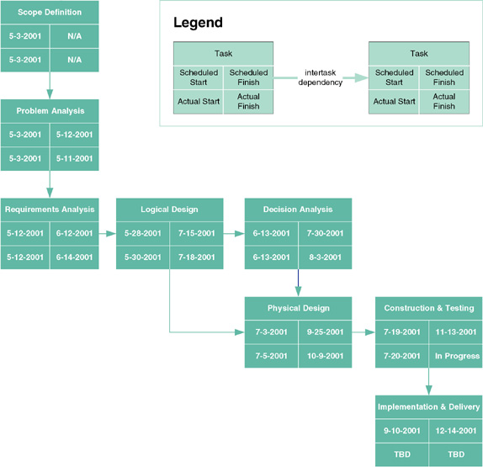
PERT Chart

Slide 13
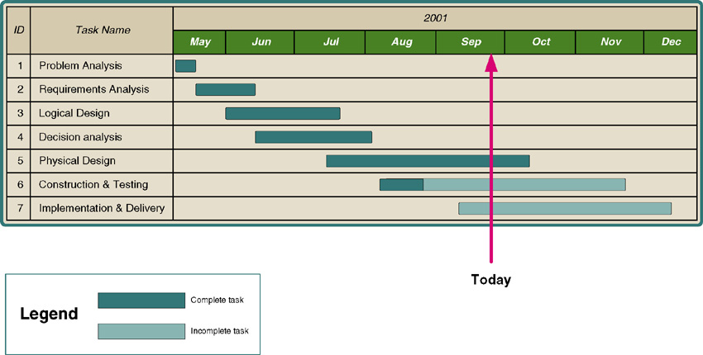
Gantt Chart

Slide 14
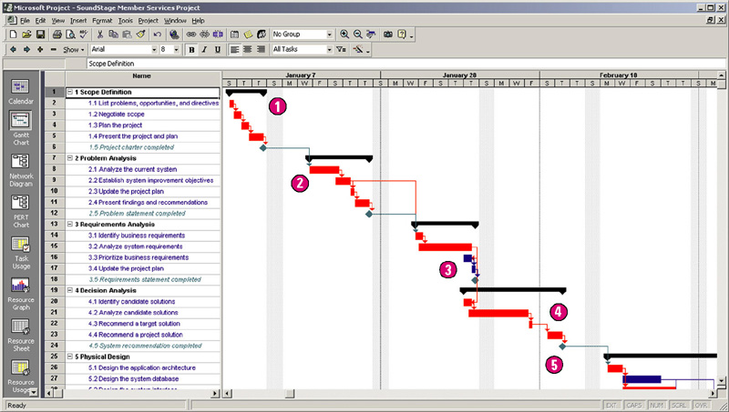
Microsoft Project Gantt Chart

Slide 15
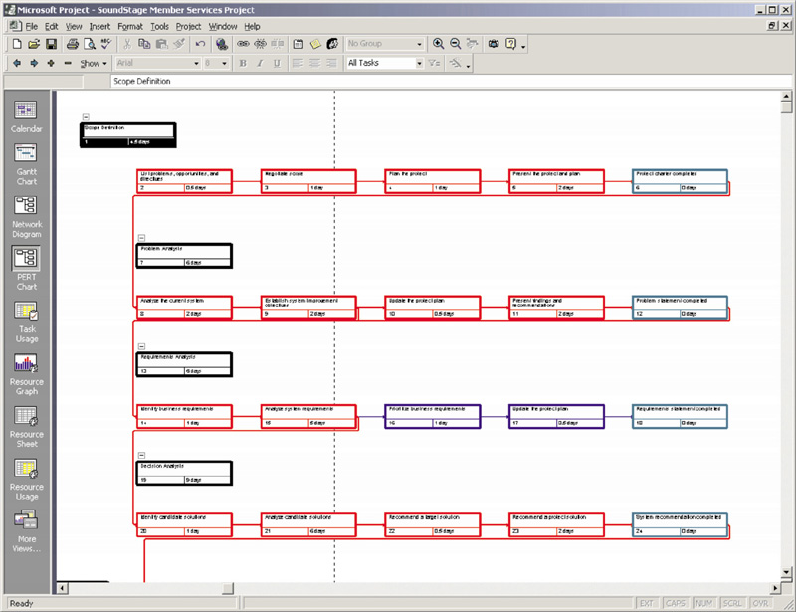
Microsoft Project PERT Chart

Slide 16
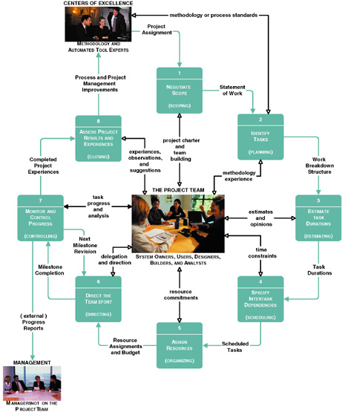
Project Management Life Cycle

Slide 17
Joint Project Planning Strategy
Joint project planning (JPP) – a strategy in which all stakeholders attend an intensive workshop aimed at reaching consensus on project decisions.

Slide 18
Activity 1 – Negotiate Scope
Scope – the boundaries of a project – the areas of a business that a project may (or may not) address. Includes answers to five basic questions:
  Product
  Quality
  Time
  Cost
  Resources
Statement of work – a narrative description of the work to be performed as part of a project. Common synonyms include scope statement, project definition, project overview, and document of understanding.

Slide 19
Statement of Work
I. Purpose
II. Background
A. Problem, opportunity, or directive statement
B. History leading to project request
C. Project goal and objectives
D. Product description
III. Scope
A. Stakeholders
B. Data
C. Processes
D. Locations
IV. Project Approach
A. Route
B. Deliverables
V. Managerial Approach
A. Team building considerations
B. Manager and experience
C. Training requirements
(continued)
Notice the use of information system building blocks

Slide 20
Statement of Work (concluded)
V. Managerial Approach (continued)
D. Meeting schedules
E. Reporting methods and frequency
F. Conflict management
G. Scope management
VI. Constraints
A. Start date
B. Deadlines
C. Budget
D. Technology
VII. Ballpark Estimates
A. Schedule
B. Budget
VIII. Conditions of Satisfaction
A. Success criteria
B. Assumptions
C. Risks
IX. Appendices

Slide 21
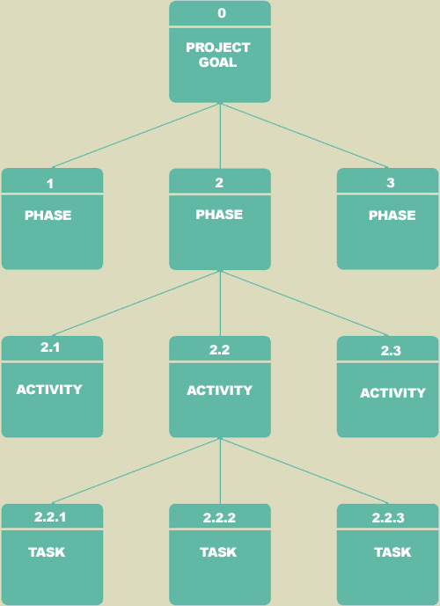
Activity 2 – Identify Tasks
Work breakdown structure (WBS) – a graphical tool used to depict the hierarchical decomposition of the project into phases, activities, and tasks.
Milestone – an event signifying the completion of a major project deliverable.

Slide 22
Activity 3 – Estimate Task Durations
Elapsed time takes into consideration:
  Efficiency - no worker performs at 100% efficiency
    Coffee breaks, lunch, e-mail, etc.
    Estimate of 75% is common
  Interruptions
    Phone calls, visitors, etc.
    10-50%

Slide 23
Activity 3 – Estimate Task Durations
1. Estimate the minimum amount of time it would take to perform the task – the optimistic duration (OD).
2. Estimate the maximum amount of time it would take to perform the task – the pessimistic duration (PD).
3. Estimate the expected duration (ED) that will be needed to perform the task.
4. Calculate a weighted average of the most likely duration (D) as follows:
D = (1 x OD) + (4 x ED) + (1 x PD)
6
OD
ED
PD
3.33 days = (1 x 2 days) + (4 x 3 days) + (1 x 6 days)
6

Slide 24
Activity 4 – Specify Intertask Dependencies
Finish-to-start (FS)—The finish of one task triggers the start of another task.
Start-to-start (SS)—The start of one task triggers the start of another task.
Finish-to-finish (FF)—Two tasks must finish at the same time.
Start-to-finish (SF)—The start of one task signifies the finish of another task.

Slide 25
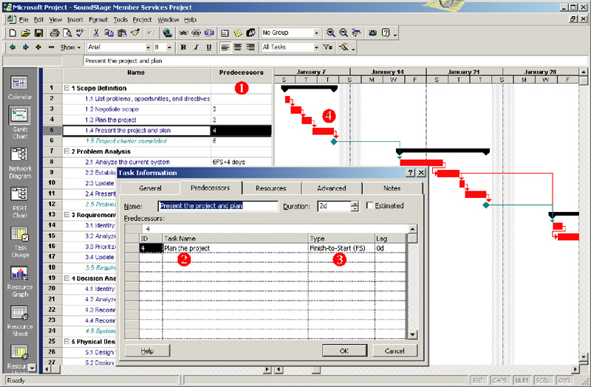
Entering Intertask Dependencies

Slide 26
Scheduling Strategies
Forward scheduling – a project scheduling approach that establishes a project start date and then schedules forward from that date.
Reverse scheduling – a project scheduling strategy that establishes a project deadline and then schedules backward from that date.

Slide 27
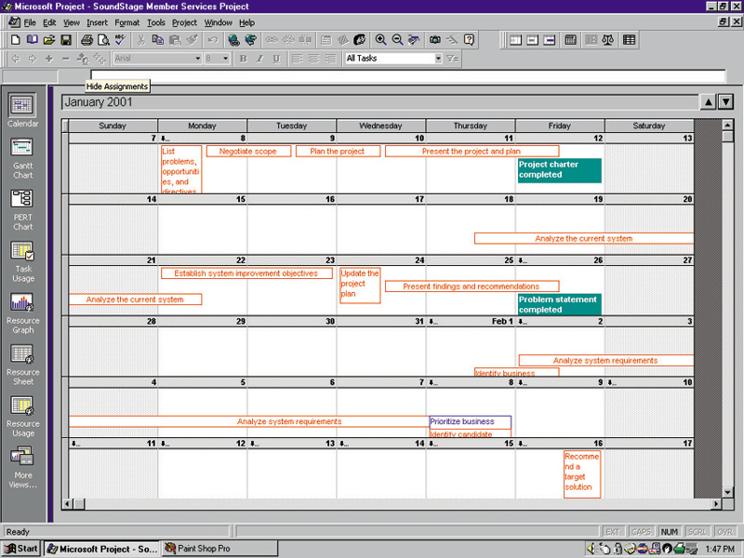
A Project Schedule in Calendar View

Slide 28
Activity 5 – Assign Resources
People – includes all system owners, users, analysts, designers, builders, external agents, and clerical help involved in the project in any way.
Services – includes services such as a quality review that may be charged on a per use basis.
Facilities and equipment – includes all rooms and technology that will be needed to complete the project.
Supplies and materials – everything from pencils, paper, notebooks to toner cartridges, and so on.
Money – includes a translation of all of the above into budgeted dollars!

Slide 29
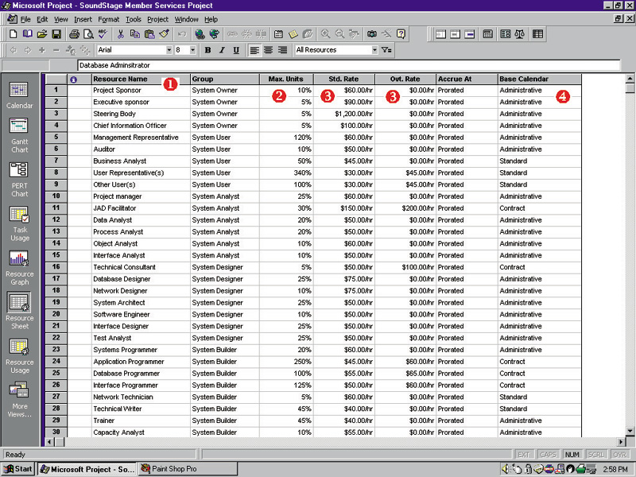
Defining Project Resources

Slide 30
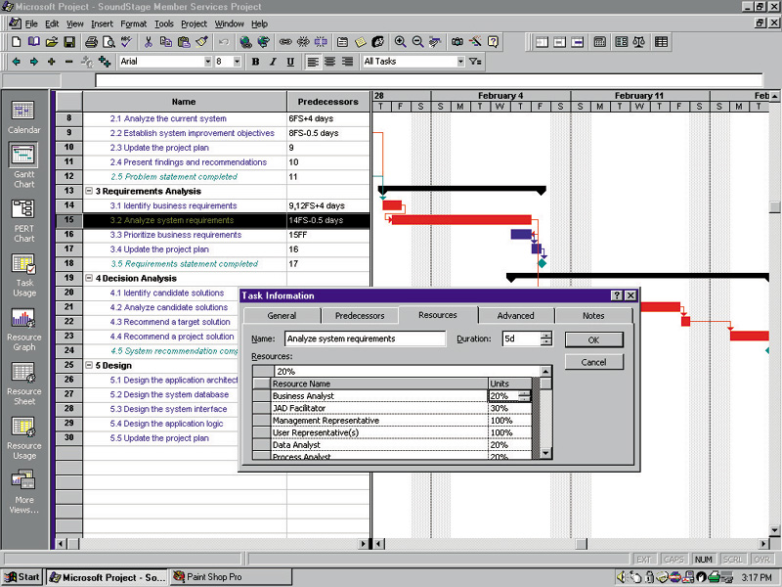
Assigning Project Resources

Slide 31
Assigning People to Tasks
Recruit talented, highly motivated people
Select the best task for each person
Promote team harmony
Plan for the future
Keep the team size small

Slide 32
Resource Leveling
Resource leveling – a strategy for correcting resource over-allocations.
Two techniques for resource leveling:
task delaying
task splitting

Slide 33
Task Splitting and Task Delaying
Critical path – the sequence of dependent tasks that determines the earliest possible completion date of the project.
  Tasks on the critical path cannot be delayed without delaying the entire project. Critical tasks can only be split.
Slack time – the amount of delay that can be tolerated between the starting time and completion time of a task without causing a delay in the completion date of the entire project.
  Tasks that have slack time can be delayed to achieve resource leveling

Slide 34
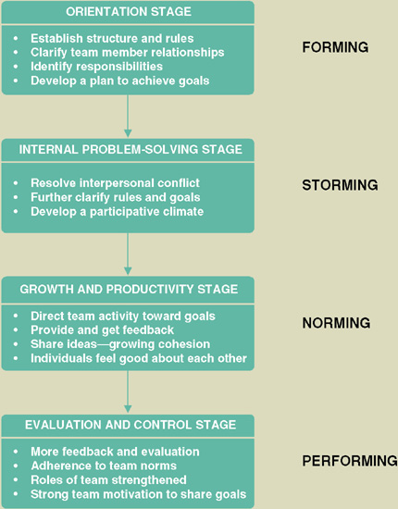
Activity 6 – Direct the Team Effort
Supervision resources
  The Deadline: A Novel about Project Management
  The People Side of Systems
  The One Minute Manager
  The One Minute Manager Meets the Monkey
Stages of Team Maturity
(see figure to the right)

Slide 35
10 Hints for Project Leadership
Be Consistent.
Provide Support.
Don’t Make Promises You Can’t Keep.
Praise in Public; Criticize in Private.
Be Aware of Morale Danger Points.
Set Realistic Deadlines.
Set Perceivable Targets.
Explain and Show, Rather Than Do.
Don’t Rely on Just Status Reports.
Encourage a Good Team Spirit.

Slide 36
Activity 7 – Monitor and
Control Progress
Progress reporting
Change management
Expectations management
Schedule adjustments—critical path analysis (CPA)

Slide 37
Sample Outline for Progress Report
I. Cover Page
A. Project name or identification
B. Project manager
C. Date or report
II. Summary of progress
A. Schedule analysis
B. Budget analysis
C. Scope analysis
(changes that may have an impact on future progress)
D. Process analysis
(problems encountered with strategy or methodology)
E. Gantt progress chart(s)
III. Activity analysis
A. Tasks completed since last report
B. Current tasks and deliverables
C. Short term future tasks and deliverables
(continued)

Slide 38
Sample Outline for a Progress Report (concluded)
IV. Previous problems and issues
A. Action item and status
B. New or revised action items
1. Recommendation
2. Assignment of responsibility
3. Deadline
V. New problems and issues
A. Problems
(actual or anticipated)
B. Issues
(actual or anticipated)
C. Possible solutions
1. Recommendation
2. Assignment of responsibility
3. Deadline
VI. Attachments
(include relevant printouts from project management software)

Slide 39
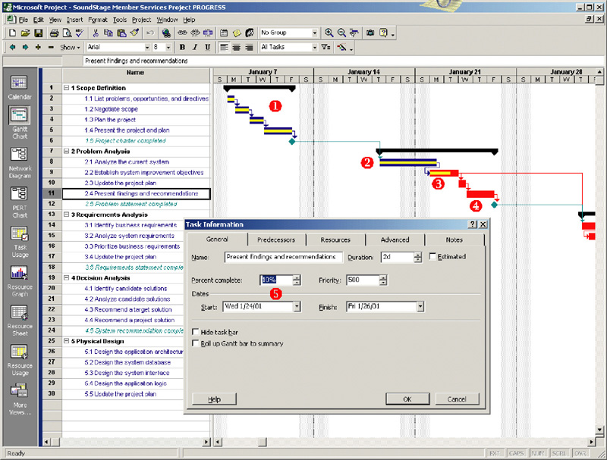
Progress Reporting on a Gantt Chart

Slide 40
Change Management
Change management – a formal strategy in which a process is established to facilitate changes that occur during a project.
Changes can be the result of various events and factors including:
An omission in defining initial scope
A misunderstanding of the initial scope
An external event such as government regulations that create new requirements
Organizational changes
Availability of better technology
Shifts in planned technology that force changes to the business organization, culture, and/or processes
Management’s desire to have the system do more
Reduced funding for project or imposition of an earlier deadline.

Slide 41
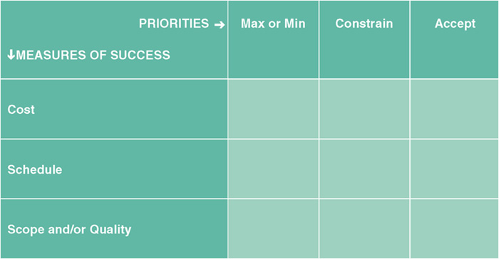
Expectations Management
Expectations management matrix – a tool used to understand the dynamics and impact of changing the parameters of a project.
The most important
The second most important
The least important
Can have only one X in each row and each column

Slide 42
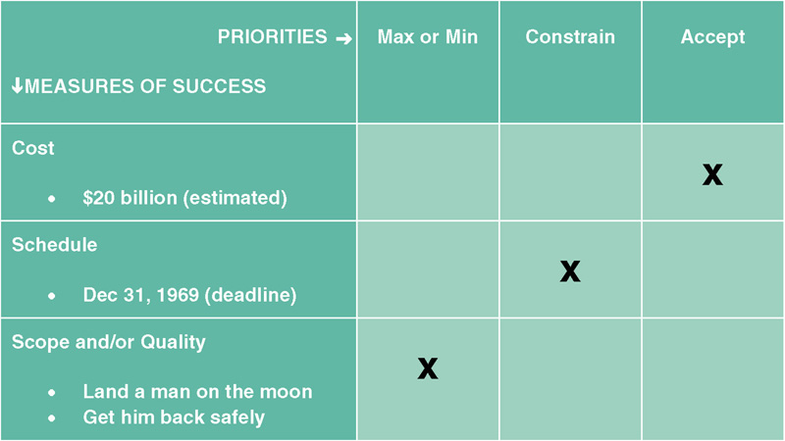
Lunar Project Expectations Management

Slide 43
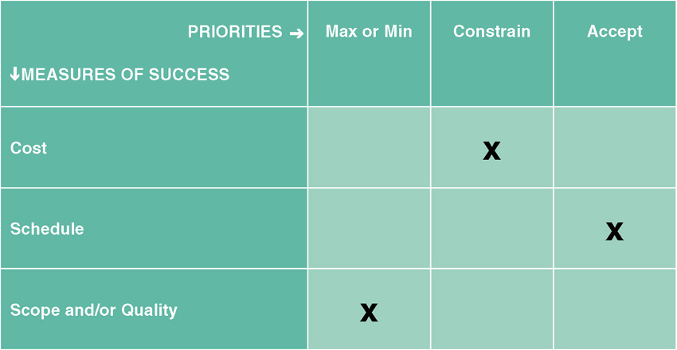
Typical, Initial Expectations for a Project

Slide 44
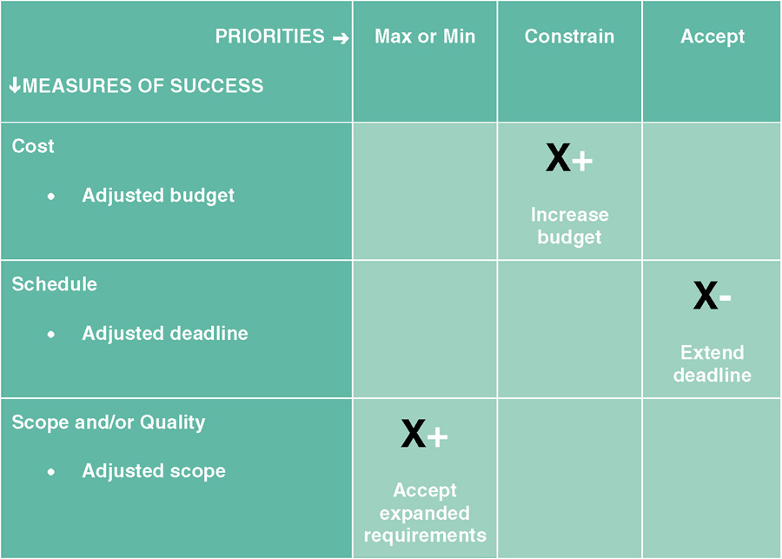
Adjusting Expectations

Slide 45
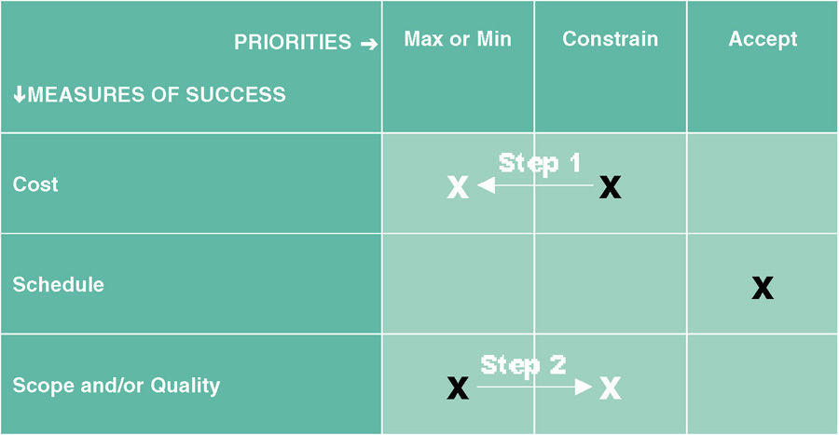
Changing Priorities

Slide 46
Schedule Adjustments -
Critical Path Analysis
Using intertask dependencies, determine every possible path through the project.
For each path, sum the durations of all tasks in the path.
The path with the longest total duration is the critical path.
  The critical path is the sequence of tasks with the largest sum of most likely durations. The critical path determines the earliest completion date of the project.
  The slack time for any non-critical task is the amount of delay that can be tolerated between starting and completion time of a task without causing a delay in the entire project.

Slide 47
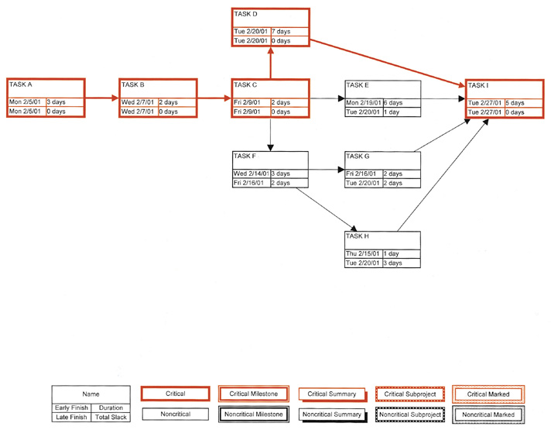
Critical Path Analysis

Slide 48
Activity 8 – Assess Project Results and Experiences
Did the final product meet or exceed user expectations?
  Why or why not?
Did the project come in on schedule?
  Why or why not?
Did the project come in under budget?
  Why or why not?

