Slide 1
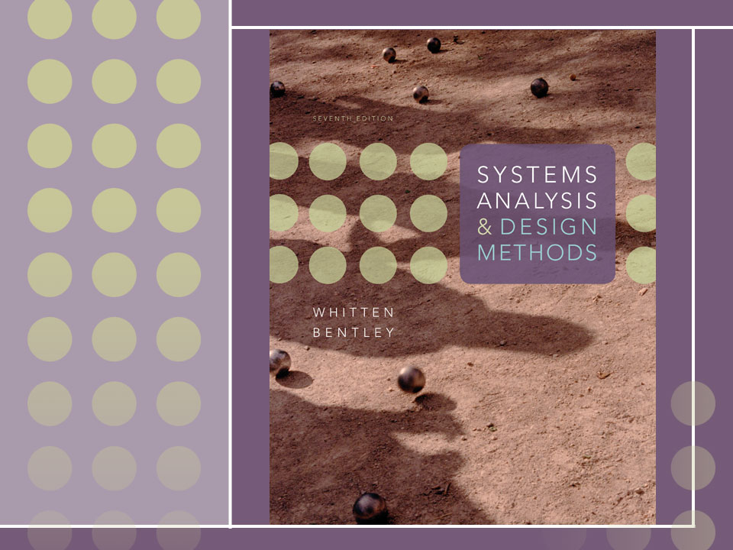
Chapter 8
Data Modeling and Analysis

Slide 2
Objectives
Define data modeling and explain its benefits.
Recognize and understand the basic concepts and constructs of a data model.
Read and interpret an entity relationship data model.
Explain when data models are constructed during a project and where the models are stored.
Discover entities and relationships.
Construct an entity-relationship context diagram.
Discover or invent keys for entities and construct a key-based diagram.
Construct a fully attributed entity relationship diagram and describe data structures and attributes to the repository.
Normalize a logical data model to remove impurities that can make a database unstable, inflexible, and nonscalable.
Describe a useful tool for mapping data requirements to business operating locations.

Slide 3
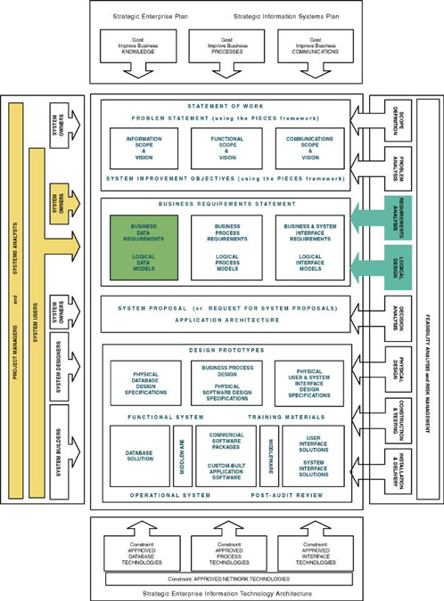

Slide 4
Data Modeling
Data modeling – a technique for organizing and documenting a system’s data. Sometimes called database modeling.
Entity relationship diagram (ERD) – a data model utilizing several notations to depict data in terms of the entities and relationships described by that data.

Slide 5
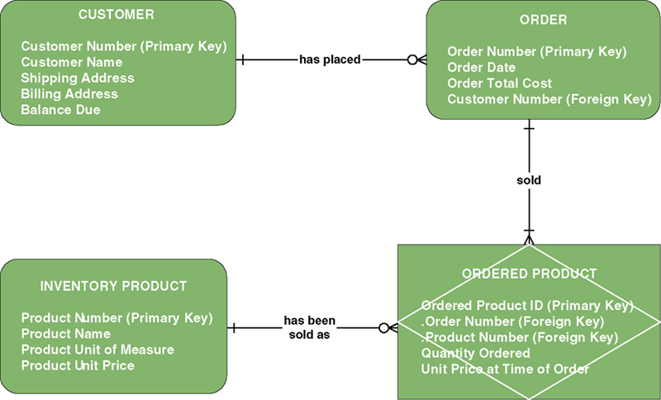
Sample Entity Relationship Diagram (ERD)

Slide 6

Data Modeling Concepts: Entity
Entity – a class of persons, places, objects, events, or concepts about which we need to capture and store data.
  Named by a singular noun
Persons: agency, contractor, customer,
department, division, employee,
instructor, student, supplier.
Places: sales region, building, room,
branch office, campus.
Objects: book, machine, part, product, raw material, software license, software package, tool, vehicle model, vehicle.
Events: application, award, cancellation, class, flight, invoice, order, registration, renewal, requisition, reservation, sale, trip.
Concepts: account, block of time, bond, course, fund, qualification, stock.

Slide 7
Data Modeling Concepts: Entity
Entity instance – a single occurrence of an entity.
entity
Student ID | Last Name | First Name
2144 | Arnold | Betty
3122 | Taylor | John
3843 | Simmons | Lisa
9844 | Macy | Bill
2837 | Leath | Heather
2293 | Wrench | Tim
instances

Slide 8
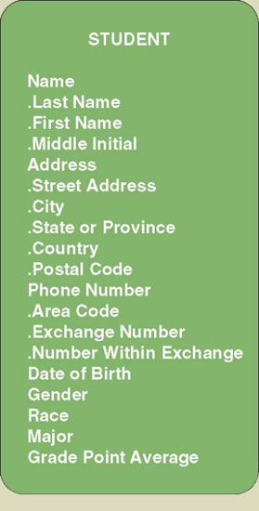
Data Modeling Concepts: Attributes
Attribute – a descriptive property or characteristic of an entity. Synonyms include element, property, and field.
  Just as a physical student can have attributes, such as hair color, height, etc., data entity has data attributes
Compound attribute – an attribute that consists of other attributes. Synonyms in different data modeling languages are numerous: concatenated attribute, composite attribute, and data structure.

Slide 9
Data Modeling Concepts: Data Type
Data type – a property of an attribute that identifies what type of data can be stored in that attribute.
Representative Logical Data Types for Attributes
Data Type | Logical Business Meaning
NUMBER | Any number, real or integer.
TEXT | A string of characters, inclusive of numbers. When numbers are included in a TEXT attribute, it means that we do not expect to perform arithmetic or comparisons with those numbers.
MEMO | Same as TEXT but of an indeterminate size. Some business systems require the ability to attach potentially lengthy notes to a give database record.
DATE | Any date in any format.
TIME | Any time in any format.
YES/NO | An attribute that can assume only one of these two values.
VALUE SET | A finite set of values. In most cases, a coding scheme would be established (e.g., FR=Freshman, SO=Sophomore, JR=Junior, SR=Senior).
IMAGE | Any picture or image.

Slide 10
Data Modeling Concepts: Domains
Domain – a property of an attribute that defines what values an attribute can legitimately take on.
Representative Logical Domains for Logical Data Types
Data Type | Domain | Examples
NUMBER | For integers, specify the range. For real numbers, specify the range and precision. | {10-99} {1.000-799.999}
TEXT | Maximum size of attribute. Actual values usually infinite; however, users may specify certain narrative restrictions. | Text(30)
DATE | Variation on the MMDDYYYY format. | MMDDYYYY MMYYYY
TIME | For AM/PM times: HHMMT For military (24-hour times): HHMM | HHMMT HHMM
YES/NO | {YES, NO} | {YES, NO} {ON, OFF}
VALUE SET | {value#1, value#2,…value#n} {table of codes and meanings} | {M=Male F=Female}

Slide 11
Data Modeling Concepts:
Default Value
Default value – the value that will be recorded if a value is not specified by the user.
Permissible Default Values for Attributes
Default Value | Interpretation | Examples
A legal value from the domain | For an instance of the attribute, if the user does not specify a value, then use this value. | 0 1.00
NONE or NULL | For an instance of the attribute, if the user does not specify a value, then leave it blank. | NONE NULL
Required or NOT NULL | For an instance of the attribute, require that the user enter a legal value from the domain. (This is used when no value in the domain is common enough to be a default but some value must be entered.) | REQUIRED NOT NULL

Slide 12
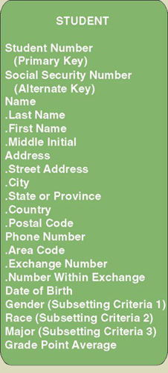
Data Modeling Concepts: Identification
Key – an attribute, or a group of attributes, that assumes a unique value for each entity instance. It is sometimes called an identifier.
  Concatenated key - group of attributes that uniquely identifies an instance. Synonyms: composite key, compound key.
  Candidate key – one of a number of keys that may serve as the primary key. Synonym: candidate identifier.
  Primary key – a candidate key used to uniquely identify a single entity instance.
  Alternate key – a candidate key not selected to become the primary key. Synonym: secondary key.

Slide 13
Data Modeling Concepts:
Subsetting Criteria
  Subsetting criteria – an attribute(s) whose finite values divide all entity instances into useful subsets. Sometimes called an inversion entry.

Slide 14

Data Modeling Concepts: Relationships
Relationship – a natural business association that exists between one or more entities.
  The relationship may represent an event that links the entities or merely a logical affinity that exists between the entities.

Slide 15
Data Modeling Concepts: Cardinality
Cardinality – the minimum and maximum number of occurrences of one entity that may be related to a single occurrence of the other entity.
  Because all relationships are bidirectional, cardinality must be defined in both directions for every relationship.
bidirectional

Slide 16
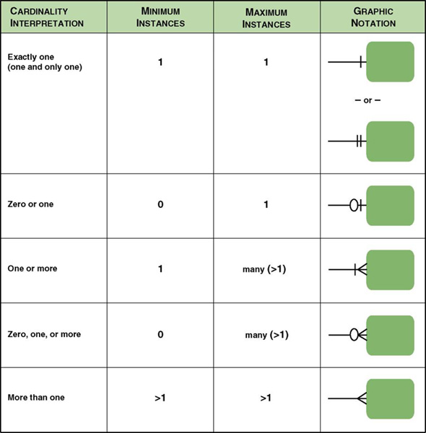
Cardinality Notations

Slide 17
Data Modeling Concepts: Degree
Degree – the number of entities that participate in the relationship.
  A relationship between two entities is called a binary relationship.
  A relationship between three entities is called a 3-ary or ternary relationship.
  A relationship between different instances of the same entity is called a recursive relationship.

Slide 18
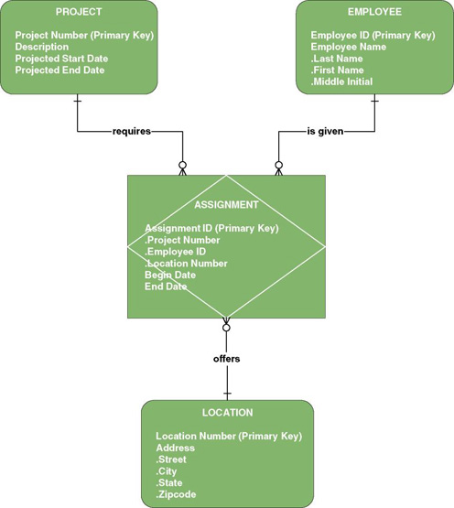
Data Modeling Concepts: Degree
Relationships may exist between more than two entities and are called
N-ary relationships.
The example ERD depicts a ternary relationship.

Slide 19
Data Modeling Concepts: Degree
Associative entity – an entity that inherits its primary key from more than one other entity (called parents).
Each part of that concatenated key points to one and only one instance of each of the connecting entities.
Associative Entity

Slide 20
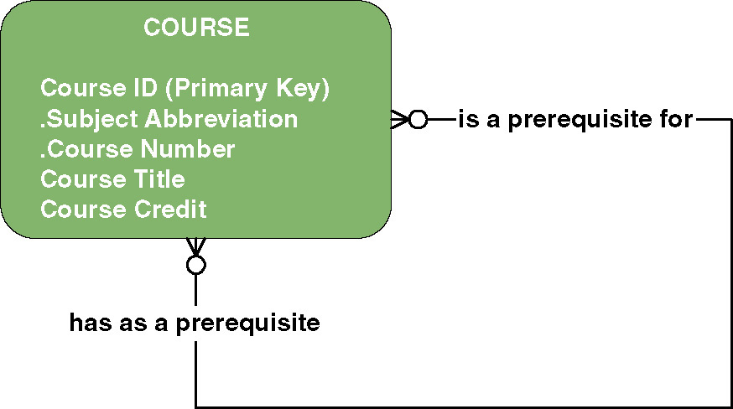
Data Modeling Concepts:
Recursive Relationship
Recursive relationship - a relationship that exists between instances of the same entity

Slide 21
Data Modeling Concepts:
Foreign Keys
Foreign key – a primary key of an entity that is used in another entity to identify instances of a relationship.
  A foreign key is a primary key of one entity that is contributed to (duplicated in) another entity to identify instances of a relationship.
  A foreign key always matches the primary key in the another entity
  A foreign key may or may not be unique (generally not)
  The entity with the foreign key is called the child.
  The entity with the matching primary key is called the parent.

Slide 22
Data Modeling Concepts:
Parent and Child Entities
Parent entity - a data entity that contributes one or more attributes to another entity, called the child. In a one-to-many relationship the parent is the entity on the "one" side.
Child entity - a data entity that derives one or more attributes from another entity, called the parent. In a one-to-many relationship the child is the entity on the "many" side.

Slide 23
Data Modeling Concepts:
Foreign Keys
Primary Key
Student ID | Last Name | First Name | Dorm
2144 | Arnold | Betty | Smith
3122 | Taylor | John | Jones
3843 | Simmons | Lisa | Smith
9844 | Macy | Bill
2837 | Leath | Heather | Smith
2293 | Wrench | Tim | Jones
Primary Key
Foreign Key
Duplicated from primary key of Dorm entity
(not unique in Student entity)
Dorm | Residence Director
Smith | Andrea Fernandez
Jones | Daniel Abidjan

Slide 24
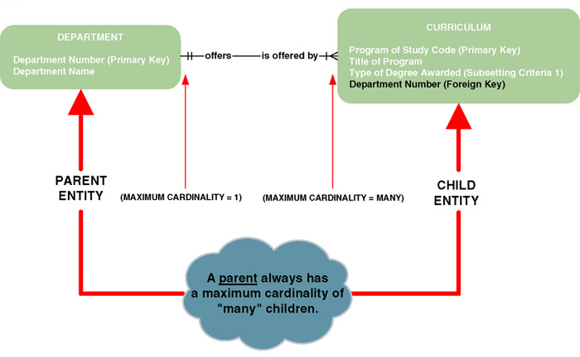
Data Modeling Concepts: Nonidentifying Relationships
Nonidentifying relationship – relationship where each participating entity has its own independent primary key
  Primary key attributes are not shared.
  The entities are called strong entities

Slide 25
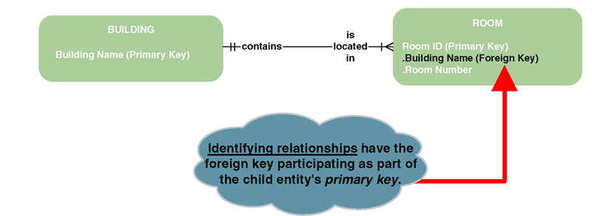
Data Modeling Concepts:
Identifying Relationships
Identifying relationship – relationship in which the parent entity’ key is also part of the primary key of the child entity.
  The child entity is called a weak entity.

Slide 26
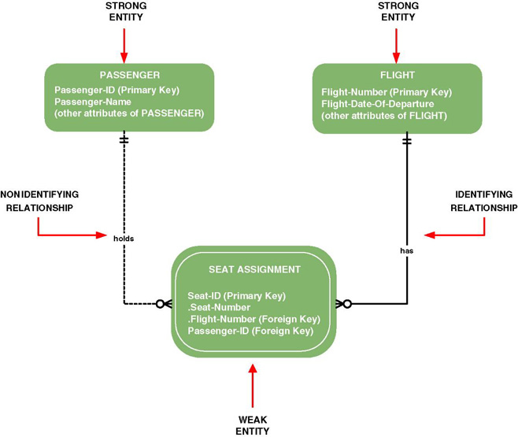
Data Modeling Concepts:
Sample CASE Tool Notations

Slide 27
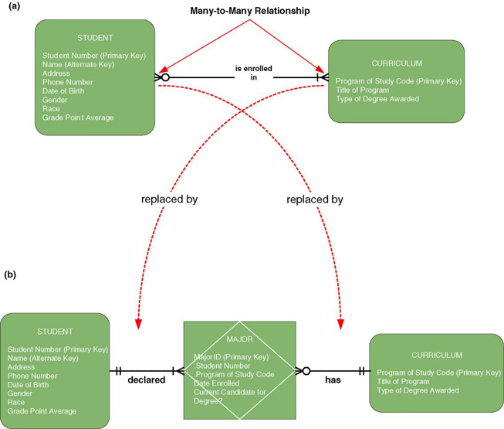
Data Modeling Concepts: Nonspecific Relationships
Nonspecific relationship – relationship where many instances of an entity are associated with many instances of another entity. Also called many-to-many relationship.
Nonspecific relationships must
be resolved, generally by introducing an associative entity.

Slide 28
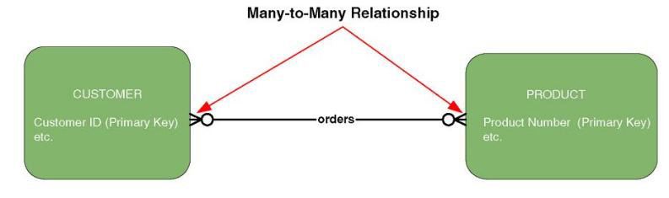
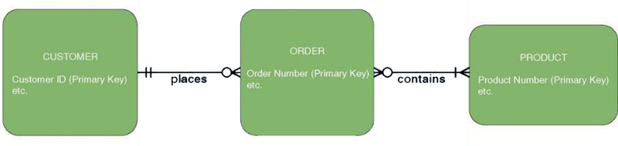
Resolving Nonspecific Relationships
The verb or verb phrase of a many-to-many relationship sometimes suggests other entities.

Slide 29
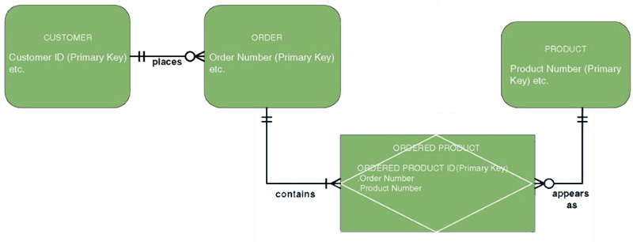
Resolving Nonspecific Relationships (continued)
Many-to-many relationships can be resolved with an associative entity.

Slide 30
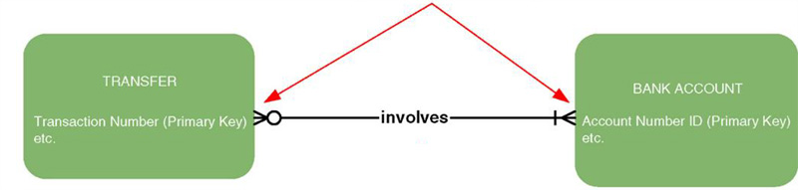
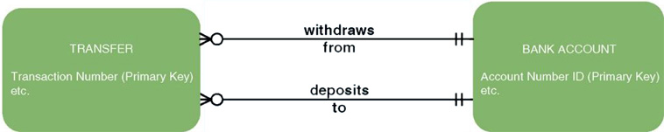
Resolving Nonspecific Relationships (continued)
Many-to-Many Relationship
While the above relationship is a many-to-many, the many on the BANK ACCOUNT side is a known maximum of "2." This suggests that the relationship may actually represent multiple relationships... In this case two separate relationships.

Slide 31
Data Modeling Concepts: Generalization
Generalization – a concept wherein the attributes that are common to several types of an entity are grouped into their own entity.
Supertype – an entity whose instances store attributes that are common to one or more entity subtypes.
Subtype – an entity whose instances may inherit common attributes from its entity supertype
  And then add other attributes unique to the subtype.

Slide 32
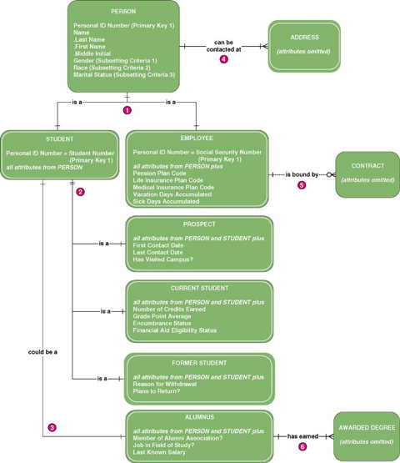
Generalization Hierarchy

Slide 33
Process of Logical Data Modeling
Strategic Data Modeling
  Many organizations select IS development projects based on strategic plans.
    Includes vision and architecture for information systems
    Identifies and prioritizes develop projects
    Includes enterprise data model as starting point for projects
Data Modeling during Systems Analysis
  Data model for a single information system is called an application data model.

Slide 34
Logical Model Development Stages
Context Data model
  Includes only entities and relationships
  To establish project scope
Key-based data model
  Eliminate nonspecific relationships
  Add associative entities
  Include primary and alternate keys
  Precise cardinalities
Fully attributed data model
  All remaining attributes
  Subsetting criteria
Normalized data model
Metadata - data about data.

Slide 35
JRP and Interview Questions for Data Modeling
Purpose | Candidate Questions (see textbook for a more complete list)
Discover system entities | What are the subjects of the business?
Discover entity keys | What unique characteristic (or characteristics) distinguishes an instance of each subject from other instances of the same subject?
Discover entity subsetting criteria | Are there any characteristics of a subject that divide all instances of the subject into useful subsets?
Discover attributes and domains | What characteristics describe each subject?
Discover security and control needs | Are there any restrictions on who can see or use the data?
Discover data timing needs | How often does the data change?
Discover generalization hierarchies | Are all instances of each subject the same?
Discover relationships? | What events occur that imply associations between subjects?
Discover cardinalities | Is each business activity or event handled the same way, or are there special circumstances?

Slide 36
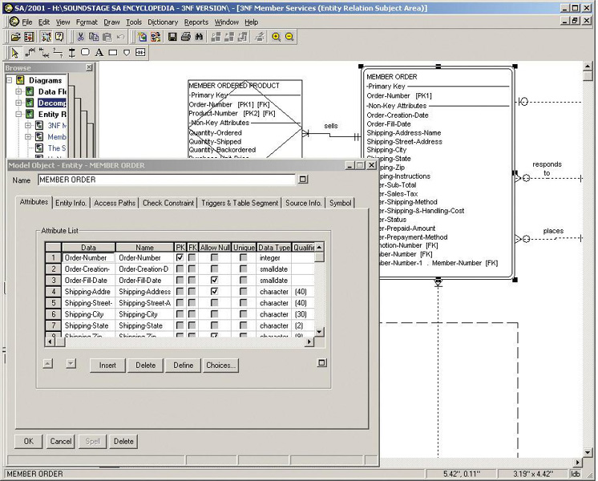
Automated Tools for Data Modeling

Slide 37
Entity Discovery
In interviews or JRP sessions, pay attention to key words (i.e. "we need to keep track of ...").
In interviews or JRP sessions, ask users to identify things about which they would like to capture, store, and produce information.
Study existing forms, files, and reports.
Scan use case narratives for nouns.
Some CASE tools can reverse engineer existing files and databases.

Slide 38
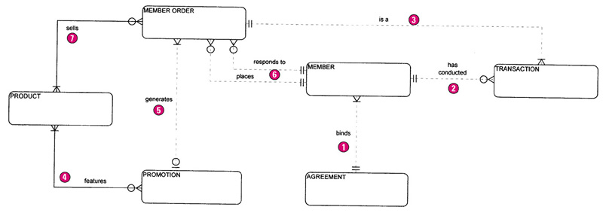
The Context Data Model

Slide 39
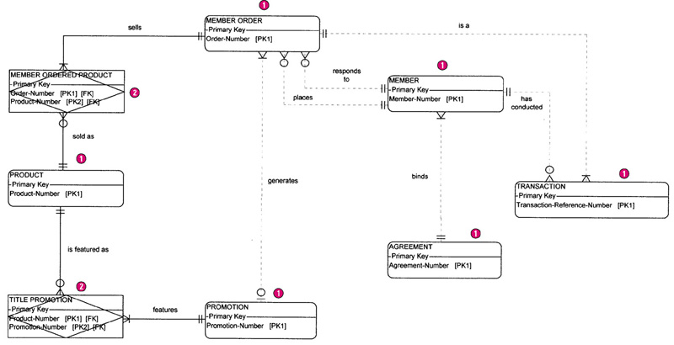
The Key-based Data Model

Slide 40
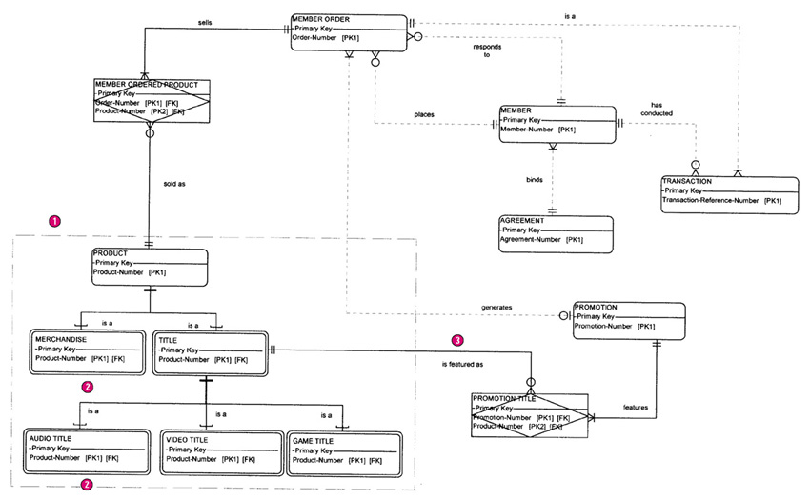
The Key-based Data Model with Generalization

Slide 41
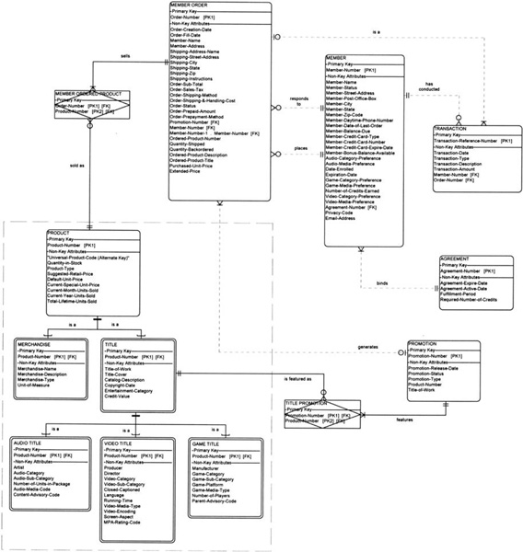
The Fully-Attributed Data Model

Slide 42
What is a Good Data Model?
A good data model is simple.
  Data attributes that describe any given entity should describe only that entity.
  Each attribute of an entity instance can have only one value.
A good data model is essentially nonredundant.
  Each data attribute, other than foreign keys, describes at most one entity.
  Look for the same attribute recorded more than once under different names.
A good data model should be flexible and adaptable to future needs.

Slide 43
Data Analysis & Normalization
Data analysis – a technique used to improve a data model for implementation as a database.
  Goal is a simple, nonredundant, flexible, and adaptable database.
Normalization – a data analysis technique that organizes data into groups to form nonredundant, stable, flexible, and adaptive entities.

Slide 44
Normalization: 1NF, 2NF, 3NF
First normal form (1NF) – entity whose attributes have no more than one value for a single instance of that entity
  Any attributes that can have multiple values actually describe a separate entity, possibly an entity and relationship.
Second normal form (2NF) – entity whose nonprimary-key attributes are dependent on the full primary key.
  Any nonkey attributes dependent on only part of the primary key should be moved to entity where that partial key is the full key. May require creating a new entity and relationship on the model.
Third normal form (3NF) – entity whose nonprimary-key attributes are not dependent on any other non-primary key attributes.
  Any nonkey attributes that are dependent on other nonkey attributes must be moved or deleted. Again, new entities and relationships may have to be added to the data model.

Slide 45
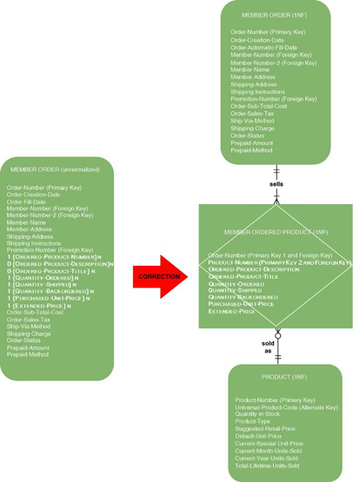
First Normal Form Example 1

Slide 46
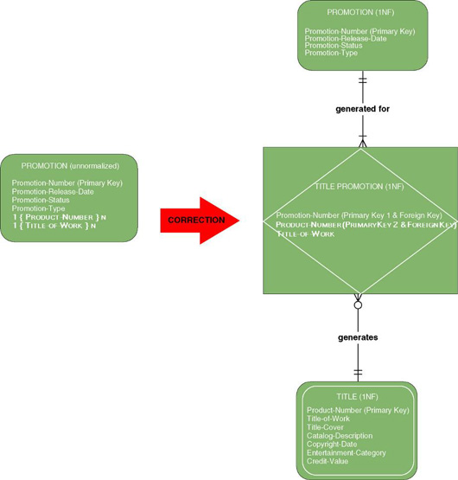
First Normal Form Example 2

Slide 47
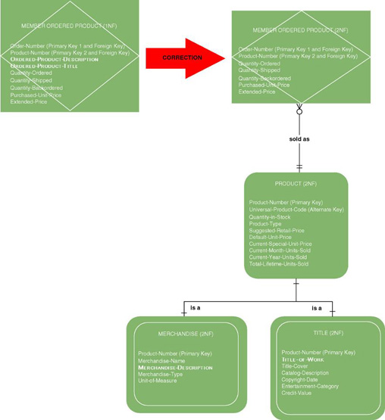
Second Normal Form Example 1

Slide 48
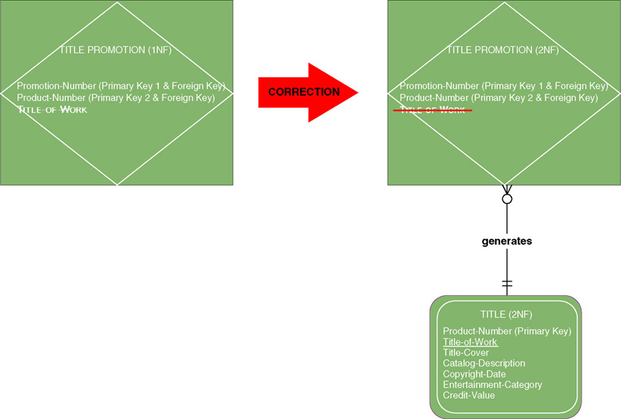
Second Normal Form Example 2

Slide 49
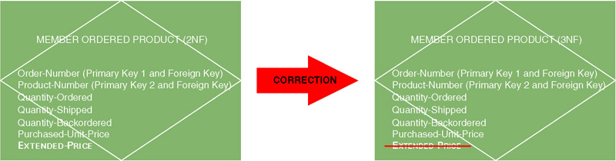
Third Normal Form Example 1
Derived attribute – an attribute whose value can be calculated from other attributes or derived from the values of other attributes.

Slide 50
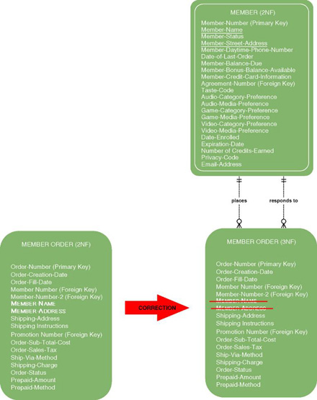
Third Normal Form Example 2
Transitive dependency – when the value of a nonkey attribute is dependent on the value of another nonkey attribute other than by derivation.

Slide 51
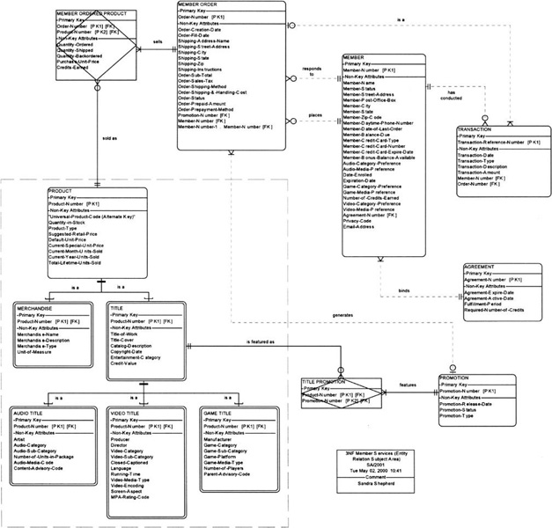
SoundStage 3NF Data Model

Slide 52
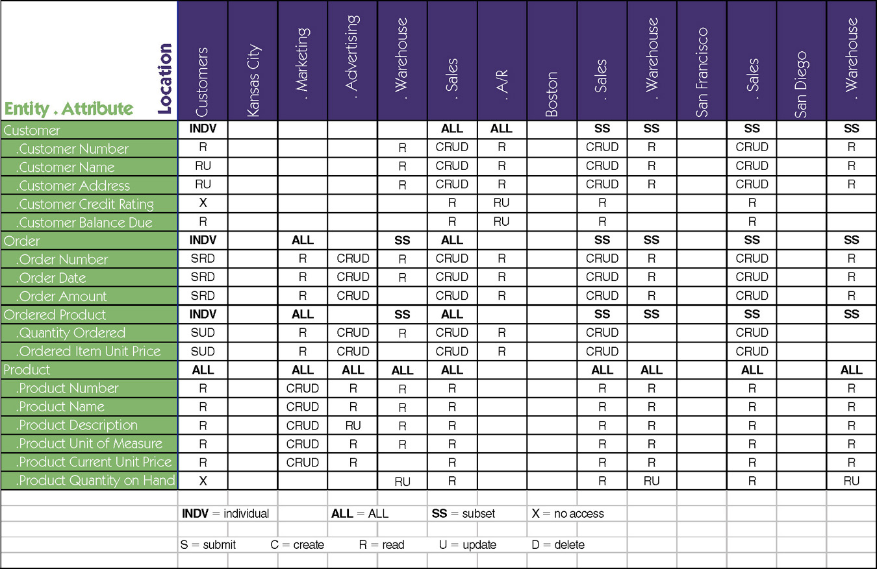
Data-to-Location-CRUD Matrix

