Slide 1
Spring Boot Rest Api with H2-console

Slide 2
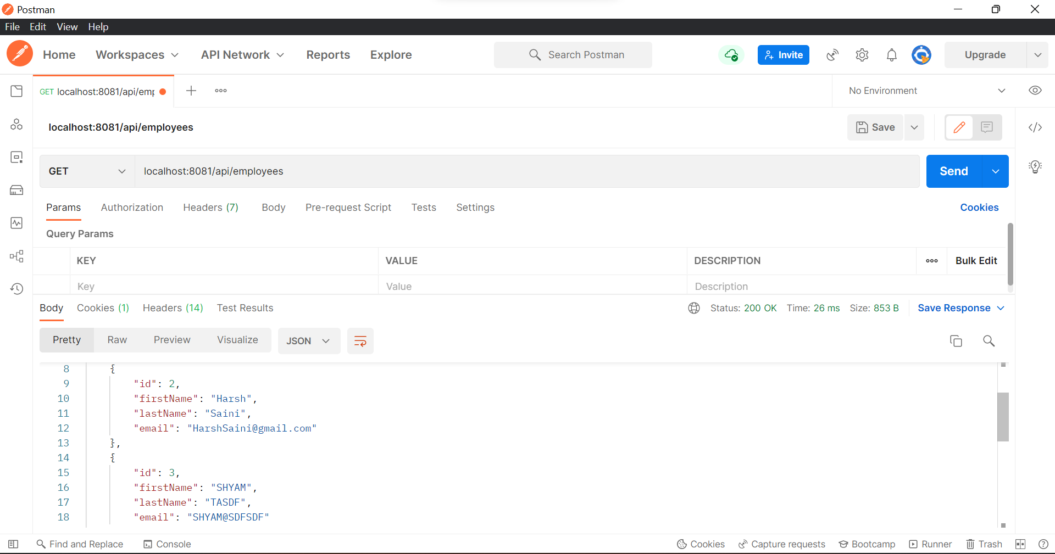
Get All Data

Slide 3
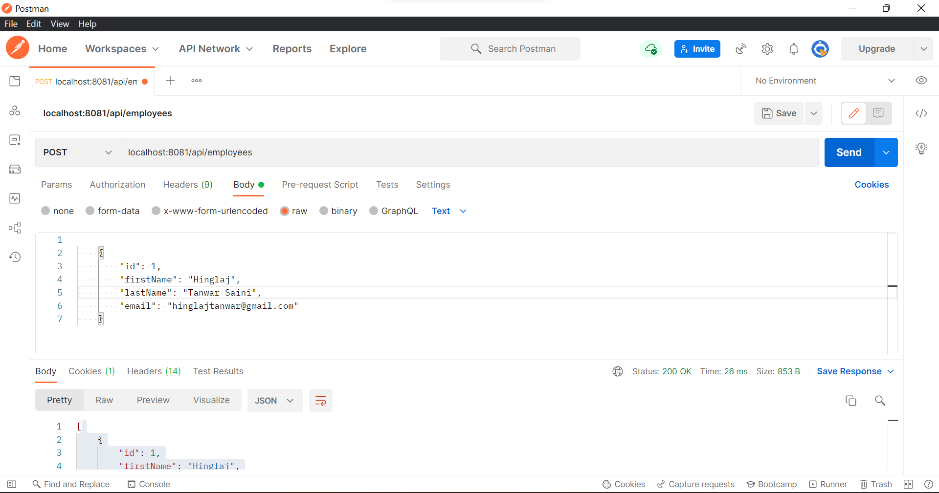
Add Employee

Slide 4
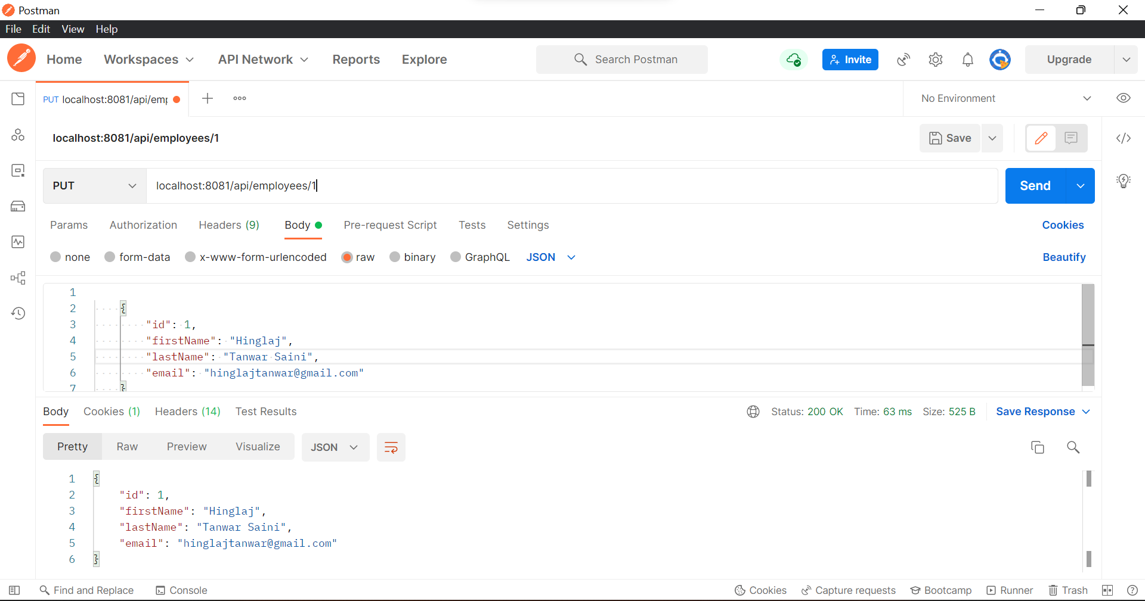
Edit/Update Employee

Slide 5
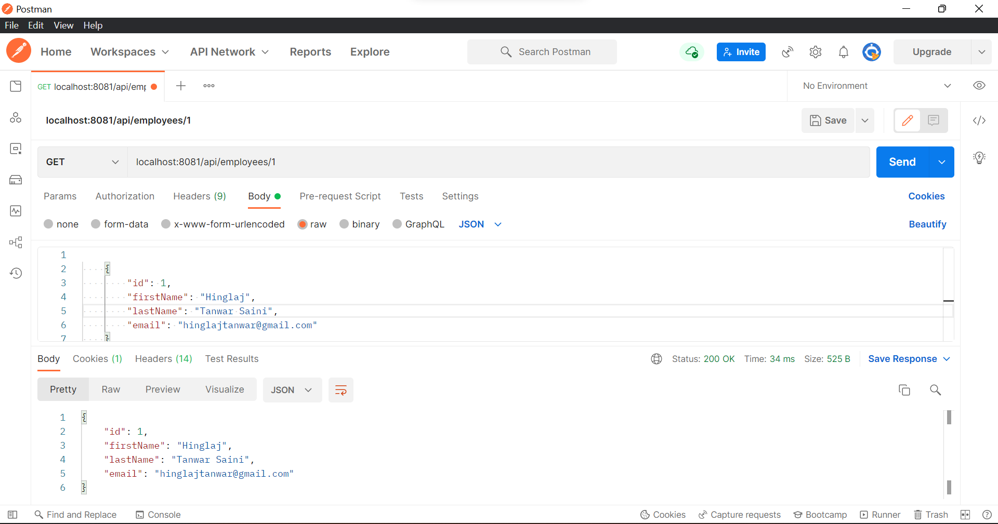
Search Employee By Id

Slide 6
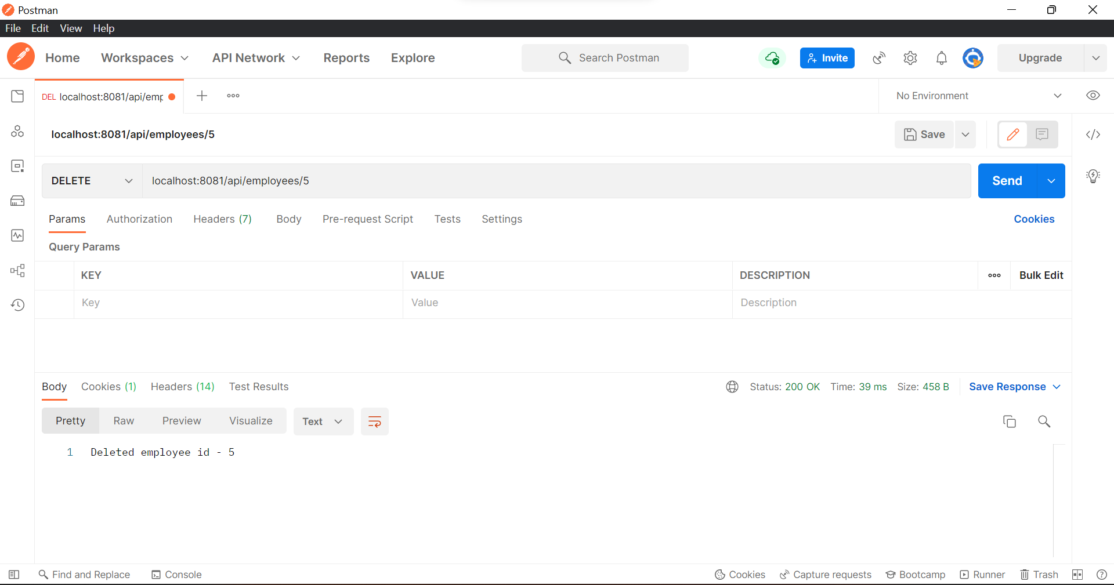
Delete Employee

Slide 7
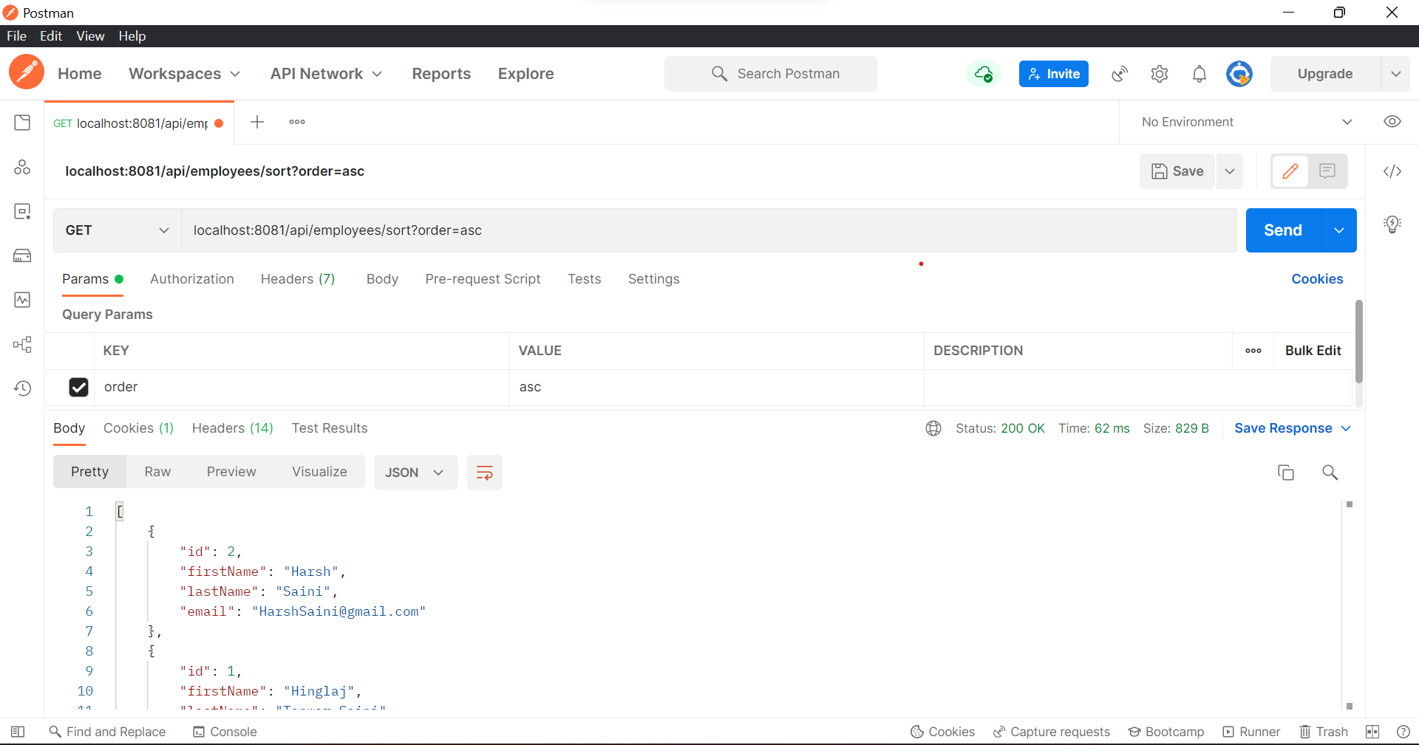
Sort By Ascending Order

Slide 8
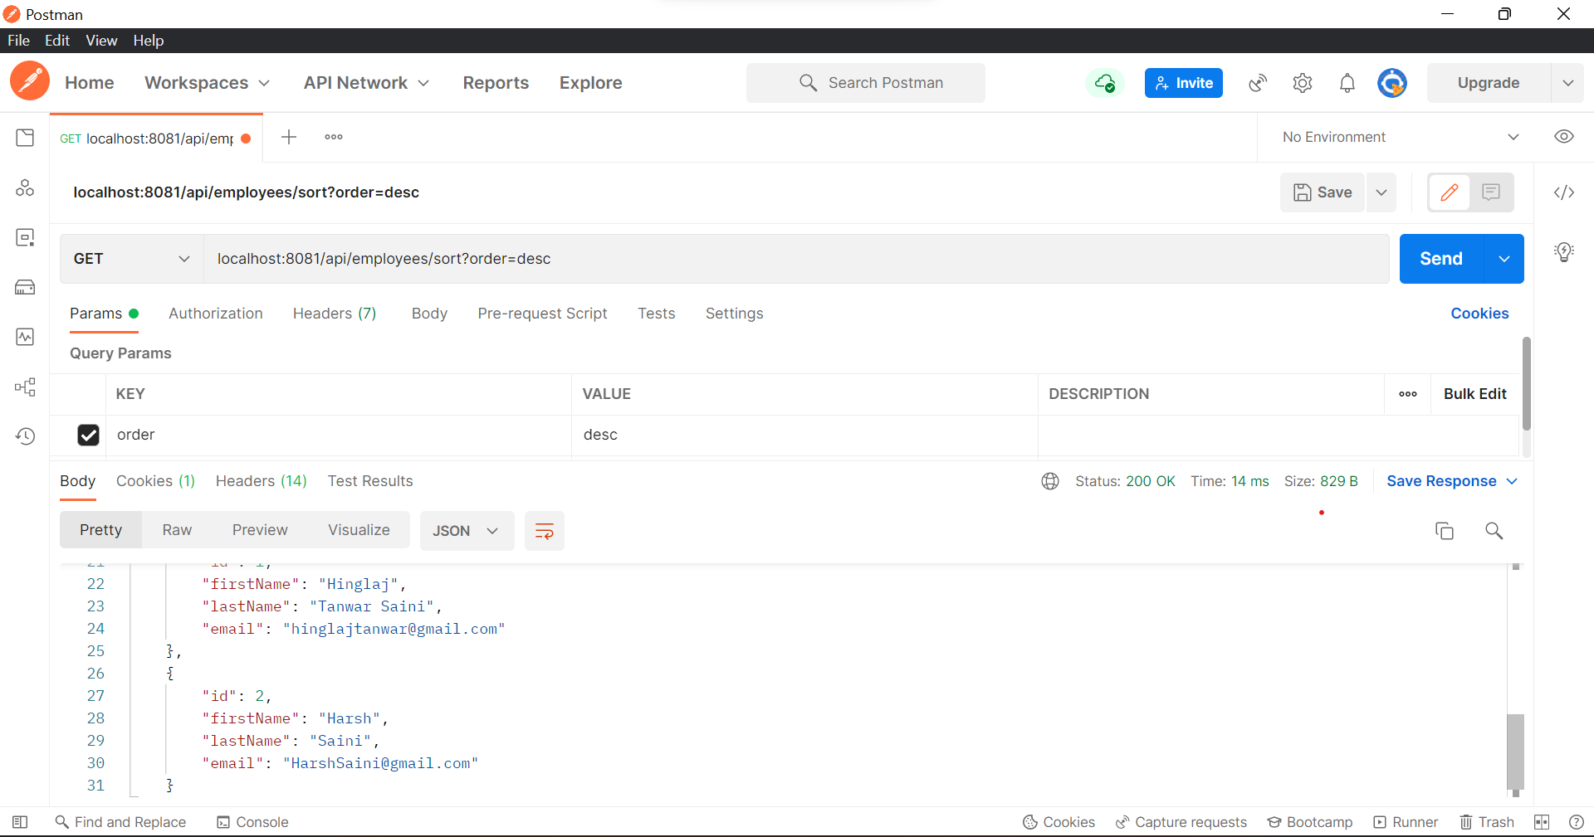
Sort By Descending Order

Slide 9
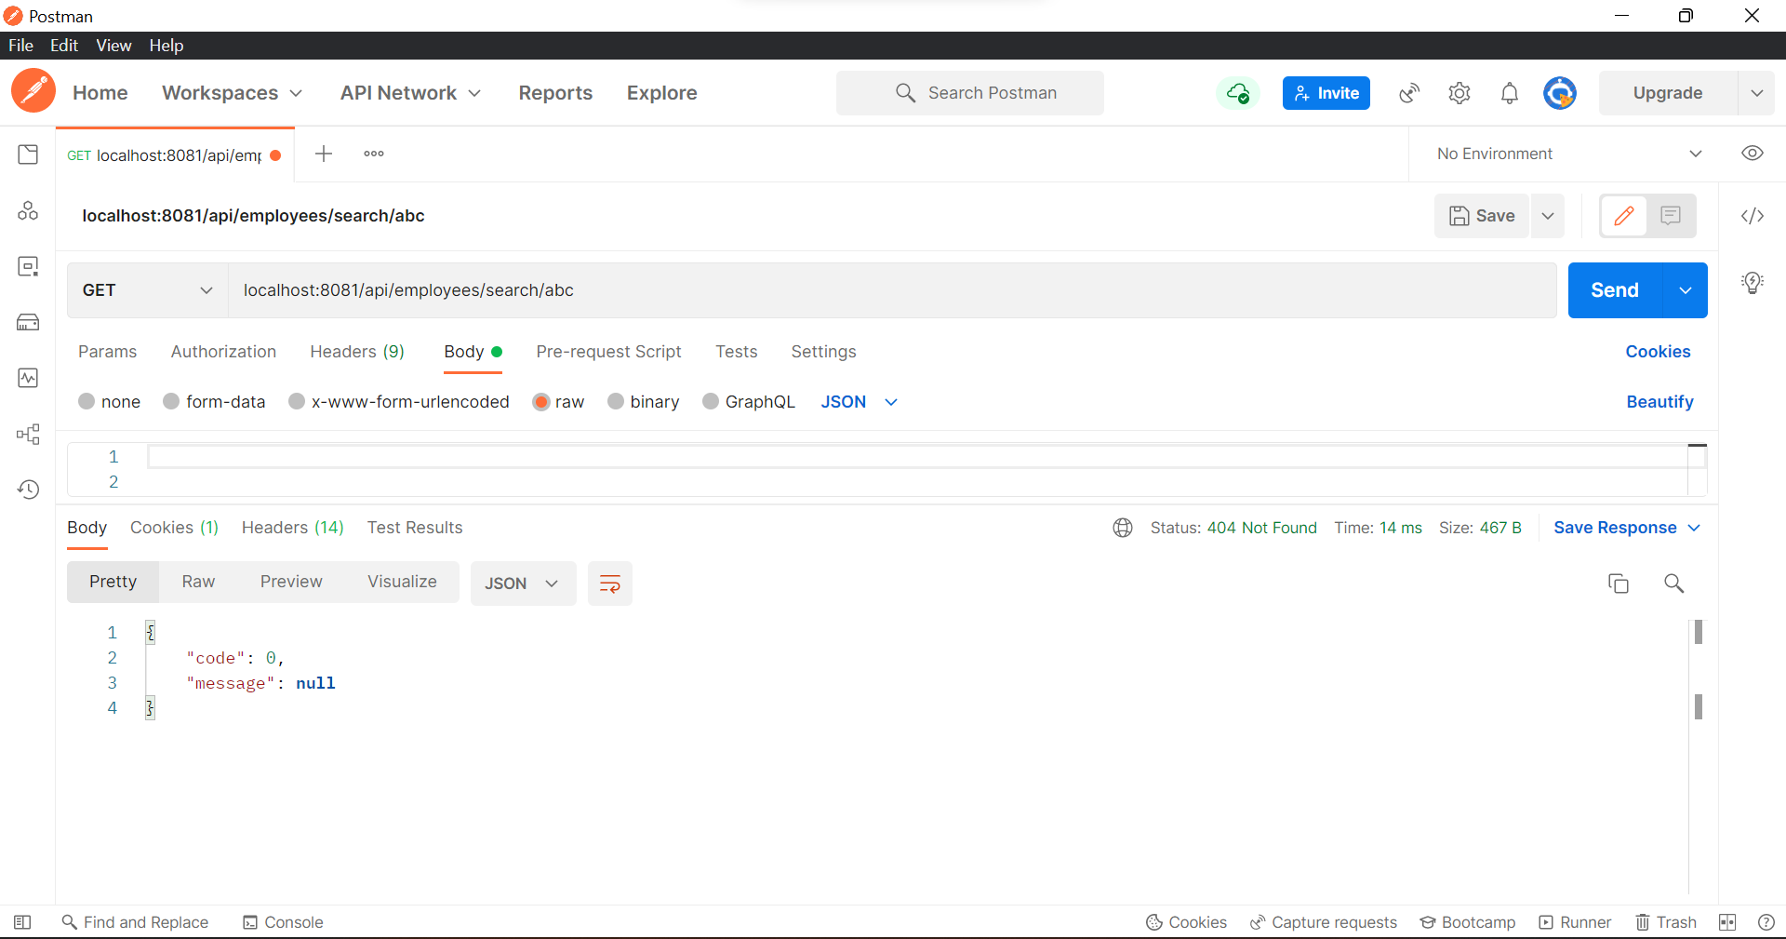
Search by First name If name not found

Slide 10
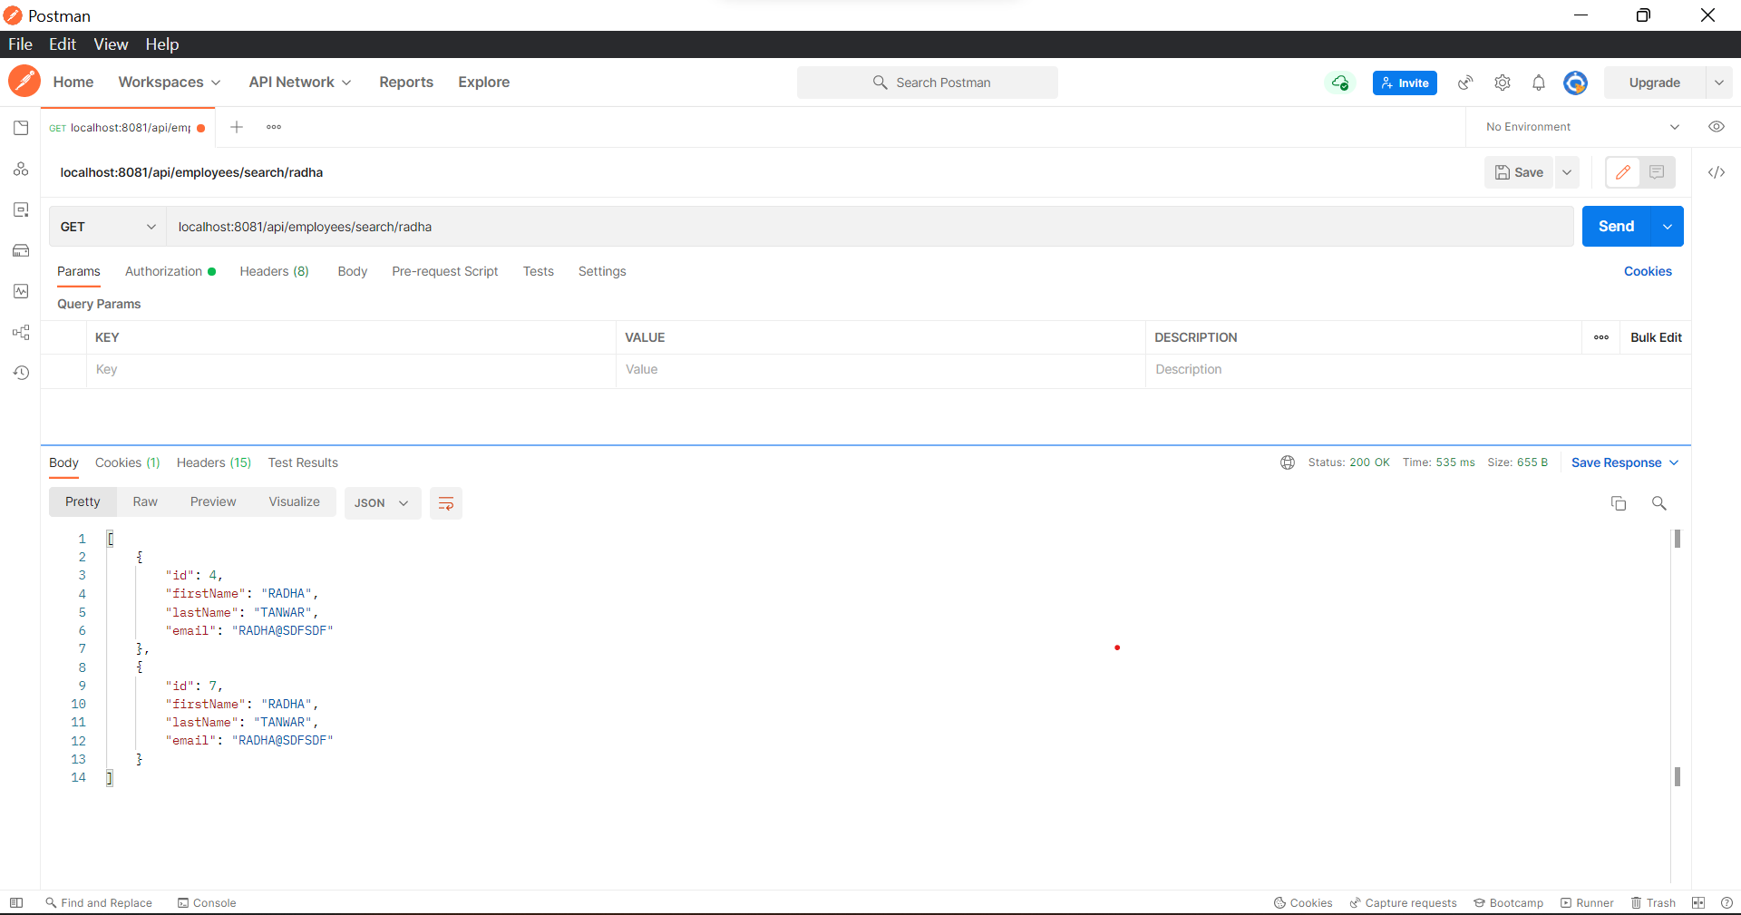
Search Via First Name with Duplicate Values

Slide 11
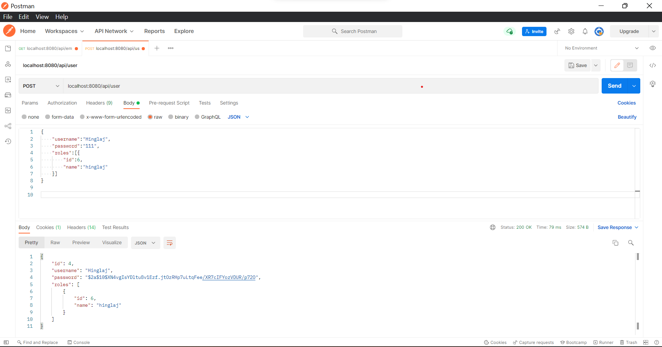
Add User id

Slide 12
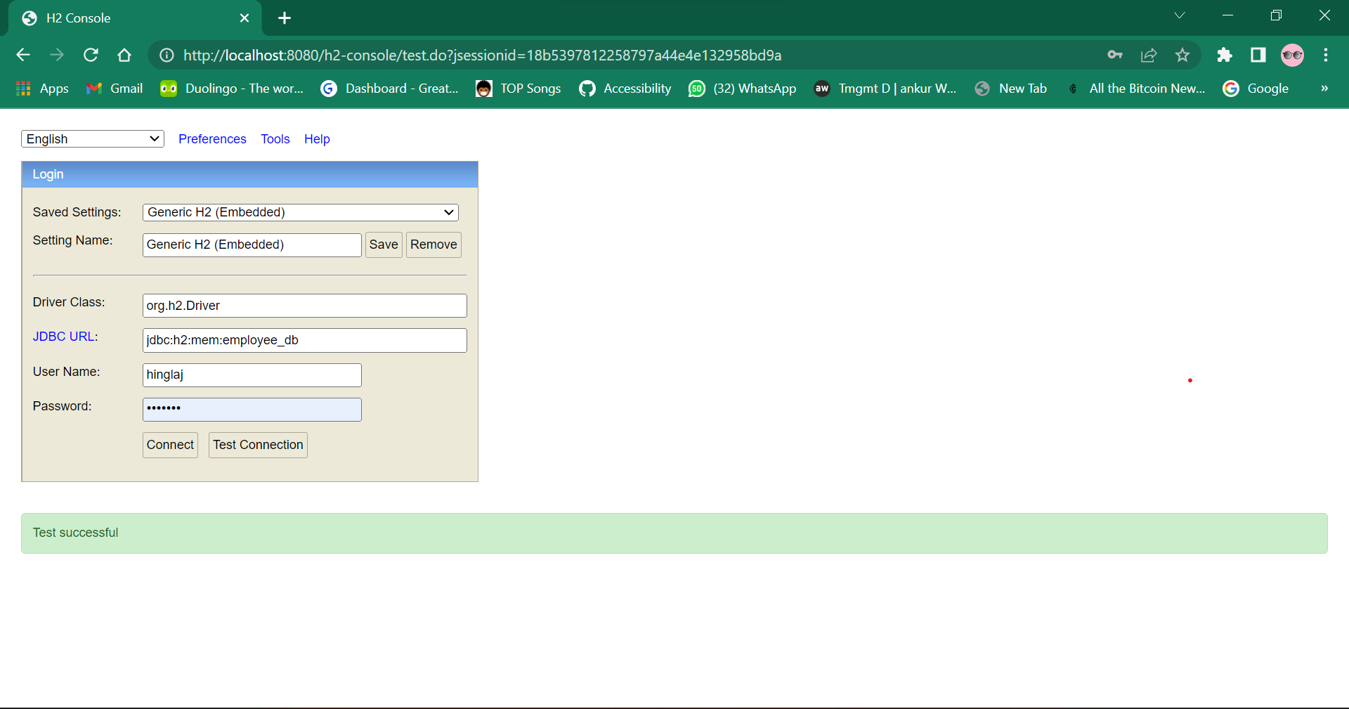
Login in H2-Console

Slide 13
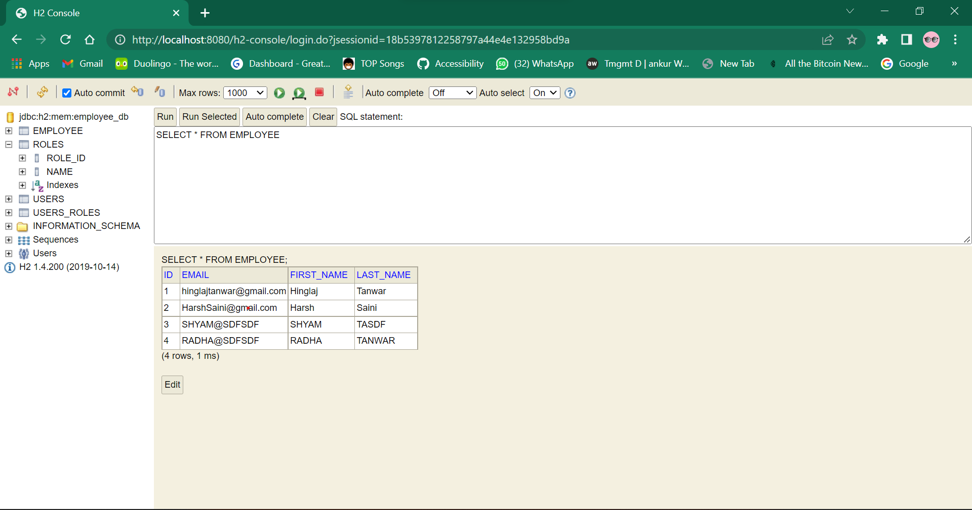
Relational Data - Employee

Slide 14
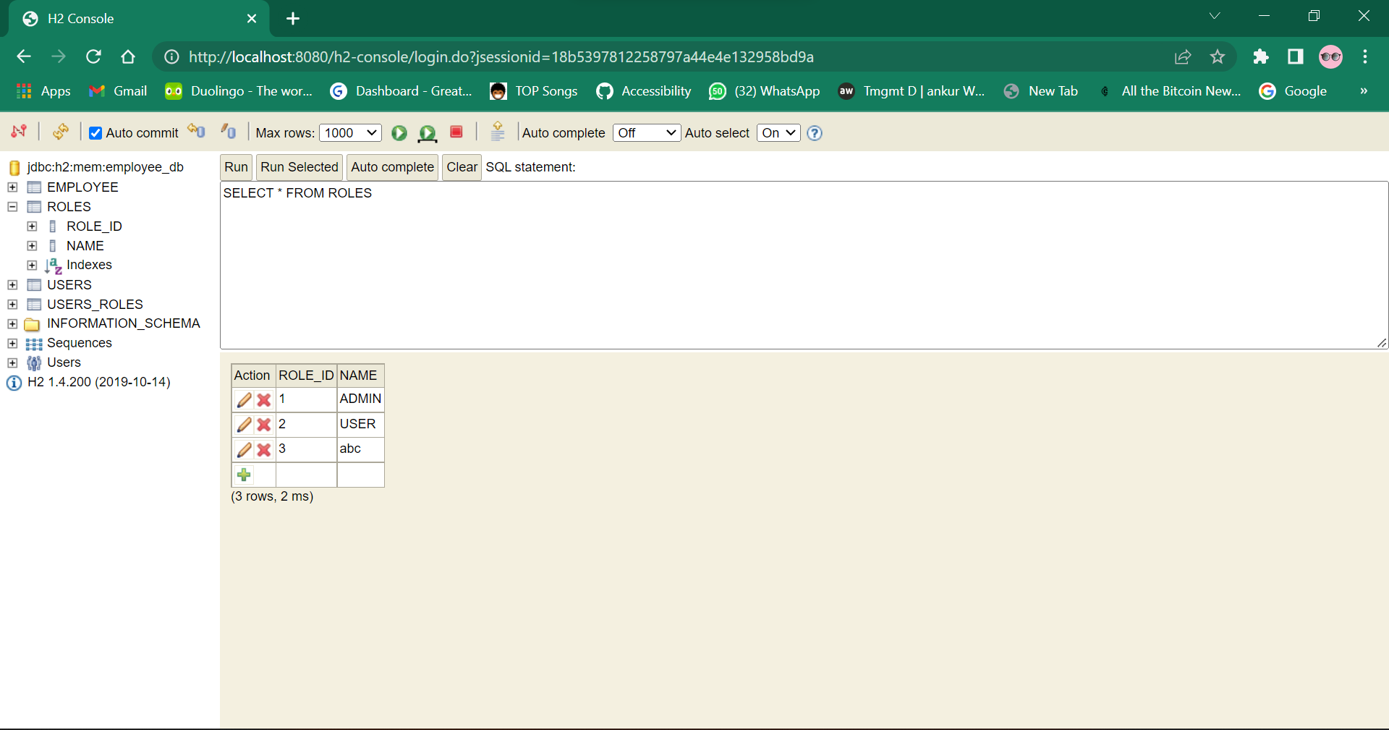
Relational Data - Roles

Slide 15
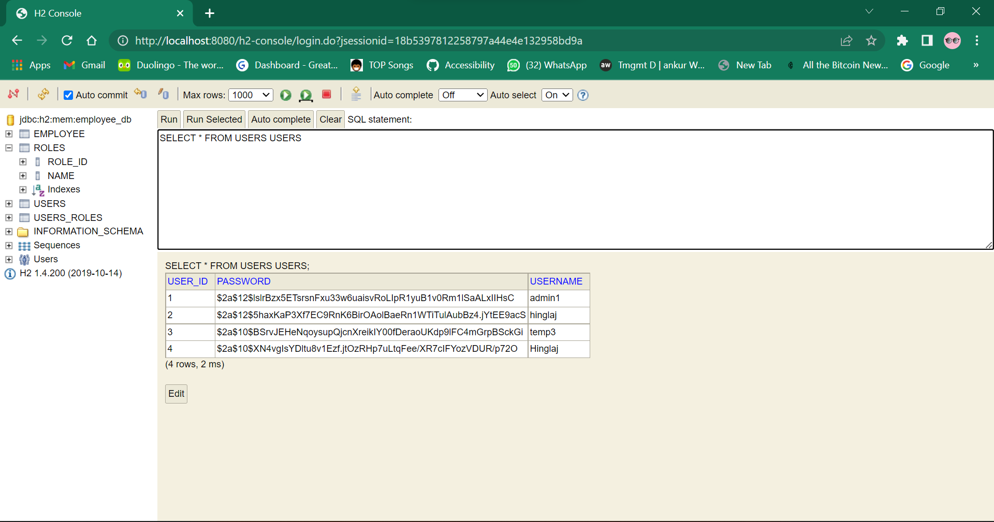
Relational Data – User id with Encrypted password

Slide 16
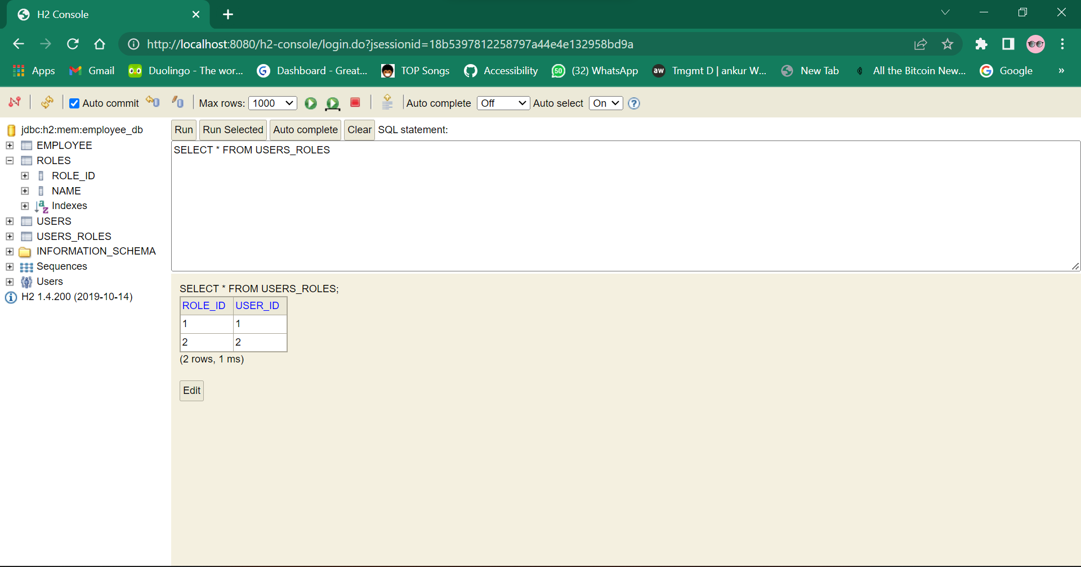
Relational Data - Roles

Slide 18
Thank you
Hinglaj Tanwar

