Slide 1
INTERNET PROGRAMMING
Chapter 14: HTTP

Slide 2
Introduction
This chapter presents the .NET WebClient class—the easiest way to communicate via HTTP from your C# programs. A discussion of the WebRequest and WebResponse classes talks about the many features available to help you create fullfeatured web programs, and a complete example walks you through the steps of creating a web program.

Slide 3
The WebClient Class
The easiest way to communicate with websites from a C# network program is to use the WebClient class, found in the System.Net namespace. This class provides methods to send requests and receive responses from a web server within your program, making it easy to incorporate web functionality in your programs.

Slide 4
Downloading Web Data
The WebClient class provides three methods that can download information from a web server:
  DownloadData() Downloads data to a byte array from a specified URI
  DownloadFile() Downloads data to a local file from a specified URI
  OpenRead() Opens a read-only stream to download data from a specified URI.
Each of the download methods requires that a URI parameter be entered to specify the website location. The URI must follow the standard HTTP URI specifications.

Slide 5
The DownloadData() Method
using System;
using System.Net;
using System.Text;
class DownloadDataTest
{
public static void Main (string[] argv)
{
WebClient wc = new WebClient();
byte[] response = wc.DownloadData(argv[0]);
Console.WriteLine(Encoding.ASCII.GetString(response));
}
}

Slide 6
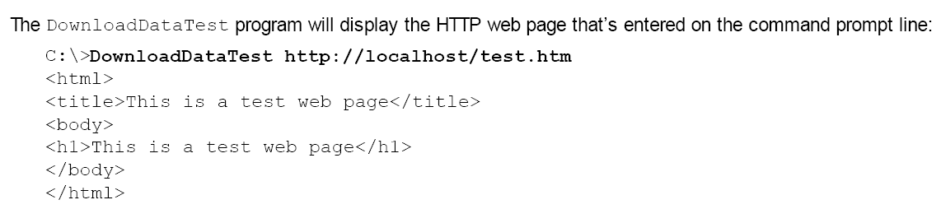
Output of previous program

Slide 7
The DownloadFile() Method
Instead of downloading the returned web page into a byte array, you can just as easily download it directly into a file on the local device using the DownloadFile() method.

Slide 8
DownloadFile example
using System;
using System.Net;
class DownloadFileTest
{
public static void Main (string[] argv)
{
WebClient wc = new WebClient();
string filename = "webpage.htm";
wc.DownloadFile(argv[0], filename);
Console.WriteLine("file downloaded");
}
}

Slide 9
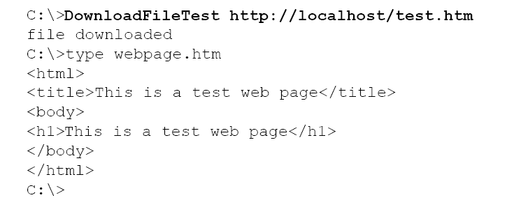
File download output

Slide 10
The OpenRead() Method
The OpenRead() method extracts the web page into a Stream object, which can then be used in a StreamReader object to easily retrieve data from the web server.

Slide 11
Example
using System;
using System.IO;
using System.Net;
class OpenReadTest
{
public static void Main (string[] argv)
{
WebClient wc = new WebClient();
string response;
Stream strm = wc.OpenRead(argv[0]);

Slide 12
Example
StreamReader sr = new StreamReader(strm);
while(sr.Peek() > -1)
{
response = sr.ReadLine();
Console.WriteLine(response);
}
sr.Close();
}
}

Slide 13
Viewing HTTP Headers
The WebClient class also contains the ResponseHeaders property, which allows you to retrieve the HTTP header fields used in the HTTP communication with the web server. These header fields don’t appear in the web page itself, but they often provide useful information about the HTTP communication.

Slide 14
Example
using System;
using System.Collections.Specialized;
using System.Net;
class ResponseHeadersTest
{
public static void Main (string[] argv)
{
WebClient wc = new WebClient();
byte[] response = wc.DownloadData(argv[0]);
WebHeaderCollection whc = wc.ResponseHeaders;

Slide 15
Example
Console.WriteLine("header count = {0}", whc.Count);
for (int i = 0; i < whc.Count; i++)
{
Console.WriteLine(whc.GetKey(i) + " = " + whc.Get(i));
}
}
}

Slide 16
About the program
The ResponseHeaders property returns a WebHeaderCollection object. Like all collections in .NET, you can access the item names (header fields) in the object by using the GetKey() method and the values by using the Get() method.

Slide 17
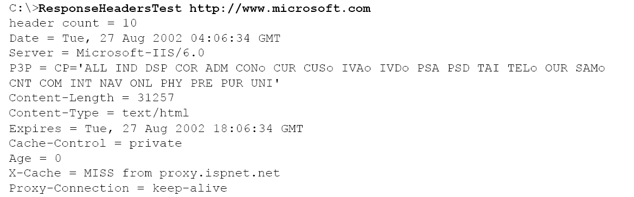
Output

Slide 18
The NetworkCredential Class
The NetworkCredential class (found in the System.Net namespace) authenticates a client to the web server using a simple username/password combination (and a specified domain name for Windows web servers). The NetworkCredential object is created using one of three constructor formats:
  NetworkCredential()
  NetworkCredential(string username, string password)
  NetworkCredential(string username, string password, string domain)

Slide 19
CredTest.cs
using System;
using System.Net;
using System.Text;
class CredTest
{
public static void Main()
{
WebClient wc = new WebClient();
NetworkCredential nc = new NetworkCredential("alex", "mypassword");
wc.Credentials = nc;
byte[] response = wc.DownloadData("http://localhost/testlogin");
Console.WriteLine(Encoding.ASCII.GetString(response));
}}

Slide 20
The CredentialCache Class
If you write a network program that must connect to several websites that require authentication, it could be a nightmare trying to keep all of the proper NetworkCredential objects straight with the proper websites. The .NET network library offers a simple solution: the CredentialCache class, found in the System.Net namespace

Slide 21
The CredentialCache Class
The CredentialCache constructor creates a new CredentialCache object but does not add any NetworkCredential objects. These objects are added using the Add() method:
  Add(URI website, string authtype, NetworkCredential cred)
The website must be specified as a URI object, created using the URI class. The authentication type is a string representing the HTTP authentication method used. Currently two types of authentication methods are possible:
  Basic Sends the username and password in plain text
  Digest Uses the MD-5 encryption method to send the username and password

Slide 22
Example
using System;
using System.Net;
using System.Text;
class CredCacheTest
{
public static void Main()
{
WebClient wc = new WebClient();
string website1 = "http://remote1.ispnet.net";
string website2 = "http://remote2.ispnet.net";
string website3 = "http://remote3.ispnet.net/login";
NetworkCredential nc1 = new NetworkCredential("mike", "guitars");
NetworkCredential nc2 = new NetworkCredential ("evonne", "singing", "home");

Slide 23
Example
NetworkCredential nc3 = new NetworkCredential("alex", "drums");
CredentialCache cc = new CredentialCache();
cc.Add(new Uri(website1), "Basic", nc1);
cc.Add(new Uri(website2), "Basic", nc2);
cc.Add(new Uri(website3), "Digest", nc3);
wc.Credentials = cc;
wc.DownloadFile(website1, "website1.htm");
wc.DownloadFile(website2, "website2.htm");
wc.DownloadFile(website3, "website3.htm");
}
}

Slide 24
Advanced Web Classes
In addition to the WebClient class, the .NET library also includes the WebRequest and WebResponse classes. Both of these classes are contained in the System.Net namespace and provide advanced functionality for the network programmer.

Slide 25
Advanced Web Classes
WebRequest and WebResponse are abstract base classes. That means they should not be used directly as objects in programs. Instead, they should be used by descendant classes once the objects are created. The descendant class used depends on the URI prefix specified in the URI parameter.

Slide 26
Advanced Web Classes
For http and https URIs, the HttpWebRequest and HttpWebResponse classes are used to handle the HTTP communication with the web server. These classes contain more advanced HTTP-specific functions than the WebClient class provides. For file URIs (accessing local HTML pages), the FileWebRequest and FileWebResponse classes are used. These classes provide the same functionality as the HTTP versions.

Slide 27
The HttpWebRequest Class
The HttpWebRequest class provides many advanced features for retrieving web pages using HTTP from the web server. To create an HttpWebRequest object, you must typecast the result of the WebRequest.Create() static method. For example:
HttpWebRequest hwr =_ (HttpWebRequest)WebRequest.Create("http://remotehost/webpage.htm");
Because the WebRequest class method is typecast to an HttpWebRequest object, the returned object is an HttpWebRequest object. After the HttpWebRequest object is created, you can set many of the HTTP header fields using the many HttpWebRequest class properties.

Slide 28
Using a Web Proxy
HttpWebRequest hwr = (HttpWebRequest)WebRequest.Create(
"http://remote1.ispnet2.net);
WebProxy proxysrv = new WebProxy("http://proxy1.ispnet.net:2000");
hwr.Proxy = proxysrv;

Slide 29
Using a Web Proxy
After the web proxy server is defined, you can send and receive HTTP messages as if there were no web proxy servers between the client and the web server.

Slide 30
Sending Data
To send data to the web server, you must use the GetRequestStream() method, as shown here:
HttpWebrequest hwr = (HttpWebRequest)WebRequest.Create("http://localhost");
Stream strm = hwr.GetRequestStream();
StreamWriter sw = new StreamWriter(strm);
sw.WriteLine(data);

Slide 31
Sending Data
This method returns a Stream object that can send data directly to the web server.
Warning The Stream object returned by the GetRequestStream() method can only be used for writing data to the server.
It cannot be used for retrieving data.

Slide 32
Retrieving Data
There are two ways to retrieve the response from a HttpWebRequest object:
GetResponse() Places the response from the web server in an HttpWebResponse object.
BeginGetResponse() Uses an asynchronous function call to place the response from the web server in an HttpWebResponse object. This method uses the asynchronous method of returning the server response.
Both of these methods return the server response as an HttpWebResponse object.

Slide 33
Web services
One of the new and exciting features facilitated by the .NET Framework is web services. Web services allow a web server to advertise specific methods that can be consumed by remote applications on the network. This can be a way to incorporate distributed computing techniques for programmers. One company can provide information via a web service to remote customers running web service client programs. The clients can write their own application programs that use the remote web service server to obtain information from the company.

