Slide 1
INTERNET PROGRAMMING
Chapter 15: Active Directory

Slide 2
Network Directory Basics
The technology of network directory services has become one of the biggest crazes of computer networks. It allows multiple hosts on a network to share information about applications, resources, and users from a common database on the network. Novell’s Netware Directory Service and Microsoft’s AD are just two examples of network directory services. Many other vendors are experimenting with this technology to handle network resources.
Notes:
A directory is a hierarchical structure that stores information about objects on the network. A directory service, such as Active Directory Domain Services (AD DS), provides the methods for storing directory data and making this data available to network users and administrators. For example, AD DS stores information about user accounts, such as names, passwords, phone numbers, and so on, and enables other authorized users on the same network to access this information.
Active Directory stores information about objects on the network and makes this information easy for administrators and users to find and use. Active Directory uses a structured data store as the basis for a logical, hierarchical organization of directory information.
This data store, also known as the directory, contains information about Active Directory objects. These objects typically include shared resources such as servers, volumes, printers, and the network user and computer accounts. For more information about the Active Directory data store, see Directory data store.

Slide 3
The LDAP System
An LDAP database is based on a hierarchical database design, similar to how the DNS database stores domain names. Hierarchical databases are often used in databases that match organizational constructs because they can easily represent the hierarchies of a company. They are known for their fast access times, but slow write times.
Notes:
Security is integrated with Active Directory through logon authentication and access control to objects in the directory. With a single network logon, administrators can manage directory data and organization throughout their network, and authorized network users can access resources anywhere on the network. Policy-based administration eases the management of even the most complex network. For more information about Active Directory security, see Security overview.
Active Directory also includes:
A set of rules, the schema, that defines the classes of objects and attributes contained in the directory, the constraints and limits on instances of these objects, and the format of their names. For more information about the schema, see Schema.
A global catalog that contains information about every object in the directory. This allows users and administrators to find directory information regardless of which domain in the directory actually contains the data. For more information about the global catalog, see The role of the global catalog.
A query and index mechanism, so that objects and their properties can be published and found by network users or applications. For more information about querying the directory, see Finding directory information.
A replication service that distributes directory data across a network. All domain controllers in a domain participate in replication and contain a complete copy of all directory information for their domain. Any change to directory data is replicated to all domain controllers in the domain. For more information about Active Directory replication, see Replication overview.

Slide 4
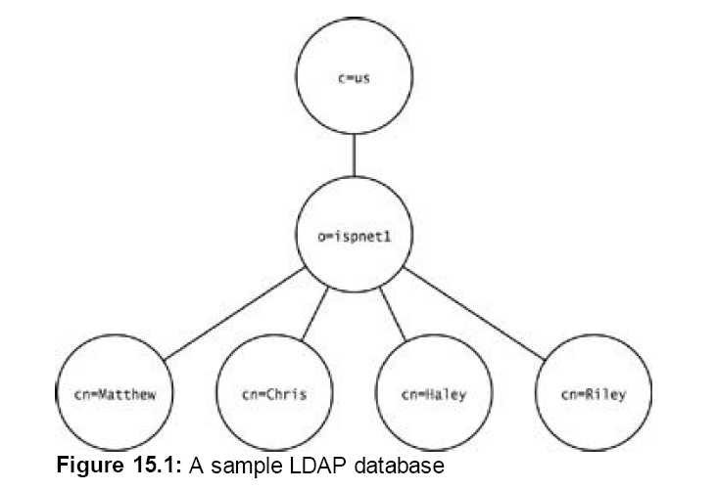
LDAP Database

Slide 5
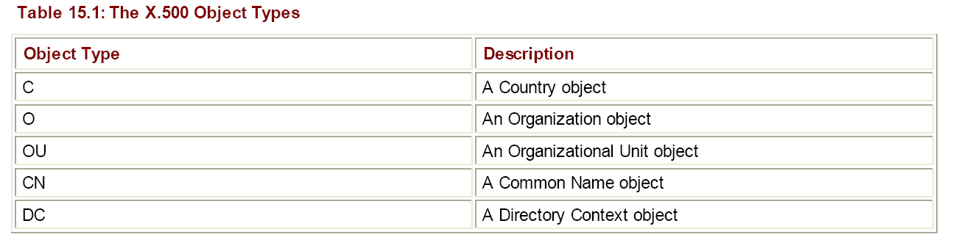
LDAP Objects and Attributes

Slide 6
Working with Active Directory
The Microsoft Active Directory (AD) system replaces the older Windows NT domain system. With the release of Windows 2000 Server, Microsoft converted the domain system to an LDAP database model. Instead of holding domain information in a flat database, a hierarchical network directory service system allows a more robust network configuration. AD databases contain objects that represent all the network resources that were previously maintained in the domain database.

Slide 7
Parts of an Active Directory
Domains
  The AD concept of a domain is similar to the original Windows NT concept. An AD domain contains a group of network resources sharing the same database structure and security policy. In the AD system, network administrators use a hierarchical database to organize network resources within directory contexts in the domain. This makes domain management much simpler than the Windows NT domain method.

Slide 8
Organizational Units
Domains themselves can be subdivided into smaller entities. Organizational Units (OUs) are the containers within the domain used to group related objects (similar to the directory context in LDAP). Often the OU is based on the business structure of the organization, keeping network resource objects in each business unit (or division) in its own OU container.

Slide 9
Trees
A trust relationship is the set of rules configured in a domain that allows users (or other network objects) from one domain to access network resources in another domain. For an organization with multiple domains to allow each domain access to resources in all of the other domains, a trust relationship has to be created between every combination of domains. This can quickly grow into a huge administration nightmare.

Slide 10
Trees
To solve this problem, the AD system created the concept of trees. A tree is an interconnection of separate domains, all within the control of a single AD database. One domain is designated as the main domain in the tree (called the root domain), and all other domains are configured as objects under the root domain (similar to the basic LDAP structure). All of the domains in the tree share the common naming space of the root domain.

Slide 11
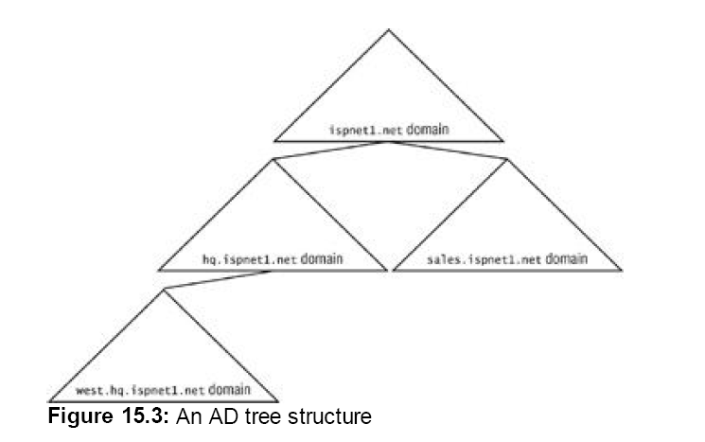
Trees

Slide 12
Connecting to an Active Directory Server
To connect to a Windows 2000 AD Server, the workstation must be running the AD Services Interface (ADSI). All communication with an AD server, whether it is from the operating system or from a user program on the system, is done through the ADSI. The .NET AD library uses the ADSI for all of its AD functions.

Slide 13
Using C# to Access a Network Directory
The main .NET class for working with network directory services objects is the DirectoryEntry class, found in the System.DirectoryServices namespace. The DirectoryEntry class allows you to bind to a directory object and perform operations to retrieve, add, delete, and modify information about the object.
The DirectoryEntry class has many constructor formats, depending on your requirements within the database.

Slide 14
Anonymous Directory Login
Many network directory services allow either all or some database objects to be read by anyone on the network, regardless of network permissions. This allows network users to look up resources on the network, such as a user phone number and address, without requiring advanced privileges on the directory server.

Slide 15
Anonymous Directory Login
To create a DirectoryEntry instance to reference a directory object without using privileges, you use the following constructor format:
  DirectyoryEntry(string ldappath)
The ldappath parameter is a string value that represents the location of the database object. The object must be referenced using a URI-like syntax, which includes the access method, the network directory service server address, and the distinguished name of the object.

Slide 16
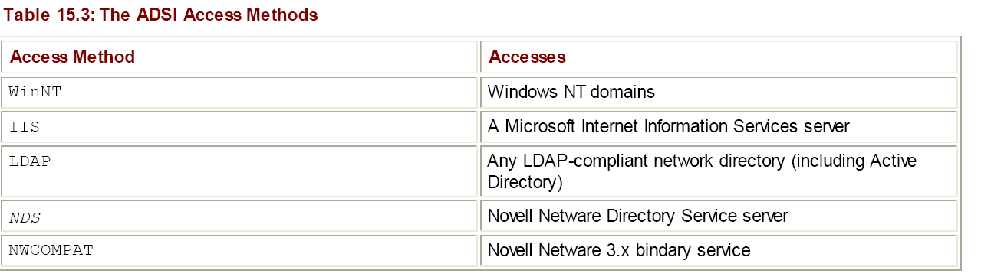
ADSI Access methods

Slide 17
ADSI Access methods
After the access method, the address of the desired directory server should be specified, along with the full distinguished name of the object to reference. A few examples of proper LDAP paths would be:
  LDAP://server1.ispnet1.net/dc=ispnet1, dc=net
  LDAP://server1.ispnet1.net/cn=kblum, ou=sales, dc=ispnet1, dc=net
  LDAP://192.168.1.100/ou=accounting, dc=ispnet1, dc=net

Slide 18
BindObject.cs program
using System;
using System.DirectoryServices;
class BindObject
{
public static void Main()
{
DirectoryEntry de = new DirectoryEntry(
"LDAP://192.168.1.100/dc=ispnet1, dc=net");
string ldappath = de.Path;
Console.WriteLine("The LDAP path is: {0}", ldappath);
de.Close();
}
}

