Slide 1
Alternative Estimators of the Proportion of Hatchery-Origin Spawners
by
Richard Hinrichsen
Rishi Sharma
Tim Fisher

Slide 2
Why Estimate Hatchery-Origin Spawners?
These fish originate in hatchery, are released as juveniles, and return to spawn in the wild.
Influx of hatchery spawners influence population dynamics by artificially increasing spawner numbers
Influences: density dependence, reproductive success.
Genetic effects (Christie et al. 2012)
Mark R. Christie, Melanie L. Marine, Rod A. French, and Michael S. Blouin. 2012. Genetic adaptation to captivity can occur in a single generation. PNAS 109:238-242.

Slide 3
Relative Reproductive Success of Hatchery-born Spawners
Chilcote et al. (2011) found that a naturally spawning population composed entirely of hatchery-origin spawners would have a reproductive performance that is 0.128 of that expected for a population composed entirely of wild-origin spawners.
The study was based on 93 salmon populations in Oregon, Washington, and Idaho, that were known to contain both wild and hatchery fish. Three species were represented: steelhead, coho and chinook.

Slide 4
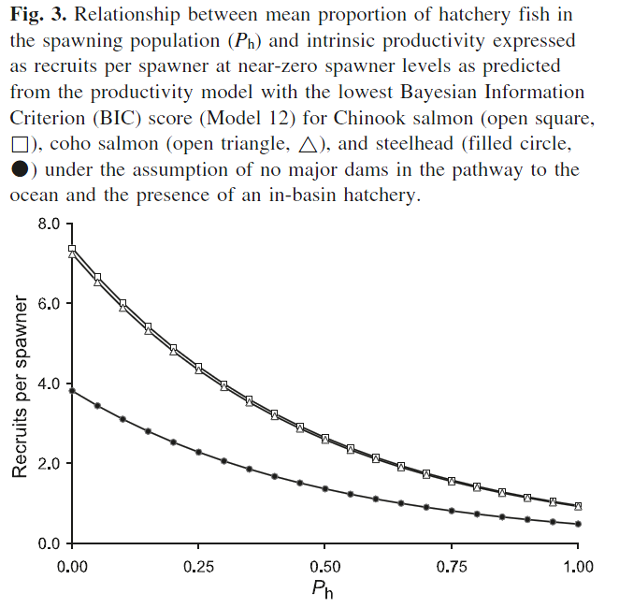
Source: Chilcote et al. (2011) CJFAS

Slide 5
How To Estimate, P_{h}?
A fraction of juvenile fish at source hatcheries are visibly marked with a fin clip (adipose or other) or implant elastomer tag.
Furthermore, some juvenile fish are tagged with a coded-wire tag that identifies the hatchery of origin.
Spawning fish are sampled using carcass surveys.

Slide 6
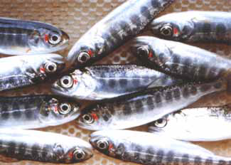
Visible Marks (VM)
Visible Implant Elastomer tags (VIE)
Adipose Fin Clip

Slide 7
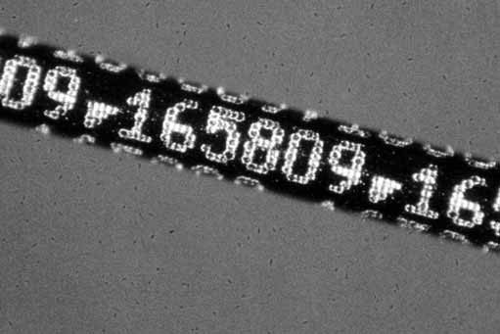
Coded Wire Tags (CWT)
Magnified section of a CWT (1.1 mm long) before it is inserted into the snout of a juvenile salmon. Source: Northwest Marine Technology.

Slide 8
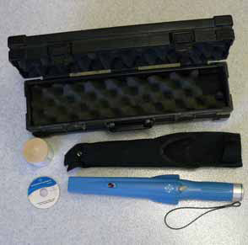
Carcass Survey
Fish with CWT are indentified with a hand-held wand device.

Slide 9
An Easy Solution
Use constant VM fraction at all source hatcheries! For example, λ = 0.25. In that case,
H is an estimate of the total number of hatchery-origin spawners on the spawning grounds.

Slide 10
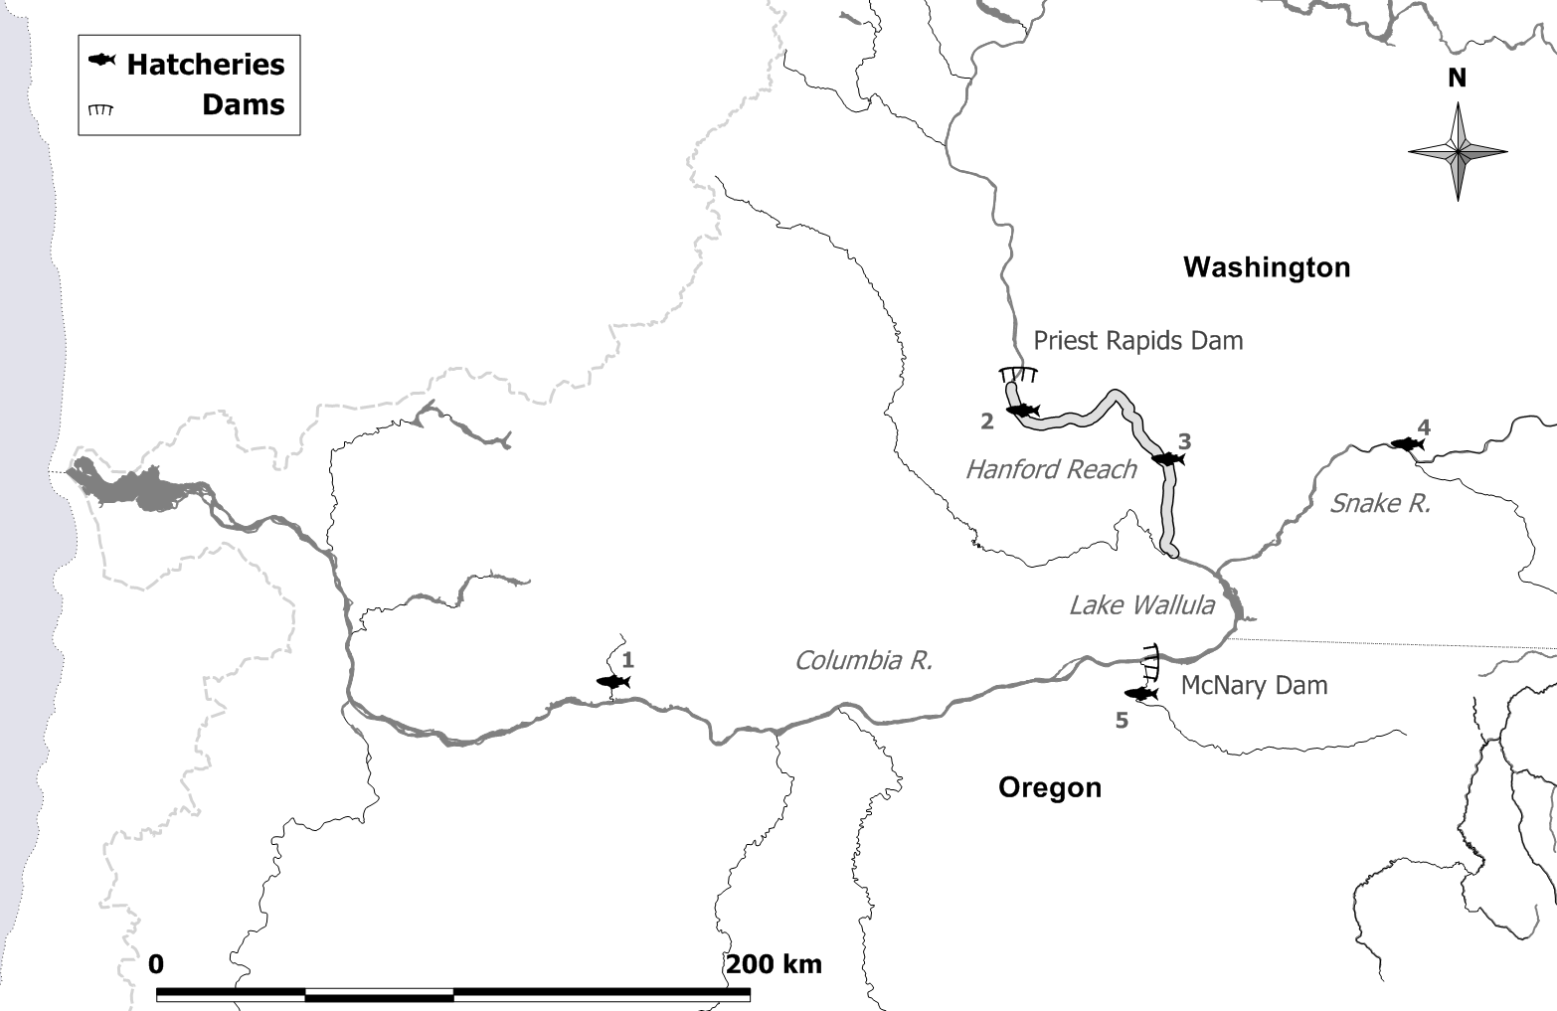
HANFORD REACH EXAMPLE
Priest Rapids H
Lyons Ferry H
Ringold Springs H
Little White Salmon NFH
Umatilla H
Source: Hinrichsen et al. (2012) TAFS:

Slide 11
Visible marking and coded-wire tagging at source hatcheries that provide spawner inputs to Hanford Reach spawning grounds. The total number of spawning ground carcasses sampled in 2010 was 9,791 and the sample rate was 0.11252. Of the carcasses sampled, 23 were VM’d and CWT’d at a hatchery and 308 were VM’d only. Numbers (#) refer to hatchery locations in Figure 2. The total number released may be calculated by summing the columns “VM & CWT,” “VM only,” “CWT only,” and “Not VM & not CWT.”
# | Hatchery | Brood year | VM & CWT | VM only | CWT only | Not VM & not CWT | VM fraction, λ | CWT fraction, φ | No. tags in sample
1 | Little White Salmon NFH | 2005 | 448,145 | 1,354,029 | 0 | 0 | 1.00 | 0.25 | 1
2 | Priest Rapids H | 2005 | 199,445 | 1,628,614 | 0 | 5,048,231 | 0.27 | 0.11 | 3
 |  | 2007 | 202,568 | 813 | 0 | 4,344,925 | 0.04 | 1.00 | 7
3 | Ringold Springs H | 2006 | 222,706 | 0 | 0 | 3,179,824 | 0.07 | 1.00 | 2
 |  | 2007 | 221,951 | 2,230,190 | 0 | 645,308 | 0.79 | 0.09 | 7
4 | Lyons Ferry H | 2006 | 231,534 | 1,673 | 220,350 | 6,076 | 0.51 | 0.99 | 1
5 | Umatilla H | 2007 | 279,480 | 0 | 0 | 0 | 1.00 | 1.00 | 2

Slide 12
VM or CWT In 2010 Hanford Reach Carcass Survey

Slide 13
Simplified Method of Moments Estimator
x_{1,i} is the number of carcasses sampled that were VM and CWT at hatchery i.
θ_{i} is the sample rate
λ_{i} is the VM fraction at source hatchery i.
φ_{i} is the CWT fraction at source hatchery i

Slide 14
Problem: The simplified method (SMME) does not include the “VM only” (x₂) spawners from the carcass survey!
An estimator that uses all of the data is needed: we call it the generalized least square estimator (GLSE).
We base this estimate on a method of moments technique that includes both VM & CWT spawners (x_{1,i}) and VM only spawners (x₂).

Slide 15
Method of Moments For both VM&CWT and VM only
VM&CWT equations
VM only equation
Hinrichsen, R.A., R. Sharma, T.R. Fisher. 2012. Precision and accuracy of estimators of the proportion of hatchery-origin spawners. Transactions of the American Fisheries Society 142:437-454.

Slide 16
Method of Moments in Matrix Notation
n+1 equations and n unknowns (suggests least squares).

Slide 17
Matrix B
Special structure
Diagonal matrix of weights in expected value equations for x₁.
Row vector of weights for describing expected value of x₂.

Slide 18
Solving n+1 equations for n unknowns (Generalized Least Squares)
Minimize the Mahalonobis distance:
where
and B is a matrix of weights derived from the method of moments equations shown earlier.

Slide 19
Generalized Least Squares Solution
GLSE of H
var(GLSE)

Slide 20
Variance matrix, Σ
A special structure of the variance matrix, derived using a multinomial distribution, simplifies inversion.
Diagonal covariance matrix for x₁ (CWT & VM)
Scalar variance for x₂ (VM only)
Covariance between x₁ and x₂.

Slide 21
Analytical Results (hatchery-specific estimators)
GLSE
Variance
SMME
var(SMME)

Slide 22
Analytical Results (Total Hatchery Spawners)
GLSE
Var(GLSE)
Var(SMME)

Slide 23
Proportions of Hatchery-Origin Spawners (Hatchery-specific)
GLSE
var(GLSE)
var(SMME)

Slide 24
Proportion of Total Hatchery-Origin Spawners
GLSE
var(GLSE)
var(SMME)

Slide 25
The CV of the GLSE of is compared to the SMME. In this study, the number of hatcheries is two, true spawning population size is 1000, the true value of p is 0.5. , sample rate is 0.20, H₁ = H₂ , the VM fraction of the second hatchery is 0.5, and the VM fraction of the first hatchery is 0.5. Note that the GLSE shows the greatest benefit to precision over the SMME when CWT fraction is low and no benefit when it is equal to 1.0

Slide 26
The CV of the GLSE of is compared to the SMME. In this study, the number of hatcheries is two, true spawning population size is 1000, the true value of p is 0.5. , sample rate is 0.20, H₁ = H₂ , the VM fraction of the second hatchery is 1.0, and the VM fraction of the first hatchery is 0.5. Note that the GLSE shows the greatest benefit to precision over the SMME when CWT fraction is low and no benefit when it is equal to 1.0

Slide 27
GLSE BIAS
SMME BIAS

Slide 28
Estimates of hatchery inputs to Hanford Reach spawning grounds in 2010. Standard errors of estimates are given in parentheses.
 |  | Hatchery contribution to spawning population |  |  |  |  | Proportion of hatchery fish in total spawning population
Source Hatchery | Brood year | GLSE |  | SMME |  |  | GLSE |  | SMME
Little White Salmon NFH | 2005 | 45.1 | (39.5) | 35.7 | (35.2) |  | 0.0005 | (0.0005) | 0.0004 | (0.0004)
Priest Rapids H | 2005 | 2100.4 | (738.3) | 919.2 | (529.9) |  | 0.0241 | (0.0085) | 0.0106 | (0.0061)
 | 2007 | 1397.2 | (526.7) | 1396.8 | (526.6) |  | 0.0161 | (0.0061) | 0.0161 | (0.0061)
Ringold Springs H | 2006 | 271.6 | (191.3) | 271.6 | (191.3) |  | 0.0031 | (0.0022) | 0.0031 | (0.0022)
 | 2007 | 2818.4 | (289.6) | 868.2 | (326.8) |  | 0.0324 | (0.0033) | 0.0100 | (0.0038)
Lyons Ferry H | 2006 | 17.7 | (17.1) | 17.6 | (17.1) |  | 0.0002 | (0.0002) | 0.0002 | (0.0002)
Umatilla H | 2007 | 17.8 | (11.8) | 17.8 | (11.8) |  | 0.0002 | (0.0001) | 0.0002 | (0.0001)
 | Total | 6668.1 | (788.9) | 3527.0 | (838.6) |  | 0.0766 | (0.0090) | 0.0405 | (0.0096)

Slide 30
Future Directions
Parentage-based tagging (PBT) instead of CWT
Single Nucleotide Polymorphisms (SNPs) can be used to determine parents and therefore, hatchery of origin and brood year.
Use prior information to solve problem of ambiguity in determining hatchery of origin ala Jaynes (1984).
Jaynes, E.T. 1984. Prior information and ambiguity in inverse problems. SIAM-AMS Proceedings 14: 151-156.

Slide 31
Parentage-Based Tagging (PBT)
The PBT method involves genotyping hatchery broodstock with SNPs and recording their genotypes in a data base of parents. Genotypes taken from carcass samples can be compared to this data base, and, if the parents of the carcass sample are found, this provides the age and hatchery of origin of the sample, and can also be used to determine the release group (Anderson 2010).
Using this method, about 95% of the hatchery releases can be tagged.
Fluidigm® microfluidic 96.96 chips allow processing of 96 samples using 96 SNPS.
VM of salmon will still be important for identifying hatchery-origin spawners.
Anderson, E.C. 2010. Computational algorithms and user-friendly software for parentage-based tagging of Pacific salmonids. SWFSC Final Report 10 March 2010.

Slide 32
Ambiguity in hatchery of origin
Hatchery #1
Hatchery #2
Hatchery #3
S p a w n i n g G r o u n d s
CWT
CWT
CWT
SAMPLE

Slide 33
Dealing with ambiguity
An alternative would be to use prior information that provides a way to include all potential source hatcheries.
Use known relative straying rates from hatchery to spawning grounds in the estimation procedure.
Is there are relationship between straying and distance between hatchery and spawning grounds?

Slide 34
Conclusions
There exists an estimator (GLSE) of p that yields a fit to both the number of sampled CWT’d recoveries and the number of sampled VM’d spawners to estimate hatchery-specific spawner escapements;
The GLSE is more precise than a simpler estimator SMME that uses recoveries that are CWT’d, but ignores the portion of the sample that is both VM’d and untagged in the estimation of hatchery-origin spawners;
The GLSE, however, can be less accurate (more biased) than the simple SMME;
When allVM fractions for all source hatcheries are the same, the GLSE does not depend on CWT fractions and it always exists; and
When VM fractions are not the same, the GLSE does not exist whenever there are zero CWT recoveries yet there are VM’d spawners in the sample.

Slide 35
Recommendations
To simplify the analysis and achieve maximum accuracy and precision in the estimates of the proportion of hatchery-origin fish spawning in the wild, we recommend that:
All sampled spawners be tested for a CWT, and
A common VM fraction be used for all hatchery releases, and that this common VM fraction be as high as possible (preferably 100%);
Barring this, we recommend that CWT fractions be as high as possible.

