Slide 1
E-commerce Customer Analytics
Turning 18 months of order data into revenue, retention and service-quality insights with Python & Pandas
Sak · September 2026
Pandas · NumPy · Matplotlib · Seaborn · SciPy · Jupyter · GitHub
Notes:
Introduce the project: an e-commerce retailer across 7 Southeast-Asian markets; goal is to answer business questions from order data using Pandas.

Slide 2
1 · Business problem & project scope
The problem
In scope
A fast-growing online retailer selling in Cambodia, Thailand, Vietnam, Singapore, Malaysia, the Philippines and Indonesia has never analysed its order history. Management cannot answer:
Order-level data, 1 Jan 2024 – 30 Jun 2025 (2,045 raw → 1,972 clean rows)
Customer attributes: age, gender, country, segment, channel
Order attributes: category, price, discount, payment, device, delivery, status, rating
Cleaning · descriptive & statistical analysis · visualisation
Which products, customers and markets actually drive revenue?
Do customers come back after their first purchase?
Why do some customers leave poor reviews and return products?
Out of scope
SKU-level product analysis (data is at category level)
Cost of goods, profit margin, marketing spend
Predictive / machine-learning models
Web-analytics events (page views, cart abandonment)
Budgets are spread evenly and decisions are made on intuition.
E-commerce Customer Analytics · 2

Slide 3
2 · Three measurable objectives
O1
O2
O3
Identify revenue drivers
Measure retention & value concentration
Diagnose service quality
Quantify revenue share by category, segment, country and channel; find the groups producing ≥ 80 % of revenue.
Determine the share of repeat buyers and how concentrated spend is among top customers.
Test whether delivery speed and returns are related to customer satisfaction.
Success measure
Success measure
Success measure
Revenue share (%), cumulative share
Repeat rate, top-20 % revenue share, churn-risk share
Correlation r with p-value, rating by delivery band, return rate by category
E-commerce Customer Analytics · 3

Slide 4
2 · Seven analytical questions
Which categories generate the most revenue — and the most returns?
Does delivery time affect the review rating?
Q1
Q5
groupby · agg · sort
filtering · pd.cut · correlation
How do New / Regular / VIP customers differ in frequency, order value and spend?
What share of customers repeat, and how many are at churn risk?
Q2
Q6
groupby · customer table
customer aggregation · RFM flags
How do orders and revenue trend month by month — is there seasonality?
Do device and payment preferences differ by age group?
Q3
Q7
time-series groupby · pivot_table
crosstab
Which countries and acquisition channels bring the most valuable customers?
Each question is answered in the notebook with a table, a chart and a written interpretation, and links back to an objective (O1–O3).
Q4
groupby · pivot_table
E-commerce Customer Analytics · 4

Slide 5
3–4 · The dataset & data dictionary
2,045
20
721
18
raw order rows
columns (+11 derived)
unique customers
months · Jan 2024 – Jun 2025
Synthetic but realistic — generated by src/generate_dataset.py (seed 42) with seasonal demand, segment-dependent frequency, category-specific prices and return rates, and a delivery-time → rating link. Realistic defects are injected on purpose: missing values, 45 duplicates, 25 out-of-range values, inconsistent category spelling.
Field | Type | Description | Example
order_id / customer_id | string | Unique order; customer id repeats across orders | ORD100305 / C1122
order_date, signup_date | date | Order date; account registration date | 2024-04-25
age, gender, country, city | int / category | Customer demographics (7 markets) | 36, Male, Cambodia
customer_segment, acquisition_channel | category | New / Regular / VIP; Organic, Social, Email, Paid Ads, Referral | VIP, Referral
product_category | category | Electronics, Fashion, Home & Kitchen, Beauty, Sports, Books, Toys | Beauty
quantity, unit_price, discount_pct, shipping_cost | int / float | Basket economics (USD, %) | 1, 37.40, 5.0, 9.99
payment_method, device_type | category | Payment and device used | Credit Card, Desktop
delivery_days, order_status, review_rating | float / category | Days to deliver; Delivered/Cancelled/Returned; 1–5 stars | 7.0, Returned, 3.0
Full 31-column dictionary in docs/data_dictionary.md
E-commerce Customer Analytics · 5

Slide 6
5–8 · Explore, clean and validate
1
Explore
2
Standardise
3
Duplicates
4
Validate
5
Impute
head · shape · columns · info · describe
strip / title-case categories, F→Female
df.duplicated() → drop_duplicates()
range rules, domains, order ≥ signup
median (age) · mode (payment) · mode-in-country (city)
›
›
›
›
describe() exposes age −5…210, quantity −2, discount 150 %, rating 0–7
7 clean categories, 2 genders
45 exact duplicates removed
25 impossible values → NaN; 28 unusable rows dropped
structural NaNs kept (no review, cancelled)
2,045
→
2,000
→
1,972
raw rows
after removing 45 duplicates
clean rows × 31 columns
Why these methods? Median resists the outlier ages; mode is the best single guess for a category; city is imputed within country because it depends on it; rows without a valid price are dropped rather than inventing revenue.
E-commerce Customer Analytics · 6

Slide 7
9 · Derived columns & customer table
total_amount
quantity × unit_price − discount + shipping
Customer-level table (RFM style)
groupby('customer_id') → one row per customer
net_revenue
total_amount if Delivered, else 0 (refunded)
total_orders, total_spent, avg_order_value
recency_days — days since last order
return_rate, avg_rating
is_repeat — more than one order
churn_risk — High > 180 d · Medium 91–180 d · Low ≤ 90 d
customer_tenure_days
order_date − signup_date
age_group
pd.cut → 18-24 … 55+
order_value_tier
Low / Medium / High / Premium
Built by build_customer_table() in src/data_cleaning.py so the notebook and the CLI pipeline share one definition.
is_returned · has_review
0/1 flags → rates via .mean()
E-commerce Customer Analytics · 7

Slide 8
Q1 · Electronics is more than half of revenue
Category | Rev. share | Return rate
Electronics | 53.8 % | 10.1 %
Home & Kitchen | 14.4 % | 10.5 %
Fashion | 12.3 % | 13.6 %
Sports | 8.1 % | 12.3 %
Beauty | 5.5 % | 10.7 %
Toys | 3.8 % | 6.2 %
Books | 2.1 % | 8.3 %
Interpretation Electronics gives 54 % of revenue from 24 % of orders (AOV $304 vs $35–$121). Top three categories ≈ 80 % of revenue (O1). Fashion has the highest return rate — the priority for sizing & product-page fixes.
E-commerce Customer Analytics · 8

Slide 9
Q2 & Q6 · VIPs win on frequency, not basket size
67 %
57 %
45 %
p = 0.60
customers who bought more than once
of revenue from the top 20 % of customers
of customers inactive > 180 days
AOV VIP vs New — not significant
Interpretation VIPs are 23 % of customers but 40 % of revenue because they order 3× as often as New customers; basket size is the same (t-test p = 0.60). Retention is solid (67 % repeat) yet nearly half the base has gone quiet — the win-back target.
E-commerce Customer Analytics · 9

Slide 10
Q3 · Strong year-end peak, January slump
$28.2k
December 2024 revenue — 2.4× the Q1 monthly average
−63 %
January 2025 revenue, month-on-month
Interpretation Nov–Dec is the peak season (mainly Electronics). H1 2025 runs slightly above H1 2024, so there is modest growth under the seasonality. Plan stock and ads for Q4; promote in January.
E-commerce Customer Analytics · 10

Slide 11
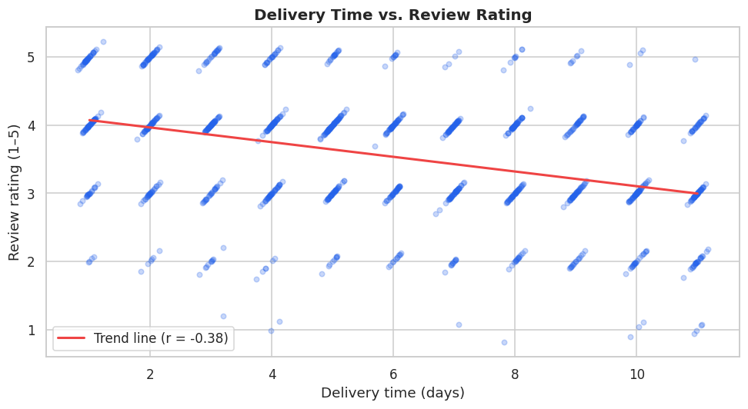
Q5 · Every extra delivery day costs ~0.1 star
r = −0.38
F = 63.8
Interpretation Ratings fall monotonically from 3.96 (1–3 days) to 3.02 (10+ days). Returned orders average 2.57 vs 3.69 for delivered. Delivery speed is the single strongest lever on satisfaction found in the data (O3).
Pearson, p < 0.001 (n = 1,223 reviews)
ANOVA across bands, p < 0.001
E-commerce Customer Analytics · 11

Slide 12
Q4 & Q7 · Markets, channels and payment habits
Interpretation Cambodia = 32 % of customers, 35 % of revenue. Indonesia is smallest but has the highest AOV ($155). Referral customers are worth 29 % less than average — the referral scheme attracts low spenders.
Interpretation Crosstabs (Q7): Mobile leads every age group (56–64 %). Customers 55+ prefer E-Wallet (38 %) and Bank Transfer (23 %) and rarely use Cash on Delivery (8 % vs 15–18 %). A mobile-first checkout with E-Wallet suits everyone.
E-commerce Customer Analytics · 12

Slide 13
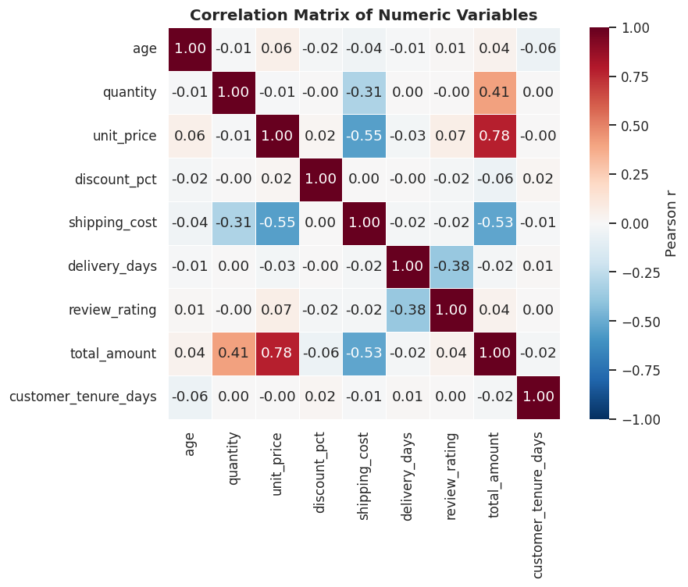
11 · Statistical summary
Variable | Mean | Median | Mode | Min | Max | Std | Variance
total_amount ($) | 136.47 | 75.73 | 12.99 | 5.24 | 1,773.79 | 177.62 | 31,549
quantity | 1.79 | 1 | 1 | 1 | 5 | 1.05 | 1.10
delivery_days | 5.96 | 6 | — | 1 | 11 | 3.16 | 10.0
review_rating | 3.55 | 4 | 4 | 1 | 5 | 0.89 | 0.80
age | 34.44 | 34 | 34 | 18 | 66 | 10.03 | 100.66
Interpretation Order value is right-skewed (skew 3.4): mean ≈ 2× median, std > mean. Use the median as the 'typical order'. Ratings cluster at 4; age is symmetric around 34.
Delivery days ↔ rating
r = −0.38, p ≈ 1e-42
Only delivery time shows a substantive, significant relationship with satisfaction; demographics and discounts have |r| < 0.07 with spend.
Rating across delivery bands
ANOVA F = 63.8, p < 0.001
AOV: VIP vs New (Welch t)
t = −0.53, p = 0.60 — no difference
Returns ↔ category (χ²)
χ² = 8.2, p = 0.23 — not significant
E-commerce Customer Analytics · 13

Slide 14
Key findings
54 %
of revenue from Electronics; top 3 categories ≈ 80 %
4.8 vs 1.6
orders per VIP vs New customer — same basket size (p = 0.60)
−0.38
correlation of delivery days with rating; 3.96★ → 3.02★
17 %
of orders returned (10.8 %) or cancelled (6.6 %); Fashion returns 13.6 %
2.4×
December revenue vs Q1 average; January −63 % MoM
45 %
of customers inactive > 180 days despite a 67 % repeat rate
$237
revenue per Referral customer vs $325 from Email (−29 %)
E-commerce Customer Analytics · 14

Slide 15
Recommendations
Delivery SLA ≤ 5 days
F3
Plan for the seasonal curve
F5
R1
Top 3 markets; show delivery estimates at checkout. Target rating 3.55 → 3.9.
R5
Stock & ad budget for Nov–Dec; January promotion to soften the trough (−63 % → −40 %).
Second-purchase programme
F2 F6
Rebalance acquisition spend
F7
R2
Voucher 14 days after first delivery; win-back for the 45 % dormant. New repeat 40 % → 70 %.
R6
Shift Referral budget to Email / Social; pay referral rewards after the 2nd order.
Cut Fashion & Sports returns
F4
Protect VIP margin
F2
R3
Size guides, fit reviews, more photos, return-reason tracking. Fashion 13.6 % → 10 %.
R7
Cap discounts at ~10 %; replace with free express shipping (supports R1).
Diversify beyond Electronics
F1
Each recommendation names the finding it rests on and a metric to track, so impact can be measured in the next reporting cycle.
R4
Cross-sell Home & Kitchen / Sports bundles; push Beauty in high-AOV markets.
E-commerce Customer Analytics · 15

Slide 16
15 · Project on GitHub & live demo
ecommerce-customer-analytics/
Live demo (≈ 8 min)
├── data/raw/ecommerce_orders_raw.csv
├── data/processed/ecommerce_orders_clean.csv
├── notebooks/ecommerce_customer_analytics.ipynb
├── src/generate_dataset.py
├── src/data_cleaning.py
├── outputs/figures/ (9 charts)
├── docs/data_dictionary.md · project_report.docx
├── README.md
├── requirements.txt
└── .gitignore
1
Repo tour
structure, README, requirements
2
Generate data
python src/generate_dataset.py → df.describe() shows the bad values
3
Clean & validate
notebook §6–8: missing values, duplicates, validation report
4
Analyse
category, segment and delivery-vs-rating tables
Commit history: scaffold → generator → cleaning pipeline → notebook → docs. Run: pip install -r requirements.txt → Restart & Run All (~15 s).
Visualise & conclude
5
charts → findings → recommendations
Thank you — questions?
E-commerce Customer Analytics · 16

