Slide 1
Visual Graph Editor
Coursework project by Alexander Savinykh
10PMI2 group
НИIT
2012-2013

Slide 2






Requirements
Add & remove nodes
Attach labels to nodes
Move nodes
Add & remove links
Save, load & view documents

Slide 3






Development

Slide 4






Tools

Slide 5

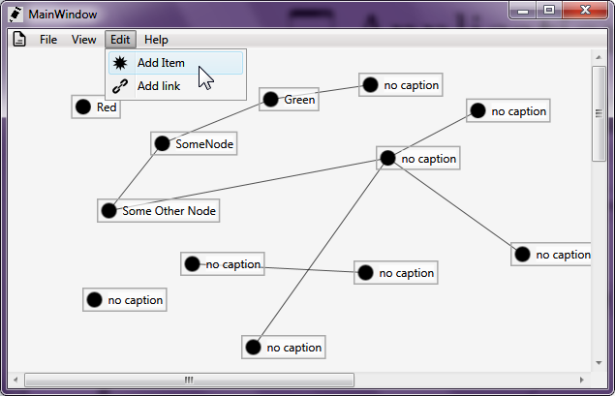
Application

Slide 6

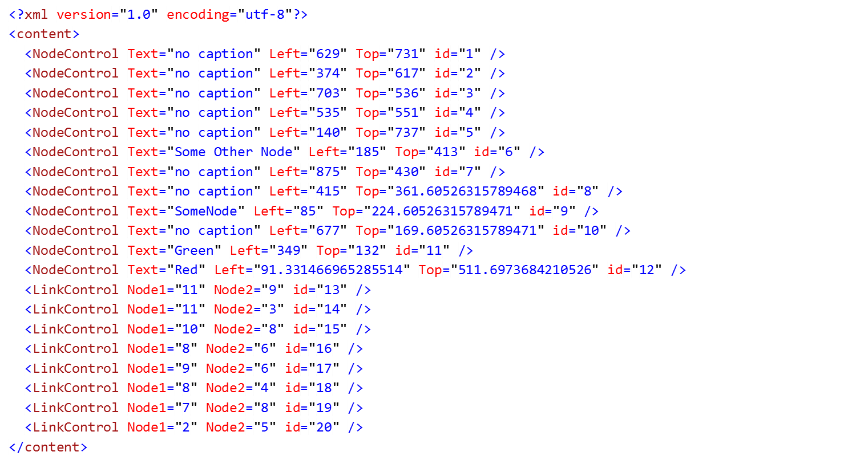
XML Documents
<?xml version="1.0" encoding="utf-8"?>
<content>
<NodeControl Text="no caption" Left="374" Top="617" id="2" />
<NodeControl Text="no caption" Left="140" Top="737" id="5" />
<LinkControl Node1="2" Node2="5" id="20" />
</content>

Slide 7


Windows Presentation Foundation
<Window x:Class="Coursework_2.MainWindow"
xmlns="http://schemas.microsoft.com/winfx/2006/xaml/presentation"
xmlns:x="http://schemas.microsoft.com/winfx/2006/xaml"
xmlns:h="clr-namespace:Coursework_2"
Title="MainWindow"
x:Name="CentralProjectMainWindow"
>
<!-- ... -->
<Window.Resources>
<Style x:Key="NodeBorderStyle" TargetType="Border">
<Setter Property="BorderThickness" Value="1.5" />
<Setter Property="BorderBrush" Value="DarkGray" />
</Style>
<Image x:Key="Image_File" Source="Images/DocumentBlack16.png" Width="16px" Height="16px" RenderOptions.BitmapScalingMode="HighQuality" />
<Image x:Key="Image_OpenFile" Source="Images/OpenFileBlack16.png" />
<Image x:Key="Image_SaveFile" Source="Images/SaveFileBlack16.png" />
<Image x:Key="Image_SaveAsFile" Source="Images/SaveAsFileBlack16.png" />
<Image x:Key="Image_NewItem" Source="Images/NewItemBlack16.png" />
<!-- ... -->
<Image x:Key="Image_DrawLink" Source="Images/LinkBlack16.png" />
</Window.Resources>
<DockPanel>
<Menu DockPanel.Dock="Top" UseLayoutRounding="True" SnapsToDevicePixels="True">
<MenuItem Header="File" Icon="{StaticResource Image_File}">
<MenuItem Header="Open file..." x:Name="OpenFileMenuItem" Icon="{StaticResource Image_OpenFile}" />
<!-- ... -->
Hardware acceleration
Resolution independent
Styling

Slide 8

WPF XAML
Declarative user interface

Slide 9


WPF Data Binding
Data binding
Dependency properties
public static readonly DependencyProperty LinkPointXProperty =
DependencyProperty.Register(
"LinkPointX",
typeof(double),
typeof(NodeControl));
return (double)this.GetValue(LinkPointXProperty);
var left = new PropertyChangeNotifier(this, Canvas.LeftProperty);

Slide 10



Features
Linq
var associatedLinks =
from link
in links
where link.LinkedNodes.Item1 == this || link.LinkedNodes.Item2 == this
select link;
Lambda expressions
ForEach.MatchingType<DependencyObject>(
TheCanvas.Children,
(element) =>
element.SetValue(IdProperty, GetNewId(element))
);

Slide 11
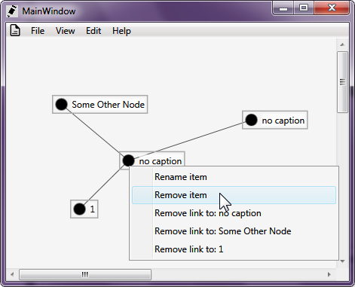

End of presentation

