Slide 1
Coursework project by | Alexander Savinykh 10PMI2 group
 | НИIT
Coursework supervisor: | Oleg Loginov
2012 – 2013

Slide 2

Visual Graph Editor

Slide 3







Requirements
Add & remove nodes
Attach labels to nodes
Move nodes
Add & remove links
Save, load & view documents
Write an application

Slide 4






Development

Slide 5






Tools

Slide 6

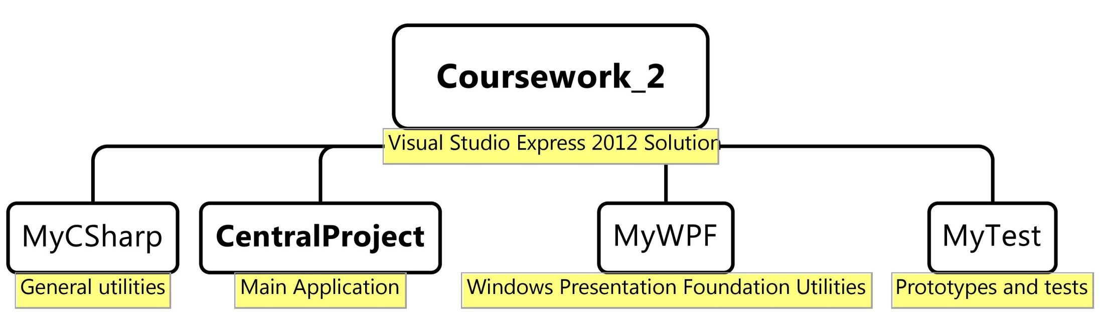
Project structure

Slide 7

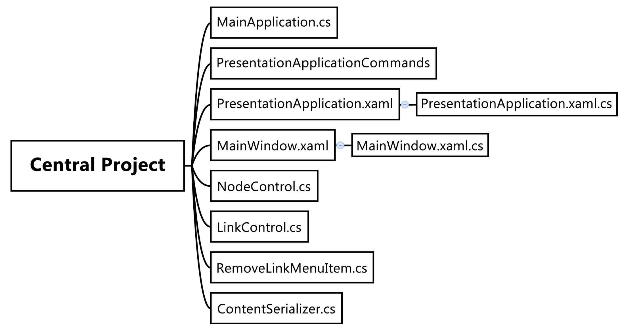
Project classes

Slide 8

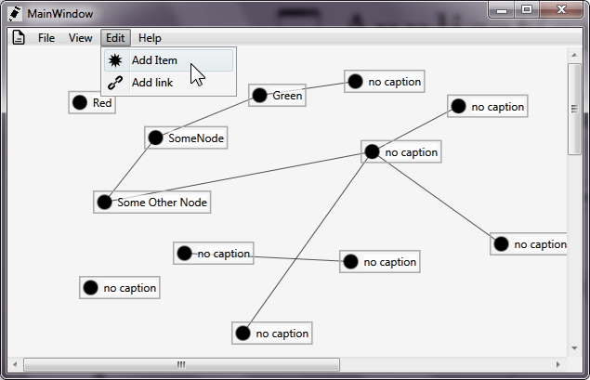
Application

Slide 9
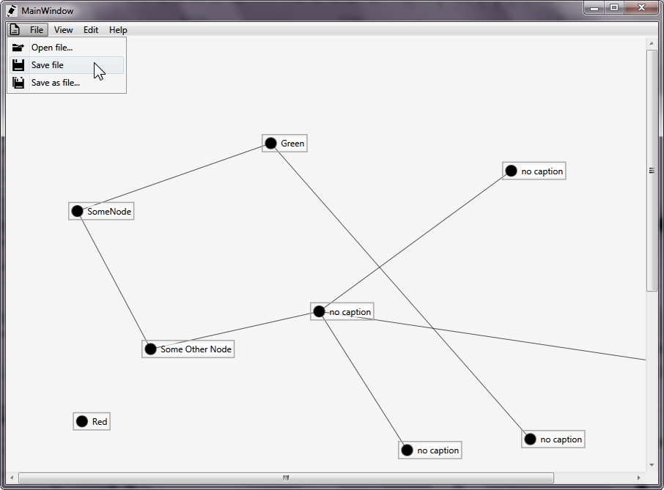
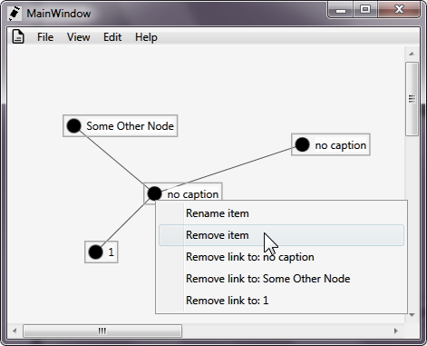
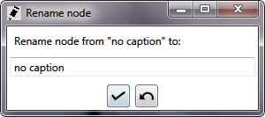

Slide 10

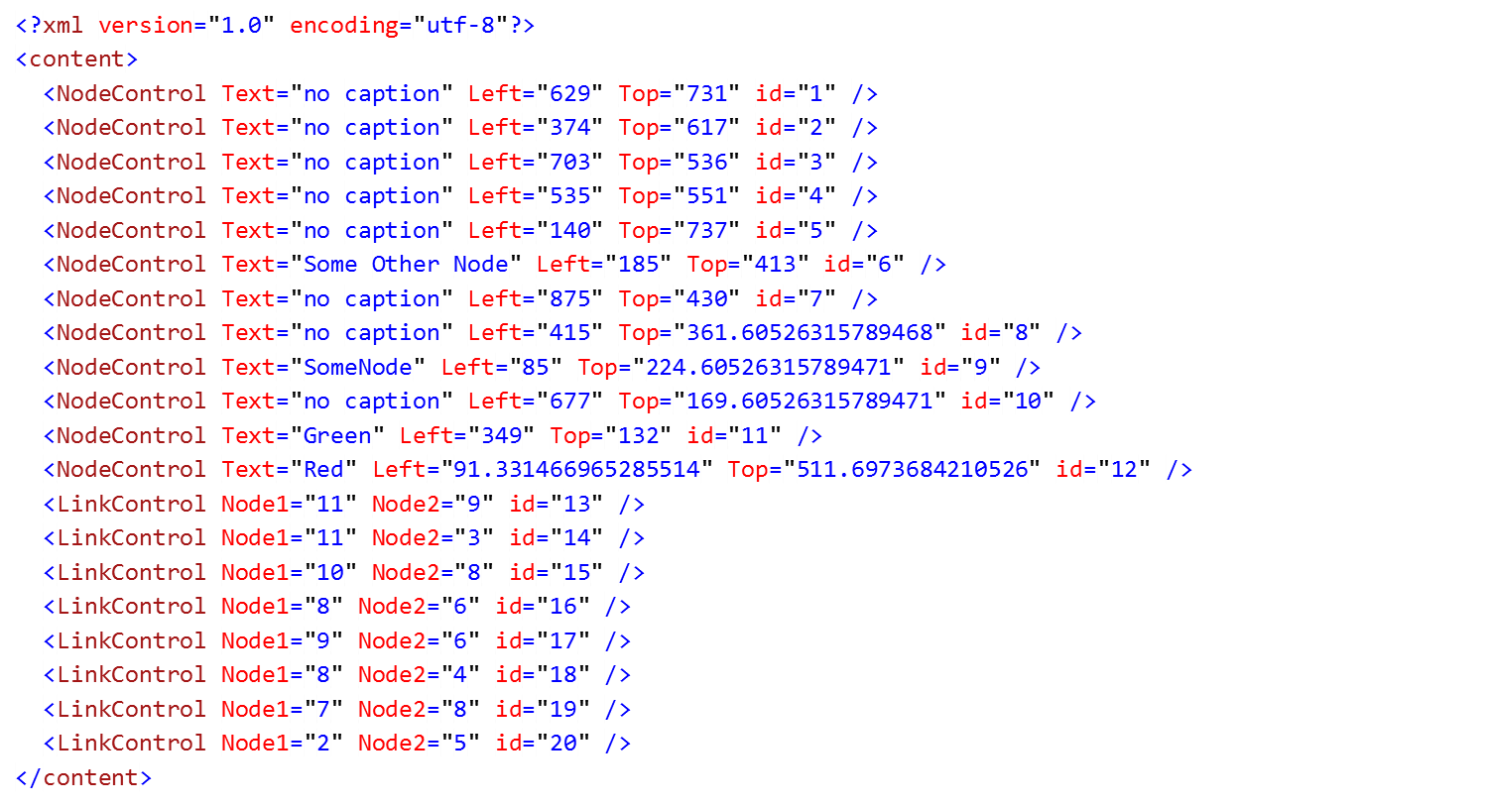
XML Documents
<?xml version="1.0" encoding="utf-8"?>
<content>
<NodeControl Text="no caption" Left="374" Top="617" id="2" />
<NodeControl Text="no caption" Left="140" Top="737" id="5" />
<LinkControl Node1="2" Node2="5" id="20" />
</content>

Slide 11




Windows Presentation Foundation
Hardware acceleration
Resolution independent
Styling

Slide 12


Slide 13

WPF XAML
Declarative user interface

Slide 14


WPF Data Binding
Data binding
Dependency properties
public static readonly DependencyProperty LinkPointXProperty =
DependencyProperty.Register(
"LinkPointX",
typeof(double),
typeof(NodeControl));
return (double)this.GetValue(LinkPointXProperty);
var left = new PropertyChangeNotifier(this, Canvas.LeftProperty);

Slide 15
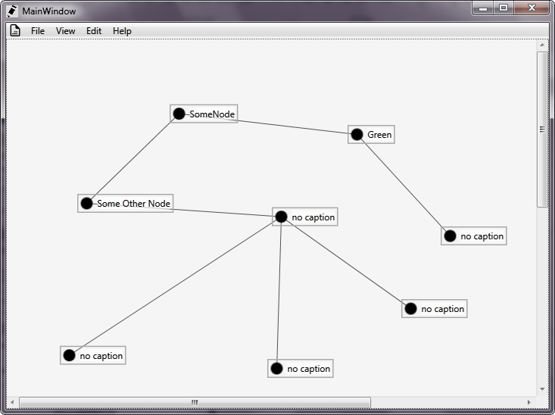

End of presentation

