Slide 1
Visual Graph Editor
Coursework project by Alexander Savinykh
10PMI2 group
НИIT
2012-2013

Slide 2






Requirements
Add & remove nodes
Attach labels to nodes
Move nodes
Add & remove links
Save, load & view documents

Slide 3






Development

Slide 4






Tools

Slide 5

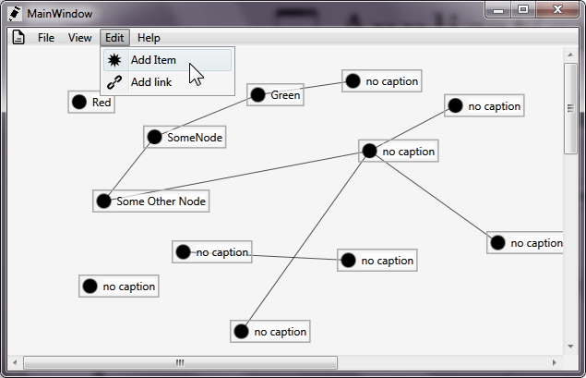
Application

Slide 6
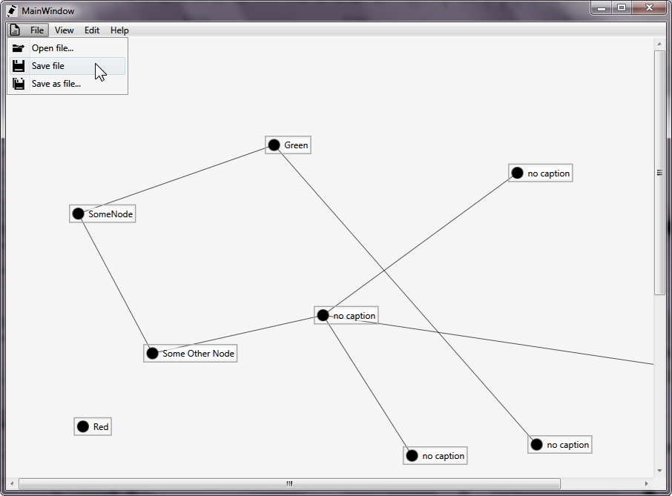
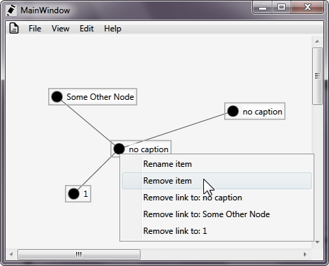
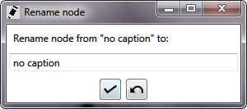

Slide 7

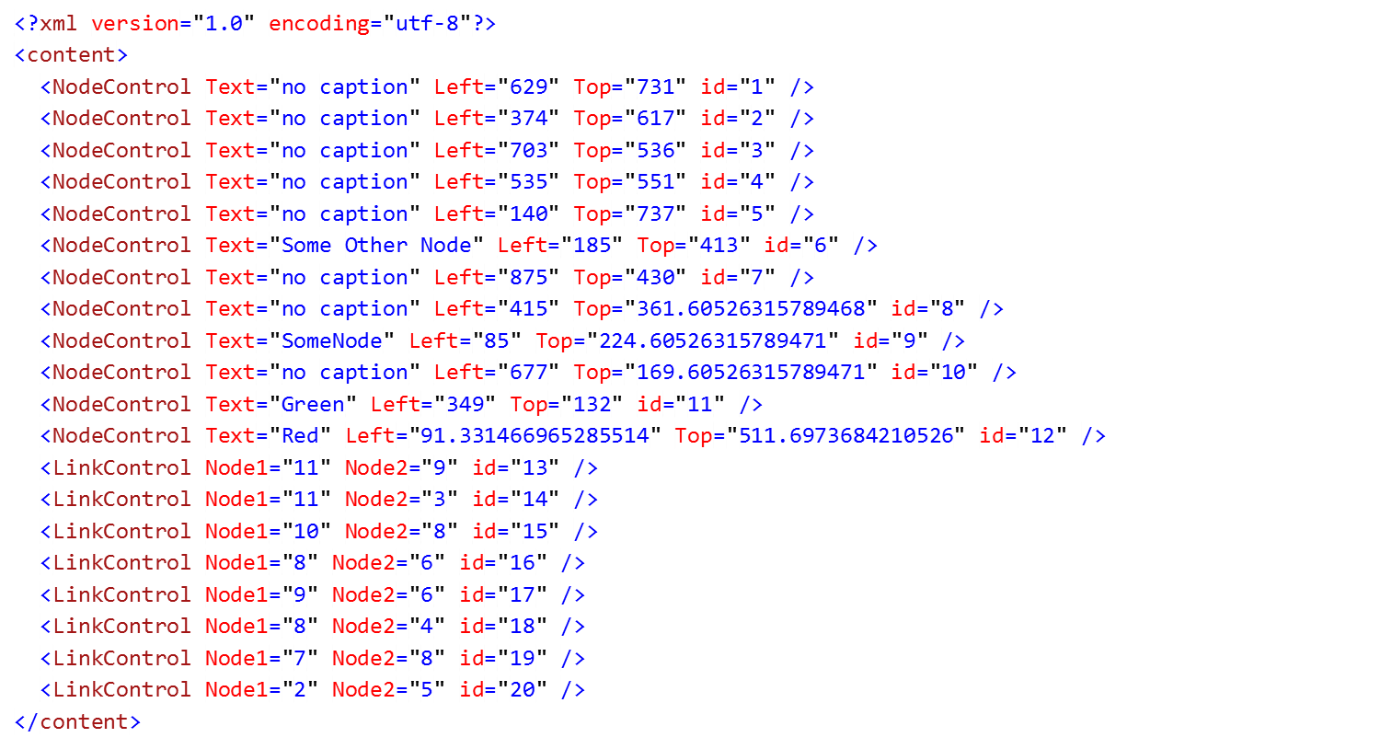
XML Documents
<?xml version="1.0" encoding="utf-8"?>
<content>
<NodeControl Text="no caption" Left="374" Top="617" id="2" />
<NodeControl Text="no caption" Left="140" Top="737" id="5" />
<LinkControl Node1="2" Node2="5" id="20" />
</content>

Slide 8




Windows Presentation Foundation
Hardware acceleration
Resolution independent
Styling

Slide 9


Slide 10

WPF XAML
Declarative user interface

Slide 11


WPF Data Binding
Data binding
Dependency properties
public static readonly DependencyProperty LinkPointXProperty =
DependencyProperty.Register(
"LinkPointX",
typeof(double),
typeof(NodeControl));
return (double)this.GetValue(LinkPointXProperty);
var left = new PropertyChangeNotifier(this, Canvas.LeftProperty);

Slide 12


Features
Microsoft LINQ (Language Integrated Query)
var associatedLinks =
from link
in links
where link.LinkedNodes.Item1 == this || link.LinkedNodes.Item2 == this
select link;

Slide 13

Features
Lambda expressions
ForEach.MatchingType<DependencyObject>(
TheCanvas.Children,
(element) =>
element.SetValue(IdProperty, GetNewId(element))
);

Slide 14
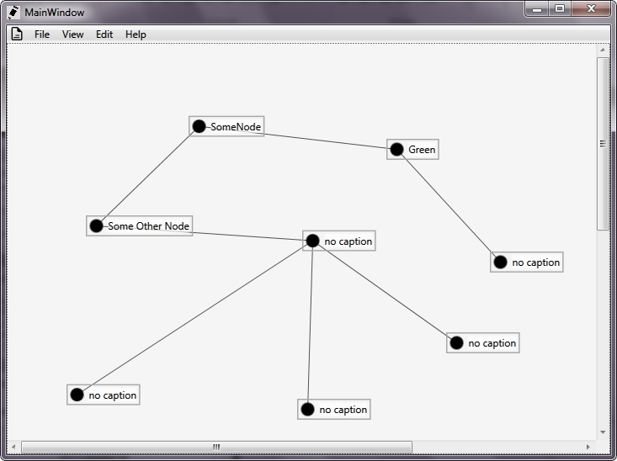

End of presentation

