Slide 1


Slide 2
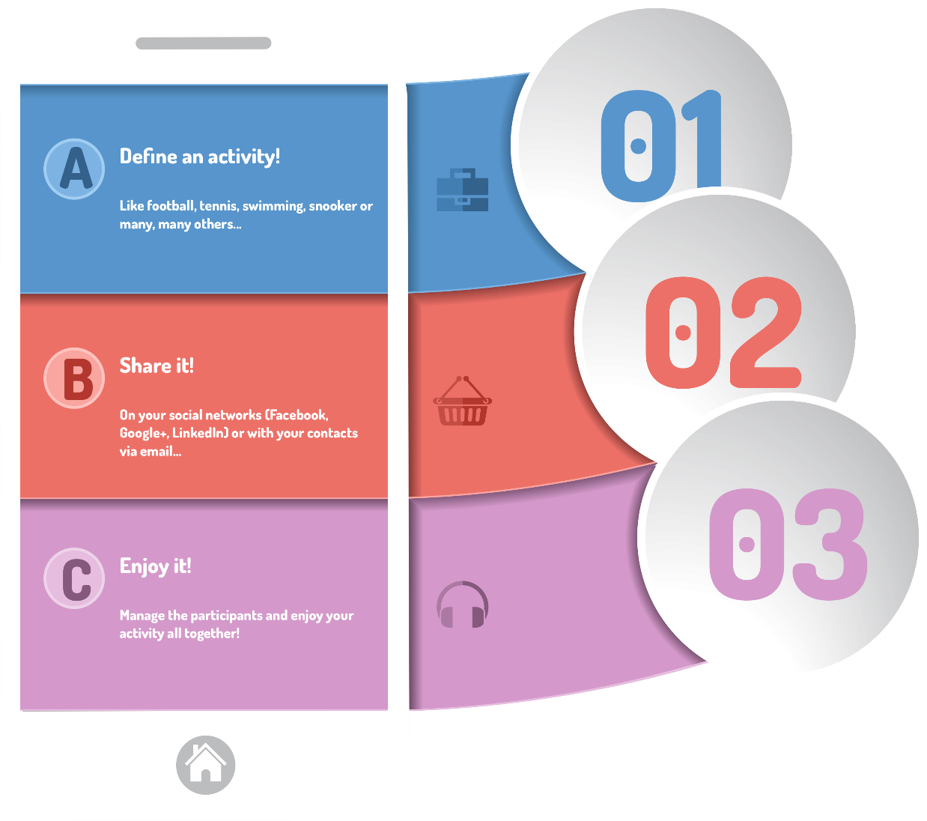

Slide 3

Initiating a new activity

Slide 4
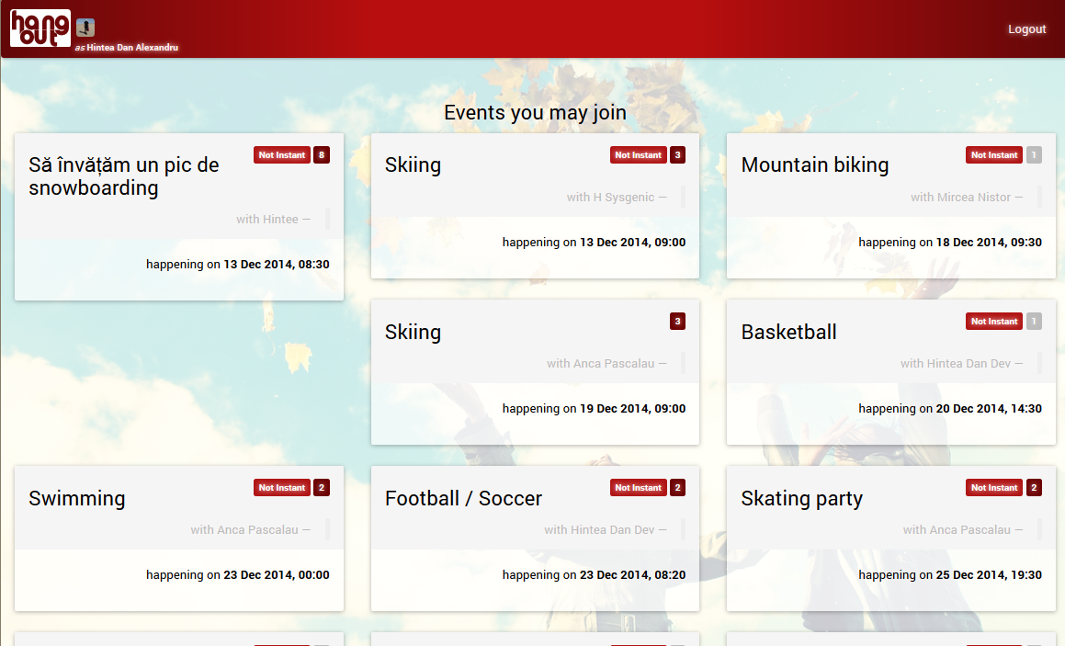
Browse and Join activities

Slide 5
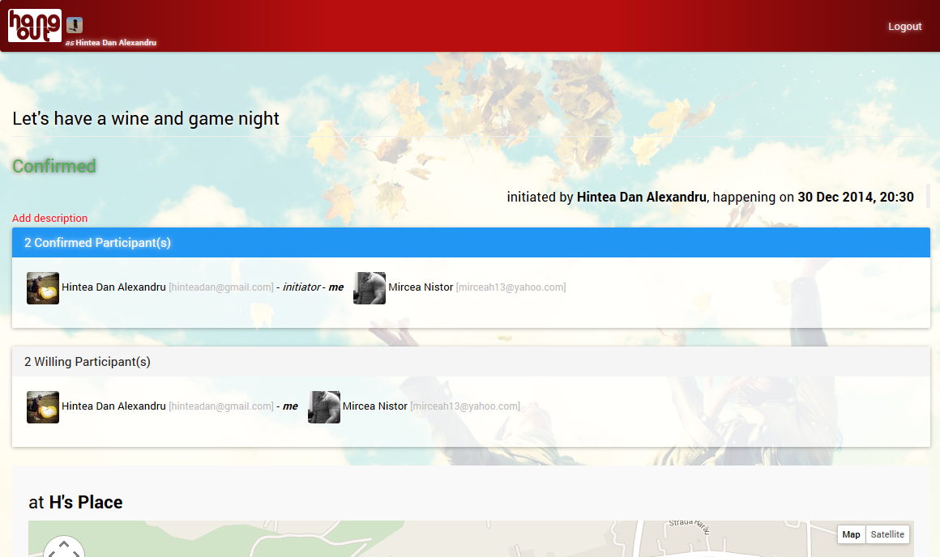
Manage activities

Slide 6
Questions?
http://hang-out-with.us
http://hang-out-with.me
https://facebook.com/hangoutlikenothing
https://twitter.com/hangoutwithus

