Slide 1
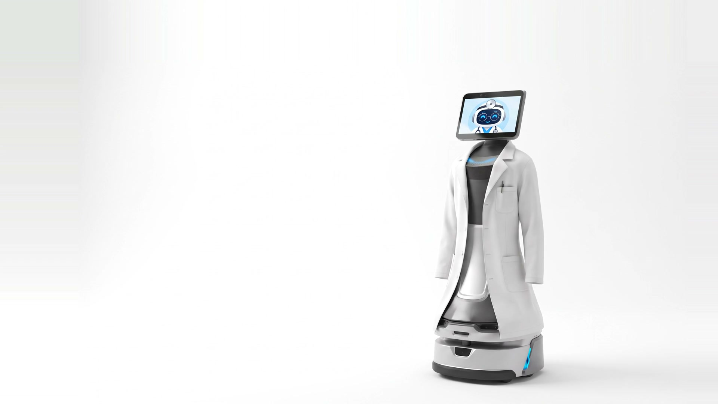

Problem
Solution
Demo
Roadmap
AURA Robotics · Hinterland Hack 2026
OttO
Your personal
hospital guide.
Notes:
(8 s) Hi, we are AURA Robotics. Say hello to OttO, your personal hospital guide. Before we start, let's watch this video.

Slide 2
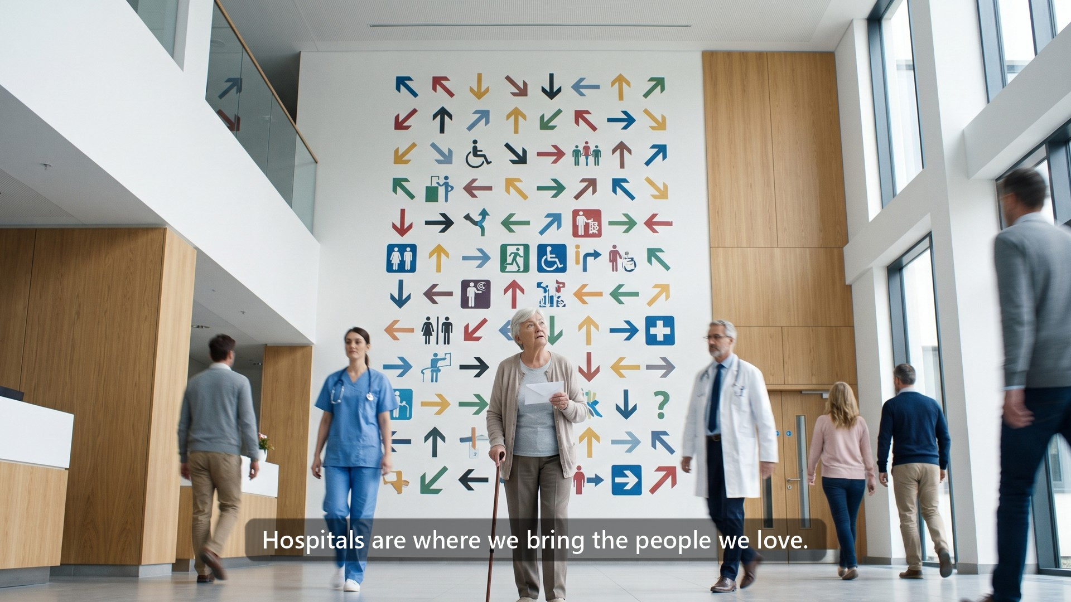
Notes:
(25 s) [Play it. Say nothing.]

Slide 3
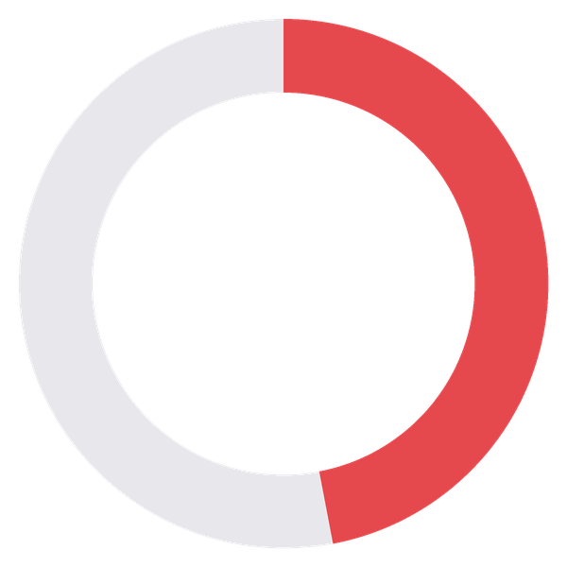
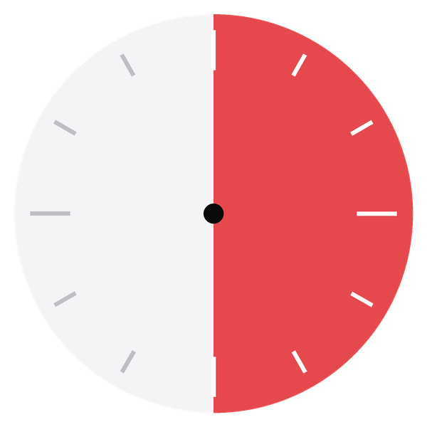
Problem
Solution
Demo
Roadmap
Not just one story. It happens every day.
65+
47 %
29 %
3 days
of hospital patients are over 65
of staff walk lost patients to the room
a year per staff member, not spent on care
Up to 690,000
nurses: the projected shortage
in Germany by 2049.
Destatis 2024 (65+: own calculation) · Jamshidi et al., HERD 2025, 301 US hospital staff (3 days: 31.8 min/week × 46 weeks ÷ 8 h, own calculation) · Destatis nursing projection 2024: 280,000–690,000, all care settings
03
Notes:
(30 s) That was one story. But it's not just one: this happens every single day, in every hospital. Almost half of all patients are over 65. 29 percent of staff have to walk patients to the room themselves, or they get lost. That's about three days a year, per staff member, not spent on care. And the problem is only getting bigger: by 2049, Germany expects a shortage of up to 690,000 nurses. So we can't fix this with more staff. We need something different, something better.

Slide 4






Problem
Solution
Demo
Roadmap
The patient journey today. Where it goes wrong.
Bring to the room
Patients get lost
Staff decide the room
!
Arrival & check-in
Exit
Very long instructions
!
Searching for the exit
The whole process:
very unpleasant
!
!
Wait & consultation
Patient late, doctor waits
!
Next department
Repeats, again and again
04
Notes:
(25 s) Let's look at where exactly it goes wrong. Everything starts at arrival. Either you get very long instructions, or someone has to bring you to the room. If not, you get lost. If the patient is late, the doctor has to wait. And then it repeats, again and again, until you finally find the exit. The whole process is very unpleasant, for the patients and for the staff.

Slide 5
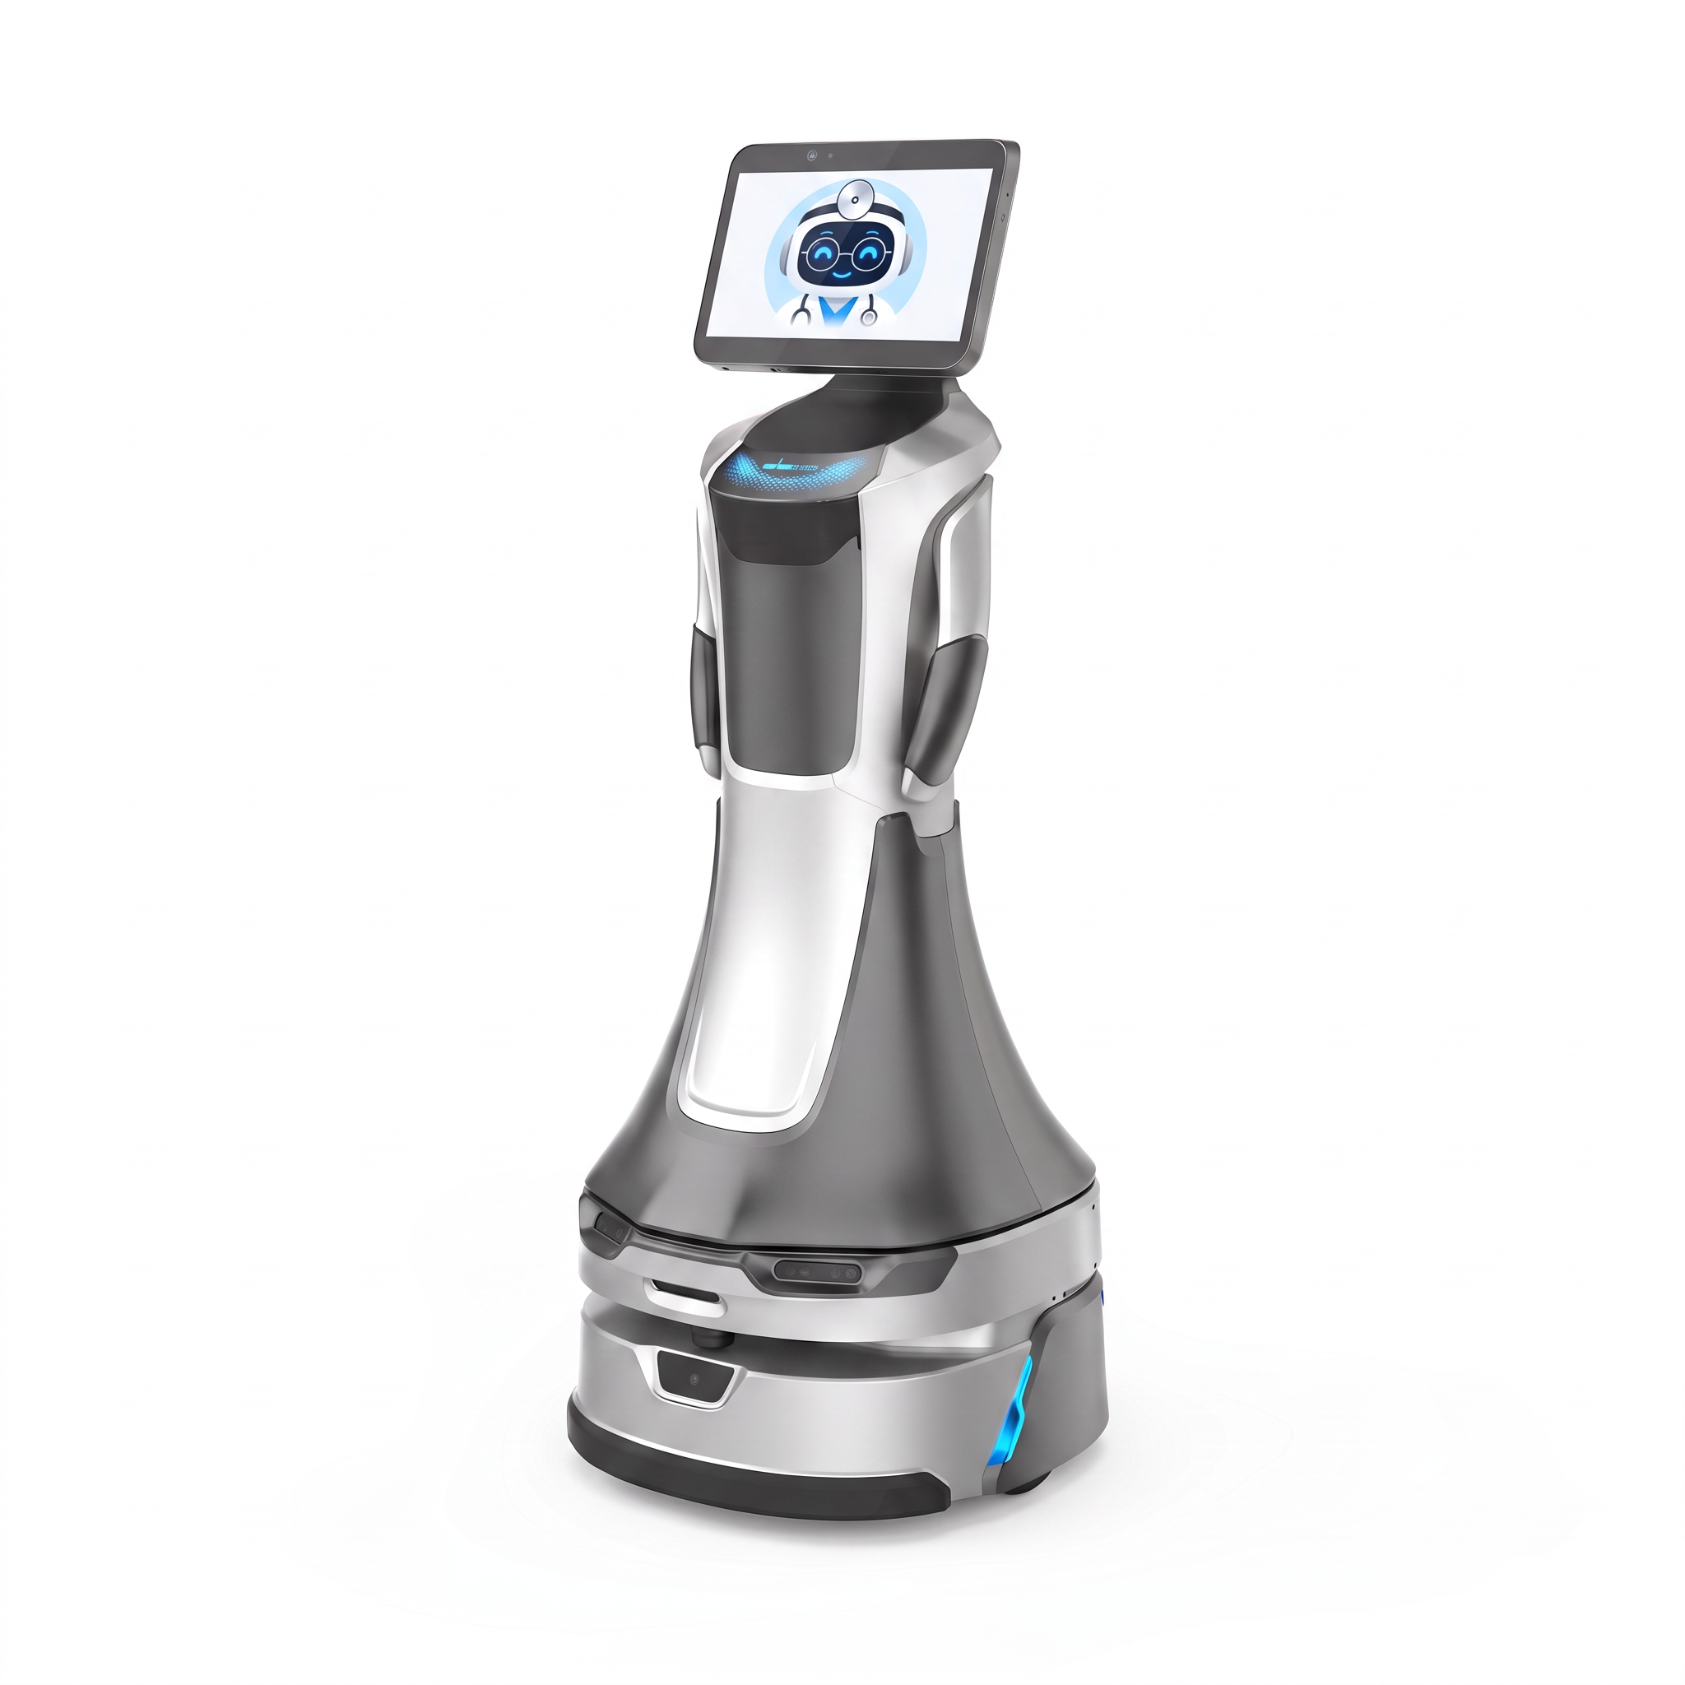
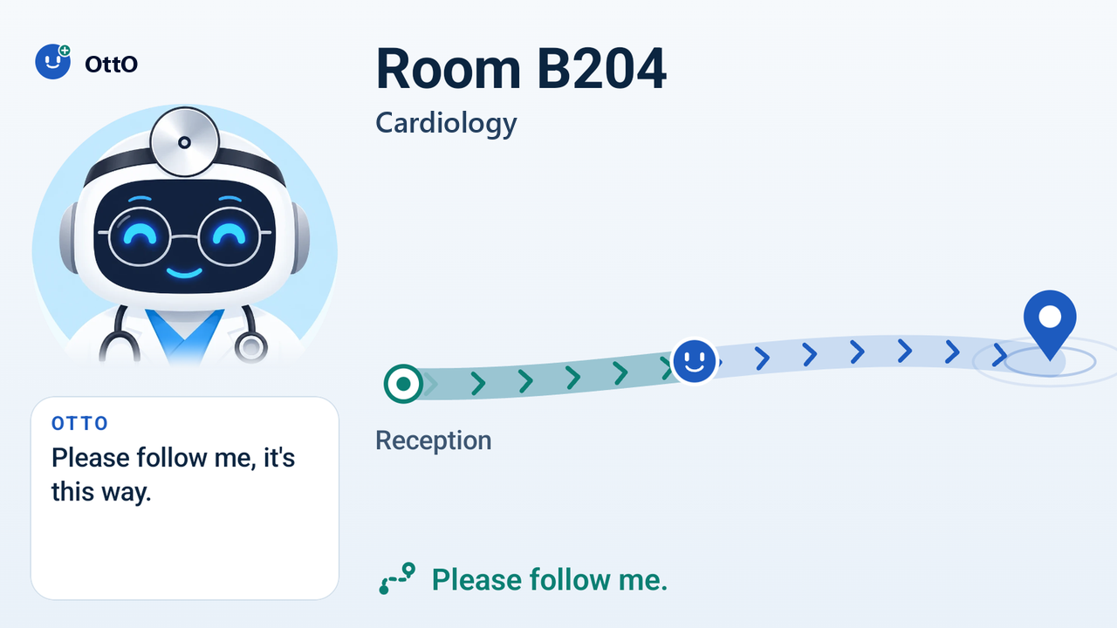



Problem
Solution
Demo
Roadmap
OttO.
Your hospital companion.
Walks with you
Keeps an eye on you
Adjusts to your pace
No personal data
Reception decides where you go. OttO walks with you, like a buddy.
05
Notes:
(23 s) That's why we built OttO, your companion through the hospital. OttO walks with you, keeps an eye on you, and adjusts its speed to your pace, depending on how you feel. And it doesn't need any of your personal data. One important thing: the nurse at reception decides where you go. OttO only walks with you, like a buddy.

Slide 6
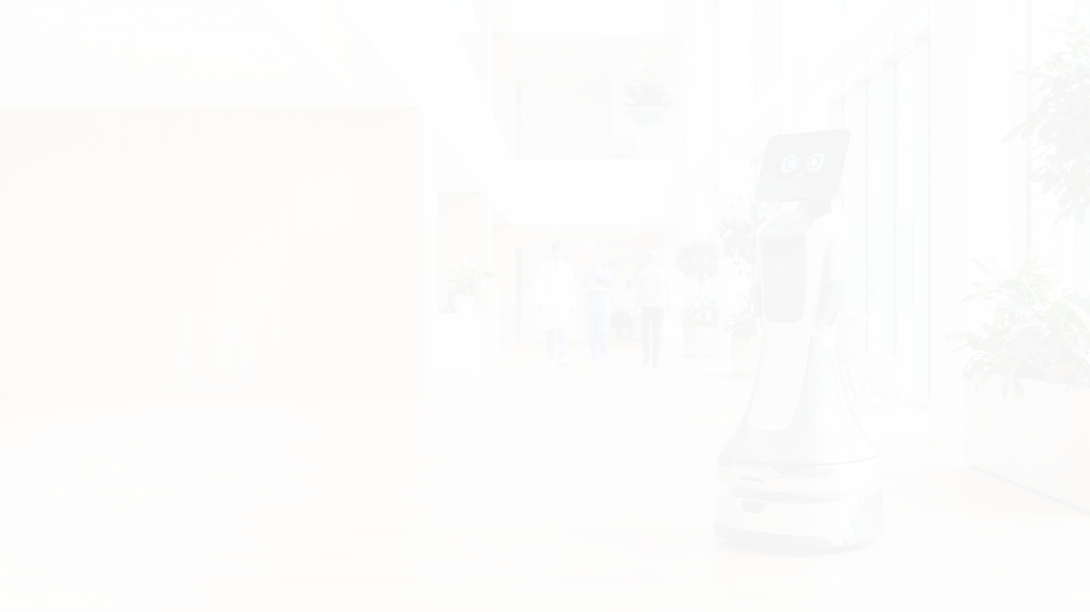
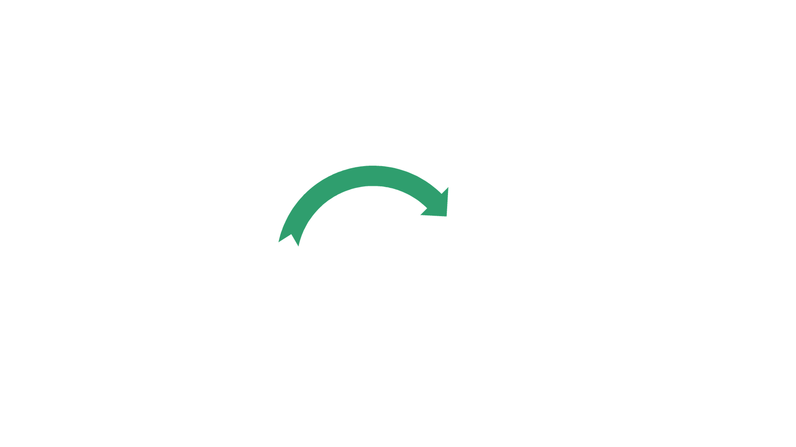



Problem
Solution
Demo
Roadmap
Same process, with OttO. From unpleasant to pleasant.
Bring to the room
Patients get lost
OttO takes over
!
Staff decide the room
✓
Arrival & check-in
Exit
!
Very long instructions
✓
No more route to explain
Searching for the exit
OttO walks you out
!
✓
!
Wait & consultation
✓
Patient late, doctor waits
Doctor knows where you are
!
✓
Next department
Repeats, again and again
OttO picks you up again
People decide
OttO walks
06
Notes:
(20 s) Now the same process, with OttO. No more route to explain: OttO takes over. No nurse has to walk the patient. The doctor knows exactly where the patient is. Then OttO picks you up again for the next department, until you leave the hospital. A very unpleasant experience becomes a pleasant one.

Slide 7
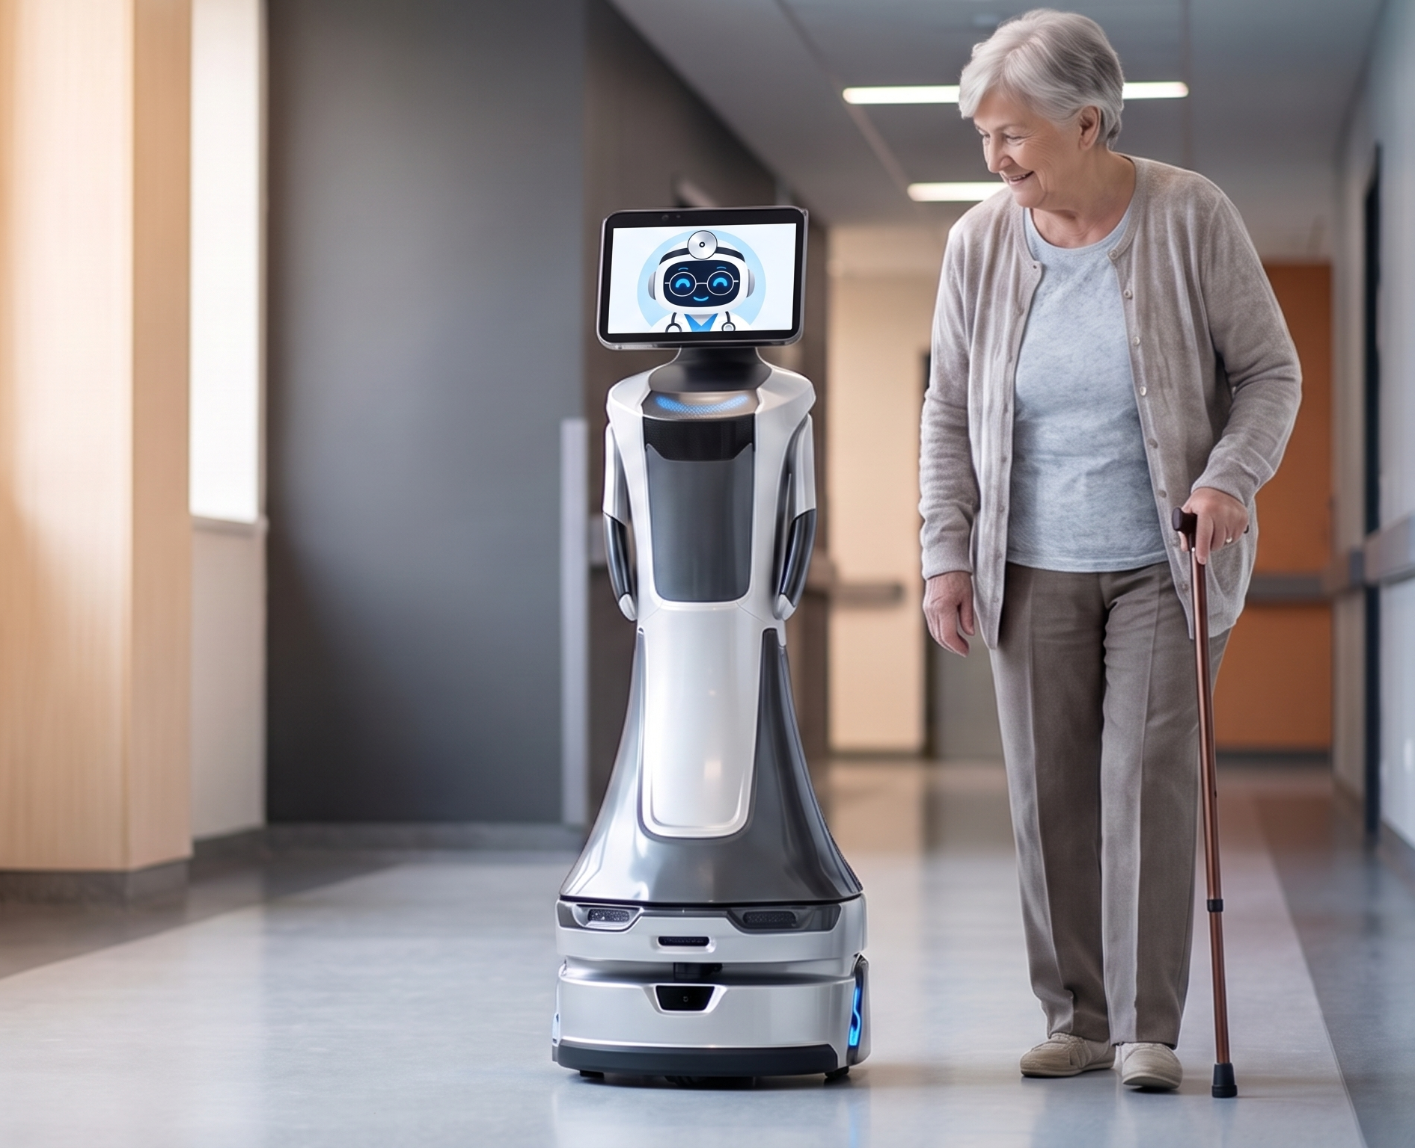
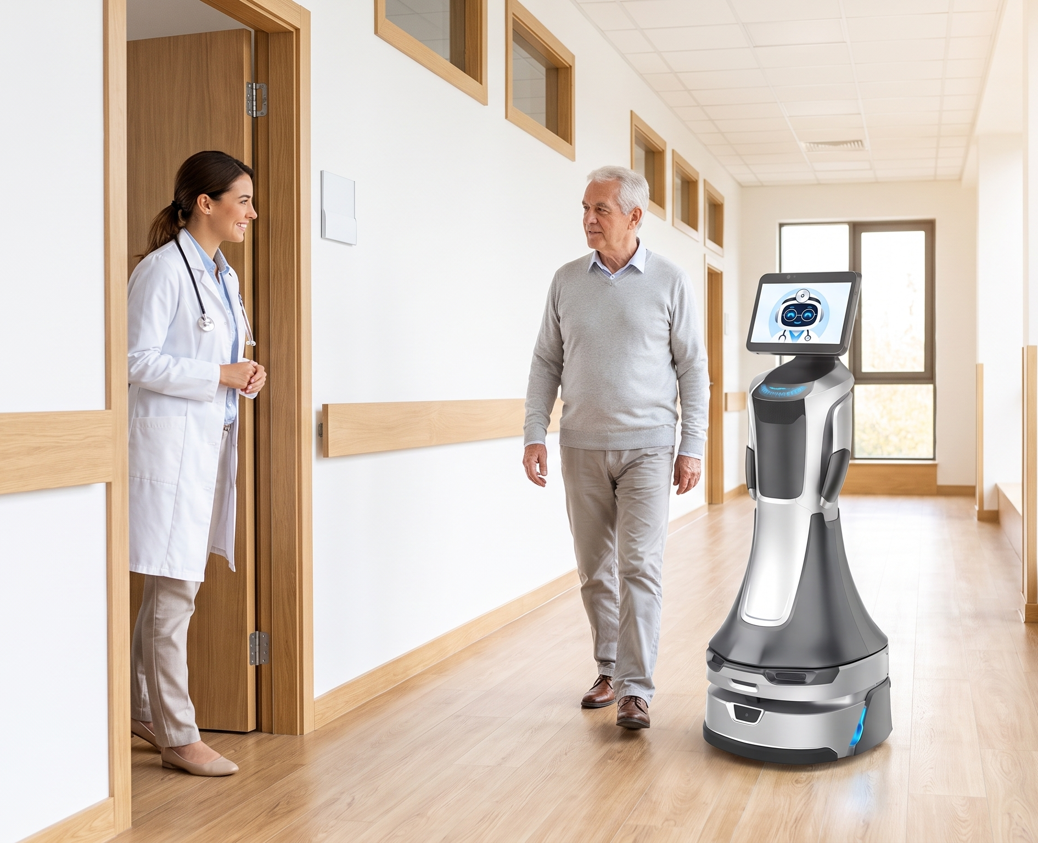
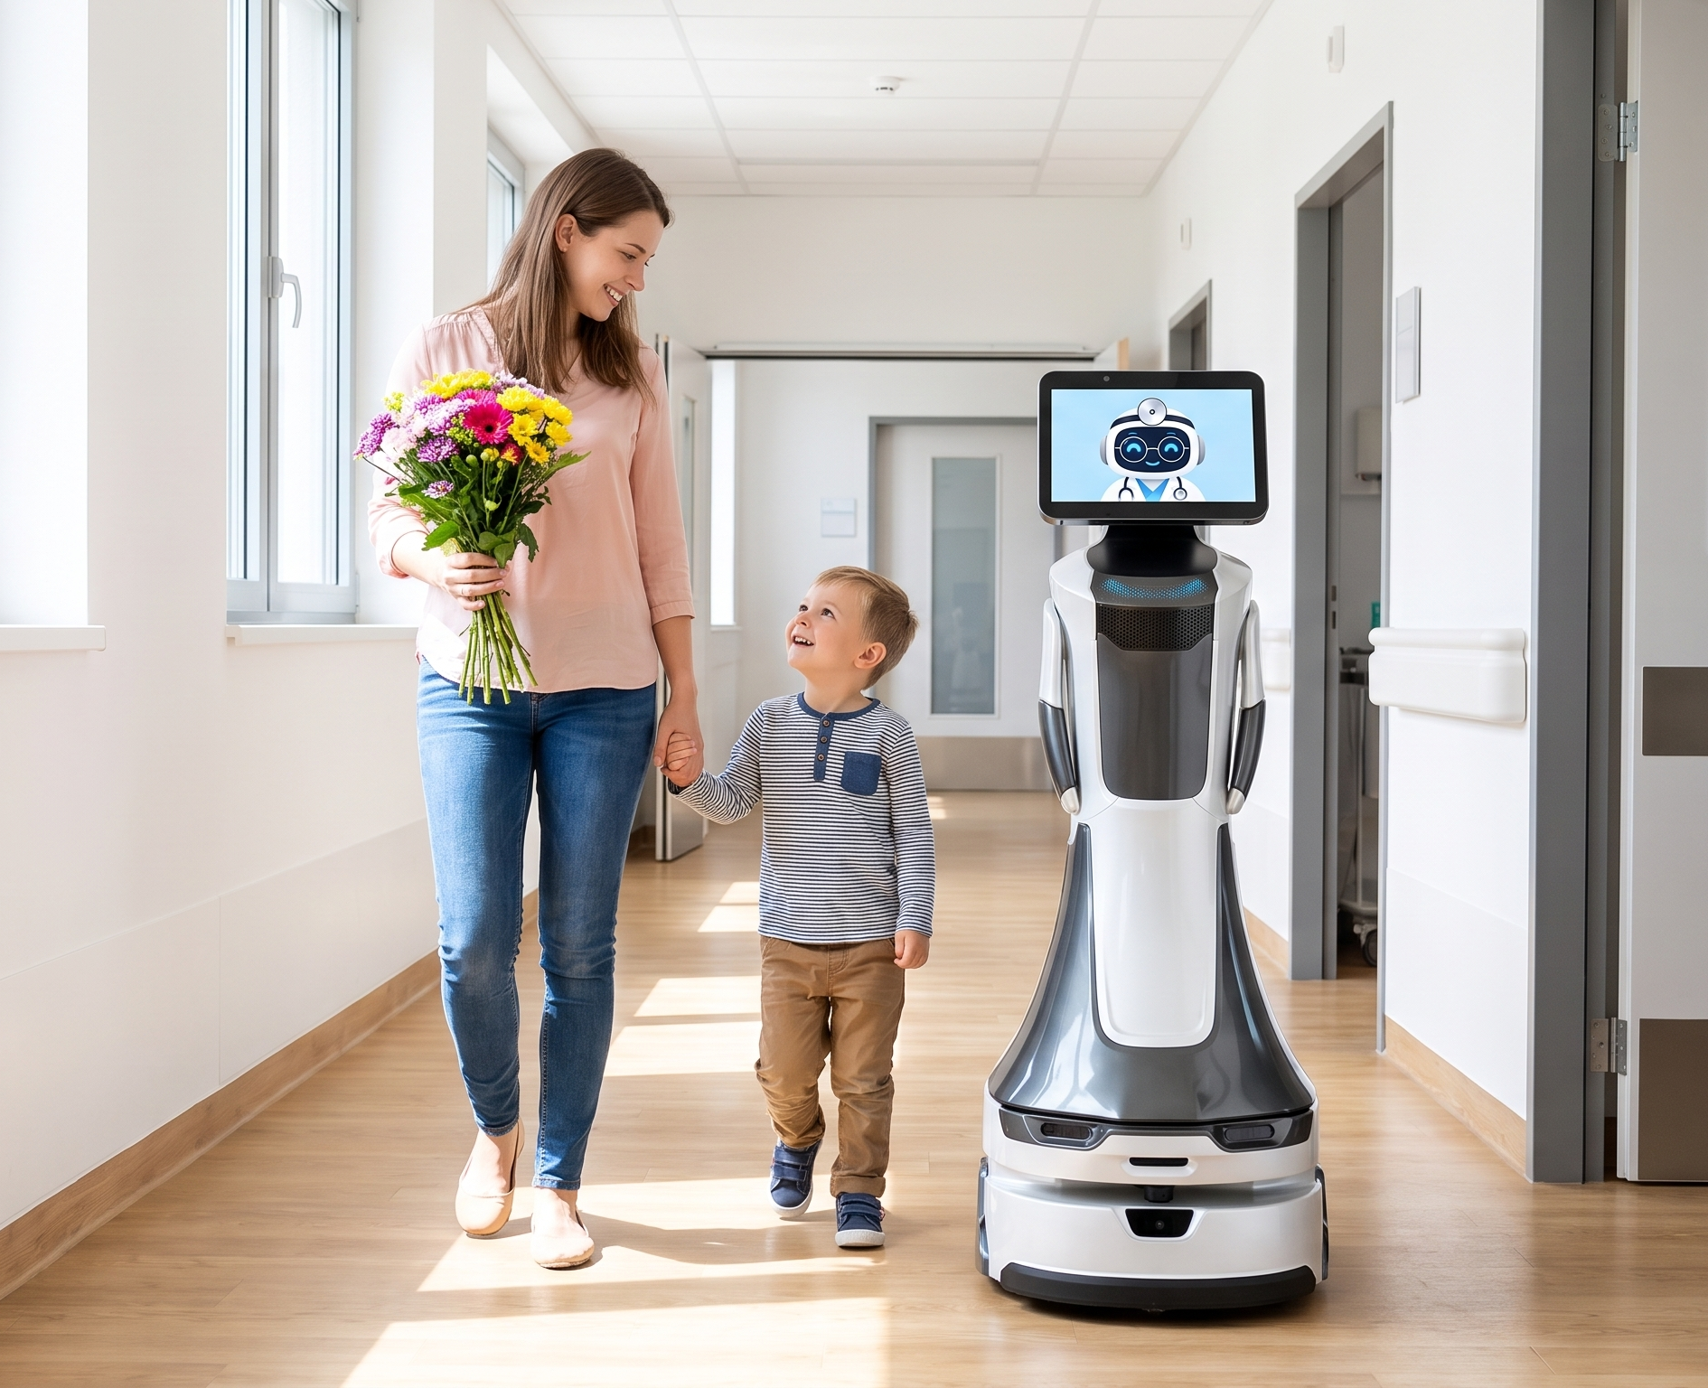
Problem
Solution
Demo
Roadmap
OttO is for everyone.
Patients
Nurses & staff
Visitors
Never get lost
Time back
to care
Guides your
family to you
07
Notes:
(15 s) And OttO is for everyone. Patients never get lost. Nurses and staff get time back to care for patients. And visitors: when you are sick, you want your family with you. OttO guides them to you.

Slide 8
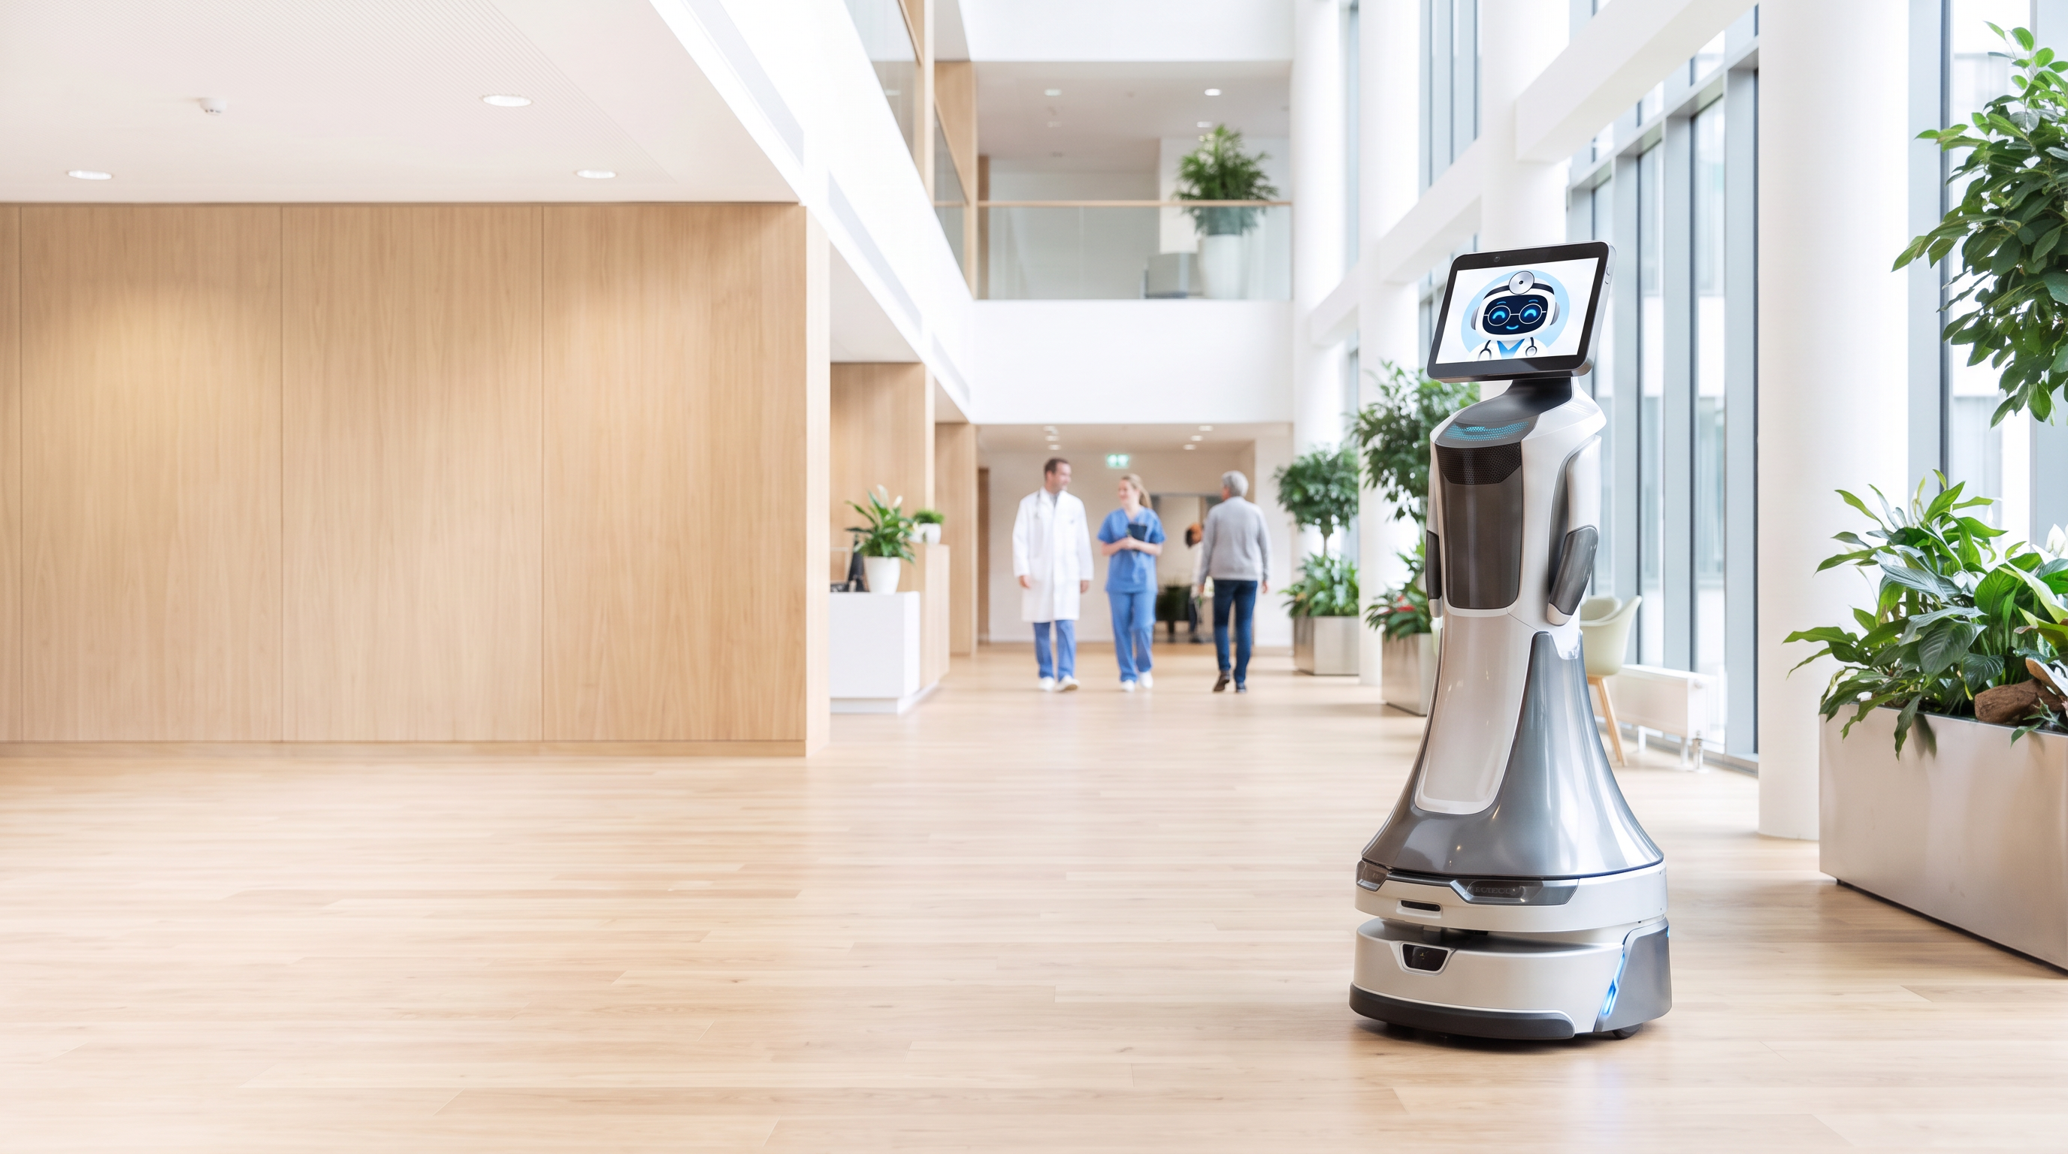

Problem
Solution
Demo
Roadmap
Running live on our robot today
Live demo
From reception to the room, and back.
08
Notes:
Now let's see the live demo. [Start the robot. Once it's running, go to slide 9.]

Slide 9
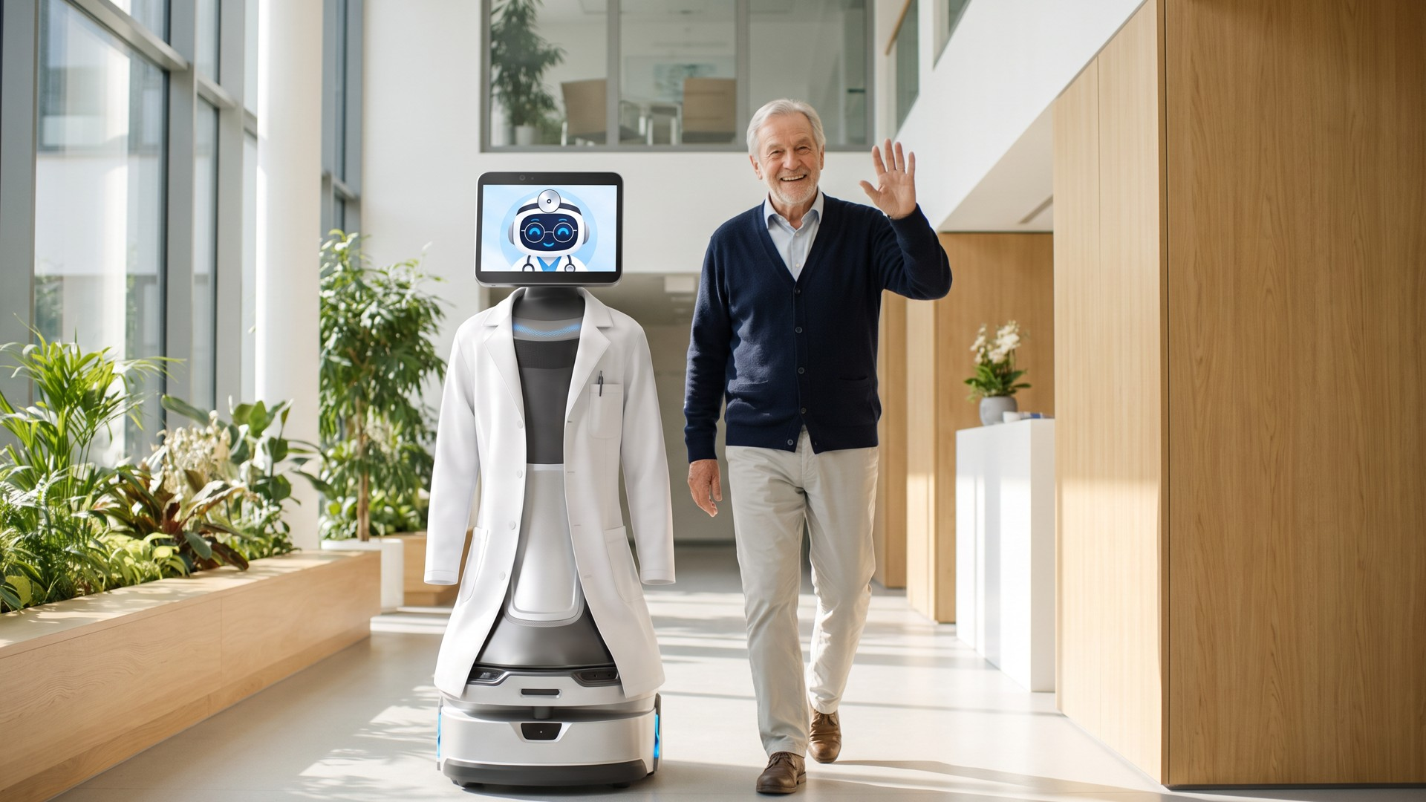
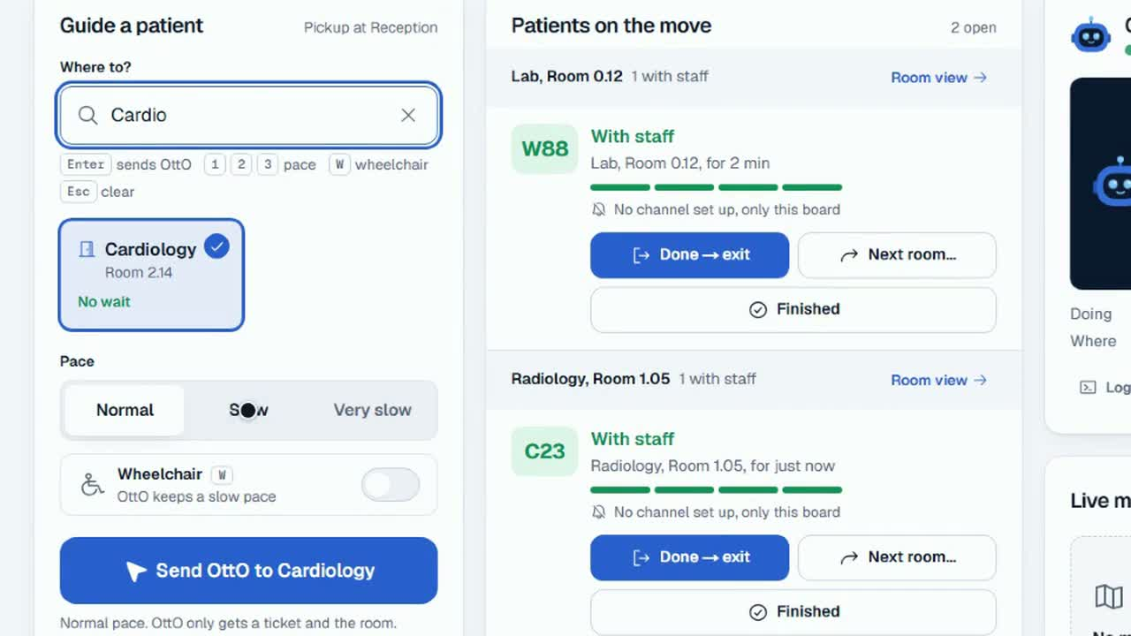
Problem
Solution
Demo
Roadmap
This is how it looks in the hospital.
09
Notes:
(while the robot runs) So this is how it looks in the hospital. At the information desk, staff assign your room and give you a ticket. Then OttO comes to greet you and guides you to the room at your own pace, the whole way. The doctor knows exactly where you are. After that, OttO guides you to the next department, or out of the hospital.

Slide 10
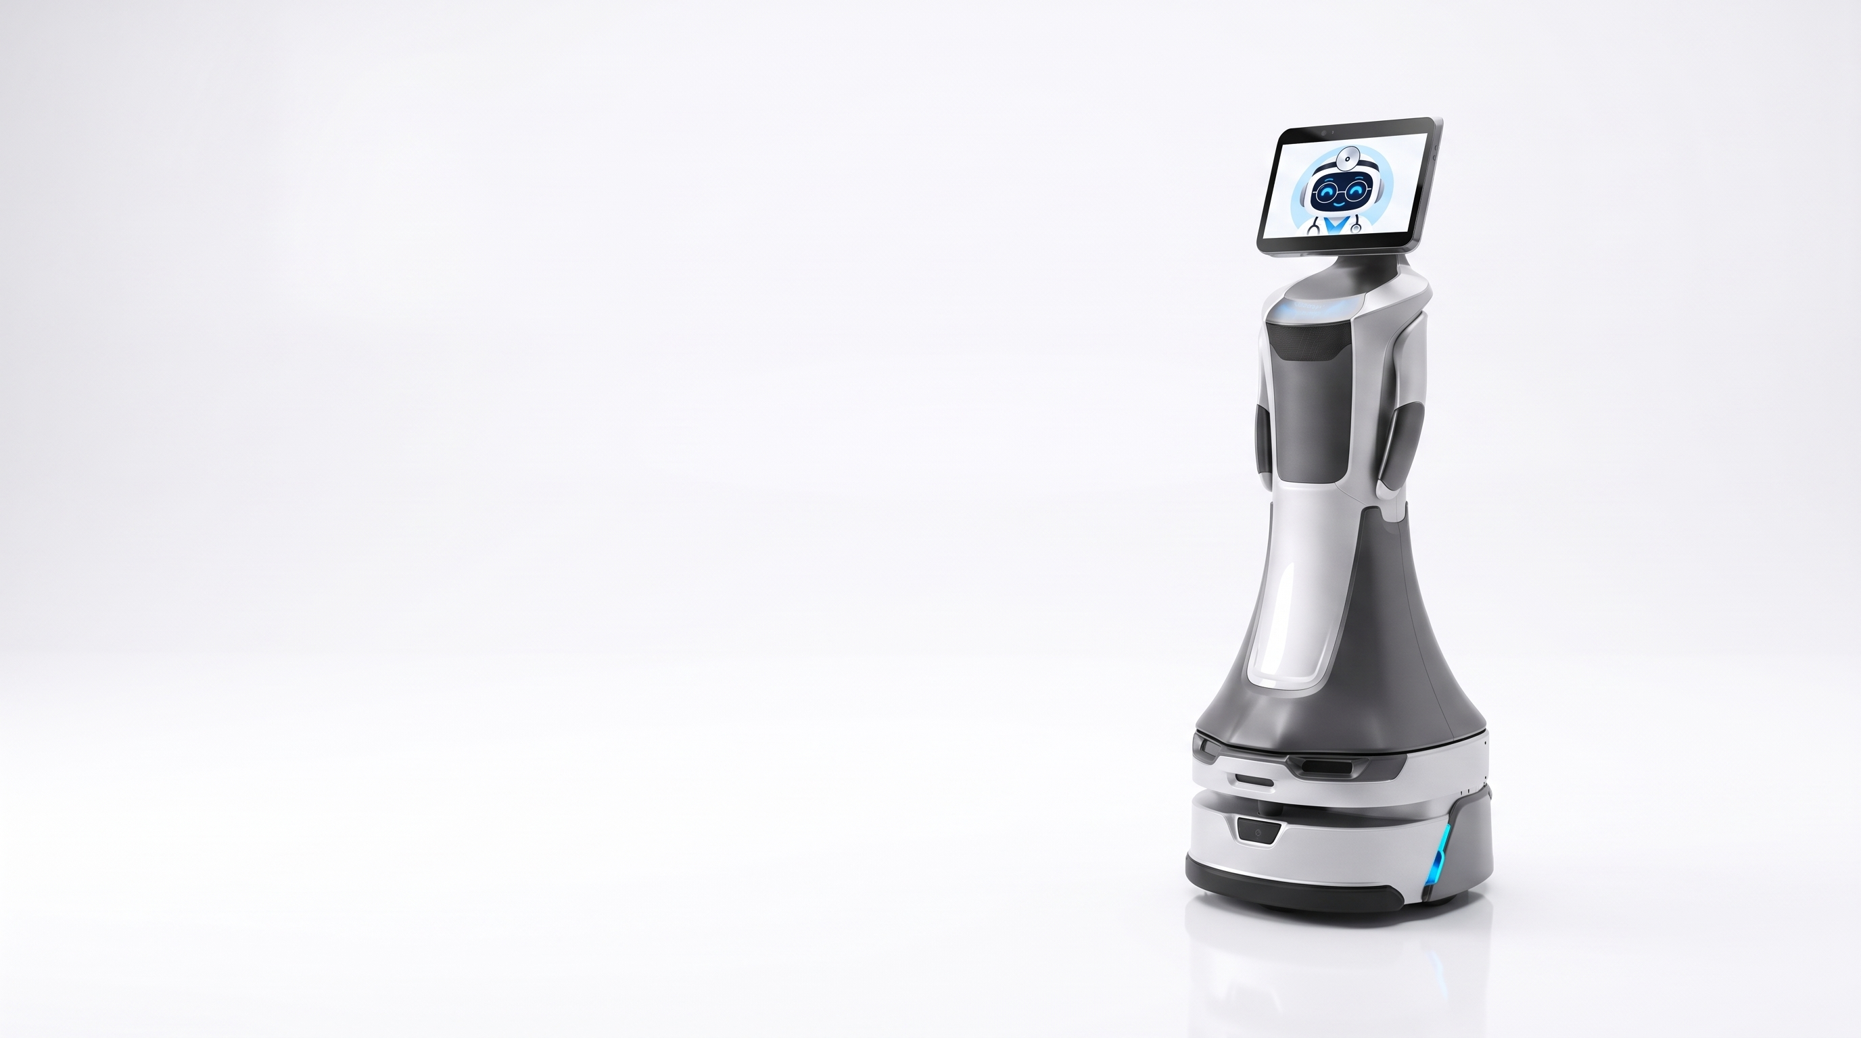
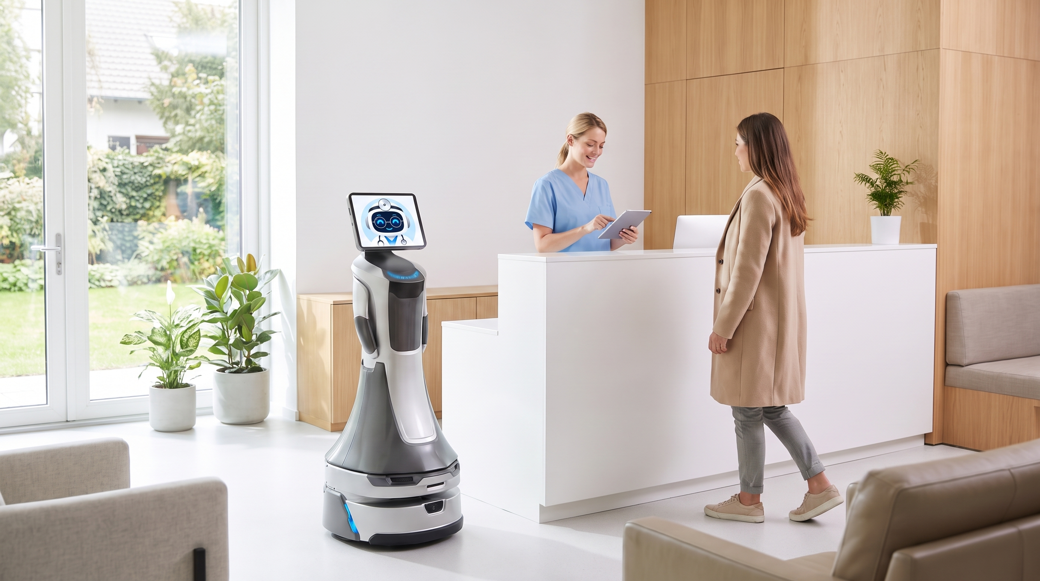
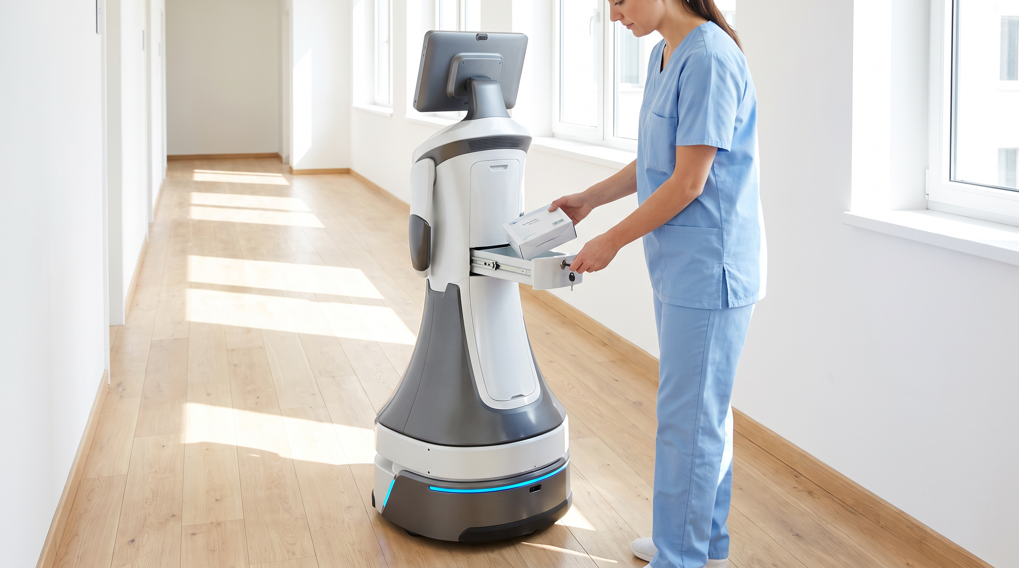
Problem
Solution
Demo
Roadmap
From hackathon to hospital. 3, 6 and 12 months.
Concept
3 months
6 months
12 months
Pilot-ready
First clinical pilot
Scale
Technology ready
With potential local partners:
New regions
Regulations approved
Bethel · Franziskus Hospital
New use cases
HDZ NRW · MHH
New functions
10
Notes:
(21 s) So what's next? How do we go from hackathon to hospital? In three months, we are pilot-ready: the technology is ready and the regulations are approved. In six months, the first clinical pilot with potential local partners, the hospitals you see here. And then we scale: new regions, new use cases and new functions.

Slide 11
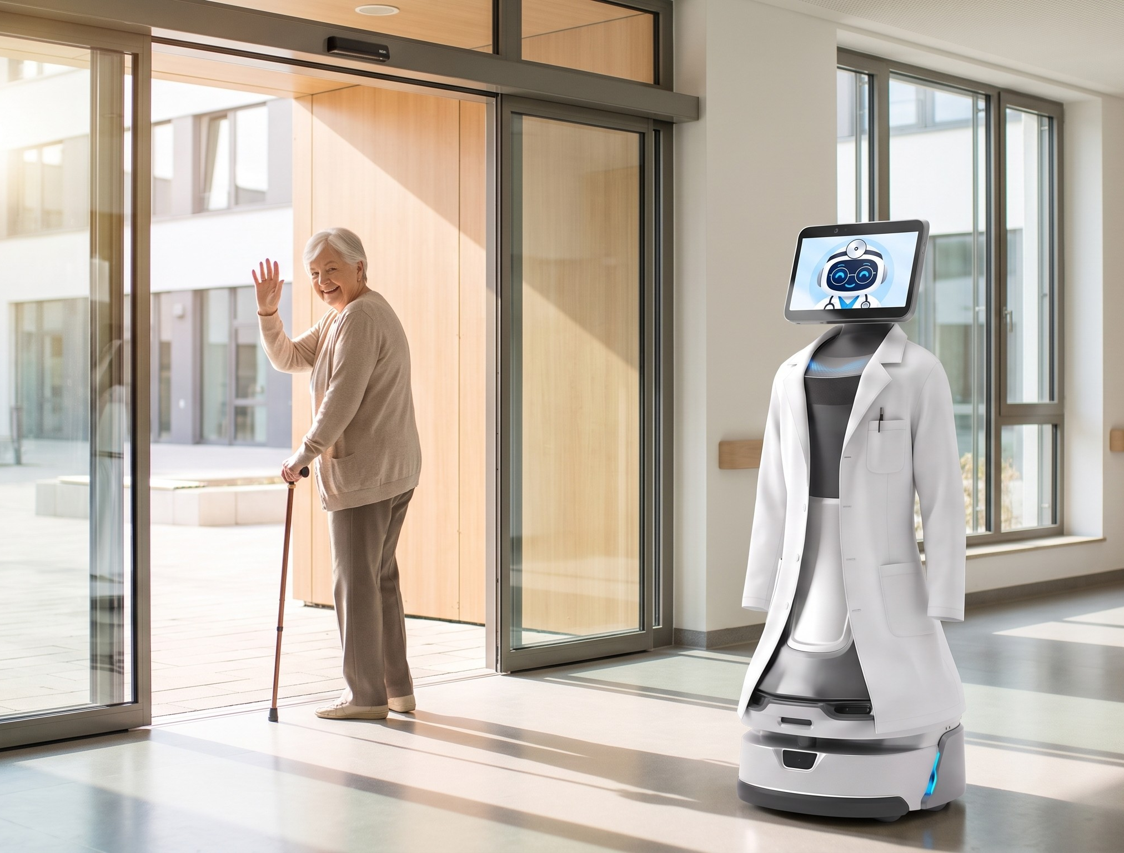
Problem
Solution
Demo
Roadmap
Remember her from the film?
She isn’t
lost anymore.
Let’s make sure your loved ones
never walk a hospital alone.
11
Notes:
(12 s) Remember her from the film? With OttO, she isn't lost anymore. Let's make sure your loved ones never walk a hospital alone.

Slide 12
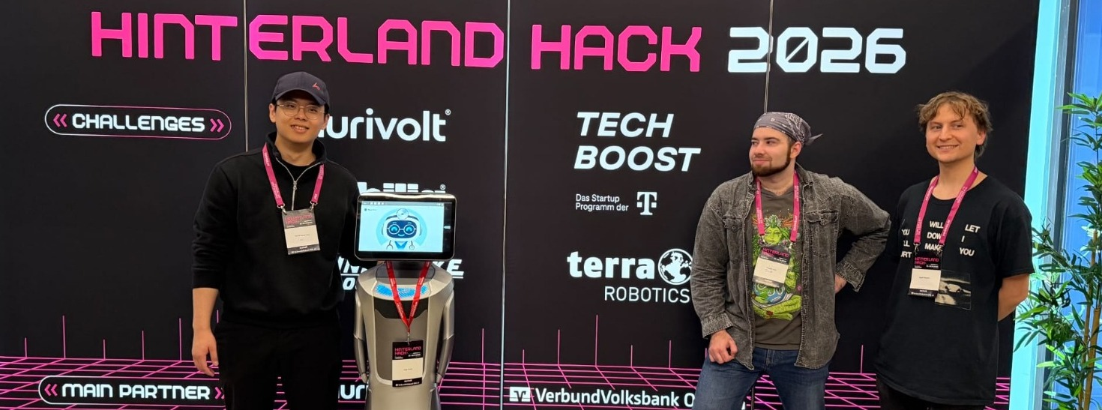
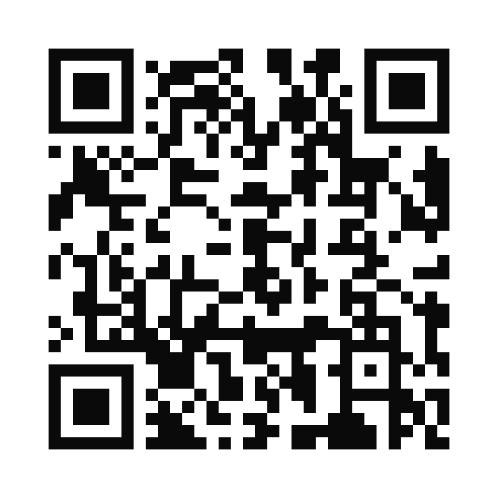
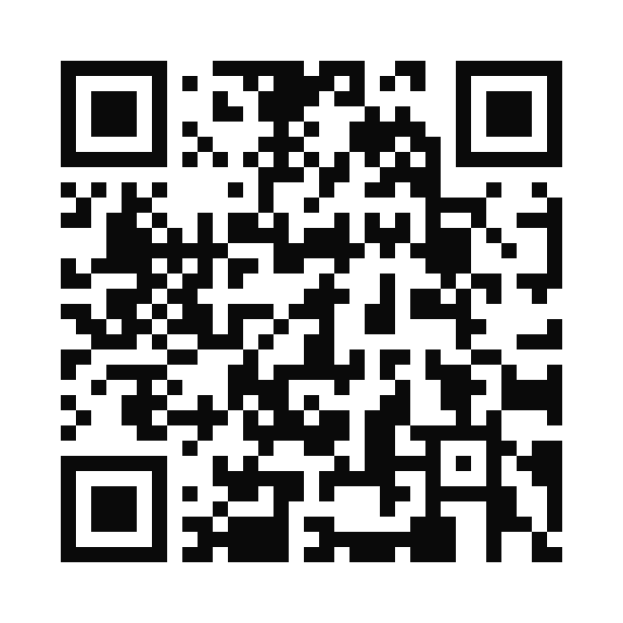
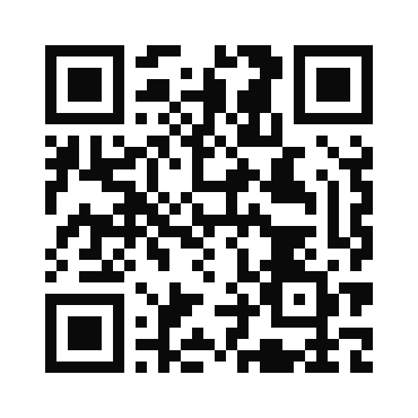
Problem
Solution
Demo
Roadmap
This is us. Let’s talk.
The Vinh Nguyen Trong
OttO
Sebastian Jack Maier
Dr. Evgenii Pustozerov
Construction robotics and AI, RWTH Aachen
Our robot guide
Cognitive computer science (AI), Bielefeld University
ML researcher, medical assistance systems
LinkedIn →
LinkedIn →
LinkedIn →
Notes:
(8 s) This is us. If you're interested, scan the code, and let's talk. Thank you.

Slide 13
Problem
Solution
Demo
Roadmap
Backup. Situations OttO handles.
First visit, 78, with a walker
A visitor with flowers
Monthly check-up, the room moved
A nurse at reception sends her to cardiology. OttO walks at her pace and waits when she stops.
He gives the patient’s name to a person at reception, who looks up the room. OttO walks him there and never learns the name.
Reception picks the new room. OttO knows the way, so the patient does not have to.
From consultation to X-ray
A wrong turn
People decide. OttO walks.
The doctor marks the visit as done. OttO picks the patient up, walks them to X-ray, then to the exit.
OttO notices, waits, asks if everything is all right, and gets them back on the way.
Reception and nurses greet you, take your data and decide where you go. OttO only knows the next room: no personal or clinical data.
Notes:
Backup for Q&A: example situations. Key line: people decide, OttO walks. OttO never gets personal or clinical data.

Slide 14
Problem
Solution
Demo
Roadmap
Backup. Market size, bottom-up.
SOM
≈ €4M a year
TAM · EU
Niedersachsen, our start: 165 hospitals × 2 robots × €12k
Niedersachsen state parliament, Drs. 19/4737 (hospitals end of 2023) · own calculation
SAM
≈ €44M a year
SAM · Germany
Germany: 1,841 hospitals × 2 robots × €12k
Destatis 2024 · own calculation
TAM
≈ €158M a year
SOM
EU: about 6,600 hospitals (Germany scaled by beds) × 2 robots × €12k
Niedersachsen
Eurostat 2022: 2.3M hospital beds in the EU, 642k in Germany · own calculation
Assumptions: 2 robots per hospital on average, €12k per robot per year incl. hardware, software and support. Top-down check: hospital wayfinding robots are about $1B worldwide in 2025 (The Business Research Company). Tailwind: medical robot sales +91 % in 2024 (IFR).
Notes:
Backup for Q&A: market, bottom-up. We start in Niedersachsen: 165 hospitals, 2 robots each, 12,000 euros per robot per year: about 4 million euros a year. Germany: 1,841 hospitals, about 44 million euros a year. EU: about 158 million euros a year. Top-down check: hospital wayfinding robots are about one billion dollars worldwide (one market report).

Slide 15
Problem
Solution
Demo
Roadmap
Backup. Growth plan, illustrative.
2027
Pilot in OWL and Hannover
2 robots
2028
First paying clinics
10 robots
2029
Niedersachsen and NRW
35 robots
2030
Germany
90 robots
2031
≈ 5 % of German hospitals
185 robots
Revenue at €12k per robot per year. A plan, not a forecast.
Notes:
Backup for Q&A: growth plan. Illustrative, at 12,000 euros per robot per year: pilot in OWL and Hannover in 2027, first paying clinics in 2028, Niedersachsen and NRW in 2029, Germany in 2030.

Slide 16
Problem
Solution
Demo
Roadmap
Backup. Go-to-market: land, expand, scale.
2027 · first pilots
2028–29 · the region
2030+ · Germany, then the EU
Land
→
Expand
→
Scale
Where
OWL and Hannover
Niedersachsen and NRW
Germany, then the EU
Who buys
1–2 pilot hospitals. Potential: Bethel, Franziskus, HDZ NRW, MHH
Large hospitals: many outpatients, long walks
Hospital groups and university hospitals
How we win
Founder-led. Nursing directors are our champions
Pilot results as proof. Hospital associations, purchasing groups
Sales and service through a robot partner. Trade fairs: DMEA, MEDICA
Goal
2 robots. Proof: staff time saved, fewer lost patients
10 → 35 robots
90 → 185 robots
Ecosystem Robot partner: hardware and service · Hospital IT: Teams, queue systems · Data protection and works council: sign-off · Nurses: champions
Robot-as-a-Service About €1,000 per robot per month: robot, software and support included. No upfront cost for the hospital.
Notes:
Backup for Q&A: go-to-market. Land: in 2027 a pilot with one or two hospitals in OWL and Hannover, potential partners Bethel, Franziskus Hospital, HDZ NRW and MHH, with the nursing directors as champions. Expand: with the pilot results across Niedersachsen and NRW, through hospital associations and purchasing groups. Scale: Germany, then the EU, through sales and service through a robot partner. Robot-as-a-Service: about 1,000 euros per robot per month, no upfront cost.

Slide 17
Problem
Solution
Demo
Roadmap
Backup. Competitor matrix.
Walks with you
Adapts pace, notices if you fall behind
Part of the clinic process
No personal or clinical data
No staff time per guide
Signs, maps, info desk
○
○
○
●
◐
today’s default
Wayfinding apps
○
○
◐
◐
●
e.g. Pointr, needs a smartphone
Staff and volunteer escorts
●
●
●
●
○
costs care time
Guide and reception robots
◐
◐
◐
◐
●
e.g. LG CLOi GuideBot, SoftBank Pepper
Delivery robots
○
○
◐
●
●
e.g. Aethon TUG, Keenon, Pudu: carry goods
OttO
●
●
●
●
●
AURA Robotics
● yes ◐ partly / depends on the product ○ no · Our view, based on public product information.
Our USP Of these options, only OttO walks with you like a person, fits into the clinic process, and needs no staff time and no personal data.
Notes:
Backup for Q&A: competitor matrix. Signs and apps do not walk with you; escorts cost care time; delivery robots carry goods; guide robots lead the way. Our USP: only OttO walks with you like a person, fits into the clinic process, and needs no staff time and no personal data.

Slide 18
Problem
Solution
Demo
Roadmap
Backup. Where OttO fits.
Our USP
Delivery robots
Walks with you like a person.
No staff time. No personal data.
carry goods
OttO
Part of the clinic process →
Staff and volunteer escorts
Info desk
cost care time
Like an escort
walks at your pace and notices if you fall behind
Unlike an escort
no nurse has to leave the ward
Stand-alone
Guide and reception robots
Wayfinding apps
lead the way
Unlike other robots
part of the clinic process, from check-in to the exit
Signs and maps
Built on
an existing service robot: we build the guide, not the hardware
Points the way
Walks with you →
Notes:
Backup for Q&A: positioning. Escorts walk with you but cost care time; robots so far point or lead the way. OttO is top right: walks with you, inside the clinic process.

Slide 19
Problem
Solution
Demo
Roadmap
Backup. The path to approval, step by step.
Step
What we do
With whom
When
Intended purpose
Write it down: OttO guides people. No diagnosis, no monitoring, no treatment. MDR qualification check (Art. 2(1), MDCG 2019-11): then likely not a medical device.
Regulatory advisor
Month 1
Data protection
Impact assessment (GDPR Art. 35), processing agreement (Art. 28), camera notice signs (Art. 13).
Hospital data protection officer
Month 1–2
Robot safety
Check the robot’s CE marking; our software keeps its speed and stop limits. Risk assessment (ISO 12100, ISO 13482). EU Machinery Regulation applies from 20 Jan 2027.
Robot maker, safety expert
Month 2
AI Act
OttO talks with people: it must say clearly that it is an AI (Art. 50, applies since 2 Aug 2026).
AURA Robotics
Month 2
Hospital sign-off
IT security, hygiene and cleaning plan, fire and escape routes, works council.
Hospital IT, hygiene, works council
Month 2–3
Pilot contract
Pilot agreement, liability insurance, staff training, information for patients.
Hospital management
Month 3
For a guide robot there is no single “approval”: it is these checks, most of them with the hospital. To be confirmed by a regulatory expert before the pilot.
Notes:
Backup for Q&A: path to approval. There is no single approval for a guide robot. Six steps in three months: intended purpose and MDR qualification, data protection with the hospital's DPO, robot safety, AI Act transparency, hospital sign-off, pilot contract.

Slide 20




Problem
Solution
Demo
Roadmap
Backup. Five challenges, five answers.
Challenge
How we solve it
Approval
→
Guide only, no diagnosis. 3-month expert check.
✓
Medical device? Safety? AI Act?
Privacy
→
No names, no clinical data, no video stored.
✓
Cameras in a hospital worry people.
Busy corridors
→
Slow, gives way, takes a detour, calls staff.
✓
Beds and crowds: robots get stuck.
Acceptance
→
People decide. OttO only walks.
✓
Will older patients trust a robot?
Budgets
→
Pilot first, then a monthly fee. No upfront cost.
✓
Tight budgets, slow purchasing.
Notes:
Backup for Q&A: challenges and how we solve them. Approval: guiding only, six checks with experts. Privacy: no personal data, no video stored. Busy corridors: slow, gives way, takes a detour, calls staff. Acceptance: people decide, OttO walks. Budgets: pilot first, then Robot-as-a-Service.

Slide 21
Problem
Solution
Demo
Roadmap
Backup. Numbers and sources.
Jamshidi et al., HERD 18(2), 2025, doi:10.1177/19375867251317240
301 US hospital staff, self-reported: mean 31.8 min/week on wayfinding help (median 15), 6.9 min per help, 29 % walk people all the way, ~44 % faced incivility. 3 days a year: 31.8 min × 46 weeks ÷ 8 h (own calculation).
Destatis, press releases 398 (Nov 2025) and 033 (Jan 2024)
1,841 hospitals, about 17.5 million inpatient cases in Germany, 2024. 280,000 to 690,000 nursing staff expected to be missing by 2049.
Destatis table 23131-b01 (own calculation)
47 % of 2024 inpatient cases were people aged 65+.
EDPB Guidelines 3/2019 · MDR (EU) 2017/745
Detecting a person without identifying them is not Art. 9 biometric data. Navigation-only is likely not a medical device (Art. 2(1), Recital 19); needs a proper check.
IFR World Robotics 2025, press release 7 Oct 2025
Almost 200,000 professional service robots sold in 2024 (+9 %); medical robots +91 % to about 16,700; robot-as-a-service fleet +31 %.
The Business Research Company, Smart Hospital Wayfinding Robot Global Market Report
$1.0B in 2025, $1.17B in 2026, $2.17B in 2030 (CAGR about 17 %). A single market-report estimate.
Illustrative value, not measured
25 walks a day × 3 min saved × 250 days ≈ 312 h staff time per robot per year (≈ €9,375 at €30/h). Robot cost not included.
Notes:
Backup for Q&A only: sources.

