Slide 1
clientContactName
{{clientBusinessName}}
{{portfolioManagerName}}
{{station}}

Slide 2
Team Commitment
The following proposal will be submitted to
{{clientBusinessName}}
The creation of this Summary of Conclusions and Recommendations is a team collaboration of media professionals with the goal of exceeding your expectations. Each of the below is committed to the highest standards of professionalism and are personally available should you have any questions or concerns throughout this campaign.
{{topLevelName}}
{{secondLevelName}}
{{thirdLevelName}}
{{fourthLevelName}}
{{topLevelTitle}}
{{secondLevelTitle}}
{{thirdLevelTitle}}
{{fourthLevelTitle}}

Slide 3
Marketplace Competition
1. How long have you been in business?
How many locations?
Plans to expand?
{{yearsInBusiness}} years
{{numberOfLocations}}
{{planToExpand}}
1st Tier
{{firstTierBusiness}}
#1 in Market Revenue
2nd Tier
{{secondTierBusiness}}
#2 in Market Revenue
3rd Tier
{{thirdTierBusiness}}
#3 in Market Revenue
4th Tier
{{fourthTierBusiness}}
#1 in Market Revenue
2. Who is the main competition?
{{competitionA}}
{{competitionB}}
A. What are their strengths?
{{competitionStrengthA}}
{{competitionStrengthB}}
B. What are their weakness?
{{competitionWeaknessA}}
{{competitionWeaknessB}}
3. What are the biggest misconceptions consumers have about your business?
{{misconceptions}}

Slide 4
Strategic Marketing I
4. If you had the power to improve three things in your marketing, what would they be in order?
1. Initiate Cause Marketing Programs
2. Tech Recruitment
3. Expand Target Consumers (by age, sex, geography)
Client Objectives
PRODUCT/SERVICE
CONSUMER
Introduce New Department/Products/Services
Feature Specific Products/Services
Call Attention to Brands/Private Labels Carried
Promote Off-price Items/Services
Utilize Co-op/Vendor Dollars
Maintain Market Dominance
Elevate Business Brand/Image
Improve Reputation and Listing Management
Enhance Website (Mobile, Response, SEO, SEM)
Increase Market Share
PROMOTION
BRAND
Make Promotional Events Stronger
Develop Digital/Mobile/Social Strategies
Establish a quarterly spike/seasonal campaign
Develop Database Marketing (Email and Text)
Initiate Cause Marketing Programs
Develop Specially Staged Events
Maintain Market Dominance
Elevate Business Brand/Image
Improve Reputation and Listing Management
Enhance Website (Mobile, Response, SEO, SEM)
Increase Market Share
Tech Recruitment
5. What are your most distinctive selling advantages?
{{sellingAdvantages}}

Slide 5
Strategic Marketing II
6. What image do you want your company's name to project to customers and potential consumers?
{{companyNameProjectImage}}
Current Company Slogan
{{currentCompanySlogan}}
Does your current slogan project the same image?
{{planToExpand}}
7. What are your: | Poorest performing months | Best performing months | Best performing days
 | {{poorestMonths}} | {{bestMonths}} | {{bestDays}}
8. a. What’s the most frequent compliment you get?
{{compliments}}
b. What’s the most frequent complaint you get?
{{complaint}}
9. What are your digital marketing strategies? What are your goals and measures of success?
10. Do you have social media strategy (i.e. Facebook, Instagram, etc.)? If so, what are your goals and measures of success?
{{marketingStrategy}}
{{socialStrategy}}

Slide 6
Target Marketing
A. What percentage of your "target" consumers are men?
{{pctMen}}
Women?
{{pctWomen}}
B. What is the perceived income of your “target” consumer household?
{{under50Id}}
{{5099Id}}
{{100149Id}}
{{150Id}}
Under 50K
50K-
99K
100K-
149K
150K plus
C. How else would you describe your ideal "target" consumer (i.e. geo-targeting, home value, behavior, lifestyle, interests, family structure, etc)?
{{describeIdealTargetConsumer}}
A lenograph is a picture of consumption by target values expressed by ratings 1-10, 10 the highest.
 |  | Target 85%
12-18 | 19-25 | 26-35 | 36-45 | 46-55 | 56+
{{have12to18}} | {{have19to25}} | {{have26to35}} | {{have36to45}} | {{have46to55}} | {{have56Plus}}
{{want19to25}} | {{want19to25}} | {{want26to35}} | {{want36to45}} | {{want46to55}} | {{want55Plus}}
HAVE
WANT

Slide 7
Target Marketing
A. What percentage of your "target" consumers are men?
{{pctMen}}
Women?
{{pctWomen}}
B. What is the perceived income of your “target” consumer household?
{{under50Id}}
{{5099Id}}
{{100149Id}}
{{150Id}}
Under 50K
50K-
99K
100K-
149K
150K plus
C. How else would you describe your ideal "target" consumer (i.e. geo-targeting, home value, behavior, lifestyle, interests, family structure, etc)?
{{describeIdealTargetConsumer}}
A lenograph is a picture of consumption by target values expressed by ratings 1-10, 10 the highest.
 |  |  | Target 85%
12-18 | 19-25 | 26-35 | 36-45 | 46-55 | 56+
{{have12to18}} | {{have19to25}} | {{have26to35}} | {{have36to45}} | {{have46to55}} | {{have56Plus}}
{{want19to25}} | {{want19to25}} | {{want26to35}} | {{want36to45}} | {{want46to55}} | {{want55Plus}}
HAVE
WANT

Slide 8
Target Marketing
A. What percentage of your "target" consumers are men?
{{pctMen}}
Women?
{{pctWomen}}
B. What is the perceived income of your “target” consumer household?
{{under50Id}}
{{5099Id}}
{{100149Id}}
{{150Id}}
Under 50K
50K-
99K
100K-
149K
150K plus
C. How else would you describe your ideal "target" consumer (i.e. geo-targeting, home value, behavior, lifestyle, interests, family structure, etc)?
{{describeIdealTargetConsumer}}
A lenograph is a picture of consumption by target values expressed by ratings 1-10, 10 the highest.
 |  |  |  | Target 85%
12-18 | 19-25 | 26-35 | 36-45 | 46-55 | 56+
{{have12to18}} | {{have19to25}} | {{have26to35}} | {{have36to45}} | {{have46to55}} | {{have56Plus}}
{{want19to25}} | {{want19to25}} | {{want26to35}} | {{want36to45}} | {{want46to55}} | {{want55Plus}}
HAVE
WANT

Slide 9
Target Marketing
A. What percentage of your "target" consumers are men?
{{pctMen}}
Women?
{{pctWomen}}
B. What is the perceived income of your “target” consumer household?
{{under50Id}}
{{5099Id}}
{{100149Id}}
{{150Id}}
Under 50K
50K-
99K
100K-
149K
150K plus
C. How else would you describe your ideal "target" consumer (i.e. geo-targeting, home value, behavior, lifestyle, interests, family structure, etc)?
{{describeIdealTargetConsumer}}
A lenograph is a picture of consumption by target values expressed by ratings 1-10, 10 the highest.
 | Target 85%
12-18 | 19-25 | 26-35 | 36-45 | 46-55 | 56+
{{have12to18}} | {{have19to25}} | {{have26to35}} | {{have36to45}} | {{have46to55}} | {{have56Plus}}
{{want19to25}} | {{want19to25}} | {{want26to35}} | {{want36to45}} | {{want46to55}} | {{want55Plus}}
HAVE
WANT

Slide 10
Target Marketing
A. What percentage of your "target" consumers are men?
{{pctMen}}
Women?
{{pctWomen}}
B. What is the perceived income of your “target” consumer household?
{{under50Id}}
{{5099Id}}
{{100149Id}}
{{150Id}}
Under 50K
50K-
99K
100K-
149K
150K plus
C. How else would you describe your ideal "target" consumer (i.e. geo-targeting, home value, behavior, lifestyle, interests, family structure, etc)?
{{describeIdealTargetConsumer}}
A lenograph is a picture of consumption by target values expressed by ratings 1-10, 10 the highest.
Target 85%
12-18 | 19-25 | 26-35 | 36-45 | 46-55 | 56+
{{have12to18}} | {{have19to25}} | {{have26to35}} | {{have36to45}} | {{have46to55}} | {{have56Plus}}
{{want19to25}} | {{want19to25}} | {{want26to35}} | {{want36to45}} | {{want46to55}} | {{want55Plus}}
HAVE
WANT

Slide 11
Recommended Reallocation of
Total Advertising Investment (TAI)
A.
Previous Year’s Media Allocation
Proposed 12 Month Media Allocation
{{lastYearLabel1}}
{{lastYearLabel2}}
{{lastYearLabel3}}
{{lastYearLabel4}}
{{lastYearLabel5}}
{{lastYearLabel6}}
{{lastYearLabel7}}
{{lastYearLabel8}}
{{lastYearLabel9}}
{{lastYearValue1}}
{{lastYearValue2}}
{{lastYearValue3}}
{{lastYearValue4}}
{{lastYearValue5}}
{{lastYearValue6}}
{{lastYearValue7}}
{{lastYearValue8}}
{{lastYearValue9}}
{{proposedLabel1}}
{{proposedLabel2}}
{{proposedLabel3}}
{{proposedLabel4}}
{{proposedLabel5}}
{{proposedLabel6}}
{{proposedLabel7}}
{{proposedLabel8}}
{{proposedLabel9}}
{{proposedValue1}}
{{proposedValue2}}
{{proposedValue3}}
{{proposedValue4}}
{{proposedValue5}}
{{proposedValue6}}
{{proposedValue7}}
{{proposedValue8}}
{{proposedValue9}}
Total Adv. Investment
{{totalMediaInvestment}}
Total Adv. Investment
{{totalMediaInvestmentTwo}}
B.
{{totalMediaInvestmentInput}}
/
{{pctTAIGrossSalesLastYear}}
{{grossSalesLastyear}}
=
Total Adv Investment Next 12 Months
Adv % of Gross Sales
Estimated Gross Sales Next
12 Months
C.
{{taiNext12Months}}
{{pctGrossSales}}
{{estimatedGrossSalesNext12Months}}
/
=
Stretch Goal Total Adv. Investment Next 12 Months
Adv % of Gross Sales
Stretch Gross Sales Next
12 Months

Slide 12
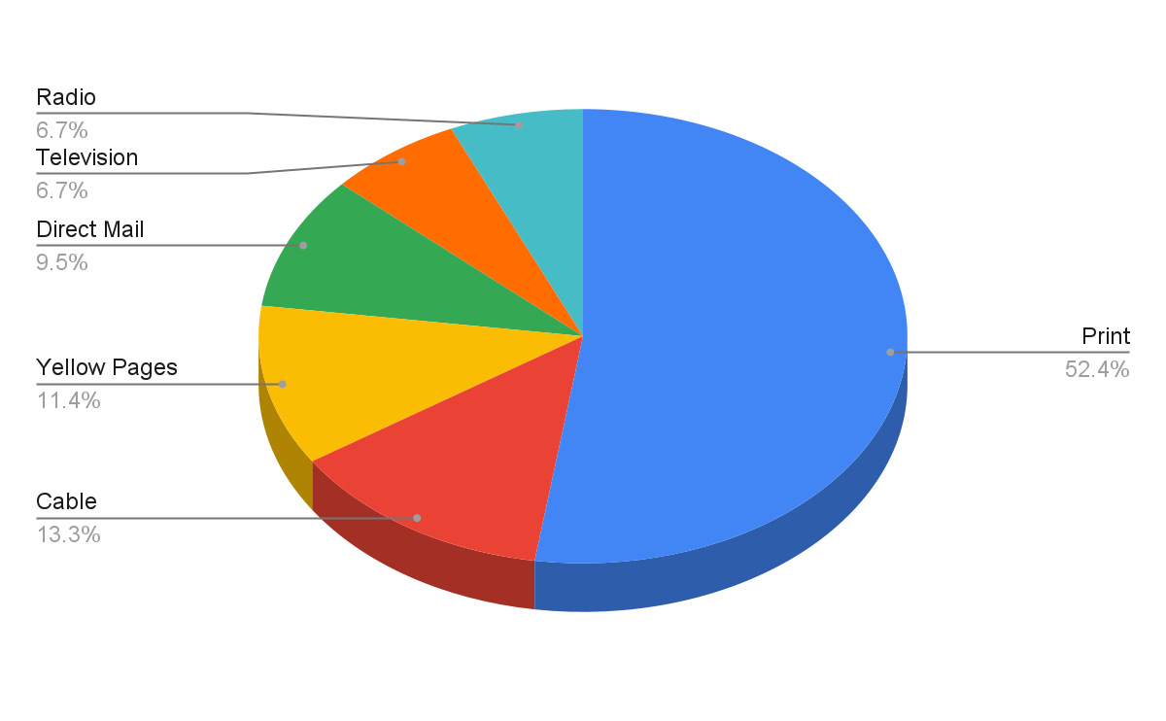
Previous Year’s Media Allocation
Total Advertising Investment (TAI): {{totalAdvertisingInvestmentConfidentialClientEvaluationOnePage}}

Slide 13
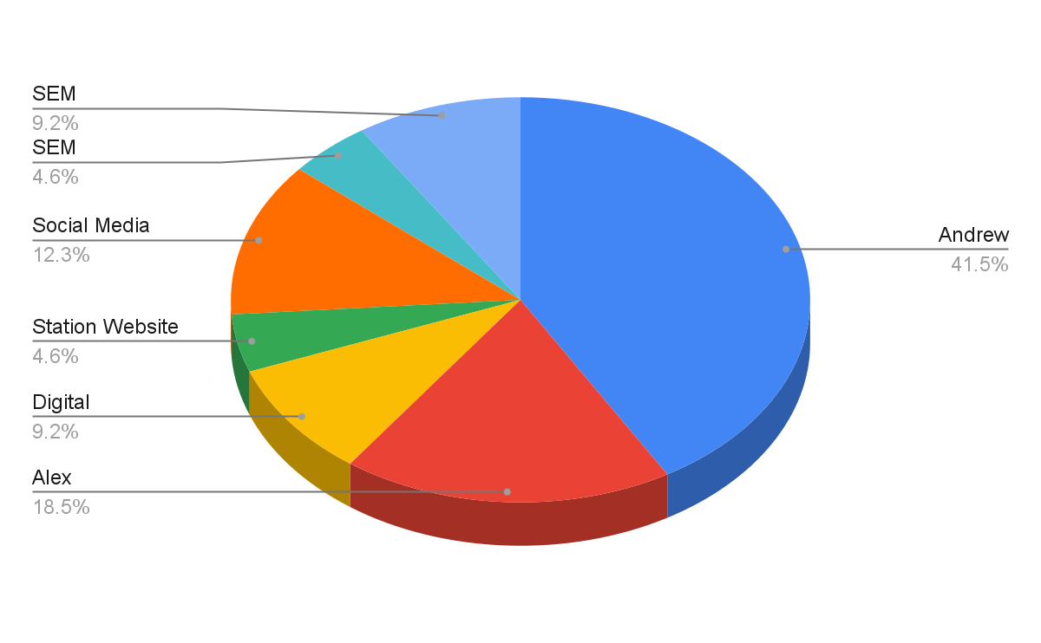
Proposed Year’s Media Allocation
Total Advertising Investment (TAI): {{totalAdvertisingInvestmentConfidentialClientEvaluationProposed}}

Slide 14
Profile of Consumers
Replace this text with station/consumer information and/or customized research.

Slide 15
Marketing Strategies
Replace this text with marketing stra

Slide 16
Creative Concepts I

Slide 17
Creative Concepts II

Slide 18
Digital Marketing Strategies
Replace this text with station/consumer information and/or customized research.

Slide 19
Long Range Strategic Plans
SATURATION
13 WEEKS
AWARENESS
PENETRATION
26 WEEKS
RECOGNITION
DOMINANCE
52 WEEKS
ACCEPTANCE

Slide 20
Advantages to Long-Range Strategic Planning
Long-term investments placed for a year usually achieve lower rates.
Advertising “Away from the Clutter” gains the competitive edge.
Consistent continuity creates lasting impressions, not just short-term attention.
Consistent advertising creates the image of credibility and stability.
All successful businesses consider long-range strategic planning a smart business decision.

Slide 21
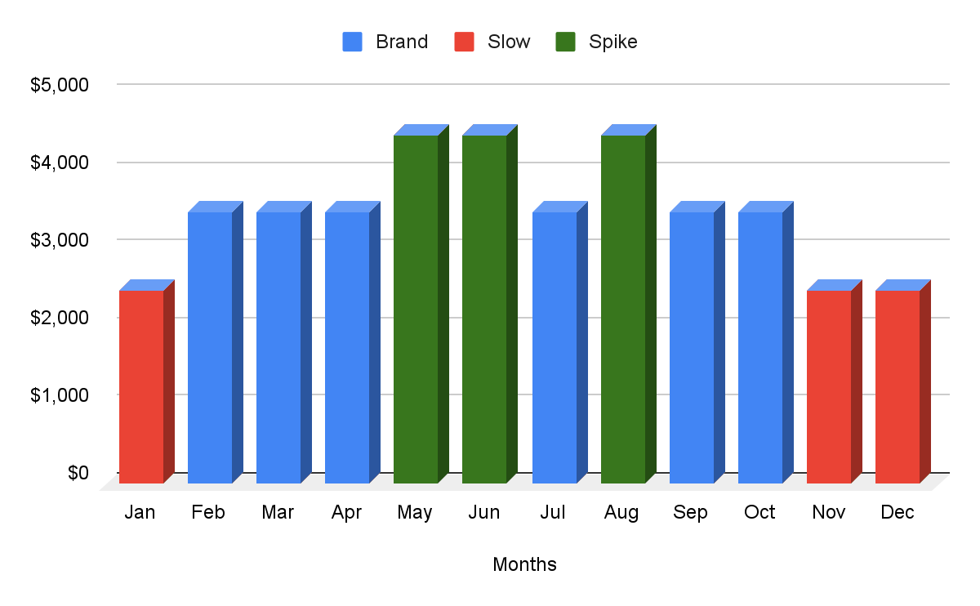
Proposed Schedule - Plan A
Budget Breakout by Month (For Next 12 Months)
Proposed Media Plan: {{station}}

Slide 22
Proposed Schedule - Plan A
 | Branding Months
Station | Days | DayPart | Weekly Commercials | Branding Months
WAAA | M-F | 6:00am - 7:00pm | 15 | # of Weeks/Months
WAAA | M-F | 7:00pm - 12mid | 5 | 1
WBBB | M-F | 6:00am - 7:00pm | 15 | Base Investment
WBBB | M-F | 7:00pm - 12mid | 5 | $1,000
 |  |  |  | Total # of Commercials
 |  |  |  | 40
 | Spike Months
Station | Days | DayPart | Weekly Commercials | Spike Months
WAAA | M-F | 6:00am - 7:00pm | 15 | #Week/Months:
WAAA | M-F | 7:00pm - 12mid | 5 | 2
WBBB | M-F | 6:00am - 7:00pm | 15 | Continuity Investment:
WBBB | M-F | 7:00pm - 12mid | 5 | $2,000
 |  |  |  | Total # of Commercials
 |  |  |  | 80
 | Slow Months
Station | Days | DayPart | Weekly Commercials | Slow Months
WAAA | M-F | 6:00am - 7:00pm | 15 | #Week/Months:
WAAA | M-F | 7:00pm - 12mid | 5 | 3
WBBB | M-F | 6:00am - 7:00pm | 15 | Continuity Investment:
WBBB | M-F | 7:00pm - 12mid | 5 | $3,000
 |  |  |  | Total # of Commercials
 |  |  |  | 120

Slide 23
Proposed Schedule - Plan A
{{clientBusinessName}}
Brand Equity Schedule
Monthly Station Summary
Market: {{planACity}}
Average Projected Broadcast Monthly Reach: {{planAReach}}
Average Projected Monthly Broadcast Frequency: {{planAFrequency}}
Average Estimated Monthly Digital Gross Impressions: {{planADigitalImpressionsMonthly}}
Average Base Monthly Advertising Investment: {{planAMonthly}}
Average Base Daily Advertising Investment: {{planADaily}}

Slide 24
Break Even Analysis - Plan A
Average sale (ticket, transaction, invoice) =
Gross profit margin on average sale (sale less closing costs) =
Closing or conversion rate =
Projected prospect value (=A*B*C)=
Client base monthly advertising investment =
Monthly prospects needed to pay for advertising investment (=E/D)=
Monthly # of sales from prospects needed to break even (=F*C) =
Gross sales per month needed to break even (=G*A)=
Number of months to run in proposed marketing plan =
Additional gross sales per year needed to break even (=H*I)=
{{planAAverageSale}}
{{planAGrossMargin}}
{{planAClosingPct}}
{{planAProspectValue}}
{{planAMonthly}}
{{planAProspectsNeeded}}
{{planAProspectSalesNeeded}}
{{planAGrossProfitOnSales}}
{{planAMonths}}
{{planAAdditionalGrossSales}}

Slide 25
Lifetime Value Analysis - Plan A
Average sale (ticket, transaction, invoice) =
Times gross profit margin on average sale (sale less variable costs) =
Equals gross profit per average sale (A*B) =
Times the average repeat sales per year (per customer/client) =
Equals the average customer/client value per year (C*D)=
Times the average number of years of patronage =
Equals the lifetime value of one customer/client (E*F) =
So if your base monthly advertising investment averages =
Then monthly customers/clients needed to break even (H/G)=
{{a_averageSale}}
{{a_grossProfitMargin}}
{{a_grossProfitPerSale}}
{{a_averageRepeatSales}}
{{a_averageCustomerValue}}
{{a_yearsOfPatronage}}
{{a_lifetimeValuePerCustomer}}
{{planAMonthly}}
{{a_prospectsNeededToBreakEven}}

Slide 26
Digital ROI Calculator - Plan A
Monthly Digital Investment =
Cost Per Thousand (CPM) =
Monthly Impressions (=A/B*1,000) =
Click Through Rate (.01%, .1%, etc) =
Monthly # clicks (=C*D) =
Cost per Click (=A/E) =
Sales Conversion Percentage (2%, 10%, etc)=
Monthly Number of Conversions (E*G) =
Cost Per Conversion (A/H) =
Projected Gross Profit Per Conversion ($100, $1,000, etc.) =
Monthly Gross Profit Generated from all Conversions (H*J) =
$Monthly Return on Investment (K-A) =
% Monthly Return on Investment (L/A) =
{{planAMonthlyDigitalInvestment}}
{{planACostPerThousand}}
{{planAClosingPctNumber}}
{{planAClickThroughRate}}
{{planAMonthlyClicks}}
{{planACostPerClicks}}
{{planASalesConversionPercentage}}
{{planAMonthlyConversions}}
{{planACostPerConversion}}
{{planAProjectedGrossProfit}}
{{planAMonthlyGrossProfit}}
{{planAMonthlyROID}}
{{planAMonthlyROIP}}

Slide 27
Proposed Schedule - Plan B
Budget Breakout by Month (For Next 12 Months)
Proposed Media Plan: {{station}}

Slide 28
Proposed Schedule - Plan B
Station | Days | DayPart | Weekly Commercials |  | Branding Months
WAAA | M-F | 6:00am - 7:00pm | 15 |  | #Week/Months:
WAAA | M-F | 7:00pmStation Days DayPart Weekly Commercials Branding Months WAAA M-F 6:00am - 7:00pm 15 #Week/Months: WAAA M-F 7:00pm - 12mid 5 1 WBBB M-F 6:00am - 7:00pm 15 Base Investment: WBBB M-F 7:00pm - 12mid 5 $1,500 WCCC M-F 6:00am - 7:00pm 15 Total # of Commercials WCCC M-F 7:00pm - 12mid 5 60 - 12mid | 5 |  | 1
WBBB | M-F | 6:00am - 7:00pm | 15 |  | Base Investment:
WBBB | M-F | 7:00pm - 12mid | 5 |  | $1,500
WCCC | M-F | 6:00am - 7:00pm | 15 |  | Total # of Commercials
WCCC | M-F | 7:00pm - 12mid | 5 |  | 60
Station | Days | DayPart | Weekly Commercials |  | Spike Months
WAAA | M-F | 6:00am - 7:00pm | 15 |  | #Week/Months:
WAAA | M-F | 7:00pm - 12mid | 5 |  | 2
WBBB | M-F | 6:00am - 7:00pm | 15 |  | Continuity Investment:
WBBB | M-F | 7:00pm - 12mid | 5 |  | $3,000
WCCC | M-F | 6:00am - 7:00pm | 15 |  | Total # of Commercials
WCCC | M-F | 7:00pm - 12mid | 5 |  | 120
Station | Days | DayPart | Weekly Commercials |  | Slow Months
WAAA | M-F | 6:00am - 7:00pm | 15 |  | #Week/Months:
WAAA | M-F | 7:00pm - 12mid | 5 |  | 3
WBBB | M-F | 6:00am - 7:00pm | 15 |  | Average Spike Investment:
WBBB | M-F | 7:00pm - 12mid | 5 |  | 4,500
WCCC | M-F | 6:00am - 7:00pm | 15 |  | Total # of Commercials
WCCC | M-F | 7:00pm - 12mid | 5 |  | 180

Slide 29
Proposed Schedule - Plan BT
Station | Days | DayPart | Weekly Commercials |  | Branding Months
WAAA | M-F | 6:00am - 7:00pm | 15 |  | #Week/Months:
WAAA | M-F | 7:00pm - 12mid | 5 |  | 1
WBBB | M-F | 6:00am - 7:00pm | 15 |  | Base Investment:
WBBB | M-F | 7:00pm - 12mid | 5 |  | $1,500
WCCC | M-F | 6:00am - 7:00pm | 15 |  | Total # of Commercials
WCCC | M-F | 7:00pm - 12mid | 5 |  | 60

Slide 30
Proposed Schedule - Plan B
{{clientBusinessName}}
Brand Equity Schedule
Monthly Station Summary
Market: {{planBCity}}
Average Projected Broadcast Monthly Reach: {{planBReach}}
Average Projected Monthly Broadcast Frequency: {{planBFrequency}}
Average Estimated Monthly Digital Gross Impressions: {{planBDigitalImpressionsMonthly}}
Average Base Monthly Advertising Investment: {{planBMonthly}}
Average Base Daily Advertising Investment: {{planBDaily}}

Slide 31
Break Even Analysis - Plan B
Average sale (ticket, transaction, invoice) =
Gross profit margin on average sale (sale less closing costs) =
Closing or conversion rate =
Projected prospect value (=A*B*C)=
Client base monthly advertising investment =
Monthly prospects needed to pay for advertising investment (=E/D)=
Monthly # of sales from prospects needed to break even (=F*C) =
Gross sales per month needed to break even (=G*A)=
Number of months to run in proposed marketing plan =
Additional gross sales per year needed to break even (=H*I)=
{{planBAverageSale}}
{{planBGrossMargin}}
{{planBClosingPct}}
{{planBProspectValue}}
{{planBMonthly}}
{{planBProspectsNeeded}}
{{planBProspectSalesNeeded}}
{{planBGrossProfitOnSales}}
{{planBMonths}}
{{planBAdditionalGrossSales}}

Slide 32
Lifetime Value Analysis - Plan B
Average sale (ticket, transaction, invoice) =
Times gross profit margin on average sale (sale less variable costs) =
Equals gross profit per average sale (A*B) =
Times the average repeat sales per year (per customer/client) =
Equals the average customer/client value per year (C*D)=
Times the average number of years of patronage =
Equals the lifetime value of one customer/client (E*F) =
So if your base monthly advertising investment averages =
Then monthly customers/clients needed to break even (H/G)=
{{b_averageSale}}
{{b_grossProfitMargin}}
{{b_grossProfitPerSale}}
{{b_averageRepeatSales}}
{{b_averageCustomerValue}}
{{b_yearsOfPatronage}}
{{b_lifetimeValuePerCustomer}}
{{planBMonthly}}
{{b_prospectsNeededToBreakEven}}

Slide 33
Digital ROI Calculator - Plan B
Monthly Digital Investment =
Cost Per Thousand (CPM) =
Monthly Impressions (=A/B*1,000) =
Click Through Rate (.01%, .1%, etc) =
Monthly # clicks (=C*D) =
Cost Per Click (=A/E) =
Sales Conversion Percentage (2%, 10%, etc)=
Monthly Number of Conversions (E*G) =
Cost Per Conversion (A/H) =
Projected Gross Profit Per Conversion ($100, $1,000, etc.) =
Monthly Gross Profit Generated from all Conversions (H*J) =
$Monthly Return on Investment (K-A) =
% Monthly Return on Investment (L/A) =
{{planBMonthlyDigitalInvestment}}
{{planBCostPerThousand}}
{{planBClosingPctNumber}}
{{planBClickThroughRate}}
{{planBMonthlyClicks}}
{{planBCostPerClicks}}
{{planBSalesConversionPercentage}}
{{planBMonthlyConversions}}
{{planBCostPerConversion}}
{{planBProjectedGrossProfit}}
{{planBMonthlyGrossProfit}}
{{planBMonthlyROID}}
{{planBMonthlyROIP}}

Slide 34
Plan A
For the benefit of the client, {{station}} agrees to develop a marketing strategy to help:
Initiate Cause Marketing Program
Tech Recruitment
Expand Target Consumers (by age, sex, geography)
In return for fulfilling stated goals {{clientBusinessName}} agrees to invest in the following long-term plan:
Media | Jan | Feb | Mar | Apr | May | Jun | Jul | Aug | Sep | Oct | Nov | Dec | Total
WWWW | $1,500 | $1,500 | $1,500 | $3,000 | $3,000 | $4,500 | $4,500 | $4,500 | $3,000 | $3,000 | $3,000 | $3,000 | $36,000
Digital | $1,000 | $1,000 | $1,000 | $1,000 | $1,000 | $1,000 | $1,000 | $1,000 | $1,000 | $1,000 | $1,000 | $1,000 | $12,000
wwww.com | $500 | $500 | $500 | $500 | $500 | $500 | $500 | $500 | $500 | $500 | $500 | $500 | $6,000
Monthly Totals | $3,000 | $3,000 | $3,000 | $4,500 | $4,500 | $6,000 | $6,000 | $6,000 | $4,500 | $4,500 | $4,500 | $4,500 | $54,000
Client may cancel after 13 weeks from schedule start date with two weeks’ notice and no short rate. This offer is good for 10 business days from the date of presentation. In accordance with Paragraphs 49 and 50 of United States Federal Communications Commission Report and Order No. FCC 07-217, this station will not discriminate in any contract for advertising on the basis of race or ethnicity, and all such contracts will be evaluated, accepted, negotiated and completed without regard to race or ethnicity
Analysis of Schedule:
Average Monthly Client Investment: $3
Average Daily Client Investment: $0
Thank you for you trust and confidence
Accepted for
Date
Accepted for
Date

Slide 35
Plan B
For the benefit of the client, {{station}} agrees to develop a marketing strategy to help:
Initiate Cause Marketing Program
Tech Recruitment
Expand Target Consumers (by age, sex, geography)
In return for fulfilling stated goals {{clientBusinessName}} agrees to invest in the following long-term plan:
Media | Jan | Feb | Mar | Apr | May | Jun | Jul | Aug | Sep | Oct | Nov | Dec | Total
WWWW | $1,500 | $1,500 | $1,500 | $3,000 | $3,000 | $4,500 | $4,500 | $4,500 | $3,000 | $3,000 | $3,000 | $3,000 | $36,000
Digital | $1,000 | $1,000 | $1,000 | $1,000 | $1,000 | $1,000 | $1,000 | $1,000 | $1,000 | $1,000 | $1,000 | $1,000 | $12,000
wwww.com | $500 | $500 | $500 | $500 | $500 | $500 | $500 | $500 | $500 | $500 | $500 | $500 | $6,000
WWWA | $500 | $500 | $500 | $1,000 | $1,000 | $1,500 | $1,500 | $1,500 | $1,000 | $1,000 | $1,000 | $1,000 | $12,000
Monthly Totals | $3,500 | $3,500 | $3,500 | $5,500 | $5,500 | $7,500 | $7,500 | $7,500 | $5,500 | $5,500 | $5,500 | $5,500 | $66,000
Client may cancel after 13 weeks from schedule start date with two weeks’ notice and no short rate. This offer is good for 10 business days from the date of presentation. In accordance with Paragraphs 49 and 50 of United States Federal Communications Commission Report and Order No. FCC 07-217, this station will not discriminate in any contract for advertising on the basis of race or ethnicity, and all such contracts will be evaluated, accepted, negotiated and completed without regard to race or ethnicity
Analysis of Schedule:
Average Monthly Client Investment: $3
Average Daily Client Investment: $0
Thank you for you trust and confidence
Accepted for
Date
Accepted for
Date

Slide 36
Client Policy Agreement
At {{station}} we have an agreement, which we will discuss with all our business partners and review throughout the year
We will conduct a confidential needs analysis (Database) to gain a complete understanding of your business, your market and your stated objectives.
You will be supplied with a customized Summary of Conclusions and Recommendations (SCR) that is tailored to help you achieve your business goals.
You can be sure that your Marketing Representative will be professional, objective and totally focused on your needs (vs. what’s only in the best interest of the station group).
You will be offered total production and digital services and once complete, we will provide all creative to you for your final approval before going on-air or on-line.
The order will be placed as requested and you can expect a duplicate of your submitted broadcast schedules and net figures so that you know all times and costs.
You will be contacted following the first week on air to ensure that everything is running as scheduled.
You will be provided with the latest qualitative research and will be continuously updated on relevant market information and changes.
You can expect an exceptional customer experience including follow-through on all promises made and prompt return phone calls.
While we will be in constant contact, you will be asked to formally evaluate our performance and your results every 3, 6, 9 and 12 months.
If any of the above conditions are not met, please contact {{portfolioManagerName}} at +1 (804) 356-7006

Slide 37
Sales Service Agreement
This Sales Service Agreement is part of our Consumer Satisfaction Index (CSI) which is meant to build and serve long term alliances. Please help me know how well we are servicing you by grading each of the following segments 1 to 5 with 5 being the highest.
CONTINUOUS BASIC SERVICE
The Marketing Representative has a full understanding of my business needs, goals and objectives.
He/she has been in constant contact to make sure that the program is running as planned.
Statement/Invoice questions have been handled in a timely fashion.
Client calls have been returned within a reasonable time frame.
Promises have been kept and commitments have been honored at all times.
The overall service experience rating I would give my Marketing Representative.
The marketing program has met my expectations given the time period it has been running.
How likely I would be to recommend someone else to this group.
Signed by Integrated Marketing Consultant
Date
Signed by Client
Date

