Slide 1
Previous Year’s Media Allocation
Total Advertising Investment (TAI): totalAdvertisingInvestmentConfidentialClientEvaluationOnePage

Slide 2
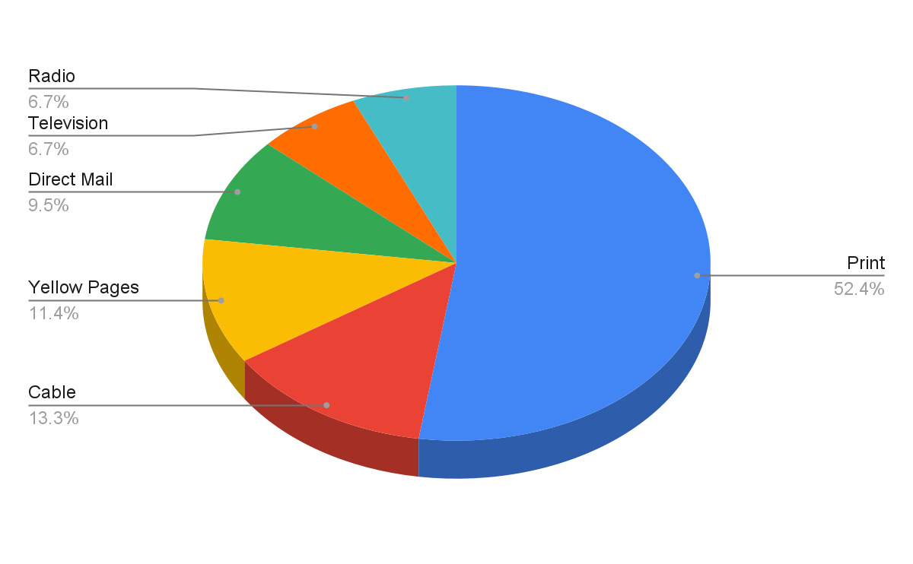
Previous Year’s Media Allocation
Total Advertising Investment (TAI): totalAdvertisingInvestmentConfidentialClientEvaluationOnePage

Slide 3
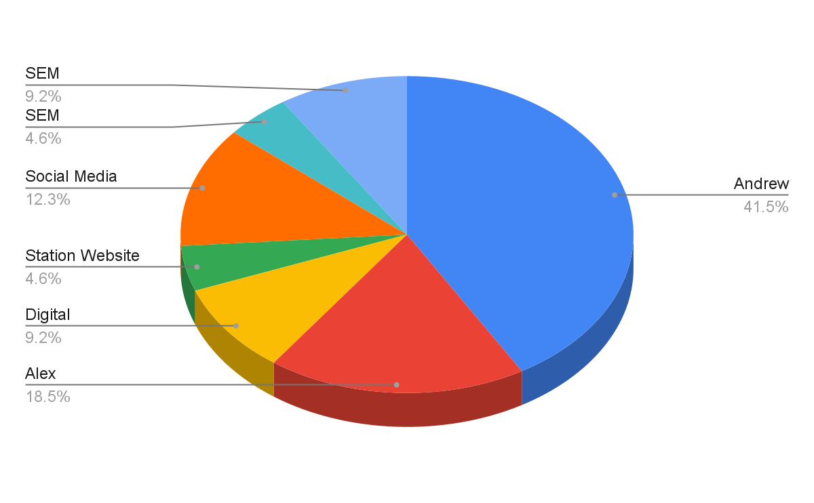
Proposed Year’s Media Allocation
Total Advertising Investment (TAI): totalAdvertisingInvestmentConfidentialClientEvaluationProposed

Slide 4
Profile of Consumers
Replace this text with station/consumer information and/or customized research.

Slide 5
Marketing Strategies
Replace this text with marketing stra

Slide 6
Creative Concepts I

Slide 7
Creative Concepts II

Slide 8
Digital Marketing Strategies
Replace this text with station/consumer information and/or customized research.

Slide 9
Long Range Strategic Plans
SATURATION
13 WEEKS
AWARENESS
PENETRATION
26 WEEKS
RECOGNITION
DOMINANCE
52 WEEKS
ACCEPTANCE

Slide 10
Advantages to Long-Range Strategic Planning
Long-term investments placed for a year usually achieve lower rates.
Advertising “Away from the Clutter” gains the competitive edge.
Consistent continuity creates lasting impressions, not just short-term attention.
Consistent advertising creates the image of credibility and stability.
All successful businesses consider long-range strategic planning a smart business decision.

Slide 11
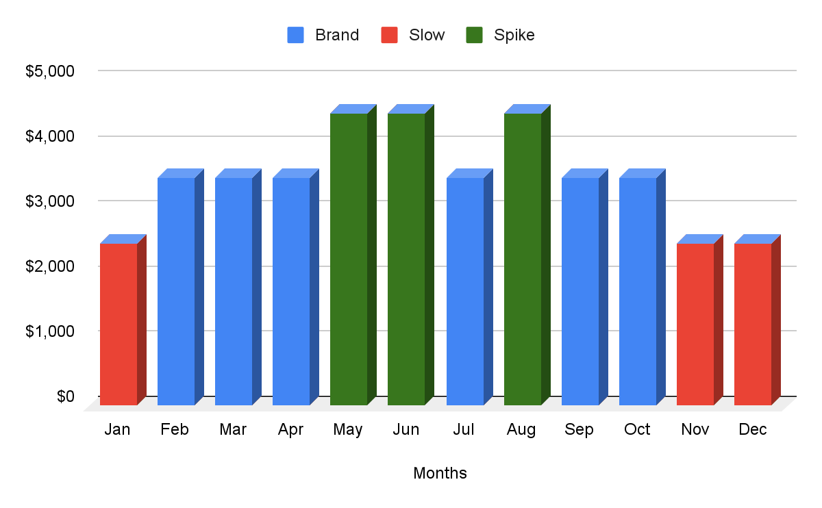
Proposed Schedule - Plan A
Budget Breakout by Month (For Next 12 Months)
Proposed Media Plan: station

Slide 12
Proposed Schedule - Plan A
 | Branding Months
Station | Days | DayPart | Weekly Commercials | Branding Months
WAAA | M-F | 6:00am - 7:00pm | 15 | # of Weeks/Months
WAAA | M-F | 7:00pm - 12mid | 5 | 1
WBBB | M-F | 6:00am - 7:00pm | 15 | Base Investment
WBBB | M-F | 7:00pm - 12mid | 5 | $1,000
 |  |  |  | Total # of Commercials
 |  |  |  | 40
 | Spike Months
Station | Days | DayPart | Weekly Commercials | Spike Months
WAAA | M-F | 6:00am - 7:00pm | 15 | #Week/Months:
WAAA | M-F | 7:00pm - 12mid | 5 | 2
WBBB | M-F | 6:00am - 7:00pm | 15 | Continuity Investment:
WBBB | M-F | 7:00pm - 12mid | 5 | $2,000
 |  |  |  | Total # of Commercials
 |  |  |  | 80
 | Slow Months
Station | Days | DayPart | Weekly Commercials | Slow Months
WAAA | M-F | 6:00am - 7:00pm | 15 | #Week/Months:
WAAA | M-F | 7:00pm - 12mid | 5 | 3
WBBB | M-F | 6:00am - 7:00pm | 15 | Continuity Investment:
WBBB | M-F | 7:00pm - 12mid | 5 | $3,000
 |  |  |  | Total # of Commercials
 |  |  |  | 120

Slide 13
Proposed Schedule - Plan A
clientBusinessName
Brand Equity Schedule
Monthly Station Summary
Market: planACity
Average Projected Broadcast Monthly Reach: planAReach
Average Projected Monthly Broadcast Frequency: planAFrequency
Average Estimated Monthly Digital Gross Impressions: planADigitalImpressionsMonthly
Average Base Monthly Advertising Investment: planAMonthly
Average Base Daily Advertising Investment: planADaily

Slide 14
Break Even Analysis - Plan A
Average sale (ticket, transaction, invoice) =
Gross profit margin on average sale (sale less closing costs) =
Closing or conversion rate =
Projected prospect value (=A*B*C)=
Client base monthly advertising investment =
Monthly prospects needed to pay for advertising investment (=E/D)=
Monthly # of sales from prospects needed to break even (=F*C) =
Gross sales per month needed to break even (=G*A)=
Number of months to run in proposed marketing plan =
Additional gross sales per year needed to break even (=H*I)=
planAAverageSale
planAGrossMargin
planAClosingPct
planAProspectValue
planAMonthly
planAProspectsNeeded
planAProspectSalesNeeded
planAGrossProfitOnSales
planAMonths
planAAdditionalGrossSales

Slide 15
Lifetime Value Analysis - Plan A
Average sale (ticket, transaction, invoice) =
Times gross profit margin on average sale (sale less variable costs) =
Equals gross profit per average sale (A*B) =
Times the average repeat sales per year (per customer/client) =
Equals the average customer/client value per year (C*D)=
Times the average number of years of patronage =
Equals the lifetime value of one customer/client (E*F) =
So if your base monthly advertising investment averages =
Then monthly customers/clients needed to break even (H/G)=
a_averageSale
a_grossProfitMargin
a_grossProfitPerSale
a_averageRepeatSales
a_averageCustomerValue
a_yearsOfPatronage
a_lifetimeValuePerCustomer
planAMonthly
a_prospectsNeededToBreakEven

Slide 16
Digital ROI Calculator - Plan A
Monthly Digital Investment =
Cost Per Thousand (CPM) =
Monthly Impressions (=A/B*1,000) =
Click Through Rate (.01%, .1%, etc) =
Monthly # clicks (=C*D) =
Cost per Click (=A/E) =
Sales Conversion Percentage (2%, 10%, etc)=
Monthly Number of Conversions (E*G) =
Cost Per Conversion (A/H) =
Projected Gross Profit Per Conversion ($100, $1,000, etc.) =
Monthly Gross Profit Generated from all Conversions (H*J) =
$Monthly Return on Investment (K-A) =
% Monthly Return on Investment (L/A) =
planAMonthlyDigitalInvestment
planACostPerThousand
planAClosingPctNumber
planAClickThroughRate
planAMonthlyClicks
planACostPerClicks
planASalesConversionPercentage
planAMonthlyConversions
planACostPerConversion
planAProjectedGrossProfit
planAMonthlyGrossProfit
planAMonthlyROID
planAMonthlyROIP

Slide 17
Proposed Schedule - Plan B
Budget Breakout by Month (For Next 12 Months)
Proposed Media Plan: station

Slide 18
Proposed Schedule - Plan B
Station | Days | DayPart | Weekly Commercials |  | Branding Months
WAAA | M-F | 6:00am - 7:00pm | 15 |  | #Week/Months:
WAAA | M-F | 7:00pmStation Days DayPart Weekly Commercials Branding Months WAAA M-F 6:00am - 7:00pm 15 #Week/Months: WAAA M-F 7:00pm - 12mid 5 1 WBBB M-F 6:00am - 7:00pm 15 Base Investment: WBBB M-F 7:00pm - 12mid 5 $1,500 WCCC M-F 6:00am - 7:00pm 15 Total # of Commercials WCCC M-F 7:00pm - 12mid 5 60 - 12mid | 5 |  | 1
WBBB | M-F | 6:00am - 7:00pm | 15 |  | Base Investment:
WBBB | M-F | 7:00pm - 12mid | 5 |  | $1,500
WCCC | M-F | 6:00am - 7:00pm | 15 |  | Total # of Commercials
WCCC | M-F | 7:00pm - 12mid | 5 |  | 60
Station | Days | DayPart | Weekly Commercials |  | Spike Months
WAAA | M-F | 6:00am - 7:00pm | 15 |  | #Week/Months:
WAAA | M-F | 7:00pm - 12mid | 5 |  | 2
WBBB | M-F | 6:00am - 7:00pm | 15 |  | Continuity Investment:
WBBB | M-F | 7:00pm - 12mid | 5 |  | $3,000
WCCC | M-F | 6:00am - 7:00pm | 15 |  | Total # of Commercials
WCCC | M-F | 7:00pm - 12mid | 5 |  | 120
Station | Days | DayPart | Weekly Commercials |  | Slow Months
WAAA | M-F | 6:00am - 7:00pm | 15 |  | #Week/Months:
WAAA | M-F | 7:00pm - 12mid | 5 |  | 3
WBBB | M-F | 6:00am - 7:00pm | 15 |  | Average Spike Investment:
WBBB | M-F | 7:00pm - 12mid | 5 |  | 4,500
WCCC | M-F | 6:00am - 7:00pm | 15 |  | Total # of Commercials
WCCC | M-F | 7:00pm - 12mid | 5 |  | 180

Slide 19
Proposed Schedule - Plan BT
Station | Days | DayPart | Weekly Commercials |  | Branding Months
WAAA | M-F | 6:00am - 7:00pm | 15 |  | #Week/Months:
WAAA | M-F | 7:00pm - 12mid | 5 |  | 1
WBBB | M-F | 6:00am - 7:00pm | 15 |  | Base Investment:
WBBB | M-F | 7:00pm - 12mid | 5 |  | $1,500
WCCC | M-F | 6:00am - 7:00pm | 15 |  | Total # of Commercials
WCCC | M-F | 7:00pm - 12mid | 5 |  | 60

Slide 20
Proposed Schedule - Plan B
clientBusinessName
Brand Equity Schedule
Monthly Station Summary
Market: planBCity
Average Projected Broadcast Monthly Reach: planBReach
Average Projected Monthly Broadcast Frequency: planBFrequency
Average Estimated Monthly Digital Gross Impressions: planBDigitalImpressionsMonthly
Average Base Monthly Advertising Investment: planBMonthly
Average Base Daily Advertising Investment: planBDaily

Slide 21
Break Even Analysis - Plan B
Average sale (ticket, transaction, invoice) =
Gross profit margin on average sale (sale less closing costs) =
Closing or conversion rate =
Projected prospect value (=A*B*C)=
Client base monthly advertising investment =
Monthly prospects needed to pay for advertising investment (=E/D)=
Monthly # of sales from prospects needed to break even (=F*C) =
Gross sales per month needed to break even (=G*A)=
Number of months to run in proposed marketing plan =
Additional gross sales per year needed to break even (=H*I)=
planBAverageSale
planBGrossMargin
planBClosingPct
planBProspectValue
planBMonthly
planBProspectsNeeded
planBProspectSalesNeeded
planBGrossProfitOnSales
planBMonths
planBAdditionalGrossSales

Slide 22
Lifetime Value Analysis - Plan B
Average sale (ticket, transaction, invoice) =
Times gross profit margin on average sale (sale less variable costs) =
Equals gross profit per average sale (A*B) =
Times the average repeat sales per year (per customer/client) =
Equals the average customer/client value per year (C*D)=
Times the average number of years of patronage =
Equals the lifetime value of one customer/client (E*F) =
So if your base monthly advertising investment averages =
Then monthly customers/clients needed to break even (H/G)=
b_averageSale
b_grossProfitMargin
b_grossProfitPerSale
b_averageRepeatSales
b_averageCustomerValue
b_yearsOfPatronage
b_lifetimeValuePerCustomer
planBMonthly
b_prospectsNeededToBreakEven

Slide 23
Digital ROI Calculator - Plan B
Monthly Digital Investment =
Cost Per Thousand (CPM) =
Monthly Impressions (=A/B*1,000) =
Click Through Rate (.01%, .1%, etc) =
Monthly # clicks (=C*D) =
Cost Per Click (=A/E) =
Sales Conversion Percentage (2%, 10%, etc)=
Monthly Number of Conversions (E*G) =
Cost Per Conversion (A/H) =
Projected Gross Profit Per Conversion ($100, $1,000, etc.) =
Monthly Gross Profit Generated from all Conversions (H*J) =
$Monthly Return on Investment (K-A) =
% Monthly Return on Investment (L/A) =
planBMonthlyDigitalInvestment
planBCostPerThousand
planBClosingPctNumber
planBClickThroughRate
planBMonthlyClicks
planBCostPerClicks
planBSalesConversionPercentage
planBMonthlyConversions
planBCostPerConversion
planBProjectedGrossProfit
planBMonthlyGrossProfit
planBMonthlyROID
planBMonthlyROIP

Slide 24
Plan A
For the benefit of the client, station agrees to develop a marketing strategy to help:
Initiate Cause Marketing Program
Tech Recruitment
Expand Target Consumers (by age, sex, geography)
In return for fulfilling stated goals clientBusinessName agrees to invest in the following long-term plan:
Media | Jan | Feb | Mar | Apr | May | Jun | Jul | Aug | Sep | Oct | Nov | Dec | Total
WWWW | $1,500 | $1,500 | $1,500 | $3,000 | $3,000 | $4,500 | $4,500 | $4,500 | $3,000 | $3,000 | $3,000 | $3,000 | $36,000
Digital | $1,000 | $1,000 | $1,000 | $1,000 | $1,000 | $1,000 | $1,000 | $1,000 | $1,000 | $1,000 | $1,000 | $1,000 | $12,000
wwww.com | $500 | $500 | $500 | $500 | $500 | $500 | $500 | $500 | $500 | $500 | $500 | $500 | $6,000
Monthly Totals | $3,000 | $3,000 | $3,000 | $4,500 | $4,500 | $6,000 | $6,000 | $6,000 | $4,500 | $4,500 | $4,500 | $4,500 | $54,000
Client may cancel after 13 weeks from schedule start date with two weeks’ notice and no short rate. This offer is good for 10 business days from the date of presentation. In accordance with Paragraphs 49 and 50 of United States Federal Communications Commission Report and Order No. FCC 07-217, this station will not discriminate in any contract for advertising on the basis of race or ethnicity, and all such contracts will be evaluated, accepted, negotiated and completed without regard to race or ethnicity
Analysis of Schedule:
Average Monthly Client Investment: $3
Average Daily Client Investment: $0
Thank you for you trust and confidence
Accepted for
Date
Accepted for
Date

Slide 25
Plan B
For the benefit of the client, station agrees to develop a marketing strategy to help:
Initiate Cause Marketing Program
Tech Recruitment
Expand Target Consumers (by age, sex, geography)
In return for fulfilling stated goals clientBusinessName agrees to invest in the following long-term plan:
Media | Jan | Feb | Mar | Apr | May | Jun | Jul | Aug | Sep | Oct | Nov | Dec | Total
WWWW | $1,500 | $1,500 | $1,500 | $3,000 | $3,000 | $4,500 | $4,500 | $4,500 | $3,000 | $3,000 | $3,000 | $3,000 | $36,000
Digital | $1,000 | $1,000 | $1,000 | $1,000 | $1,000 | $1,000 | $1,000 | $1,000 | $1,000 | $1,000 | $1,000 | $1,000 | $12,000
wwww.com | $500 | $500 | $500 | $500 | $500 | $500 | $500 | $500 | $500 | $500 | $500 | $500 | $6,000
WWWA | $500 | $500 | $500 | $1,000 | $1,000 | $1,500 | $1,500 | $1,500 | $1,000 | $1,000 | $1,000 | $1,000 | $12,000
Monthly Totals | $3,500 | $3,500 | $3,500 | $5,500 | $5,500 | $7,500 | $7,500 | $7,500 | $5,500 | $5,500 | $5,500 | $5,500 | $66,000
Client may cancel after 13 weeks from schedule start date with two weeks’ notice and no short rate. This offer is good for 10 business days from the date of presentation. In accordance with Paragraphs 49 and 50 of United States Federal Communications Commission Report and Order No. FCC 07-217, this station will not discriminate in any contract for advertising on the basis of race or ethnicity, and all such contracts will be evaluated, accepted, negotiated and completed without regard to race or ethnicity
Analysis of Schedule:
Average Monthly Client Investment: $3
Average Daily Client Investment: $0
Thank you for you trust and confidence
Accepted for
Date
Accepted for
Date

Slide 26
Client Policy Agreement
At station we have an agreement, which we will discuss with all our business partners and review throughout the year
We will conduct a confidential needs analysis (Database) to gain a complete understanding of your business, your market and your stated objectives.
You will be supplied with a customized Summary of Conclusions and Recommendations (SCR) that is tailored to help you achieve your business goals.
You can be sure that your Marketing Representative will be professional, objective and totally focused on your needs (vs. what’s only in the best interest of the station group).
You will be offered total production and digital services and once complete, we will provide all creative to you for your final approval before going on-air or on-line.
The order will be placed as requested and you can expect a duplicate of your submitted broadcast schedules and net figures so that you know all times and costs.
You will be contacted following the first week on air to ensure that everything is running as scheduled.
You will be provided with the latest qualitative research and will be continuously updated on relevant market information and changes.
You can expect an exceptional customer experience including follow-through on all promises made and prompt return phone calls.
While we will be in constant contact, you will be asked to formally evaluate our performance and your results every 3, 6, 9 and 12 months.
If any of the above conditions are not met, please contact portfolioManagerName at +1 (804) 356-7006

Slide 27
Sales Service Agreement
This Sales Service Agreement is part of our Consumer Satisfaction Index (CSI) which is meant to build and serve long term alliances. Please help me know how well we are servicing you by grading each of the following segments 1 to 5 with 5 being the highest.
CONTINUOUS BASIC SERVICE
The Marketing Representative has a full understanding of my business needs, goals and objectives.
He/she has been in constant contact to make sure that the program is running as planned.
Statement/Invoice questions have been handled in a timely fashion.
Client calls have been returned within a reasonable time frame.
Promises have been kept and commitments have been honored at all times.
The overall service experience rating I would give my Marketing Representative.
The marketing program has met my expectations given the time period it has been running.
How likely I would be to recommend someone else to this group.
Signed by Integrated Marketing Consultant
Date
Signed by Client
Date

