Slide 1
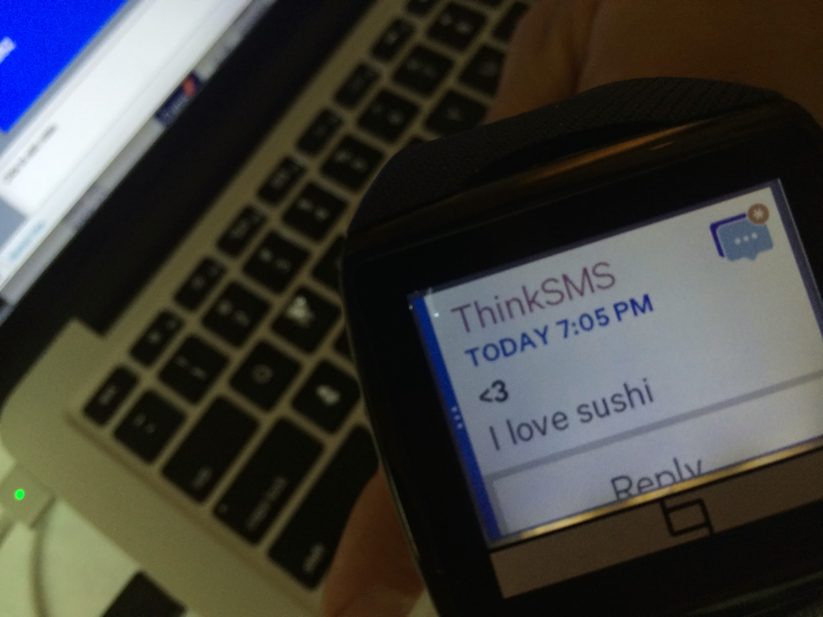
ThinkSMS
Wearables
MMS
Smartphones
SMS
Feature Phones

Slide 2
Dan Treiman @DanTreiman
Ricky Wong @kinwong
Philippe Furlan @HealthyScore
Rebecca Evans @rebecca_evans

