Slide 1

Presentation on ansible
B.Tech. (CS) –V Semester-A Batch
Session : July-Dec’2018
Presented To
Department of Computer Science
AIM & ACT
Banasthali Vidyapith
Presented By
Nupur Thakur
BTBTC16245
Roll No.121

Slide 2
TABLE OF CONTENTS
WHAT IS ANSIBLE?
HISTORY OF ANSIBLE
WHAT ANSIBLE AUTOMATES?
HOW ANSIBLE WORKS?
ANSIBLE ARCHITECTURE
INSTALLATION
ANSIBLE TOWER
ADVANTAGES & DISADVANTAGES
APPLICATIONS
CONCLUSION
REFERENCES

Slide 3

What is ansible?

Slide 4
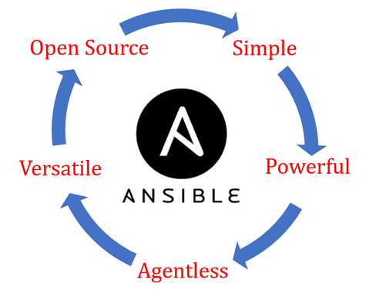
Ansible is a radically simple IT automation engine.
Its Features are:
Opensource tool
Written in Python
Don’t need an agent
YAML
SSH

Slide 5
HISTORY
Ansible (n.) – is a category of fictional device and technologies capable of instantaneous or faster than light
communication.
Ansible was founded by Michael DeHaan in 2012 to provide a new way to think about managing systems and applications.

Slide 6
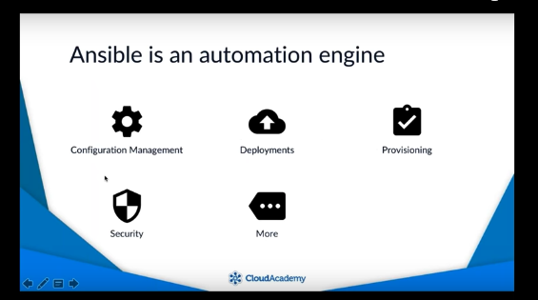
ANSIBLE AUTOMATES
Software Provisioning
Application Deployment
Orchestration
Configuration Management

Slide 7
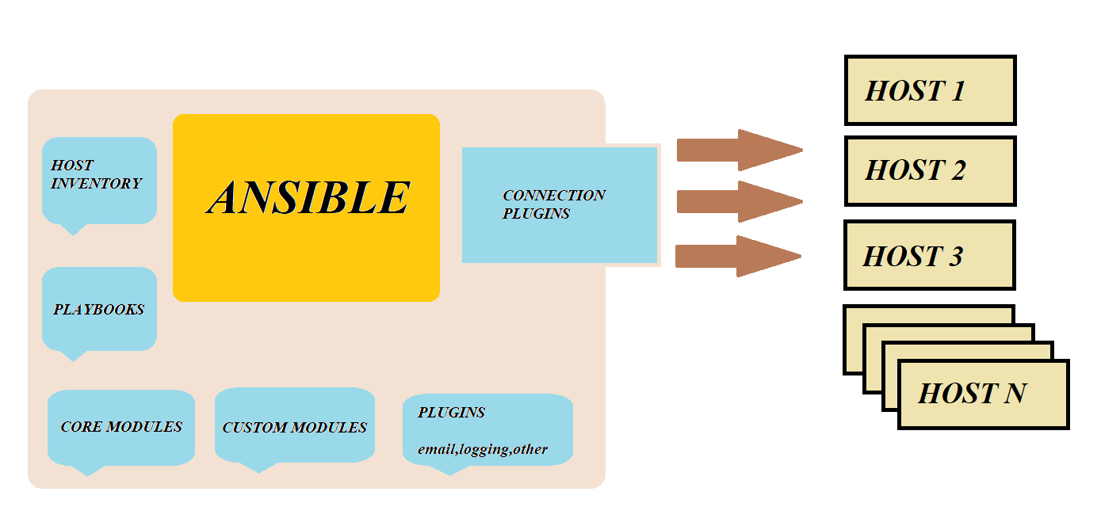
ANSIBLE ARCHITECTURE

Slide 8
Playbooks defines deployment steps and configuration .They are the files created to perform many tasks in on go written in YAML.
Host Inventory is a text file from where ansible reads all the IPs .
Core Modules are the small piece of code to do specific work.
Core modules are the inbuilt modules.
Custom Modules are the modules defined by users using python.
Plugins are pieces of code that augment Ansible’s core functionality.

Slide 9
INSTALLATION
The installation of the ansible package is only required on the host that generated the SSH key*.
On a RHEL/Centos Linux based system
sudo yum install ansible
On Fedora
sudo dnf install ansible
*Generation
of SSH key:
ssh-keygen
ssh-copy-id <ip>

Slide 10
For Ubuntu-based systems, installation is done from PPA
sudo apt-add-repository ppa:ansible/ansible
sudo apt-get update
sudo apt-get install ansible
Using python PIP
sudo pip install ansible

Slide 11
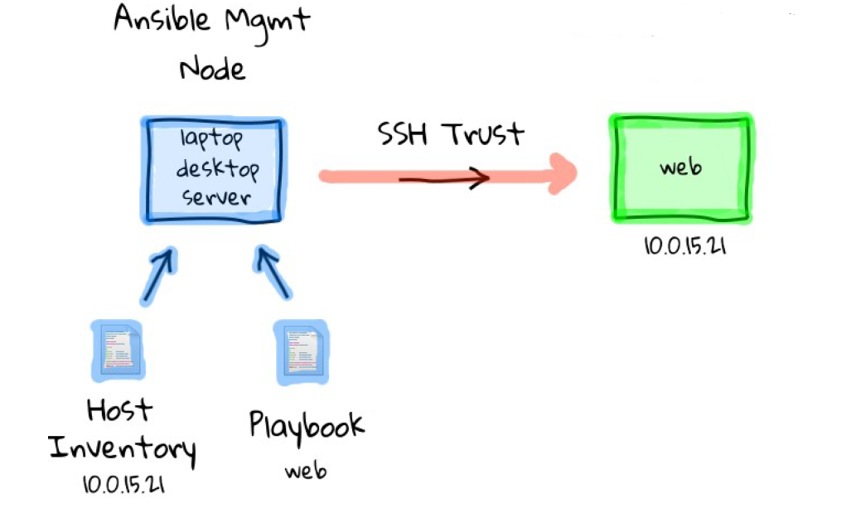
HOW ANSIBLE WORKS?

Slide 12
Example of a Inventory File(example.txt)
[group1]
192.168.10.96
192.168.10.203
[group2]
192.168.10.93
192.168.10.176
To use this inventory file
ansible group1 –i example.txt –a “date”

Slide 13
Example of a Playbook (example.yaml):
---
-hosts: group1
tasks:
-name: Print date
command: date
-name: install firefox
yum: name = firefox
-name: copy data from url
get_url: url=‘http://192.168.10.182/index.html’ dest=/var/www/html
To run this playbook:
ansible-playbook example.yaml

Slide 14
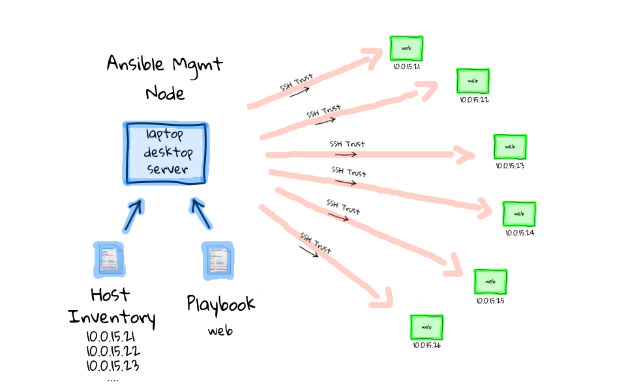

Slide 15
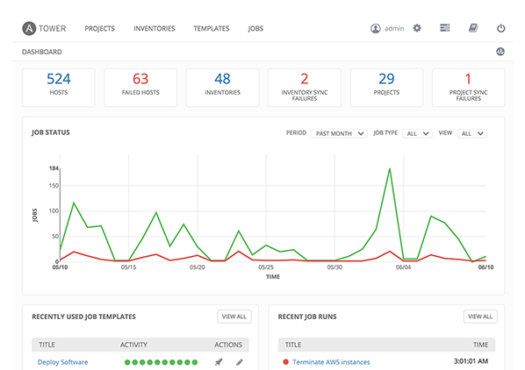
ANSIBLE TOWER
Ansible Tower is a web-based solution
that makes Ansible easy to use.
Control access.
Inventories can be graphical manages
or synced.

Slide 16
USE CASE
USE CASE | PROBLEM | SOLUTION | RESULT
NASA | NASA had to move many applications from traditional hardware based datacentres to cloud based environment for better speed and cost saving. This cloud could not be easily managed. | Ansible Tower was used to manage and schedule cloud environment. (Use case :Configuration Management) | Updating nasa.gov went from 1 hour to 5 minutes. Supplying OS in 10 minutes.

Slide 17
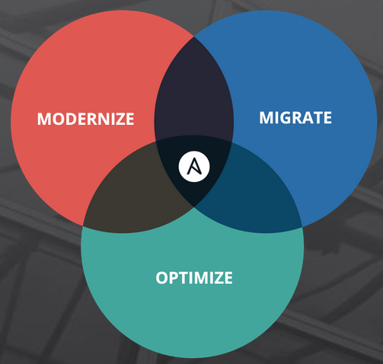
ADVANTAGES
Agentless Architecture
Single framework that can fully automates todays modern enterprise apps.
Routable
Efficient and Simple

Slide 18
DISADVANTAGES
Lacking in GUI.
Windows control machine not possible.
Smallest developer/user community.
Less experience.
No appropriate description of error in case of any system failure.

Slide 19
CONCLUSION
Ansible is the fastest automation engine leading all other automation tools in last decade. Ansible is the only agentless automation tool which requires a very simple language(YAML) to configure.
Ansible is also increasing its Graphical Interface for the ease of user through Ansible Tower.

Slide 20
REFERENCES
https://www.ansible.com/
https://networklore.com/ansible/
https://www.cyberciti.biz/python-tutorials/linux-tutorial-install-ansible-configuration-management-and-it-automation-tool/
http://blog.stoneriverelearning.com/what-is-ansible-and-how-does-it-work/
https://en.wikipedia.org/wiki/Ansible_(software)
https://www.redhat.com/en/technologies/management/ansible
https://cloudacademy.com/course/getting-started-with-ansible/

Slide 21
THANK YOU
ANY QUESTIONS?

