Slide 1
Weather Image Classification – CNN
Yao Zhang

Slide 2
Problem Statement/Business Values
Enhance weather detection mechanism by developing an optimal prediction model.
Complement traditional forecast models with the developed model.
Traditional forecasting methods often miss rapidly changing weather conditions.
Lack of instantaneous information about weather changes is a challenge.
Incorporate live pictures of approaching weather patterns.
Swiftly capture and classify upcoming weather using the model.
Provide valuable and timely information about imminent weather changes.
Serve as a valuable enhancement to the existing weather detection approach.

Slide 3
Assumptions/Hypotheses about data and model
Assumptions | Data | Model
The data is diverse and captures the variations and patterns present in the real-world scenarios. The quality of the data is guaranteed and ready for modelling. | The data has four categories, cloudy, rainy, shine, and sunrise. The total number of images is 1125. The dataset has no extreme noises, no missing values, and each image has been properly labelled.
The features learnt by the model should be relevant for the classification task |  | CNN’s layer can automatically extract meaningful and discriminative features from the input images
The learned representations are general enough to recognize similar patterns in different instances of the same class |  | CNN model can generalize well to unseen images from the same distribution where the training set is from
If the model architecture can be properly formed, hyperparameters appropriately selected, the model’s accuracy can be improved |  | Upon careful selection of model architecture and hyperparameters, CNN can improve its performance on prediction with the test set.

Slide 4
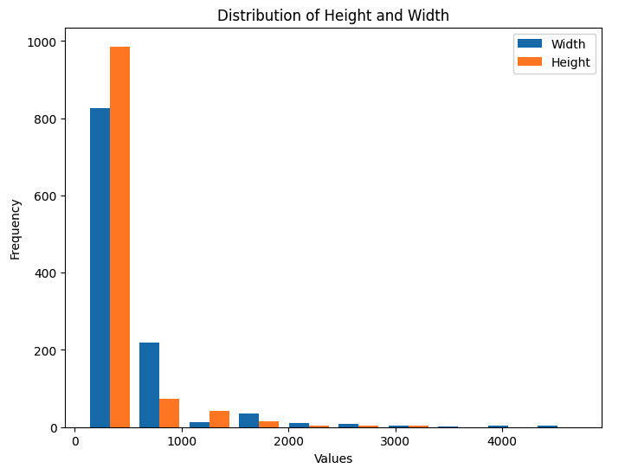
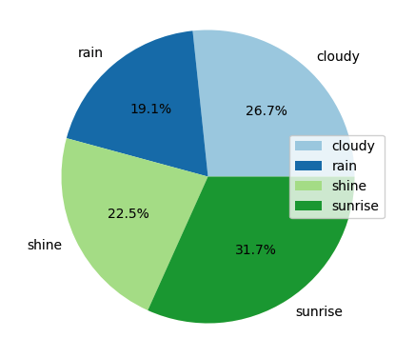
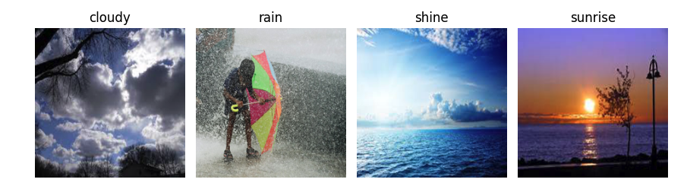
Exploratory Data Analysis
Distribution of Images’ Height and Width
Category Distribution
Sample Image from Each Category
*Necessary resizing are needed

Slide 5
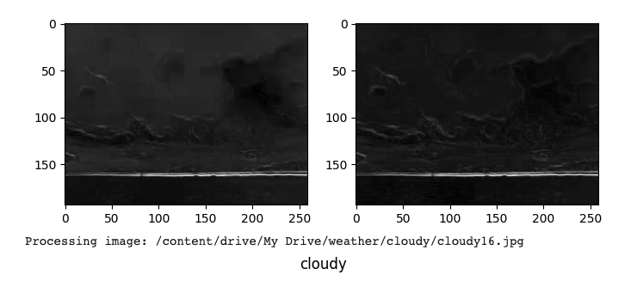
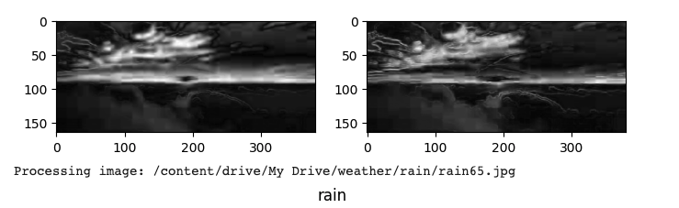
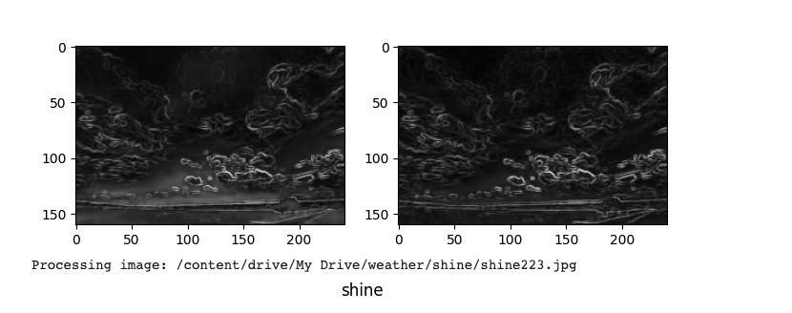
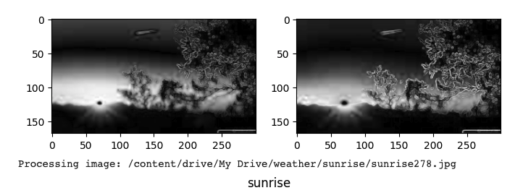
Exploratory Data Analysis–Edge Detection

Slide 6
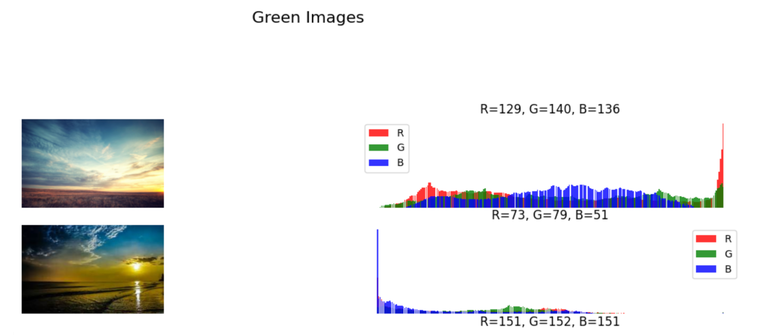
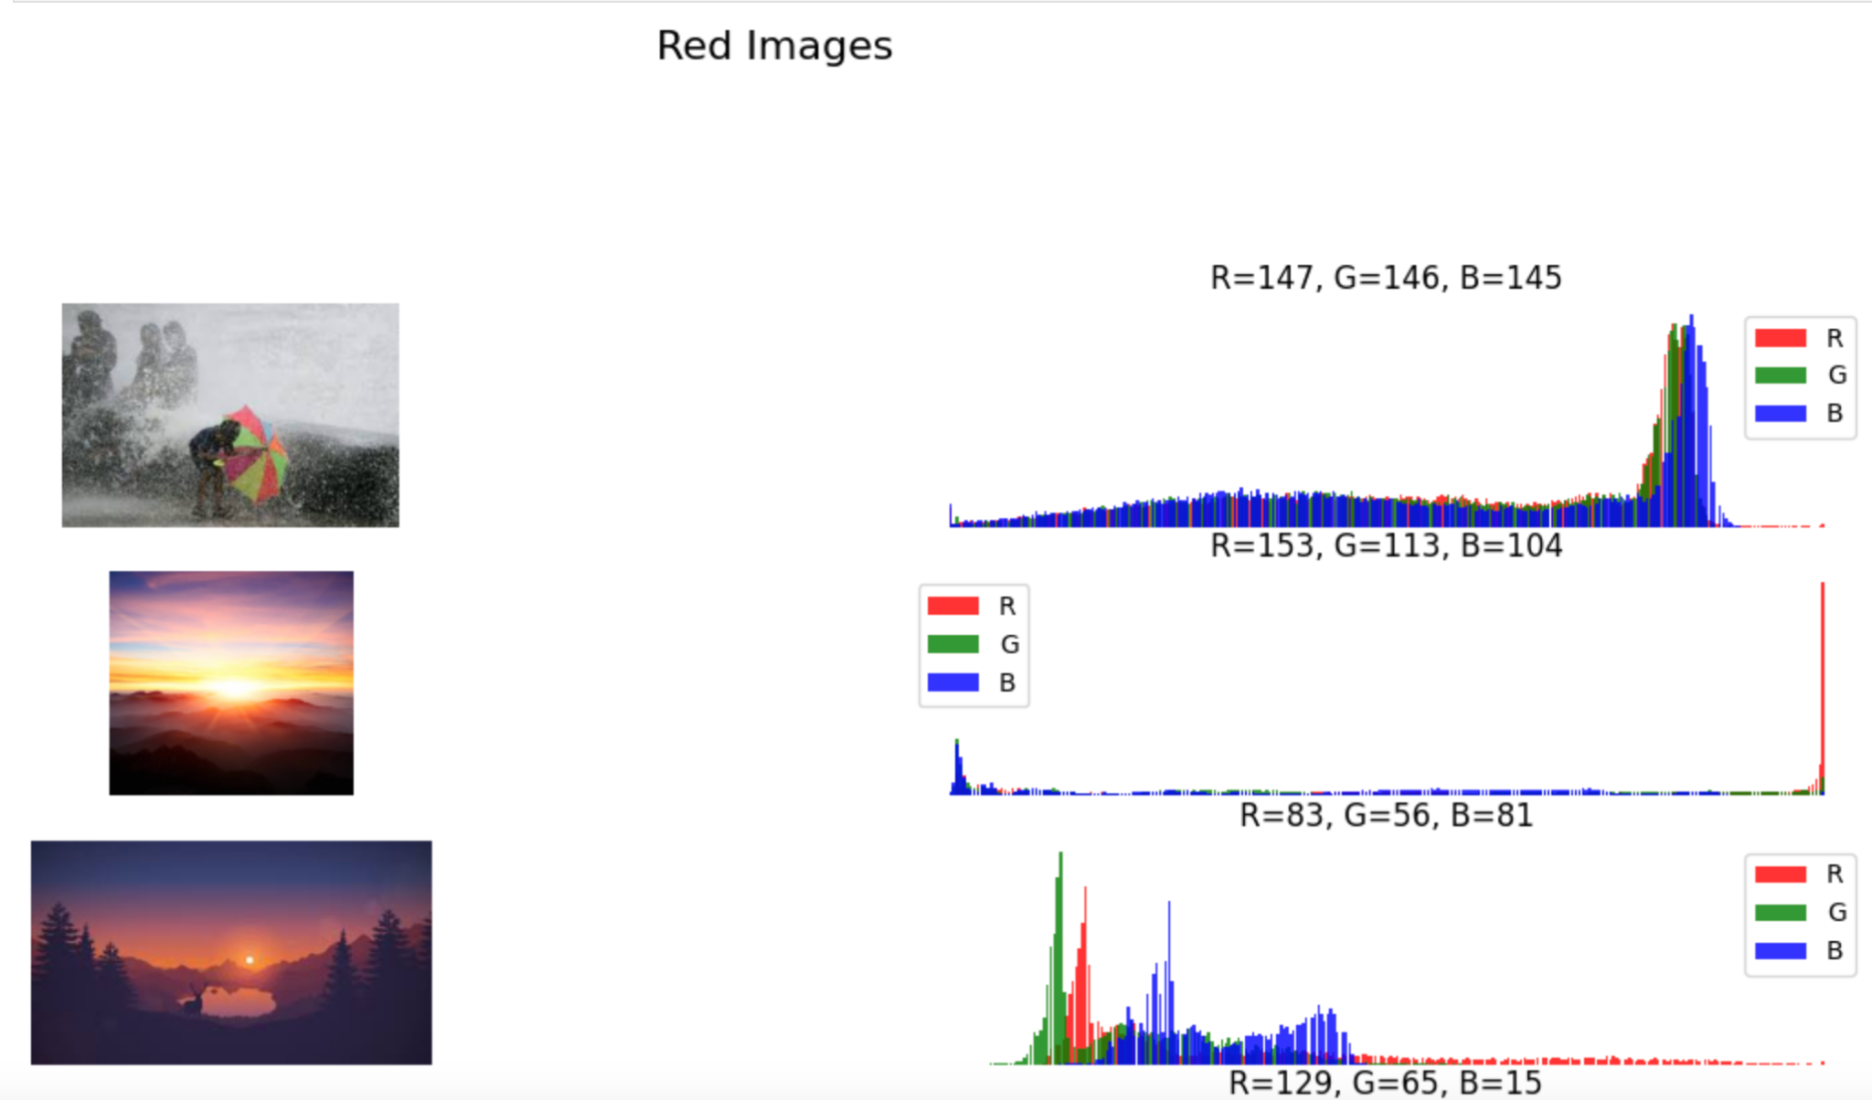
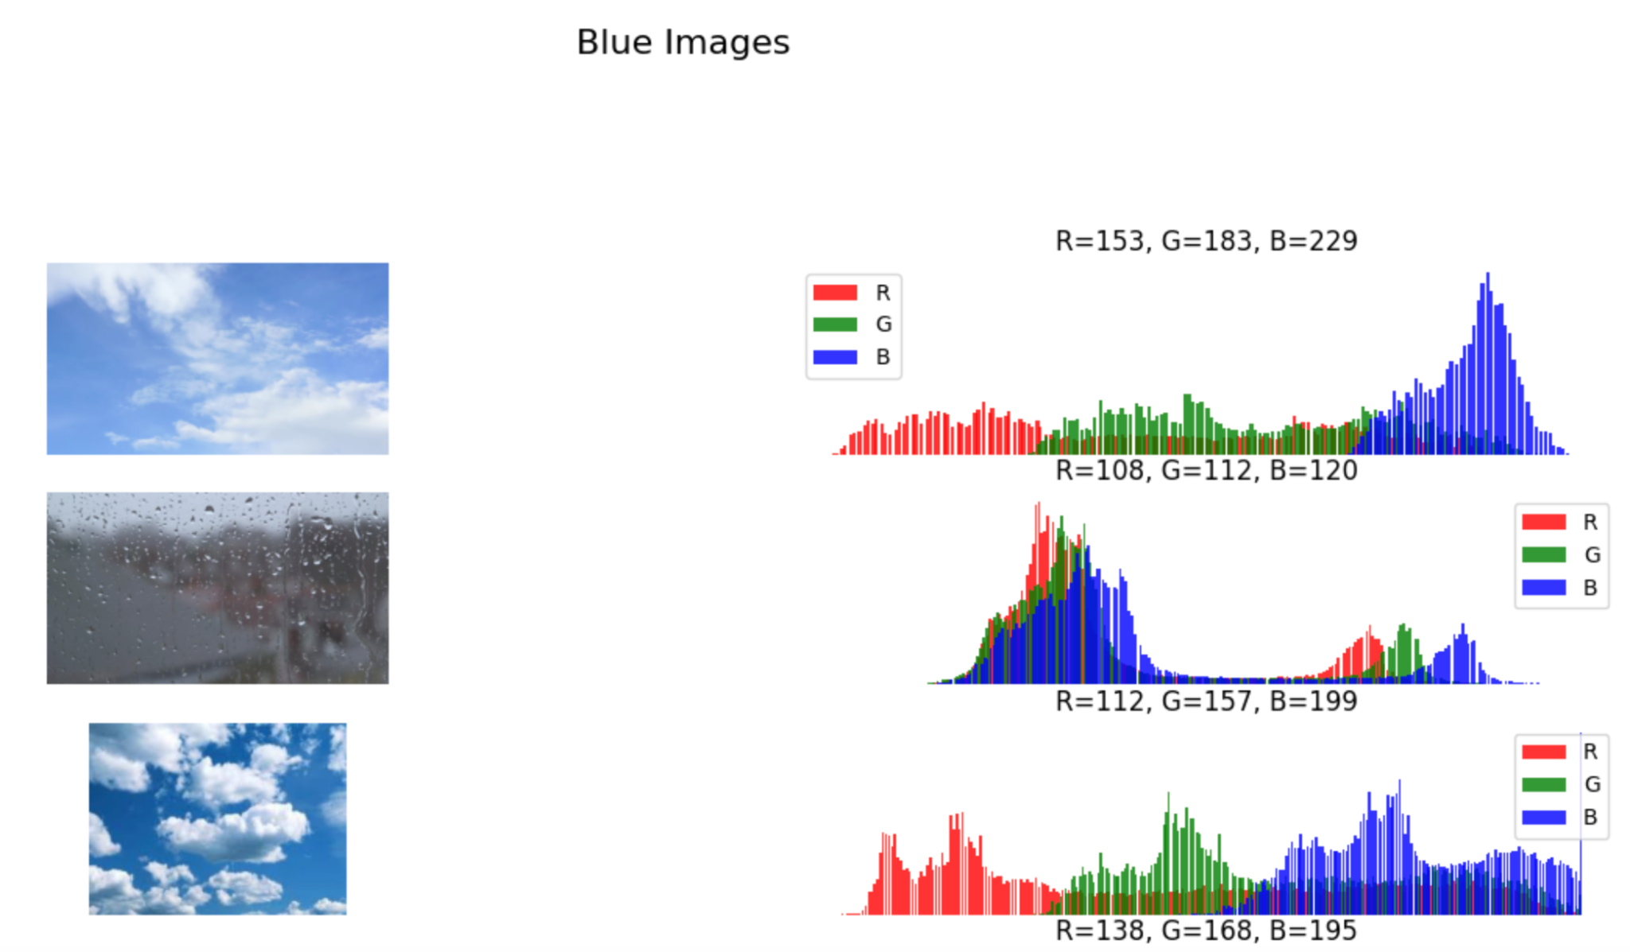
Exploratory Analysis-Color Analysis
Start off with the calculation of scale value
Found scale value to be small
Determined only Red Blue and Green colors are needed

Slide 7
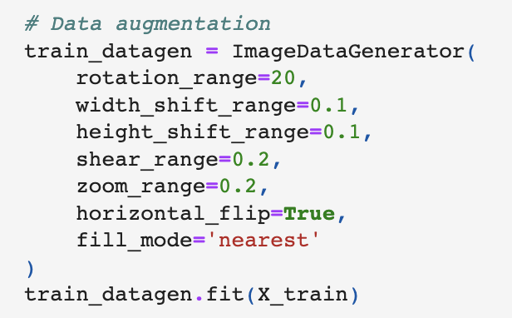

Feature Engineering & Transformations
Resizing the inputs
3. Label Encoding
*Early EDA indicates not all pictures have the same size
*Assign a numeric value as label for each category
4. Data Augmentation
*The base model demonstrates overfitting issues; one solution would be to increase the training set by incorporating data augmentation
2. Array Conversion and Normalization
*The values can scale to between 0 and 1

Slide 8
Procedure to find the Optimal Model
Step 1.
Step 2.
Step 3.
Step 4.
Implement Transfer Learning:
VGG-16 with two basic layers, Global Average Pooling 2D(), and Dense, serving as the base model, and the base model is overfitting.
The new model adopts Data Augmentation, L2 regularization, Drop out Rate and early stopping criteria, and test if the prediction performance can be consistent across different values of epoch and Batch Size
Hyperparameter Tuning on Epochs, Batch Size, L2 regularization, Dropout Rate to make the model to yield consistent prediction performance
Implement the optimal Hyperparameters and Obtain the optimal Model

Slide 9
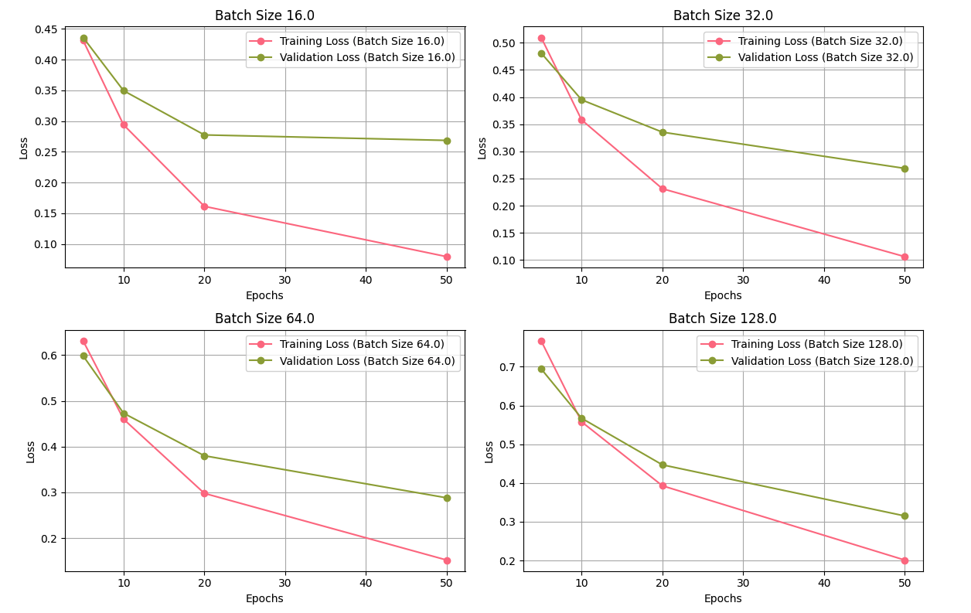
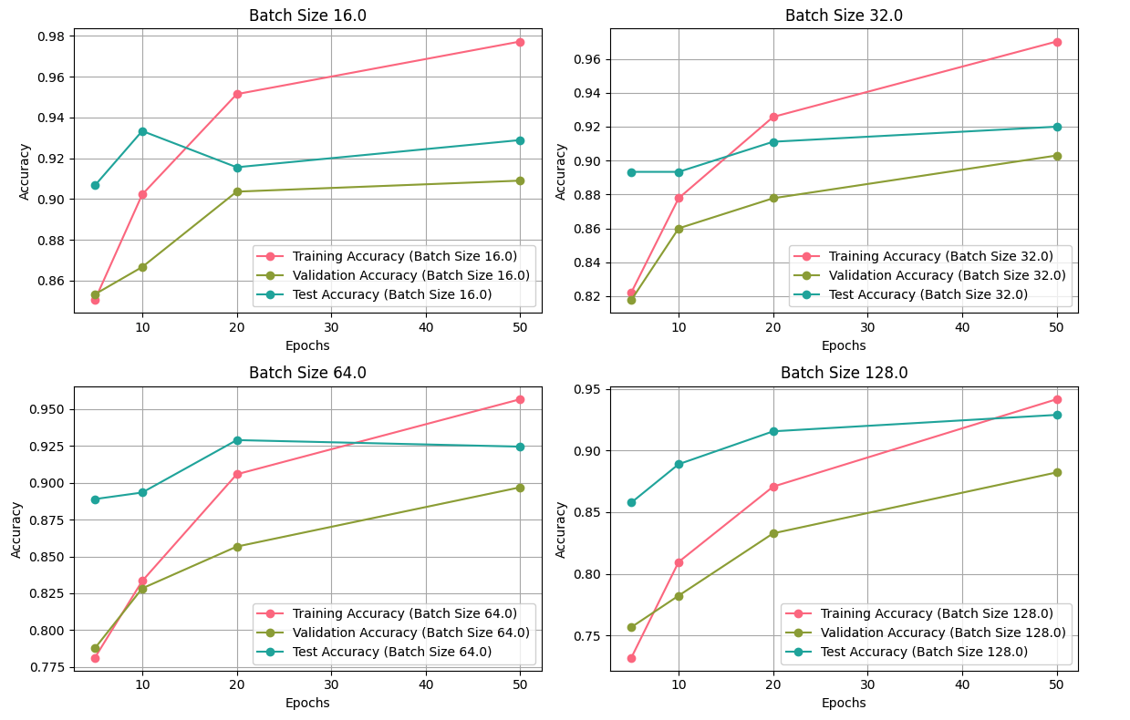
Step 1. Transfer Learning–VGG16
Mobilize VGG-16 with addition of “GlobalAveragePooling2D” and “Dense” layers as base model.
Examine Accuracy and Loss performance in general across different epoch and batch size
The training accuracy increases rapidly as epoch increases and larger than the test accuracy, signalling a severe overfitting issue
Loss
Accuracy

Slide 10
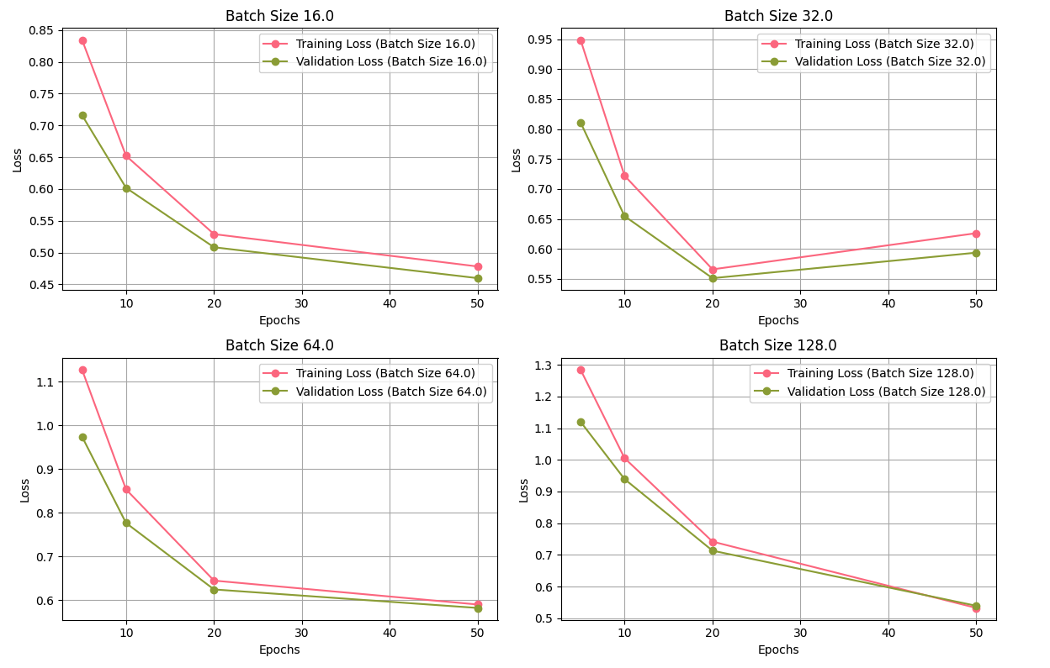
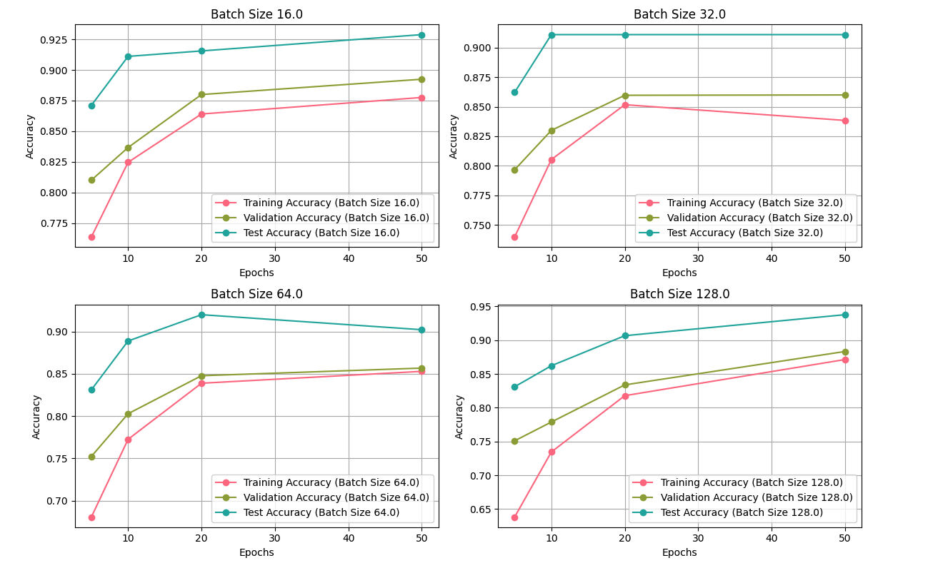
Step 2. Base Model with Regularization Techniques
Base model add Data Augmentation, dropout with default rate=0.5, L2 regularization with default rate=0.001, and Early Stopping based on validation loss
Accuracy and Loss performance really well in almost all different epoch and batch size
The training and validation losses keep decreasing in general except for Batch Size=32;
Training, Validation, and Testing accuracy all perform really well by demonstrating increasing in different extents except for Batch Size=32
Loss
Accuracy

Slide 11
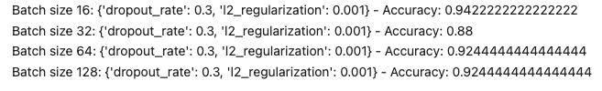
Step 3. Enhanced Model with Hyperparameter Tuning
Though the above model produces decent prediction performance, it is still possible to conduct hyperparameter tuning in attempt to explore a better model performance in terms of both in prediction accuracy and save of computation resources
The training log indicates that early stopping primarily intervenes for the group of epoch=50, and a detailed look reveals that early stopping mainly occur within the range from epoch=23 to epoch=28.
Setting epoch=30 would be a reasonable choice of hyperparameter for this particular project.
Given epoch=30, conduct further analysis for the optimal dropout_rate, L2 regularization value, and the best batch size
Hyperparameter Tuning Outputs
The optimal hyperparameters:
Epoch=30
Batch Size=16
Dropout Rate=0.3
L2 Regularization=0.001

Slide 12
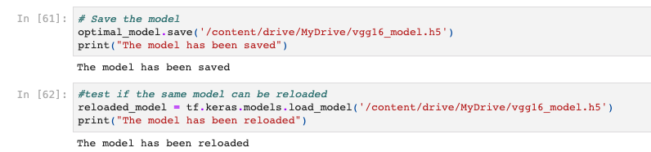
Step 4. Run the optimal model and Save to be ready for reloading
The model implements transfer learning
The model has sufficiently good number of layers
Dropout rate, Regularization technique, Early Stopping play a collectively important role
The optimal model yields prediction accuracy to be 93.78%

Slide 13
Learnings from the Methodology and Future Work
Learnings
Future Work
Transfer Learning, though as a powerful technique, isn’t necessarily able to be perfectly implemented for every different case or dataset without proper adjustments
Regarding to address overfitting issue, L2 regularization is very powerful because it adds a penalty term to the loss function, which encourages the model’s weights to remain small, and thereby reducing the likelihood of overfitting in this case
Early Stopping is also a powerful technique that diminishes the computation resources and also prevents overfitting by monitoring key metric such as validation loss and stopping the training process when the metric stops improving.
It is potentially beneficial to fine-tune the transfer learning models directly and therefore leading to better model performance and increased accuracy
The base model of VGG16 might not work very well without regularization in this particular case for this particular project. Further works can try to implement and test out multiple models with the same architecture.
The hyperparameter tuning process can try to implement more advanced optimization techniques like Bayesian optimization

