Slide 1
EASY & CHEAP DIY VOIP Using Python
Randy Dryburgh, Co-founder, hipcast.com
email: randy@hipcast.com
TWITTER: @rwdim
Linked in: https://linkedin.com/in/rdryburgh

Slide 2
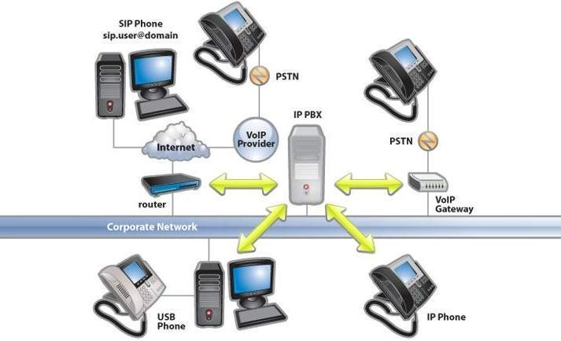
VOIP Hell

Slide 3
Requirements
Freeswitch (1.4+, 1.8 preferred)
Python 2.5+ (3.x may not be supported at this time)
1 Core (1Ghz+ pref)
1GB RAM
16GB Disk
Signaling / SIP Ports 5060 (UDP, Inbound), 5080 (UDP, Outbound)
Media Channel Ports 16384-32768 (audio/video streams)

Slide 4
Why AlcazarNetworks.com?
We’ve used them for over 4 years
Very stable (3 minor routing issues in the last two years)
Scary cheap.
Tier 1 is $0.001/min – that’s 800% cheaper than Twilio ($0.0085).
Tier 2 is $0.004/min – Still ½ the price of Twilio ($0.0085).
Lots of phone numbers around the country, Toll Free too.
Much better communications than any other company we’ve used.
John Chisca , our sales rep, is *always* available…
He might be AI…
Email:johnc@alcazarnetworks.com
We get NO commissions, credits, fees, or benefit from the promo code.

Slide 5
Build Freeswitch
Linux
Prep
sudo apt update
sudo apt install build-essential autoconf cmake yasm \ python2 python2-dev libtool-bin git libjpeg-dev libsqlite3-dev \ libcurl4-openssl-dev libspeex-dev libspeexdsp-dev libedit-dev \ libtiff-dev -y

Slide 6
Build Freeswitch
Linux
git clone https://freeswitch.org/stash/scm/fs/freeswitch.git
cd freeswitch
run: ./bootstrap.sh
edit: modules.conf
un-comment: languages/mod_python
comment: #mod_enum #mod_opus #languages/mod_lua
run: ./configure
Watch for any additional required libraries (shouldn’t be any)
run: make && sudo make install
Will install into /usr/local/freeswitch

Slide 7
Freeswitch Configuration
cd /usr/local/freeswitch/conf/dialplan/public
Edit public/00_inbound.xml
<include>
<extension name="public_did">
<condition field="destination_number" expression="^(.*)$">
<action application="set“ data="domain_name=$${domain}"/>
<action application="python" data=“proxy"/>
</condition>
</extension>
</include>
Tell freeswitch to answer all calls using a python script.

Slide 8
Add AlcazarNetworks Config For Inbound Calls
cd /usr/local/freeswitch/conf/sip_profiles
Edit internal/alcazarnetworks.xml
<include>
<gateway name="alcazar_east2">
<param name="username" value=“YOUR_USER_NAME" />
<param name="liberal-dtmf" value="true"/>
<param name="password“ value=“YOUR_ALCAZAR_GATEWAY_PASSWORD" />
<param name="from-user" value="YOUR_USER_NAME" />
<param name="proxy" value="162.212.218.52" />
<param name="register-proxy" value="162.212.218.52:5060" />
<param name="realmx" value="alcazarnetworks.com" />
<param name="caller-id-in-from" value="true"/>
<param name="register" value="false" />
<param name="rtp-ip" value="${local_ip_v4}"/>
<param name="sip-ip" value="${local_ip_v4}"/>
<param name="ext-rtp-ip" value="auto-nat"/>
<param name="ext-sip-ip" value="auto-nat"/>
</gateway>
</include>
Tell freeswitch who to accept calls from.

Slide 9
Add AlcazarNetworks Config For Outbound calls
cd /usr/local/freeswitch/conf/sip_profiles
Edit external/alcazarnetworks.xml
<include>
<gateway name="alcazar_out">
<param name="username" value=“YOUR_ALCAZAR_USERNAME" />
<param name="password" value=“YOUR_ALCAZAR_GATEWAY_PASSWORD" />
<param name="proxy" value="162.212.218.11" />
<param name="realm" value="162.212.218.11" />
<param name="caller-id-in-from" value="true"/>
<param name="domain" value="$${domain}"/>
<param name="interval" value="10"/>
<param name="ping" value="25"/>
<param name="dtmf-mode" value="rfc2833" />
<param name="from-user" value=" YOUR_ALCAZAR_USERNAME " />
<param name="caller-id-name" value="$${outbound_caller_name}"/>
<param name="caller-id-number" value="$${outbound_caller_id}"/>
<param name="caller-controls" value="plain"/>
<param name="comfort-noise" value="true"/>
</gateway>
</include>
Tell freeswitch who to send calls to.

Slide 10
Allow AlcazarNetworks Through Freeswitch’s Firewall
cd /usr/local/freeswitch/conf/autoload_configs
Edit acl.conf
Edit to get the following lines: <network-lists>
<list name="domains" default="deny">
<node type="allow" domain="$${domain}"/>
<node type="allow" cidr="162.212.218.50/32" />
<node type="allow" cidr="162.212.218.52/32" />
</list>
</network-lists>
Tell freeswitch to allow connections from alcazar’s servers.

Slide 11
Add proxy.py to the scripts folder.
Minimal proxy file:
from freeswitch import *
def handler( session, args ):
print session
print args
session.answer()
session.hangup()
session.destroy()
Place your python script in the scripts folder.
./scripts is a module root

Slide 12
Go Nuts!
Freeswitch Python API
https://freeswitch.org/confluence/display/FREESWITCH/mod_python
Tons of examples
Okay, 4 REALLY good ones, but lots there.
API is very easy to pickup
*Everything* is managed in a single Session object
Session.setVariable( key, textValue )
Session.getvar
Easy file recording:
result = session.recordFile("\tmp\recording.wav", 240, 500, 3)
https://freeswitch.org/confluence/display/FREESWITCH/Example%3A+frontdoor.py

Slide 13
One Last Thing…
Dynamic Code Execution Is Easy!!
cmd = "pyrun easy.taskname %s %s %s %s" % (session_id, param1, param2, param3)
api = API()
api.executeString( cmd )

Slide 14
Really, THIS is the Last Thing…
Github repo
https://github.com/hipcast/freeswitch-python.git

