Slide 1
NEURO-ENHANCE
Data Debrief
Ben Cowley,
19.12.

Slide 2
Overview
Problem and Solution
Finnish data
  Structure, processing pipe, outcomes
Chinese data
  Key points
Lessons learned
Next steps and discussion

Slide 3
Problem and Solution
2 mid/large datasets
  Helsinki (327 recordings), Beijing (754 recordings)

Slide 4
Problem and Solution
2 mid/large datasets
  Helsinki (327 recordings), Beijing (754 recordings)
Requirement:
  Provide cleaned, annotated data for all protocols, with guidelines for further work (especially to Chinese partners)

Slide 5
Problem and Solution
2 mid/large datasets
  Helsinki (327 recordings), Beijing (754 recordings)
Requirement:
  Provide cleaned, annotated data for all protocols, with guidelines for further work (especially to Chinese partners)
Solution:
  Use a computational approach that can be precisely replicated, explain how it works
  CTAP (Computational Testing for Automated Preprocessing) toolbox, built on EEGLAB/Matlab

Slide 6
Demographics: Finland
N = 56
  Intake test data = 56
    4 groups x 3 protocols
  Outtake test data = 53
    4 groups x 3 protocols

Slide 7
Demographics: Finland
-
N = 56
4 groups (N at intake):
  movement = 19
  control = 13
  music = 15
  music+movement = 9

Slide 8
Demographics: Finland
-
N = 56
4 groups (N at intake):
  movement = 19
  control = 13
  music = 15
  music+movement = 9
N at outtake:
  movement = 19
  control = 12
  music = 15
  music+movement = 7
-

Slide 9
Demographics: Finland
N = 56
4 groups x 3 protocols:
  AV, multiMMN, switch ing
  AV, mu, sw
  mov = 19, 19, 18
  19, 19, 19
  con = 13, 13, 13
  12, 12, 12
  mus = 15, 15, 15
  15, 15, 15
  mmo = 9, 9, 9
  7, 7, 7
intake outtake
-
-
-
-
-
-

Slide 10
Data: Finland
Brain Amp 32 channel @ 500Hz
  Left / right mastoid reference
  Canonical channel location file from EEGLAB
Trigger codes non-functional
  Event information imported from Presentation logfiles
Data seems very susceptible to cleaning
  Good quality outcomes!

Slide 11
Signal Processing Pipe
Step 1:
data, events
trim, resample
chanlocs, reref
filter, ICA
Step 2:
denoising
by finding /
cleaning bad
ICs
Step 3:
denoising
by finding /
cleaning bad
channels
Step 4:
denoising
by finding /
cleaning bad
epochs
Step 5:
export
average
amplitudes
per event-type
‘Test’ step:
denoising
by finding /
cleaning bad
segments

Slide 12
Signal Processing Pipe: step 1
Load data
  Overwrite triggers from Presentation log
  Trim data to exclude noisy start/end
  Resample factor 2 -> 250Hz
  Load channel locations, label and clean-up (e.g. accelerometer channels)
  Rereference to linked mastoids
  Filtering in two parts (recommended over single-step bandpass, e.g. by A. Widmann)
    High-pass filter 0.5 Hz
    Low-pass filter 30 Hz
  Independent Components Analysis (ICA)

Slide 13
Signal Processing Pipe: step 1
Failures from Load data:
  Did not pass event-loading function’s error check
Failure rate:
Intake =
  5 / 167
    LA133_AV, LA160_multi, LA160_swi, LB108_multi, JC158_multi
Outtake =
  56 / 159
    (see next)

Slide 14
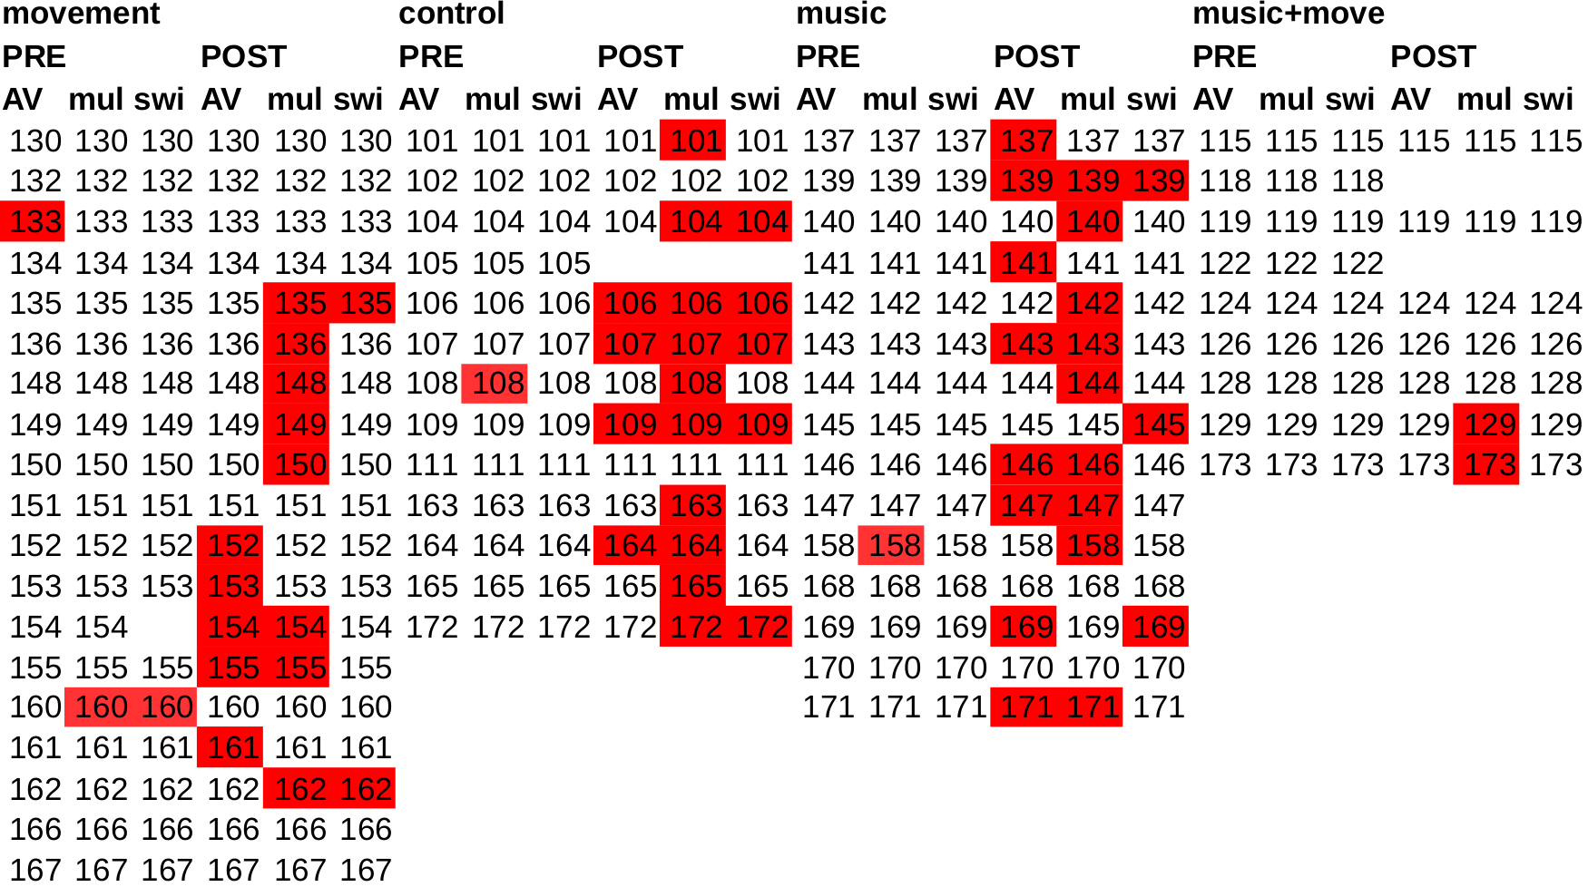
Signal Processing Pipe: step 1

Slide 15
Signal Denoising: step 2, ICs
Find+clean bad Independent Components (ICs)
  FASTER toolbox, using metrics
    median gradient, spectral slope, kurtosis, Hurst exponent
    Exclude EOG-correlation
  Blink-correction by IC template
    Probabilistic blink classification in temporal
    Generate canonical ‘template’ IC from blinks
    Calculate similarity metric from data ICs to template IC
    Iterate and test on top n data ICs to find those that really reduce amplitude of a blink ERP (generated from classified blinks)

Slide 16
Signal Denoising: step 2, ICs
Find+clean bad Independent Components (ICs)
Average badness:
Intake =
mean 14.8% ≃ 4.5 ICs, std.dev. = 5.7
Outtake =
mean 15.08% ≃ 4.5 ICs, std.dev. = 5.7

Slide 17
Signal Denoising: step 3, channels
Find+interpolate bad channels
  FASTER toolbox, using metrics
    Channel correlation, variance, Hurst exponent
    Multi-variate metric aggregate: ‘Mahalanobis distance’
    Estimate bad channels by median-average deviation thresholding (less sensitive to outliers than std.dev.)
Average badness:
Intake = 9.6% (~3 channels), std.dev. = 5.06
Outtake = 11.1% (~3 channels), std.dev. = 4.77

Slide 18
Signal Denoising: step 4, epochs
Find+cut bad epochs
  Epochs with amplitude exceeding ±120μV
    Excess in 1 channel is enough
    But channels-of-interest only are examined:
      F3,z,4 C3,z,4 P3,z,4
Average badness:
Intake =
1.13% (# epochs varies by proto), std.dev. = 2.4
Outtake =
1.9%, std.dev. = 7.4

Slide 19
Signal Denoising: test step
Find+cut bad segments (of continuous temporal raw EEG)
  Contiguous periods with amplitude exceeding ±120μV
    Excess in 1 channel is enough
    But channels-of-interest only are examined:
      F3,z,4 C3,z,4 P3,z,4
Average badness (more precise than bad epochs):
Intake =
0.36% of samples, std.dev. = 0.68
Outtake =
0.46% of samples, std.dev. = 0.62

Slide 20
Data epoching / export: step 5
Epoch to events of interest:
  AV
    sound_NOTNOVEL
    sound_NOVELxx
    pic_ANIMAL/THINGnnxx
    pic_ANIMAL/THINGnovxx
  multiMMN
    'dur' 'freq1' 'freq2' 'gap' 'int' 'loc1' 'loc2' 'novel' 'stand'
  Switching
    Std
    Congruent/incongruent audio-visual stimuli, 1 & 2

Slide 21
Demographics: China
N = 122
3 groups x 4 protocols:
  Control, English, Music
  Attention, AV, multiMMN,
  musmelo
  Co, En, Mu
  Att = 35, 50, 37 (intake)
  15, 26, 23 (outtake)
  AV = 35, 50, 37
  15, 26, 25
  MMN = 34, 50, 37
  15, 27, 25
  mus = 35, 50, 37
  13, 31, 26
intake outtake

Slide 22
Data: China
EGI Geodesic 128 channel @ 1000Hz
  Left / right mastoid reference
  EGI-defined channel location file
Trigger codes in data -> no import needed
Signal processing pipe similar to Finnish
  Bad ICs use only FASTER metrics, inc. EOG correlation
  Bad channels use variance

Slide 23
Signal Processing Outcomes
Step 2 – bad ICs (by FASTER only)
  Intake, mean = 10.2% (~13 ICs), std.dev = 2.4
  Outtake, mean = 9.8% (~12 ICs), std.dev = 2.4
Step 3 – bad channels (by variance)
  Intake, mean = 1.6% (~2 channels), std.dev = 0.14
  Outtake, mean = 1.5% (~2 channels), std.dev = 0.2
Step 4 – pending
Test Step – bad segments
  Intake, pending
  Outtake, mean = 0.9% of samples, std.dev = 0.5

