Slide 1
Angular 2 + ngrx

Slide 2
Agenda
A Quick look at how we build Angular Application
What is Redux?
Redux – Key Ideas
Redux – Key benefits
Principles of Redux
Redux Dependencies for Angular Apps
Demo Project

Slide 3
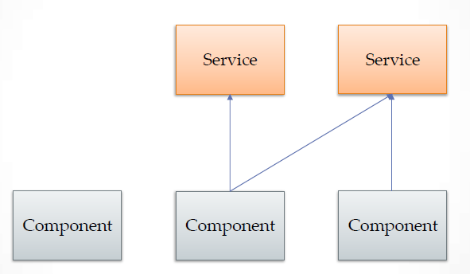
You start with the basic architecture

Slide 4
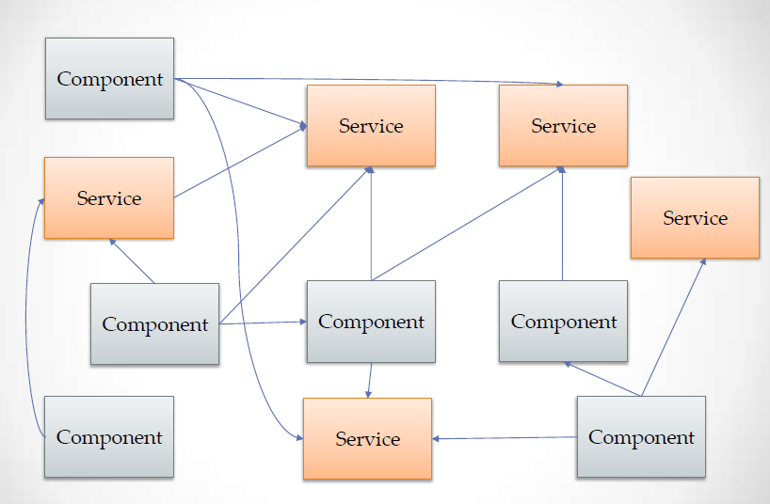
You application starts getting bigger

Slide 5
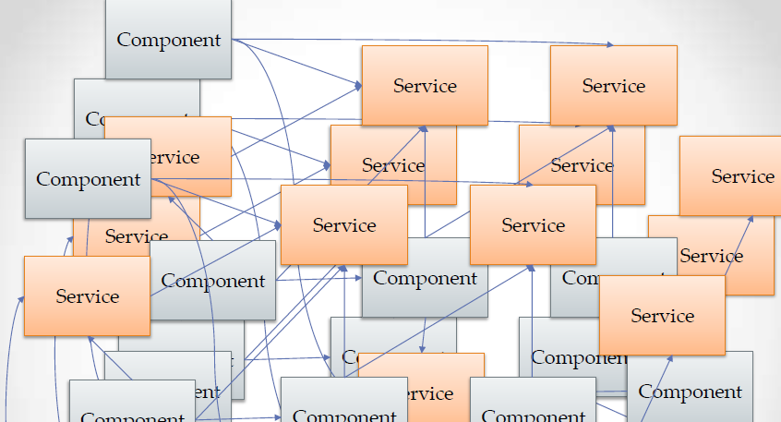
To a point where it starts looking like this

Slide 6

Then you make a small change and this

Slide 7
Ngrx is RxJS powered state management framework for Angular applications, inspired by Redux.
.

Slide 8
Redux – Key Ideas
All of your application’s data is in a single data structure called the state which is held in the store
Your app reads the state from this store
This store is never mutated directly
User interaction (and other code) fires actions which describe what happened
A new state is created by combining he old state and the action by a function called the reducer

Slide 9
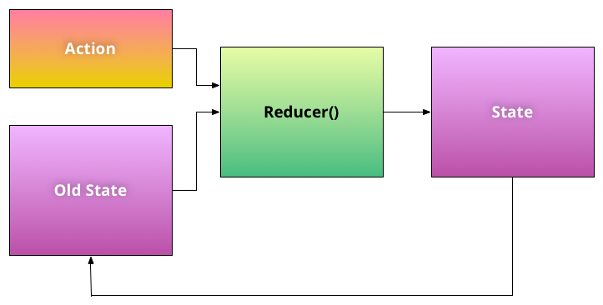

Slide 10
Redux – Key Benefits
Maintain the state of UI such as keeping the sidebar opened or closed when changing routes
Control the UI from any point of the application without worrying about how components are related and how to inject a specific service
Chain UI-layout specific actions with other events as saving data server-side or changing a route

Slide 11
Flavours of Redux for Angular

Slide 12
Redux Dependencies for Angular

