Slide 1
Angular 2 + ngrx

Slide 2
Agenda
A Quick look at how we build Angular Application
What is Redux?
Redux – Key Ideas
Redux – Key benefits
Principles of Redux
Redux Dependencies for Angular Apps
Demo Project

Slide 3
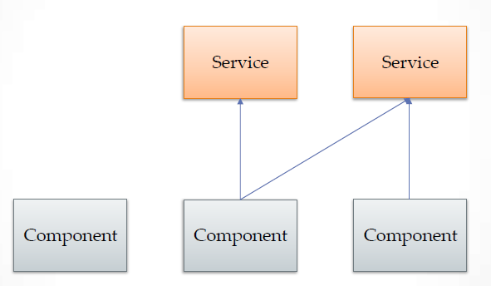
You start with the basic architecture

Slide 4
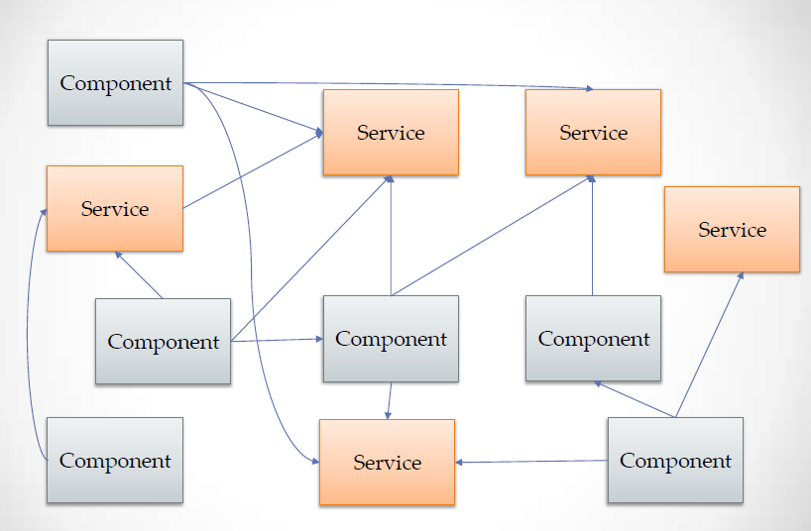
You application starts getting bigger

Slide 5
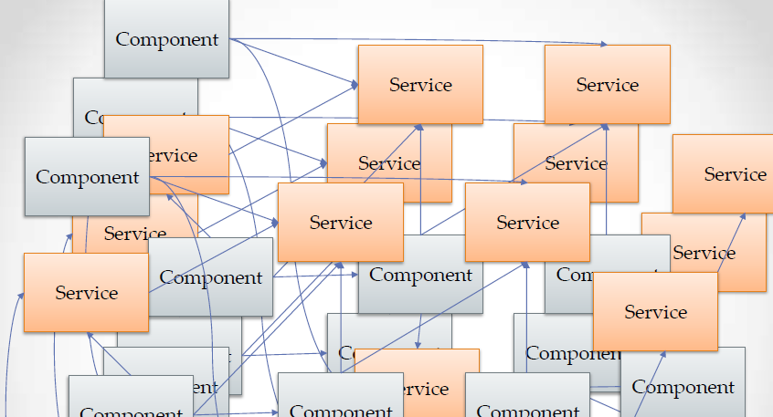
To a point where it starts looking like this

Slide 6
Then you make a small change

Slide 7
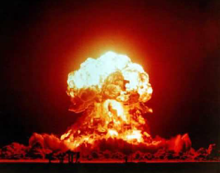
Then you make a small change and this

Slide 8


Slide 9
Redux is a predictable state container for JavaScript apps
Redux?
.

Slide 10
Ngrx is RxJS powered state management framework for Angular applications, inspired by Redux.
.

Slide 11
Redux – Key Ideas
All of your application’s data is in a single data structure called the state which is held in the store
Your app reads the state from this store
This store is never mutated directly
Requests to change state have to go through a dispatcher
User interaction (and other code) fires actions which describe what happened
Functions, called reducers, get a chance to operate on the action
A new state is created by combining the old state and the action by reducer
The store provides a stream of updates that can be watched by components needing to bind that data to the page or other components

Slide 12
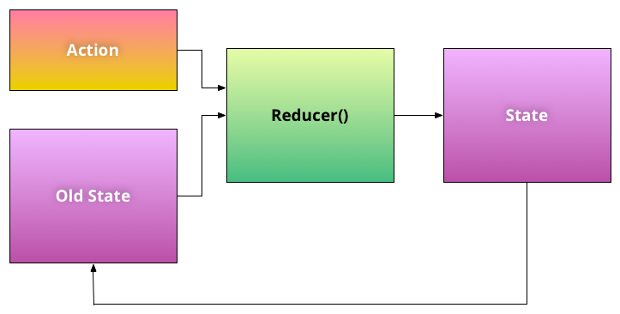

Slide 13
Redux – Key Benefits
Maintain the state of UI such as keeping the sidebar opened or closed when changing routes
Control the UI from any point of the application without worrying about how components are related and how to inject a specific service
Chain UI-layout specific actions with other events as saving data server-side or changing a route

Slide 14
Flavours of Redux for Angular
@ngrx/store
ng2-redux
Key differences b/w the two
@ngrx/store is a standalone implementation of Redux pattern which is heavily Observable based whereras
Angular2-redux/ng2-redux uses redux itself as a dependency and adds some angular helpers

Slide 15
Redux Dependencies for Angular
@ngrx/store
@ngrx/effects
reselect
rgrx-store-logger

Slide 16
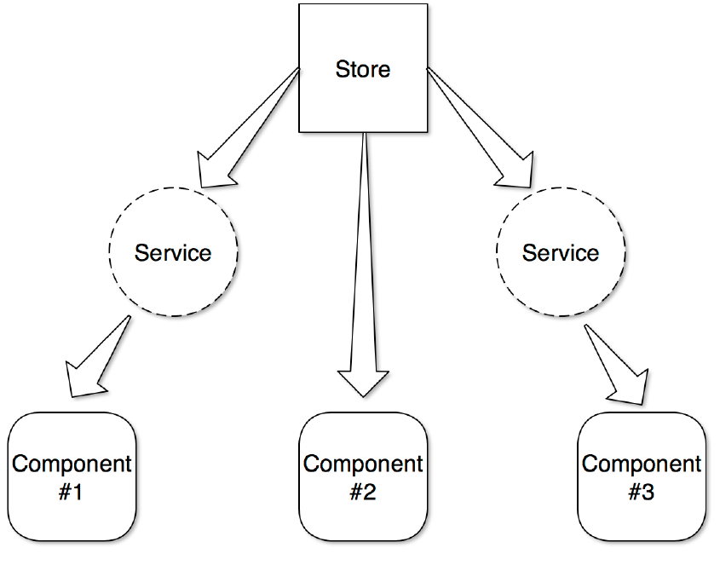
Store
All the application specific data is stored in application store.
Like a traditional database, it can be thought of as a single source of truth or a database.

Slide 17
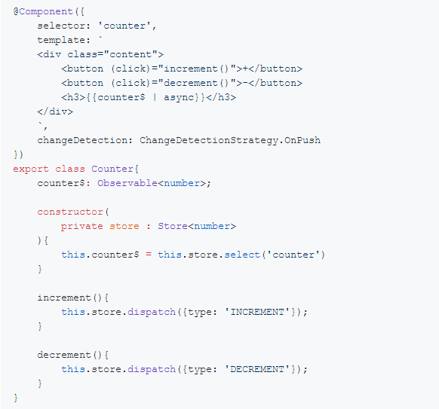
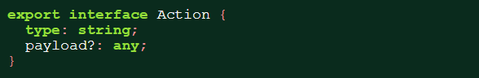
Action
An action defines what to do
Every Action has two properties, type: string, and payload?: any

Slide 18
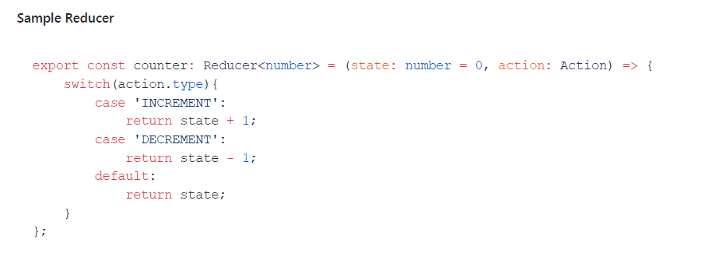
Reducers
Reducers are pure function
Meaning that pure functions do not produce any side effects (like making an HTTP call)
Given the state and action, reducer will produce a new state
It is important for a reducer function not to mutate the arguments and return a new reference of the state

Slide 19
Reference material
http://redux.js.org/
http://blog.ng-book.com/introduction-to-redux-with-typescript-and-angular-2/
http://onehungrymind.com/build-better-angular-2-application-redux-ngrx/
http://blog.rangle.io/managing-state-redux-angular/
https://www.slideshare.net/gilfink/redux-data-flow-with-angular-2
https://julienrenaux.fr/2017/02/16/from-redux-to-angular-ngrxstore/
https://gist.github.com/btroncone/a6e4347326749f938510
https://egghead.io/lessons/angular-2-ngrx-store-in-10-minutes
https://egghead.io/lessons/rxjs-what-is-rxjs

Slide 20
Thank You Questions?

