Slide 1

XENON COMPILER
MEXICO CITY

Slide 2

A MEXICAN COMPILER
XENON, A ENERGY COMPILING
¿What’s Xenon?
Xenon is a compiler with simple structure associated to a continuos information Flow. You can compiling simple programs to simple process.

Slide 3
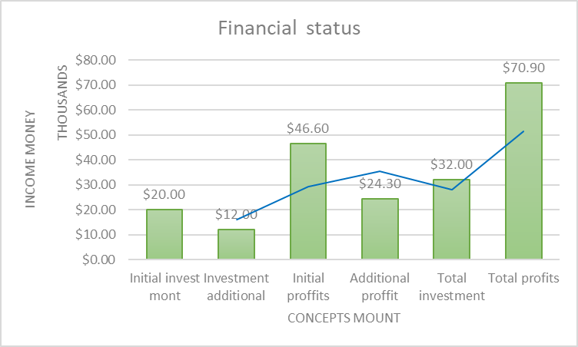
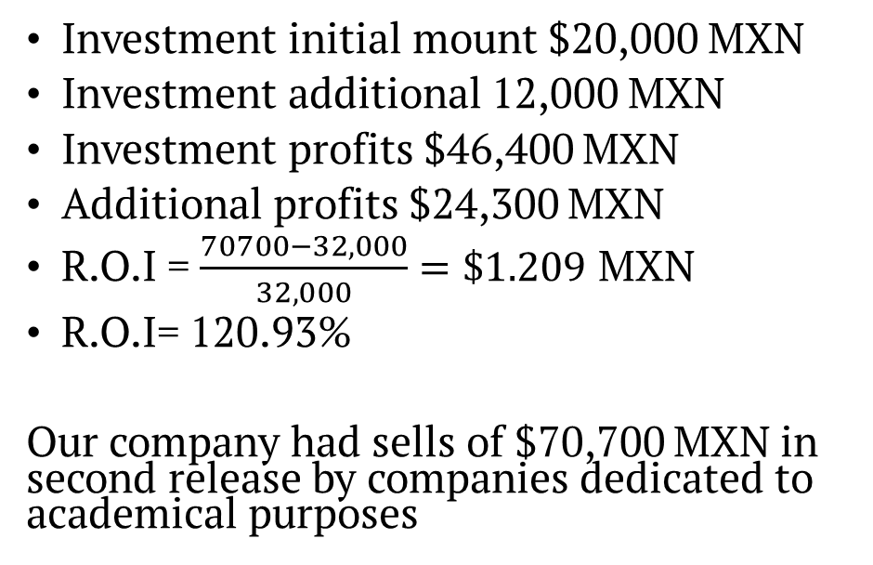
FINANCIAL ANYLISIS
RETURN ON INVESTMEN
GRAPHICAL RESULTS
Investment initial mount $20,000 MXN
Investment additional 12,000 MXN
Investment profits $46,400 MXN
Additional profits $24,300 MXN
R.O.I = $\frac{70700−32,000}{32,000}=\$1.209$ MXN
R.O.I= 120.93%
Our company had sells of $70,700 MXN in second release by companies dedicated to academical purposes

Slide 4
THANKS C.E.O NORBERTO ORTIGOZA

