Slide 1
Universidad Nacional Autónoma de México Facultad de Ingeniería
First Project Delivery
Talisman team
Team members:
Acosta Hernández Horacio
Sánchez Bautista Alan Ulises

Slide 2
Topics
Objective and Stakeholders Information
Documentation
Project Plan
Restrictions
Delivery Protocol
Requirements
Communication
Project Architecture

Slide 3

Objective
The objective of this project is to create a functional C compiler using the Elixir language as the core; not only that, we will try out all the knowledge we have got about Software Engineering and Project Development.

Slide 4
Stakeholders Information
Acosta Hernández Horacio
Software Architect and Project Manager
8th semester student of the engineering faculty, with knowledge and main interest in programming, oriented to creating applications on Android devices. Basic level courses for mastering different programming languages.
Sánchez Bautista Alan Ulises
Tester and Integrator
Student from the faculty of engineering of the UNAM 2017 generation, with different knowledge in various programming languages focused on objects and numerical analysis. Complete domain of four skills in English (FCE certificate by the British Council on December 2017).

Slide 5
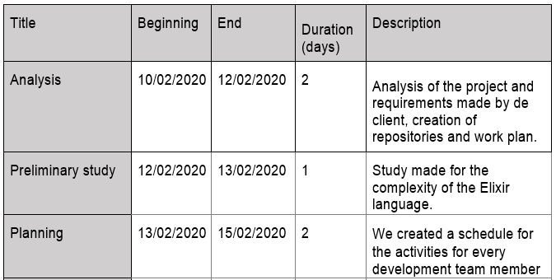
Project Plan

Slide 6
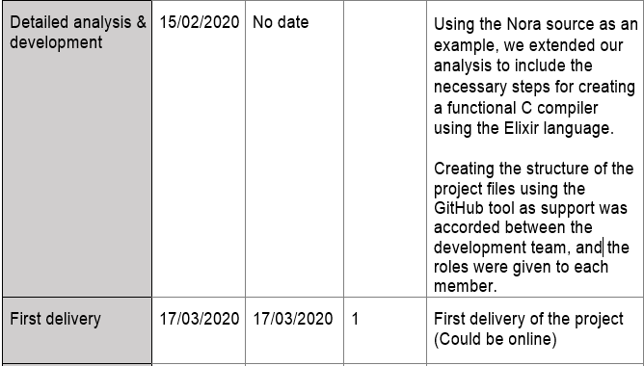

Slide 7
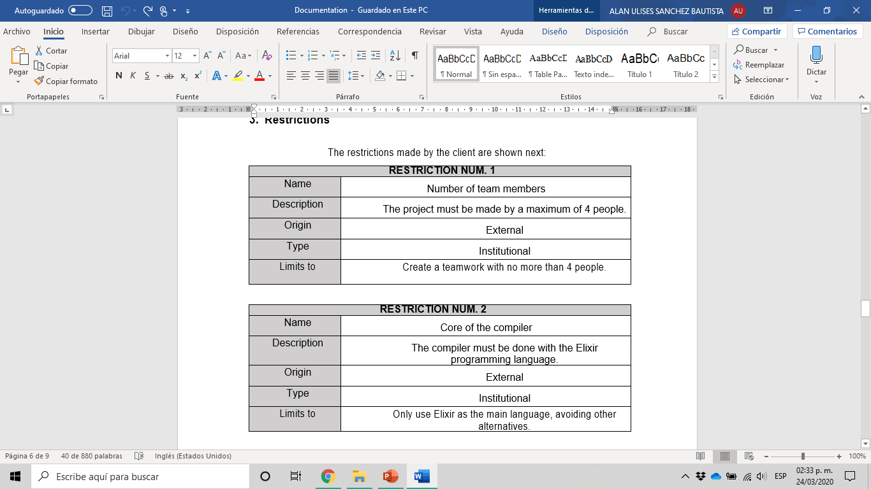
Restrictions

Slide 8
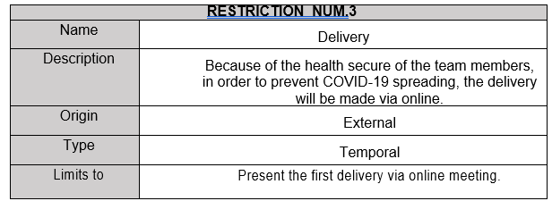

Slide 9
Delivery Protocol
Delivery Protocol
Responsible | Acosta Hernández Horacio, Sánchez Bautista Alan Ulises
Destinatary | Ortigoza Márquez Norberto Jesús
Date | 24/03/2020
Max. duration | No indicated
Place | Video call
Communication media | Zoom
Elements delivered | Documentation and Code

Slide 10
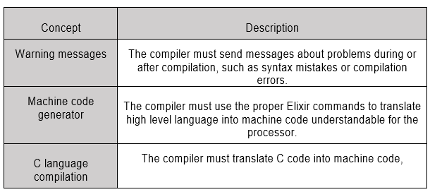
Requirements

Slide 11


Communication

Slide 12
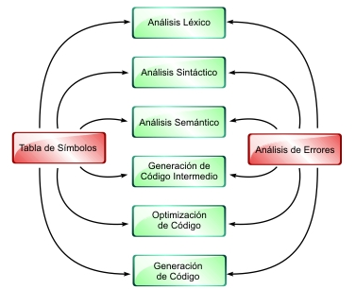
Project Architecture

Slide 13
Conclusions, problems and comments
Communication problems
Unexperienced team
Bad planning

