Slide 1

HBase

Slide 2
Agenda
1.What is Apache HBase? 2.HBase data model 3.CRUD operations 4.HBase architecture 5.HBase schema design 6.Java API

Slide 3

What is Apache HBase?

Slide 4
Apache HBase is
Open source project built on top of Apache Hadoop
NoSQL database
Distributed, scalable datastore Column-family datastore
•
•

Slide 5
Use cases
Time Series Data
Sensor, System metrics, Events, Log files User Activity
Hi Volume, Velocity Writes
•
•
Information Exchange
Email, Chat, Inbox
High Volume, Velocity Read\Write
•
Enterprise Application Backend
Online Catalog Search Index
Pre-Computed View
High Volume, Velocity Reads
•
•
•

Slide 6

HBase data model

Slide 7
Data model overview
Component | Description
Table | Data organized into tables
RowKey | Data stored in rows; Rows identified by RowKeys
Region | Rows are grouped in Regions
Column Family | Columns grouped into families
Column Qualifier (Column) | Indentifies the column
Cell | Combination of the row key, column family, column, timestamp; contains the value
Version | Values within in cell versioned by version number → timestamp

Slide 8
Data model: Rows
RowKey | contacs |  |  | accounts |  | …
 | mobile | email | skype | UAH | USD | …
084ab67e | VAL |  |  | VAL
2333bbac |  | VAL | VAL
342bbecc | VAL
4345235b |  |  |  |  | VAL
565c4f8f | VAL |  | VAL |  | VAL
675555ab | VAL | VAL | VAL | VAL | VAL
9745c563 |  | VAL |  | VAL
a89d3211 | VAL | VAL |  | VAL | VAL
f091e589 |  |  | VAL | VAL | VAL

Slide 9
Data model: Rows order
Rows are sorted in lexicographical order
+bill 04523
10942
53205
_tim andy josh steve will

Slide 10
Data model: Regions
RowKey | contacs |  |  | accounts |  | …
 | mobile | email | skype | UAH | USD | …
084ab67e | VAL |  |  | VAL
2333bbac |  | VAL | VAL
… | VAL
4345235b |  |  |  |  | VAL
… | VAL |  | VAL |  | VAL
675555ab | VAL | VAL | VAL | VAL | VAL
9745c563 |  | VAL |  | VAL
… | VAL | VAL |  | VAL | VAL
f091e589 |  |  | VAL | VAL | VAL
R1
R2
R3
RowKeys ranges → Regions

Slide 11
Data model: Column Family
RowKey | contacs |  |  | accounts
 | mobile | email | skype | UAH | USD
084ab67e | VAL |  |  | VAL
2333bbac |  | VAL | VAL
342bbecc | VAL
4345235b |  |  |  |  | VAL
565c4f8f | VAL |  | VAL |  | VAL
675555ab | VAL | VAL | VAL | VAL | VAL
9745c563 |  | VAL |  | VAL

Slide 12
Data model: Column Family
Column Families are part of the table schema and defined on the table creation
Columns are grouped into column families Column Families are stored in separate HFiles at HDFS
Data is grouped to Column Families by common attribute
•
•

Slide 13
Data model: Columns
RowKey | contacs |  |  | accounts
 | mobile | email | skype | UAH | USD
084ab67e | 977685798 | user123@gmail.com | user123 | 2875 | 10
… | … | … | … | … | …

Slide 14
Data model: Cells
Key |  |  |  | Value
RowKey | Column Family | Column Qualifier | Version
084ab67e | contacs | mobile | 1454767653075 | 977685798

Slide 15
Data model: Cells
Data is stored in KeyValue format
Value for each cell is specified by complete coordinates: RowKey, Column Family, Column Qualifier, Version

Slide 16
Data model: Versions
 | CF1:colA |  |  | CF1:colB |  | CF1:colC
Row1 | val3 | l2 | 1 | val1 |  | val2 l1
Row10 | val1 |  |  | val2 | l1 | val3 l2 1
Row2 | val2 | l1 |  |  |  | val1
va
vl
va
va
va
vl
va

Slide 17

CRUD Operations

Slide 18
Create table
create 'user_accounts',
{NAME=>'contacts',VERSIONS=>1},
{NAME=>'accounts'}
•
Default Versions = 1, since HBase 0.98 Default Versions = 3, before HBase 0.98
•

Slide 19
Insert/Update
put 'user_accounts', 'user3455','contacts:mobile','977685798'
put 'user_accounts', 'user3455','contacts:email','user@mail.c om',2
There is no update command. Just reinsert row.

Slide 20
Read
get 'user_accounts', 'user3455'
get 'user_accounts', 'user3455', 'contacts:mobile'
get 'user_accounts', 'user3455',
{COLUMN
=> 'contacts:email', TIMESTAMP => 2} scan ‘user_accounts’
scan 'user_accounts',
{STARTROW=>'a',STOPROW=>'u'}

Slide 21
Delete
delete 'user_accounts', 'user3455','contacts:mobile'
delete 'user_accounts', 'user3455','contacts:mobile', 1459690212356
deleteall 'user_accounts', 'user3455'

Slide 22
Useful commands
list
describe 'user_accounts' truncate 'user_accounts' disable 'user_accounts' alter 'user_accounts',
{NAME=>'contacts',VERSIONS=>2},
{NAME=>'spends'}
enable 'user_accounts'

Slide 23

HBase Architecture

Slide 24
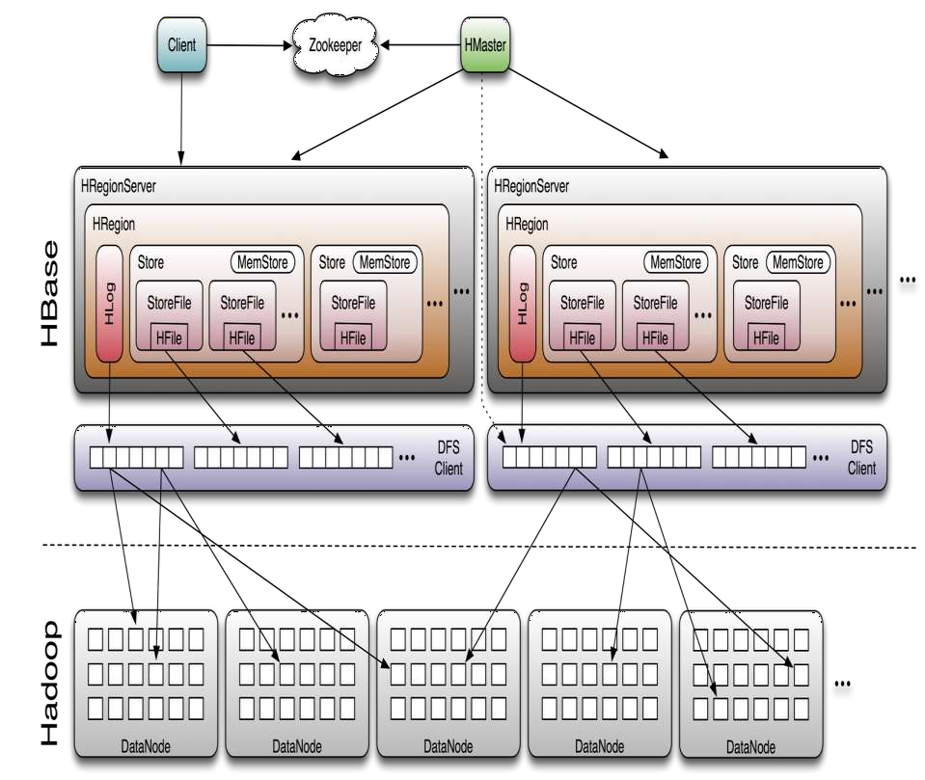
HBase Architecture

Slide 25
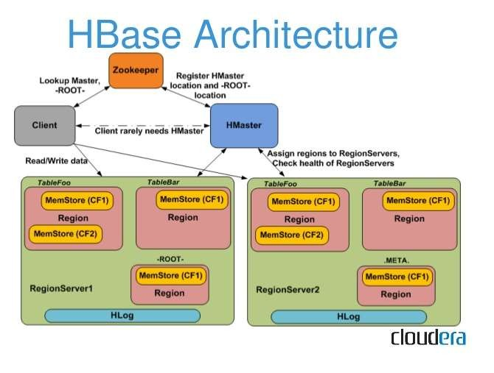
HBase Architecture

Slide 26
HBase First Read or Write
The client gets the Region server that hosts the META table from ZooKeeper.
The client will query the .META. server to get the region server corresponding to the row key it wants to access. The client caches this information along with the META table location.
It will get the Row from the corresponding Region Server.
There is a special HBase Catalog table called the META table, which holds the location of the regions in the cluster. ZooKeeper stores the location of the META table.
ZooKeeper stores the location of the META table.
This is what three steps happens the first time a client reads or writes to HBase:

Slide 27
WAL: Write Ahead Log is a file on the distributed file system. The WAL is used to store new data that hasn't yet been persisted to permanent storage; it is used for recovery in the case of failure.
BlockCache: is the read cache. It stores frequently read data in memory. Least Recently Used data is evicted when full.
MemStore: is the write cache. It stores new data which has not yet been written to disk. It is sorted before writing to disk.
There is one MemStore per column family per region.
Hfiles store the rows as sorted KeyValues on disk.

Slide 28
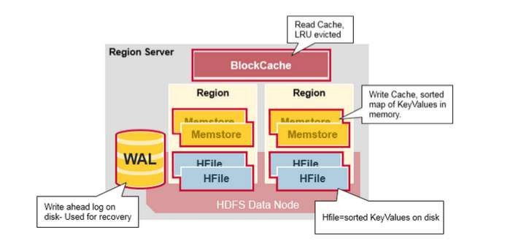

Slide 29
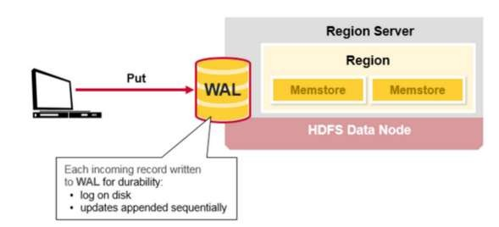
HBase Write Steps (1)e Steps (1)
When the client issues a Put request, the first step is to write the data to the write-ahead log, the WAL:
Edits are appended to the end of the WAL file that is stored on disk
The WAL is used to recover not-yet-persisted data in case a server
crashes.

Slide 30
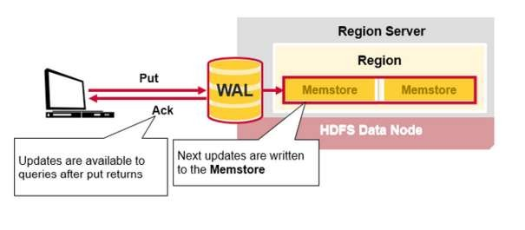
HBase Write Steps (2)e Steps (2)
Once the data is written to the WAL, it is placed in the MemStore.
Then, the put request acknowledgement returns to the client.

Slide 31
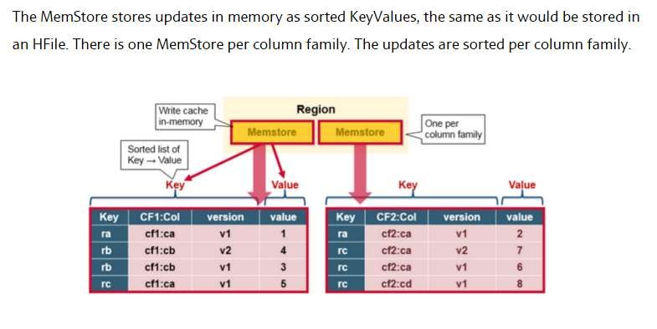
HBase MemStore MemStore

Slide 32
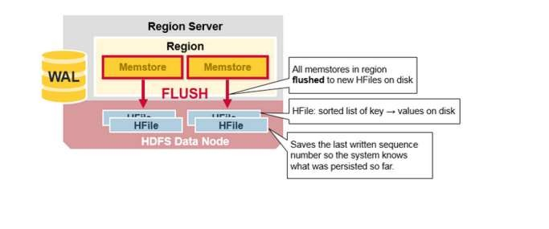
`

Slide 33
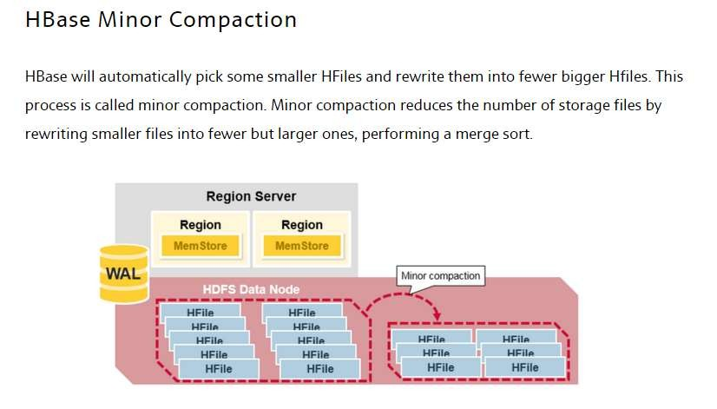

Slide 34
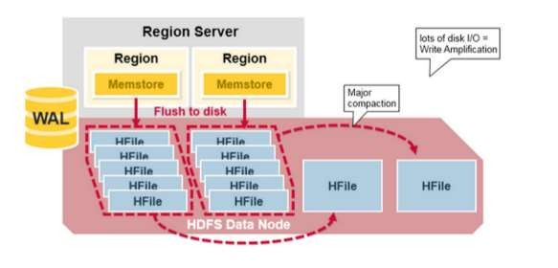
Major compaction merges and rewrites all the HFiles in a region to one HFile per column family, and in the process, drops deleted or expired cells.
since major compaction rewrites all of the files, lots of disk I/O and network traffic might occur during the process. This is called write amplification.
Major compactions can be scheduled to run automatically. Due to write amplification, major compactions are usually scheduled for weekends or evenings.

Slide 35
Data write and fault tolerance
Data writes are recorded in WAL
Data is written to memstore
When memstore is full -> data is written to disk in HFile

Slide 36
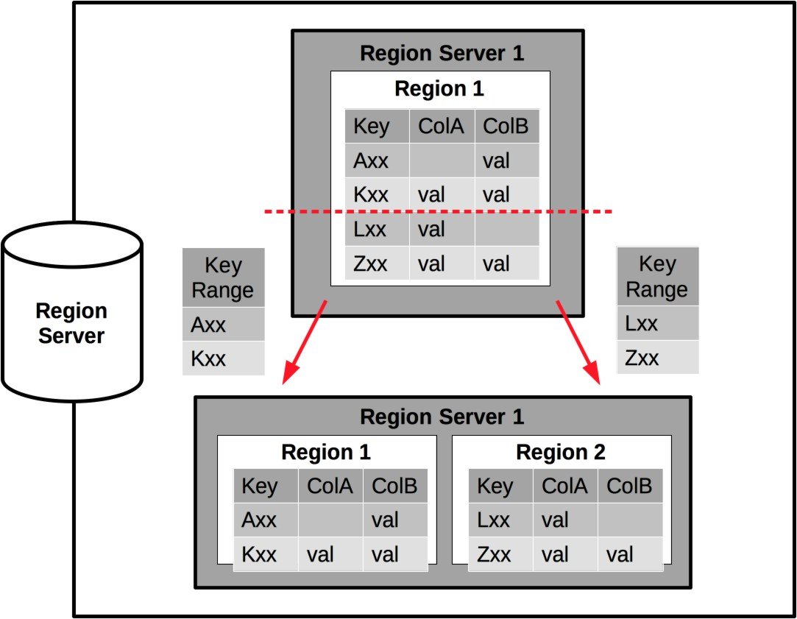
Region split
When region size > hbase.hregion.max.filesize -> split

Slide 37
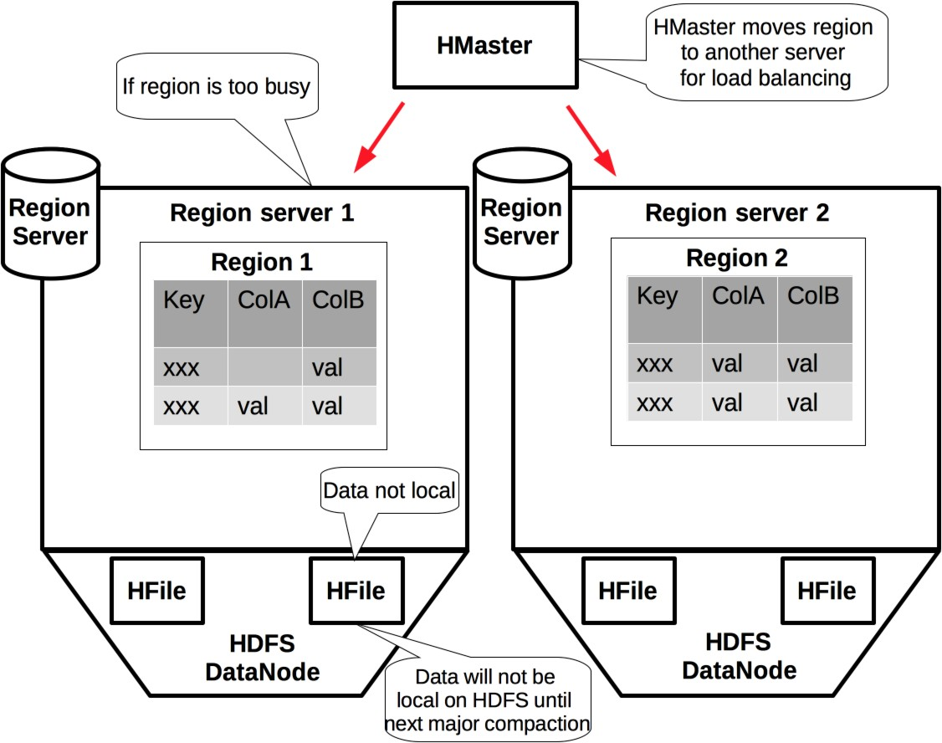
Region load balancing

Slide 38
Web console
Default address: master_host:60010
Shows:
Live and dead region servers
Region request count per second
Tables and region sizes
Current compactions
Current memory state

Slide 39

HBase Schema Design

Slide 40
Elements of Schema Design
HBase schema design is QUERY based 1.Column families determination 2.RowKey design
3.Columns usage 4.Cell versions usage
5.Column family attribute: Compression, TimeToLive, Min/Max Versions, Im-Memory

Slide 41
Column Families determination
Data, that accessed together should be stored together!
•
Big number of column families may avoid performance. Optimal: ≤ 3
•
Using compression may improve read performance and reduce store data size, but affect write performance
•

Slide 42
RowKey design
Do not use sequential keys like timestamp
Use hash for effective key distribution
Use composite keys for effective scans

Slide 43
Columns and Versions usage
Tall-Narrow Table Flat-Wide Table

Slide 44
Tall-Narrow Vs. Flat-Wide Tables
Tall-Narrow provides better quality granularity
Finer grained RowKey Works well with Get
•
Flat-Wide supports build-in row atomicity
More values in a single row
Works well to update multiple values
Works well to get multiple associated values
•
•

Slide 45
Column Families properties
Compression
LZO GZIP SNAPPY
•
•
Time To Live (TTL)
Keep data for some time and then delete when TTL is passed
Versioning
Keep fewer versions means less data in scans. Default now 1 Combine MIN_VERSIONS with TTL to keep data older than TTL
•
In-Memory setting
A setting to suggest that server keeps data in cache. Not guaranteed Use for small, high-access column families
•

Slide 46

HBase Java API

Slide 47
API: All the things
New Java API since HBase 1.0
Table Interface for Data Operations: Put, Get, Scan, Increment, Delete
Admin Interface for DDL operations: Create Table, Alter Table, Enable/Disable
•
•

Slide 48
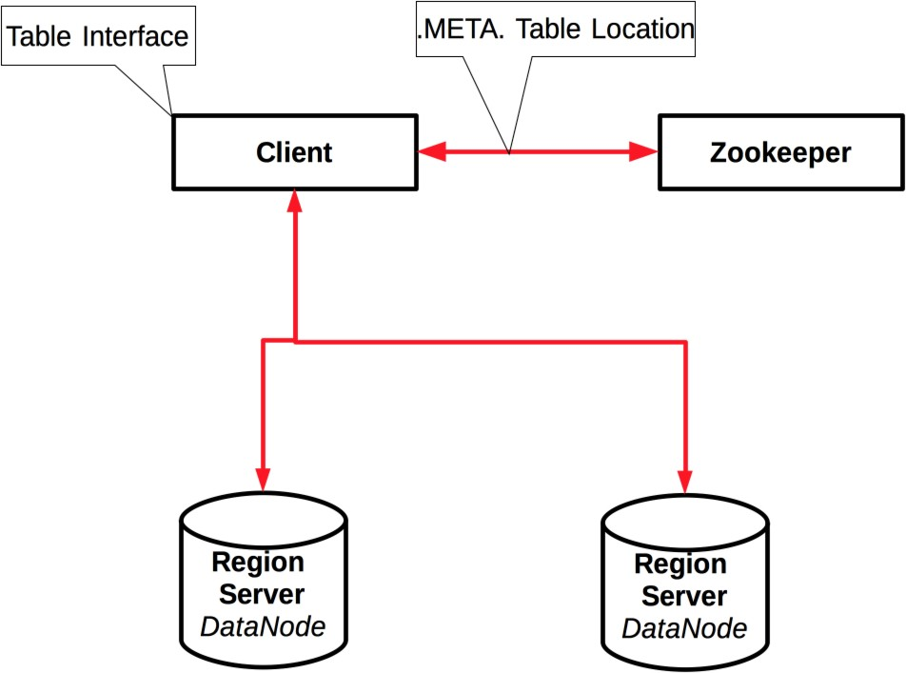
Client

Slide 49

Let’s see the code

Slide 50
Performance: Client reads
Determine as much key component, as possible Determination of ColumnFamily reduce disk IO Determination of Column, Version reduce network traffic
Determine startRow, endRow for Scans, where possible
Use caching with Scans
•
•
•
•

Slide 51
Performance: Client writes
Use batches to reduce RPC calls and improve performance
Use write buffer for not critical data. BufferMutator introduced in HBase API 1.0
Durability.ASYNC_WAL may be good balance between performance and reliability

Slide 52

The last few words

Slide 53
Thank you

