Slide 1
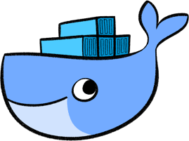
Induction to Docker
by Maciek Plachta

Slide 2
Agenda
Demistifying containers - what they are and what they are not
Docker - what it is and what technology stack made it number one on the market
What is its purpose, and when it is useful
Docker ecosystem
Real life scenarios and aplications

Slide 3
Presentation outline
A story of three acts:
  Concept behind containers
  (presentation warm-up)
  Case study
  (learn by example)
  Diving into details
  (what the heck just happened?)

Slide 4
Spaces for applying containers:
highly coupled systems with a huge dependencies chain,
having the same environments for development, CI and production,
systems which scales both ways,
microservices,
design requires strong abstraction,
reduce provisioning (make things portable),

Slide 5
Spaces for applying Containers (continued):
request of port and service mapping,
‘it works for me’,
‘you want to run what?’,
‘you did what ?!’,
reproducibility is of an essence,
sandboxing and doing experiments with a different tech stack, where one wants to preserve the current environment unaffected.

Slide 6
Container X-ray
“A Container is not a lightweight VM”
Container acts like VM, but they are only a self contained processes. They use Linux Kernel features to limit their resources and access rights. Container lives as long as their root process and exits immediately when it stops.

Slide 7
Container X-ray
Container has:
  binaries
  libraries
  file system
Container use:
  host network
  host kernel
  host resources

Slide 8
Docker
In short. It is one of the container standards which has a large ecosystem around it, strong community and business model built on top of an open project codebase.
Launched at March 2013, hit v1.0 in a late 2014, and had over 100 millions downloads till 2015.
...Oh and it was written in Go. An accident ? I DON’T THINK SO !!! :-)

Slide 9
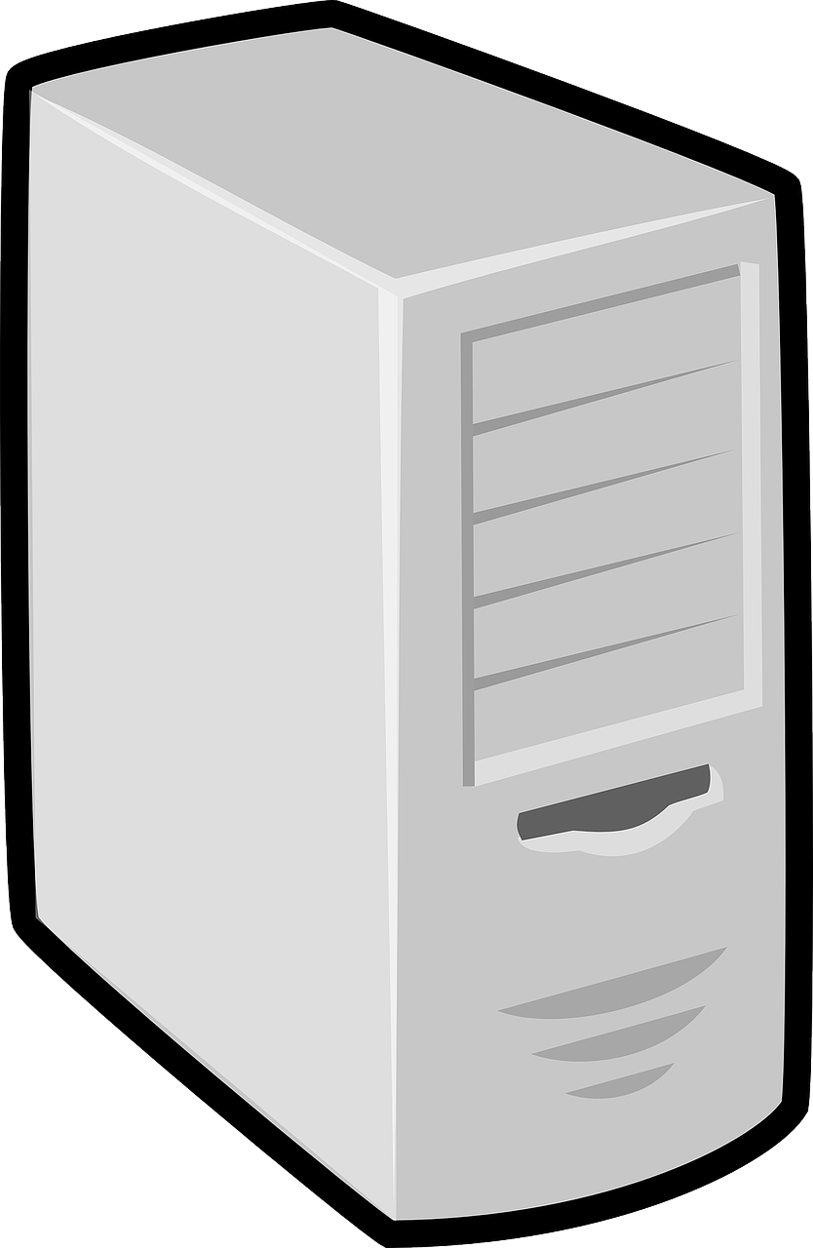
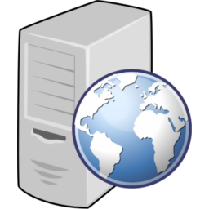
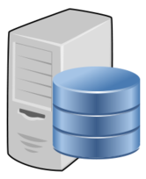
Case study: small, distributed system
HTTP server
Port: 8080
App: demoapp
Net: frontend, backend
frontend
HTTP client
App: demoapp-d
Net: frontend
backend
PostgesSQL database
User: demo
Password: demo123
Database: demoapp
Net: backend
PRIVATE NETWORK – no access from outside

Slide 10
Solution: Slice this cake!
Stage 1: Let’s make services deployable
Stage 2: Configure database
Stage 3: Configure networks
Stage 4: Link everything together
Stage 5: Test it
- Are we done?
- Well… we could do it better !
Stage 6: Extracting toolchain
Stage 7: Automated local setup

Slide 11
Demystifying Docker
Over time Docker has scaled up rapidly. So its model evolved. The current state is:
Moby project (open source community driven)
Docker project (based on Moby core but also containing proprietary content).
  Docker CE (stable, edge) – free of charge fully supported ecosystem,
  Docker EE (stable, edge) – paid, extra support.

Slide 12
Docker Ecosystem
Docker Engine (also Docker daemon/server)
Docker CLI
Docker Swarm
Docker Compose
Docker Machine
Docker for Mac / Docker for Windows (port)
Docker Registry aka Docker Hub
Docker Cloud
Docker Store

Slide 13
Docker Image
Application binaries and dependencies
Metadata about the image data and how to run it
Not a complete OS. No kernel modules(drivers). The host provides its kernel.
By definition: ‘An image is an ordered collection of root filesystem changes and the corresponding execution parameters for use within a container runtime’

Slide 14
Docker Container
A textbook definition explained before plus instantiation of a docker image. It is an additional layer build on top of an image with read/write privileges (immutable, ephemeral by default). You can have multiple containers spawned from just one image.

Slide 15
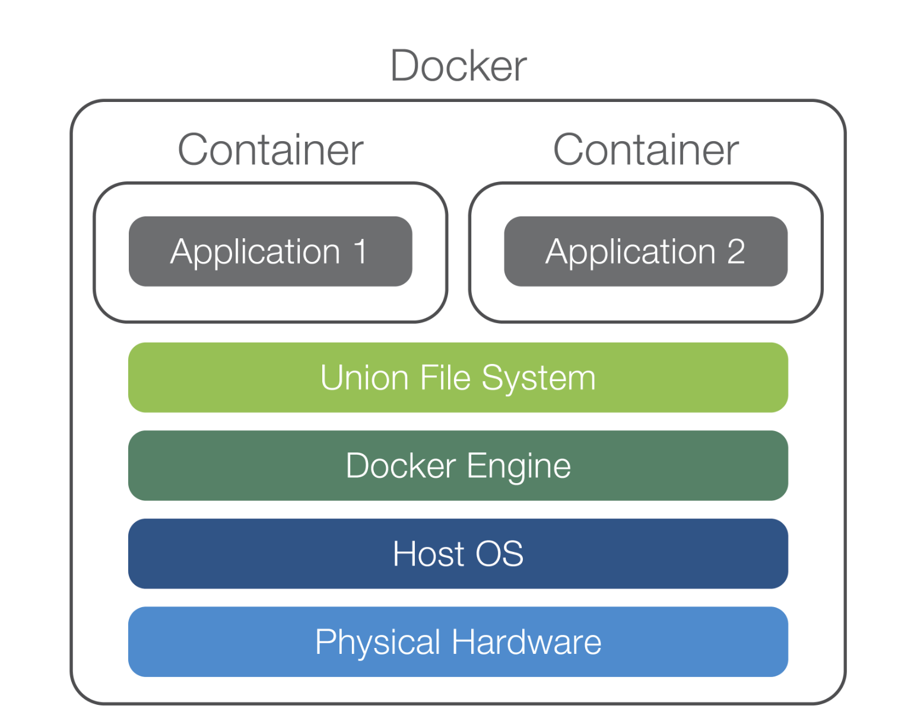
Docker layout

Slide 16
Docker Virtual Network Model
(“Battery included but removable”)
Three types of network drivers:
bridge (default) – secure, different subnet, behind NAT firewall
host – no NAT, container use host network,
none – only localhost,
….. plus various plugins

Slide 17
Container lifetime & Persistent Data
By default everything within a container lives and dies with it. When one want data to outlive container it has to options:
bind mounts – map host file/directory to the container space.
volume – makes special memory location outside of a container File System layer, handled by docker storage driver

Slide 18
What next ?
Docker tools set (docker-compose)
Docker in depth
Distributed systems
More live examples
Dockerfile and Yaml syntax
Workshops – maybe ?
...but not Today :(

Slide 19
Summary
Container is just a process
Containers are stateless by default
Docker image is just an app we want to run
Docker container is an instance of an image running as a process
You can spawn multiple containers from just one image
Docker API is easy to use
Docker Hub is a mine of official images, as well as custom ones
Build, ship and run application in one environment to minimalize failure

Slide 20
References
Bret Fisher docker course on Udemy
docs.docker.com
store.docker.com
get.docker.com
hub.docker.com

Slide 21
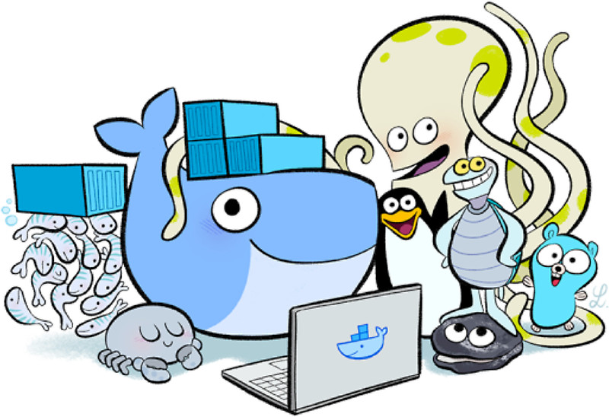
Thanks

