Slide 1
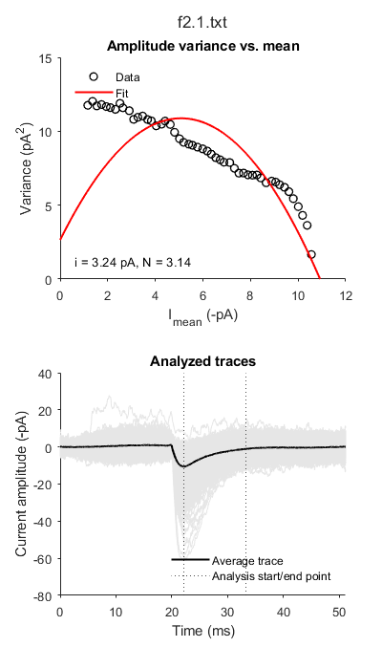
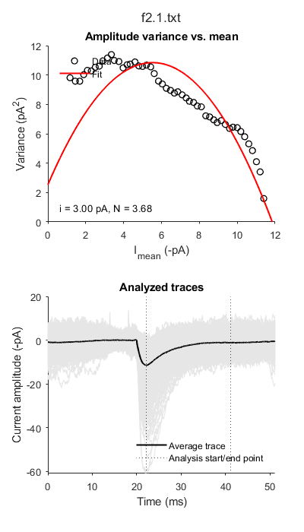
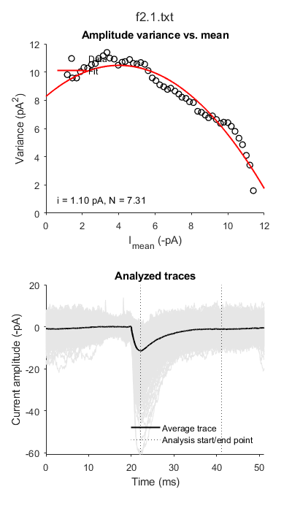
Setting baseline at 14-18 ms instead of 0-4 ms
Variance at the end of decay is a bit smaller now
Lower variance in baseline
Setting 0 to 4 ms as baseline and 0-4 ms for baseline noise calculation
i = 3.23927982
N = 3.13708442
R^2 = 0.20650728
2729 events were excluded from the analysis.
Background noise variance = 2.64702594 pA
Setting 14 to 18 ms as baseline and 14-18 ms for baseline noise calculation
i = 3.00442057
N = 3.68142626
R^2 = 0.51453202
2693 events were excluded
Background noise variance = 2.53304261 pA
Setting 14 to 18 ms as baseline and 0-14 ms for baseline noise calculation
i = 1.09692866
N = 7.31431600
R^2 = 0.94264009
2693 events were excluded from the analysis.
- Background noise variance = 8.27159741 pA

