Slide 1
Mathematical Modelling of Highway Traffic Policies
Ben Squire, Nate Minor, John-Paul Mann

Slide 2

Mathematical Competition in Modeling
96hr World-Wide Math
Modeling Competition
COMAP
Prompt:
Model & Analyze the
efficiency and safety
Stay-Right-Except-to-Pass
highway traffic law.
Over 8000 teams
Awarded ‘Meritorious’
top 10%

Slide 3
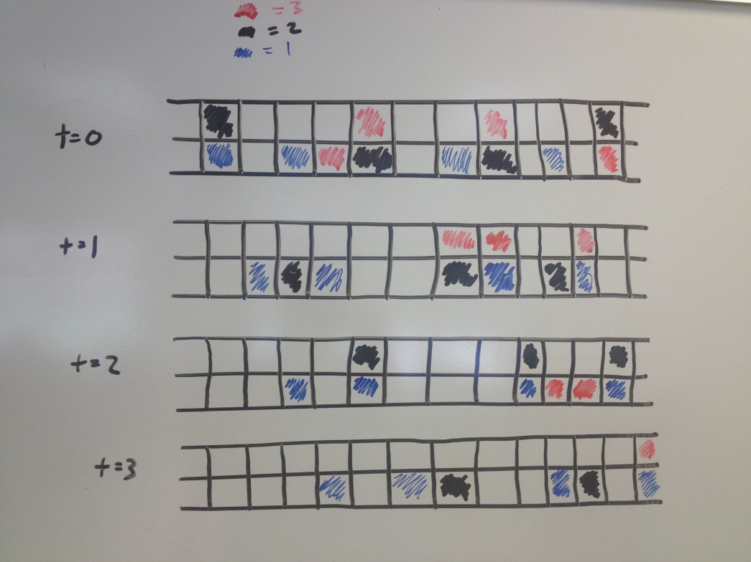
Approach
Macroscopic Model: Differential Equations
Fluid Dynamics: Convection-Diffusion Equation
Lighthill-Whitman-Richards Model
Microscopic Model
Proto-Model

Slide 4
Assumptions & Definitions
No Exit or Entry Ramps
Conservation of Cars
Identical Vehicles
Length, Driving Ability, Braking Ability
Lane Width, Curvature, and Shoulder Width and Weather aren’t important to analysis
Only Side Swipe and Rear End
Crashes only a count, not actually happen in system
Normal Distribution of Initial Velocities
Models variations from the average speed limit
Random Initial Positions of Vehicles

Slide 5
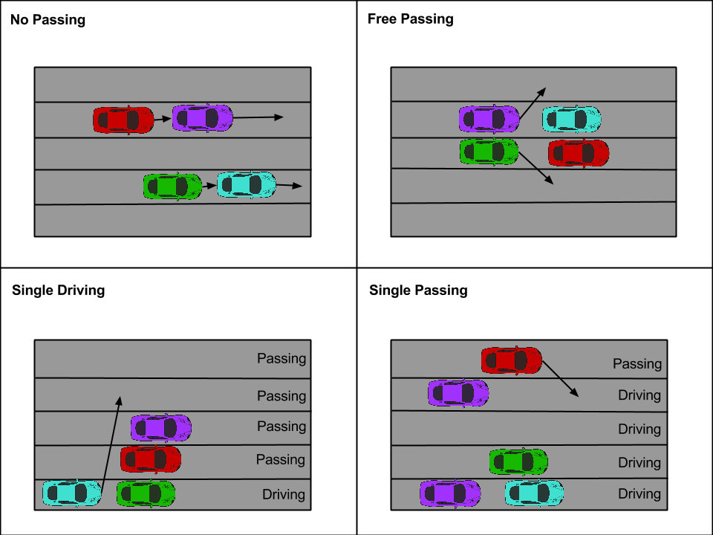
Road Rules

Slide 6
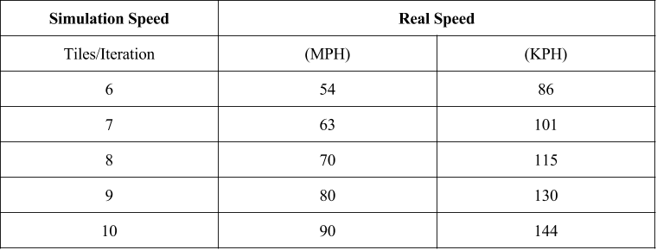
Simulation Scaling

Slide 7
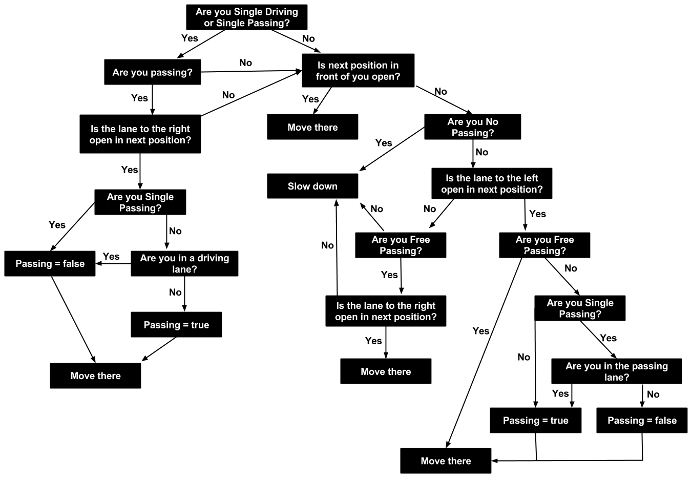
Vehicle Interaction Decision Tree

Slide 8
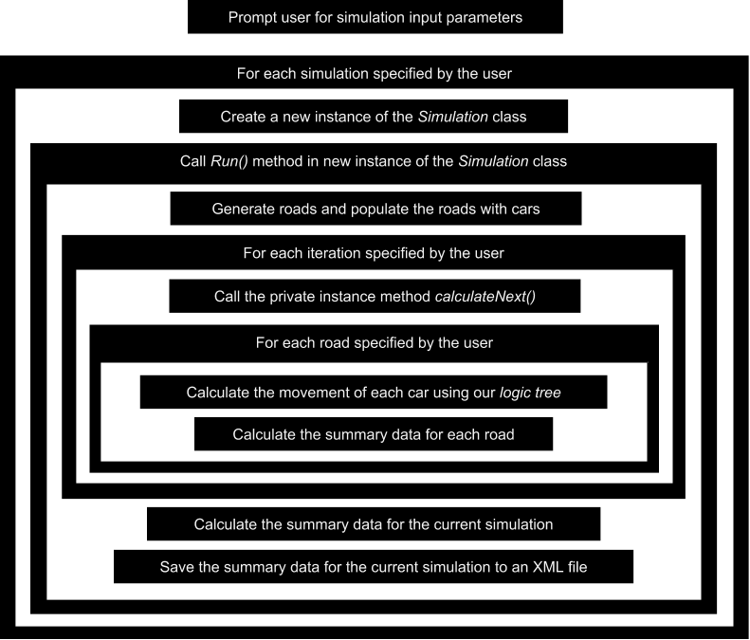
Computer Program Execution
Notes:
change the text into layman's terms

Slide 9
Statistical Analysis
What our Data was:
Iteration Data:
Average road speed
Number of Decisions
Number of Lane change
Number of Slow downs
Simulation Data:
Average Iteration summary speed
Average number of decisions
Average number of Lane changes
Average number of Slow downs
Notes:
The data points we were able to track in our Java programming were quite vast. We had the ability to track the position, speed, and initial speed of every car on a given road way for every iteration in a simulation (upwards of 37,500 cars per second for over 8 minutes). Furthermore, we also kept a counter for each iteration which tracked the total number of lane changes, slow downs, and decisions made for that snapshot of time. We originally organized all this data in an XML persistence data format which would allow us to call back particular pieces of information by tag line headings. This type of data storage proved to be to large and difficult to handle at the iteration summary level (summary of each second), with expected file sizes being in TB, we quickly realized a summary data of the entire 8 minutes would be necessary within the Java program. Thus, for each simulation we averaged the Iteration summary speed for a particular road way, e.g 2 lanes, low density, for the free passing rule. This reduced file size and time of analysis dramatically, allowing us to find statistically significant results over 30 simulations much quicker.

Slide 10
Challenges & Solutions
Challenges
Exporting XML to Excel without Macros
Interpreting results
Solutions
Perform summary statistics in Java
Reviewing statistical process step by step
Notes:
Although performing the statistical analysis itself was very difficult, another major challenge was identifying and interpreting the results. We were on a very short time frame so going back and redoing the simulations and finding the sample statistics again was not possible. After organizing and consolidating the pieces of data we were going to compare from rule to rule, we found some very significant differences between the average simulations speeds that at first seemed to high to be true. For example, the difference between the average simulation speed for the Free passing rule and Single driving rule for a 2 lane low density road showed a p- value of 6 x 10^ -460. Upon further investigation it became apparent these very significant differences were due to two things, namely the large number of iterations we were averaging over were highly centralizing these figures, so the variance between them was becoming extremely low, and also the variance to begin with was not extremely high because there were only 2 randomized factors in the entire simulation, namely position( uniformly distributed) and speed (normally distributed). These results are in fact perfectly reasonable for the model we designed and with some tweaking to the number of iterations and the addition of more realistic randomized factors, we would begin to see a more unstable and less significant difference which would better reflect reality.

Slide 11
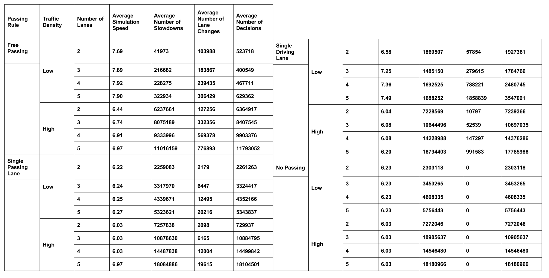
Summary
Notes:
Notice that the Average number of slow down, lane changes, and decisions goes into the millions of interactions as the roadways and density grows. We use these

Slide 12
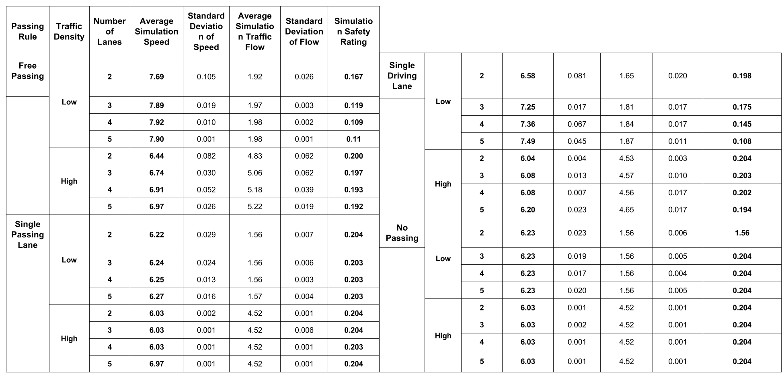
Statistics

Slide 13
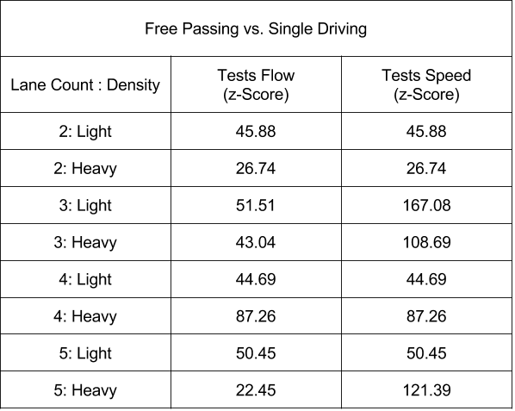
Conclusion
Free Passing: highest Flow, Speed, & Safety for all density and number of lanes

Slide 14
Further Works
Car Individualized Rules
Driver’s Concern for Rules
Variations in Driver Psychology
Oncoming Traffic
Condition of Road
Weather
Following Reaction Time

