Slide 1
Passing Rules
No Passing
Free Passing
Single Driving Lane
Single Passing Lane
Notes:
change into pictures for each rule

Slide 2
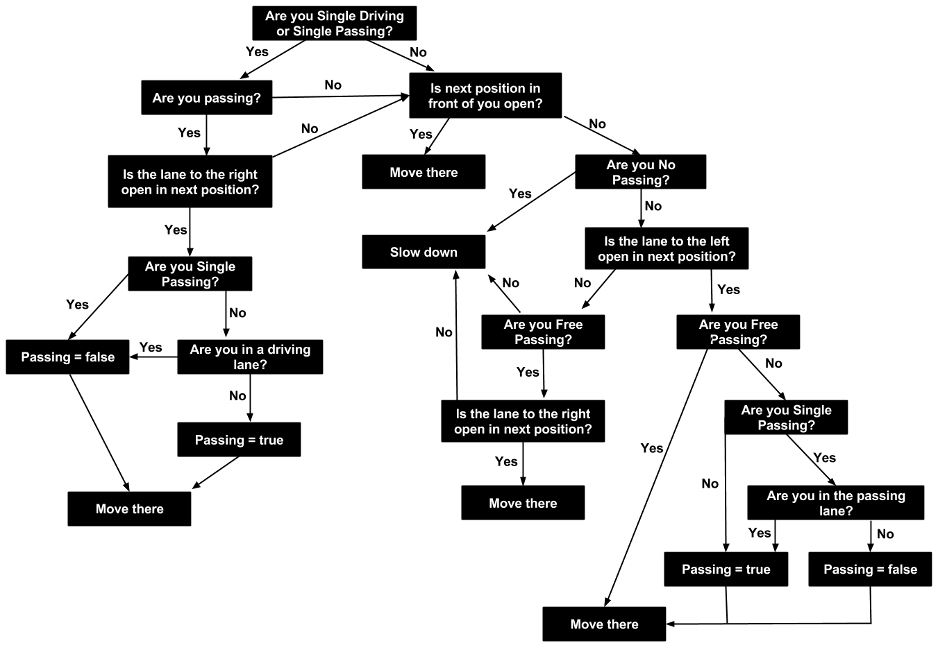
Vehicle Interactions Decision Tree

Slide 3
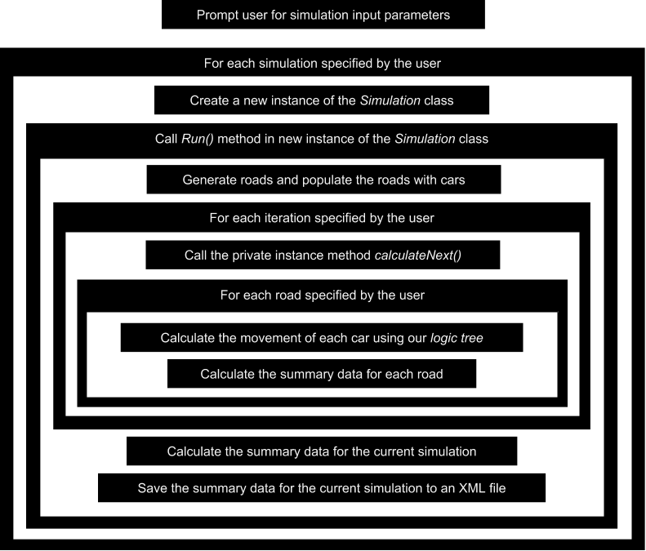
Computer Program Execution
Notes:
change the text into layman's terms

