Slide 1
Mathematical Modeling of Highway Traffic Policies
Ben Squire, Nate Minor, John-Paul Mann
Notes:
JP introduces everyone

Slide 2

Mathematical Competition in Modeling
96-hour International Math Competition organized by COMAP
Prompt:
    Model and analyze the efficiency and safety of the Stay-Right-Except-to-Pass highway traffic policy
Over 8000 teams
Awarded ‘Meritorious’ (top 10%)
Notes:
JP

Slide 3
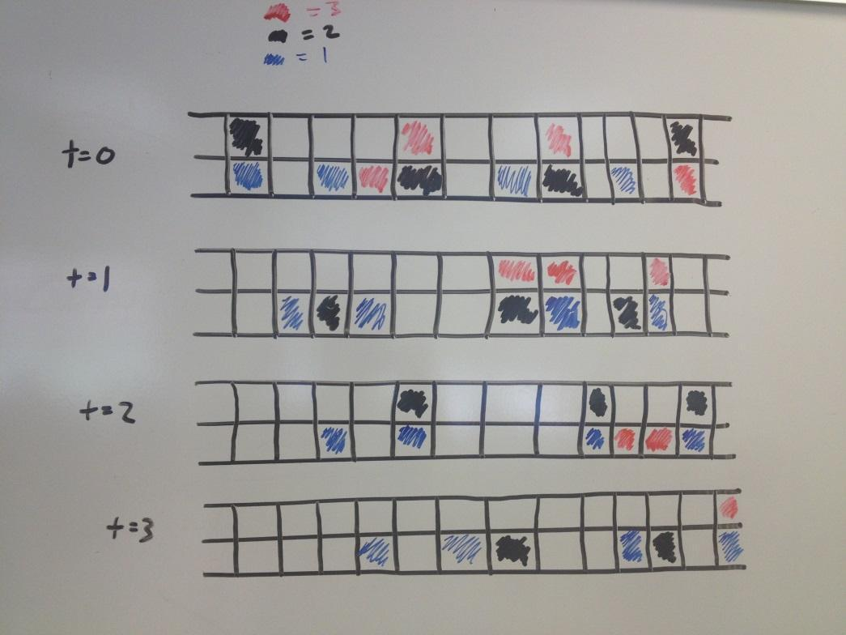
Approach
Macroscopic Model: Differential Equations
  Fluid Dynamics: Convection-Diffusion Equation
  Lighthill-Whitman-Richards Model
Microscopic Model: Agent-Based
  Proto-Model
Notes:
JP

Slide 4
Assumptions & Definitions
No Exit or Entry Ramps (Conservation of Cars)
Identical Vehicles (length, driving ability, braking ability)
Lane width, road curvature, shoulder width, and weather are not considered in our analysis
Only Side-Swipe and Rear-End Accidents
Accidents are only counted, they do not actually happen during the computer simulation
Normal distribution of initial velocities
Uniform random initial positions of vehicles
Notes:
JP

Slide 5
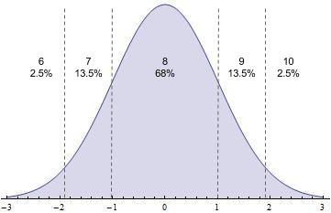
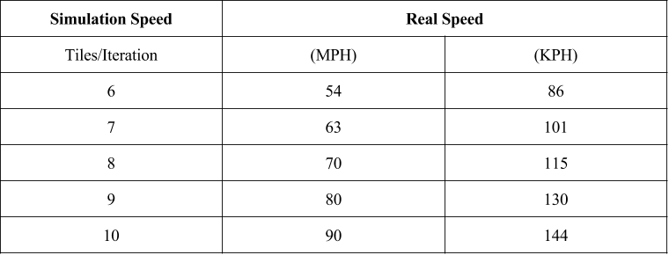
Simulation Scaling
Road Length: 10,000 tiles
High Density: 75% tiles occupied by vehicles
Low Density: 25% tiles occupied by vehicles
500 iterations per simulation (approx. 8 minutes)
Notes:
NM

Slide 6
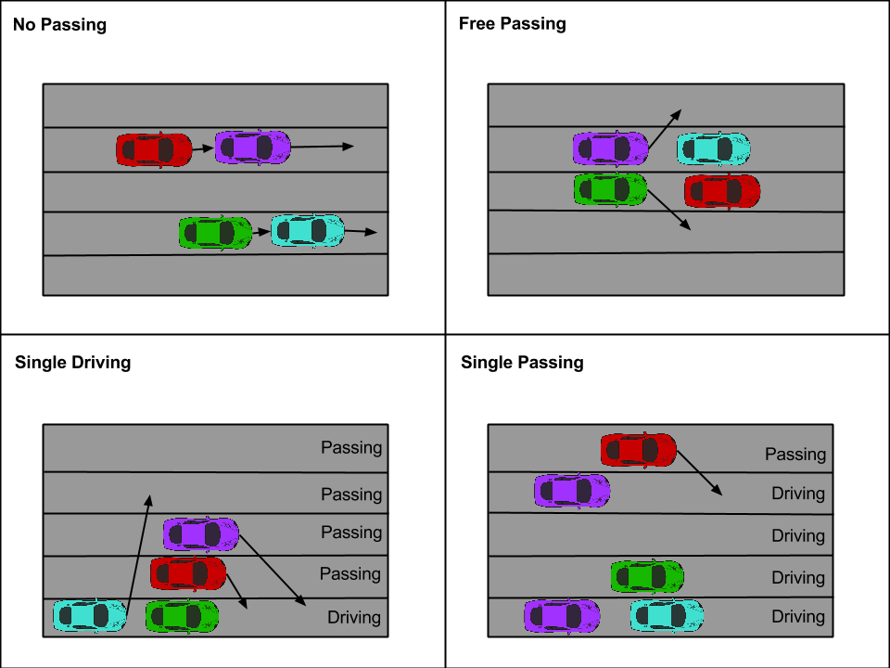
Road Rules
Notes:
NM

Slide 7
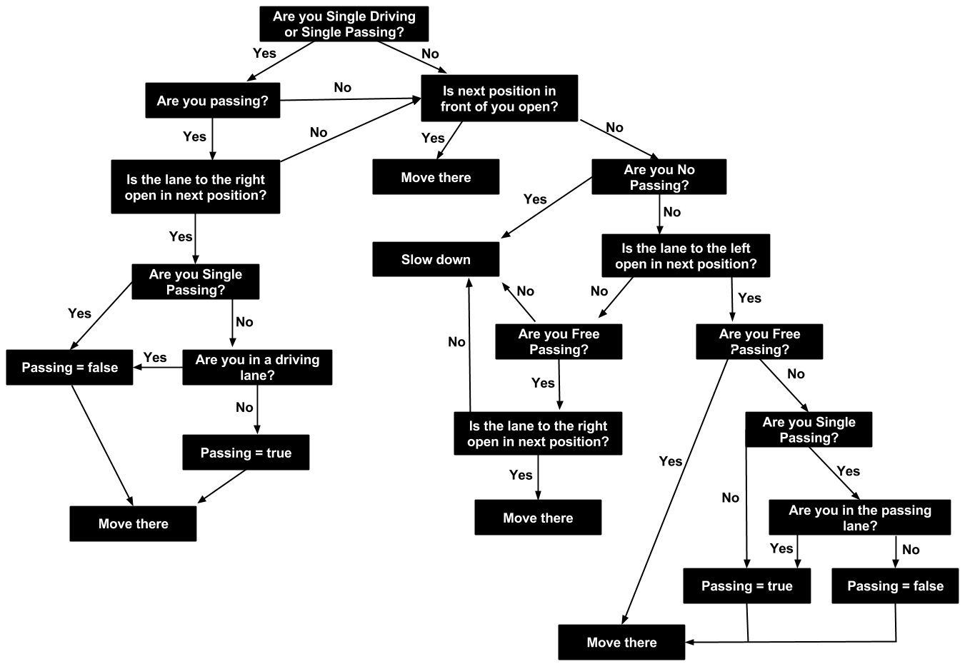
Vehicle Interaction Decision Tree
Notes:
NM

Slide 8
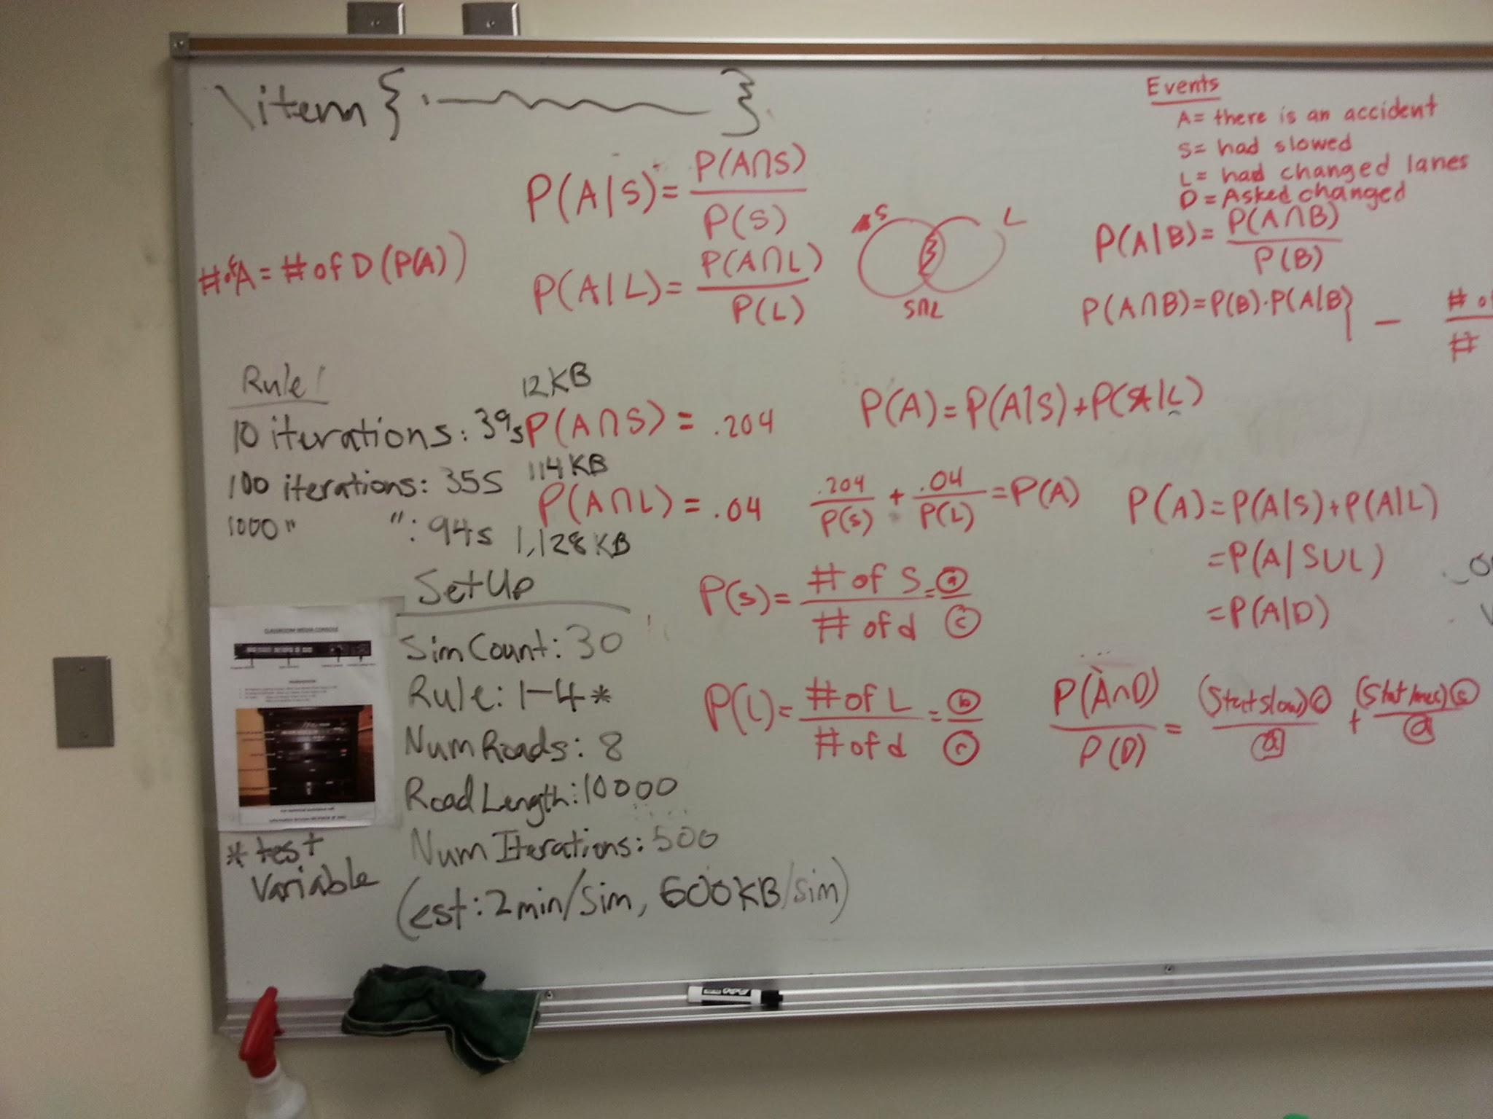
Experimental Methods
Test 4 passing rules on 8 different road types (high/low density, 2-5 lanes)
Run 30 computer simulations per passing rule
Compare the average vehicle speed, average traffic flow, and average safety rating for each rule paired with a road type (i.e.,compare free passing to single driving for a high-density 3-lane road)
Notes:
NM

Slide 9
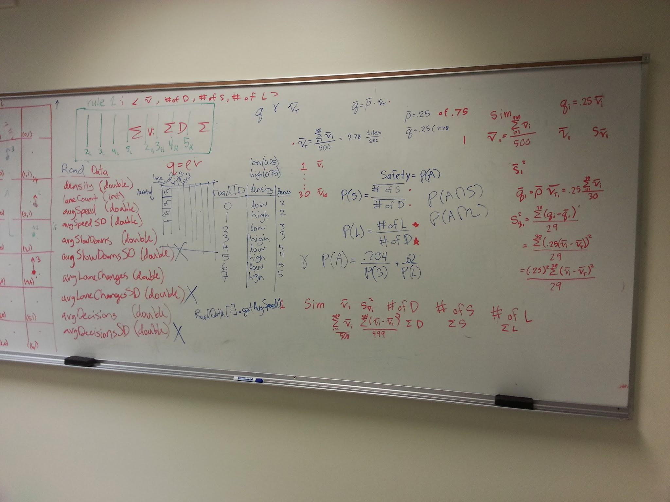
Simulation Data
Collected per Iteration:
  Average vehicle speed
  Number of decisions
  Number of lane change
  Number of slow downs
Calculated at the end of each Simulation:
  Average vehicle speed
  Average number of decisions
  Average number of lane changes
  Average number of slow downs
Notes:
The data points we were able to track in our Java programming were quite vast. We had the ability to track the position, speed, and initial speed of every car on a given road way for every iteration in a simulation (upwards of 37,500 cars per second for over 8 minutes). Furthermore, we also kept a counter for each iteration which tracked the total number of lane changes, slow downs, and decisions made for that snapshot of time. We originally organized all this data in an XML persistence data format which would allow us to call back particular pieces of information by tag line headings. This type of data storage proved to be to large and difficult to handle at the iteration summary level (summary of each second), with expected file sizes being in TB, we quickly realized a summary data of the entire 8 minutes would be necessary within the Java program. Thus, for each simulation we averaged the Iteration summary speed for a particular road way, e.g 2 lanes, low density, for the free passing rule. This reduced file size and time of analysis dramatically, allowing us to find statistically significant results over 30 simulations much quicker.

Slide 10
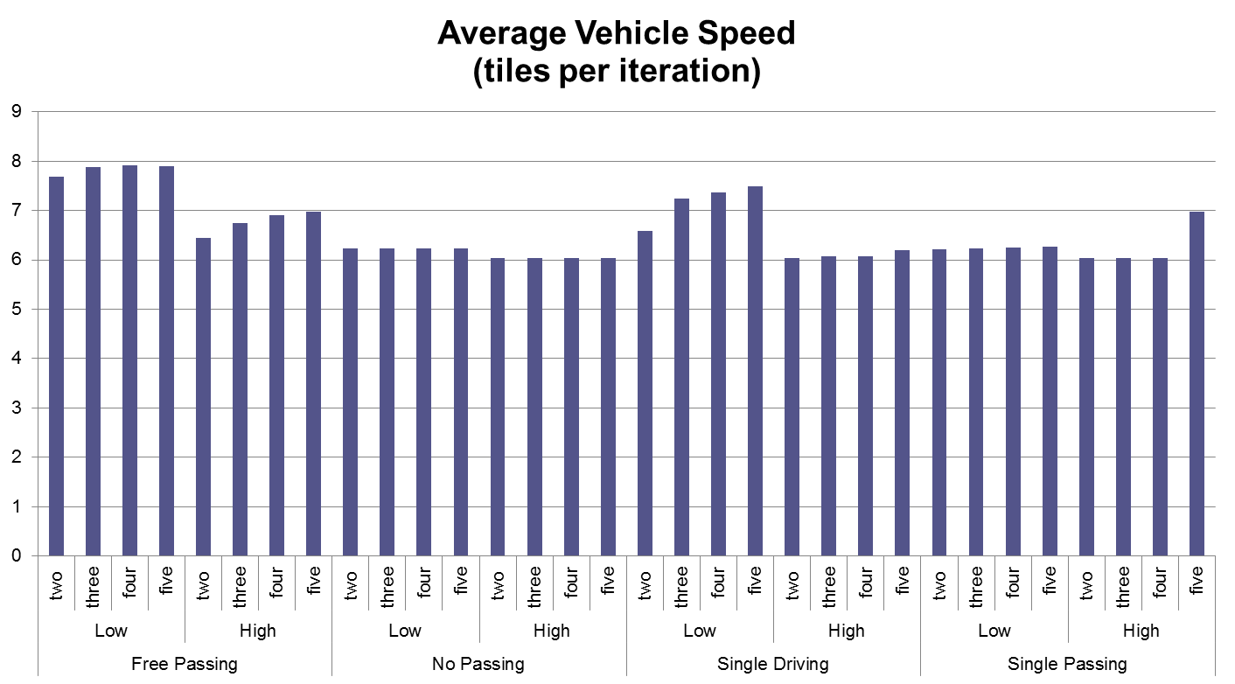
Simulation Results
Notes:
BS

Slide 11
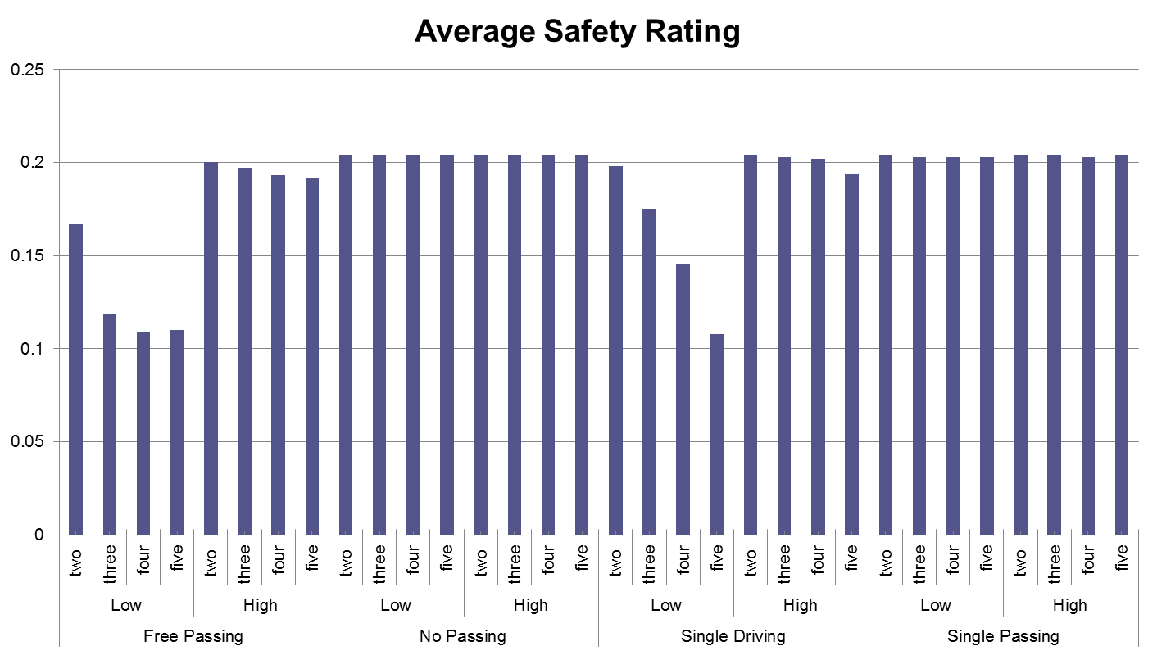
Simulation Results
Notes:
BS

Slide 12
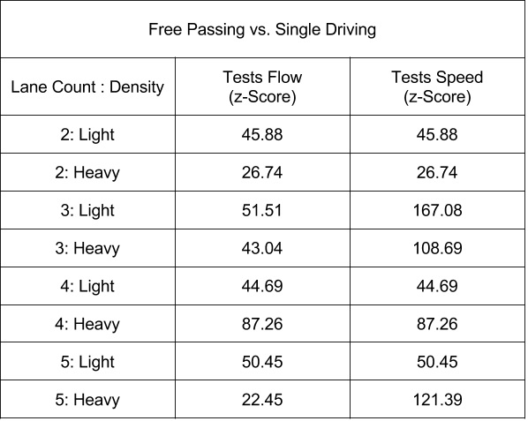
Conclusion
Free Passing: highest average traffic flow, highest average vehicle speed, & lowest average safety rating for all traffic densities and lanes counts.
Notes:
BS

Slide 13
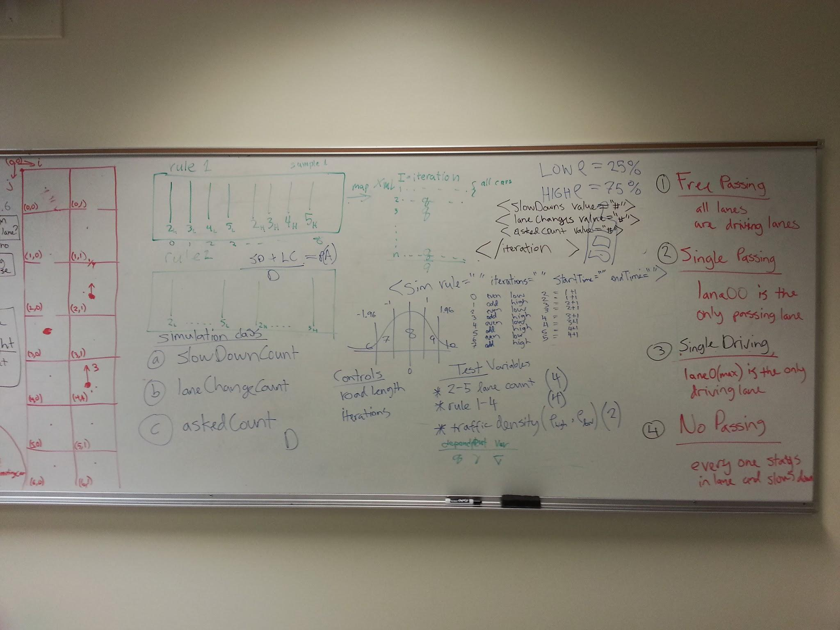
Challenges & Solutions
Challenges
  Exporting XML to Excel without Macros
  Interpreting results
Solutions
  Perform summary statistics in Java
  Review statistical analysis step-by-step
Notes:
Although performing the statistical analysis itself was very difficult, another major challenge was identifying and interpreting the results. We were on a very short time frame so going back and redoing the simulations and finding the sample statistics again was not possible. After organizing and consolidating the pieces of data we were going to compare from rule to rule, we found some very significant differences between the average simulations speeds that at first seemed to high to be true. For example, the difference between the average simulation speed for the Free passing rule and Single driving rule for a 2 lane low density road showed a p- value of 6 x 10^ -460. Upon further investigation it became apparent these very significant differences were due to two things, namely the large number of iterations we were averaging over were highly centralizing these figures, so the variance between them was becoming extremely low, and also the variance to begin with was not extremely high because there were only 2 randomized factors in the entire simulation, namely position( uniformly distributed) and speed (normally distributed). These results are in fact perfectly reasonable for the model we designed and with some tweaking to the number of iterations and the addition of more realistic randomized factors, we would begin to see a more unstable and less significant difference which would better reflect reality.

Slide 14
Further Research
Simulation data moved to a database
Graphical User Interface (GUI) for ‘playing-back’ simulation data
Individualized Vehicle Rules
Variations in Driver Psychology
  Oncoming Traffic
  Condition of Road
  Weather
  Following Reaction Time
Notes:
mixed

Slide 15
References
Wilco Burghout, Haris N Koutsopoulos, and Ingmar Andreasson. Hybrid mesoscopic-microscopic traﬃc simulation. Transportation Research Record: Journal of the Transportation Research Board, 1934(1):218–255, 2005.
Rune Elvik, Truls Vaa, Alena Erke, and Michael Sorensen. The handbook of road safety measures. Emerald Group Publishing, 2009.
Norman Kennedy. Fundamentals of Traﬃc Engineering- 8th Edition. Berkley, 1973.
Douglas A Kurtze and Daniel C Hong. Traﬃc jams, granular ﬂow, and soliton selection. Physical Review E, 52(1):218, 1995.
U.S. Dept of Trans. National motor vehicle crash causation survey, 2008.
BENEDETTO PICCOLI and ANDREA TOSIN. A review of continuum mathematical models of vehicular traﬃc.
Benjamin Seibold, Morris R Flynn, Aslan R Kasimov, and Rodolfo Ruben Rosales. Constructing set-valued fundamental diagrams from jamiton solutions in second order traﬃc models. arXiv preprint arXiv:1204.5510, 2012.
Howard A Stone. Introduction to ﬂuid dynamics for microﬂuidic ﬂows. In CMOS Biotechnology, pages 5–30. Springer, 2007.

